Slide 1
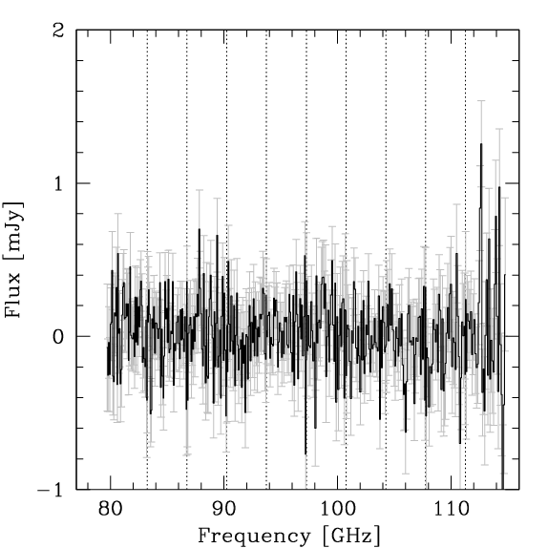
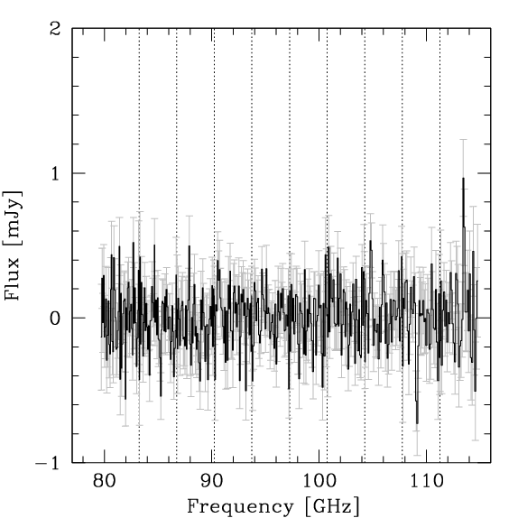
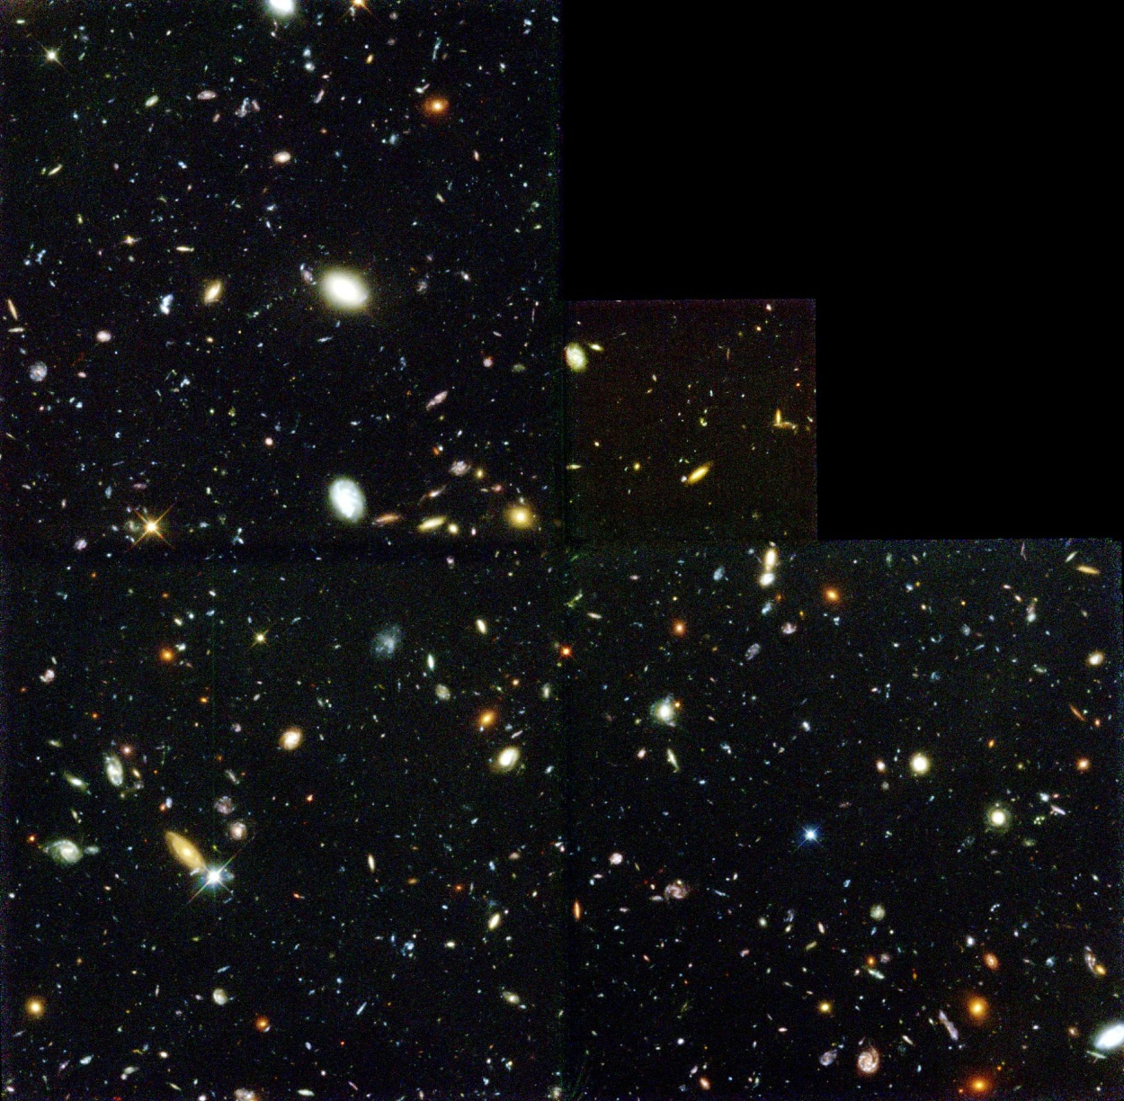
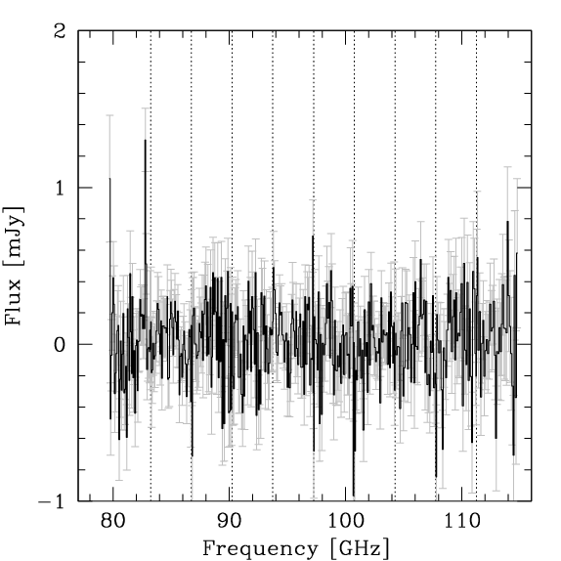
A molecular scan in the Hubble Deep Field North Roberto Decarli (MPIA Heidelberg, Germany)
F. Walter, M. Aravena, F. Bertoldi, C. Carilli, P. Cox, E. da Cunha, E. Daddi, D. Downes, M. Dickinson, R. Ellis, R. Maiolino, K. Menten, R. Neri, D. Riechers, H.-W. Rix, M. Sargent, D. Stark, B. Weiner, A. Weiss

Slide 2
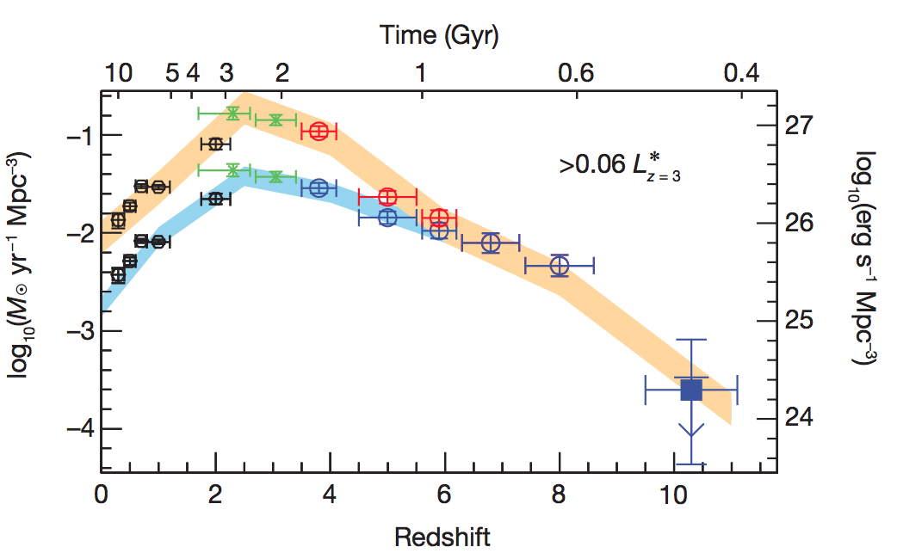
Cosmic Star Formation
Volume density of star formation in galaxies as f(cosmic time)
uncorrected
dust corrected
SFR density
epoch of galaxy assembly
?
Bouwens et al. 2011
First galaxies
present day
Peak of the star formation rate density at z~2-3

Slide 3
Cosmic Star Formation
Volume density of star formation in galaxies as f(cosmic time)
following SFR?
?
flat (HI)?
following Mstar ?
Peak of the star formation rate density at z~2-3
What about the molecular content?

Slide 4
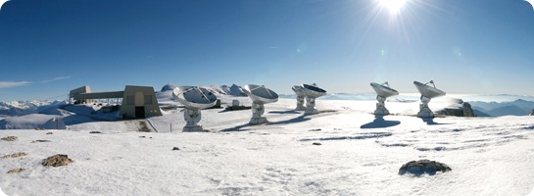
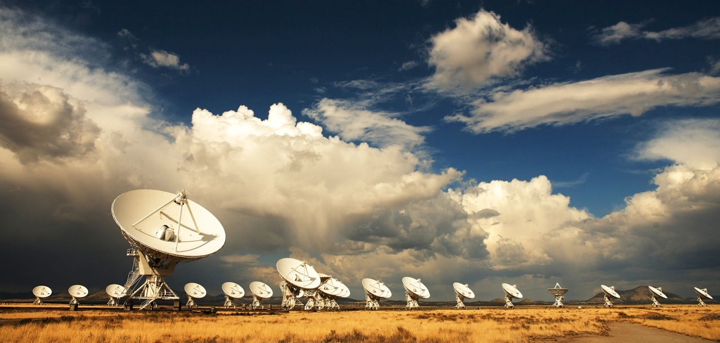
The `Golden Age’
Plateau de Bure Interferometer (PdBI), NOEMA
6x15m antennas 3-0.8mm
Jansky Very Large Array
27x25m antennas
20cm – 6mm
Atacama Large (sub)Millimeter Array (ALMA)
66 antennas (7-12m)
4mm – 300µm

Slide 5
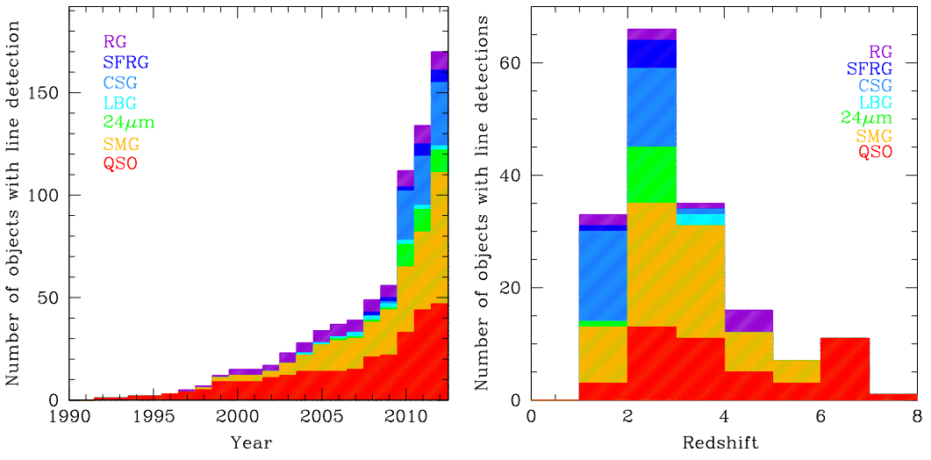
High-z galaxies detected in CO so far
Carilli & Walter 2013 ARA&A
z>1
Dramatic (~10x) increase in number of detections in the past decade
Still dominated by QSOs & SMGs
All observations targeted — i.e. pre-selection by SF

Slide 6
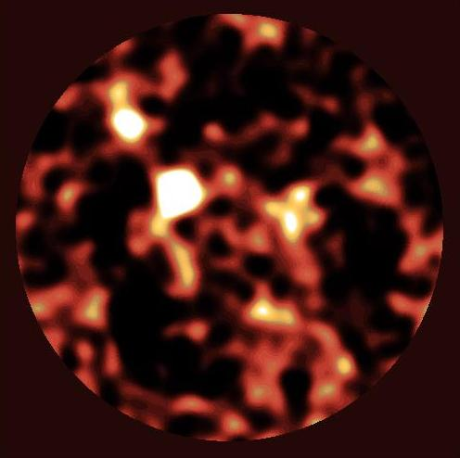
First molecular deep field (HDF-N)
~50”
Selected to include HDF850.1
Hughes+98

Slide 7
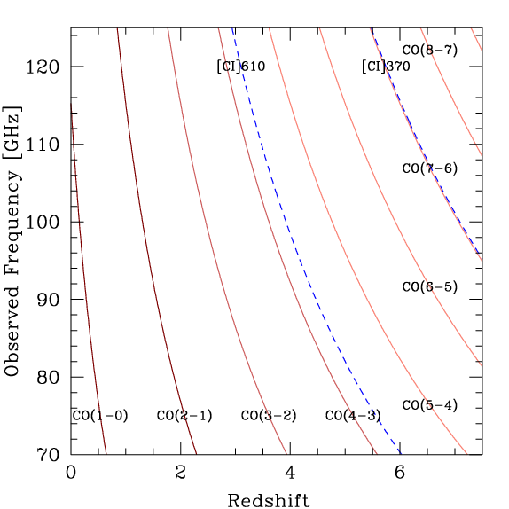
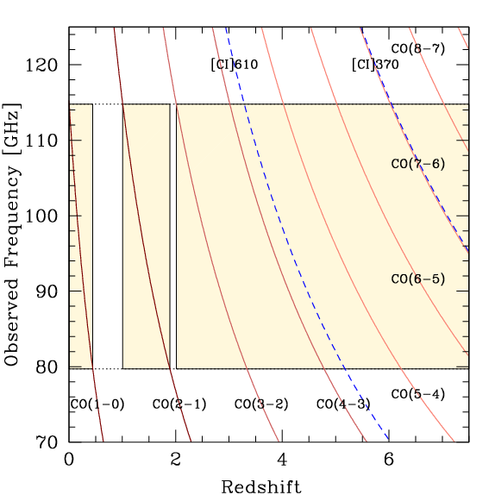
First molecular deep field (HDF-N)
PdBI
PdBI (<2010)

Slide 8
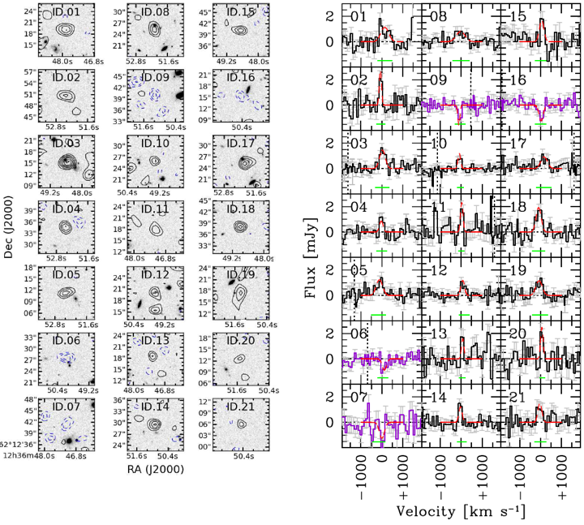
Molecular deep field: line candidates
Maps
Spectra
total of 21 IDs, 4 ‘negative’
Decarli et al. (2014)

Slide 9
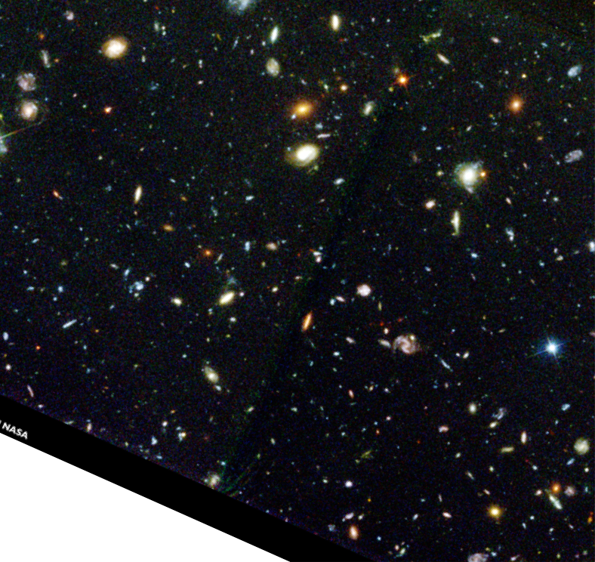
Molecular deep field: location of line candidates
=position
of CO detection
Decarli et al. (2014)

Slide 10
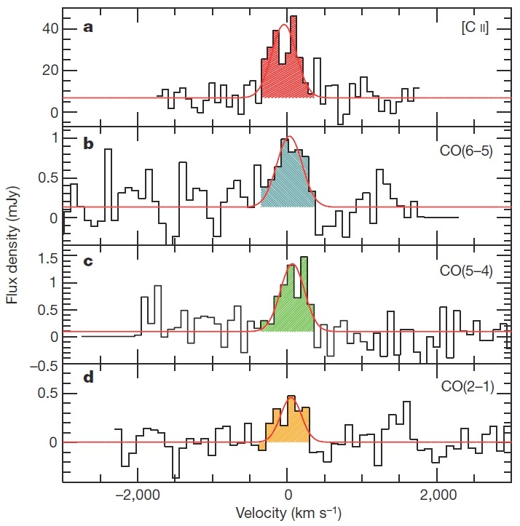
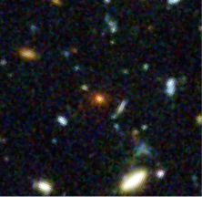
Molecular deep field: blind detections
ID.08 & ID.17
Walter et al. (2012, Nature)

Slide 11
Molecular deep field: blind detections
ID.08 & ID.17
spatially coincident IDs
this corresponds to HDF850.1 — z=5.183
Walter et al. (2012, Nature)

Slide 12
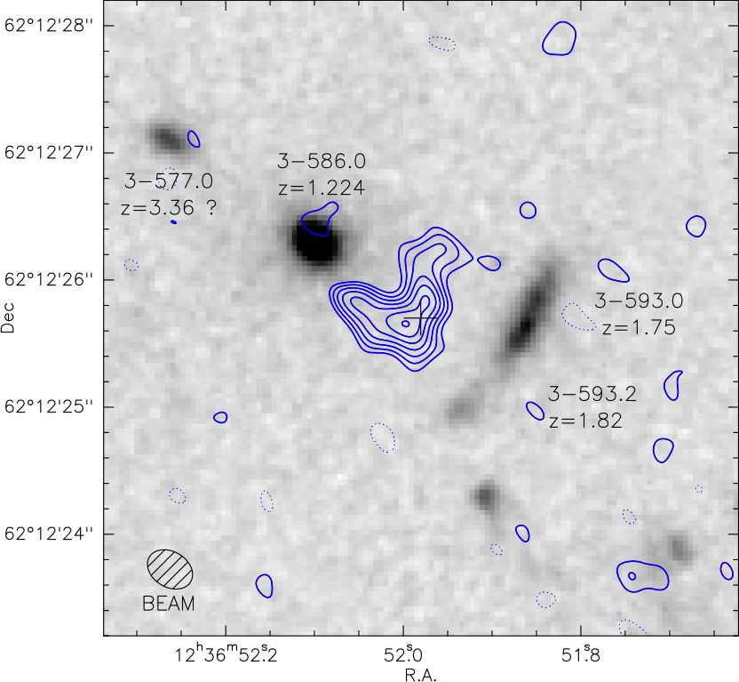
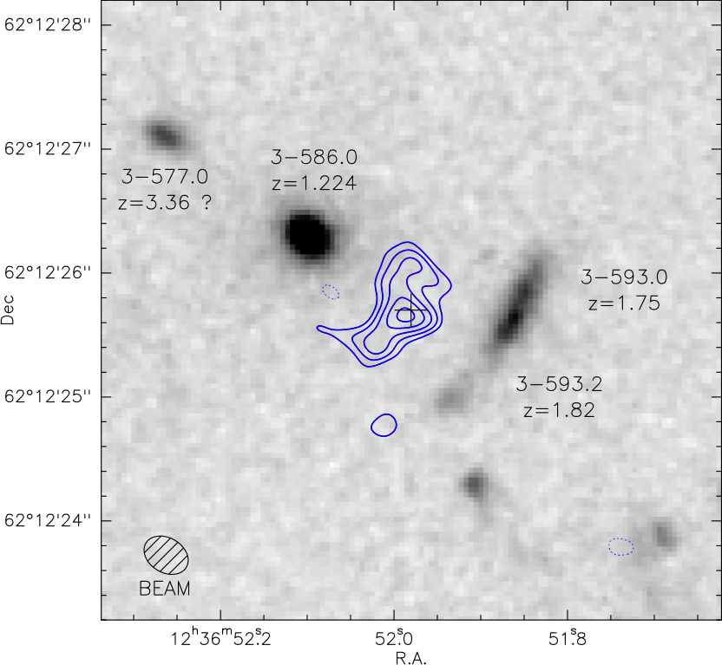
HDF850.1: precise location and environment
[CII]
continuum
Precise location and redshift: no counterpart identifiable in HST.
Dynamics at 0.3” (1.8kpc) consistent with merger
Neri et al. (2014)

Slide 13
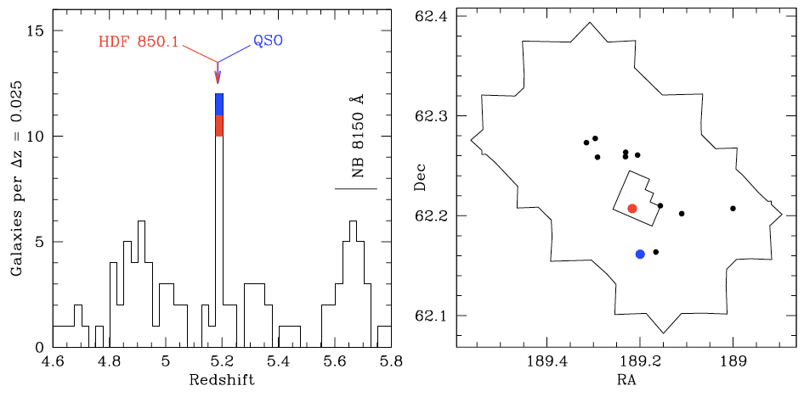
HDF850.1: precise location and environment
[CII]
continuum
Precise location and redshift: no counterpart identifiable in HST.
Dynamics at 0.3” (1.8kpc) consistent with merger
Neri et al. (2014)
Galaxy overdensity at z=5.2, including one quasar!
Walter et al. (2012, Nature)

Slide 14
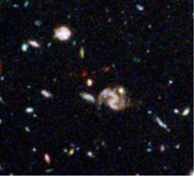
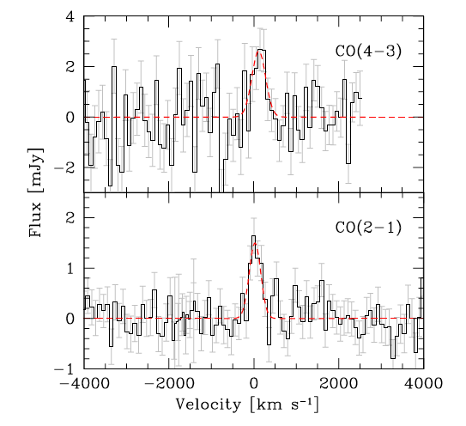
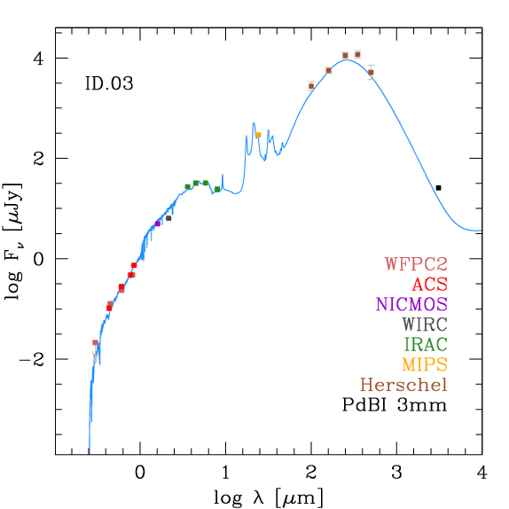
Molecular deep field: blind detections
ID.03
Most secure line in scan, ‘BzK’ galaxy
z=1.784
MH2=9 10¹⁰ Msun
SFR=38 Msun yr ⁻¹
SMG-like excitation
sSFR=0.15 Gyr ⁻¹
Mstar=2.5 10¹¹ Msun

Slide 15
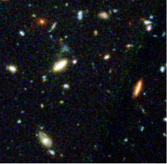
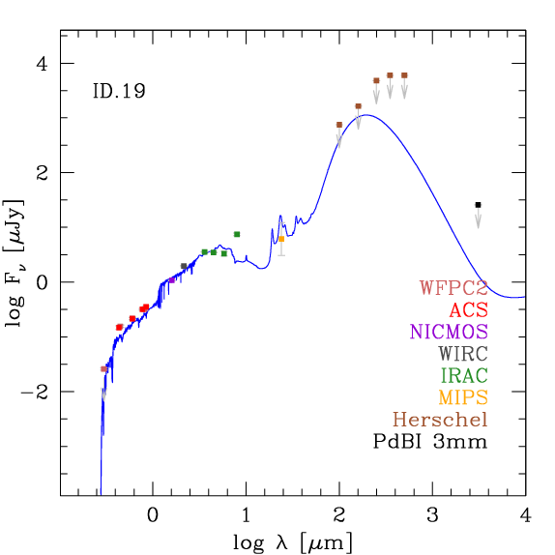
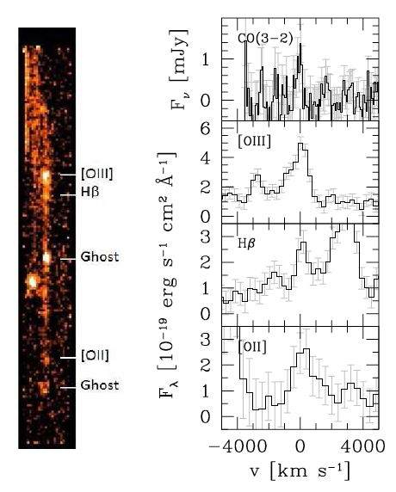
Molecular deep field: blind detections
ID.19
CO id confirmed with HST grism spec
z=2.047
MH2=1.3 10¹¹ Msun
SFR=8 Msun yr ⁻¹
sSFR=0.4 Gyr ⁻¹
Mstar=1.9 10¹⁰ Msun
HST GRISM
CO(3-2)
[OIII]
Hbeta
Weiner et al. in prep
[OII]

Slide 16
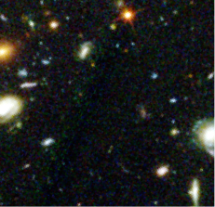
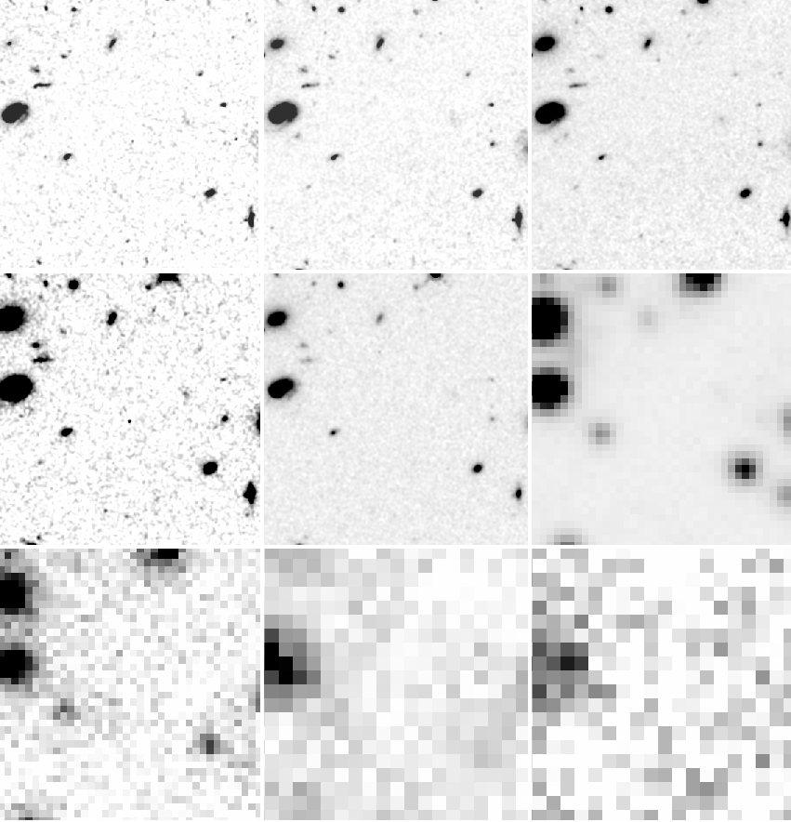
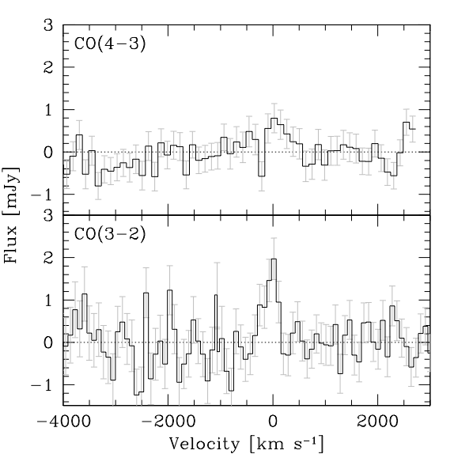
Molecular deep field: blind detections
ID.18
optical: Williams et al. 1996
NIR: CANDELS, Grogin et al. 2011
IRAC/24um: Dickinson in prep.
Herschel: Elbaz et al. 2011
0.44 μm
0.61 μm
0.85 μm
20”
2 detected lines, z=2.07 or z=5.14
1.25 μm
1.60 μm
3.6 μm
5.8 μm
24 μm
100 μm
no continuum detection in any band in the HDF-N

Slide 17
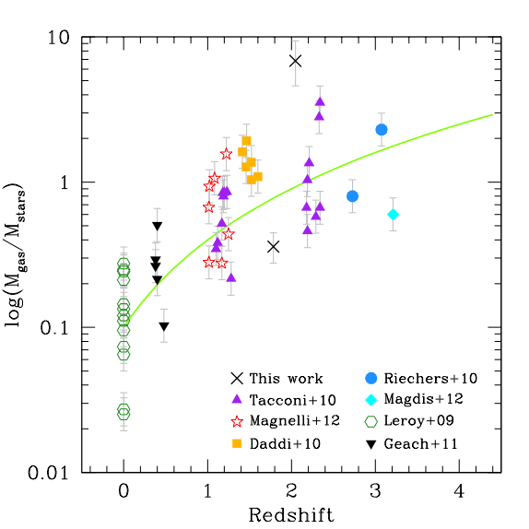
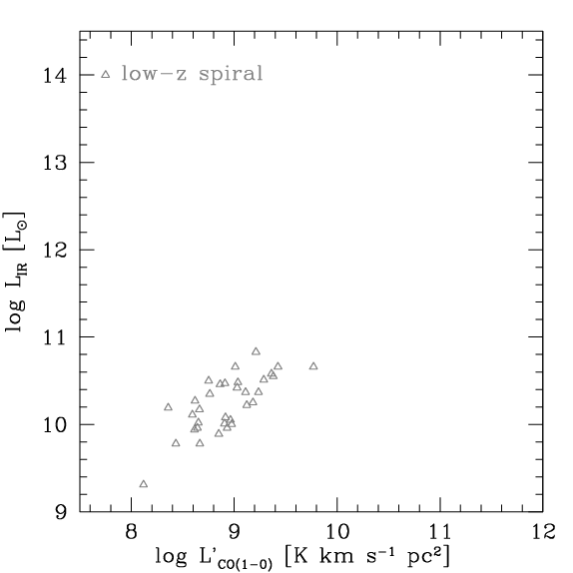
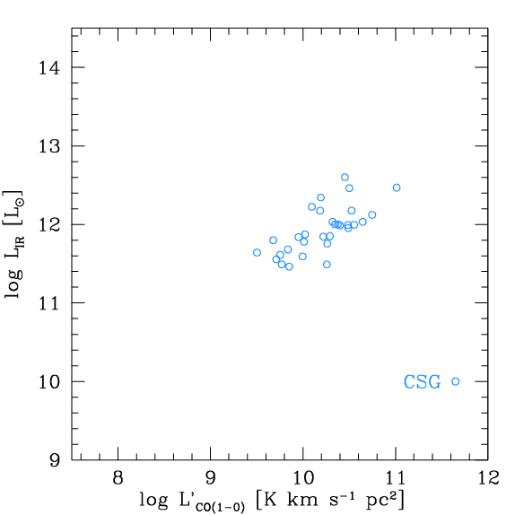
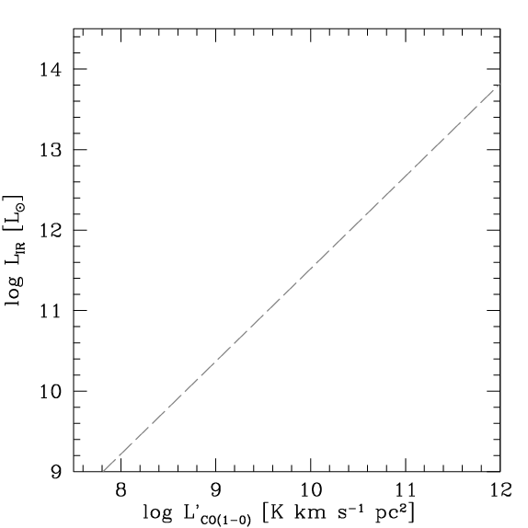
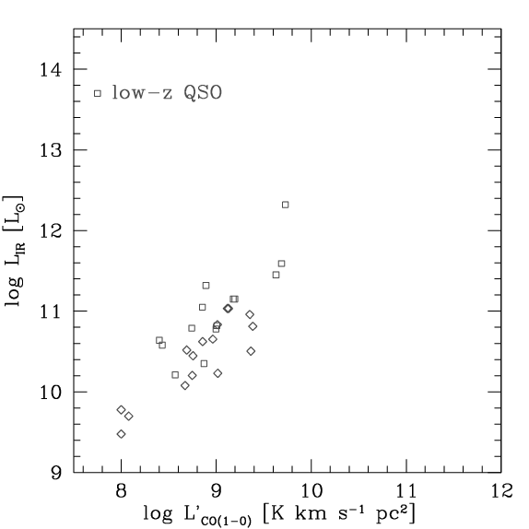
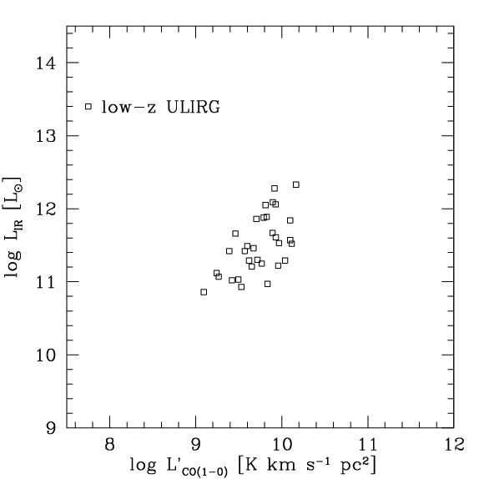
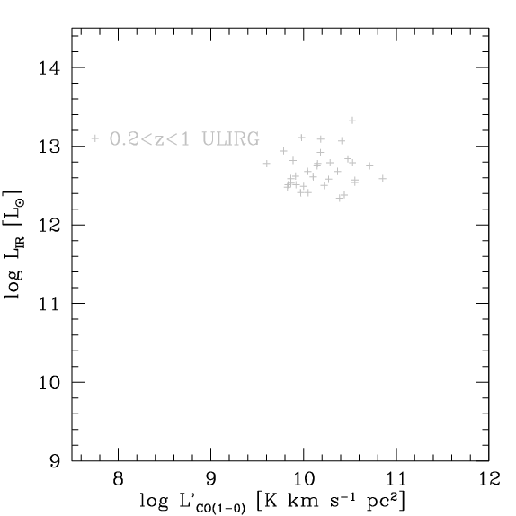
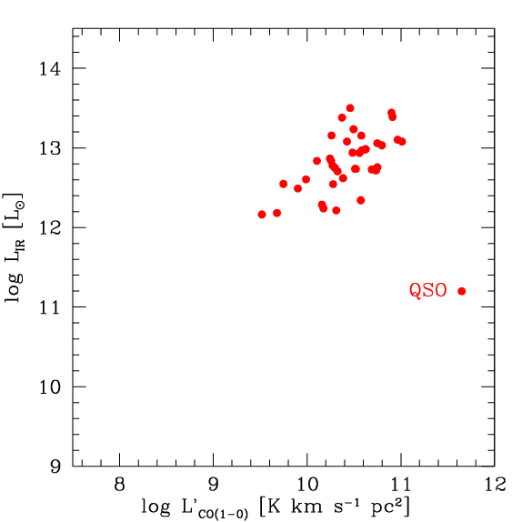
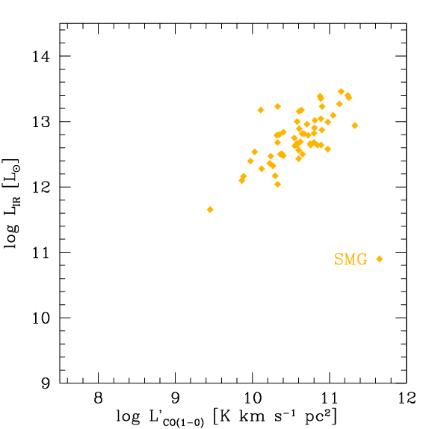
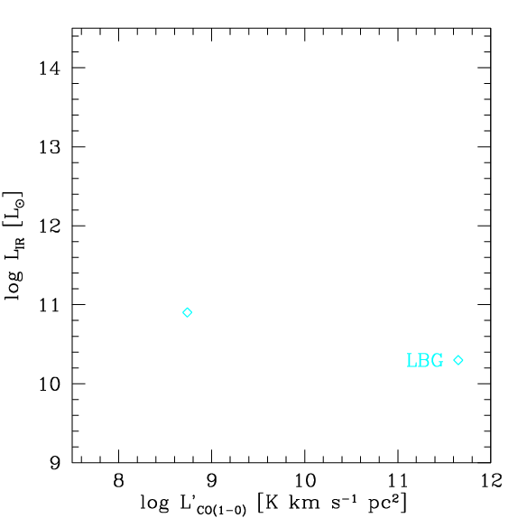
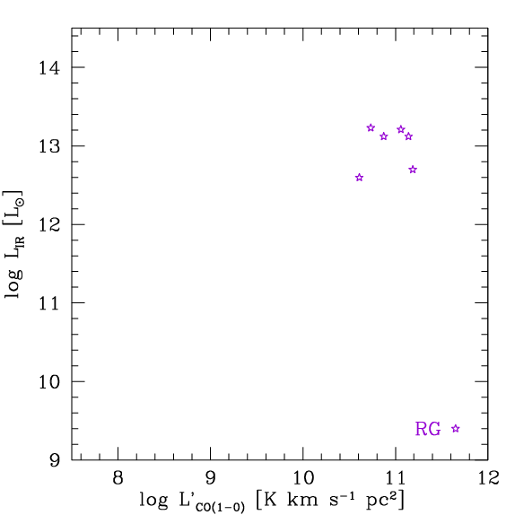
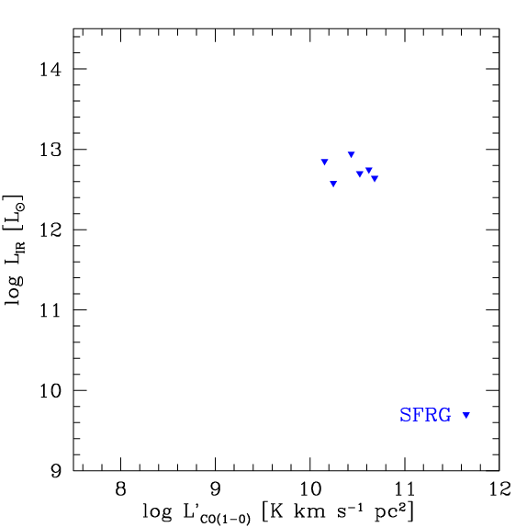
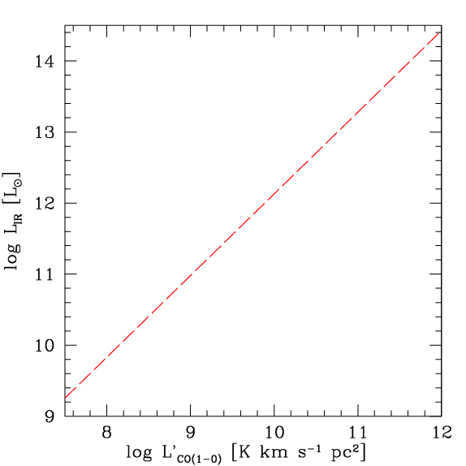
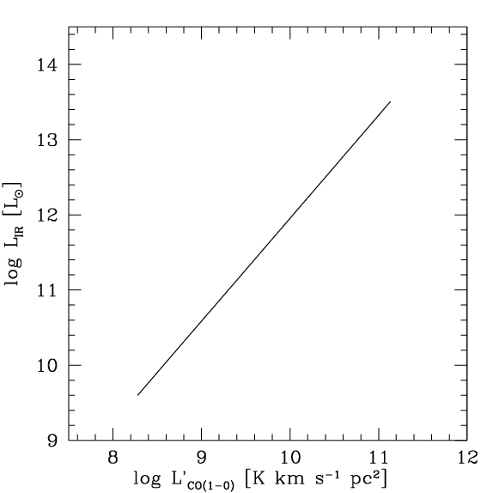
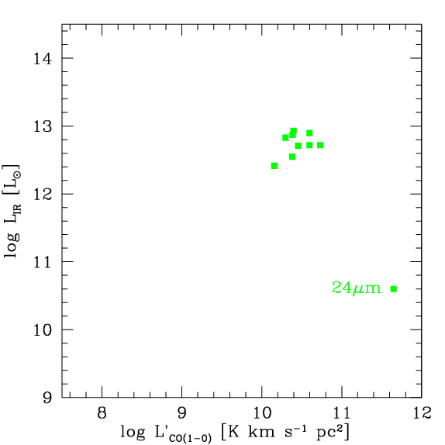
Blind detections: gas fractions and location on ‘SF law’

Slide 18
Blind detections: gas fractions and location on ‘SF law’
?
ID.18
ID.19
ID.03
ID.03
ID.19
ID.18
?
= new blind detections from HDF-N
= ‘dark’ galaxy

Slide 19
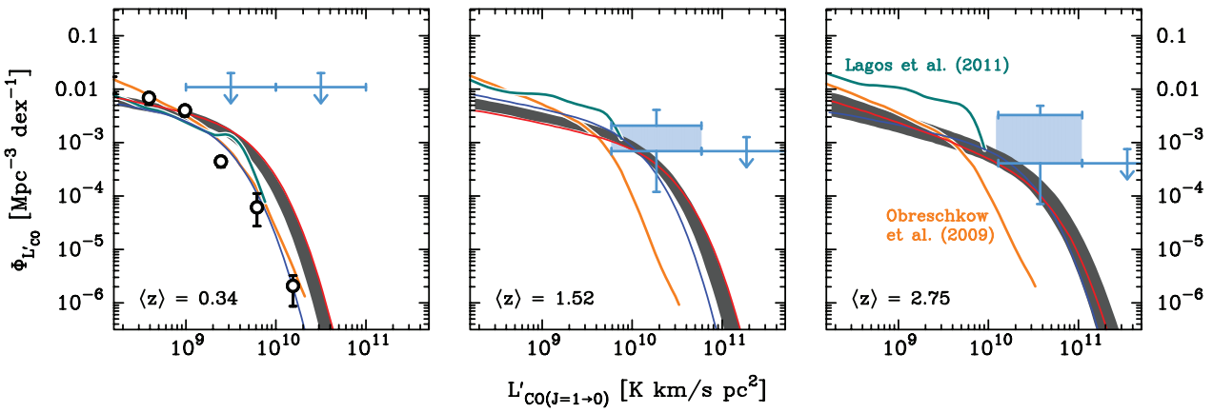
Blind constraints: CO luminosity functions
<z>=0.34
<z>=1.52
<z>=2.75
Sargent et al. (2014)
Keres et al.
Obreschkow et al. (2009)
Sargent et al. 2014: empirical predictions
Lagos et al. 2011
: based on SAMs + ‘recipes’
Obreschkow et al. 2009

Slide 20
Blind constraints: CO luminosity functions
limits from blind detections in HDF
<z>=0.34
<z>=1.52
<z>=2.75
Sargent et al. (2014)
Keres et al.
Obreschkow et al. (2009)
Sargent et al. 2014
measurements: higher than the predictions
caveats: small number statistics
small volume covered
Lagos et al. 2011
Obreschkow et al. 2009
Walter et al. (2014)

Slide 21
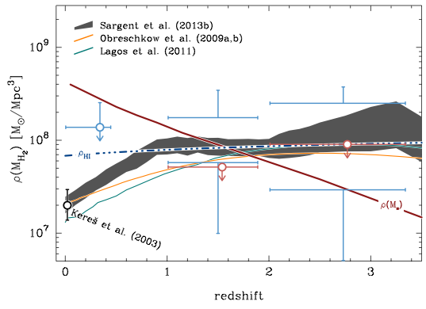
Blind constraints: cosmic H2 density
ρ(MH2) predictions + densities of stars and HI
ρ(MHI)
ρ(Mstars)
Sargent et al., in prep (based in Sargent et al. 2011, 2012)

Slide 22
Blind constraints: cosmic H2 density
limits from blind detections in HDF-N
ρ(MHI)
ρ(Mstars)
our measurements are consistent with predictions BUT: not extrapolated over lum. function
Walter et al. (2014)

Slide 23
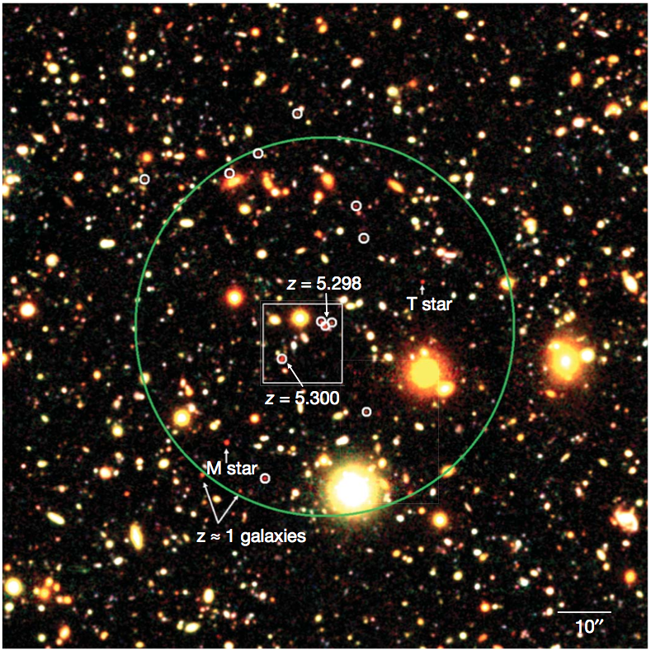
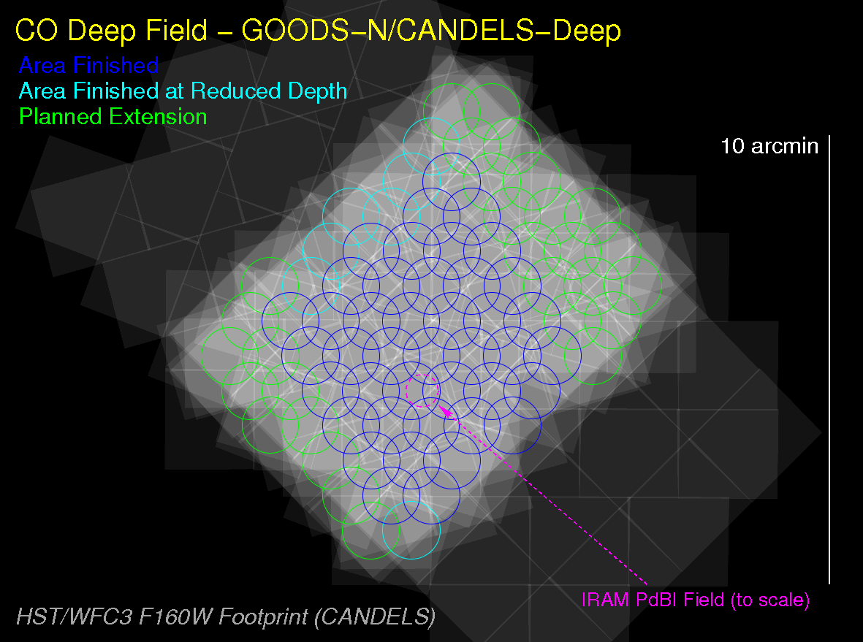
Ongoing effort: VLA large program
6.5 arcmin² field in COSMOS
42 arcmin² field in GOODS-N/CANDELS
VLA DnC/D, 279 hr
30-38 GHz (9 mm), 8 GHz BW
56 pointings (7 “deep”, 49 “wide”), ~50 arcmin², resolution 2“
cont. sens: 1.3 µJy/b (COSMOS),
4.5 µJy/b (GOODS-N)
PI: Dominik Riechers
COSMOS ‘deep’ 7 pnt
GN/CANDELS
‘wide’
49 pointings
ongoing, computationally challenging
continuum
continuum

Slide 24
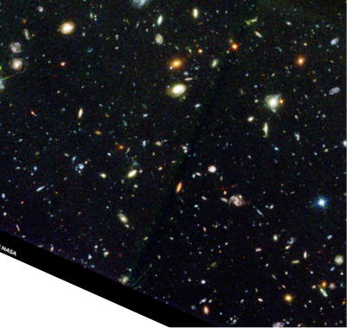
Summary
Number of CO-detected galaxies in the literature is limited and pre-selected based on SFR or M*
Our PdBI molecular scan on the HDF-N suggests that substantial molecular gas may reside in not-so-massive/SFing galaxies
- Ultimate goal: constraints on ρ mol(z)
- This needs molecular deep fields and ALMA

Slide 25
THE END

Slide 26
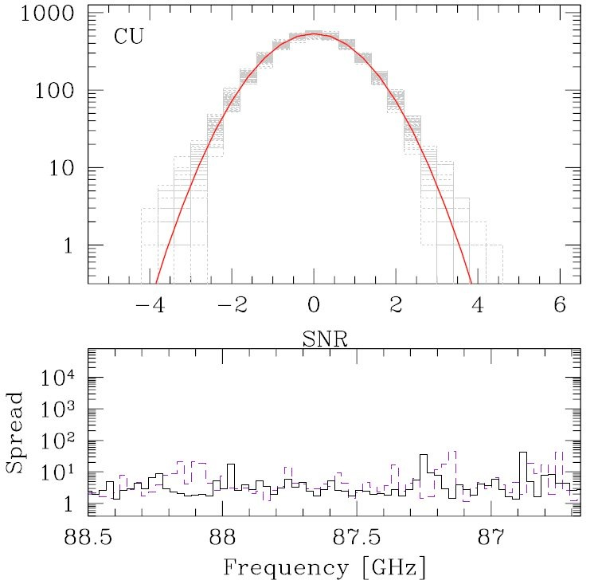
molecular deep field: line search
Decarli et al. 2014

Slide 27
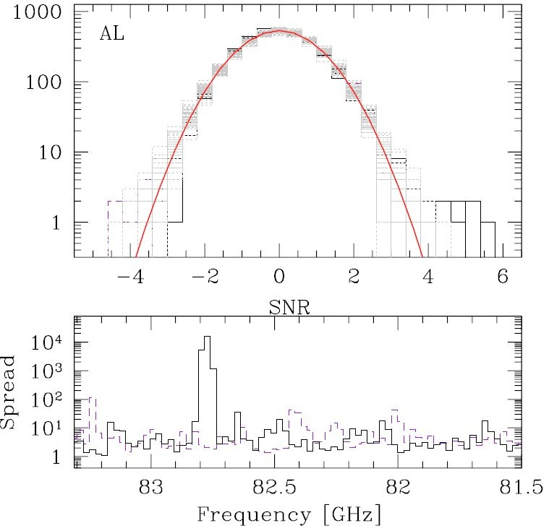
molecular deep field: line search
also used a modified version of cprop (Decarli et al. 2014)
and Bayesian method using prior (Lentati et al. 2014)

Slide 28
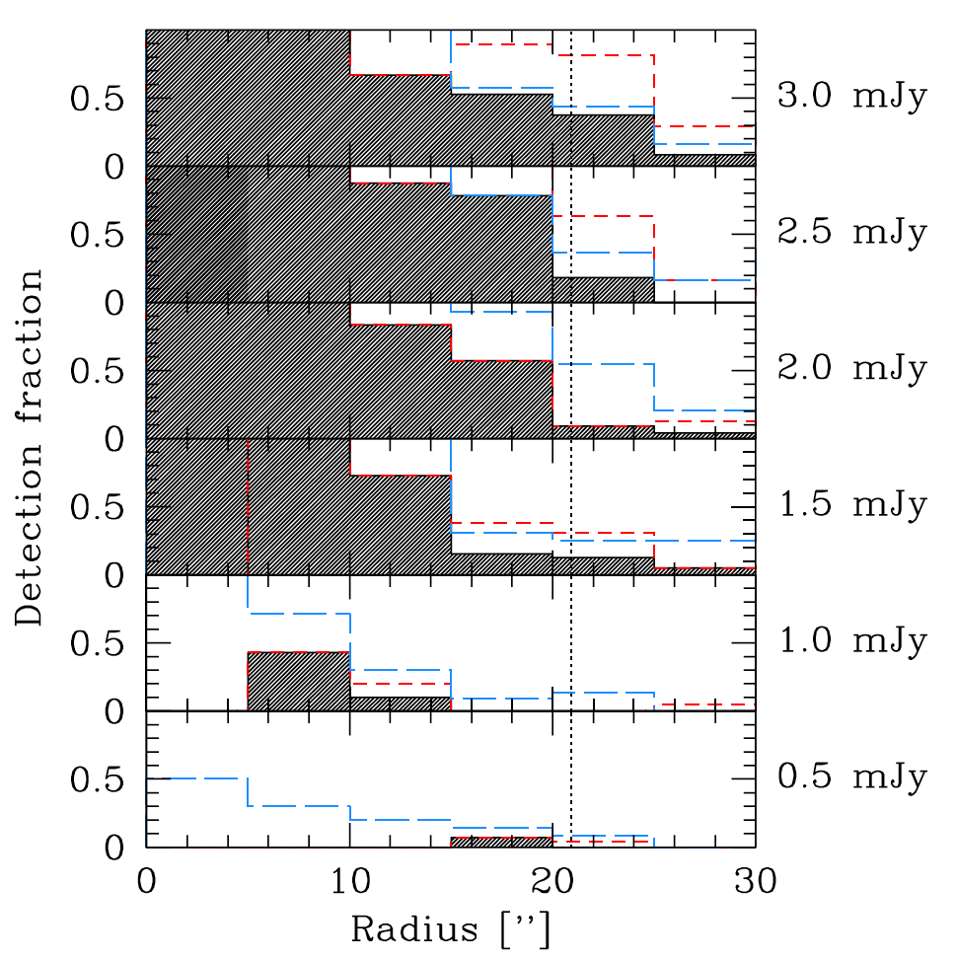
Molecular deep field: completeness tests
high
completeness
simulated UV data:
high detection fraction within primary beam
@ > ~2mJy peak
Decarli et al. 2014

Slide 29
The ‘star formation law’
LIR vs L’CO proxy for SFR vs. M(H2)
Linear relation, with two different normalization?
Or one super-linear relation?
…many subtleties…
starbursts
main sequence
Carilli & Walter 2013 ARAA, after Daddi et al. 2010, Genzel et al. 2010

Slide 30
Molecular deep field: survey setup
PdBI ~100 hr on-source 10 freq. setups, ~const σ
Deep enough to detect any previous CO line reported at 3mm
Decarli et al. 2014

Slide 31
Molecular deep field: other blind detections
in case we only have one CO line:
assigned ‘most likely z’ for other candidates based on SED
follow-up scheduled

Slide 32
CO stacking of galaxies with good z
CO covered CO not covered in scan
Longslit spec
Grism spec
Very complete at mH<24 mag
M*~5 10⁷ Msun, 3 10⁹ Msun, 10¹⁰ Msun
Walter et al. 2014

Slide 33
CO stacking of galaxies with good z
No additional detections towards galaxies w/ spectroscopic redshifts.
CO stack: also non-detection.
Walter et al. 2014

Slide 34
And wrt the galaxy ‘main sequence’?
ID.03
ID.19
Higher z: more SFR per Mstar, flatter slope? (cf. Karim)
Whitaker et al. 2012

Slide 35
The future: ALMA molecular deep field
da Cunha et al. 2013
Detailed prediction for continuum and line strengths in deep fields

Slide 36
the future: ALMA molecular deep field
da Cunha et al. 2013
Detailed prediction for continuum and line strengths in deep fields
ALMA will rock — ‘only’ 20 hours will blow current study out of the water.
PdBI limits
Lagos
Obreschkow
Sargent
PdBI limits
ALMA 5 sigma limit
ALMA 5 sigma limit
ALMA 5 sigma limit
PdBI limits

Slide 37
Dense gas tracers through stacking in 3mm scan
stacking: HCN(6-5), HCN(7-6), HCN(8-7), HNC(6-5), HNC(7-6), HCO⁺(6-5), HCO⁺(7-6), CS(11-10), CS(12-11), CS(13-12), CS(14-13), HOC⁺(6-5), HOC⁺(7-6)
line stacking of high-density lines → no detection, consistent with expectations
(line) stacking will be powerful tool in ALMA era
Walter et al. 2012

Slide 38
CO excitation
summary of all high-z
CO excitation measurements
ν²
M82
MW
Carilli & Walter, ARA&A 2013

Slide 39
complementarity of different frequency bands
redshift coverage and detections: CO lines
redshift coverage and detections: other lines
Carilli & Walter, ARA&A 2013

