Slide 1
KMOS Deep Survey:
galaxy evolution over the first
3 billion years
PI: Michele Cirasuolo
Royal Observatory Edinburgh
Collaborators: J. Dunlop, R. McLure, F. Cullen, R. Maiolino, R. Ivison, G. Wright, M. Swinbank, R. Sharples, R. Bower, M. Cappellari

Slide 2
“Apologies for not being able to attend the meeting.
Thanks to the organisers and especially Roberto for presenting these few summary slides on the KMOS GTO programme.”

Slide 3
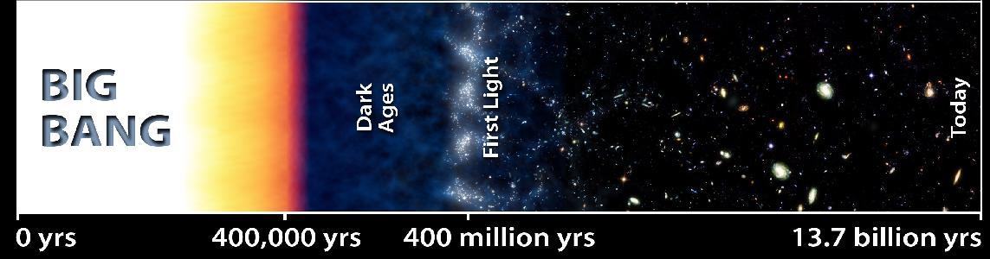
Why the first 3 billion years ?
z≈∞
z≈7
Redshift
z≈1
z=0
3Gyr

Slide 4
Why the first 3 billion years ?
z≈∞
z≈7
Redshift
z≈1
z=0
3Gyr
The redshift range 3 < z < 10 encompasses:
The shining of primeval galaxies and the epoch of cosmic re-ionization
The formation of the first massive discs and spheroids
The emergence of the red sequence

Slide 5
The KMOS Deep Survey (KDS)
35 nights GTO programme
Several hundred sources at 3 < z < 10
Faint targets require long integrations: 8-12hrs on source
Excellent multi-wavelength supporting data

Slide 6
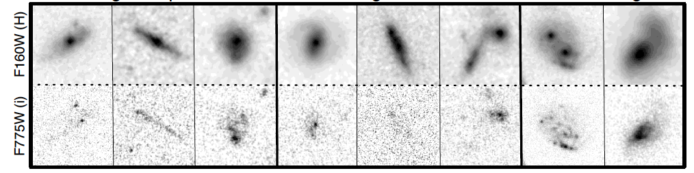
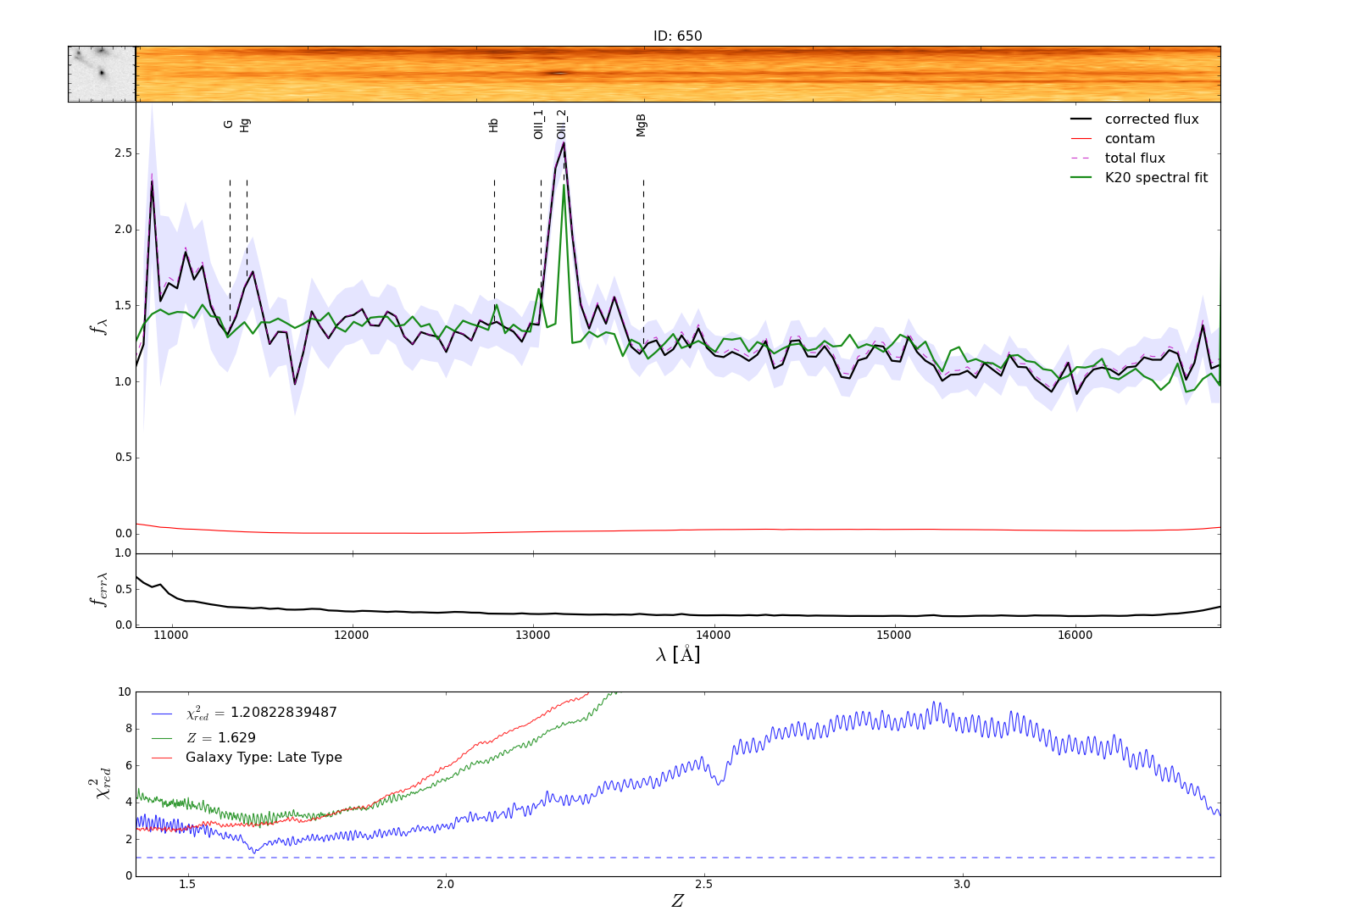
Selection and ancillary data
Fields
COSMOS
UKIDSS-UDS
GOODS-South
SSA-22
Hubble Ultra-Deep Field and Parallels
Grogin et al. 2011
Excellent multi-wavelength data including HST CANDELS imaging
Extensive spectroscopy available, ground-based + WFC3 near-IR spectroscopy as part of 3D-HST (PI van Dokkum)
Cullen, Cirasuolo et al. 2013

Slide 7
KDS: galaxies at z>7 and the epoch of re-ionization

Slide 8
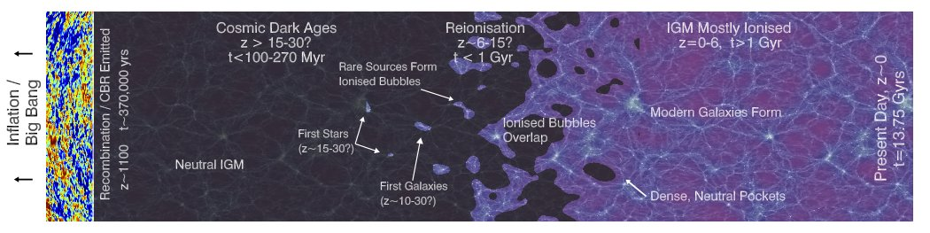
KDS: galaxies at z>7 and the epoch of re-ionization
Target selection and observing strategy
~50 Lyman Break Galaxies with robust photo-z at z > 7.5
Observing band: YJ to detect Lyα
Aims:
- Spectroscopic confirmation
- Fraction of Lyα emitters (LAE)
- Escape fraction and evolution of neutral hydrogen
- Improved stellar mass and SFR
McLure, Cirasuolo et al. 2012, 2013

Slide 9
KDS: Formation of the first discs and bulges at z>3

Slide 10
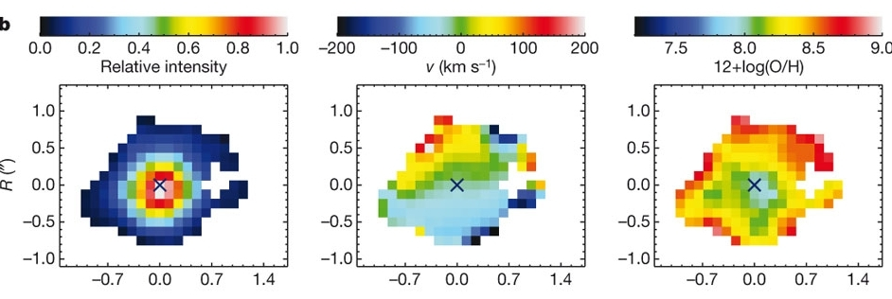
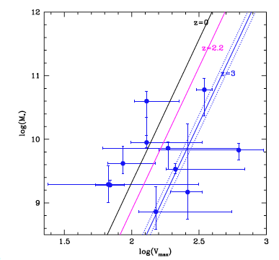
KDS: Formation of the first discs and bulges at z>3
Target selection and observing strategy
- 250 galaxies in the redshift range 3<z<5
- Mostly spectroscopic redshifts + some with photo-z to test selection bias.
- Wide range in mass and SFR
- Observing bands: H+K to detect OII, Hβ, OIII
Aims:
- Spatially resolved Metallicity and SFR
Cresci et al. 2010
- Mass-metallicity-SFR relation
- Dynamics and Tully-Fisher relation
Cullen, Cirasuolo et al. 2013, 2014
Troncoso et al. 2013
Gnerucci et al. 2011

Slide 11
KDS: Ancillary science 1
While observing the primary samples, some spare IFUs will be devoted to:

Slide 12
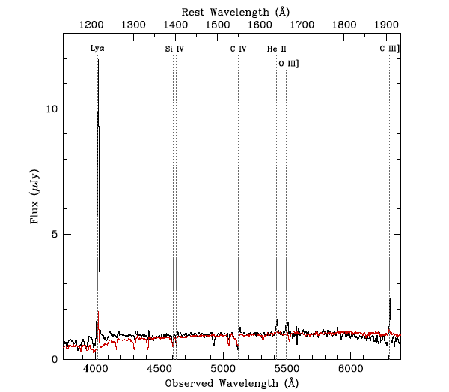
KDS: Ancillary science 1
While observing the primary samples, some spare IFUs will be devoted to:
Tentative detection of CIII] in young, low-metallicity galaxies at z>5
- Observed at z=2.3 (Erb et al. 2010)
CIII] emission strongly depends on both metallicity and ionization parameter.
Should be more common feature in the early Universe
- High CIV / CIII] indicates presence of AGN
- If Lyα fully absorbed by neutral hydrogen, CIII] (with HeII) could be the strongest line we can detect from the ground at z>6.
Young, Low-metallicity galaxy at z=2.3 (Erb et al. 2010)

Slide 13
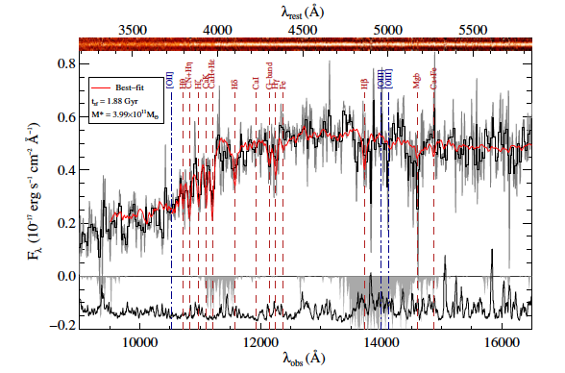
KDS: Ancillary science 2
While observing the primary samples, some spare IFUs will be devoted to:
Emergence of the red-sequence
- Passive galaxies at z > 2
- Dynamical masses
- Discriminate models for evolution of mass-size relation
- Ages and residual SFR
Ono et al. 2012

Slide 14
KMOS Deep Survey: Status and Plan
- 35 nights program
- First 4 nights observed in November 2013: very unlucky due to bad weather conditions.
- Next observing runs: April and September 2014
- Very faint targets need extreme care in removing systematics:
Detector noise and persistence
Sky subtraction
Science cases | Number of objects
Galaxies at z>7 | ~50
Star-forming galaxies at z>3 | 200-300
CIII] at z>5 | ~30
Passive galaxies at z>2 | ~50
1-2 nights integration per pointing

Slide 15
KMOS Deep Survey: Summary
35 nights program over 5 years
Galaxies at z > 7 and the epoch of reionization
- spectroscopic confirmation
- fraction of LAE and evolution of neutral hydrogen
- improved stellar mass and SFR
Formation of the first discs and bulges at z>3
- Spatially resolved Metallicity and SFR
- Mass-metallicity-SFR relation
- Dynamics and Tully-Fisher relation
Ancillary science:
- Dynamical masses, ages and residual SFR for passive galaxies at z ~2
- Tentative detection of CIII] at z>5

