Slide 1
Deep fields with MUSE
Simon Lilly (ETH Zurich)
with Sebastiano Cantalupo (UCSC)
and the MUSE Consortium

Slide 2
Emerging observational paradigms (1):
“Flow-through” of galaxies in (m,sSFR)
What quenches galaxies?
Linked to cool gas content (Amelie Saintonge talk)
But is it ejection or cut-off of supply, or both
AGN?
Halo physics?
Links to structure? Mergers?
“Outliers”
sSFR_{MS} declines by twenty since z = 2
What causes sSFR_{MS}(z)
SFR
Main Sequence
“quenched” passive
sMIR = specific accretion rate
Stellar mass

Slide 3
Emerging observational paradigms (2):
Flow-through of gas through regulator systems
Star-formation
Outflow
Galaxy evolves in quasi-equilibrium. If regulated by m_{gas} (see Lilly+2013):
sSFR ~ sMIR (independent of ε or λ!)
gas fraction m_{gas}/m_{star} = ε⁻¹ sSFR
Z ~ y f_{star}(m), linking metallicity to production of stars and thus to m_{star}/m_{halo}
a Z(m,SFR) relation which is also epoch-independent (FMR) if ε(m) and λ(m) constant
But what exactly is in balance with what? Need m_{mol}, m_{atom}, metallicity, outflow, SFR, (inflow)
See Bouche et al 2010, Krumholz & Dekel 2012, Dave et al 2011, 2012, Lilly et al 2013, Dekel & Mandelker 2014

Slide 4
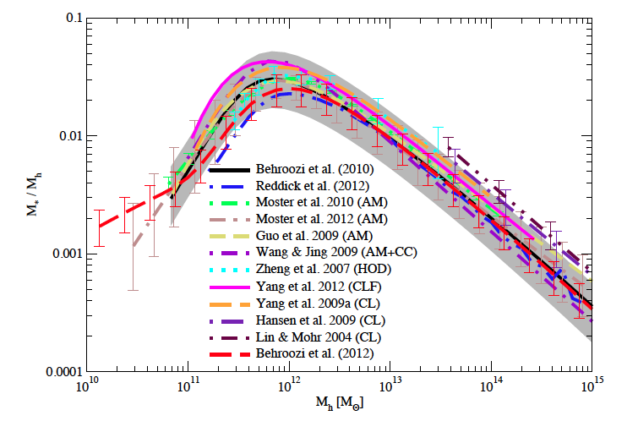
Understanding the conversion of baryons into stars in haloes
Aside: Quenching occurs just as m_{star}/m_{halo} approaches the maximum possible (cosmic baryon fraction ~ 0.15). What is this telling us? see Birrer et al (2014)
from Behroozi et al (2012)
25%(!)
Increasingly efficient conversion of stars to baryons in galaxies (due mostly to decreasing effect of winds λ(m) as traced by Z(m)
m_{star}/m_{halo} ∝ m_{halo}
plus low SFE in very low mass haloes ?
Effect of (mass-) quenching as required by constant M*_{SF}, plus some modest mass increase due to merging
(Mass-) quenching as required by constant M*_{SF}
M* = 10^{10.7} M

Slide 5
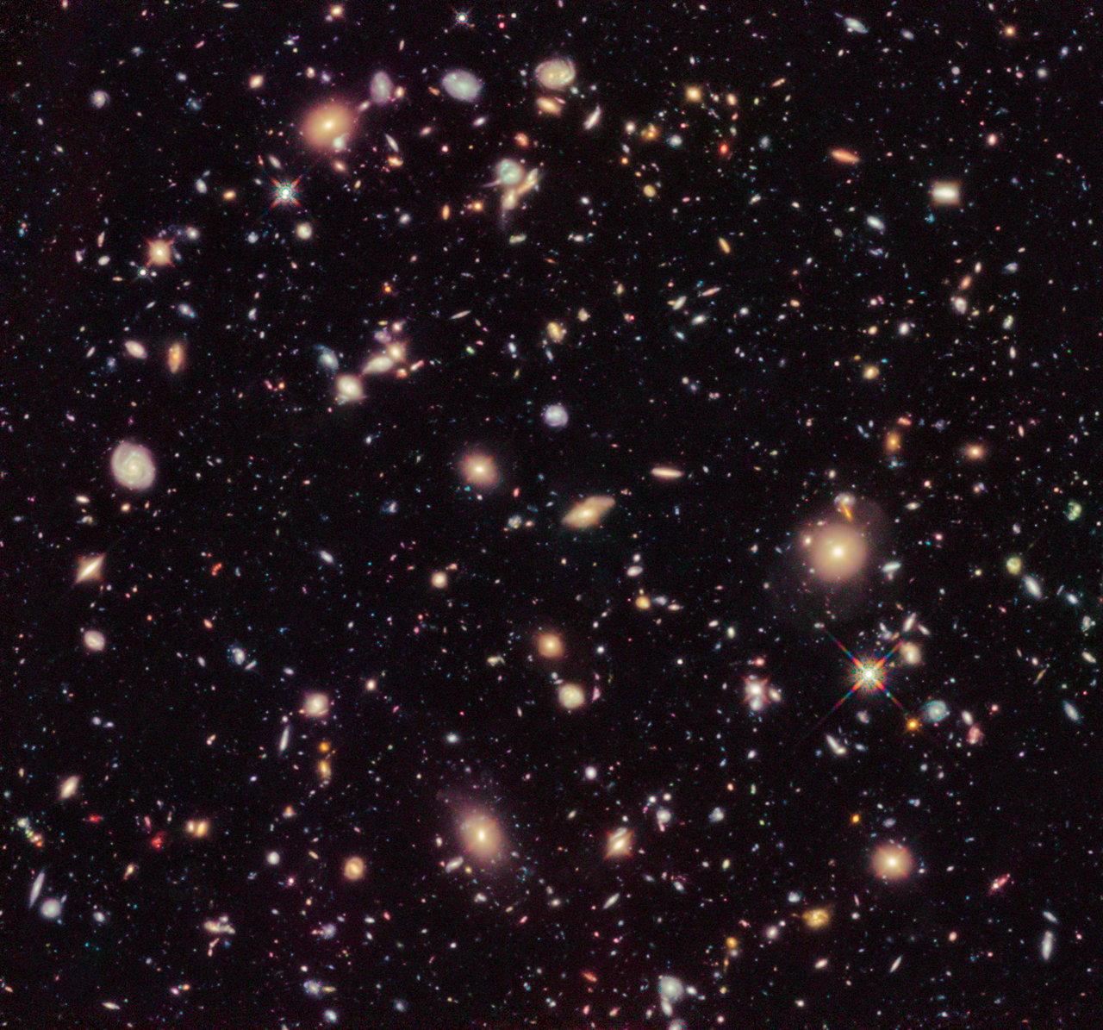
The visible Universe

Slide 6
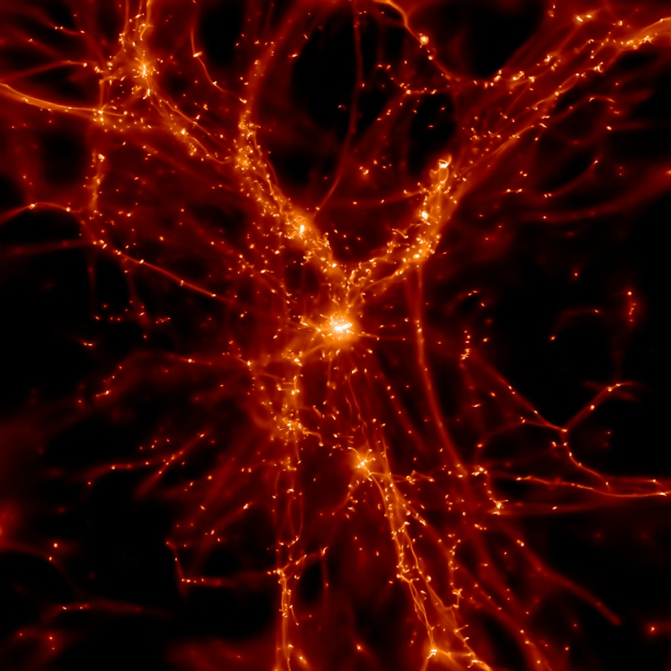
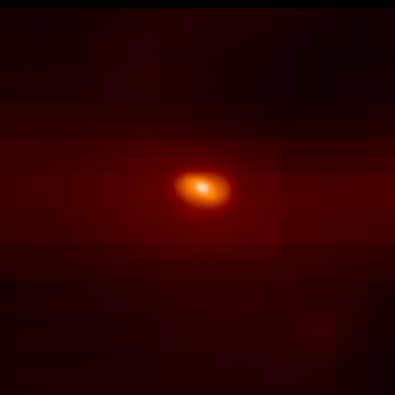
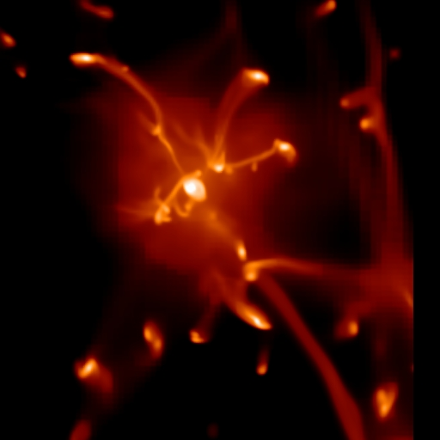
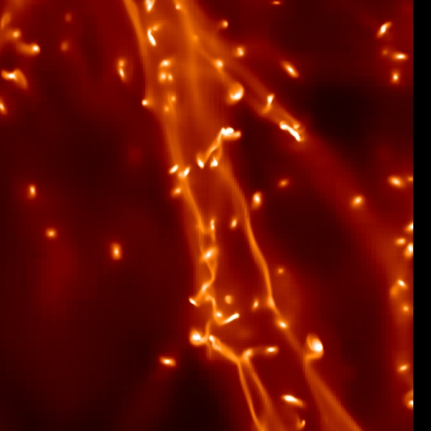
Gas questions
The real Universe
What determines star-formation efficiency in galaxies? Are there gas-rich “dark galaxies” in low mass haloes at high z?
Where is gas deposited in galaxies? How does it reach the central AGN?
How are winds launched??
1-10 kpc
What is the morphology of the accreting gas and how does this affect galaxy evolution?
What happens to the ejected material?
10-200 kpc
Simulation and slide from Sebastiano Cantalupo 2014
What are the physical and morphological properties of the gaseous Cosmic Web?
200-1000+ kpc

Slide 7
MUSE
MUSE Consortium
P.I. Roland Bacon
CRAL Lyon
Leiden (NOVA)
Gottingen
AIP Potsdam
IRAP Toulouse
ETH Zurich
+ ESO
  1x1 arcmin², advanced slicer design feeding 24 identical spectrographs
  4650 < λ < 9300 A @ 1500 < R < 3500
  90,000 0.2×0.2 arcsec spaxels, image quality limited by atmosphere (eventually GALACSI seeing-assist)
  High stability (no moving parts)
  High throughput (0.35 end-to-end)
  400 Mpixels
  but most of them will be empty or uninteresting!
First Light Feb 2014!

Slide 8
MUSE
MUSE Consortium
P.I. Roland Bacon
CRAL Lyon
Leiden (NOVA)
Gottingen
AIP Potsdam
IRAP Toulouse
ETH Zurich
+ ESO
  1x1 arcmin², advanced slicer design feeding 24 identical spectrographs
  4650 < λ < 9300 A @ 1500 < R < 3500
  90,000 0.2×0.2 arcsec spaxels, image quality limited by atmosphere (eventually GALACSI seeing-assist)
  High stability (no moving parts)
  High throughput (0.35 end-to-end)
  400 Mpixels
MUSE is not a redshift-survey machine!
MUSE deep surveys will be best for:
Spatially resolved objects (N.B. GALACSI seeing-assist will be very important)
“Unknown” (untargettable) objects – e.g. very faint emission line sources
Crowded contiguous fields (lensing clusters, qso sight lines etc) where other MOS approaches are inefficient
Using adaptive apertures (no slit losses)

Slide 9
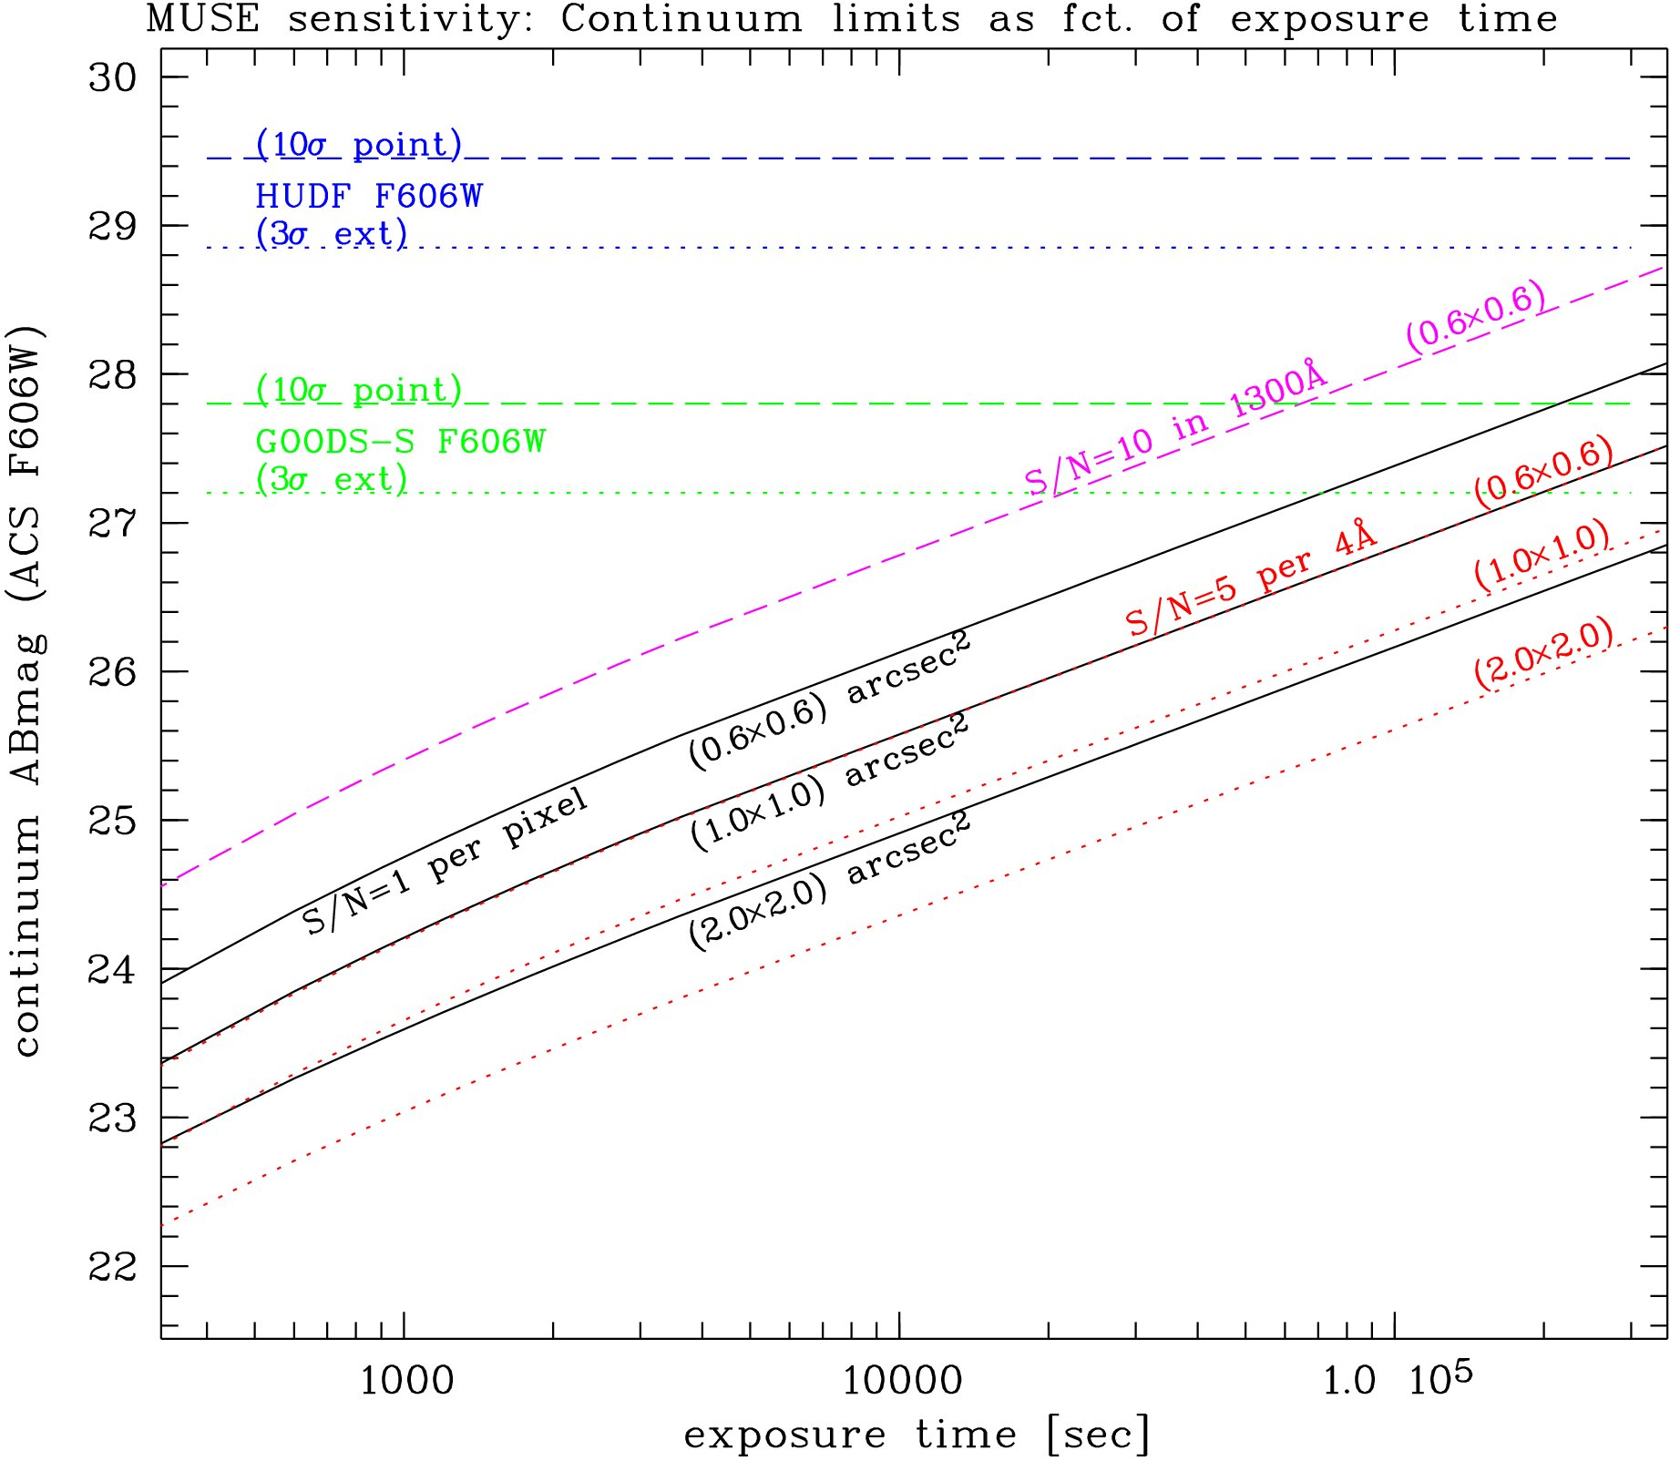
Continuum sensitivity
Gains from:
High throughput
Adaptive apertures
Note: Broad-band sensitivity in 10hrs comparable to GOODS

Slide 10
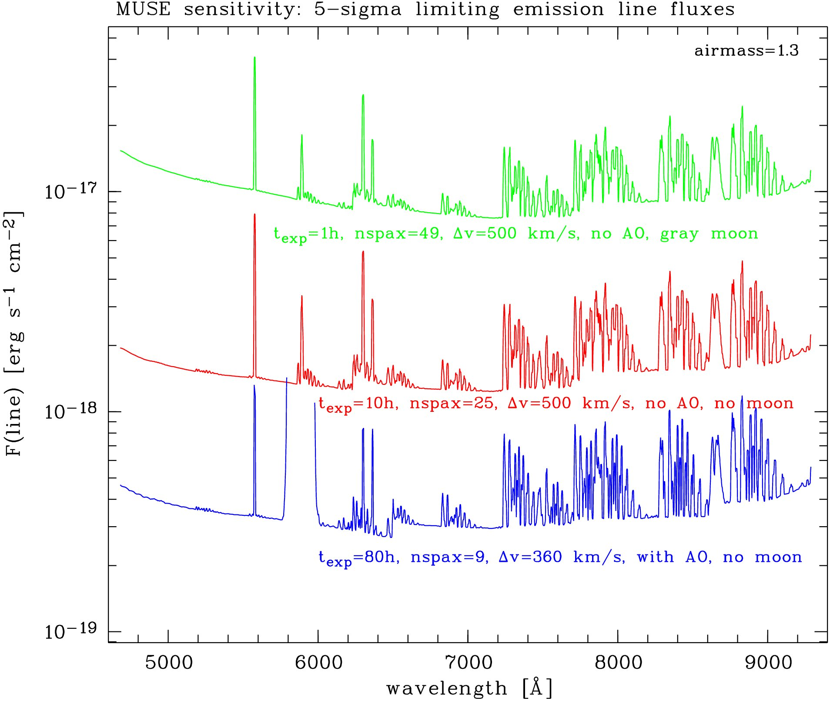
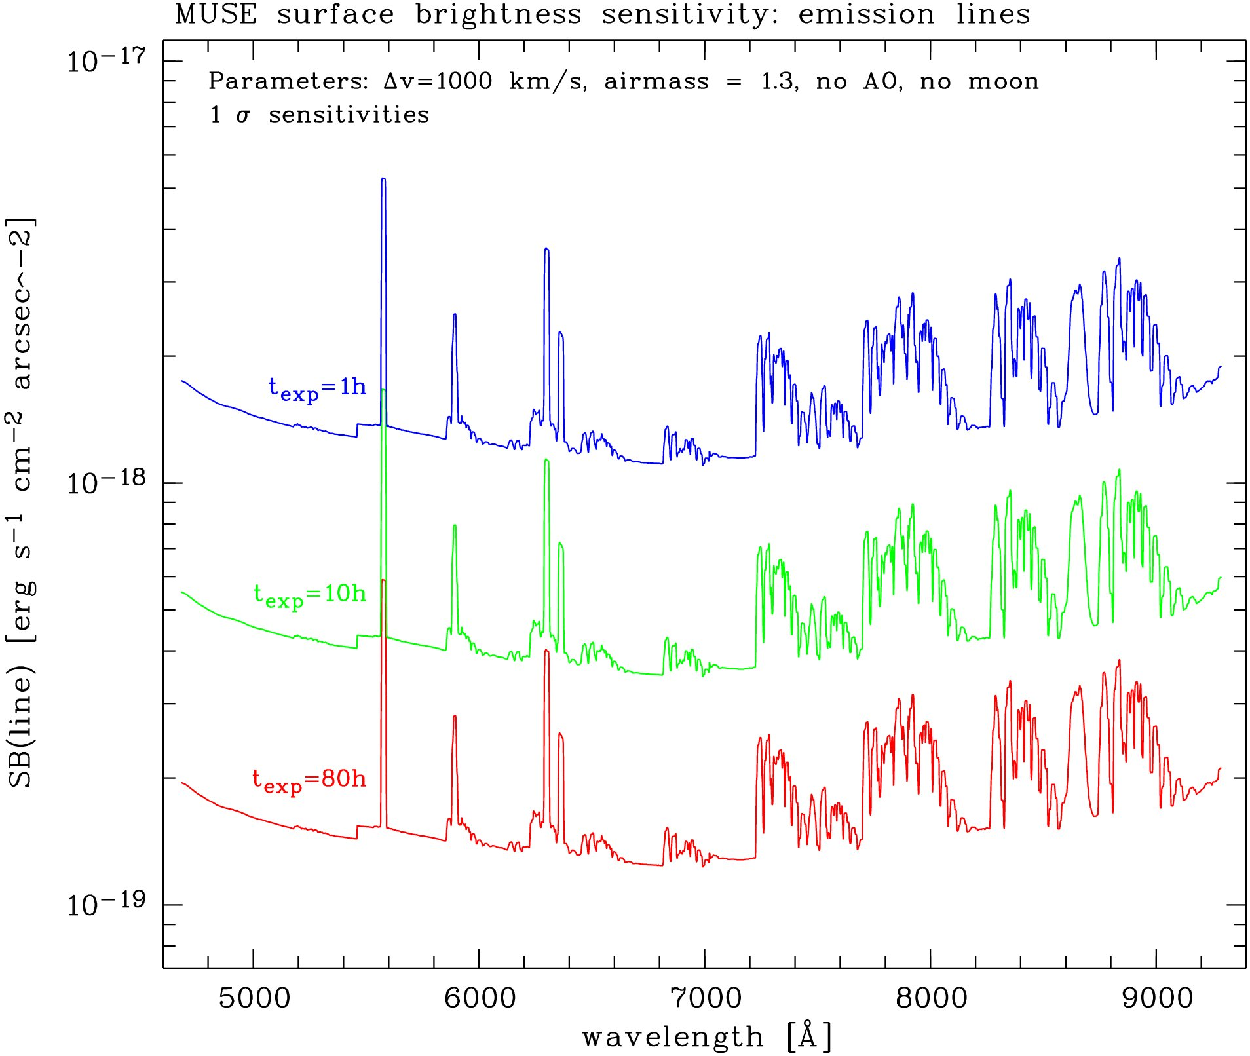
Line sensitivity
Importance of adaptive apertures for asymmetric structure

Slide 11
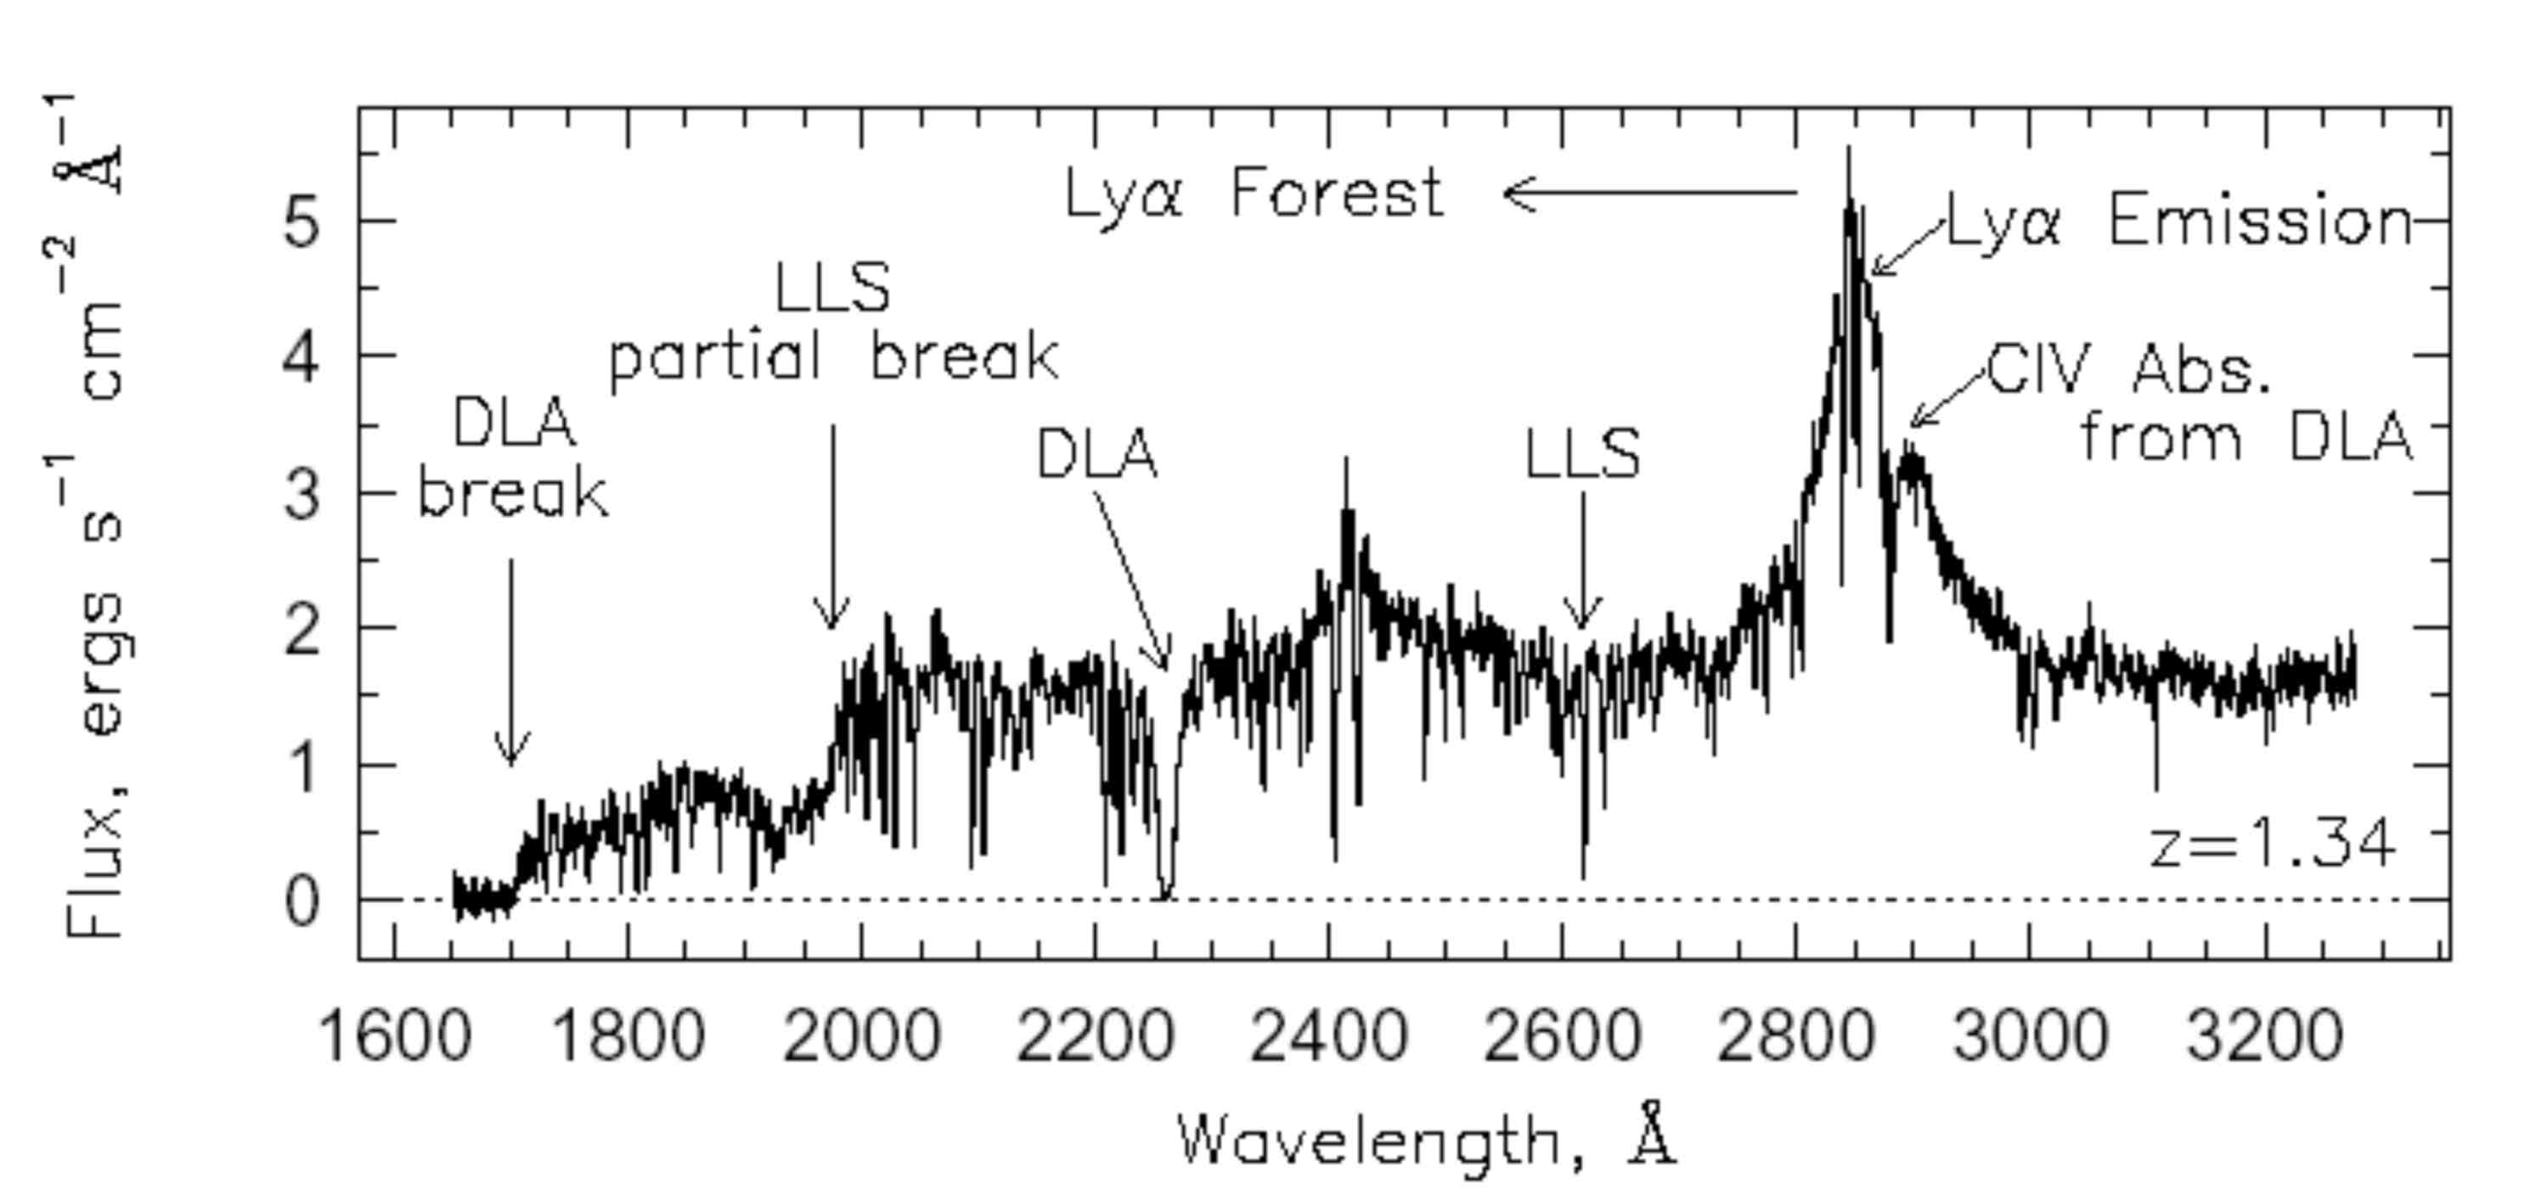
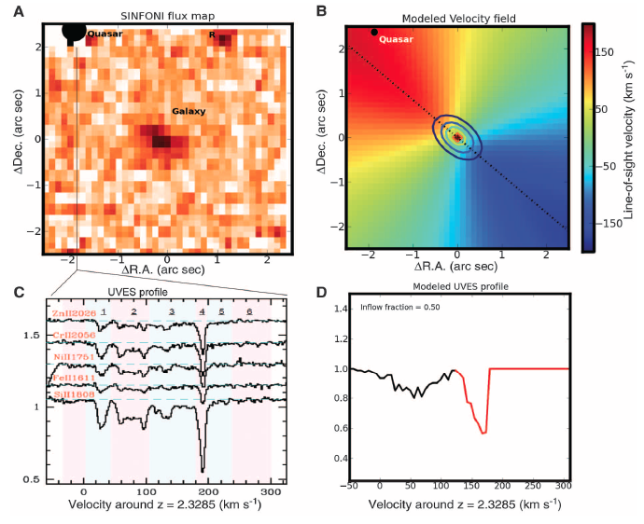
MUSE and absorption
See talks by Nicholas Bouché and Celine Péroux
Bright quasars give exquisite sensitivity to intervening material, but only along one-dimension
Two dimensional information available only through statistical approaches.
e.g. stacking ~5000 zC background galaxy spectra passing close to ~ 4000 0.5 < z < 0.9 galaxies
Bordoloi et al (2011)
Gain of MUSE is to characterize 2-d characteristics of nearby objects (velocity fields, metalicity gradients etc), plus settle ambiguities in associations

Slide 12
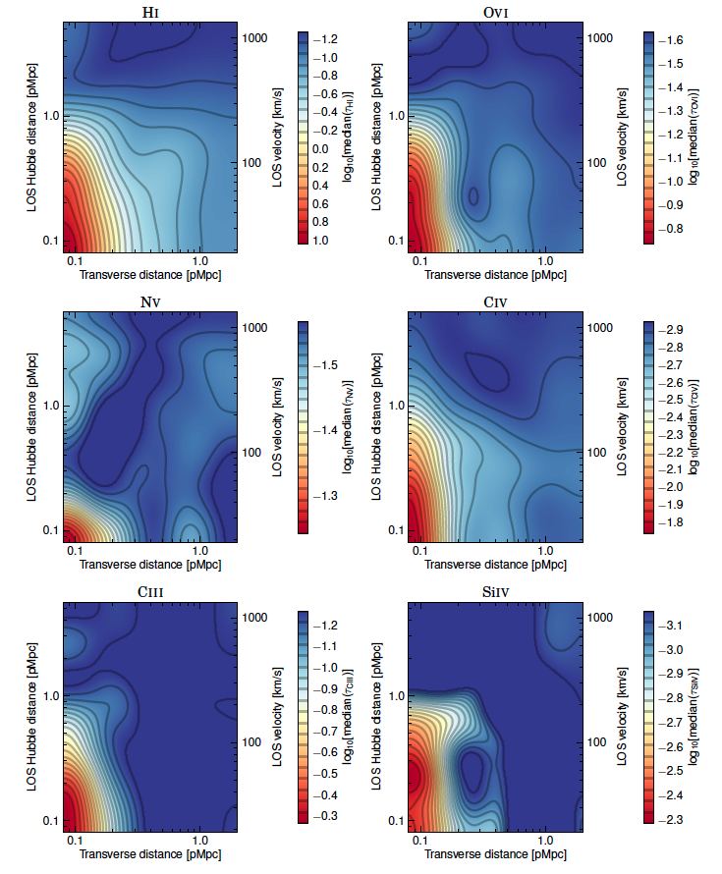
MUSE and absorption
From Turner et al (2014)
Optical depth (r_{p},π) for different species derived from ~ 480 z ~ 2 MOS (continuum-selected) galaxies near quasar sightlines
MUSE can simultaneously measure “every” redshift within 250 kpc of a given sightline, especially in Lyα where ~ 40+ Lyα emitting galaxies detectable per unit z in 8 hrs.

Slide 13
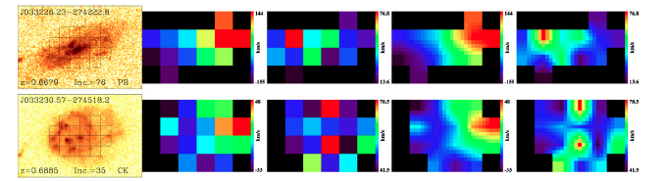
MUSE and intermediate-z galaxy kinematics and metalllicity
See talk by Matthieu Puech
Puech et al (2012)
Note that the full-octave MUSE spectral range gives R₂₃ lines ([OII]3727, Hβ, [OIII]4959,5007) for 0.3 < z < 0.9, plus Hα and [NII] for 0.3 < z < 0.5
(nice to add KMOS for Hα+[NII] at z > 0.5!)

Slide 14
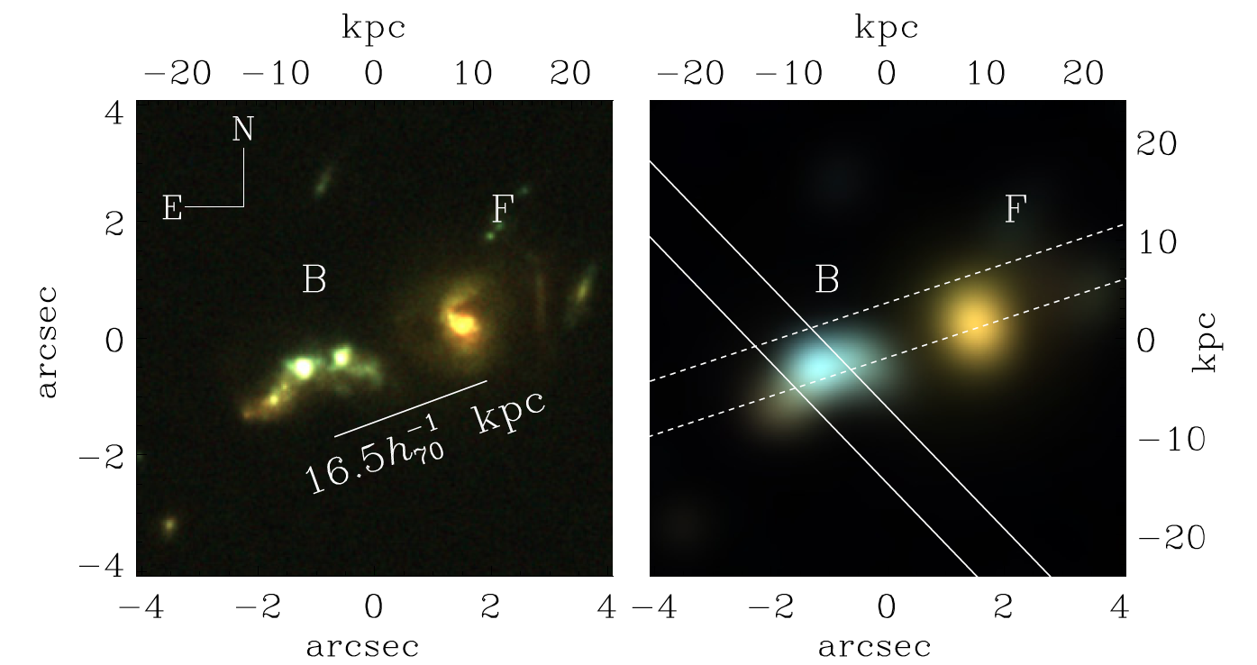
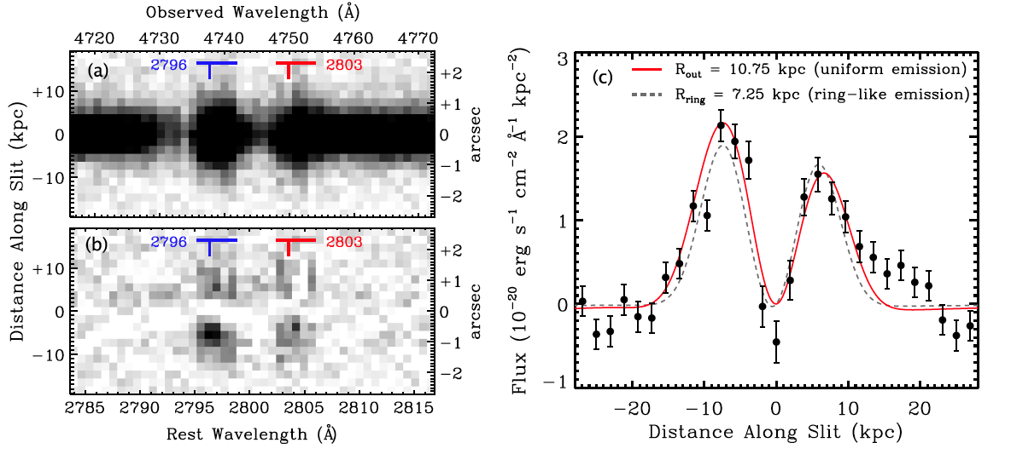
Emission from outflowing material
from Rubin et al (2011)
also Masami Ouchi talk
z = 0.694
SFR ~ 80 Myr⁻¹
Mass ~ 10^{10.3} M
sSFR ~ 4 Gyr⁻¹ (~ 10x MS)

Slide 15
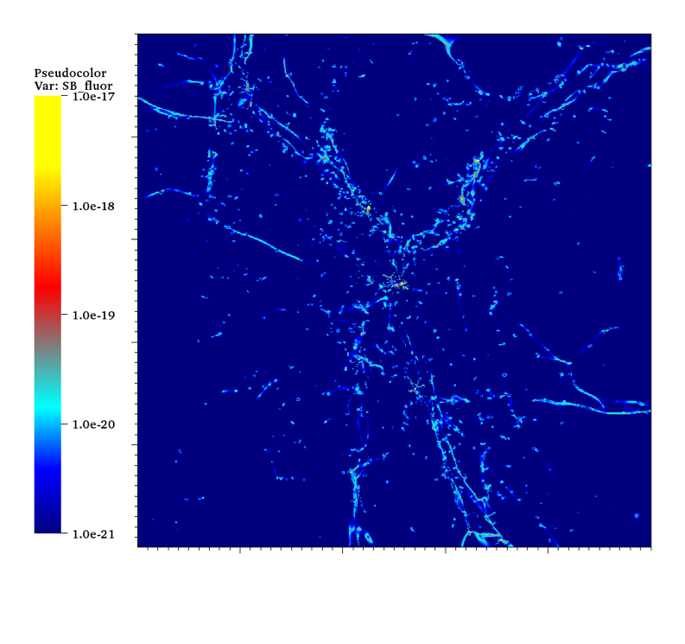
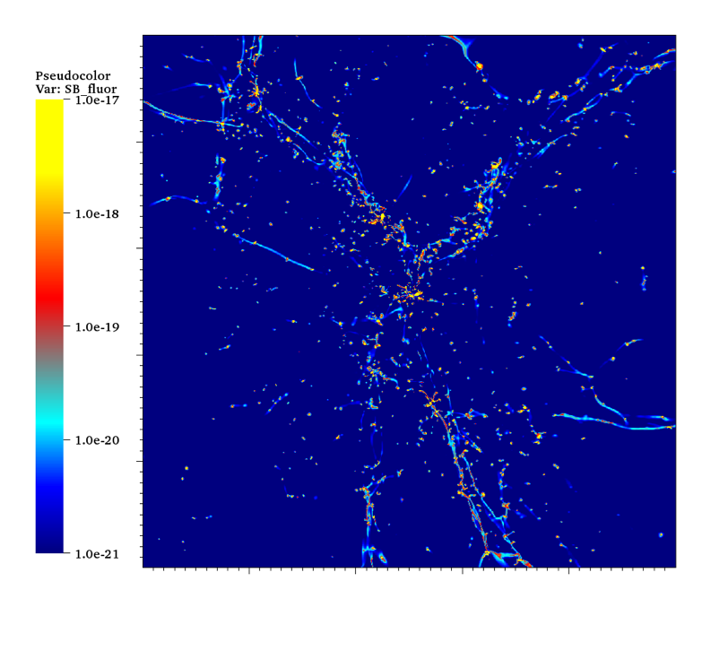
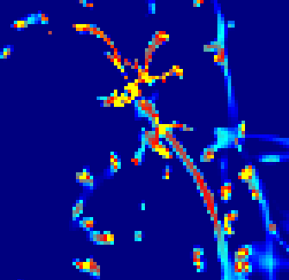
Can we see the cosmic web and feeding filaments in emission?
Self-shielded neutral gas fluoresces when illuminated by the UV background (in principle every ionizing photon produces ~ 0.6 Lyα photon)
Hogan & Weymann 1987; Gould & Weinberg 1996; Zheng & Miralda-Escude 2005; Cantalupo+05,07; Kollmeier+08, Cantalupo+12
Extra illumination by a nearby quasar shrinks self-shielded region but boosts surface brightness over region > 10 Mpc
Cantalupo+05,07,12
SB
(cgs/arcsec²)
10 cMpc box @ z ~ 2
MUSE
UVBgd +Stars
UVBgd+Stars+QSO boost
from Cantalupo et al 2012

Slide 16
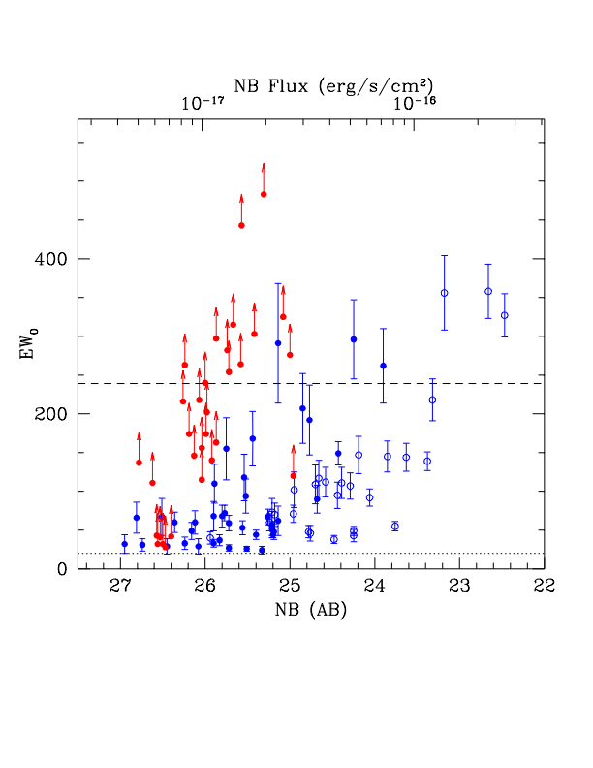
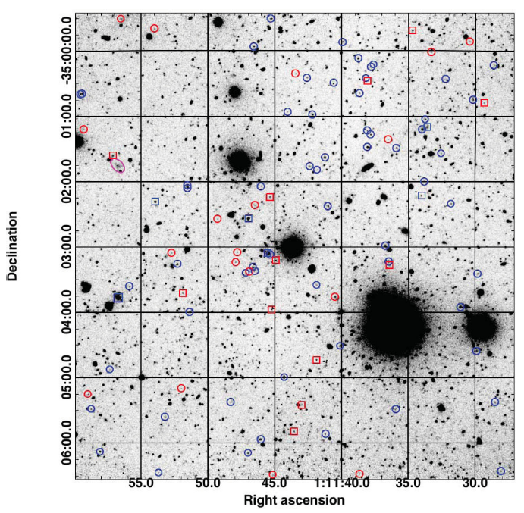
“Dark galaxies” on the VLT
Cantalupo, Lilly & Haehnelt 2012
Based on 20 hr FORS integration in custom 40A nb filter on HE0109-3518 z = 2.4057 b_{J} = 16.7

Slide 17
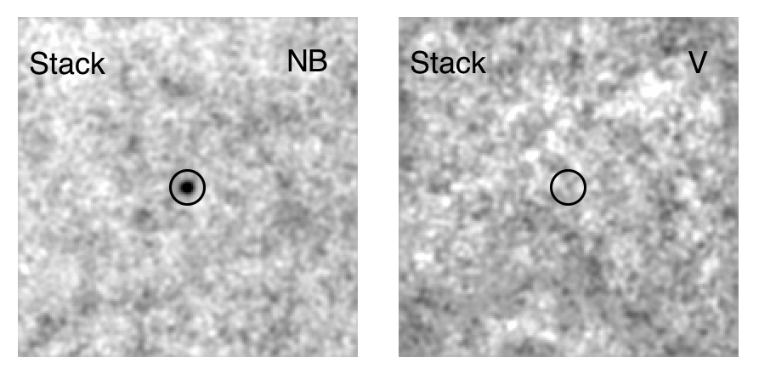
“Dark galaxies” on the VLT
Cantalupo, Lilly & Haehnelt 2012
Based on 20 hr FORS integration in custom 40A nb filter on HE0109-3518 z = 2.4057 b_{J} = 16.7
18/100 LAE have EW₀ > 240 A, and of these 12 unresolved have no detected continuum
Stacked image gives combined constraint: EW₀>800A (1σ)
Estimate SFR < 0.01 Myr⁻¹
Estimate M_{gas} ~ 10⁹ M
sSFR plausibly < 0.01 sSFR_{MS}
i.e. “dark galaxies” ?

Slide 18
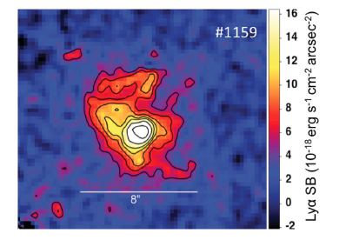
“Dark galaxies” on the VLT
Cantalupo, Lilly & Haehnelt 2012
Based on 20 hr FORS integration in custom 40A nb filter on HE0109-3518 z = 2.4057 b_{J} = 16.7
Extended high EW emission around galaxies in quasar field
8 arcsec = 60 kpc
Inflowing filaments?
or just tidal features?

Slide 19
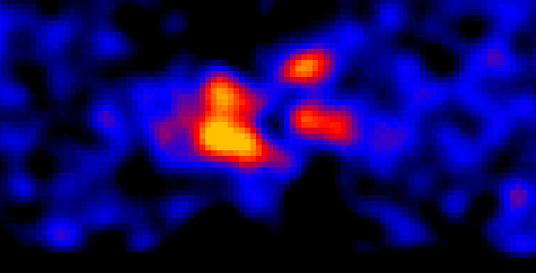
“Dark galaxies” on the VLT
Cantalupo, Lilly & Haehnelt 2012
Based on 20 hr FORS integration in custom 40A nb filter on HE0109-3518 z = 2.4057 b_{J} = 16.7
Double line structure consistent
with cold gas illuminated by the quasar
Extended high EW emission around galaxies in quasar field
500 kms⁻¹
75 kpc
Inflowing filaments?
or just tidal features?

Slide 20
“Dark galaxies” on the VLT
Cantalupo, Lilly & Haehnelt 2012
Based on 20 hr FORS integration in custom 40A nb filter on HE0109-3518 z = 2.4057 b_{J} = 16.7
Extended high EW emission around galaxies in quasar field
MUSE 5σ 8 hrs
point source
MUSE 3σ 8 hrs
per arcsec²
Filaments?
Tidal features?

Slide 21
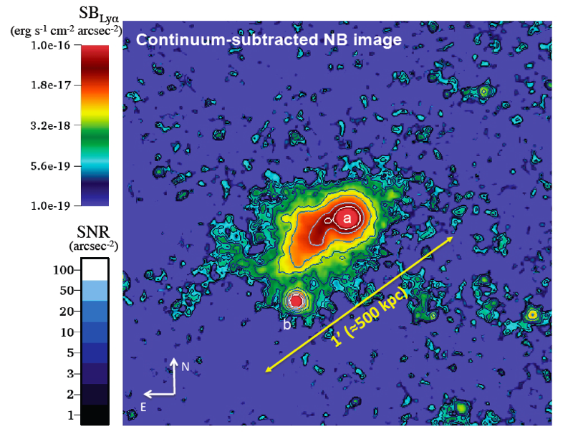
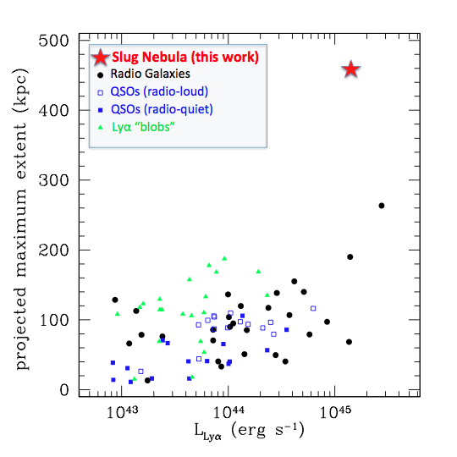
Giant Lyα nebulae in the high redshift Universe
The Slug Nebula around radio quiet UM287 at z = 2.4 (0.5 Mpc in extent)
L_{neb}(Lyα) = 2.2x10⁴⁴ erg s⁻¹
from Cantalupo et al (2014, Nature 506, 63)
MUSE 3σ 8hr 2x2 arcsec²
280 kpc virial diameter of 10^{12.5} M halo
MUSE FoV

Slide 22
1 arcmin² of HUDF
MUSE as parallel science
MUSE = 90,000 spectra
400 million pixels
Most of which will be “empty” even in extremely deep exposures
But, you get everything in the field regardless of whether you wanted it. Every 1 arcmin² field s will contain:
Five I_{AB} < 22.5 galaxies (0.1 < z < 1.2)
  OK for resolved spectroscopy in several hrs
Thirty I_{AB} < 24.5 galaxies (0.1 < z < 4)
OK for absorption z in several hrs
Many Lyα emitters at 2.8 < z < 6.7
Nominal MUSE sensitivity in 8 hours
GalLICS simulations Garel et al 2012

Slide 23
MUSE (GTO) deep survey strategy
Build up large samples of serendipitous objects at all redshifts 0.05 < z < 6.5 using pointed observations of:
(1) Interesting objects at particular redshifts, e.g.
  Bright quasars for extended Ly α and/or Lyα blobs
  Bright quasars for absorption line studies (Mg II at z < 1, Lyα and metal lines at z > 3)
  Intermediate redshift groups
  Lensing clusters
  Others….
  HST deep fields
Will produce a homogeneous data set with “standard” exposure time of about 8hr, with a few 80hr extremely deep fields and also multiple 1 hr “snapshots”.
Key point: Apart from observational details like dithering, all MUSE extragalactic cubes (beyond nearby extended galaxies) should be more or less identical → highly homogeneous and representative data set on the distant Universe over an octave of wavelength

Slide 24
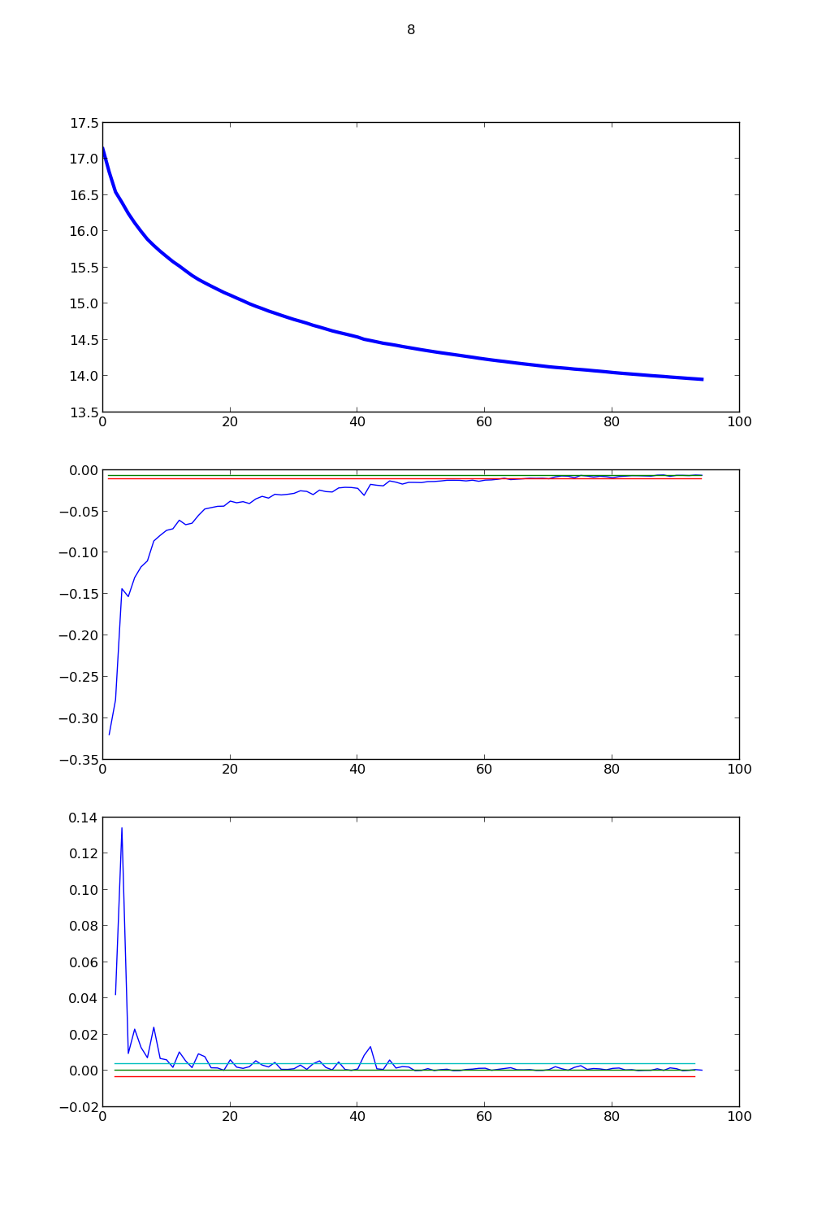
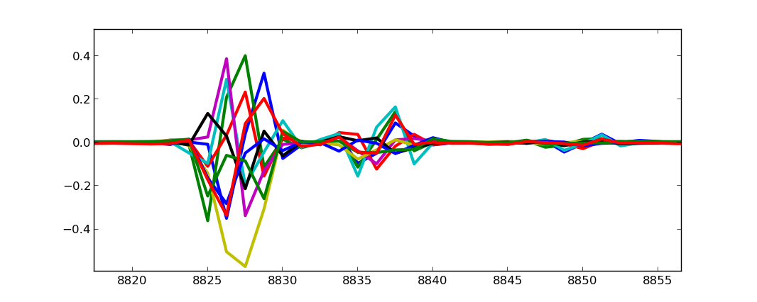
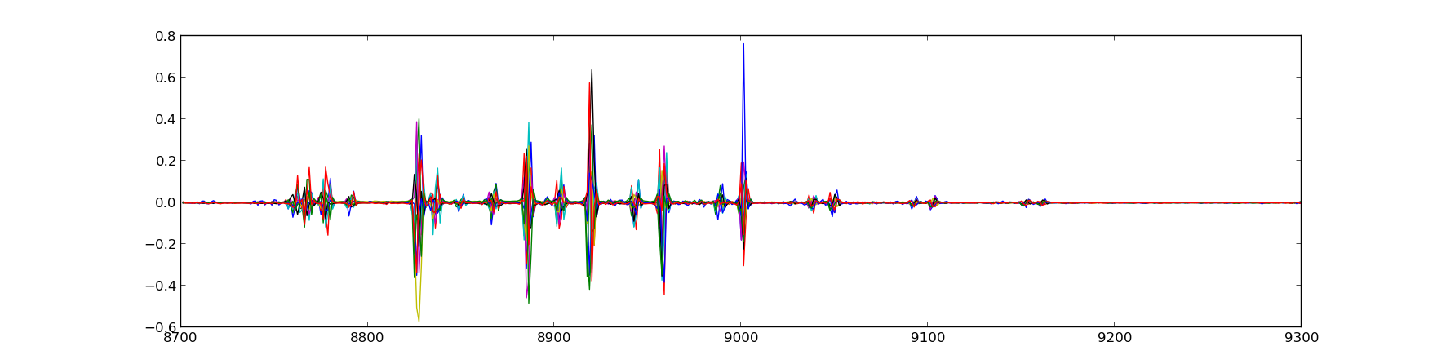
How deep can we go with MUSE?
MUSE has been designed for high stability (no moving parts) allowing self-calibration techniques, but
High quality sky-subtraction needed with different spatial characteristics than usual
Variance
Number of Eigenmodes
Promising post-processing approaches:
e.g. ZAP (Soto et al. in prep).
PCA identification of eigenspectra of sky residuals (see Sharp & Parkinson 2010 for AAT fibres)
Eigenspectra
8800
9000
9200
λ (Å)

Slide 25
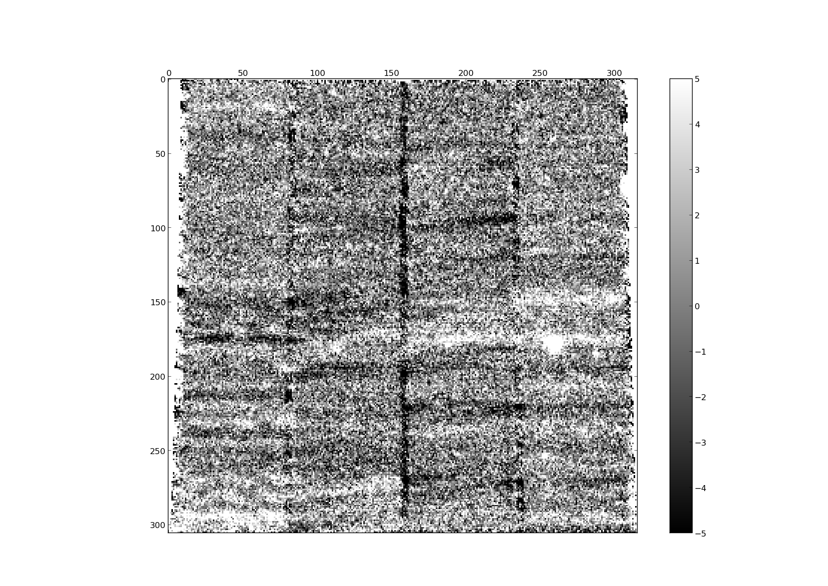
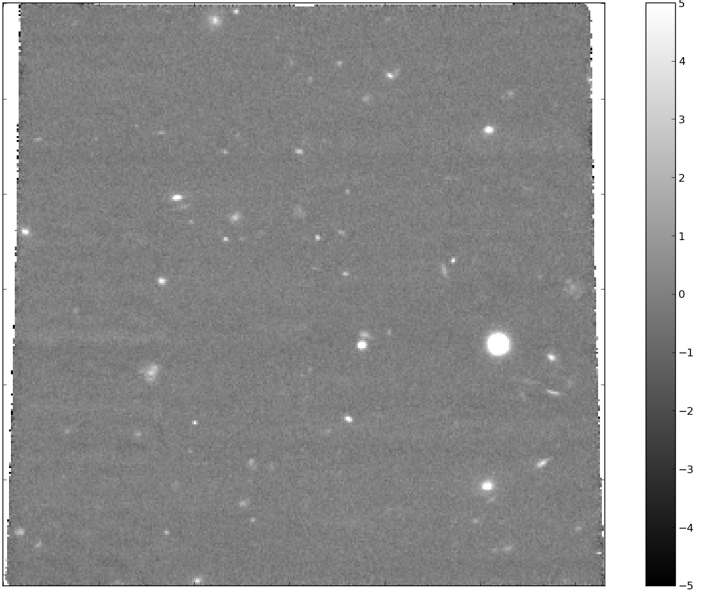
Encouraging results so far
preservation of (real) line fluxes and profiles, even for extended objects
no artificial “de-noising”
Variance
Number of Eigenmodes
simulated MUSE data on an OH sky line

Slide 26
Summary
Gas content (mass, state, metallicity etc) and gas flows, in and out, are essential for understanding the regulation of star-formation in galaxies
MUSE offers new capabilities/efficiencies for studying gas (and continuum) at both intermediate redshifts and (Lyα) at very high redshifts 3 < z < 6.7
Excellent prospects for tracing extended filamentary gas feeding galaxies from the cosmic web
The 1x1 arcmin² 465 < nm < 930 MUSE cubes will
contain everything (regardless of whether you whether you wanted it)
be highly homogeneous (no “settings” beyond dithering etc)
So we will build up large uniform data set on the deep (optical) Universe.

