Slide 1

The SAMI Galaxy Survey
Lisa Fogarty
CAASTRO/University of Sydney

Slide 2
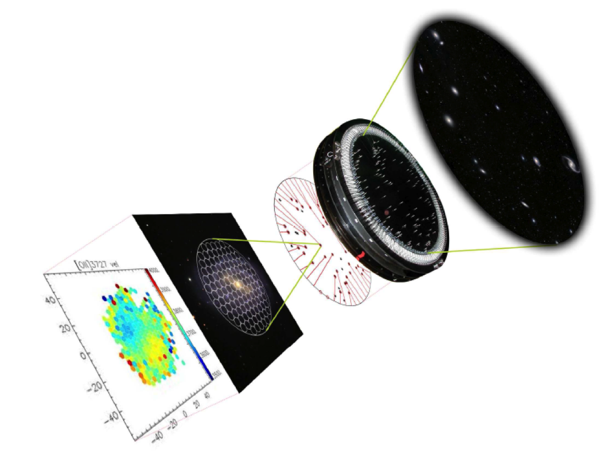
SAMI
Sydney-
AAO
Multi-object
Integral field spectrograph
Notes:
An implementation of IFUs here in Sydney

Slide 3
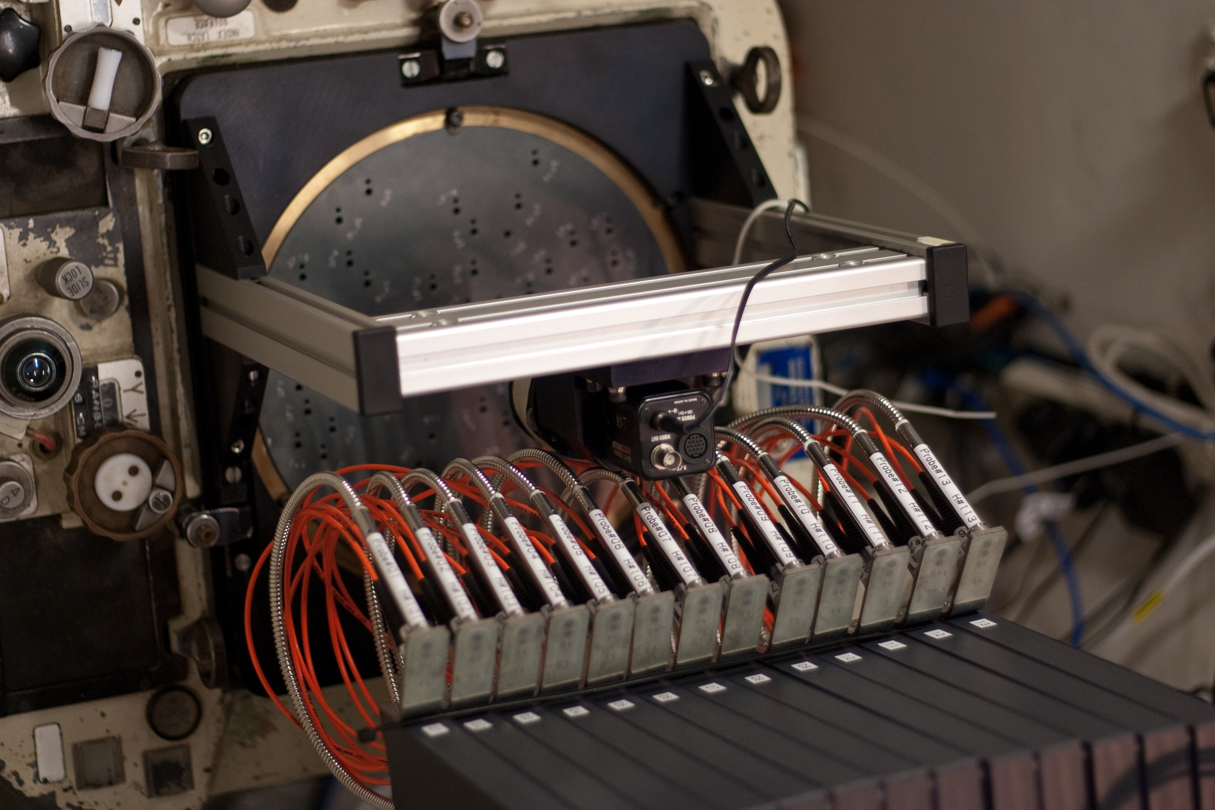
SAMI – At a Glance.
Bundles (IFUs): 13
Sky Fibres: 26
Total Fibres: 819
Total fov: 1 degree
Bundle fov: 15’’
Fibre resolution element: 1.6’’
RED
R~4500
λ: 625nm-735nm
BLUE
R~1700
λ: 370nm-570nm
Notes:
Specs at a glance…
CHECK TIME – should have 10 mins left!

Slide 4
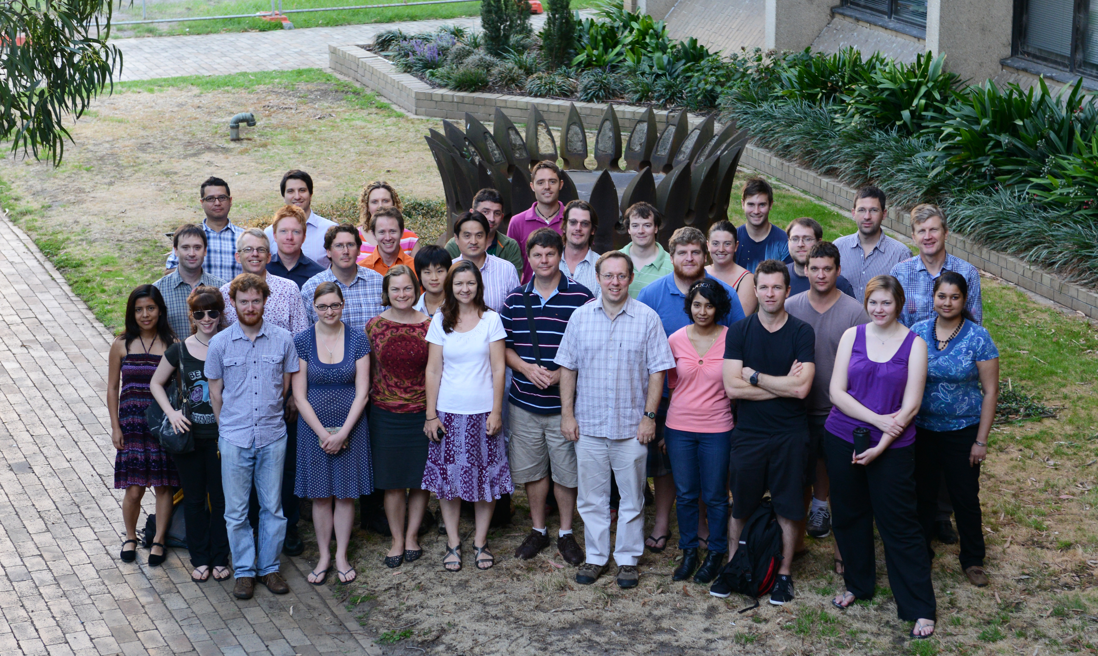
The SAMI Galaxy Survey

Slide 5
The SAMI Galaxy Survey
Physics of galaxy transformations.
Gas Flows in galaxy evolution.
Build up of mass and angular momentum.
3400 galaxies – broad range of mass and environments.
3 years – awarded 151-181 nights on AAT!
Already underway! ~650 galaxies already!
36 nights in 14A (including some KOALA nights)

Slide 6

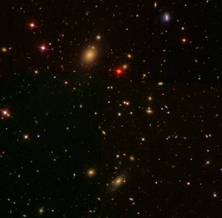
Target Selection
Primary Sample: Field and Group
70% of galaxies
Secondary Sample: Clusters
30% of galaxies
Notes:
Different multi-wavelength data and possibilities for follow-up.

Slide 7
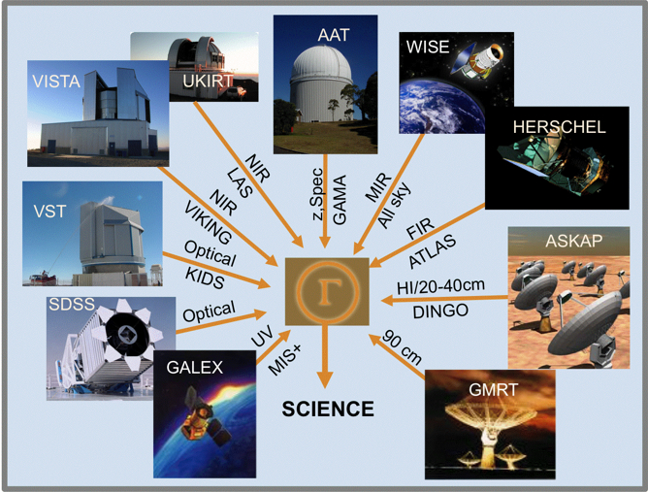
Galaxy and Mass Assembly (GAMA)
Figure Credit: Simon Driver

Slide 8
GAMA
VST (KiDS) Imaging
VISTA (VIKINGS) Imaging
325-MHz GMRT Observations.
HI – ALFALFA
Current: eVLA HI proposal.
Future: HI - ASKAP DINGO
Notes:
NB – GAMA multi-wavelength.
VST KiDS – optical imaging survey u,g,r,I
VISTA VIKINGS – moderate depth
GMRT Radio continuum
ALFALFA – not so deep, doesn’t overlap completely, 250 confirmed detections.

Slide 9
Targets - GAMA
Figure from Julia Bryant.
Notes:
Our target selection.

Slide 10
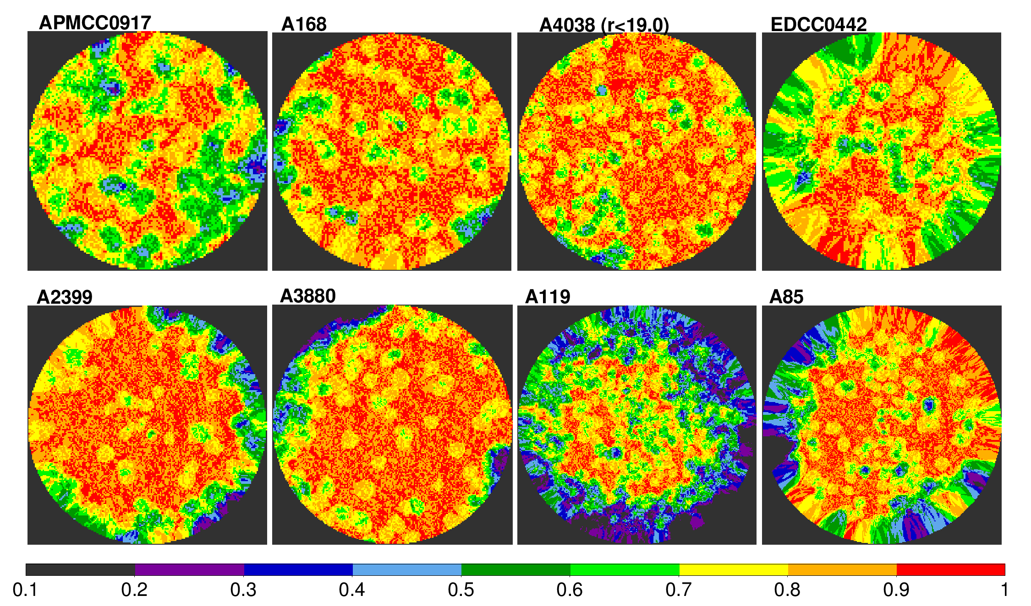
Targets - Clusters
Match GAMA redshift data:
Completeness 85% to r = 19.4.
Completeness 90% to r = 19.0.

Slide 11
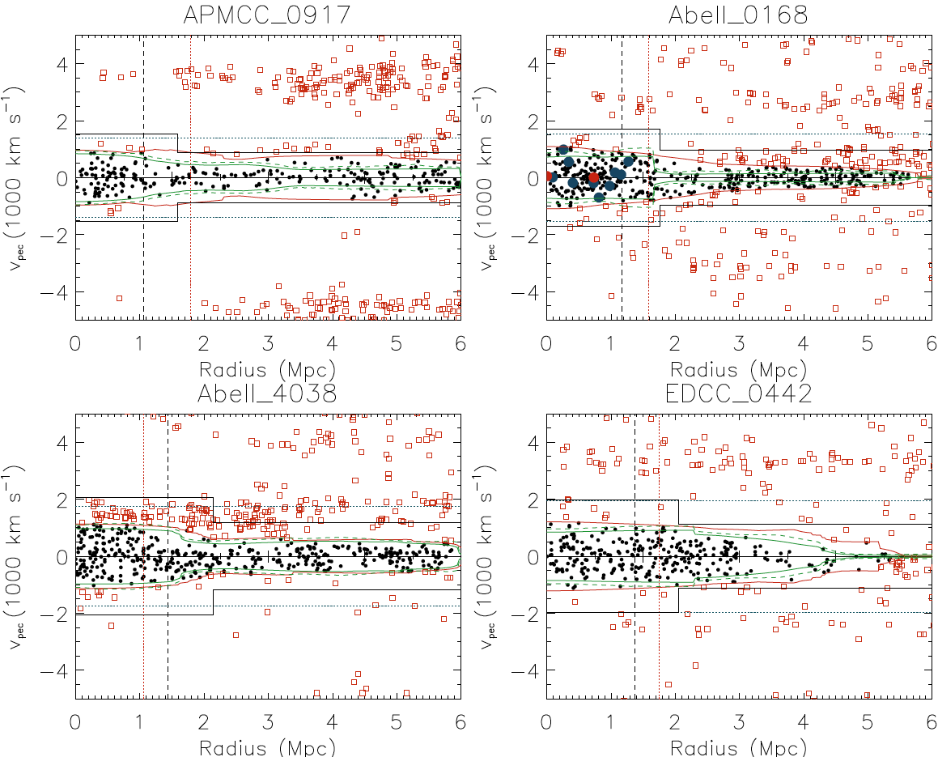
Targets - Clusters
Abell 4038 M=2.3x10¹⁴M_{sun}
Abell 168 M=1.9x10¹⁴M_{sun}
EDCC 0442 M=2.5x10¹⁴M_{sun}
APMCC 0917 M=1.3x10¹⁴M_{sun}
Figures from Matt Owers.

Slide 12
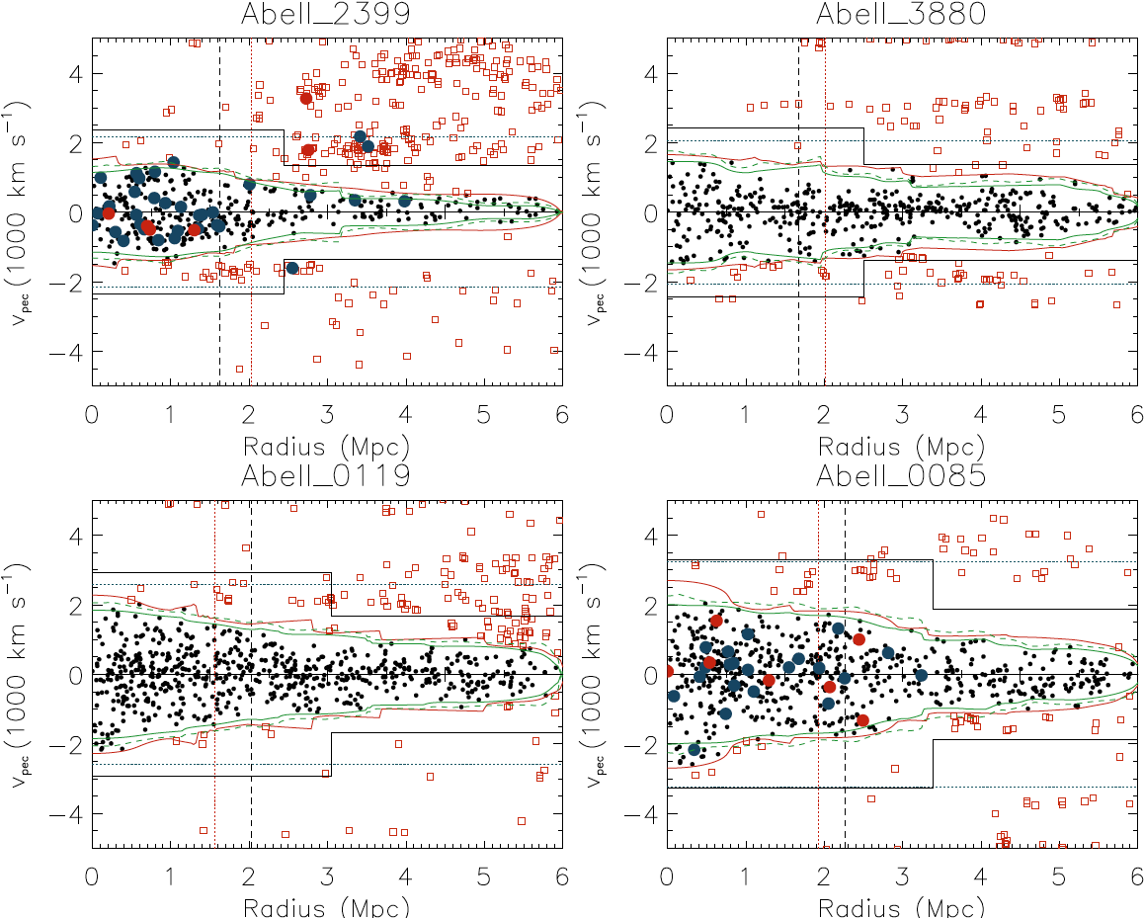
Targets - Clusters
Abell 2399 M=4.8x10¹⁴M_{sun}
Abell 119 M=9.7x10¹⁴M_{sun}
Abell 85 M=13.4x10¹⁴M_{sun}
Abell 3880 M=5.2x10¹⁴M_{sun}
Figures from Matt Owers.
Notes:
FIX.

Slide 13
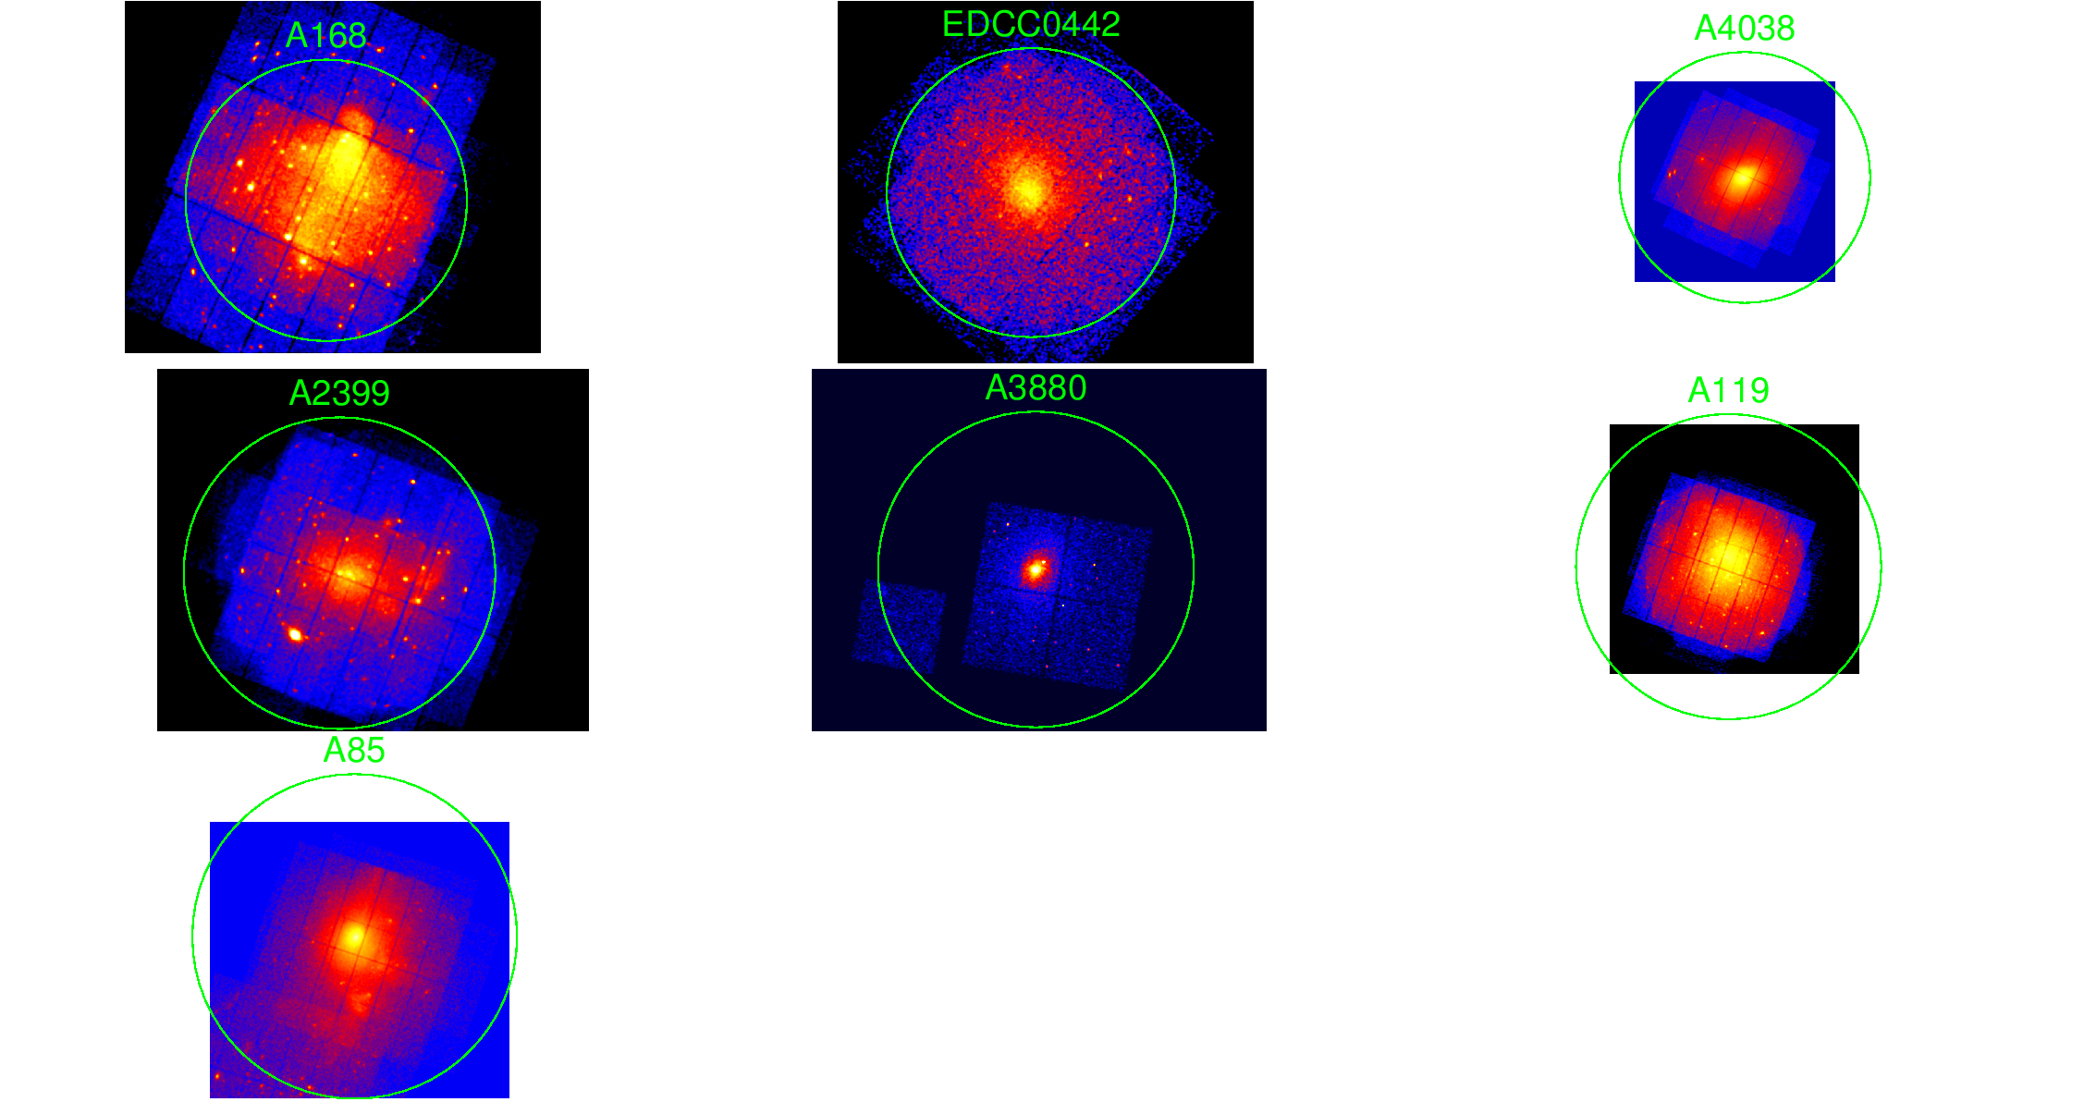
Cluster Archive Data and Follow-Up
Archival Chandra/XMM data.
WISE (IR).
Future: Targetted Chandra/XMM proposals
Future: HI proposals (eVLA)
Future: GMRT Radio Contiuum
Future: Deep optical from DECam.

Slide 14
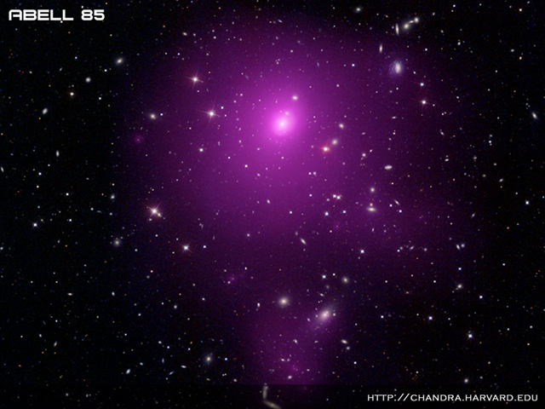
First Science – Stellar Kinematics in the SAMI Pilot Survey
Notes:
What SAMI brings to the picture among these very rich data sets – spatially-resolved spectroscopy allowing us to probe things like the angular momentum and put these properties into the picture etc.
Will now highlight a science case that shows this complementarity. Using the SAMI Pilot Survey, a precursor to the SAMI Galaxy Survey.

Slide 15
The SAMI Pilot Survey
Abell 168 M=1.9x10¹⁴M_{sun}
Abell 2399 M=4.8x10¹⁴M_{sun}
Abell 85 M=13.4x10¹⁴M_{sun}
3 Clusters – range of cluster properties.
Goal: Study kinematic morphology density relation.
106 galaxies, 79 ETGs

Slide 16
Kinematic Morphology-Density Relation
ATLAS3D (Virgo):
Cappellari et al. 2011
Abell 1689:
D’Eugenio et al. 2013
f_{SR}
Coma:
Houghton et al. 2013
Fornax:
Scott et al. 2014
Density

Slide 17
SAMI Stellar Kinematics
Fogarty et al. in prep.
Notes:
Velocity fields for 79 galaxies.

Slide 18
Classification
f_{SR}=21%
f_{SR}=8%
λ_{R}
f_{SR}=14%
f_{SR}=16%
Ellipticity
Notes:
New plot!

Slide 19
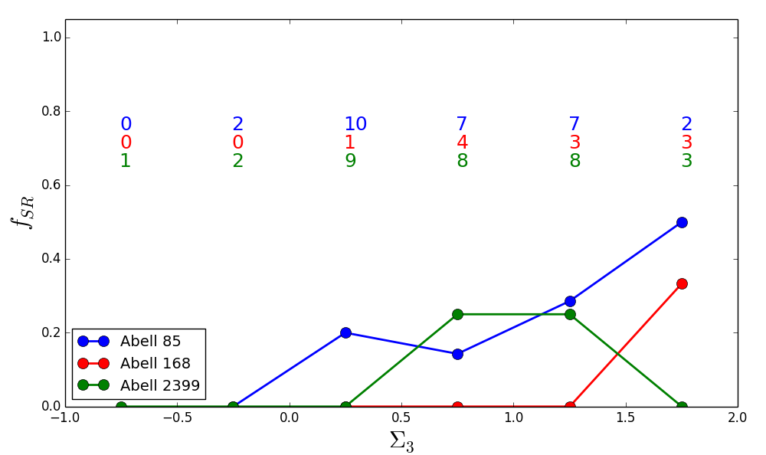
Kinematic Morphology-Density Relation.

Slide 20
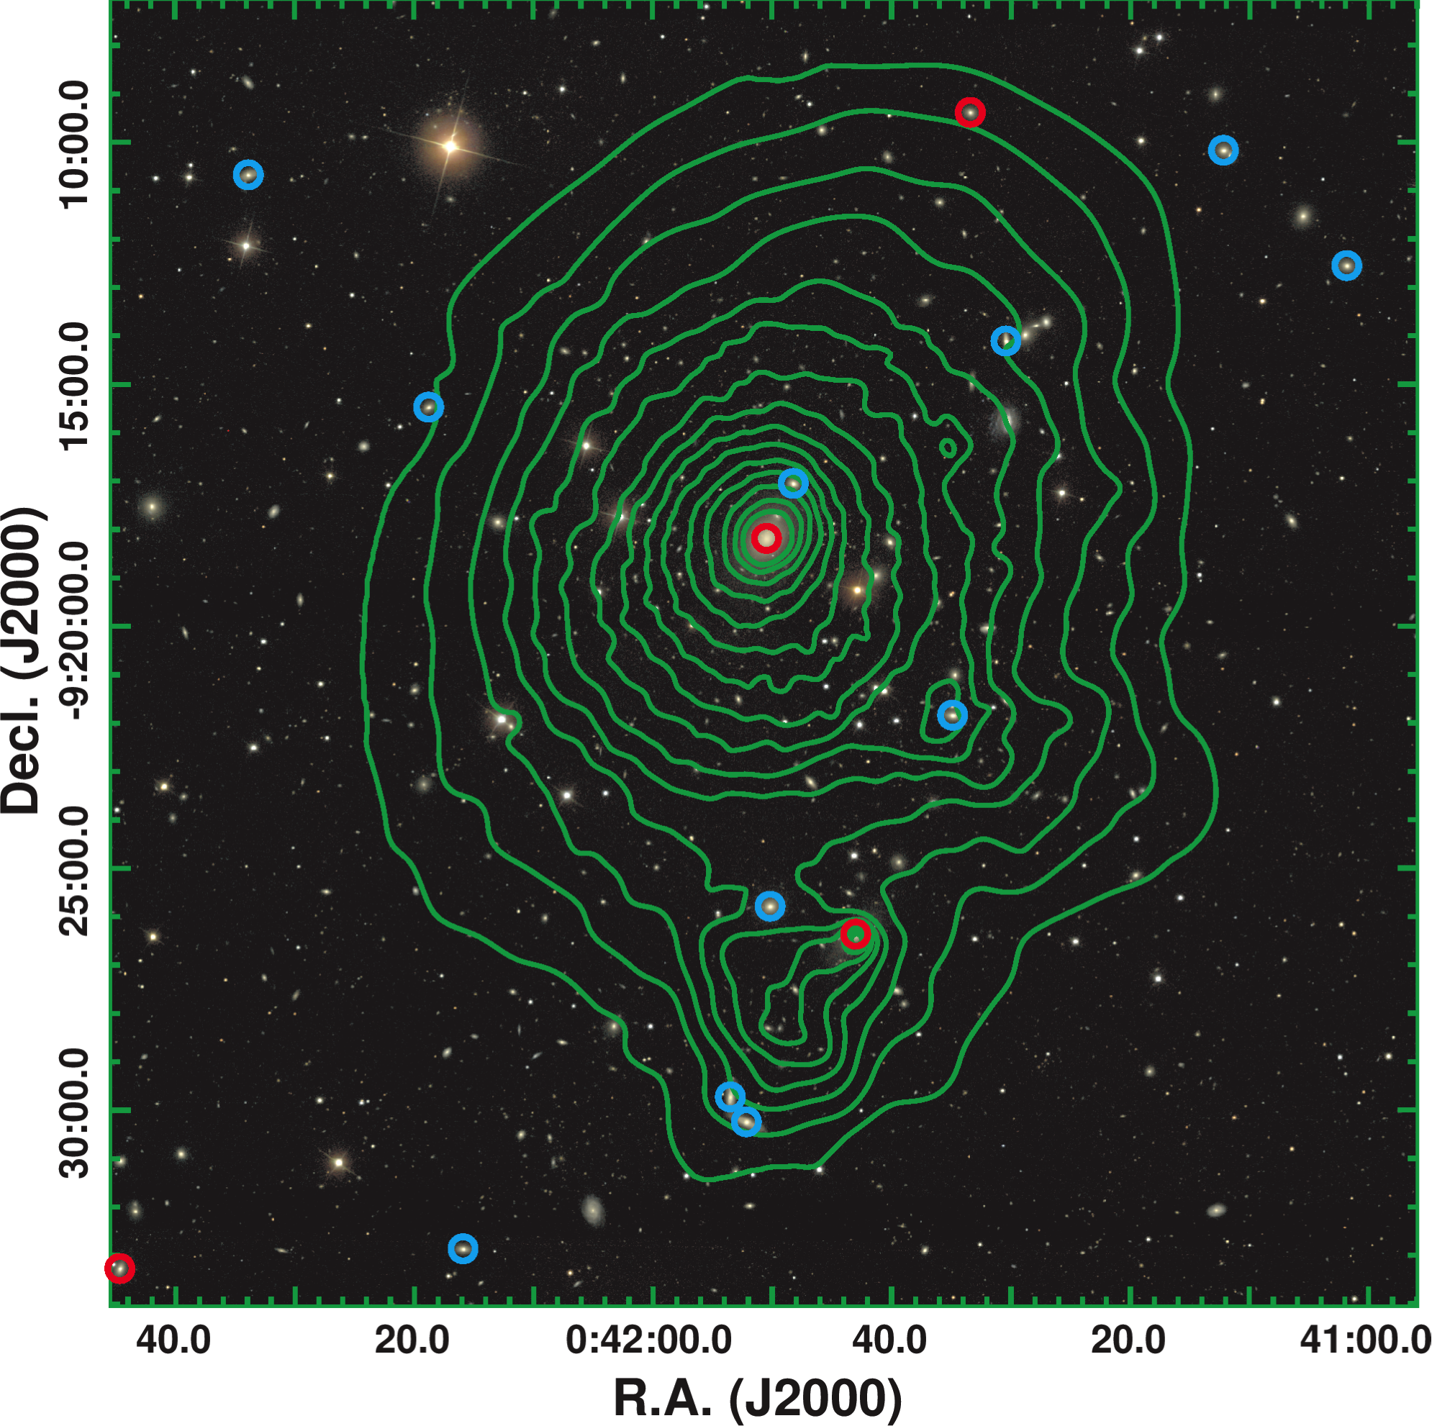
Abell 85
SDSS + Chandra
Images created by Matt Owers

Slide 21
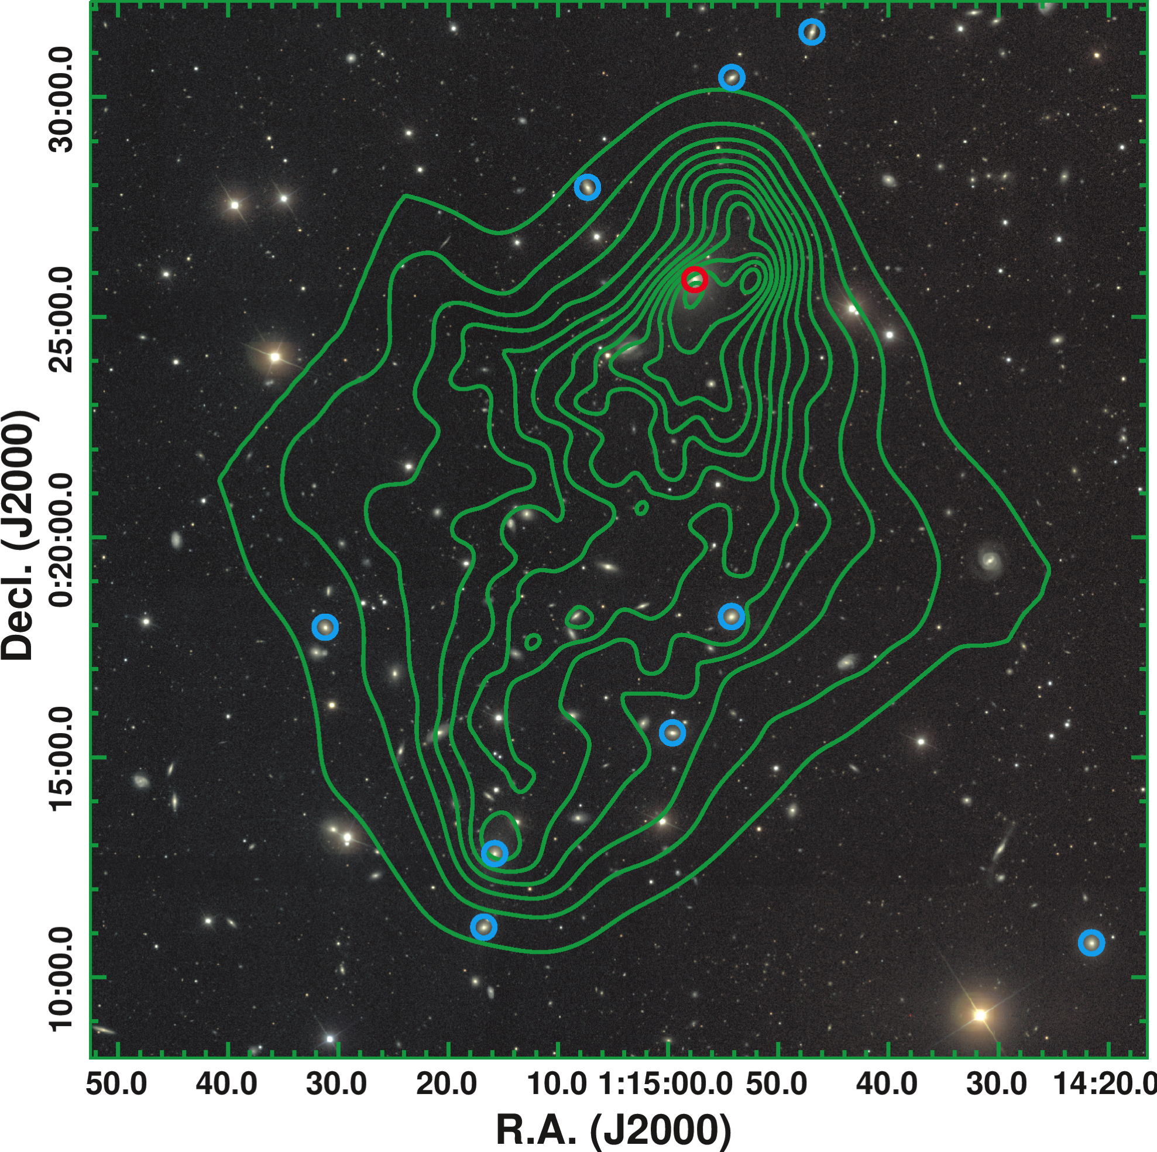
Abell 168
SDSS + Chandra
Images created by Matt Owers

Slide 22
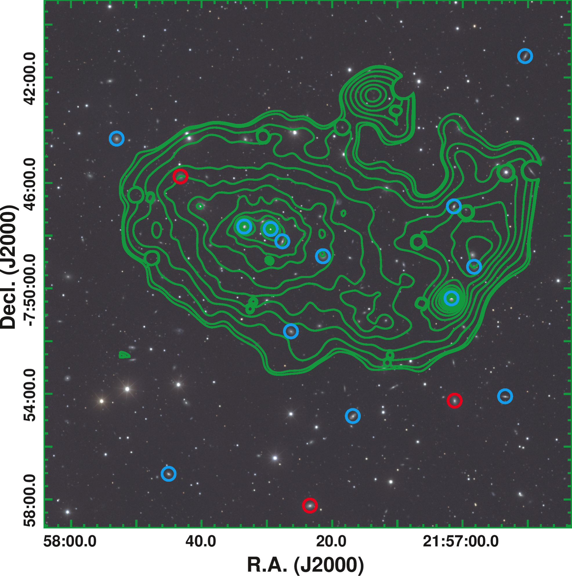
Abell 2399
SDSS + XMM
Images created by Matt Owers

Slide 23
Conclusions
Strong evidence for SR formation in groups.
Qualitative evidence to suggest some dependence of kinematic morphology-density relation on dynamical state of cluster.
To be expanded with full SAMI Galaxy Survey.

Slide 24
SAMI Associate Membership
Associate membership status available.
Propose a specific project.
Access to SAMI data for that project.
Contact: scroom@physics.usyd.edu.au
OR come and talk to me this week!

Slide 25
Target Selection
Slides from Julia Bryant.

Slide 26
Fibres and Pixels
Sharp et al. in prep.

Slide 27
Fibres and Pixels
1
2
All
Sharp et al. in prep.

