Slide 1
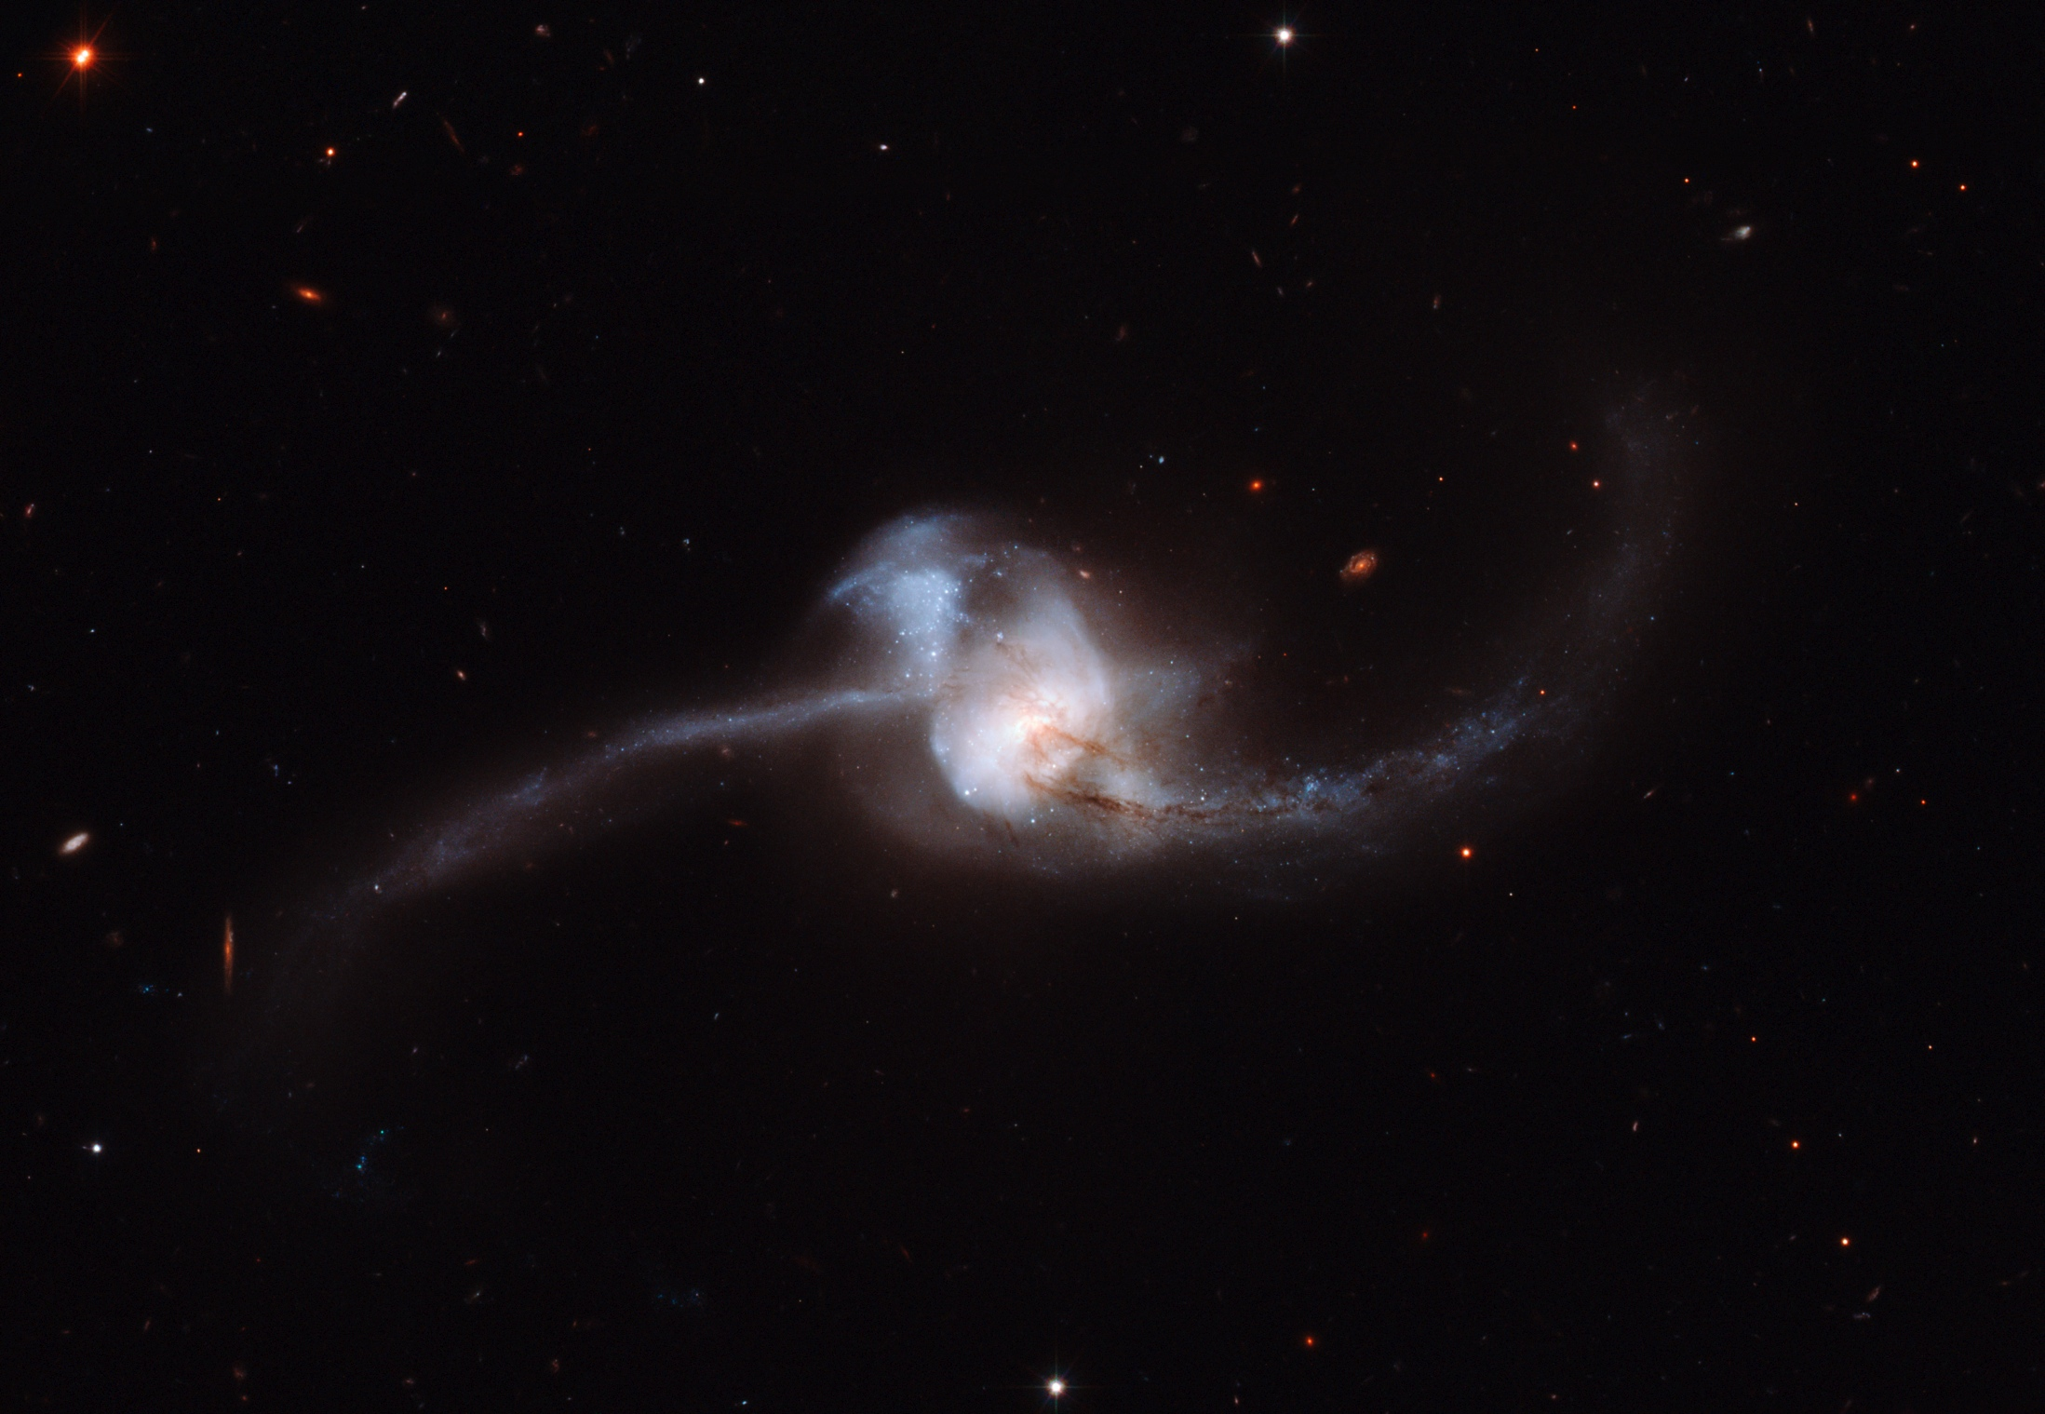
Probing the evolution of merger remnants via formation of cold molecular gas disks
Late-stage merger
after a merging event
Junko Ueda
(University of Tokyo/NAOJ)
D. Iono (NAOJ), M. Yun (UMass), D. Narayanan (Haverford College),
A. Crocker (University of Toledo), and the Merger Remnant Team
Image credit: NASA, ESA and A. Evans (Stony Brook University, New York)
Notes:
Thank you for giving me a chance to give a talk.
I’m Junko Ueda. I’m a PhD student at University of Tokyo, Japan.
Today I’d like to talk about our merger remnant CO study.
Merger remnant is
The title is “Probing the evolution…”.
At first, I’ll give you a short introduction about a scenario of galaxy evolution after a merging event.

Slide 2
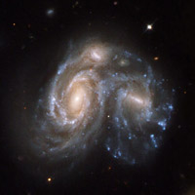
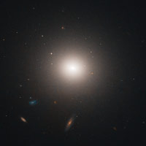
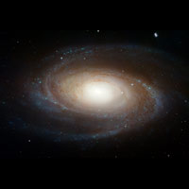
Galaxy evolution after merging
Classical Scenario
Classical Scenario
A major merger of two disk galaxies results in a formation of the spheroid-dominated early-type galaxy (e.g., Barnes & Hernquist 92).
Early-type galaxies
(E+S0)
late-type galaxies
(Sa+Sb)
Notes:
From numerical simulations, it’s been long predicted a major merger results in a formation of an early-type galaxy.
#01:00

Slide 3
Galaxy evolution after merging
Classical Scenario
Classical Scenario
A major merger of two disk galaxies results in a formation of the spheroid-dominated early-type galaxy (e.g., Barnes & Hernquist 92).
Early-type galaxies
(E+S0)
late-type galaxies
(Sa+Sb)
Not all of mergers will become an early-type galaxy, but some will reemerge as a disk dominated late-type galaxy (e.g., Springel & Hernquist 05; Robertson & Bullock 08).
Recent Simulations
Notes:
Contrary to this classical scenario, recent simulations show not all of mergers become an early-type galaxy, but some mergers reemerge as a disk galaxy

Slide 4
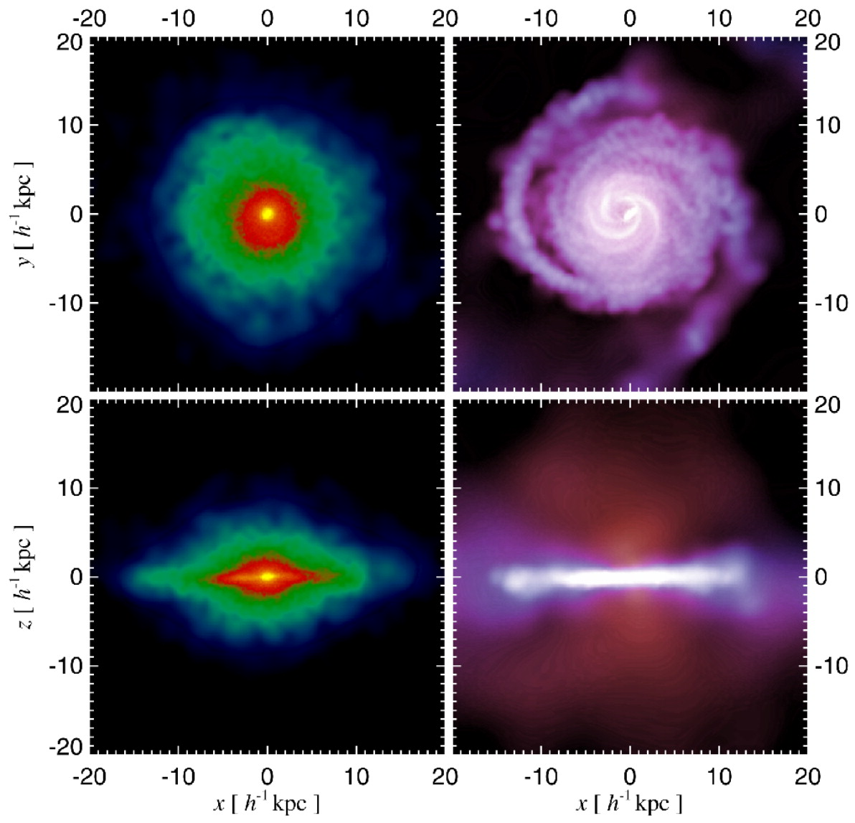
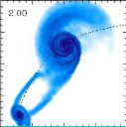
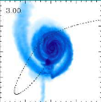
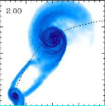
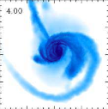
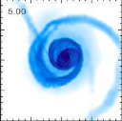
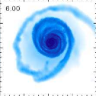
Formation of an extended gas disk
Gas that does not lose significant angular momentum through merging will reform an extended gas disk.
The large gas mass fraction (M_{H2}/M*) leads to a more efficient formation of an extended gas disk.
(Cox+08)
(Springel & Hernquist+05)
Notes:
When galaxies collide, some part of gas fall to the galactic center.
And then it contributes to a nuclear starburst and subsequently a formation of the spheroidal component.
But some gas doesn’t lose angular momentum and will reform an extended gas disk.
These figures show results of numerical simulations.
Please look at the right figure. This figure show the distribution of stellar and gas component in a merger remnant.
The left panel shows stellar components and the right panel shows gas components.
The size of gas disk is larger than the stellar spheroidal component.
In addition, some simulations also suggest increasing the gas mass fraction leads to a more efficient formation of an extended gas disk.
#02:00

Slide 5
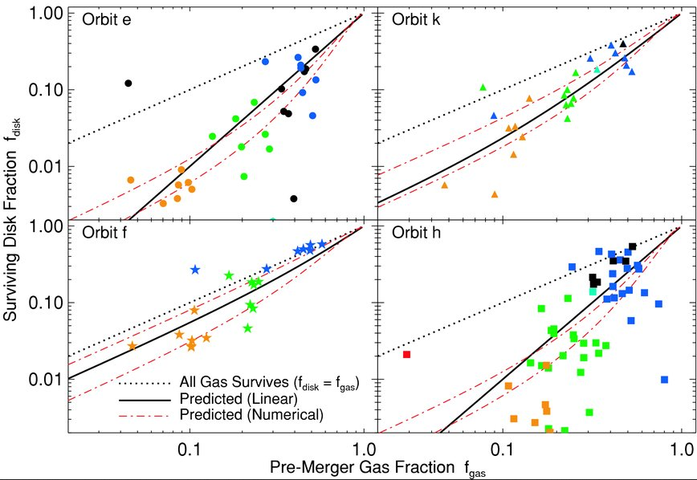
Depending on Gas Mass Fractions
(Hopkins+09)
Notes:
These figures show the relation between the gas mass fraction and the surviving disk fraction.
Each panel corresponds to a different collision orbit.
You can see the surviving disk fraction increase with the gas mass fraction.
The typical gas mass fraction in local disk galaxies is about 10 %.
In that case, the surviving disk fraction is a few %.
#02:30

Slide 6
Scientific Questions
In order to look for an observational evidence of extended gas disk in merger remnants and check the scenario of galaxy evolution after a merging event, we have conducted a ¹²CO imaging study toward optically-selected merger remnants.
Do extended molecular gas disks form in merger remnants?
Does the relative size of the molecular gas disk depend on the gas mass fraction?
What type of galaxies will merge remnants evolve into?
Notes:
In order to look for an observational evidence of an extended gas disk in merger remnants and check a scenario of galaxy evolution after a merging event, we have conducted a CO imaging study toward optically-selected merger remnants using millimeter/submilimeter interferometers and discuss the following three main question.
The first question is whether extended molecular gas disks form in the merger remnants.
The second question is whether the gas mass fraction is related to the formation of extended molecular gas disks.
And the last one is “what type of galaxies will merger remnants evolve into?”
#03:30

Slide 7
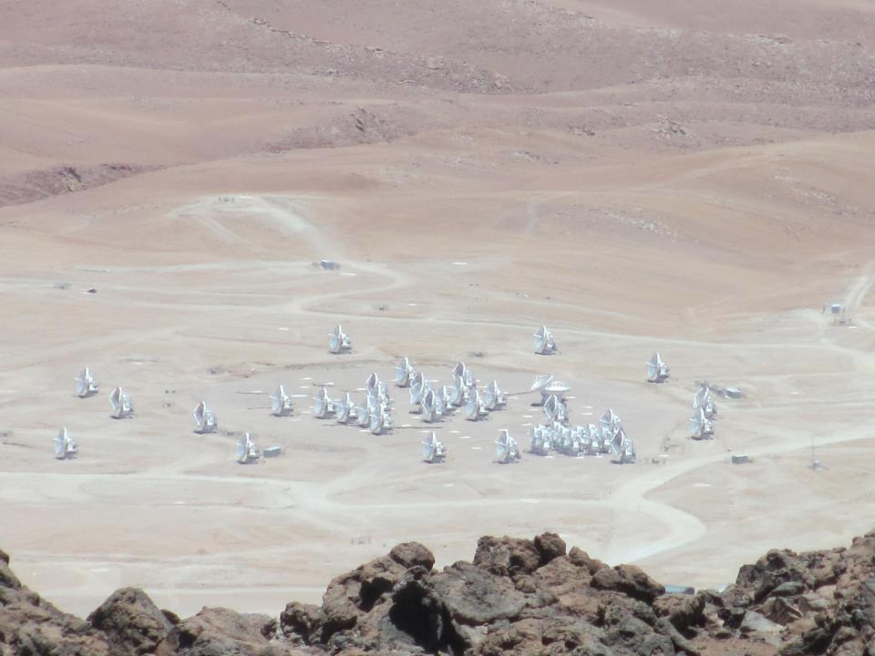
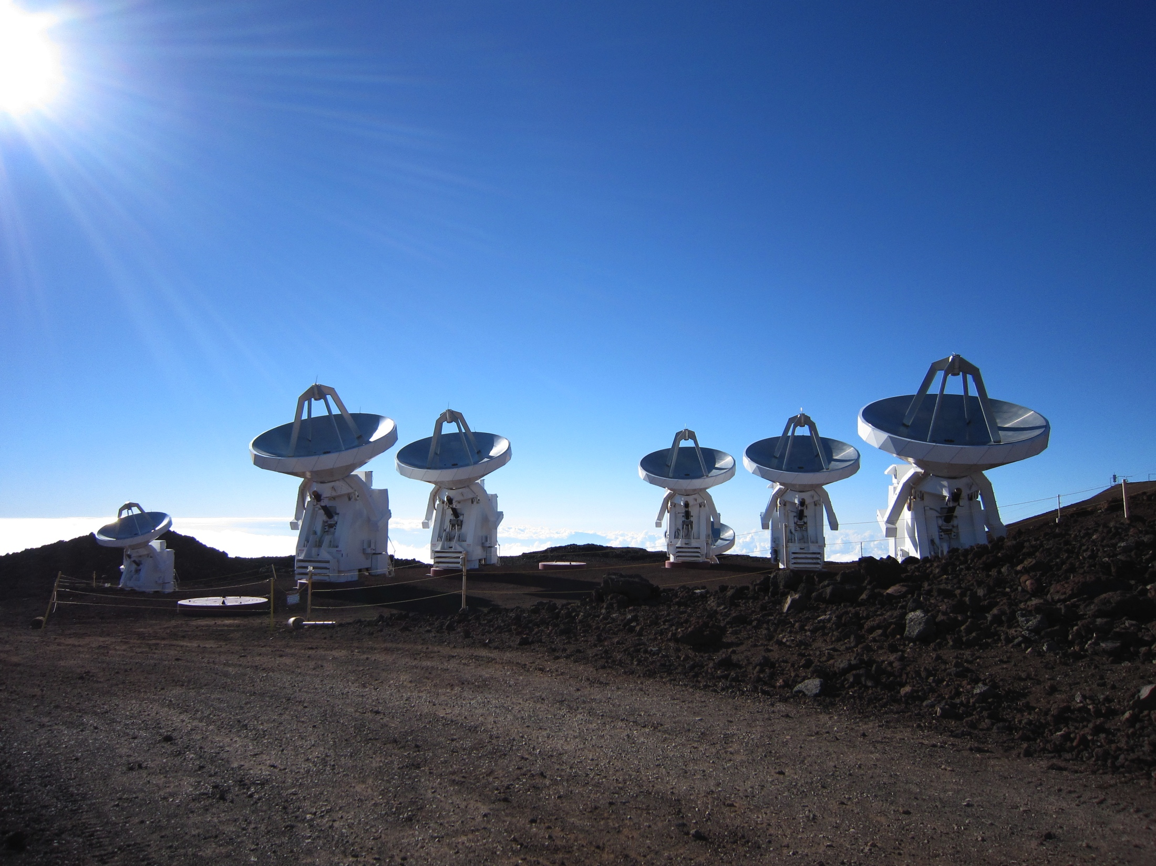
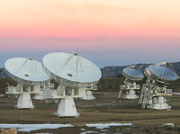
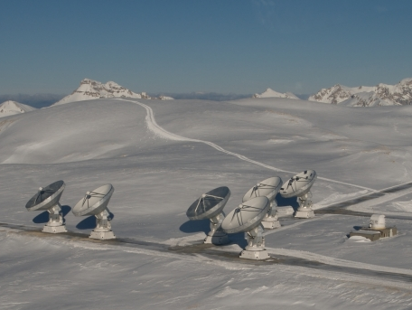
Merger Remnant
CO Imaging Study
© Caltech
© IRAM
Notes:
Next, let me show you a merger remnant CO imaging study.

Slide 8
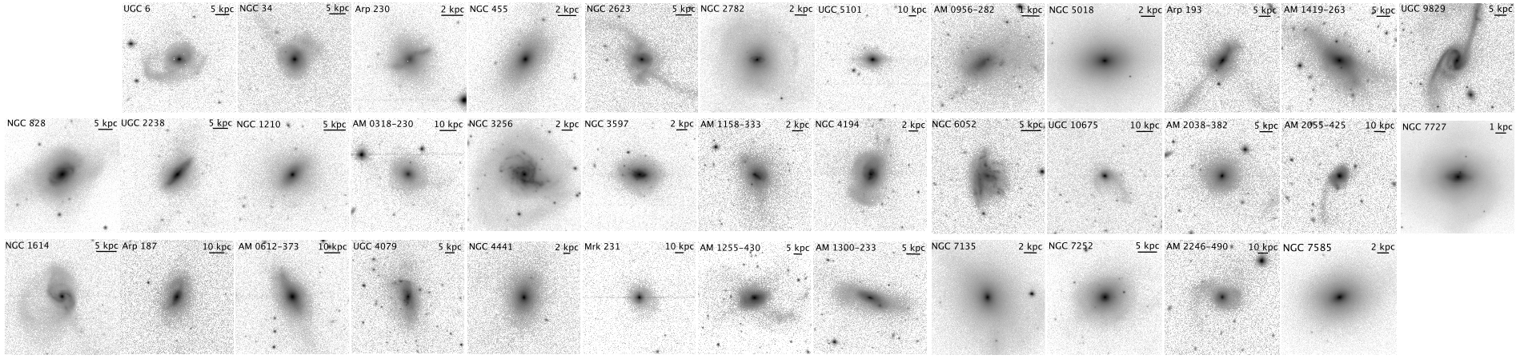
Sample of Merger Remnants
K-band images of our 37 merger remnant sample
Our sample is drawn from the optically-selected merger remnant sample (Rothberg & Joseph 2004) according to the following criteria:
      Optical morphology (tidal tails, loops, and shells)
      Single nucleus
      The absence of nearby companion
(Images: Rothberg & Joseph 2004)
Notes:
At first, I’ll show you the sample selection.
Our sample is taken from the catalog by Rothberg & Joseph.
These galaxies were selected based on optical morphology.
The first criteria is a source has a structure suggesting strong dynamical interaction such as tidal tails, shells, and loops.
In addition, a source has a single nucleus and no nearby companion. This criteria is needed to remove sources before merging.
The number of our sample is 37
#04:30

Slide 9
Interferometric CO Observations & Data
 | Telescope | No. of sources | CO line | Resolution [arcsec] | Noise level [mJy/Beam]
Observations | ALMA | 20 | CO (1-0) | 1.2 – 6.4 | 1.3 – 5.8
 | SMA | 5 | CO (2-1) | 2.9 – 3.6 | 18 – 24
 | CARMA | 2 | CO (1-0) | 1.7 | 1.9 – 3.4
Archival Data | SMA | 7 | CO (2-1) CO (3-2) | 0.8 – 3.6 | 11 – 23
 | PdBI | 2 | CO (1-0) | 1.8 – 2.9 | 1.9 – 2.9
 | ALMA | 1 | CO (1-0) | 6.4 | 1.3
© Caltech
© IRAM
Notes:
We have conducted CO observations for 27 sources using ALMA, SMA, and CARMA, and also obtained CO archival data for 10 sources.
This table is a summary of CO data. The resolution range from a few hundreds pc to 1 kpc.
#05:00

Slide 10
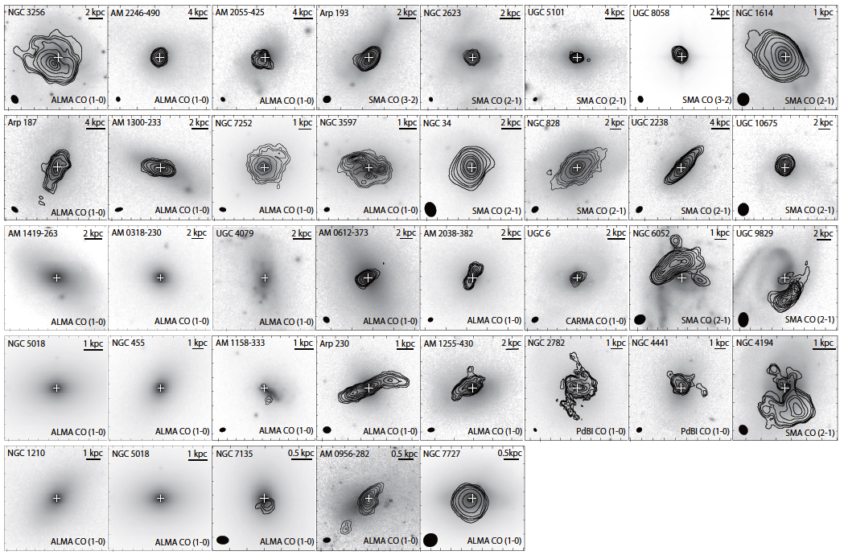
Distribution of the Molecular Gas
HIGH
FIR Luminosity
Detection Rate
30/37 (81%)
LOW
Notes:
These are integrated intensity maps.
The contours show the CO emission and the background is the K-band image.
The CO emission was detected in 30 sources.
The FIR luminosities of the sample increase from bottom to top.
The galaxies undetected in CO have relatively low FIR luminosities.
#05:30

Slide 11
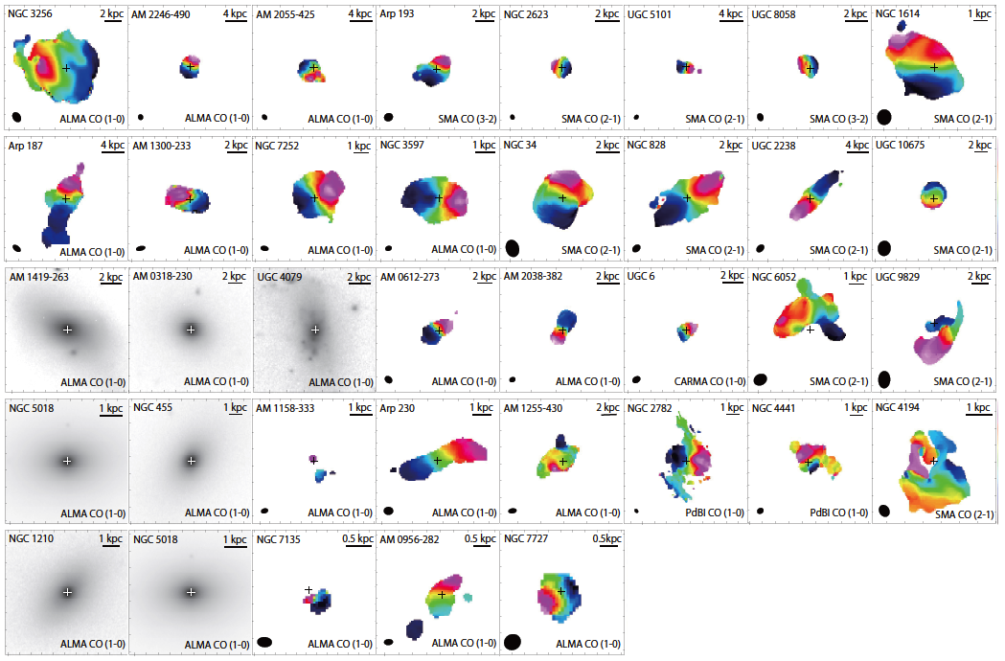
Fitting the Velocity field
HIGH
FIR Luminosity
Disk-like Rotation
24/30 (80%)
LOW
Notes:
Next, these are velocity fields. You can see disk-like rotation in many sources.
We fitted the velocity filed with concentric rings.
As a result, the velocity fields of 24 sources can be modeled by disk-like rotation.
The velocity fields of the other 6 sources are complicated.
The fitting procedure failed due to clumpy CO distribution or complicated velocity distribution.
After this, I discuss the CO properties for 24 sources with molecular gas disks.
#06:00

Slide 12
The relative size of the Molecular Gas Disk
Investigating the relative size of the molecular gas disk to the stellar spheroidal component.
  R₈₀ : the radius which contains
    80 % of the total CO flux
  R_{eff} : the K-band effective radius
    = the radius of the isophote containing
    half of the total K-band luminosity
      (Rothberg & Joseph 2004)
R₈₀
star
R_{eff}
R_{ratio} =
R_{eff}
gas
R₈₀
R_{eff}
star
gas
R₈₀
Notes:
At first, we investigate the size of the molecular gas disk.
In this study, we define the relative size of the gas disk to the stellar spheroidal component as R_ratio.
R_ratio is the ratio of R_80 to the K-band effective radius.
R_80 is the radius which contains 80 % of the total CO flux.
We estimate R_ratio for the merger remnant sample and control samples to compare the disk size.

Slide 13
The relative size of the Molecular Gas Disk
Using the control sample
38 early-type galaxies (ETGs) in ATLAS^{3D} sample
  (Alatalo+13, Davis+13)
25 late-type galaxies (LTGs) in BIMA-SONG sample
(Regan+01, Helfer+03)
Kolmogorov-Smirnov (K-S) tests give P-values:
 | ETG | LTG
MR | 0.256 | 0.000
The relative disk size in the MRs is similar to that in the ETGs rather than LTGs.
Notes:
We use 38 early-type galaxies in the ATLAS3D sample and 25 late-type galaxies in BIMA-SONG sample.
This is a histogram of the relative size of the gas disk, merger remnants, early-type galaxies, and late-type galaxies.
We compare the distribution of R_ratio among the three samples using a KS test.
As a results, the population of the merger remnants is different from the late-type galaxies, and it is not significant different from the early-type galaxies.
Therefore the relative disk size in the merger remnants is similar to that in the early-type galaxies rather than late-type galaxies.
#09:15

Slide 14
The Gas Mass Fraction (f_{gas})
  M(H₂): the molecular gas mass
  M* : the stellar mass
  24 merger remnants
  38 early-type galaxies
        (Young+11)
  25 late-type galaxies
        (Helfer+03)
K-S tests give P-values:
M(H₂)
f_{gas} =
M*
 | ETG | LTG
MR | 0.001 | 0.002
The gas mass fraction in the MRs is different from those in the ETGs and LTGs.
Notes:
We compare the gas mass fraction among three samples, the merger remnants, early-type galaxies, and late-type galaxies.
In this study, we define the gas mass fraction as the ratio of the molecular gas mass to the stellar mass.
Investigating the distribution of the gas mass fraction using a KS-test, the population of the gas mass fraction in the merger remnants is different from both early-type galaxies and late-type galaxies.
#09:45

Slide 15
extended
gas disk
  The relative size in not correlated with the gas mass fraction.
compact gas disk
low
high
Notes:
We plot the relation between the gas mass fraction and disk size.
This is the gas mass fraction and this is the relative size of the molecular gas disk to the stellar spheroidal component.
In this plot, the gas mass fraction increase from left to right, and the disk size increases from bottom to top.
The filled circle shows a source whose molecular gas mass is estimated using the interferometric data, and the open circle shows a source whose molecular gas mass is estimated using the single-dish data.
There is no significant relation between the gas mass fraction and the disk size.
In this figure, I overlap the data of the control samples.
#10:45

Slide 16
Late-type galaxy (LTG)
extended
gas disk
Early-type galaxy (ETG)
compact gas disk
Merger remnants (MR)
low
high
Notes:
The red points show early-type galaxies and the blue points show late-type galaxies.
The late-type galaxies are gas-rich galaxies with extended gas disks.
In contrast, the early-type galaxies are distributed over a wide range of the gas mass fraction and show a correlation between the gas mass fraction and disk size.
From this comparison, the important findings are the early-type galaxies and late-type galaxies occupy two different regions in this plot, and the merger remnants do not follow either population on average.
This possibly suggests these merger remnants are transient sources that are ready to evolve into either early-types and late-types.
#11:45

Slide 17
Late-type galaxy (LTG)
extended
gas disk
Early-type galaxy (ETG)
compact gas disk
Merger remnants (MR)
low
high
Notes:
According to this figure, we discuss the evolutionary path of merger remnants.
At first, we focus on there merger remnants.

Slide 18
ETG candidate
Rotating compact gas disk
Low/High gas mass fraction
  The molecular gas is concentrated in the central region.
  The SFRs are high (no presence of AGN).
  The depletion times of the molecular gas are short.
  The Sersic indices are 3 -- 4 (Rothberg & Jpseph 2004).
Notes:
These merger remnants have compact molecular gas disks.
As the other features of Type A3 and Type A4:
The first is the molecular gas is concentrated in the central region.
The second is the star formation rate are high, but no presence of AGN.
The third is the depletion times of the molecular gas are short.

Slide 19

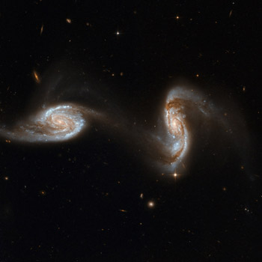
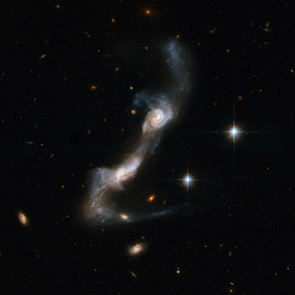
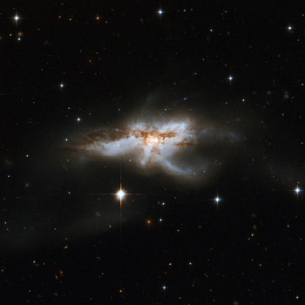
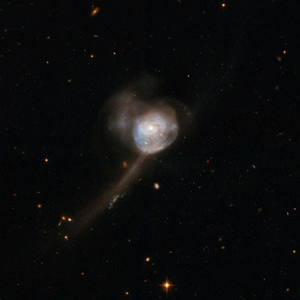
The Depletion Time of the Molecular Gas (t_{dep})
  t_{dep} = 10 Myr – 100 Myr (for ETG candidates)
  Typical merger timescale : a few Gyrs
  The molecular gas in the merger remnants will run out
    before the tidal features fade away, if t_{dep} is short.
the first
encounter
the final
coalescence
several encounters
Timescale
0 Gyr
0.5〜1 Gyr
a few × Gyrs
Tidal Features fading away
Merger Remnant
Notes:
The depletion time for these sources ranges between 10 Myr and 100 Myr.
Comparing with a typical merger timescale of a few Gyr, the depletion time is much shorter than the merger timescale.
So, the molecular gas in these sources will run out before the tidal features fade away.

Slide 20
ETG candidate
Rotating compact gas disk
Low/High gas mass fraction
  The molecular gas is concentrated in the central region.
  The SFRs are high (no presence of AGN).
  The depletion times of the molecular gas are short.
  The Sersic indices are 3 -- 4 (Rothberg & Jpseph 2004).
  These sources will become early-type galaxies, decreasing the molecular gas mass by active star formation.
Notes:
And the last feature is the Sersic indices of most of the sources are between 3 and 4, which is similar to typical elliptical galaxies.
Type A3 and Type A4 show central gas concentration and elliptical-like stellar profiles.
So we suggest these sources will become gas-poor early-type galaxies, decreasing the molecular gas mass by active star formation.

Slide 21
Late-type galaxy (LTG)
extended
gas disk
Early-type galaxy (ETG)
compact gas disk
Merger remnants (MR)
low
high
Notes:
Next, we

Slide 22
LTG candidate
Rotating extended gas disk
High gas mass fraction
  These sources have similar properties to late-type galaxies.
  These sources may become late-type galaxies, unless there are further mechanisms to transport the gas toward the central region and decrease the size of the molecular gas disk.
Notes:
These merger remnants have extended molecular gas disks and large gas mass fractions.
They already show the similar properties to late-type galaxies.
It is highly possible Type A1 sources will become late-type galaxies, unless there are further mechanisms to transport the molecular gas toward the central region.

Slide 23
Late-type galaxy (LTG)
extended
gas disk
Early-type galaxy (ETG)
compact gas disk
Merger remnants (MR)
low
high
Notes:
The red points show early-type galaxies and the blue points show late-type galaxies.
The late-type galaxies are gas-rich galaxies with extended gas disks.
In contrast, the early-type galaxies are distributed over a wide range of the gas mass fraction and show a correlation between the gas mass fraction and disk size.
From this comparison, the important findings are the early-type galaxies and late-type galaxies occupy two different regions in this plot, and the merger remnants do not follow either population on average.
This possibly suggests these merger remnants are transient sources that are ready to evolve into either early-types and late-types.
#11:45

Slide 24
Summary of this study
Aims: What is the end product of a merger ( ETG or LTG)?
Methods: Largest CO imaging study of 37 merger remnants
extended molecular gas disks form in merger remnants?
    Partly yes, but the relative disk sizes of these merger remnants are smaller than those of the LTGs.
Does the size of the gas disk depend on the gas mass fraction?
    The relative size in not correlated with the gas mass fraction.
What type of galaxies will merge remnants evolve into?
  It’s highly possible that the majority of the sample become ETGs, while a few sources which are likely to become LTGs.
  This study reveals observationally a possibility that galaxy mergers transform galaxies into a mixture of types including ETG/LTGs.
Notes:
We have conducted a CO imaging survey of merger remnants in order to reveal what is the end product of a merger.
As a results, it’s highly possible that the majority of the sample become early-type galaxies.
This is consistent with the classical scenario of galaxy evolution.
We also find a few sources which are likely to become late-type galaxies.
This study reveals observationally a possibility that galaxy mergers transform galaxies into a mixture of types including ETGs and LTGs.

Slide 26
Summary of this study
Aims:
  What is the end product of a merger (ETG or LTG)?
Methods:
  Largest CO imaging survey of 37 merger remnants
Conclusions:
  It’s highly possible that the majority of the sample become early-type galaxies, while a few sources which are likely to become late-type galaxies.
This study reveals observationally a possibility that galaxy mergers transform galaxies into a mixture of types including ETGs and LTGs.
Notes:
We have conducted a CO imaging survey of merger remnants in order to reveal what is the end product of a merger.
As a results, it’s highly possible that the majority of the sample become early-type galaxies.
This is consistent with the classical scenario of galaxy evolution.
We also find a few sources which are likely to become late-type galaxies.
This study reveals…

Slide 27
The effect of the observational sensitivities on R₈₀
Investigating the effect of the 1σ mass sensitivity on R₈₀.
  → No correlation between them
Also investigating the effect of different CO transitions on R₈₀.
  → No correlation between them
  The mass sensitivity does not strongly affect the observed extent of the molecular gas.
Black: CO (1-0),
Red: CO (2-1), Blue: CO (3-2)

Slide 28
Sample of Merger Remnants
Our sample is independent of the far-infrared (FIR) properties.
  (13/37 sources are classified as U/LIRGs.)
Our sample shows various stellar profiles.
  (The Sersic index of n = 10 means the failure of the Sersic fitting.)
&
Notes:
The left figure is a histogram of the far-infrared luminosity of the sample.
Our sample covers a wide range of galaxies from normal galaxies to ULRGs and is independent of the far-infrared properties.
The right figure is a histogram of the Sersic index of the sample.
The Sersic index is a parameter of the surface brightness profile.
The Sersic index of n = 1 indicates an exponential disk profile, and the Sersic index of n = 4 indicates a de Vaucouleurs profile.
The Sersic index of n = 10 means the failure of the Sersic fitting.
Our sample shows various stellar profiles.
#05:30

Slide 29

Possibility of Active Galactic Nuclei (AGN)
Investigating whether an AGN phase continues after merging
The radio-to-FIR correlation:
Most of the merger remnants do not show the presence of an AGN.
One source shows a radio-excess, suggesting the presence of an AGN.
IR-excess
radio-excess =
AGN dominated
  AGN activities might fade or become weak after the completion of merging.

Slide 30
The relative size of the Molecular Gas Disk
  54 % (R_{ratio}< 1) 46 % (R_{ratio}> 1)
Notes:
This figure is a histogram of the relative size of the molecular gas disk. ##CLICK##
Extended molecular gas disks form in about a half of the sample, while the majority of the sample has a compact gas disk.
Next, we estimate R_ratio for control samples and compare them to the merger remnants.
#08:15

Slide 31
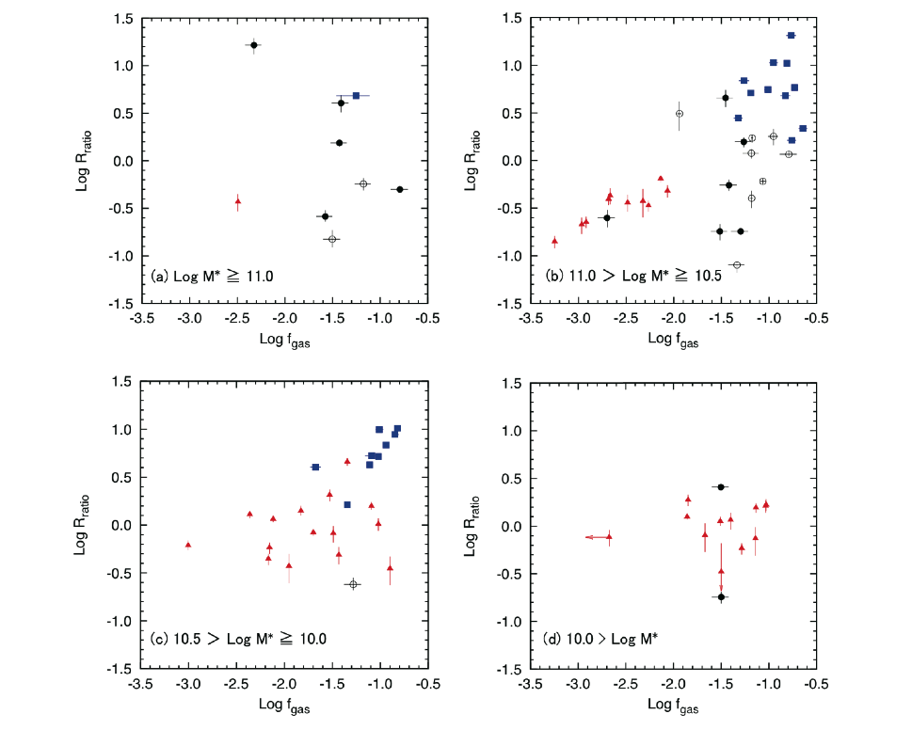
Relation between R_{ratio} and f_{gas} (2)

Slide 32
LTG: 88 %
ETG: 12 %
LTG: 12 %
ETG: 88 %
100
50
0
Percentage [%]
Notes:
Specifically, the boundary is determined by identifying a value which divides early-types and late-types by the same percentage.

Slide 33
Summary of this study
Aims:
  What is the end product of a merger (early-type or late-type)?
Methods:
  Largest CO imaging survey of 37 merger remnants
Conclusions:
  65%: ETGs, 5%:LTGs, 20%: either ETGs/LTGs
    (ETG = early-type galaxy, LTG =late-type galaxy)
This study reveals observationally a possibility that galaxy mergers transform galaxies into a mixture of types including ETGs and LTGs.
Notes:
We have conducted a CO imaging survey of merger remnants in order to reveal what is the end product of a merger.
As a results, it’s highly possible that the majority of the sample become early-type galaxies.
This is consistent with the classical scenario of galaxy evolution.
We also find a few sources which are likely to become late-type galaxies.
This study reveals…

Slide 34
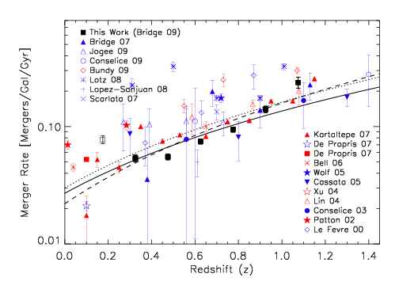
Galaxy Merger
(Bridge+10)
The merger rate increases with redshifts
Mergers are related to galaxy formation/evolution.
Notes:
The galaxy merger rate increases with redshifts.
It has been considered galaxy interactions and mergers play an important role in the formation and evolution of galaxies.
So investigating the effect of merger leads to understanding the galaxy evolution.

Slide 35
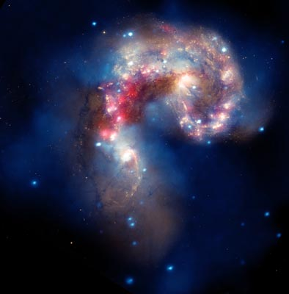
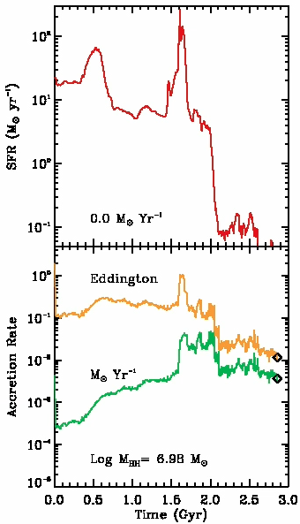
Galaxy Merger
(Ref: T. J. Cox)
Image credit: NASA, ESA, SAO, CXC, JPL-Caltech, and STScI
Disturbed morphology
Enhanced Star formation
Notes:
Gravitational interaction between galaxies change significantly their morphology.
This is a image of the Antennae galaxies, which is one of the most famous mergers.
This system is composed of two disk galaxies, but the progenitor disks are strongly disturbed.
Galaxy interaction also have powerful effects on the physical states.
For example, enhanced star formation activities.
This figure show a star formation rate evolution with time during the merging event.
When encounters and the final coalescence take place, the star formation rate increases significantly.

Slide 36
Merger Timescale
active star formation
AGN/quasar activity
the first
encounter
several encounters
the final
coalescence
Timescale
0 Gyr
Gas inflow
0.5〜1 Gyr
a few × Gyrs
The return of tidally ejected cold gas
Tidal Features fading away
Merger Remnant
Early-stage
Late-stage
(before merging)
Late-stage
(after merging)
Intermediate-stage
Image credit--NASA, ESA, the Hubble Heritage (STScI/AURA)-ESA/Hubble Collaboration, and A. Evans (University of Virginia, Charlottesville/NRAO/Stony Brook University)
Notes:
Now I’d like to explain the merger timescale.
The typical timescale of galaxy merger from the first encounter to the final coalescence is 1 Gyr.
And the timescale of the retuning of tidally ejected material after the coalescence is estimated to extend over a few Gyr.
This is longer compared to the timescale form the first encounter to the final coalescence.

Slide 37
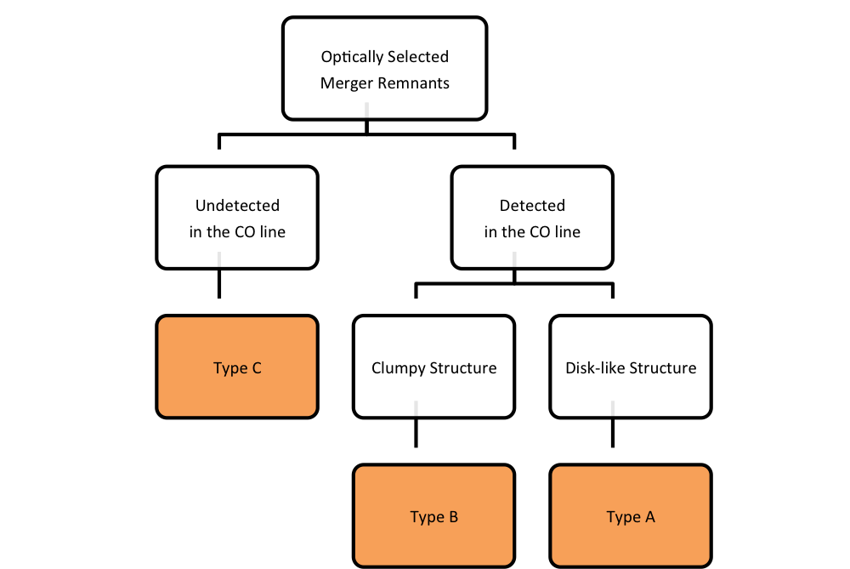
37 sources
7
sources
6
sources
24
sources
Notes:
Finally, we focus on Type C. Type C is galaxies undetected in the CO line.

Slide 38
ETG/LTG candidate ①
14% (5/37)
Rotating extended gas disk
Low gas mass fraction
  Two AGN sources are classified as this type.
  The molecular gas is not concentrated in the central region.
  The SFRs are large.
  The depletion times are short.
  The Sersic indices could not be determined
                (Rothberg & Joseph 2004).
Notes:
Five merger remnants are classified as Type A2.
There merge remnants have extended molecular gas disks and low gas mass fractions.
The most distinct feature is two AGN sources in our sample are classified as this type.
As the other features of Type A2:
The first is the molecular gas is not concentrated in the central region.
This property is similar to late-type galaxies, and Type A2 have a possibility of evolving into disk-dominated late-type galaxies.
However, the star formation rates are very large and the depletion time are short.
So it is likely that Type A2 will become gas-poor early-type galaxies, consuming the molecular gas in a short time.
In addition, the Sersic indices could not be determined and thus the R_ratio may change during the merging process. If R_ratio changes significantly, the evolution path is not clear.
Therefore the properties of Type A2 contain possibilities that Type A2 become either early-type and late-type.

Slide 39
ETG/LTG candidate ②
  16% (6/37)
  The CO velocity filed cannot be modeled by circular motion.
  The distribution of the molecular gas and stellar component is either clumpy or complex.
  early-stage of merger sequence?
  The evolution path is still not clear.
Type B might become either ETGs or LTGs
Notes:
Six sources are classified as Type B.
The distribution of the molecular gas and stellar component is clumpy and complex.
According to these properties, we suggest Type B are early in the merging process and the molecular gas has not settled in the galactic plane.
These characteristics are not seen in either early-types and late-types, therefore the evolution path of Type B is not clear and might become either early-types and late-types.

Slide 40
ETG candidate ②
  16% (6/37)
  These galaxies were not detected in the CO line.
  Gas-poor
  Small SFRs
  Featureless stellar structure (Rothberg & Joseph 2004)
  Ave. Sersic index ~ 4.12 (Rothberg & Joseph 2004)
  Dry mergers?
Type C will evolve into ETGs.
Notes:
Seven merger remnants are classified as Type C.
Type C will evolve into early-type galaxies because they already became gas-poor galaxies, have small star formation rate, and show featureless stellar structure.
In addition, we suggest a possibility Type C were dry mergers because of very small gas mass fractions.

