Slide 1
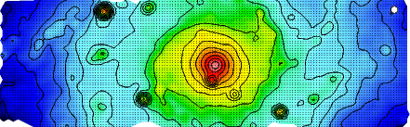
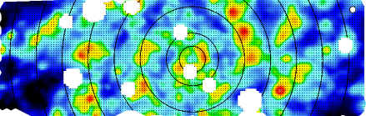
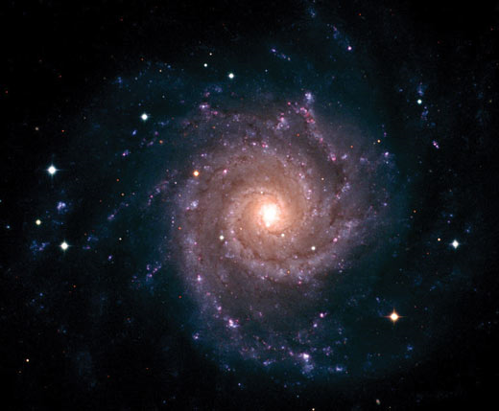
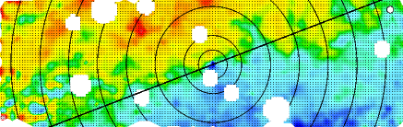
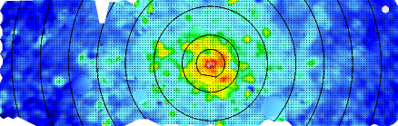
VENGA: The VIRUS-P Exploration of Nearby Galaxies
Guillermo A. Blanc
Carnegie Fellow
Carnegie Observatories, Pasadena
Departamento de Astronomía
Universidad de Chile, Santiago

Slide 2

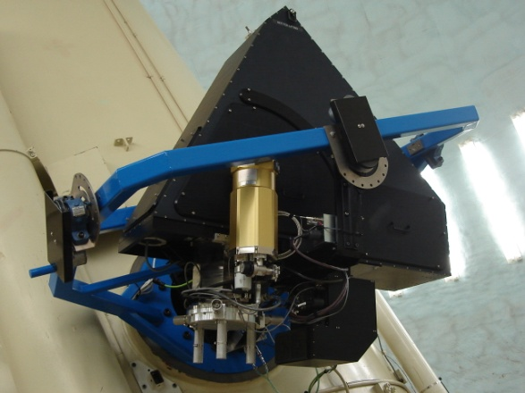
P.I.: Guillermo A. Blanc (Carnegie)
Co.Is: Niv Drory (UT Austin)
Neal Evans (UT Austin)
Max Fabricius (MPE)
David Fisher (U. of Maryland)
Karl Gebhardt (UT Austin)
Lei Hao (SHAO)
Amanda Heiderman (NRAO)
Shardha Jogee (UT Austin)
Kyle Kaplan (UT Austin)
Kathryn Kreckel (MPIA)
Rongxin Luo (SHAO)
Mimi Song (UT Austin)
Remco van den Bosch (MPIA)
Timothy Weinzirl (UT Austin)
Peter Yoachim (U. of Washington)
Notes:
VENGA is one of the first large scale systematic IFU survey of nearby spirals.
Collaborators: In red people who contributed directly to the first results I’ll show today
IFU studies have been mainly focused on early-type galaxies (SAURON, ATLAS-3D) and not on star forming galaxies, so spatially resolved spectroscopic studies of star formation have been limited.
-We are mapping 32 galaxies using the large FOV VIRUS-P IFU
-We obtain spectra for ~53,000 individual regions across the 32 galaxies with sizes of 100pc – 1kpc depending on distance to target.

Slide 3
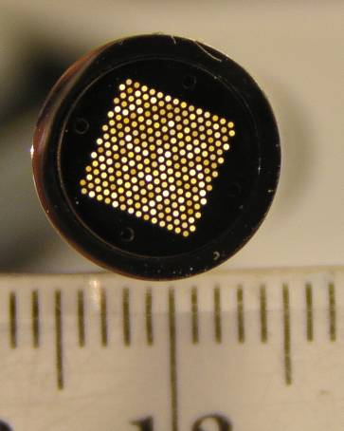
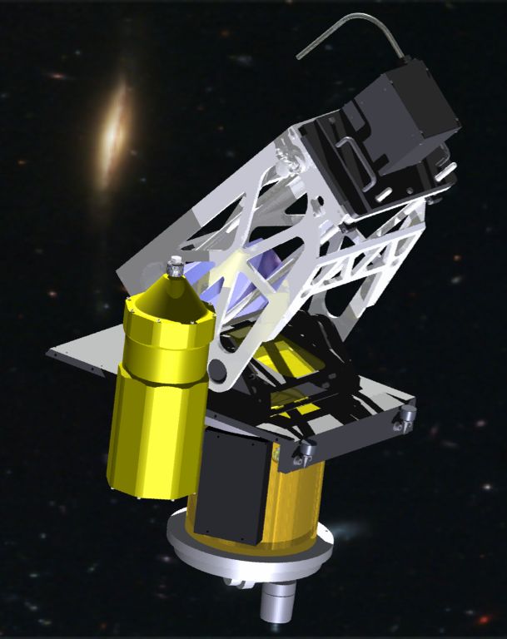
VIRUS-P
246 Fiber-fed IFU Spectrograph
1.7’x 1.7’ FOV at McDonald 2.7m
1/3 filling factor
Largest FOV of any existing IFU
4.3’’ diameter fibers on sky
3500-6800 Å / Δλ=2200 Å
R=1000 @ 5000Å
VIRUS prototype for HETDEX

Slide 4
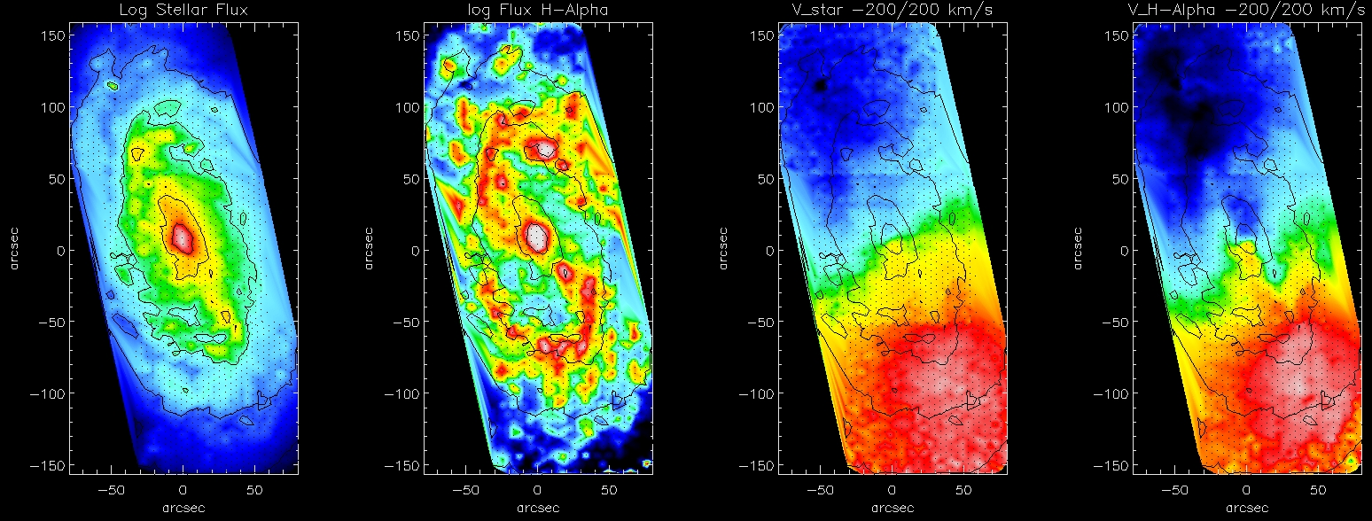
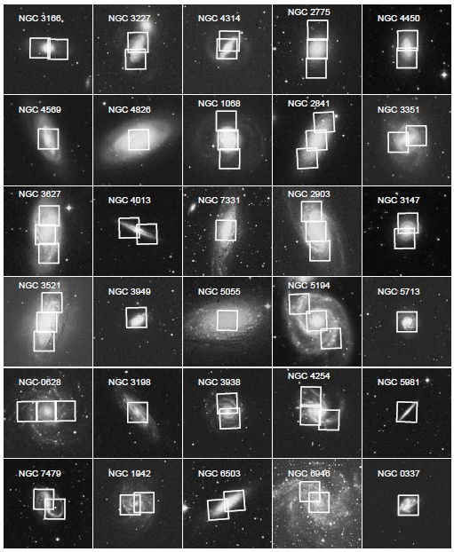
NGC 2903
IFU maps of 30 Nearby Spiral Galaxies
60 VIRUS-P Pointings
3600 Å – 6850 Å @ 5 Å FWHM
Coverage ~ 0.7 R₂₅ @ 5.6” FWHM
Median S/N=40 per fiber
GB et al. 2013b

Slide 5
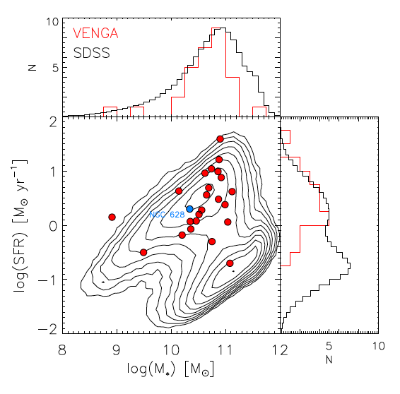
The VENGA Sample
GB et al. 2013b
Ancillary Data: GALEX, HST, Spitzer, Herschel,
CO (1-0), CO (2-1), HI 21cm.

Slide 6
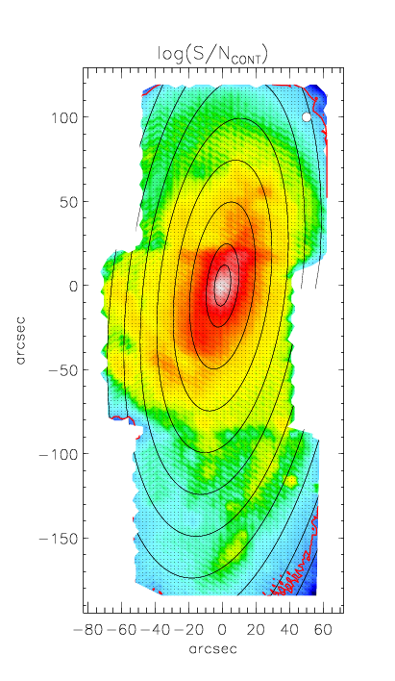
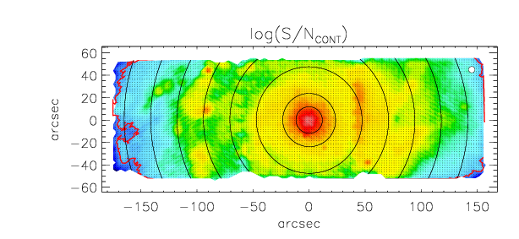
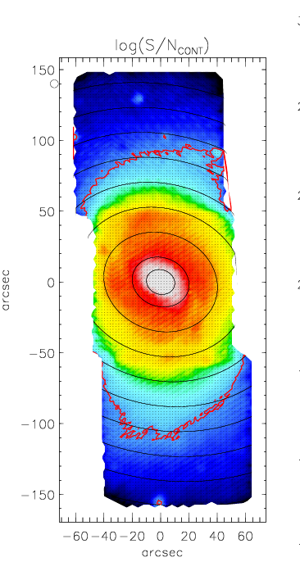
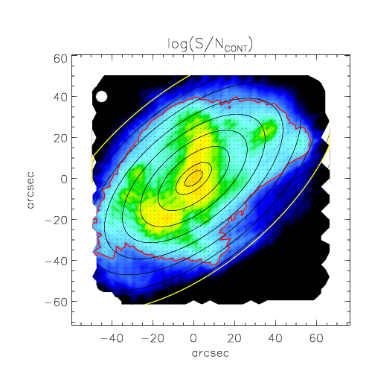
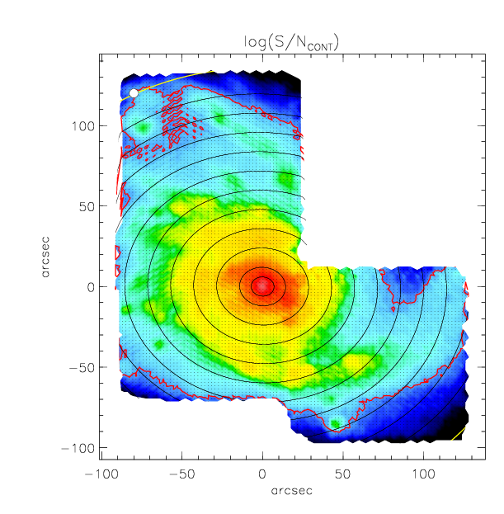
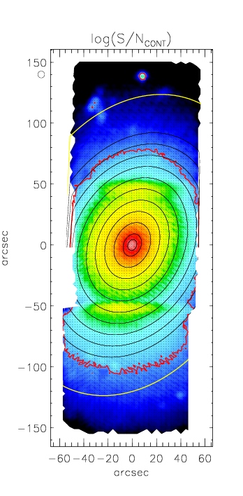
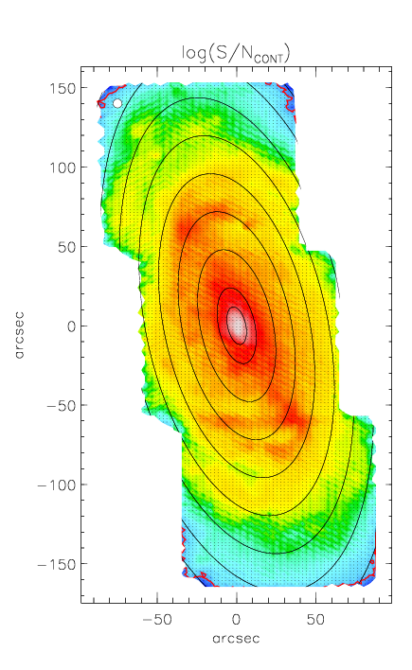
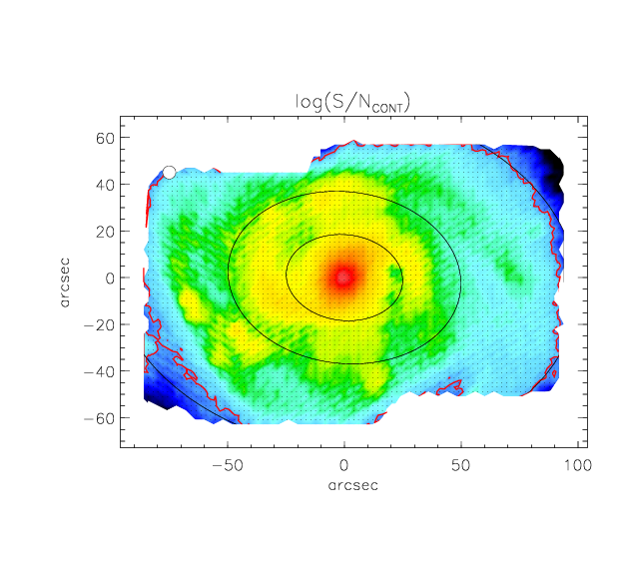
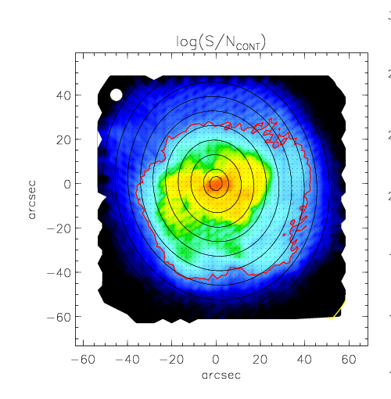
HIGH S/N AT NATIVE RESOLUTION
NGC 3627
NGC 628
NGC 1068
NGC 337
NGC 4254
S/N=40
NGC 2903
NGC 1042
NGC 5713
NGC 2775

Slide 7
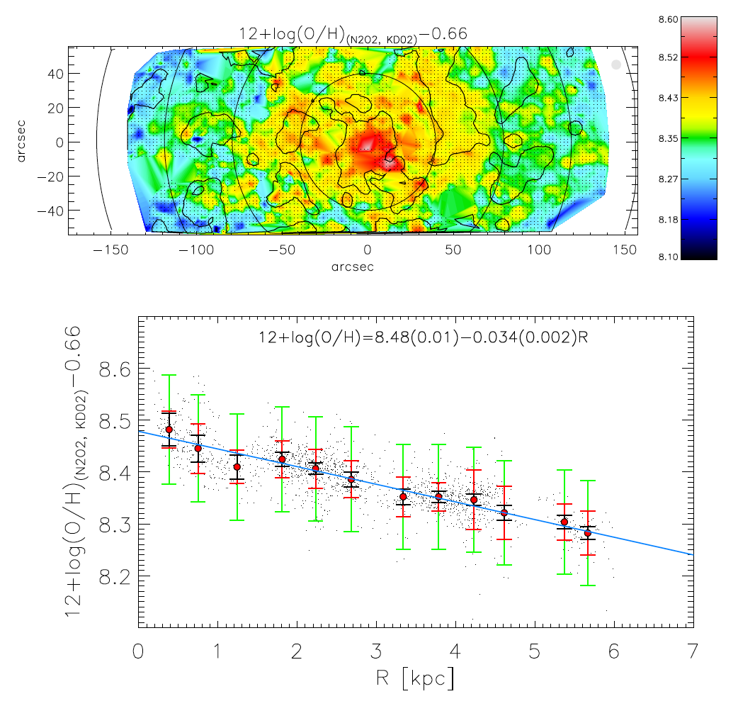

THE METALLICITY DISTRIBUTION IN THE ISM
NGC 628
N2O2
Kyle Kaplan (UT Austin)
Shardha Jogee (UT Austin)
Lisa Kewley (ANU)

Slide 8

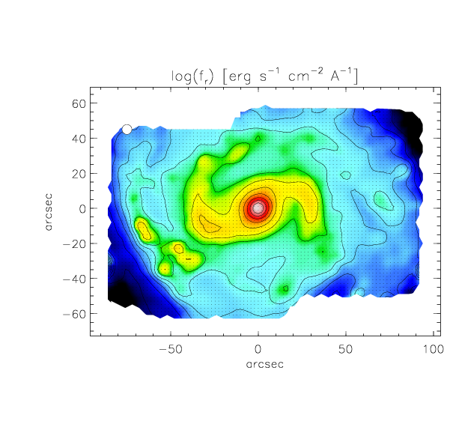
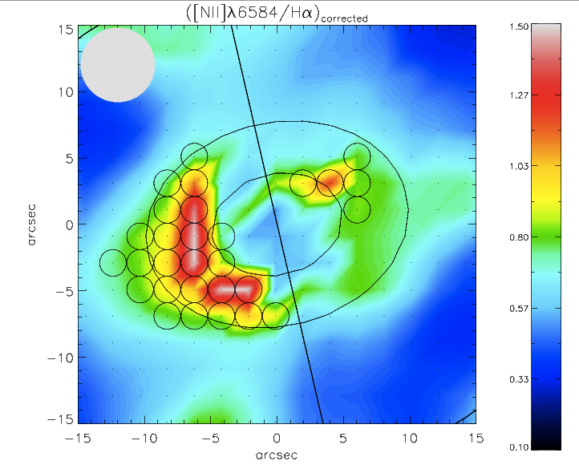
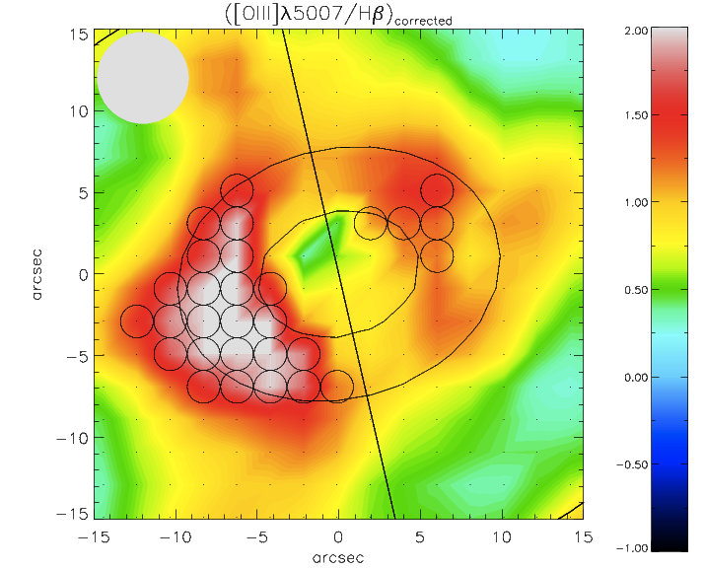
SOURCES OF IONIZATION IN THE ISM
NGC 1042
Rongxin Luo (SHAO)
Lei Hao (SHAO)
[NII]/Hα
[OIII]/Hβ

Slide 9

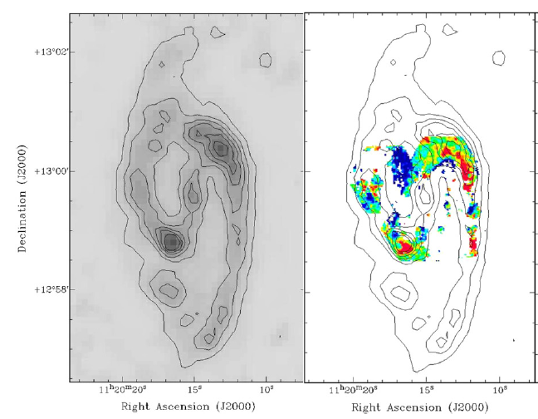
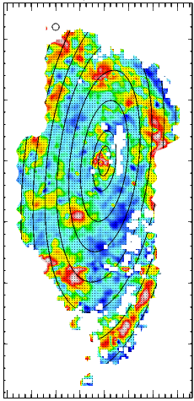
GEOMETRY AND PHYSICAL PROPERTIES OF INTERSTELLAR DUST
KINGFISH
PMAS
VENGA
Kathryn Kreckel (MPIA)
Brent Groves (MPIA)
GB (Carnegie)
Dust Mass
E(B-V)
Kreckel et al. 2013

Slide 10
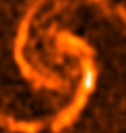
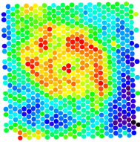
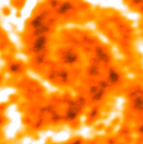
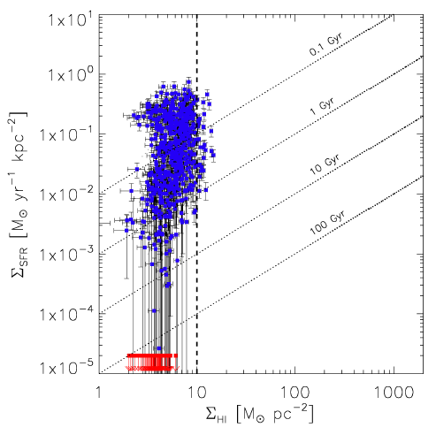
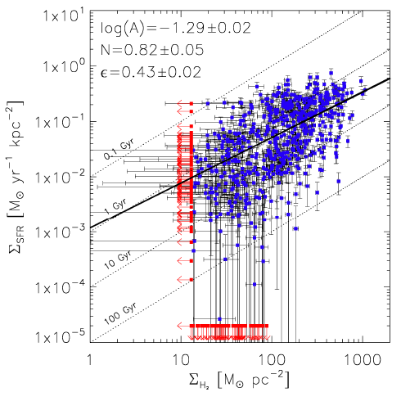
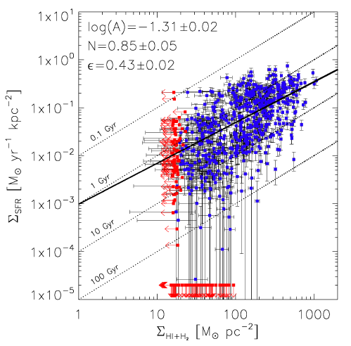
SPATIALLY RESOLVED STAR FORMATION LAW (NGC 5194)
THINGS
Walter et al. 2008
BIMA SONG
Helfer et al. 2003
HI 21cm
CO (1-0)
GB et al. 2009
N=0.82±0.05
Σ_{SFR}
HI
H₂
HI+H₂
Notes:
HI from THINGS 21cm and H2 from BIMA SONG CO J=1-0
No correlation of SFR with HI, saturation at 10 M/pc2 as observed by Wong & Blitz, Kennicutt, Bigiel
Clear correlation with molecular gas, which drives the total gas correlation.
Gas depletion timescale of 2 Gyr, or SFR of 1% per free-fall time
Significant intrinsic scatter of 0.4 dex or a factor of 3 in SFE at a given gas surface density

Slide 11
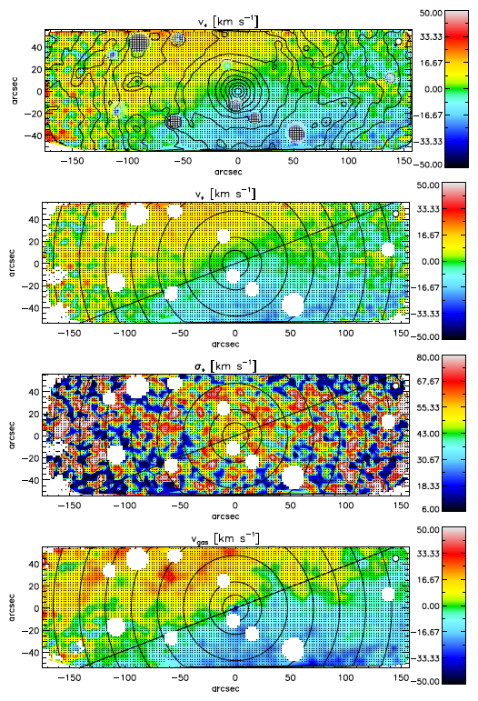
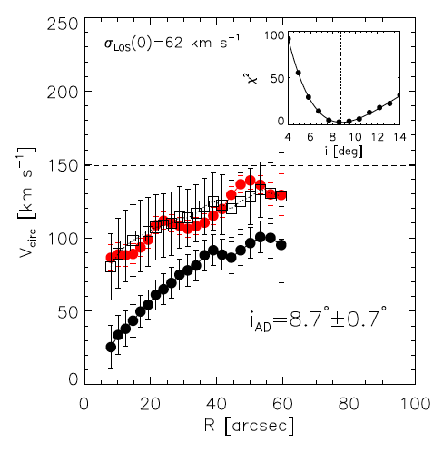
DISK INCLINATIONS USING ASYMETRIC DRIFT
NGC 628
Very sensitive to inclination!!!
GB et al. 2013b
Perfect agreement with
Tully-Fisher inclination.

Slide 12
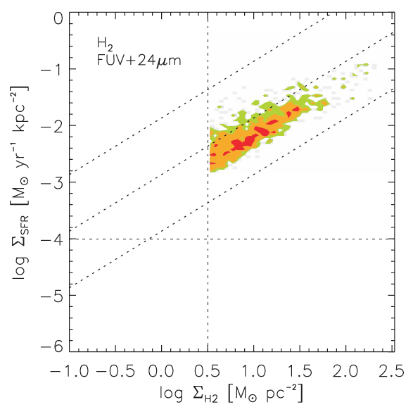
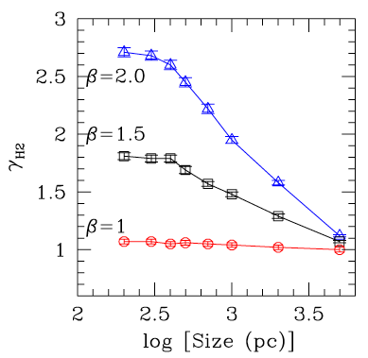
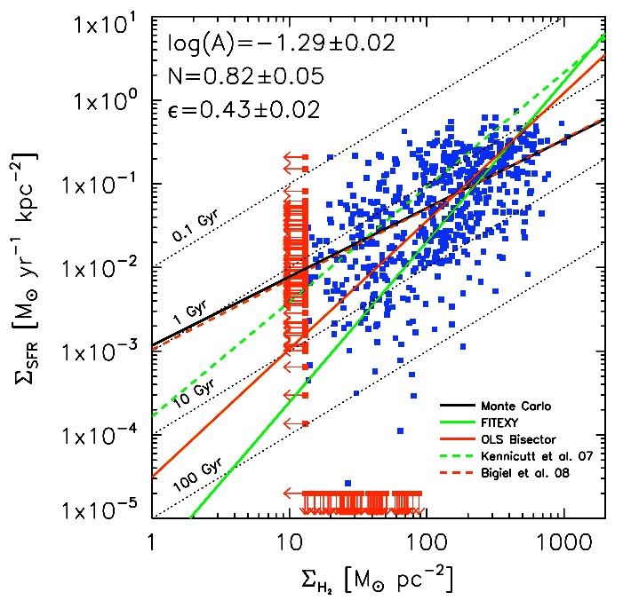
X_{CO} in NGC 628 by inverting the SFL
Calzetti et al. 2012
Bigiel et al. 2008
Star Formation Law (a.k.a. Schmidt-Kennicutt Law)
1.0 < N < 1.5
Single power-law at intermediate Σ_{H2}
SFR provides independent measure of H₂
GB et al. 2009

Slide 13
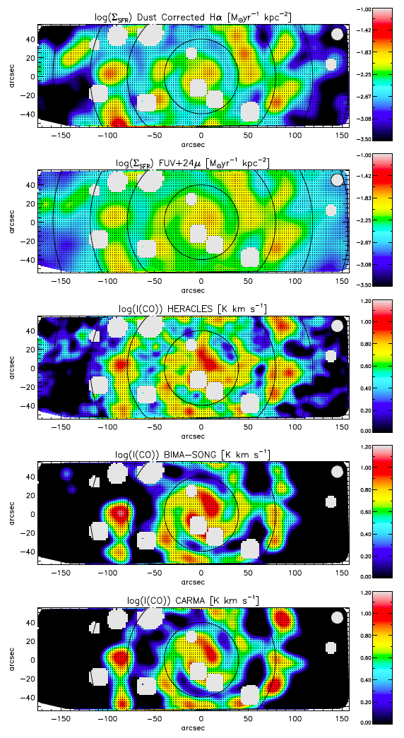
The Inner Disk of NGC 628
Control Systematic Uncertainties
  SFR tracers:
    Hα + E(B-V) (VENGA)
    24 μm + FUV (Spitzer, GALEX)
  CO(1-0) vs CO(2-1)
  Single Dish vs Interferometry
    BIMA-SONG CO(1-0)
    CARMA CO(1-0)
    HERACLES-IRAM CO(2-1)
  Assumed SFL slope:
    N=1.0 – N=1.5
GB et al. 2013a

Slide 14
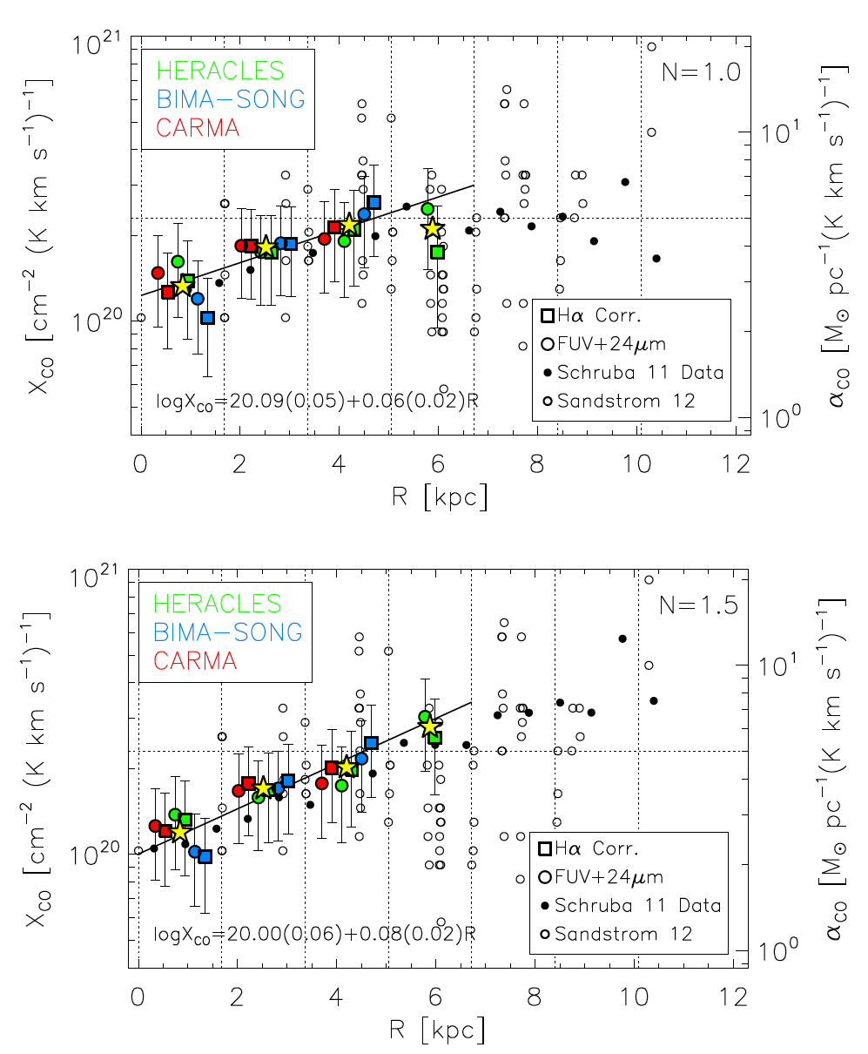
An X_{CO} Gradient in the Inner Disk of NGC 628
Xco
Radius
GB et al. 2013a

Slide 15
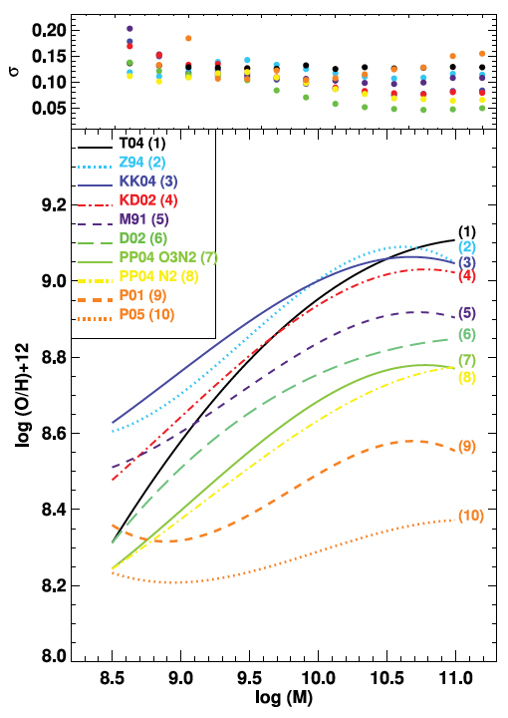
IZI: Inferring metallicities (Z) and Ionization parameters (q)
in collaboration with Liza Kewley, Mike Dopita, and Frederic Vogt (ANU)
Commonly used strong line methods show up to 0.6 dex systematic differences in derived metallicities.
One line ratio is calibrated against “Z” ignoring its dependence with “q”.
Two line ratios sensitive to metallicity and excitation (e.g. OII/NII + OIII/OII).
Different calibrations for different lines.
Kewley & Ellison 2013a

Slide 16
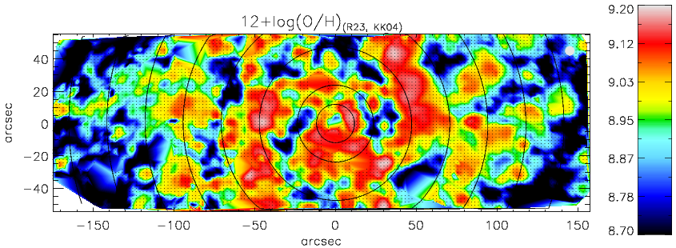
The Metallicity Distribution in NGC 628 from VENGA
NGC 628
N2O2
R23

Slide 17
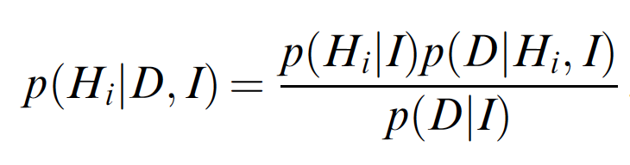
IZI: Inferring metallicities (Z) and Ionization parameters (q)
Compute joint PDF for “Z” and “q” given DATA and photoionization MODEL grid
Use arbitrary sets of available lines and include upper limits
Provide realistic error bars (i.e. non-Gaussian)
Remove the choice of a particular diagnostic (i.e. common system for all lines)
Not married to a particular calibration
One command line implementation on IDL. USER FRIENDLY!!
          IDL> output = IZI( flux, error, id, grid )

Slide 18
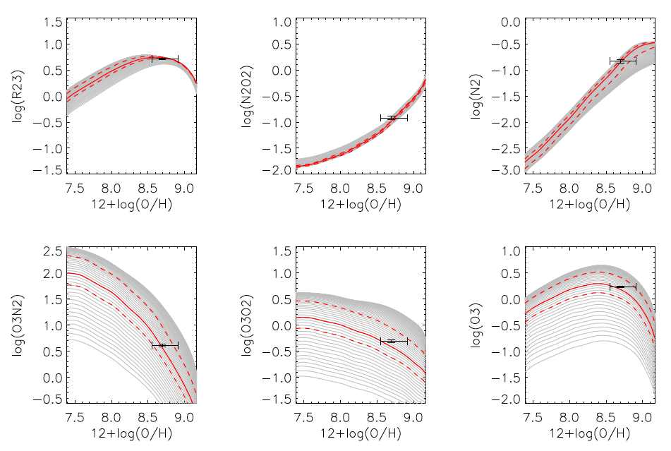
IZI: Inferring metallicities (Z) and Ionization parameters (q)

Slide 19
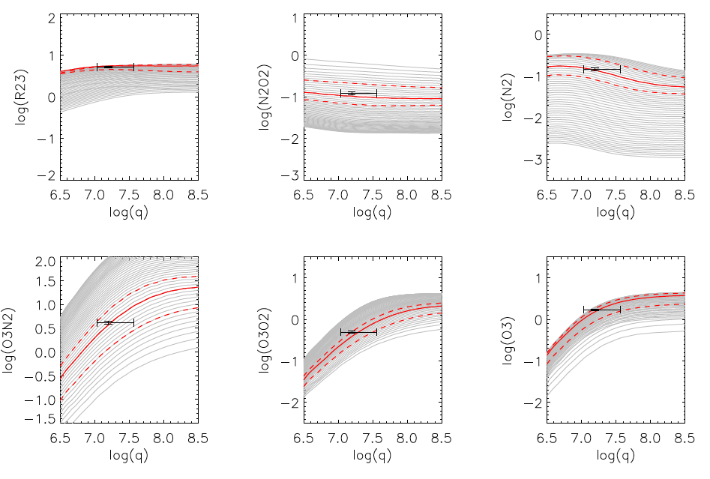
IZI: Inferring metallicities (Z) and Ionization parameters (q)

Slide 20
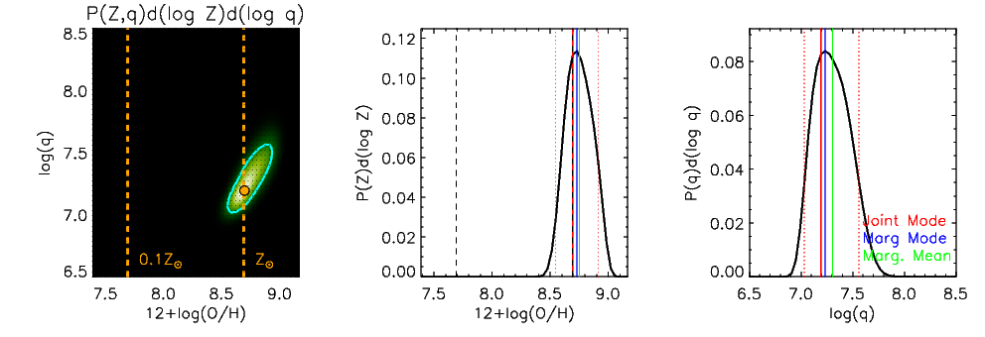
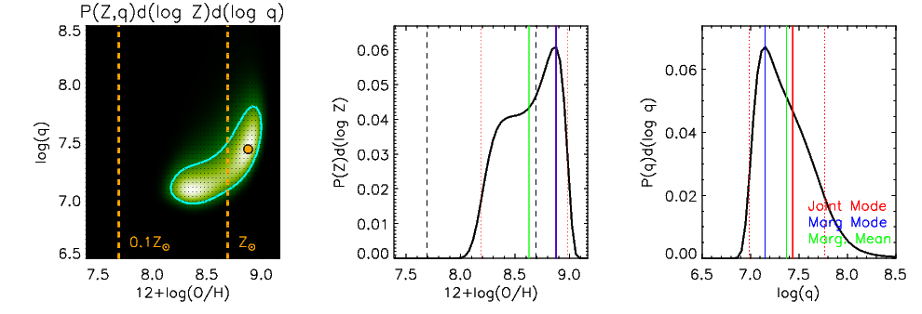
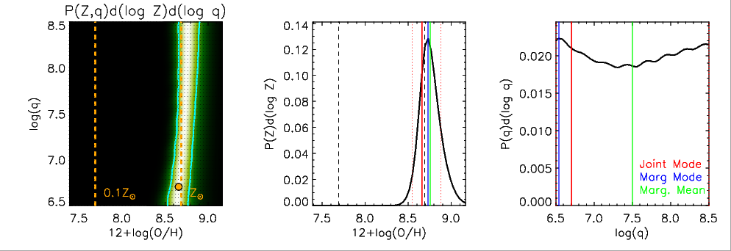
IZI: Inferring metallicities (Z) and Ionization parameters (q)
All Lines in van Zee et al. 1998
R23
N2O2

Slide 21
CONCLUSIONS
VENGA: small sample but depth, area, and multi-wavelength ancillary data.
  Very different from CALIFA, SAMI and MANGA.
Ideal for ISM and star formation studies, but great for other things too!
  Come talk to me if interested in using the data.
Combining Optical IFU maps with CO, HI, and far-IR data allows detailed studies of the process of star formation and the connections between different phases of the ISM.
S-K Law in M51 favors N=1 in normal spiral regime, and slope depends on the fitting method!!
Xco drops by a factor of 2 towards the center on NGC 628.
IZI: self-consistent metallicities through Bayesian Inference.

