Slide 1

ESO’s
scientific facilities

Slide 2
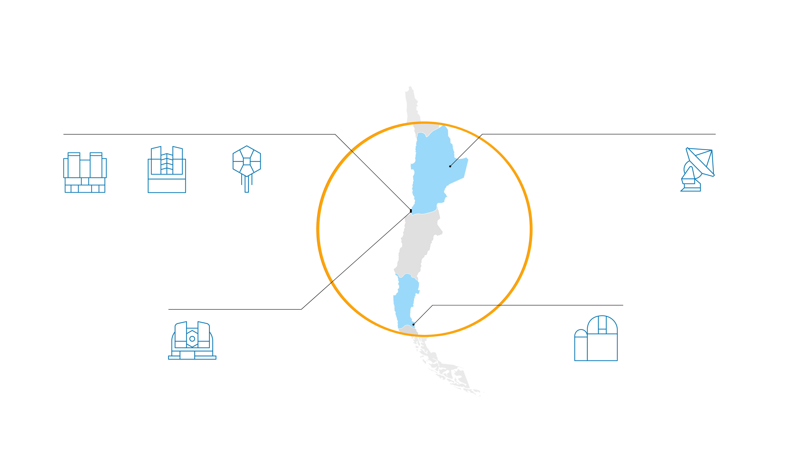

ESO telescopes
Paranal
Chajnantor
VLT
VLTI
VISTA
CTA
South*
ALMA
Armazones
La Silla
ELT**
Telescopes at La Silla
* in preparatory phase
** under construction

Slide 3
ELT
construction site
ALMA
Observatory
La Silla Observatory
Paranal Observatory
ESO site elevations

Slide 4
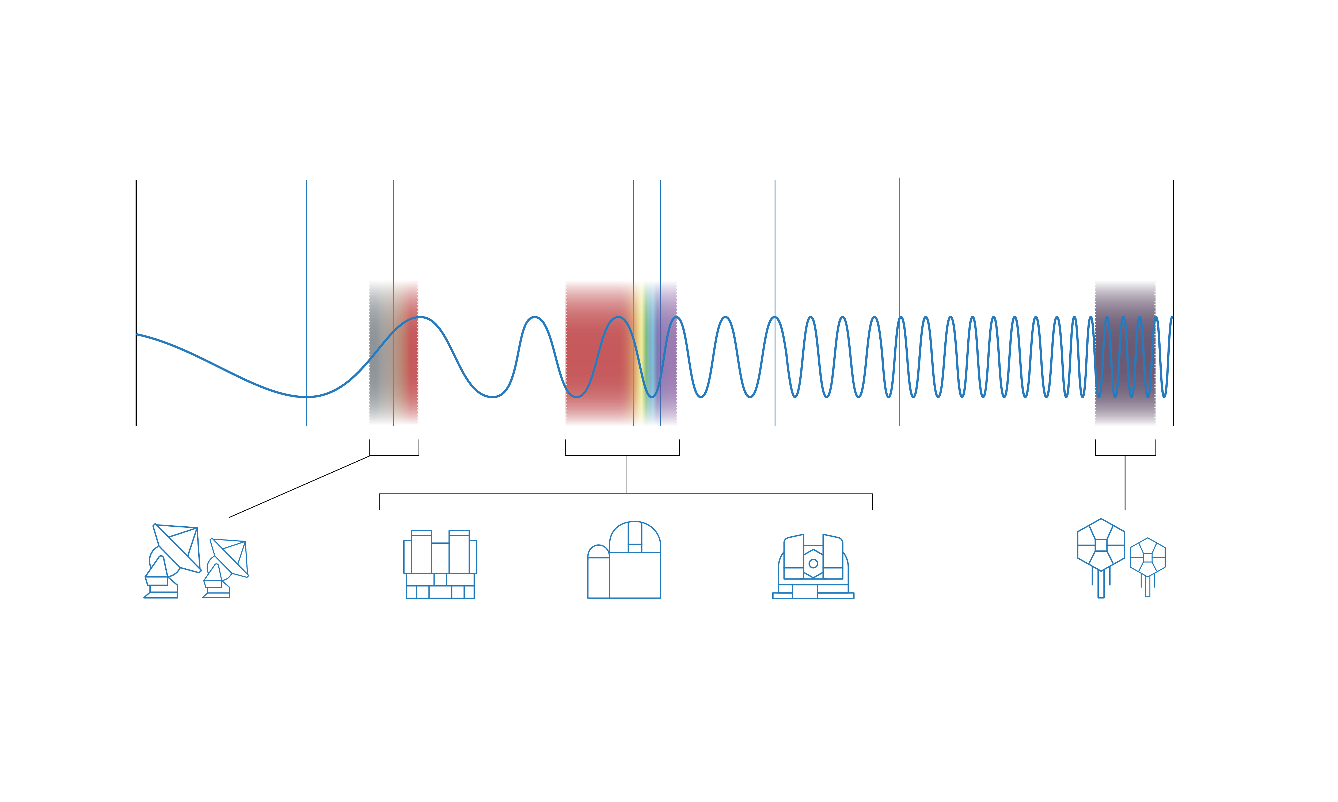
Wavelengths of ESO telescopes
Radio
Visible
X-Rays
Microwave
Infrared
Gamma Rays
ALMA
VLT, VLTI,
VISTA
ESO 3.6-metre telescope and NTT
ELT under construction
CTA-South in preparatory phase

Slide 5
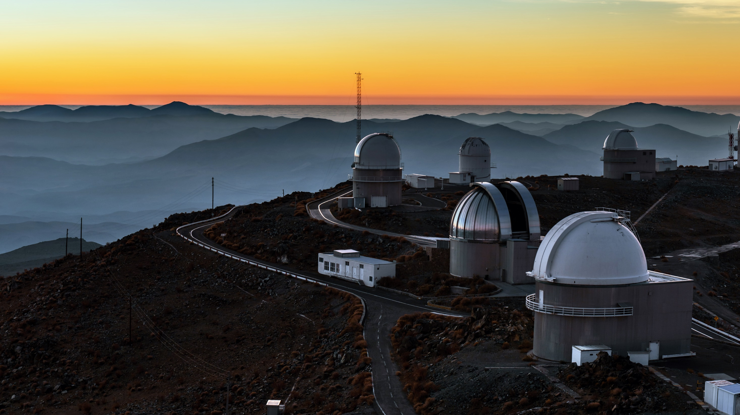
La Silla – ESO’s first observatory
Credit: ESO/B. Tafreshi (twanight.org)

Slide 6
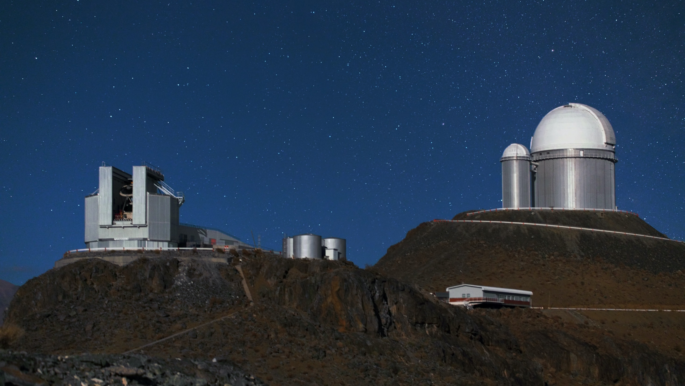
Telescopes currently operated by ESO
New Technology Telescope (NTT)
ESO 3.6-metre telescope
Credit: Y. Beletsky (LCO)/ESO

Slide 7
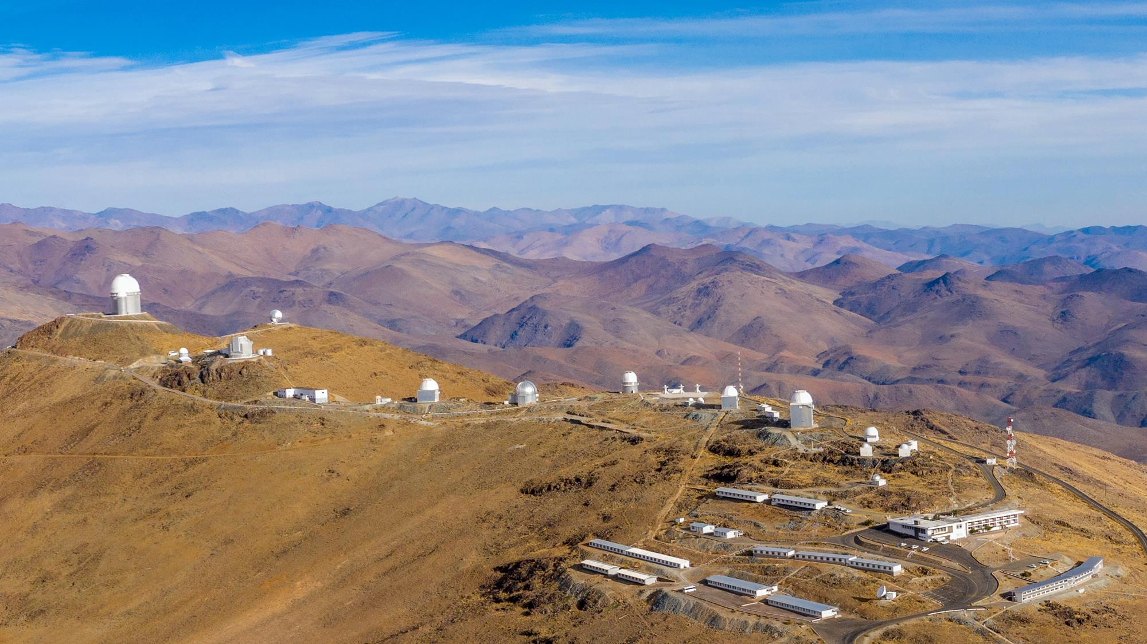
Hosted telescopes
Swiss 1.2-metre
Leonhard Euler
telescope
ESO 1-metre Schmidt
telescope
Danish
1.54-metre telescope
ESO 1-metre
telescope
Rapid Eye
Mount
telescope
MPG/ESO
2.2-metre
telescope
BlackGEM
TRAnsiting Planets and PlanetesImals Small Telescope – South
Credit: ENEL
ExTrA
Télescope à Action Rapide pour les Objets Transitoires
Multi-site All-Sky CAmeRA

Slide 8
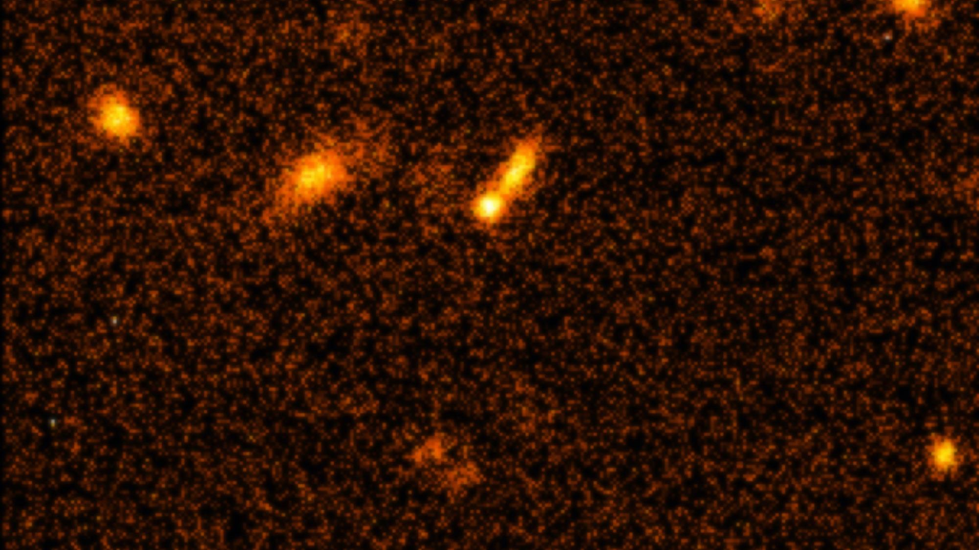
Science highlights of La Silla Observatory
Accelerating Universe
Based on observations of exploding stars, two independent research teams showed that the expansion of the Universe is accelerating
The 2011 Nobel Prize in Physics was awarded for this result
Notes:
Background image: Supernova at redshift z = 0.51 https://www.eso.org/public/news/eso9861/

Slide 9
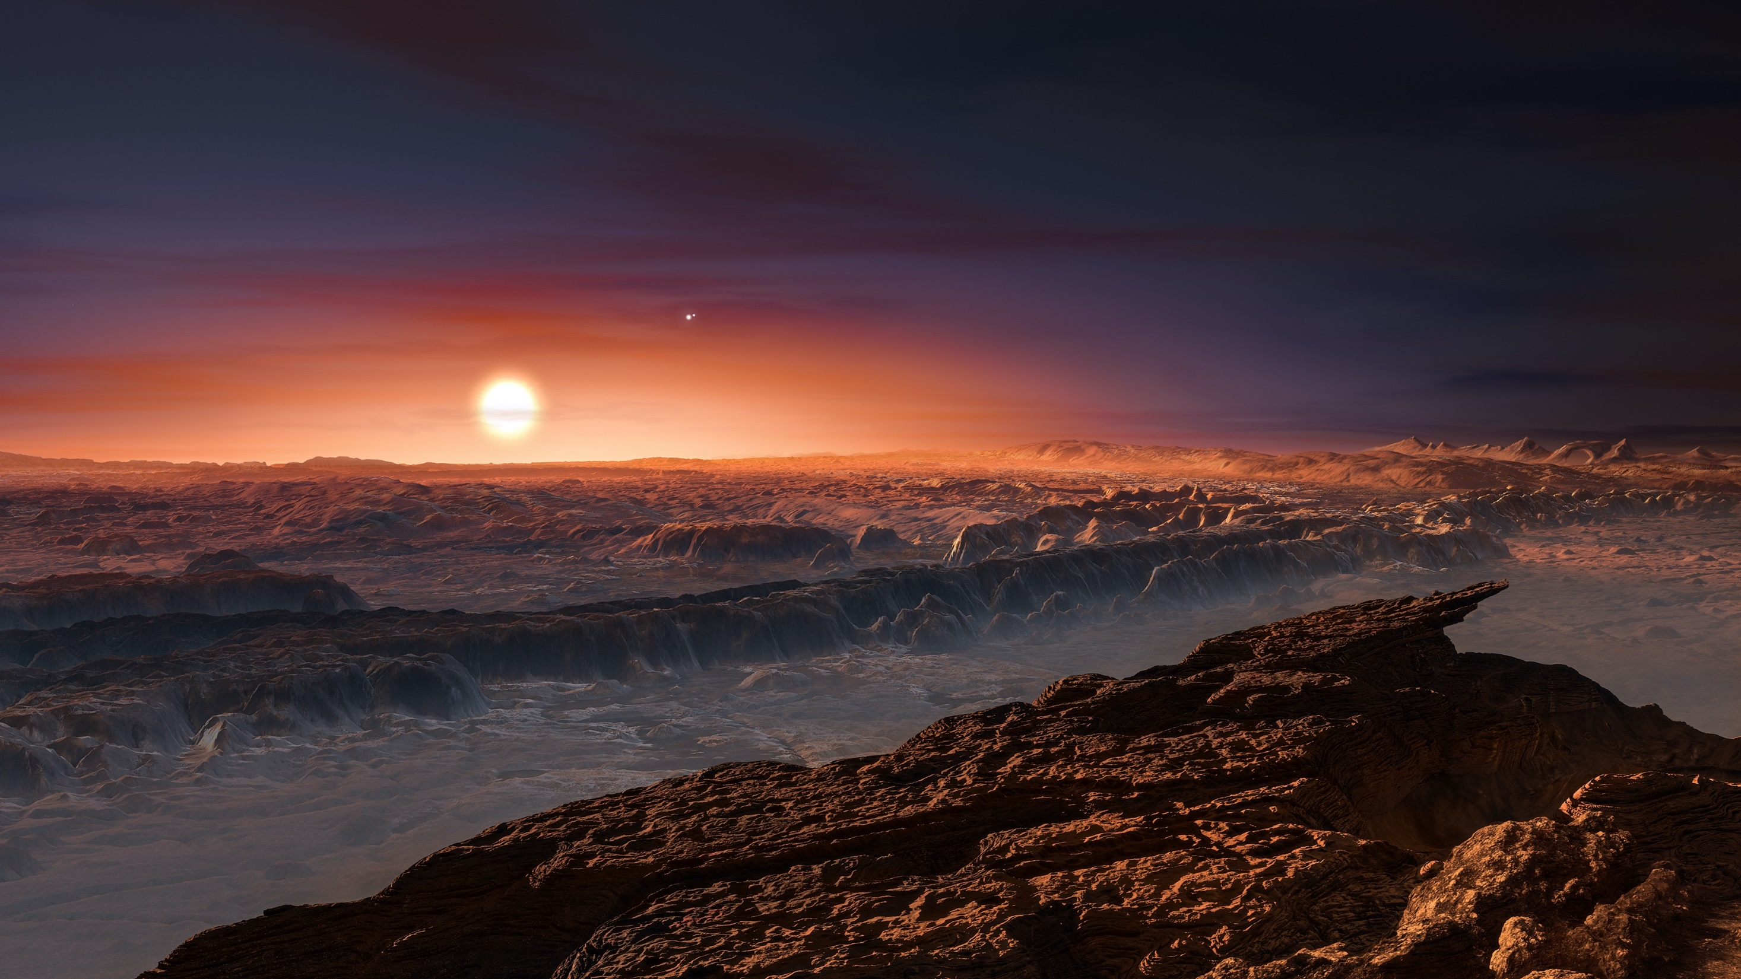
Credit: ESO/M. Kornmesser
Planet found in the habitable zone
around Proxima Centauri, the nearest star to Earth
Notes:
Background image: artist impression of Proxima Centauri b https://www.eso.org/public/news/eso1629/

Slide 10
Credit: JAXA
The anatomy of an asteroid
ESO’s New Technology Telescope (NTT) provided the first evidence that asteroids can have a highly varied internal structure
Notes:
Background image: Asteroid (25143) Itokawa seen in close-up https://www.eso.org/public/news/eso1405/

Slide 11
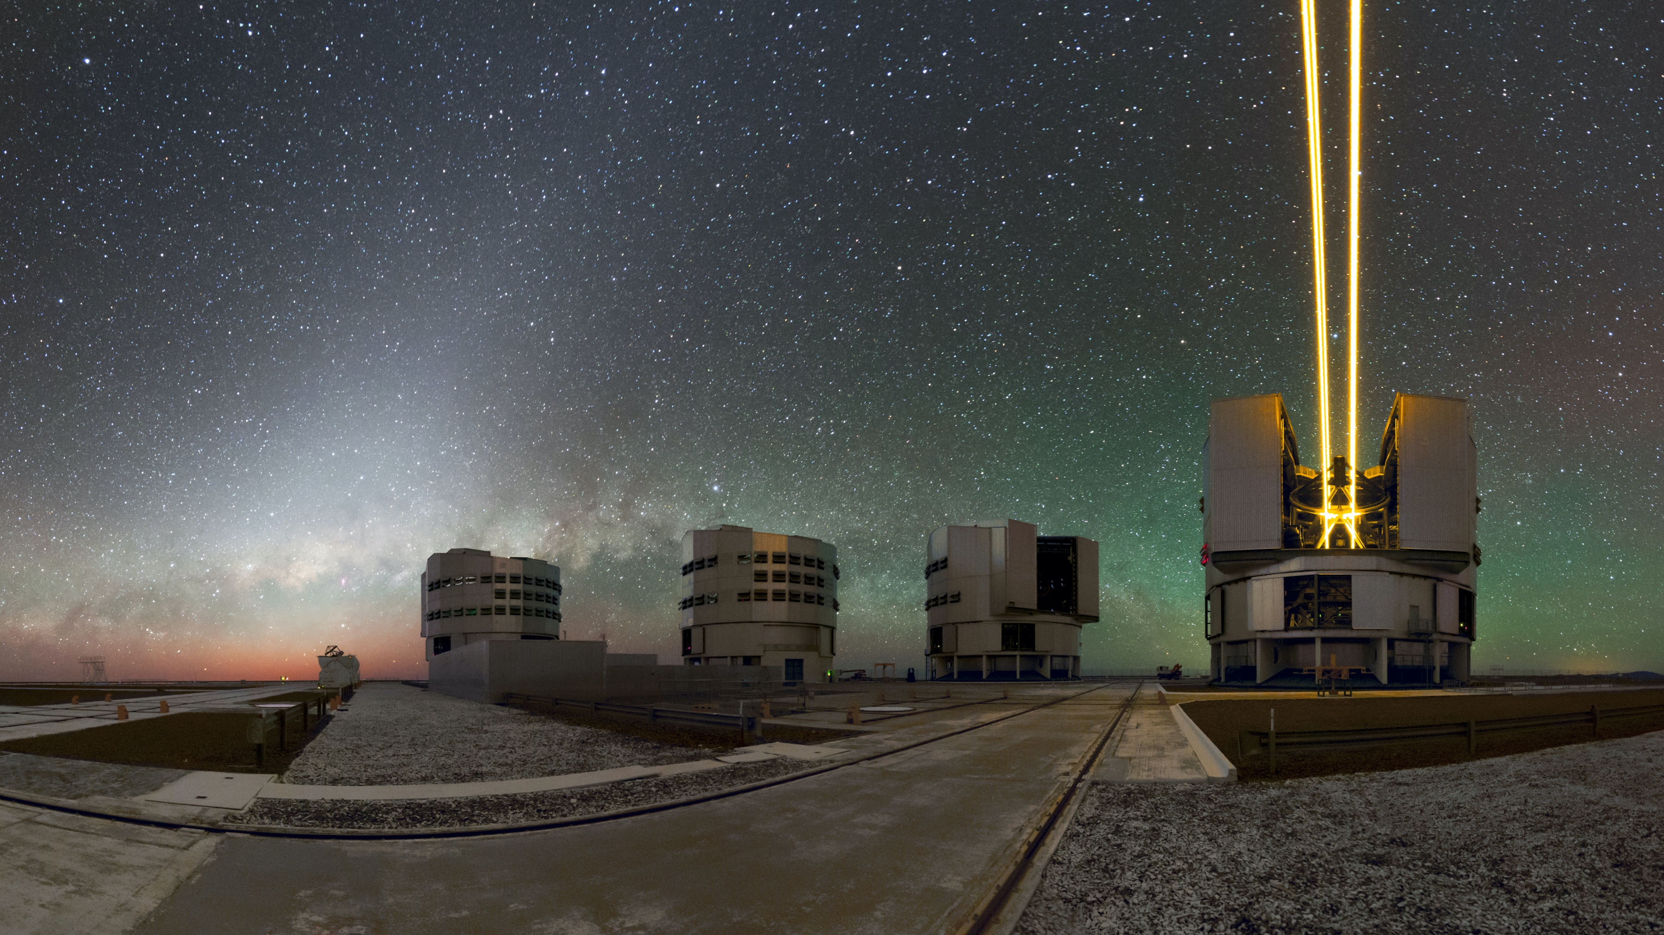
Paranal – home of the Very Large Telescope
Credit: ESO/P.Horálek

Slide 12
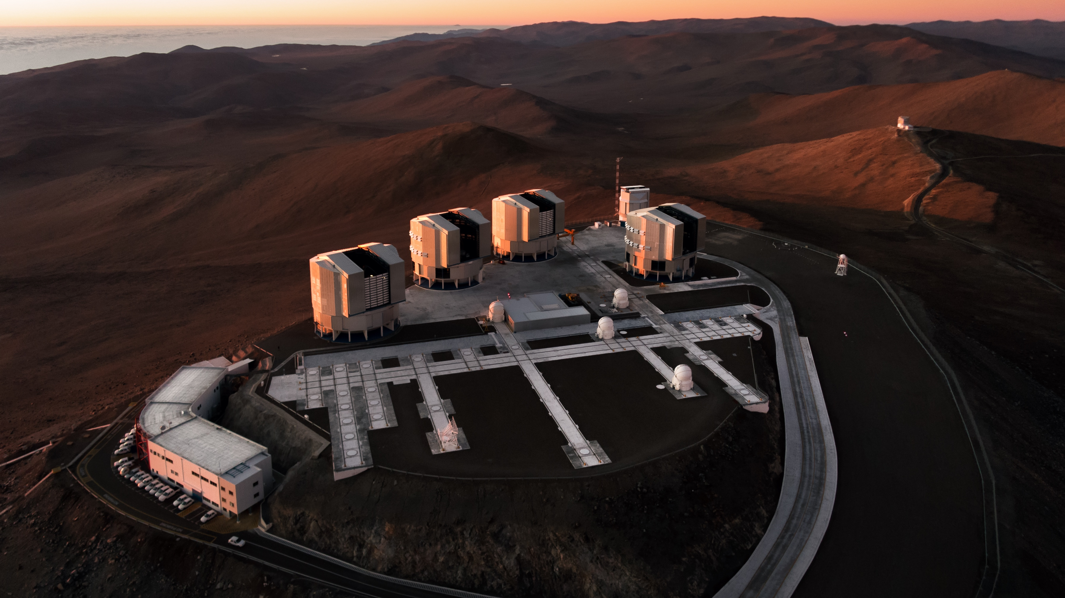
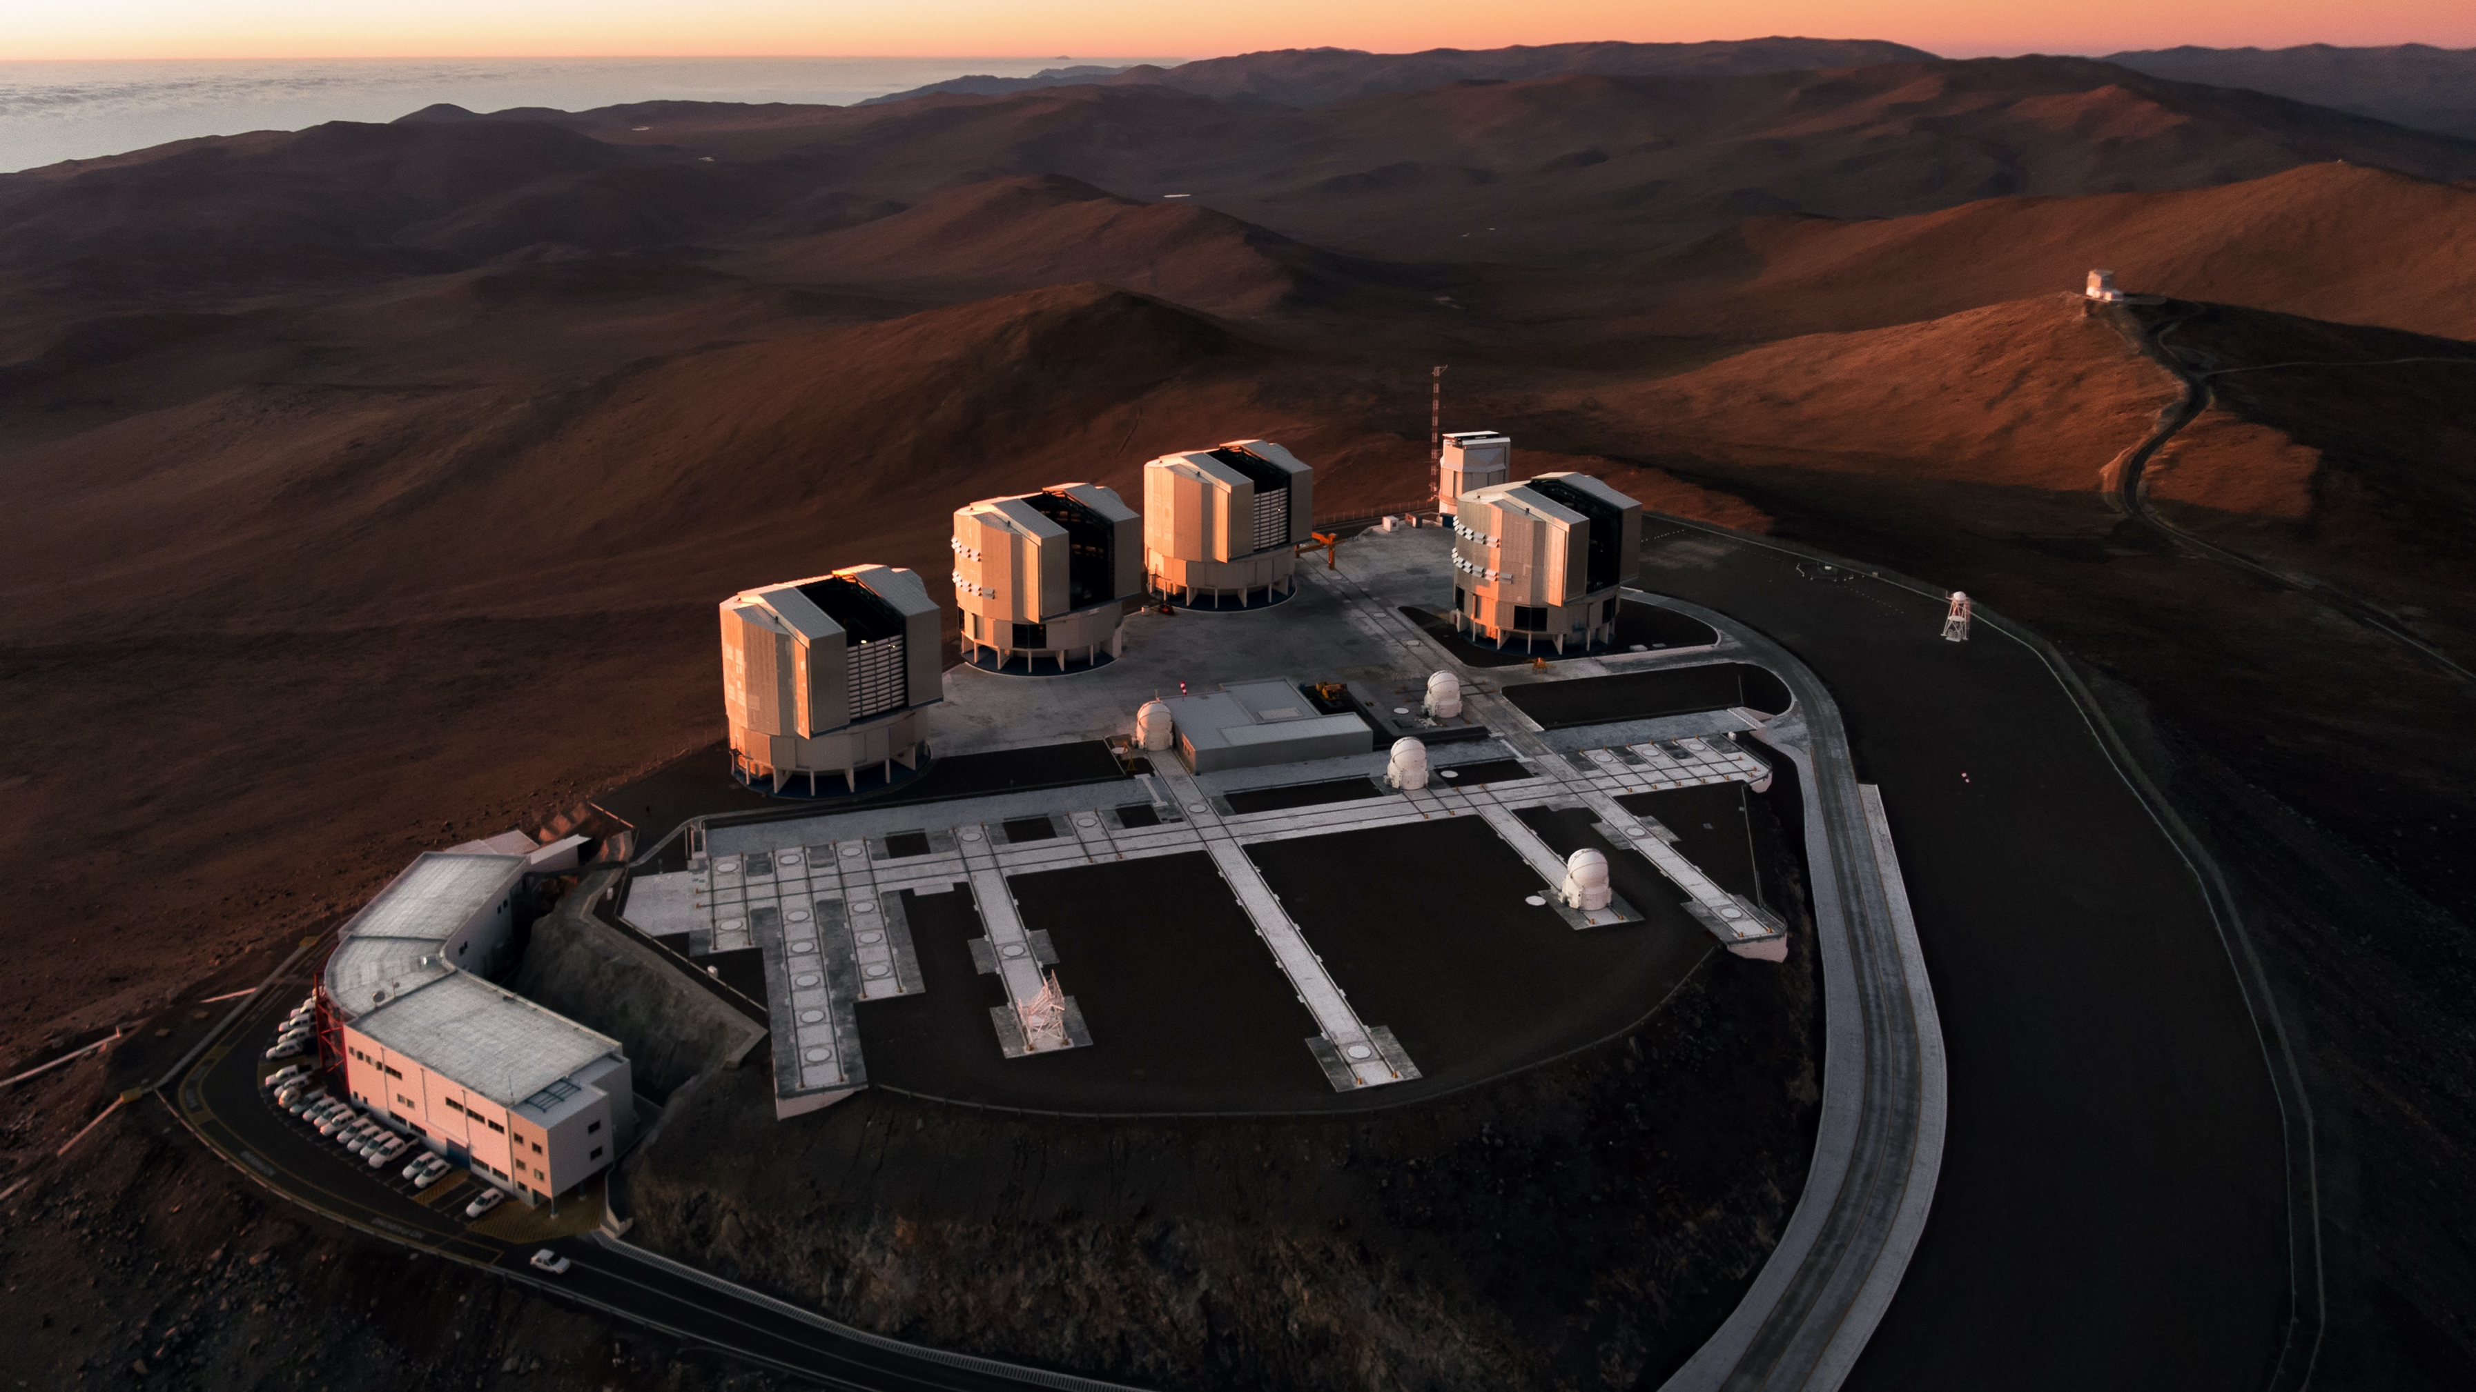
UT1
Antu
UT2
Kueyen
UT3
Melipal
UT4
Yepun
VISTA
4 Unit Telescopes
Each primary mirror:
8.2-metre diameter,
17.5 cm thick,
weighing 23 tonnes
VST
Credit: G.Hüdepohl (atacamaphoto.com)/ESO
Auxiliary Telescopes
4 movable AT’s,
1.8-metre mirror
Control
building

Slide 13
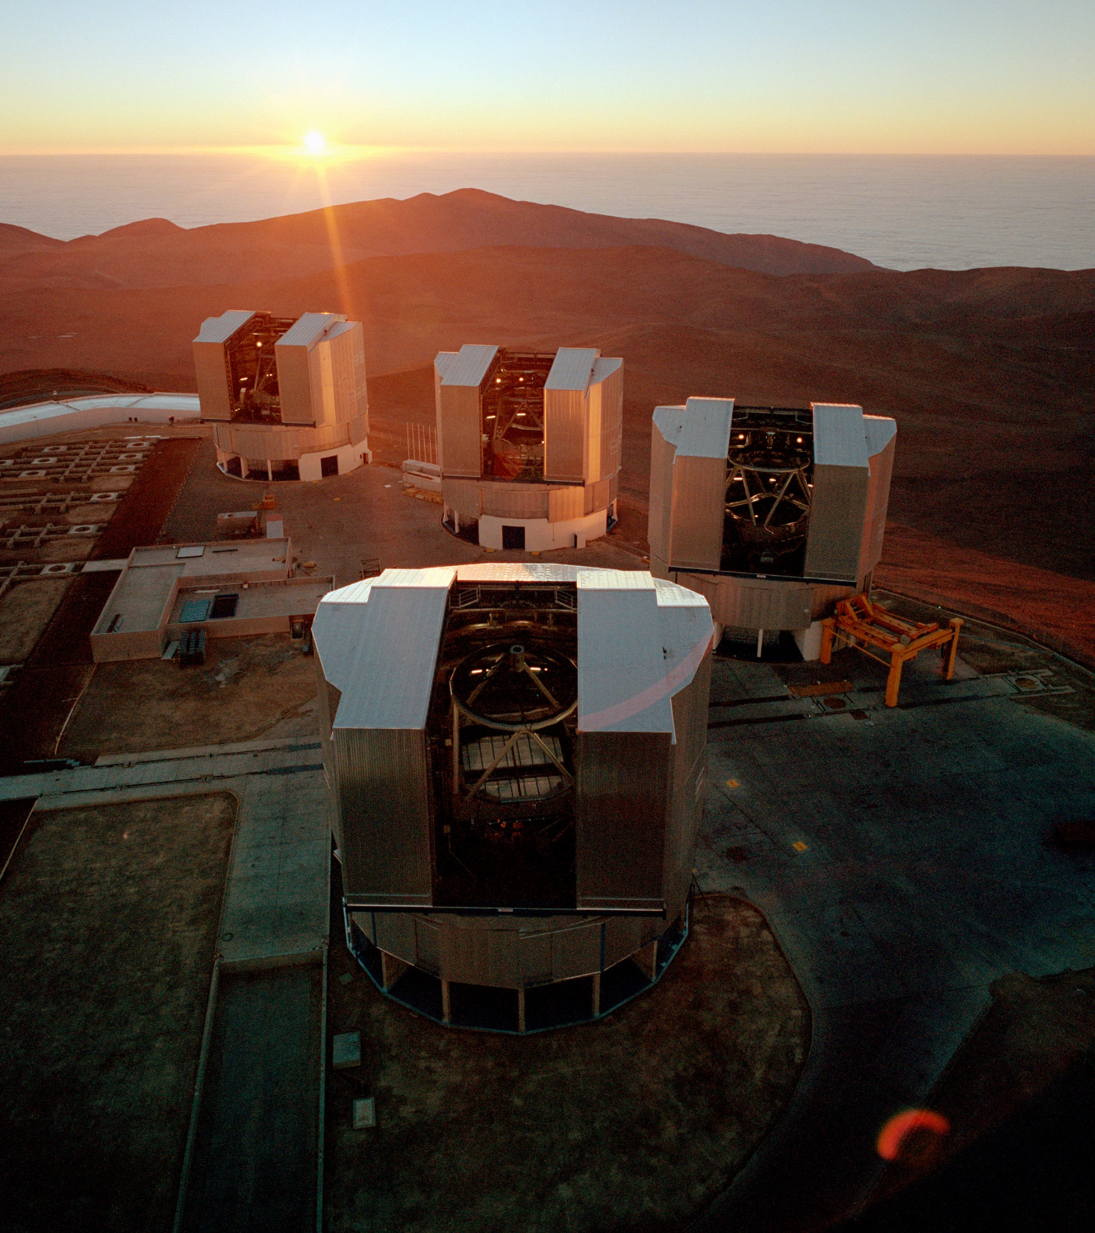
The VLT’s combined mirror area is equivalent to that of a 16-metre telescope, which effectively makes it the largest optical telescope in the world.

Slide 14
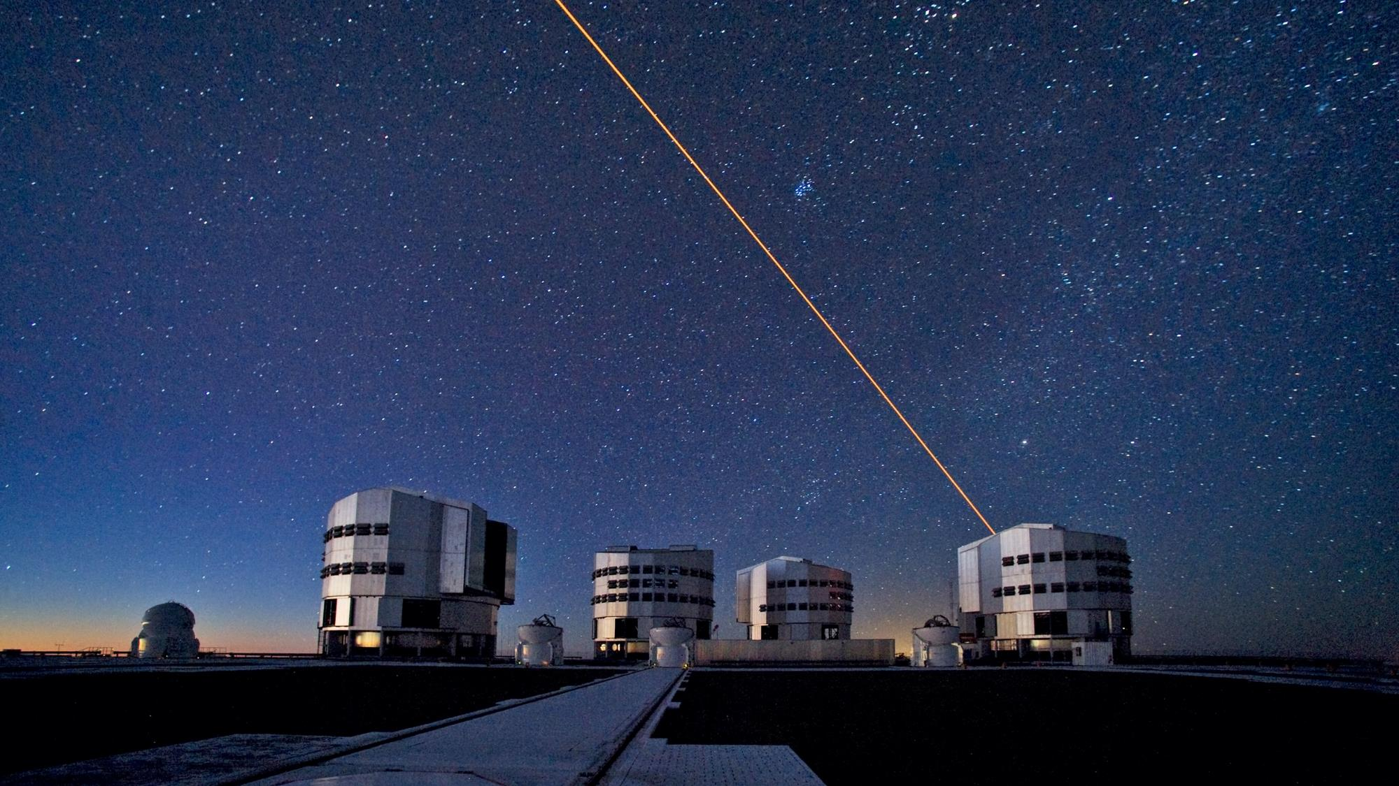
ESO’s VLT uses Active Optics, Adaptive Optics
and Interferometry to improve image quality
Credit: ESO/S. Brunier

Slide 15
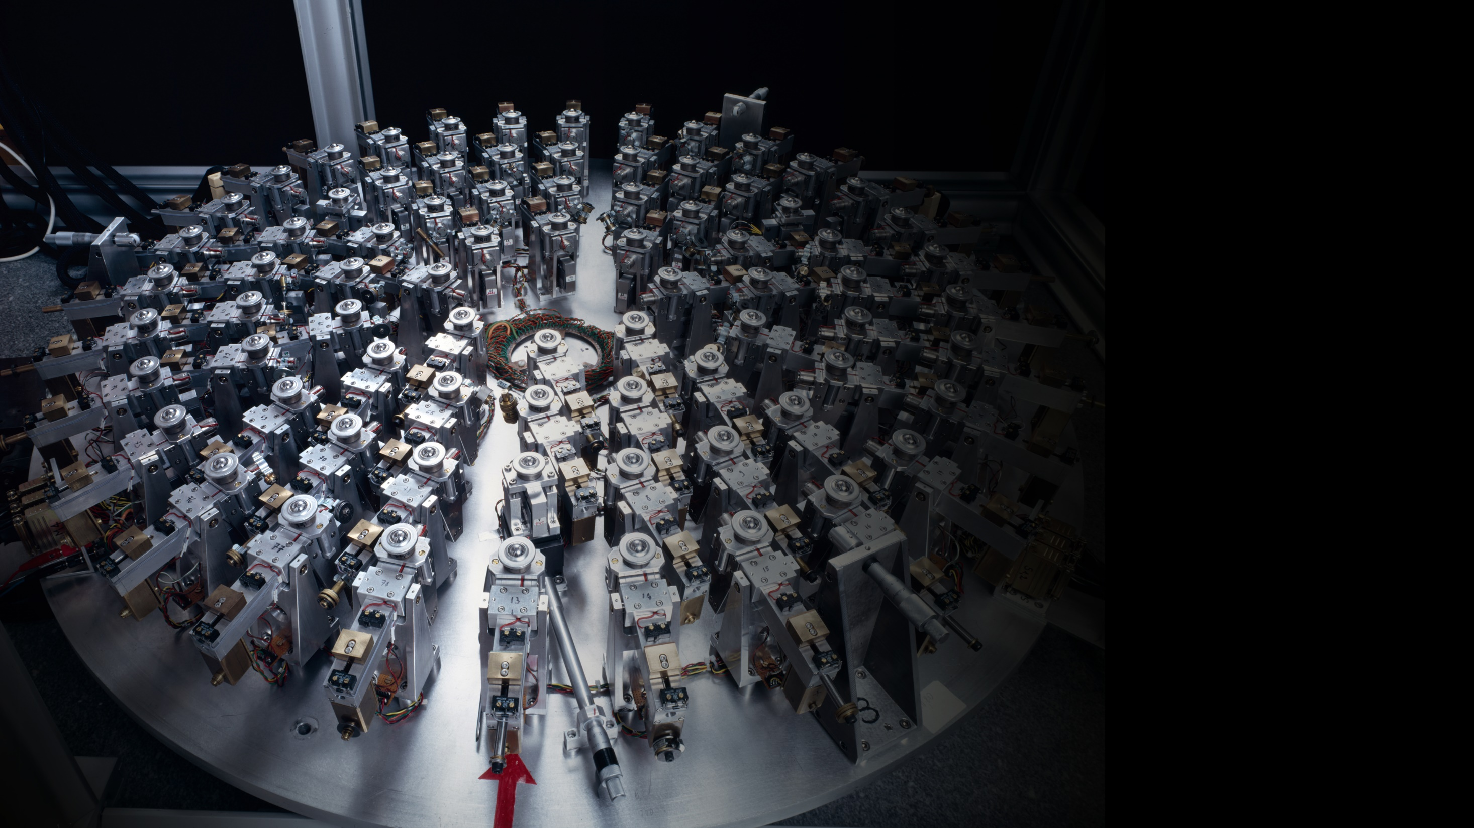
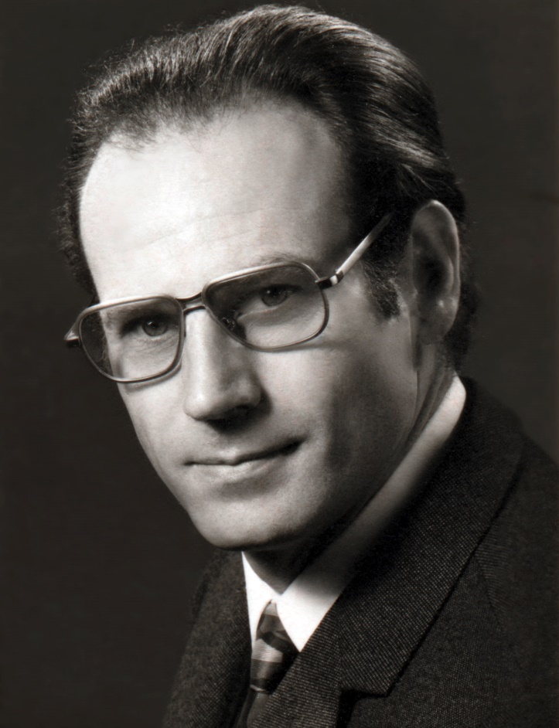
Active optics
Inventing a game changer
In the late 1980s ESO engineer Raymond Wilson invented a revolutionary technology and pioneered it at ESO’s NTT.
Today, Active optics is widely used in large telescopes all over the world.
Active optics actuators for
the NTT’s primary mirror

Slide 16
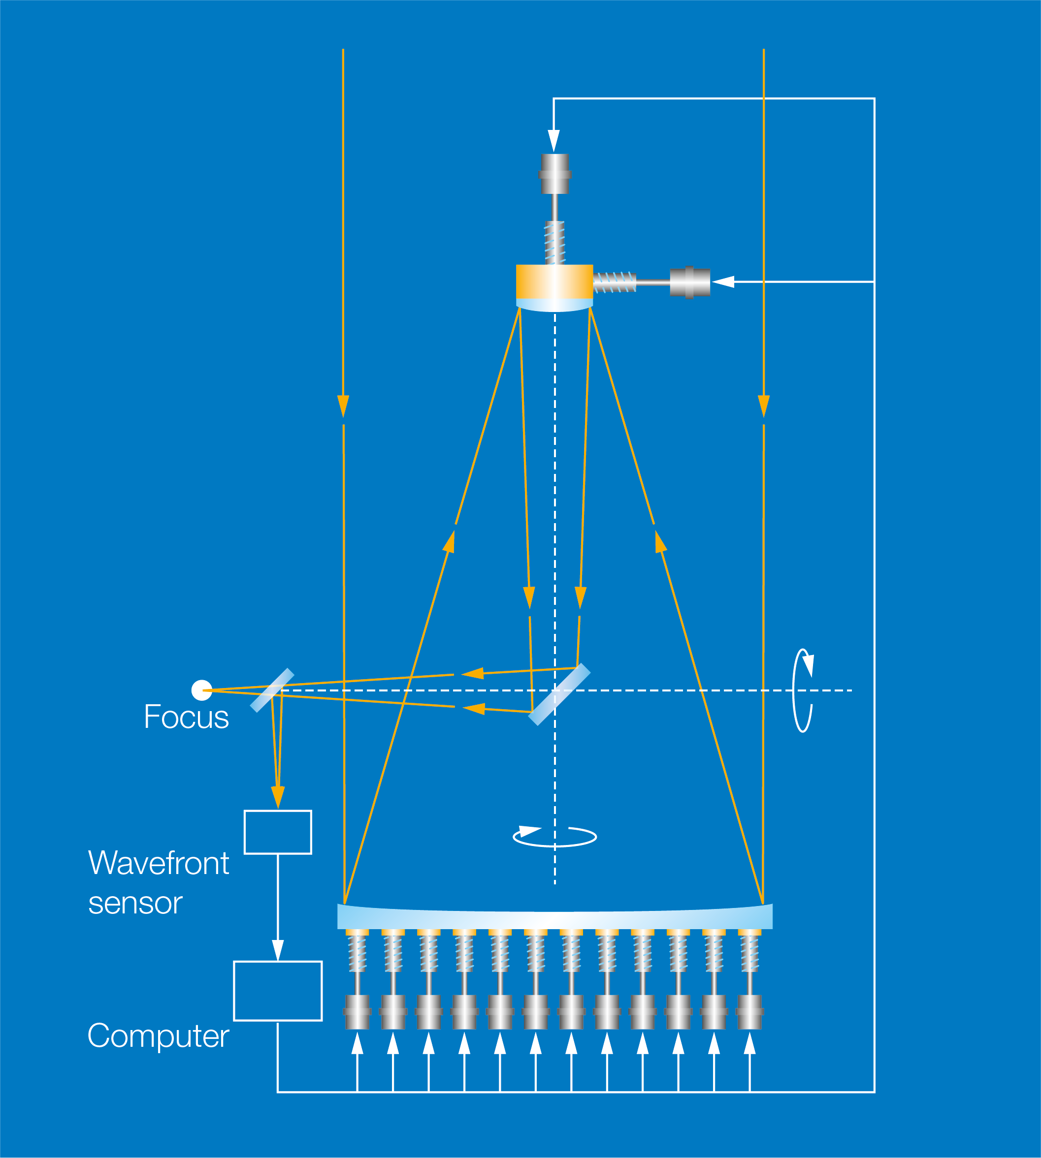
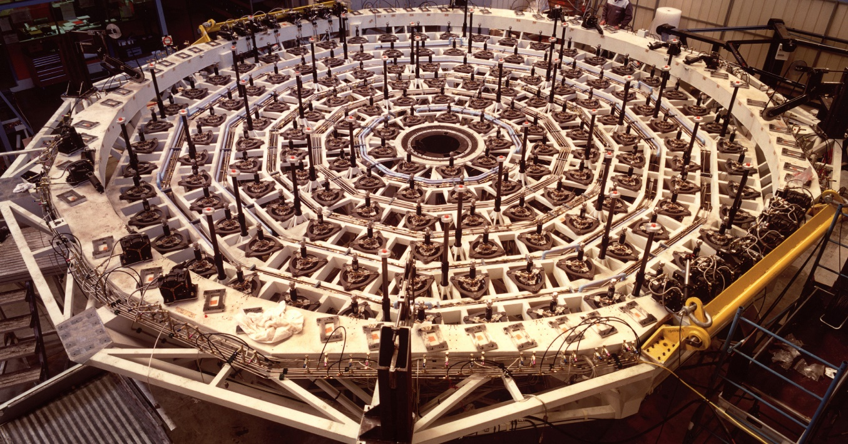
Active optics
Actuators move very accurately to correct
the mirror’s shape, compensating for the distortion produced by gravity

Slide 17
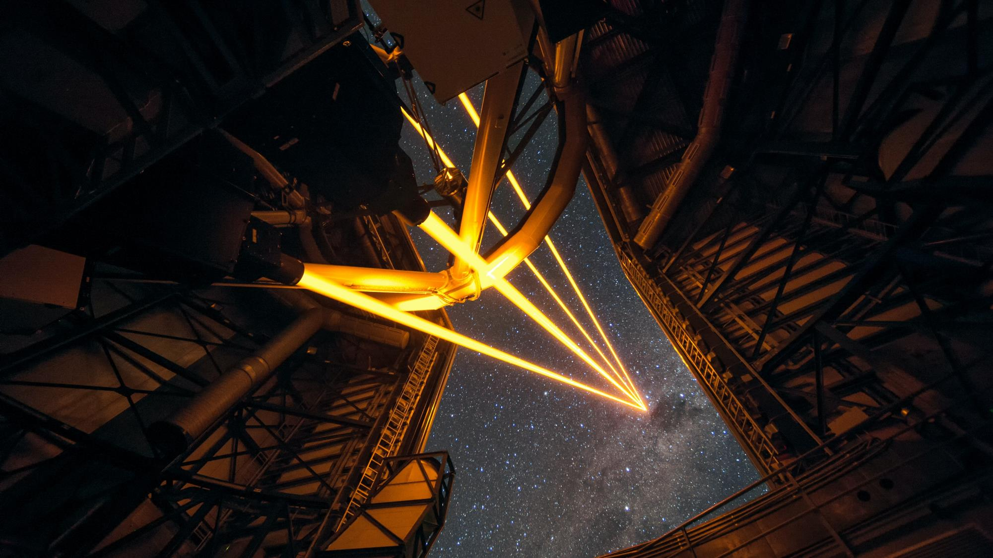
Adaptive optics
Credit: ESO/F. Kamphues
Revolution in image quality of ground-based observations

Slide 18
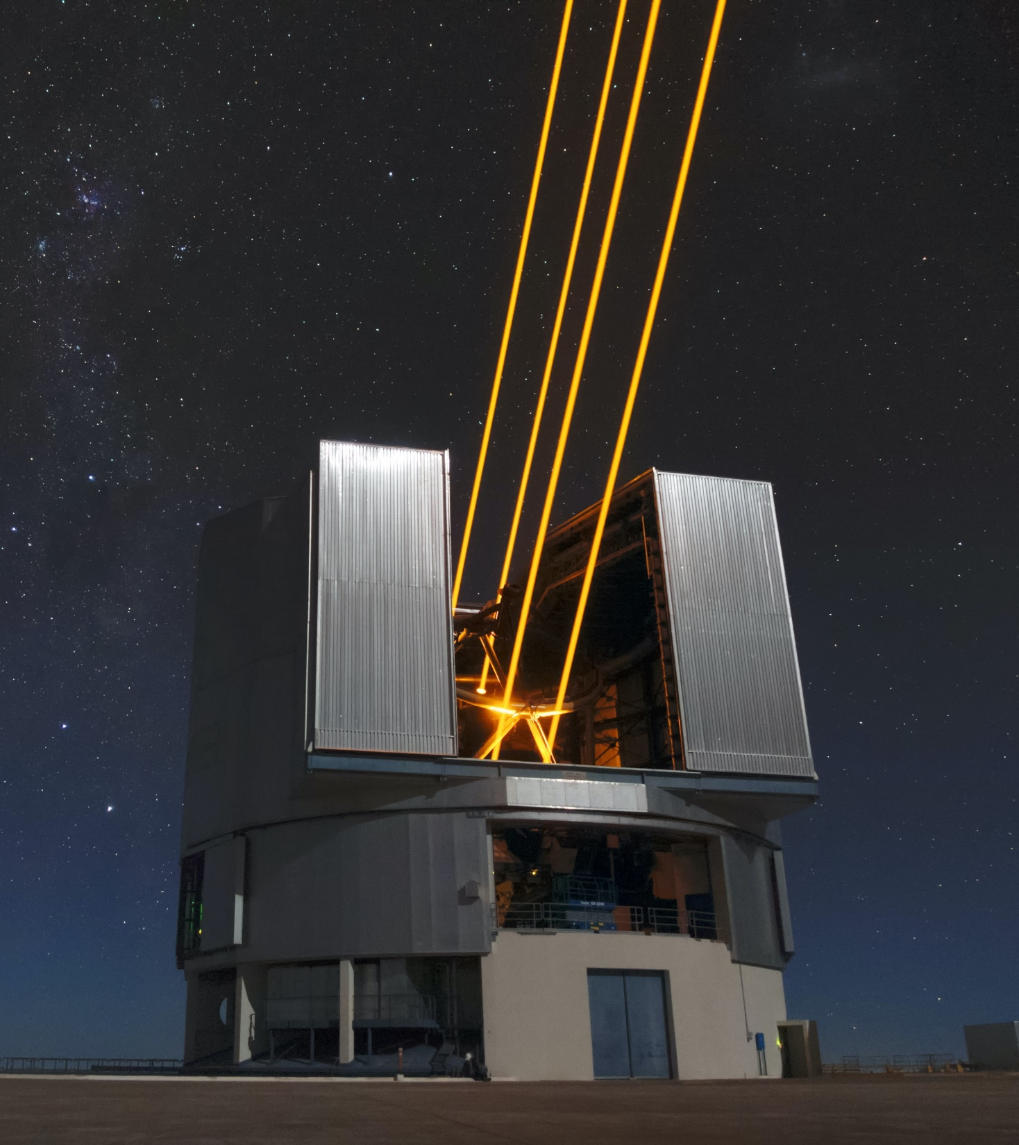
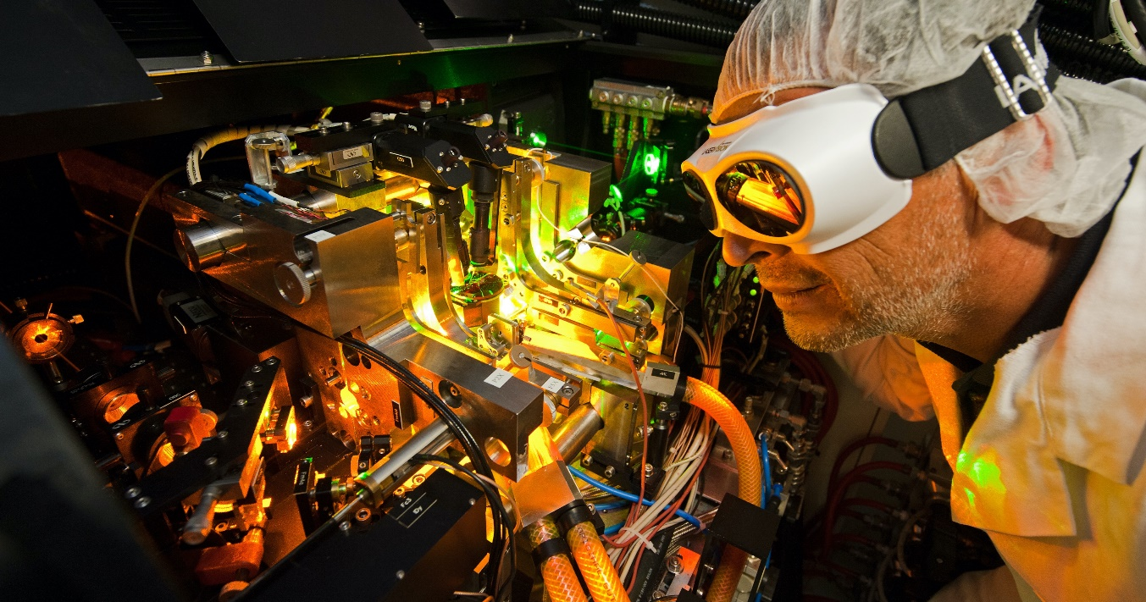
Adaptive optics
Corrects the distortions of light introduced by Earth’s atmosphere.
Relies on a sophisticated system of powerful lasers and deformable mirrors.
Credit: Matthias Siedel/ESO
Credit: ESO/Max Alexander

Slide 19
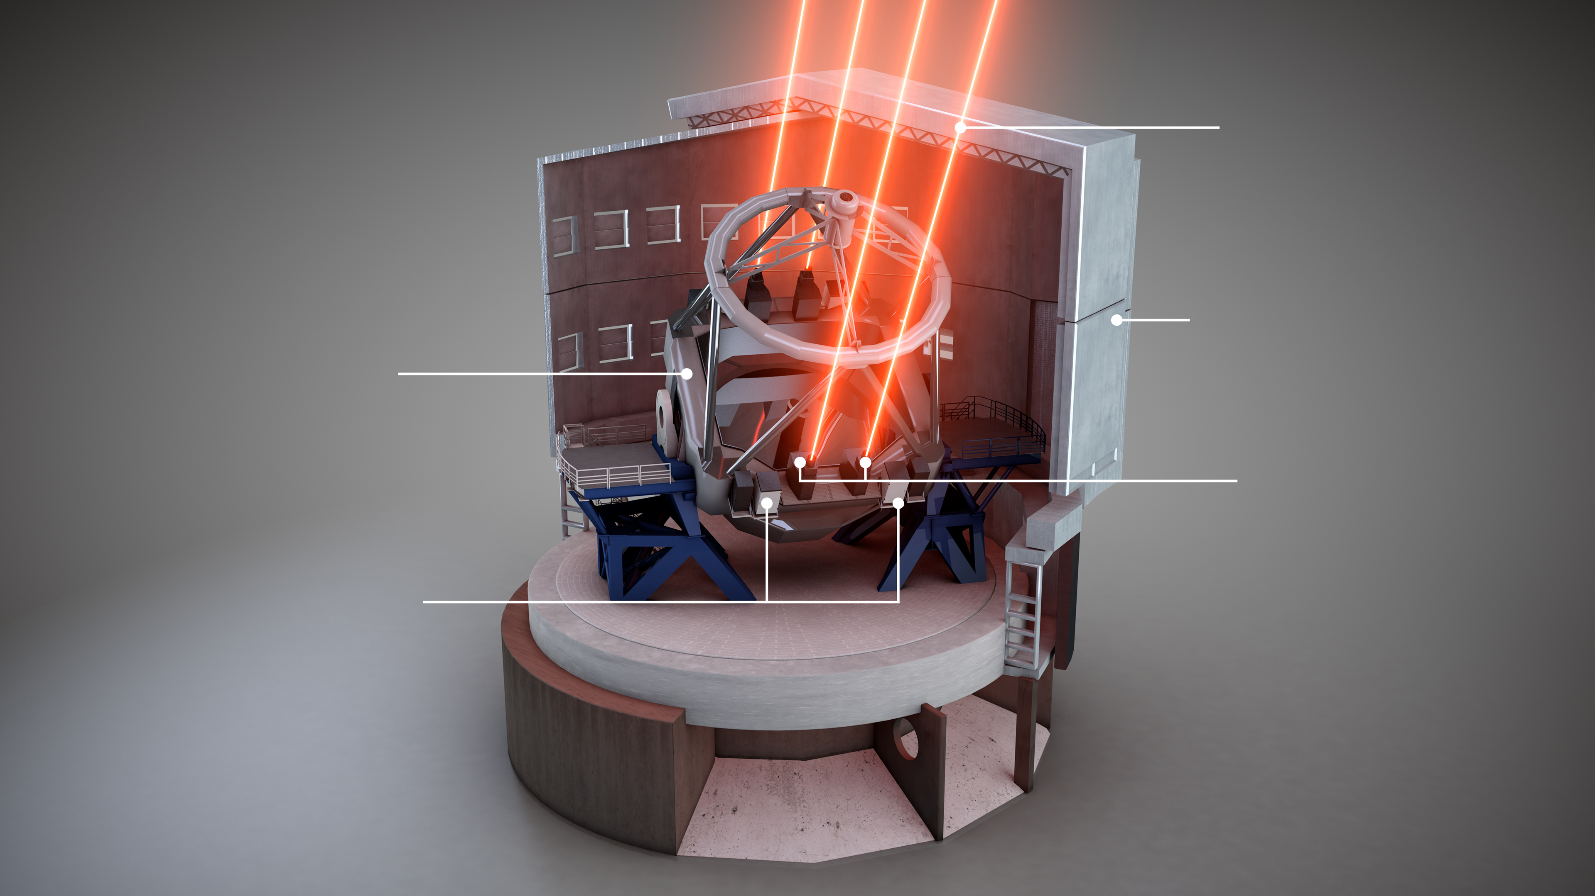
The VLT Laser Guide Star Facility was the first of its kind in the southern hemisphere.
30-cm diameter
laser beams
(wavelength 589 nm)
Telescope enclosure
(mostly cut-away)
VLT Unit Telescope 4
Credit: ESO/L. Calçada
Laser-launch telescopes
Beam control and
frequency doubler
Raman laser cabinets
Reference laser
and pump laser
(wavelength 1178 nm, infrared)

Slide 20
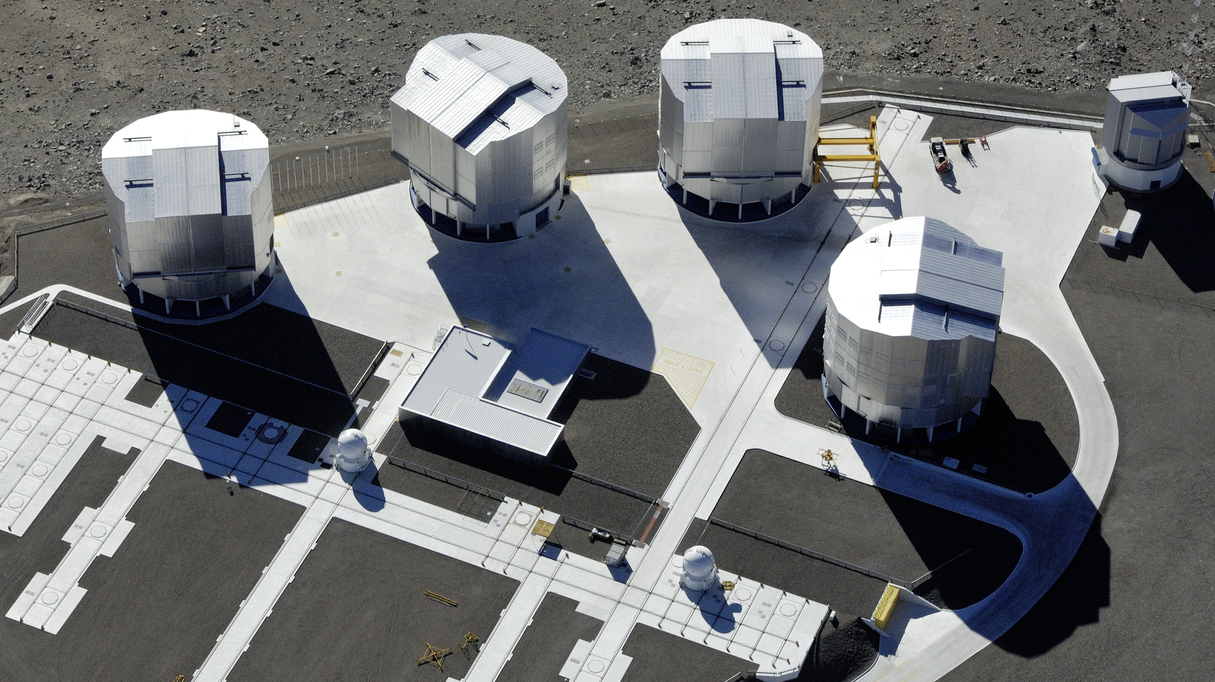
VLT Interferometer (VLTI)
acts like a virtual 130-metre telescope

Slide 21
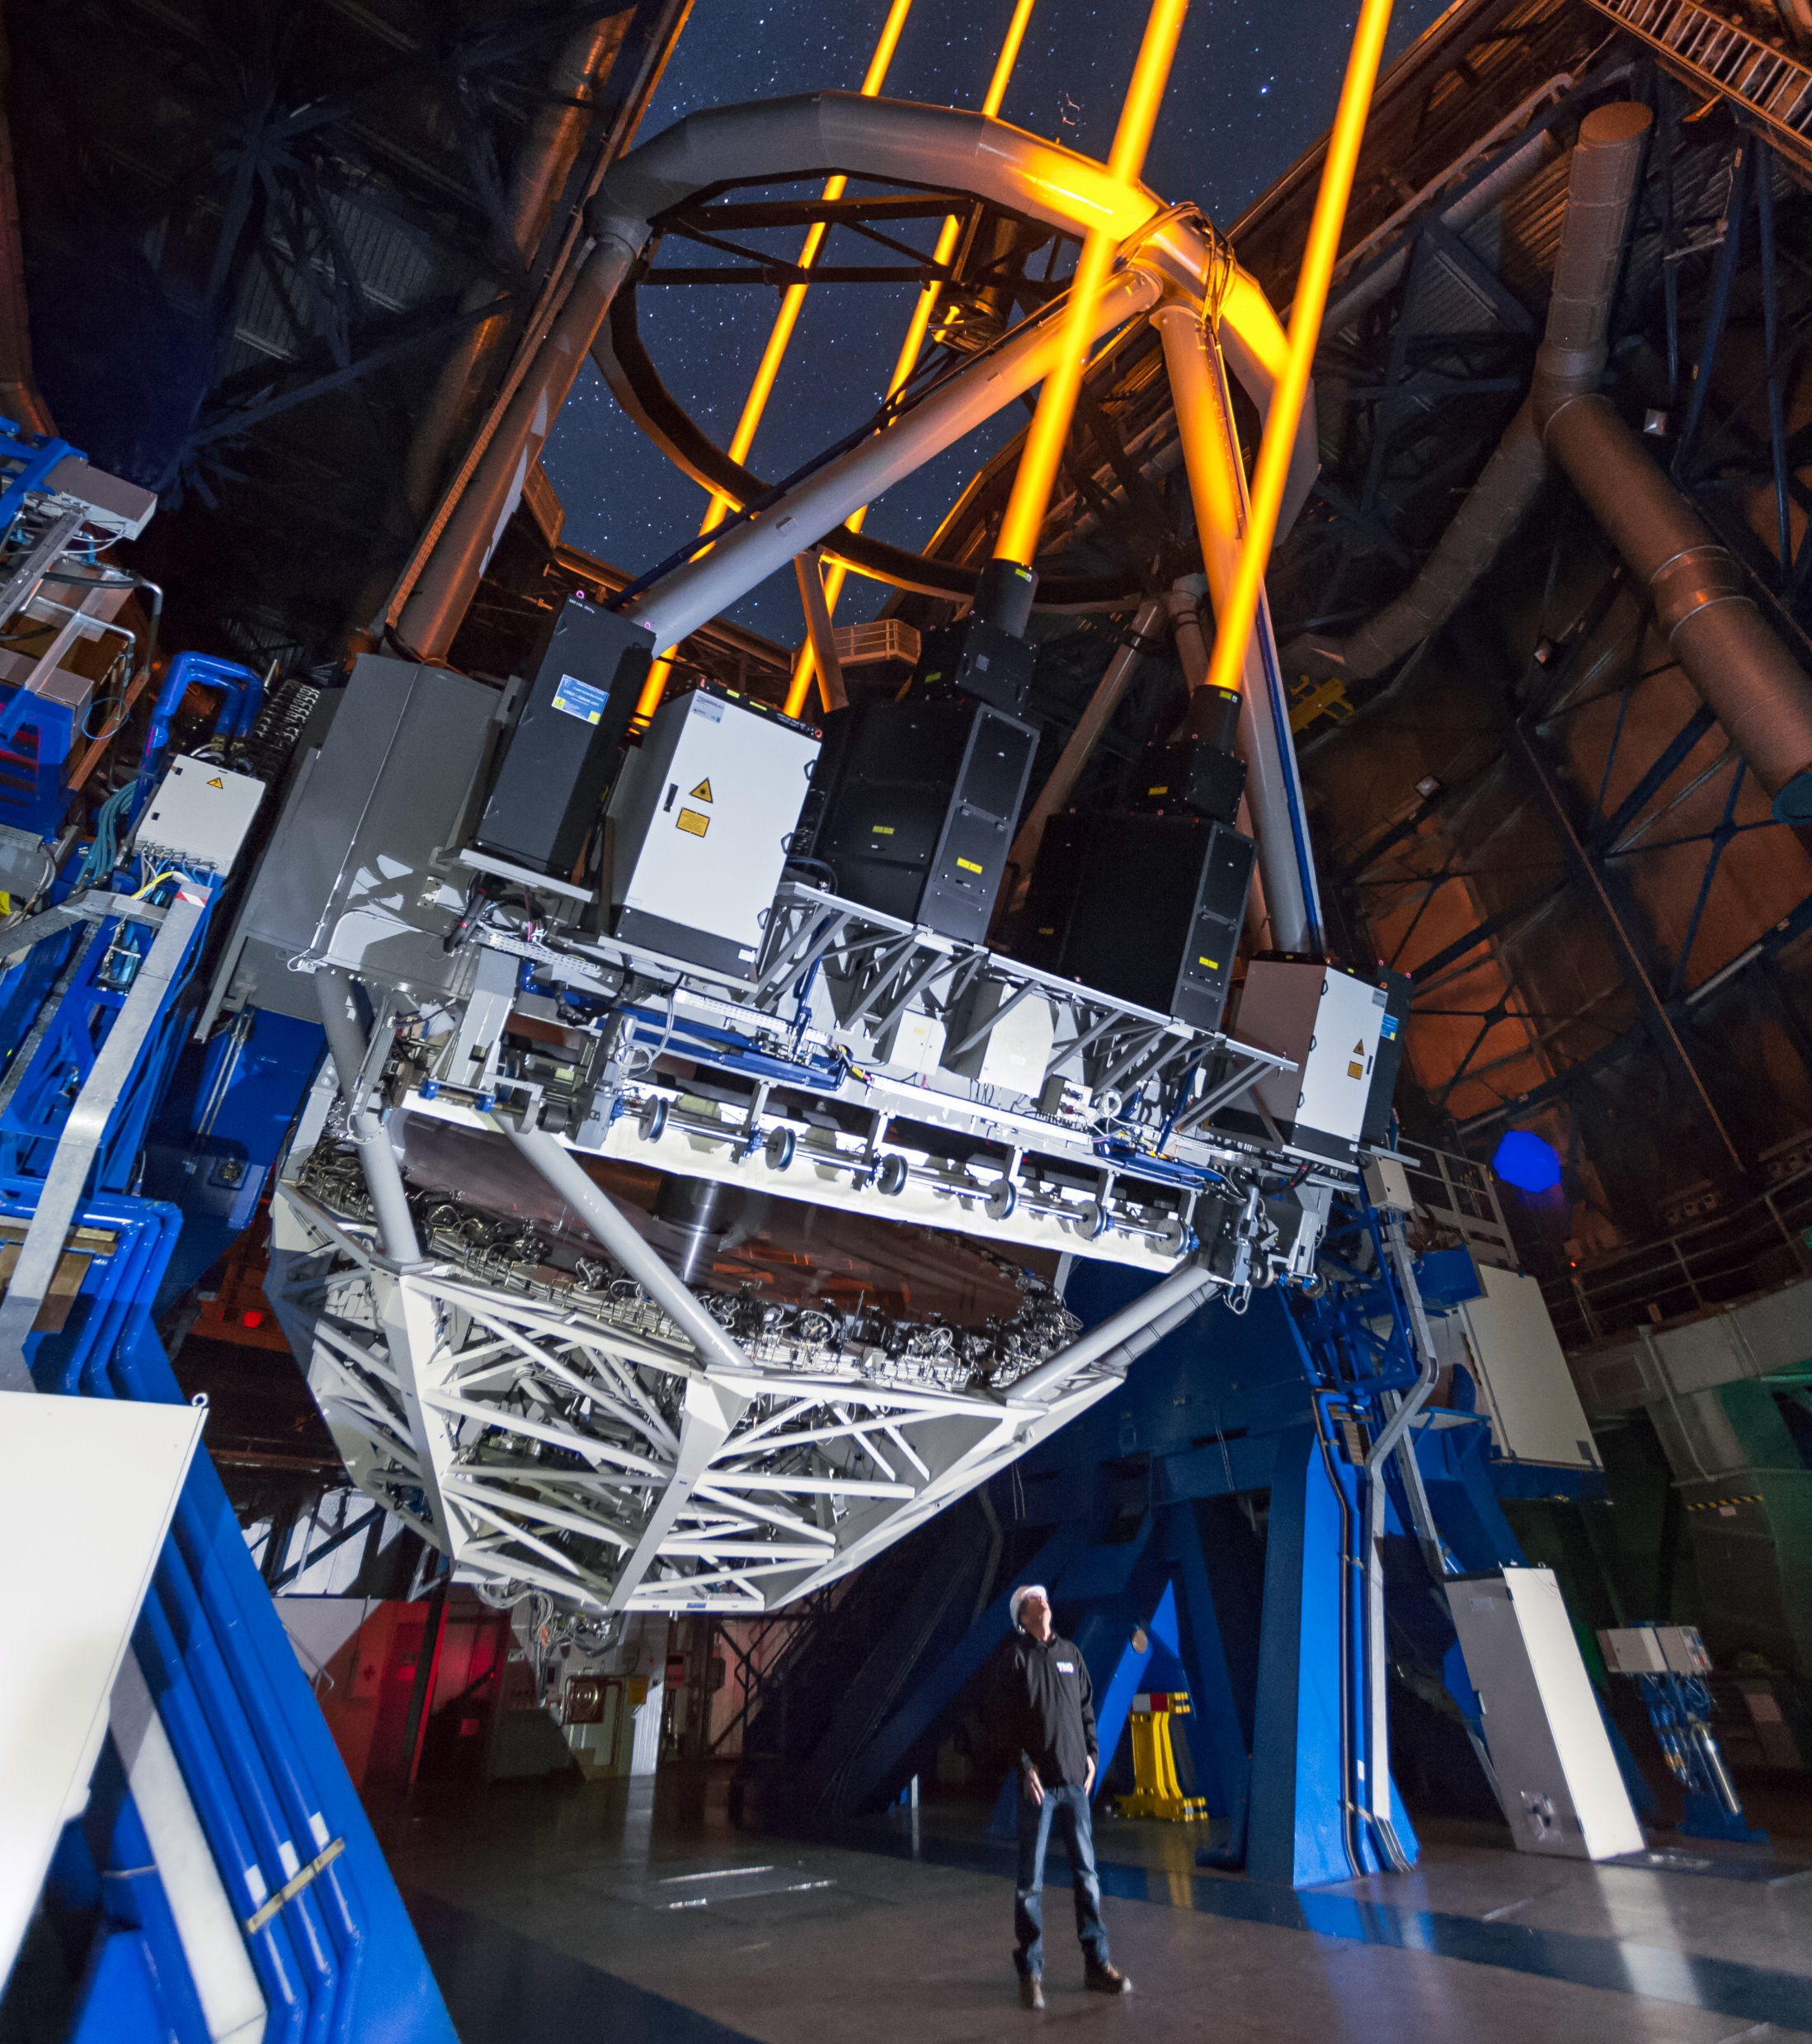
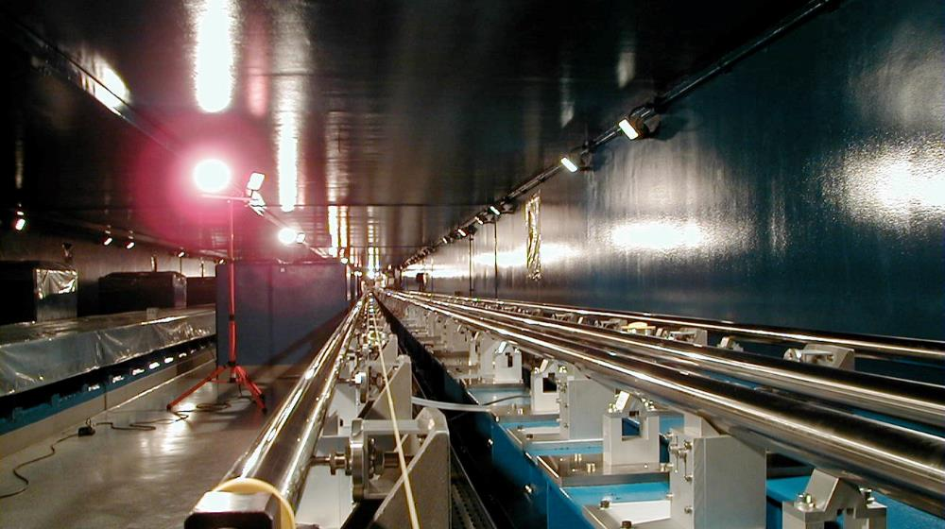
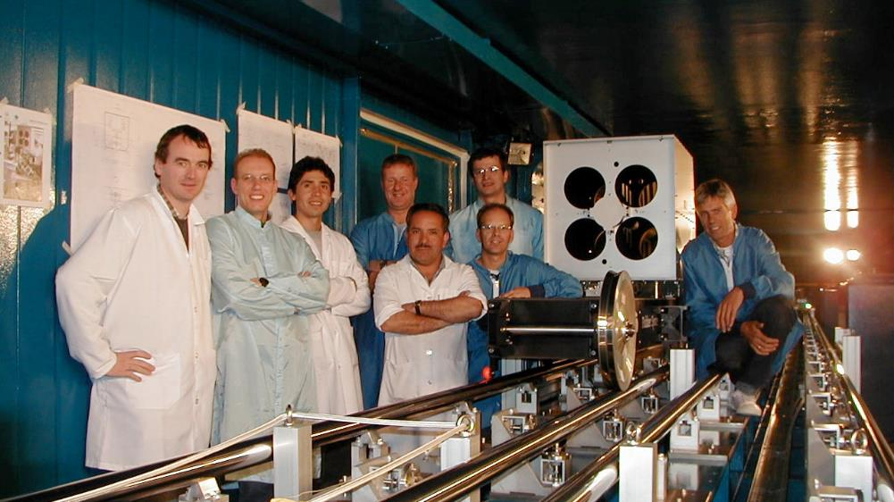
Inside the VLT…
Credit: ESO/F. Kamphues
…and the VLTI

Slide 22
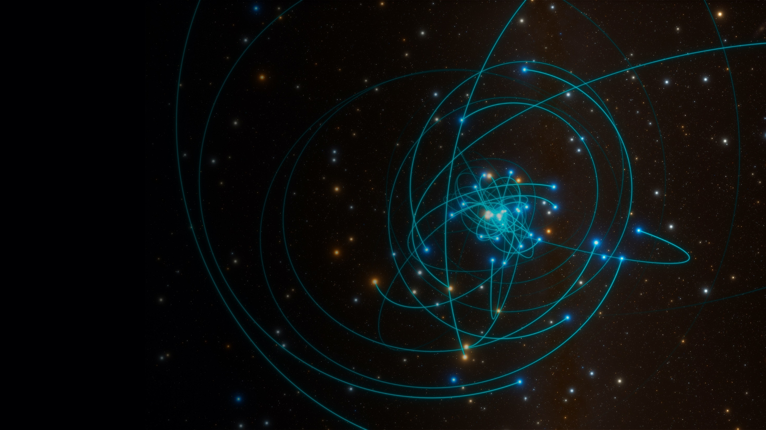
Paranal Observatory science highlights
Credit: ESO/L. Calçada/spaceengine.org
Discovery of a supermassive
black hole at the centre of the
Milky Way – our galaxy
Awarded the Nobel Prize
in Physics 2020
Notes:
https://www.eso.org/public/news/eso2017/

Slide 23
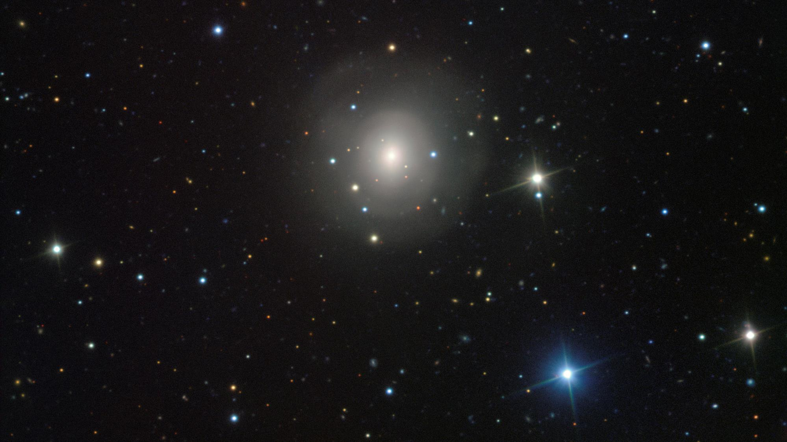
Credit: ESO/A.J. Levan, N.R. Tanvir
First light from a gravitational wave event
ESO’s fleet of telescopes characterised the first visible counterpart of a gravitational wave source. These historic observations helped reveal that this unique object is the result of the merger of two neutron stars
Notes:
Background image: VIMOS image of galaxy NGC 4993 showing the visible-light counterpart to a merging neutron star pair https://www.eso.org/public/news/eso1733/

Slide 24
First image of an exoplanet
revealed in adaptive optics assisted VLT observations
Notes:
Background image: The brown dwarf object 2M1207 and GPCC https://www.eso.org/public/news/eso0428/

Slide 25
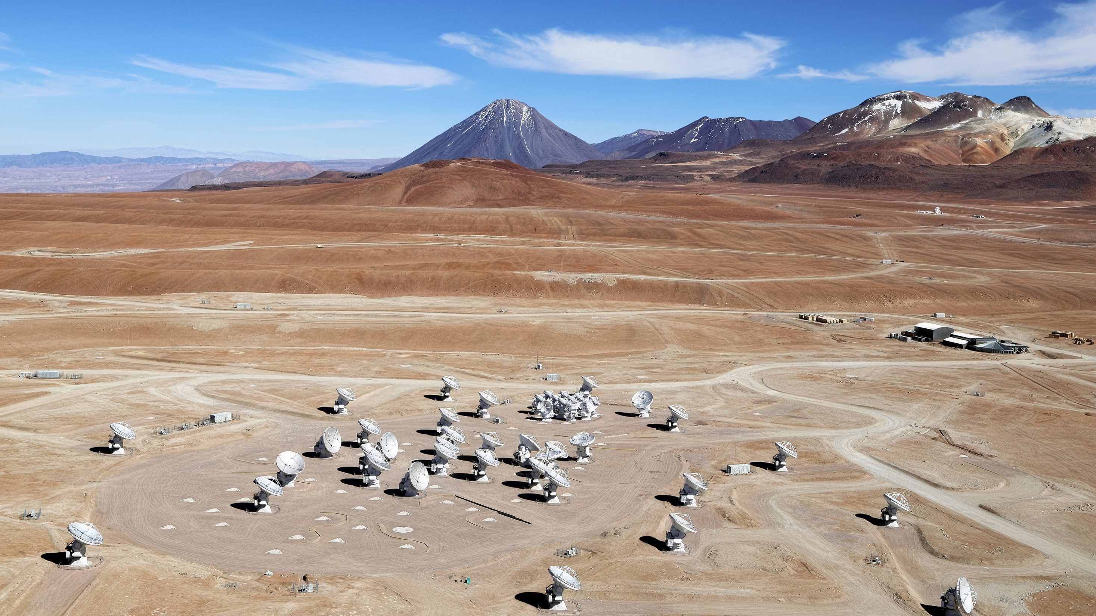
ALMA —
the Atacama Large Millimeter/submillimeter Array
Credit: Clem & Adri Bacri-Normier (wingsforscience.com)/ESO

Slide 26
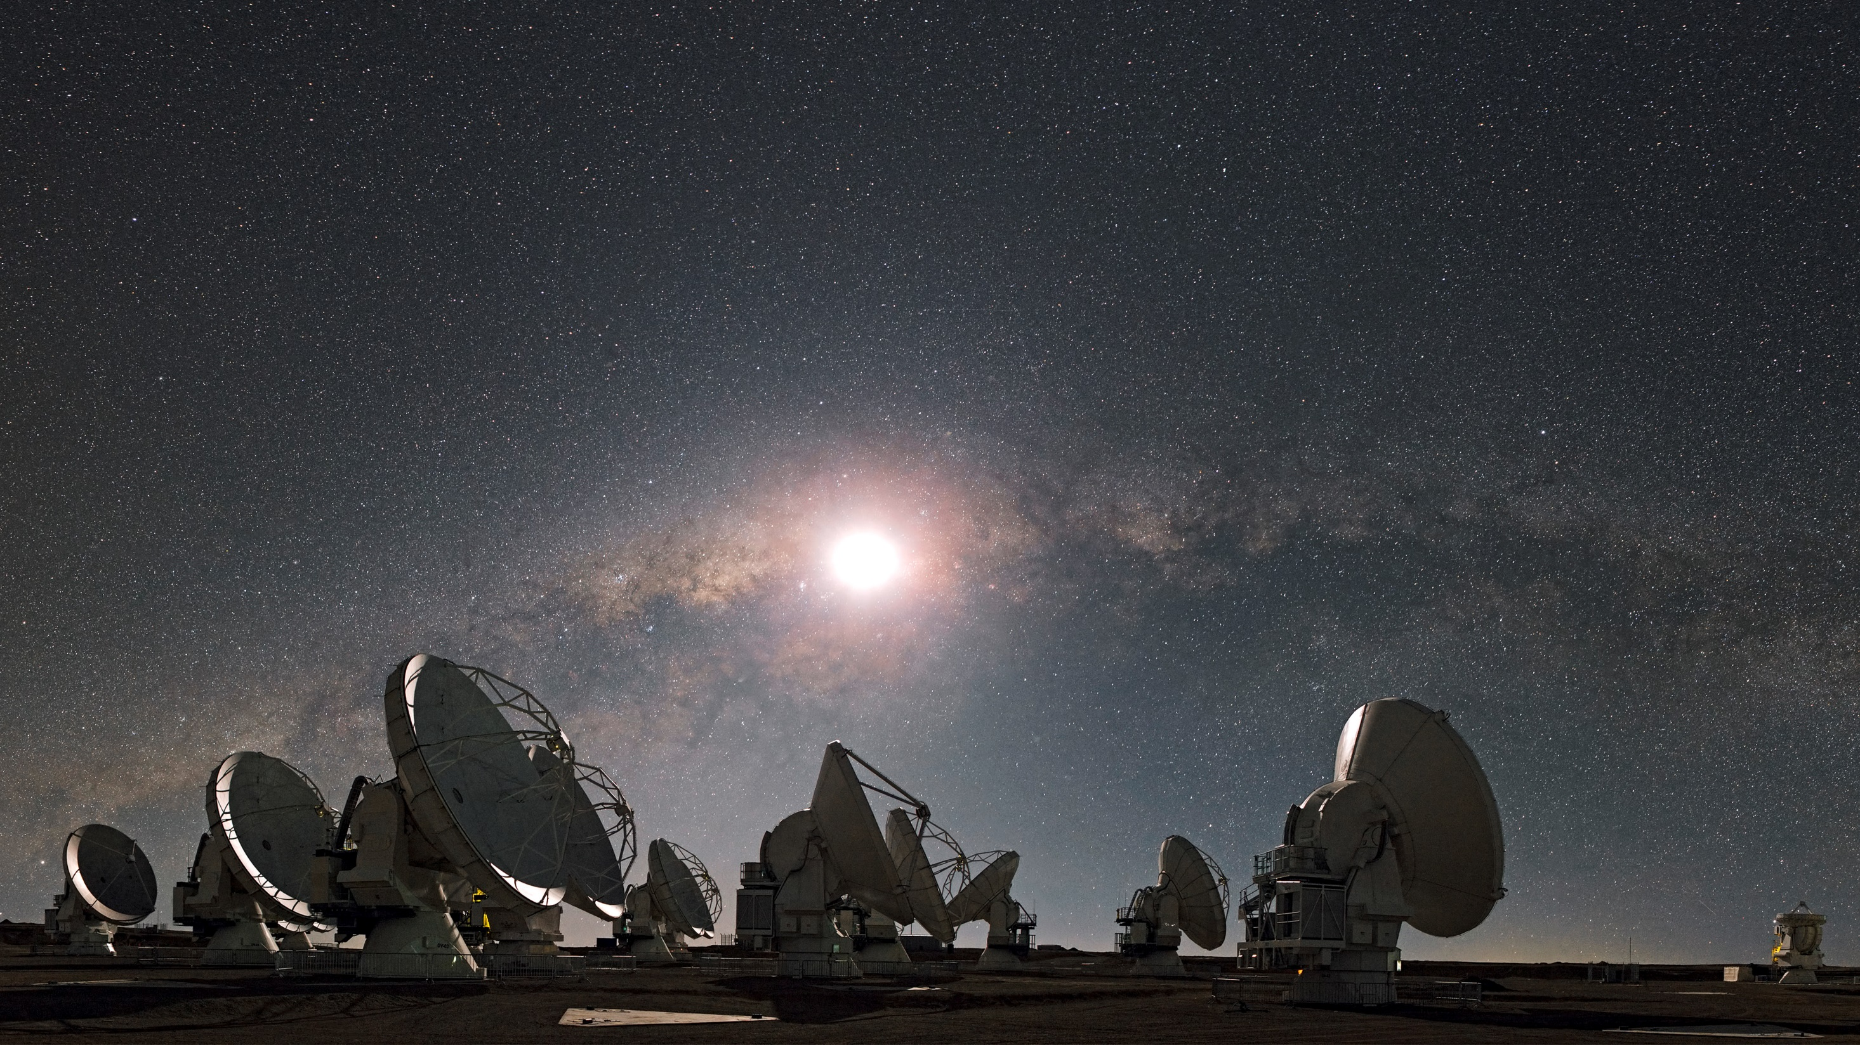
The ALMA telescope is a global partnership between the scientific communities of East Asia, ESO and North America together with Chile
Credit: ESO/S. Guisard (www.eso.org/~sguisard)

Slide 27
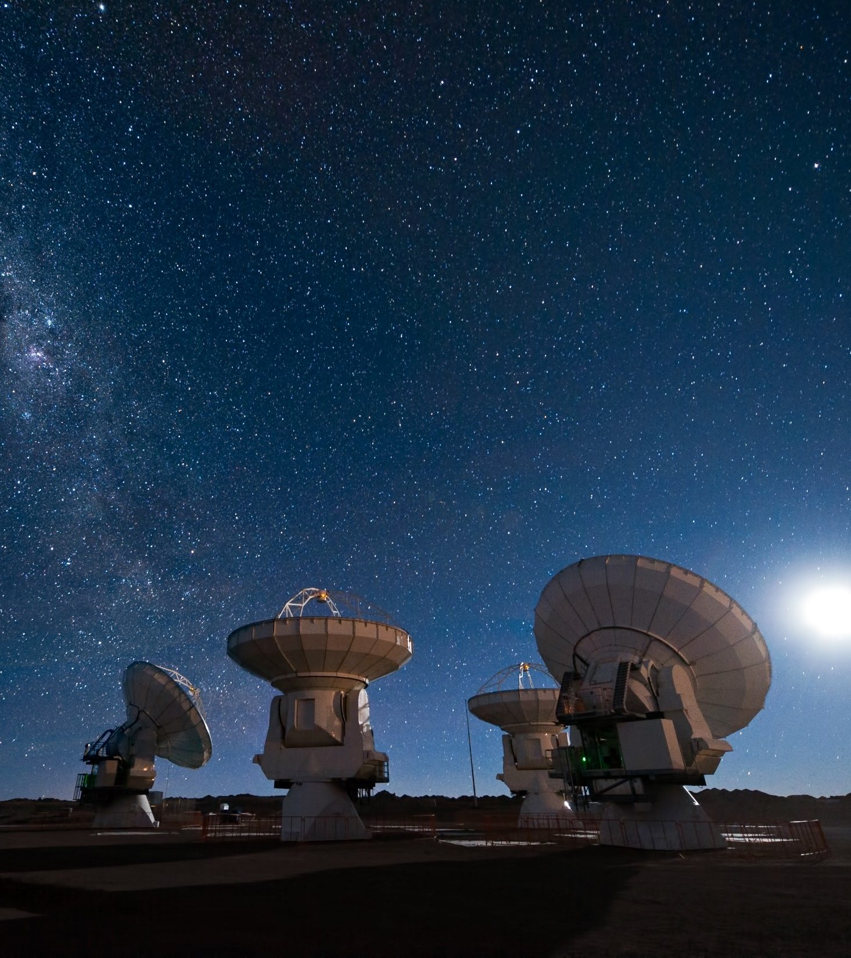
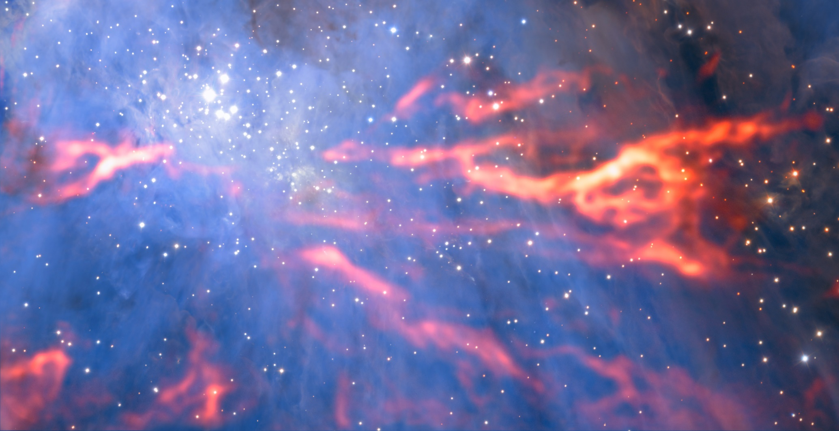
ALMA
is the most powerful telescope for observing the cool Universe — molecular gas and dust — as well as the distant Universe.
Credit: ESO/José Francisco Salgado (josefrancisco.org)
Credit: ESO/H. Drass/ALMA (ESO/NAOJ/NRAO)/A. Hacar
Notes:
Background image: Orion nebula https://www.eso.org/public/news/eso1809/

Slide 28
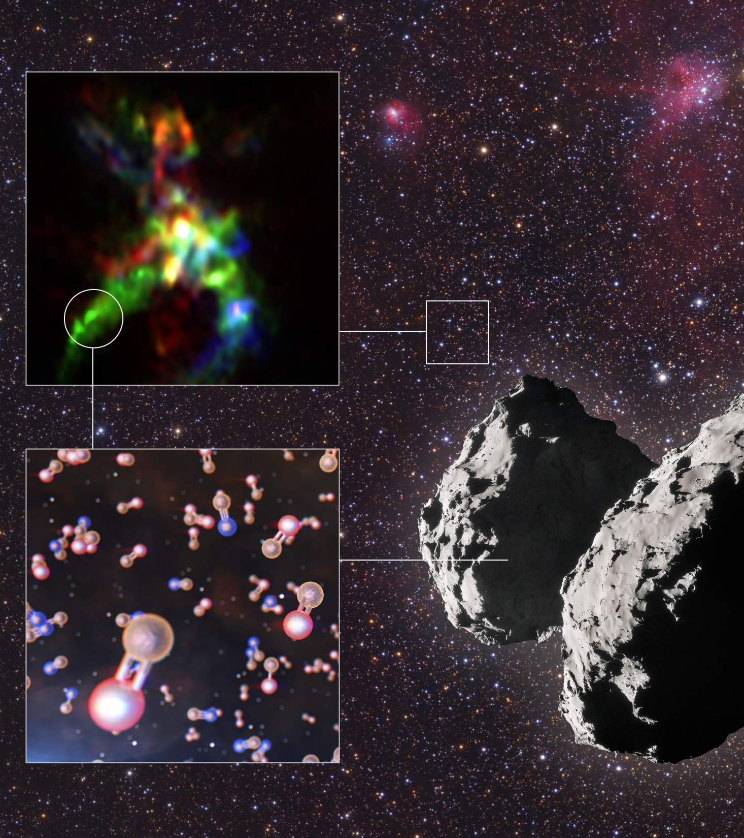
ALMA
is studying the building blocks of stars, planetary systems, galaxies and life itself.​
Credit: ALMA (ESO/NAOJ/NRAO), Rivilla et al.; ESO/L. Calçada; ESA/Rosetta/NAVCAM; Mario Weigand, www.SkyTrip.de
Thanks to ALMA, astronomers could pinpoint where phosphorus-bearing molecules form in a star-forming region and comet 67P.
Notes:
Background images: Phosphorus-bearing molecules found in a star-forming region and comet 67P/Churyumov–Gerasimenko https://www.eso.org/public/news/eso2001/

Slide 29
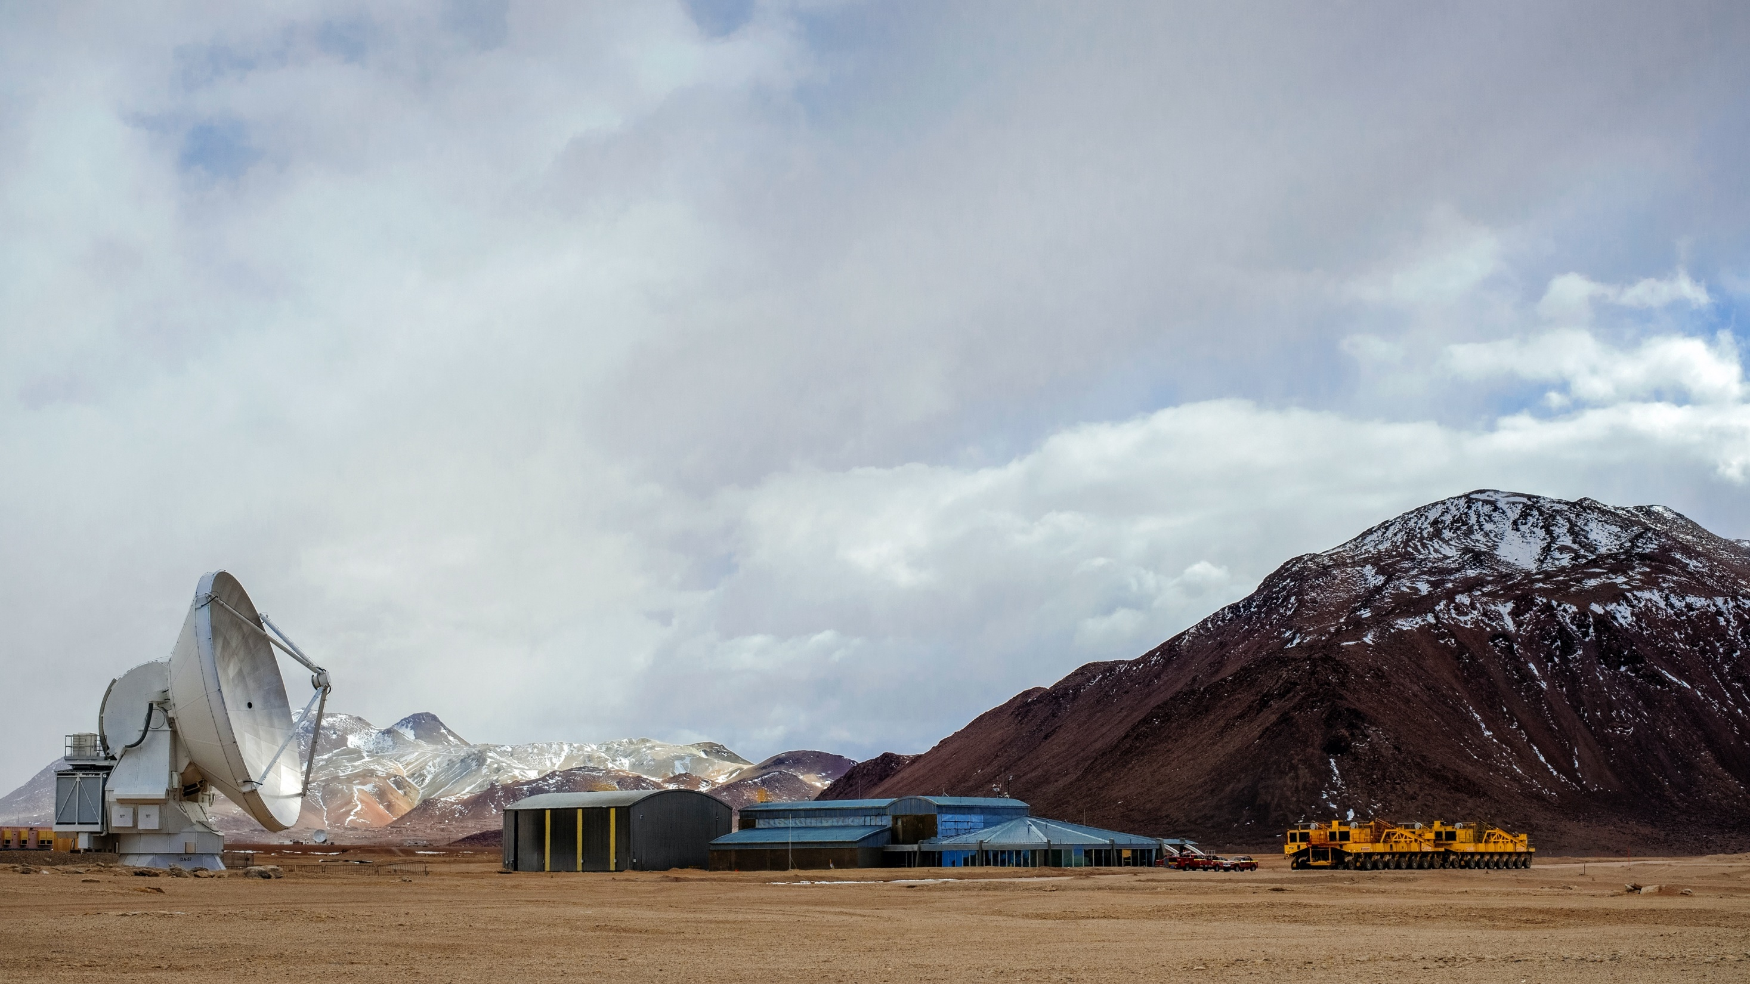
Array Operations Site in Chajnantor (5050 m): ​
66 movable antennas, over a 16-km plateau,​
receivers, back-end and correlator
Credit: ESO/S. Otarola

Slide 30
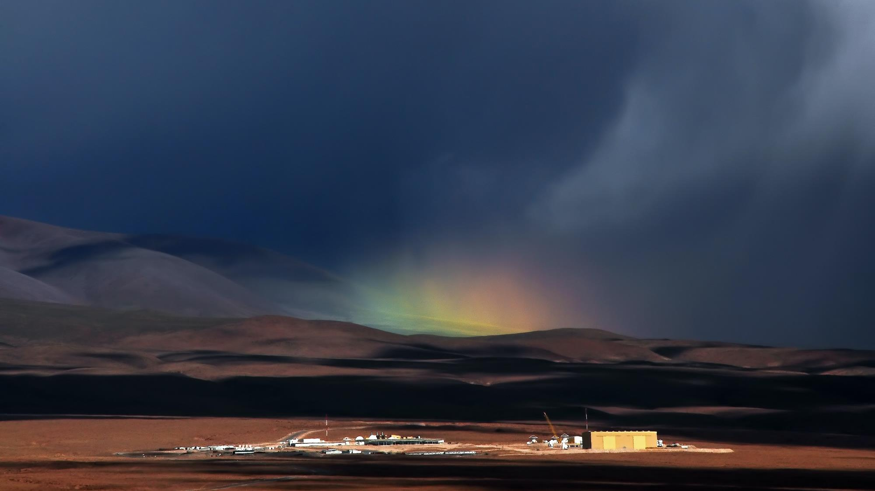
Operations:
Support Facility at 3000 m, near San Pedro de Atacama​
Regional Support Centres in Europe, North America and East Asia​
Credit: ESO/A. Silber

Slide 31
ALMA science highlights
Credit: EHT Collaboration
The first image of the shadow of the M87 black hole
ALMA’s & APEX’s crucial contribution to the Event Horizon Telescope (EHT):
Full EHT (left) and without ALMA and APEX (right)
Notes:
Background image: ALMA & APEX's Crucial Contribution to the EHT https://www.eso.org/public/images/eso1907t/

Slide 32
Planet formation
Credit: ALMA (ESO/NAOJ/NRAO)
ALMA image of the protoplanetary disc around the star HL Tauri
Notes:
Background image: protoplanetary disc around HL Tauri https://www.eso.org/public/news/eso1436/

Slide 33
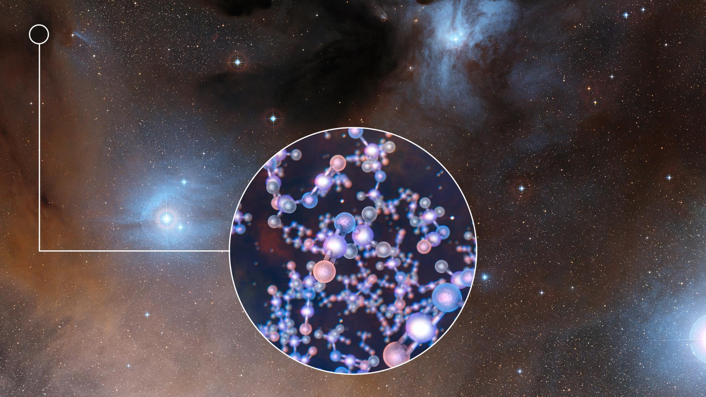
Chemical building blocks of life – prebiotic molecules in space
Credit: ESO/Digitized Sky Survey 2/L. Calçada
ALMA detects methyl isocyanate around young Sun-like stars
Notes:
Background image: Artist impression https://www.eso.org/public/news/eso1718/

Slide 34
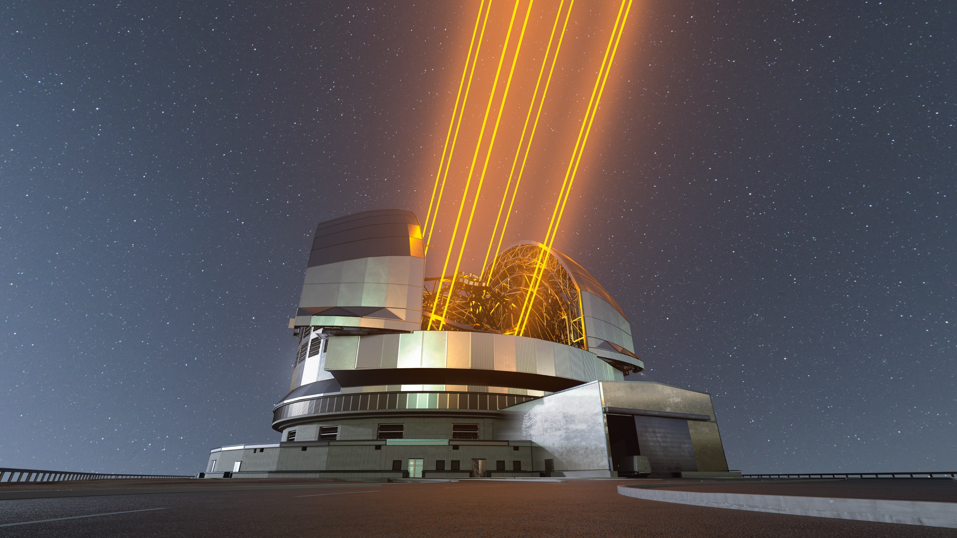
ESO’s Extremely Large Telescope (ELT)
Credit: ESO/L. Calçada

Slide 35
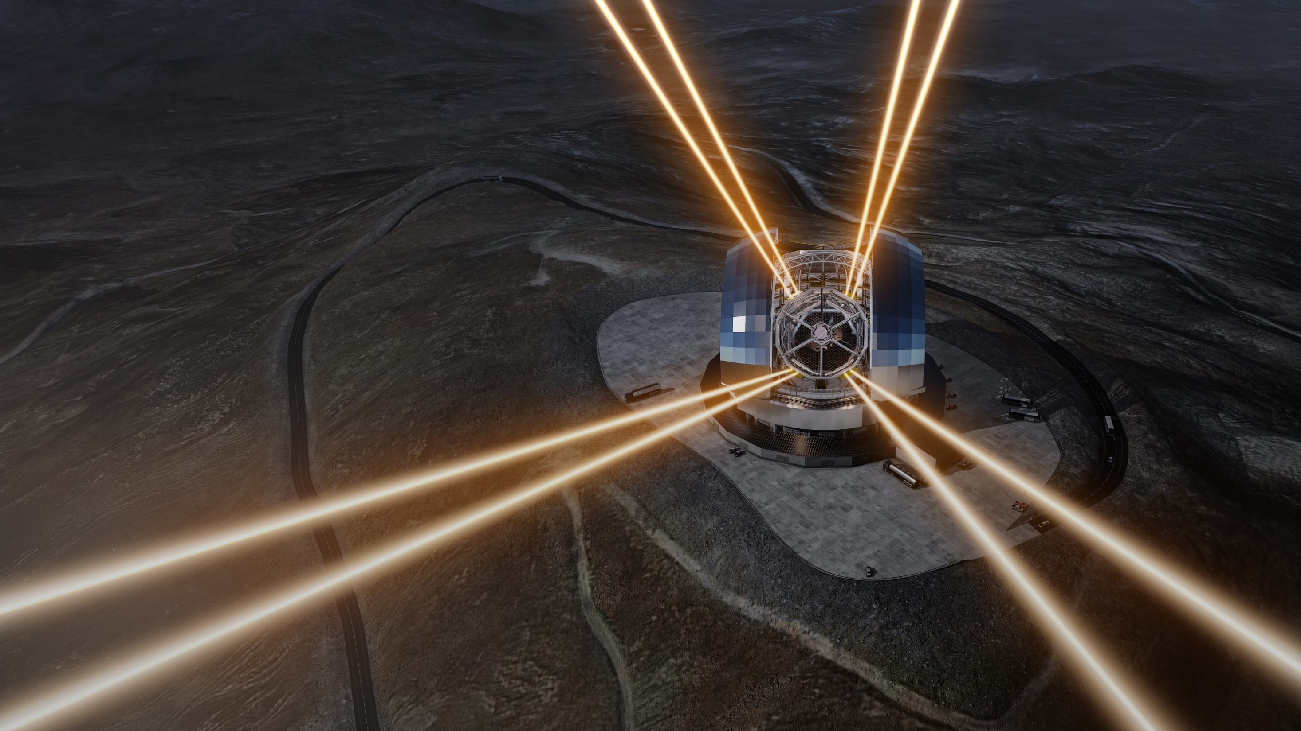
“With the ELT we’re going to see things that were impossible to see before. We’re going to see things and we’re going to be surprised!”
Credit: ESO/L. Calçada
Didier Queloz, Nobel Prize Laureate,
Professor at the Universities of Cambridge, UK, ETH Zurich, and Geneva, Switzerland

Slide 36
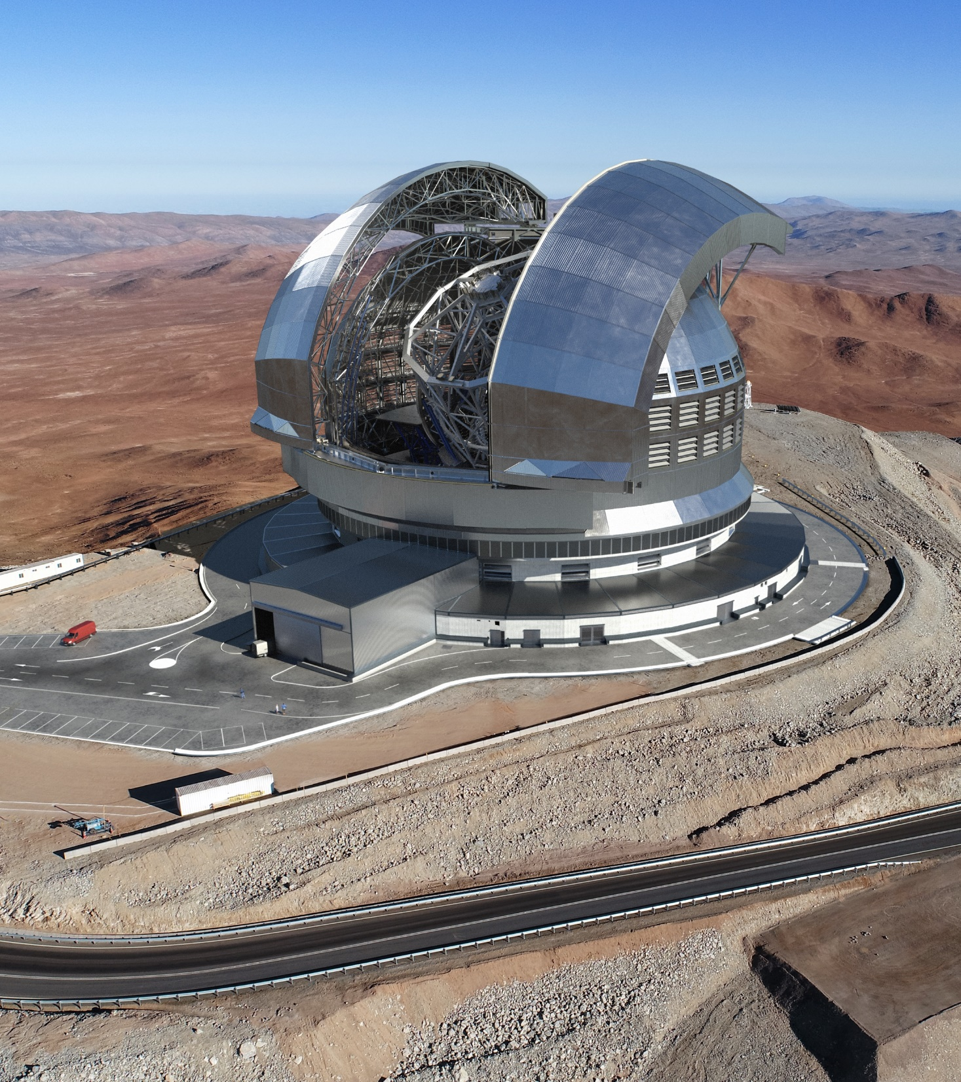
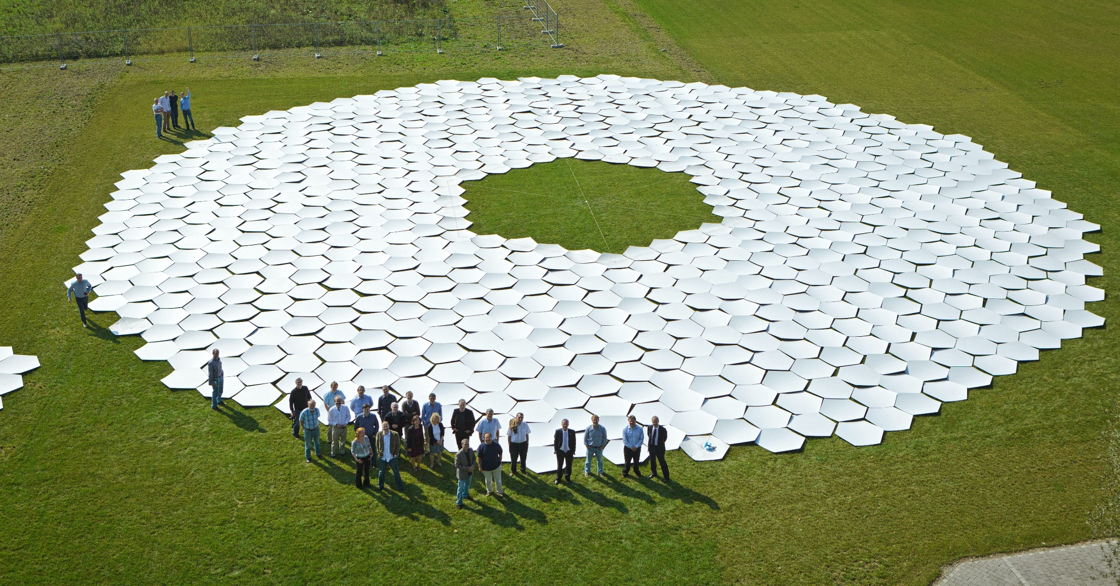
The ELT
will be the largest optical/infrared telescope in the world

Slide 37
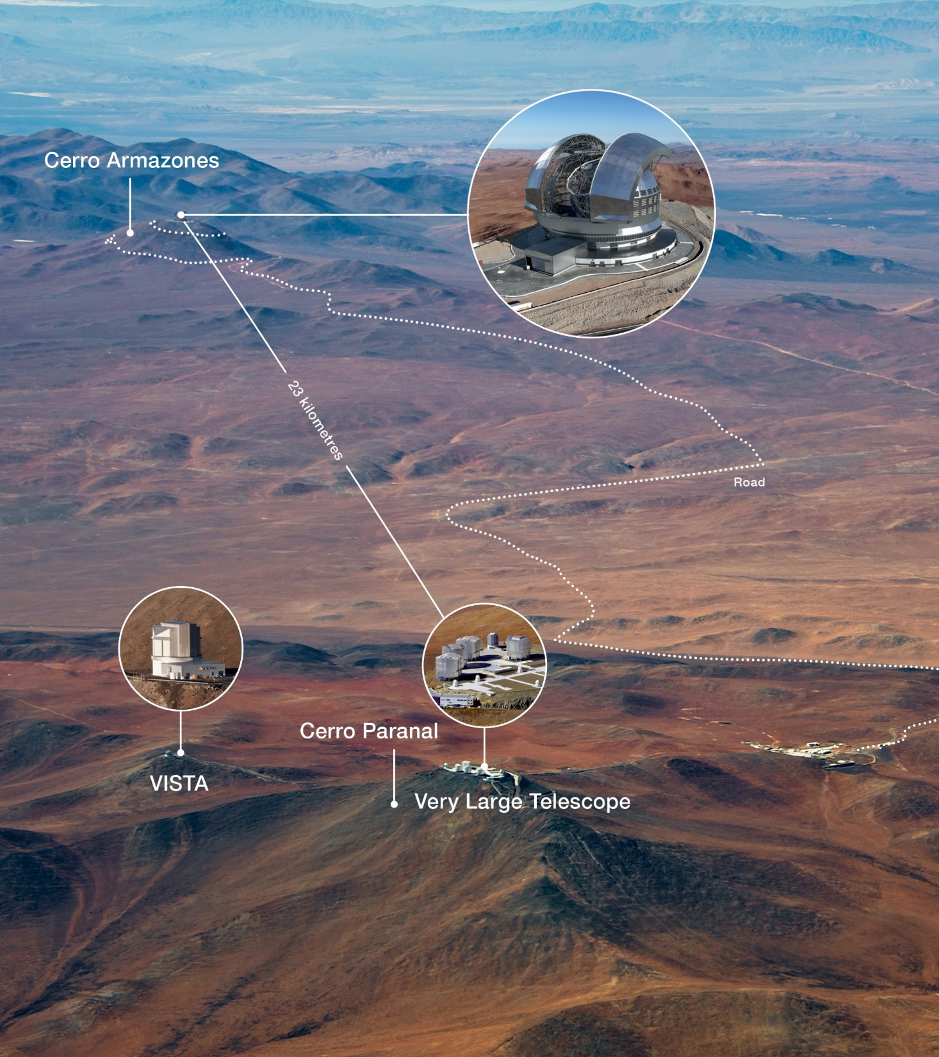
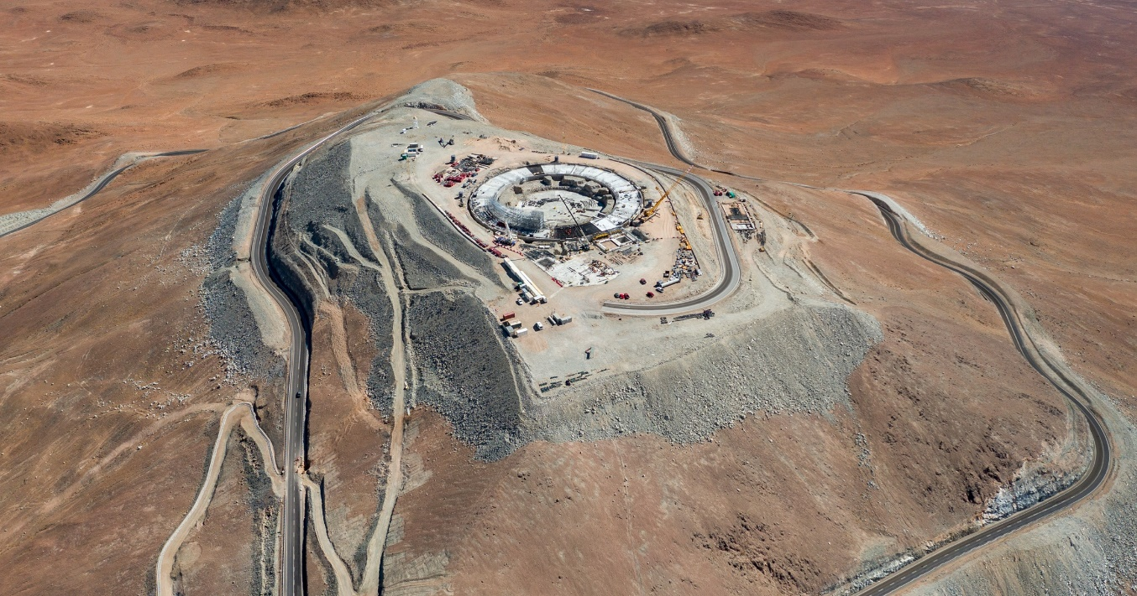
The ELT
is being built on Cerro Armazones in the Chilean Atacama Desert, at 3046 metres altitude and just 23 kilometres from the site of ESO’s Very Large Telescope (VLT) at Paranal.
Credit: ESO/M. Tarenghi
Credit: G. Hüdepohl (atacamaphoto.com)/ESO

Slide 38
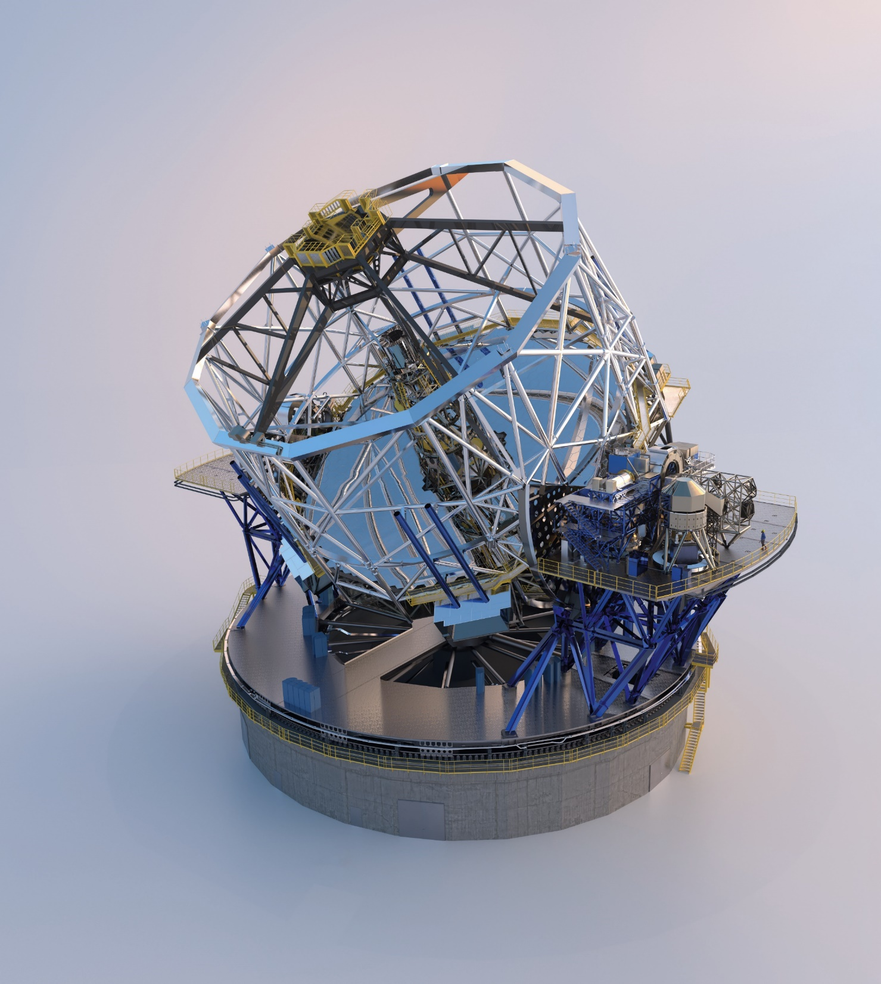
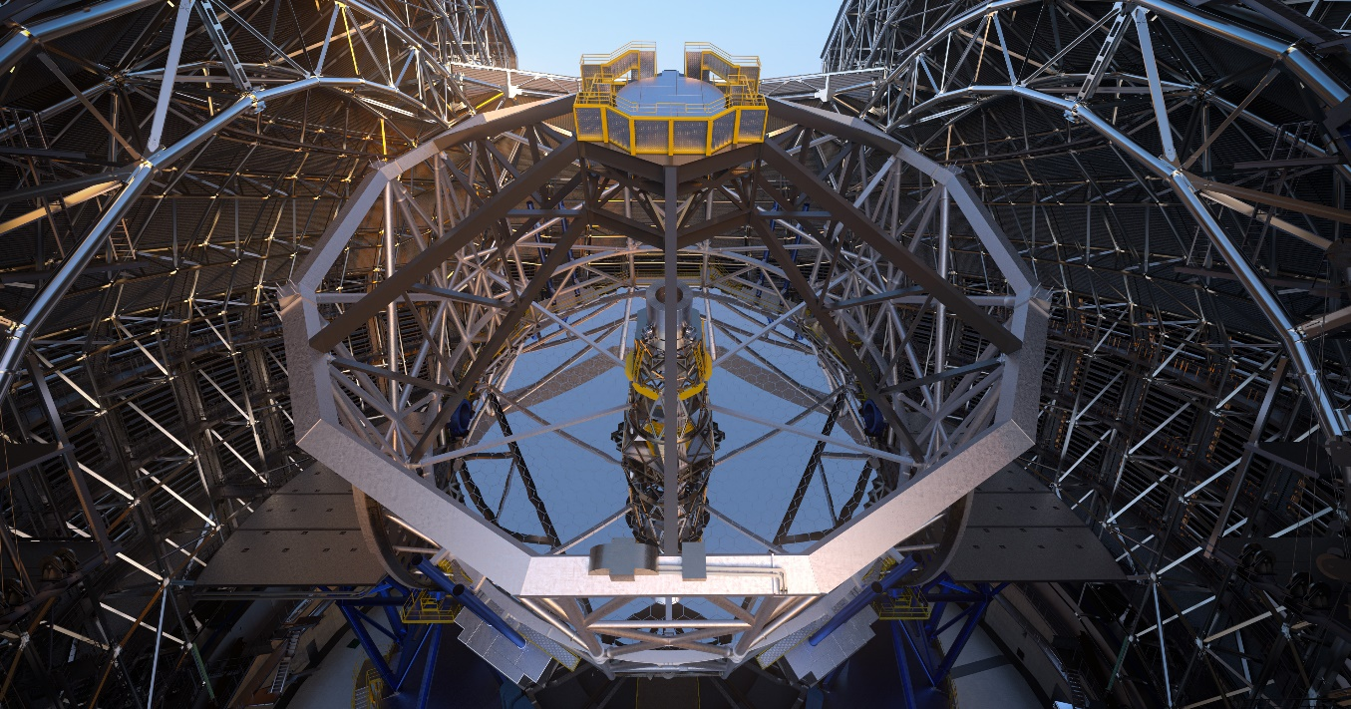
The ELT
it will have a 39.3-metre segmented primary mirror with adaptive optics​.
2
4
5
1
3
Five-mirror design:
1. Main mirror 39.3 metres diameter
2. Secondary mirror: largest secondary (and largest convex) mirror ever produced
3. Tertiary mirror
4. Adaptive fourth mirror
5. Rapid tip-tilt fifth mirror

Slide 39
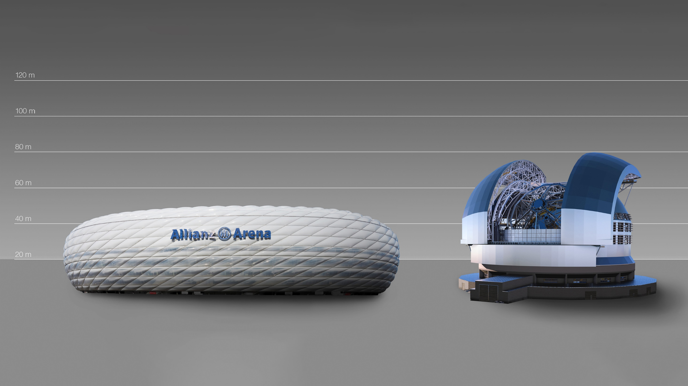
How extremely large is the ELT?
Credit: ESO/L. Calçada

Slide 40
How extremely large is the ELT?

Slide 41
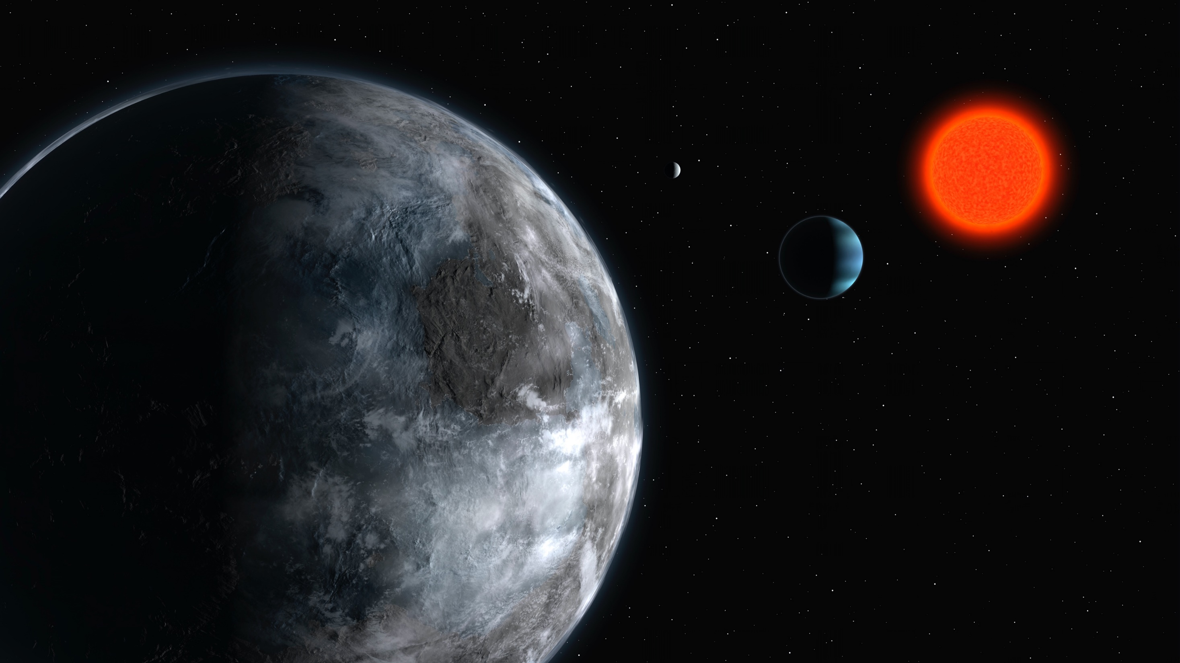
Science with the ELT
The ELT will tackle the biggest scientific challenges of our time, and will aim for a number of notable firsts, including tracking down Earth-like planets around other stars in the habitable zones where life could exist.
Notes:
Background image: Artist impression The planetary system in Gliese 581 https://www.eso.org/public/news/eso0722/

Slide 42
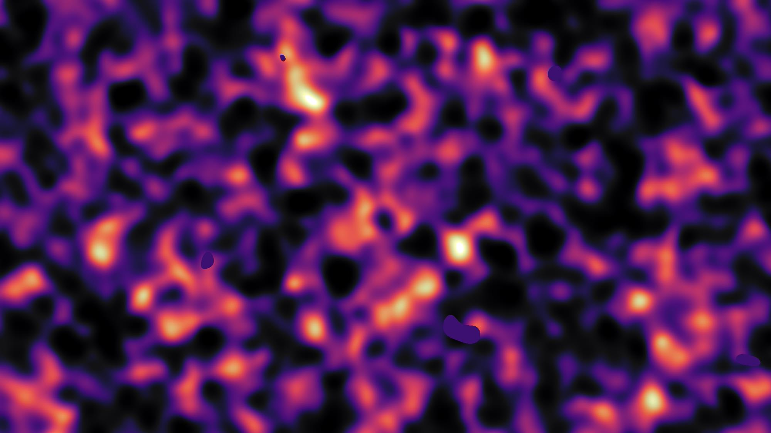
It will also make fundamental contributions to cosmology by probing the nature of dark matter and dark energy
Credit: Kilo-Degree Survey Collaboration/H. Hildebrandt & B. Giblin/ESO
Notes:
Background image: Dark matter map of KiDS survey https://www.eso.org/public/news/eso1642/

Slide 43
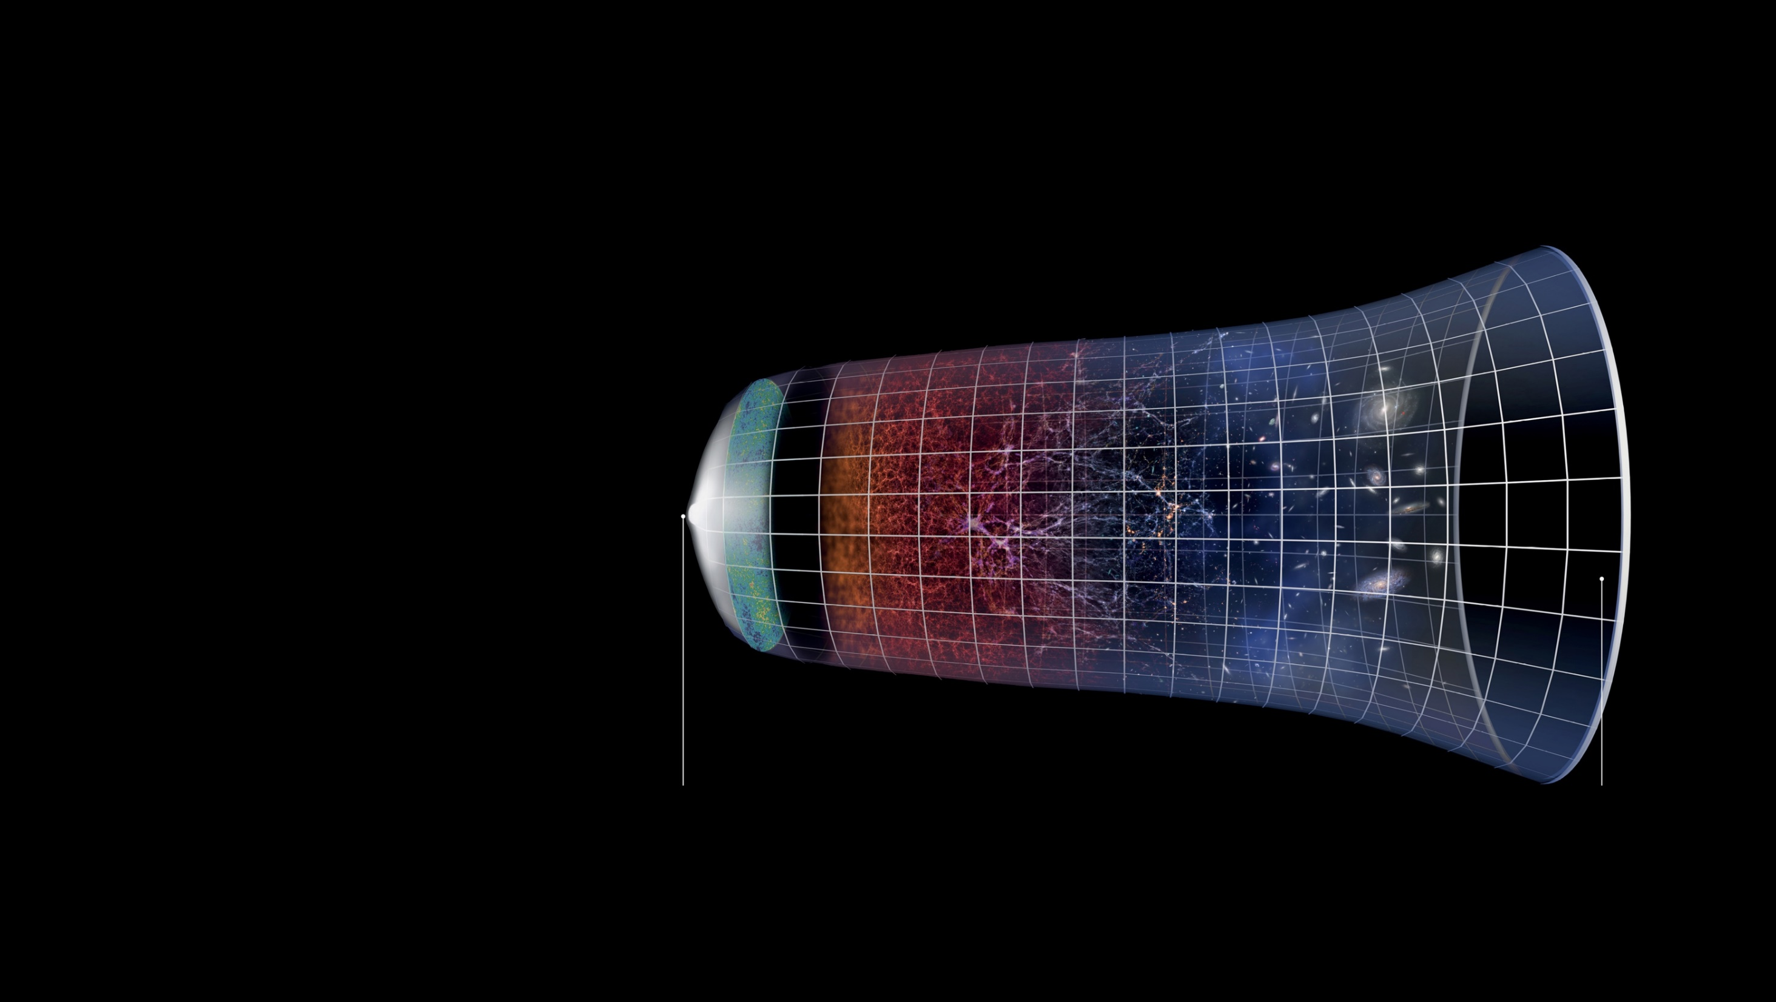
Other key science areas include the study of stars in our galaxy and beyond, black holes, the evolution of distant galaxies, up to the very first galaxies in the earliest epoch of the Universe
Credit: ESO/M. Kornmesser
Big Bang
Present Day

Slide 44
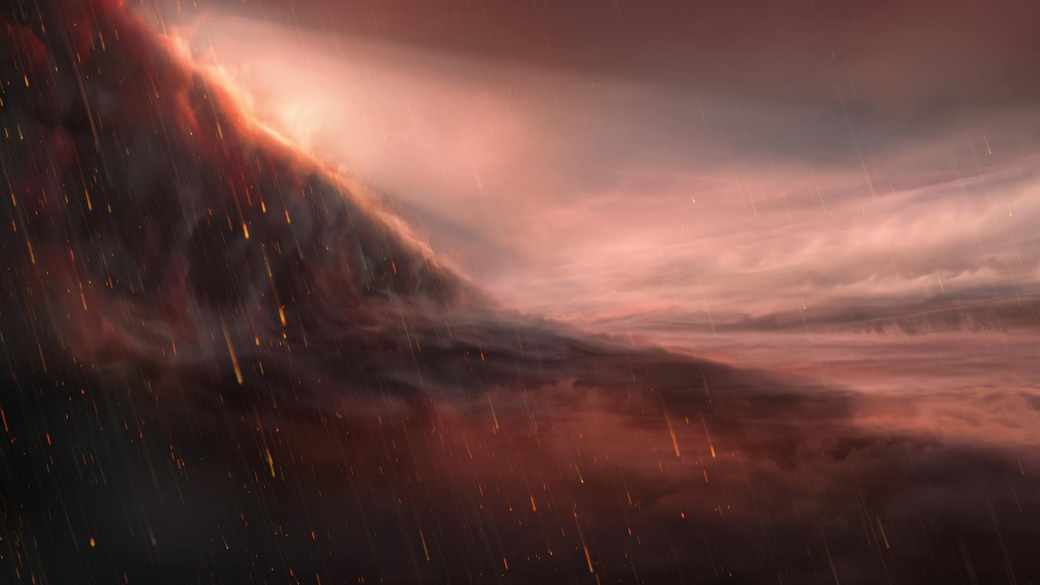
Credit: ESO/M. Kornmesser
And discoveries that nobody has ever even thought about
Notes:
Background image: Artist impression of the night side of WASP-76 b https://www.eso.org/public/news/eso2005/

Slide 45
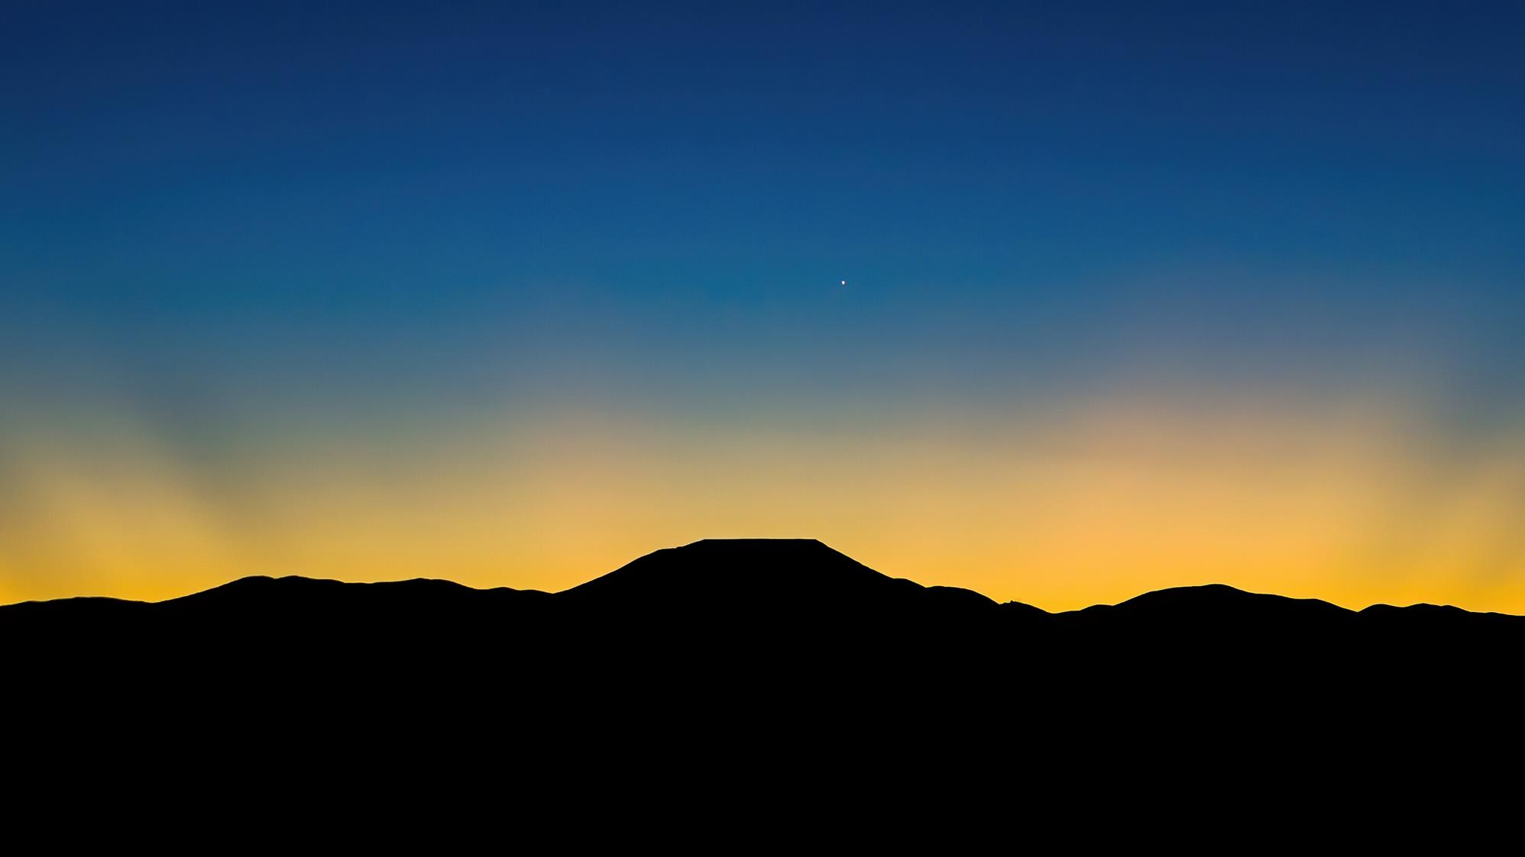
“I’m hoping that with ESO’s ELT we will be able to understand what our place in the Universe is in concrete terms – maybe finding the answer to whether we’re alone in the Universe.”
Credit: G. Hüdepohl (atacamaphoto.com)/ESO
Amina Helmi, ESO Council Member,
Professor at Kapteyn Astronomical Institute, the Netherlands

Slide 46
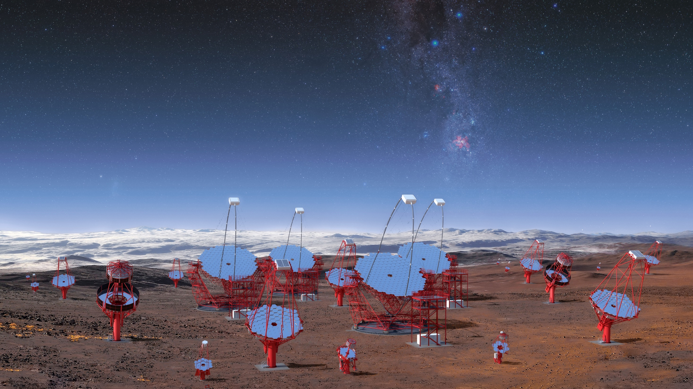
Cherenkov Telescope Array – South (CTA-S)
Credit: CTA/M-A. Besel/IAC (G.P. Diaz)/ESO

Slide 47
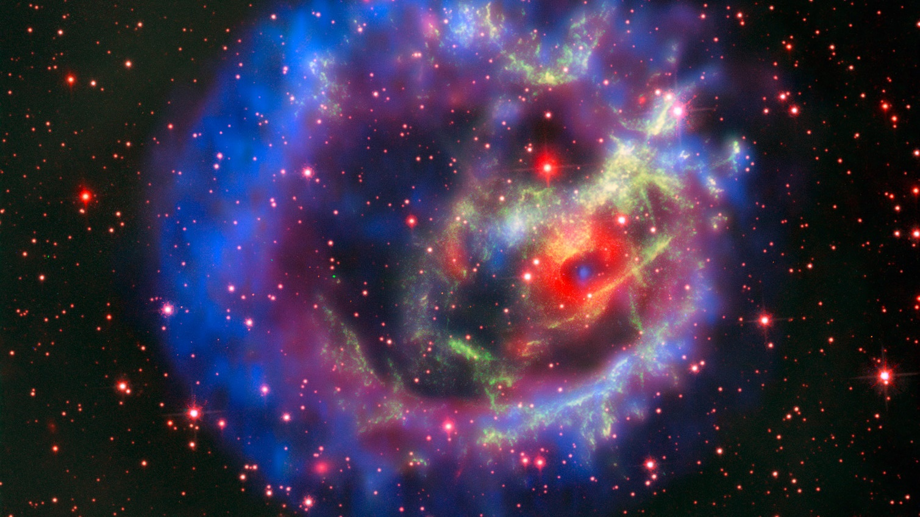
The CTA is a Cherenkov-light telescope that will enable us to observe the most energetic phenomena in the Universe
Credit: ESO/NASA, ESA and the Hubble Heritage Team (STScI/AURA)/F. Vogt et al.. Acknowledgments: Mahdi Zamani
Notes:
Background image: supernova remnant 1E 0102.2-7219 https://www.eso.org/public/news/eso1810/

Slide 48

Credit: CTAO
It will detect gamma rays that reach the earth’s atmosphere and interact with it

Slide 49

CTA will comprise about 70 telescopes spread between two sites in the northern and southern hemispheres
Credit: CTAO

Slide 50

Cerro Armazones
ESO’ ELT
Cherenkov Telescope Array Site
Credit: ESO/CTAO/N. Bartmann
Cerro Paranal
Very Large Telescope
The Southern site, CTA-S,
will be located in the vicinity of ESO's Paranal Observatory

Slide 51

It will be hosted and operated by ESO,
an 8 % partner in the CTA Observatory.
Credit: ESO/P. Horálek
This partnership will generate important operational and scientific synergies.

Slide 52

Credit: ESO/H.H.Heyer
ESO Science Archive Facility –
open data for open science

Slide 53

ESO Science Archive Facility
Astronomy is an example of open/shared data.
        Open data from all ESO telescopes
The SAF contains raw, processed, and advanced data products for scientists worldwide to use
More than 3.5 million processed data sets
archive.eso.org

Slide 54

Credit: ESO/M. Kornmesser/S. Guisard (www.eso.org/~sguisard)
ESO telescopes help uncover the largest group of rogue planets yet
Notes:
Background image: Artist impression

Slide 55
ESO premises

Slide 56

ESO Headquarters in Germany
ESO’s science, administration and technology centre is located in Garching, near Munich, where
450 people work on site

Slide 57

ESO Headquarters in Germany
Home of ESO’s Integration Hall, the Science Archive Facility, and ESO Supernova Visitor Centre & Planetarium
Credit: E. Graf/ESO

Slide 58

ESO’s integration hall
The main laboratory where many instruments are built and prepared before being installed on ESO's telescopes in Chile
Credit: Aldo Amoretti, San Remo

Slide 59

ESO office in Vitacura, Santiago, Chile
ESO’s hub for science and technology in Chile
Credit: ESO & ALMA (ESO/NAOJ/NRAO)

Slide 60

ESO Residencia at Paranal Observatory
Credit: ESO/G.Hüdepohl (atacamaphoto.com)
An oasis in the Atacama desert, providing shelter from the harsh conditions to 150 people daily

Slide 61

Credit: ESO/José Francisco Salgado (josefrancisco.org)
The Residencia houses a 1000-m² indoor garden and 35-m-wide dome for natural daylight

