Slide 1

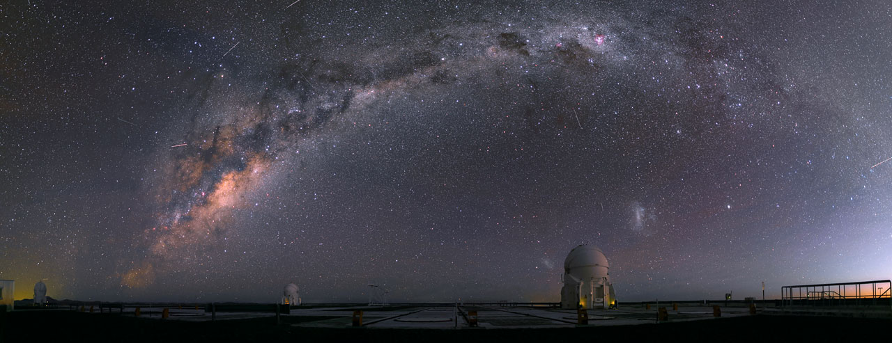
Interacting Binaries
STEPS – 8 July 2015
The Interferometric View
Henri M.J. Boffin
© R.Wesson

Slide 2
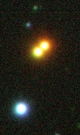
Angular Resolution: Visual binary
8-m VLT
Seeing-limited
Closest binary BD
1.5” separation 2 pc → 3 AU
0.5”
25 pc → 12.5 AU ~10-20 yr
100 pc → 50 AU ~ 100 yr
1.5 kpc → 450 AU ~ 2000 yr
(massive stars)
Luhman-16 AB
Boffin+ 13 FORS2
0.3”–0.8”

Slide 3
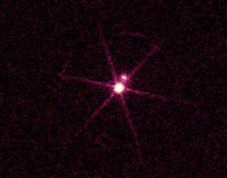
Angular Resolution: Visual binary
8-m VLT
Seeing-limited
HST or AO-limited
Sirius
HST or AO
0.02”-0.05”
Luhman-16 AB
Boffin+ 13 FORS2
0.5”–0.8”
0.05”
25 pc → ~1-2 AU ~1-3 yr
100 pc → ~5 AU ~10 yr
1.5 kpc → 75 AU ~100 yr
(massive stars)

Slide 4
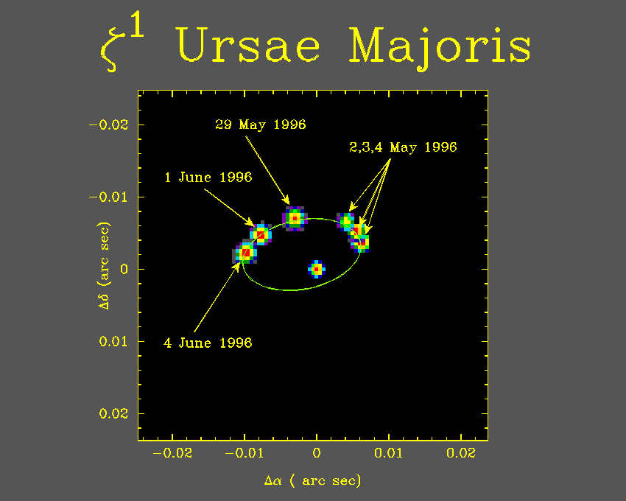
Angular Resolution: Visual binary
8-m VLT
Seeing-limited
HST or AO-limited
Interferometry
Sirius
HST or AO
0.02”–0.05”
Mizar
NPOI (C. Hummel)
~0.001”
Luhman-16 AB
Boffin+ 13 FORS2
0.5”–0.8”
25 pc → a few Rsun ~hr-d
100 pc → 0.1 AU ~ a few d
1.5 kpc → 1.5 AU ~ 0.3 yr
(massive stars)

Slide 5
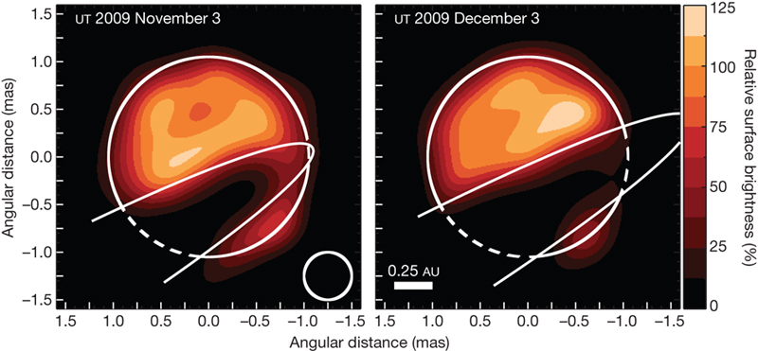
Some examples
ε Aur
β Lyr
Zhao+ 2008
V838 Mon
Kloppenborg+ 2010
HR 5171 A
See Stee 2011 for more examples.
Chesneau+ 2014
Chesneau+ 2014
Notes:
Beta Lyr is an eclipsing binary with a Roche lobe filling mass transferring star; Epsilon Aur is an eclipsing binary star with a period of 27 years containing a F supergiant, which is being eclipsed by a disc; V838 Mon is apparently the result of the merging of two stars, while HR 5171A is a yellow hypergiant that is also filling its Roche lobe.

Slide 6
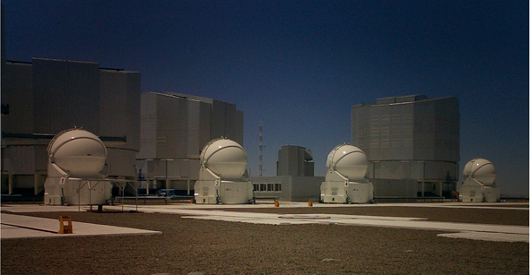
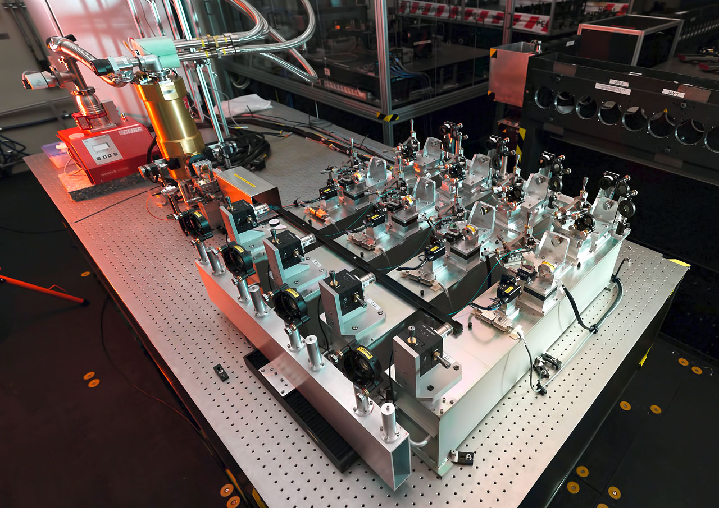
PIONIER at the VLTI
Visibilities on 6 baselines and 4 closure phases simultaneously
Highly efficient (1 point ~ 5-7 min)

Slide 7
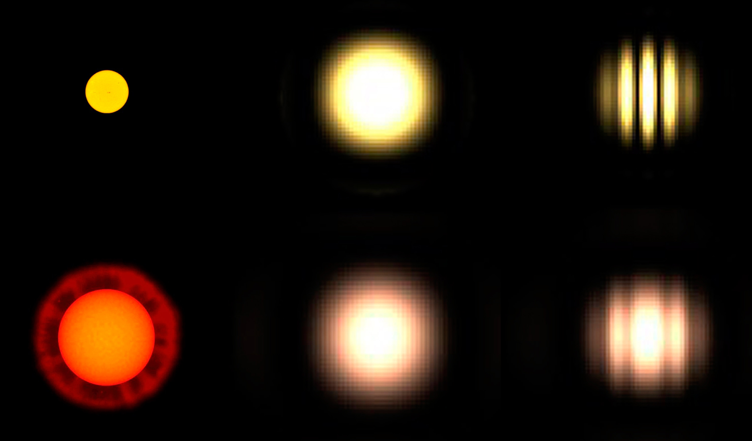
Interferometry: a primer
Visibilities

Slide 8
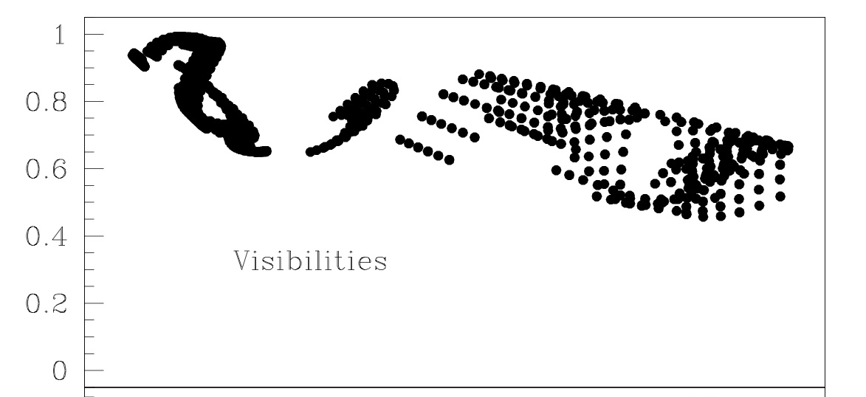
Interferometry: a primer

Slide 9
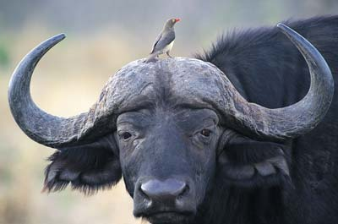
Symbiotic Stars
Symbiotic Star : a cool red giant and a small hot companion seem to live in general harmony
Merrill (1941)
Oxpeckers eat the parasites off of large animals like this African buffalo. But they're also parasites themselves, keeping wounds open and picking at scabs.
Natphotos/Digital Vision/Getty Images
howstuffworks.com

Slide 10
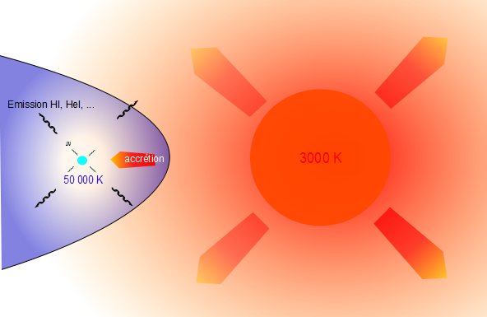
Symbiotic as Binaries
Current accepted model: Symbiotic stars are interacting binaries containing a cool giant (G, K, M) and an accreting hot star (main sequence or white dwarf)

Slide 11
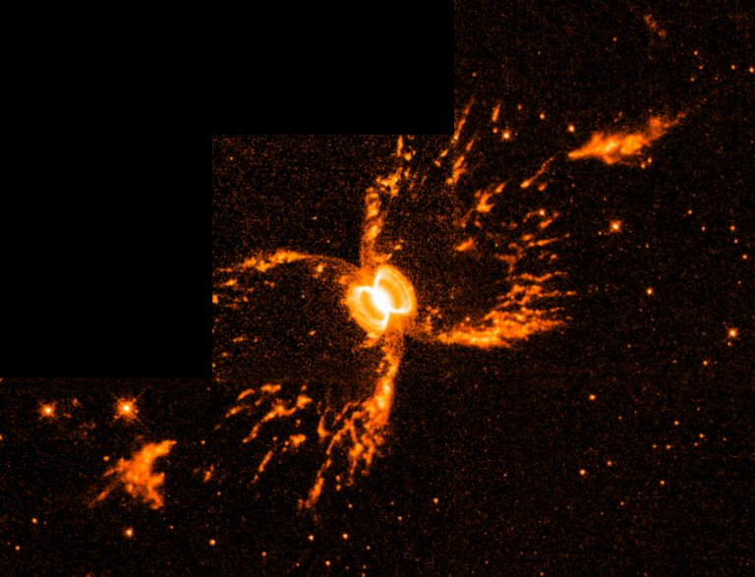
Symbiotic as Binaries
About 40 symbiotic systems with orbital period known
Orbital period: 100 – 1400 d
Giant have larger mass-loss rates than single giants of the same spectral type: why?
What is the origin of the mass transfer?
Notes:
Good systems to study mass transfer are symbiotic stars
Symbiotic stars are interacting binaries in which an evolved red giant - a normal M giant in a S type symbiotic or a Mira in a D-type symbiotic - transfers material to a hot and compact companion.
In most cases the hot star is a WD, but in some cases it is a main sequence star or a neutron star
Symbiotic stars are thus interacting binaries with the longest orbital periods and the largest component separations
They are about 40 symbiotic systems with orbital period known...
Most S-type systems seem to have normal giants, however, all symbiotic giants seem to have higher mass-loss rates than single giants of the same spectral type

Slide 12
Symbiotic as Binaries
About 40 symbiotic systems with orbital period known
Orbital period: 100 – 1400 d
Giant have larger mass-loss rates than single giants of the same spectral type: why?
What is the origin of the mass transfer?
Notes:
Good systems to study mass transfer are symbiotic stars
Symbiotic stars are interacting binaries in which an evolved red giant - a normal M giant in a S type symbiotic or a Mira in a D-type symbiotic - transfers material to a hot and compact companion.
In most cases the hot star is a WD, but in some cases it is a main sequence star or a neutron star
Symbiotic stars are thus interacting binaries with the longest orbital periods and the largest component separations
They are about 40 symbiotic systems with orbital period known...
Most S-type systems seem to have normal giants, however, all symbiotic giants seem to have higher mass-loss rates than single giants of the same spectral type

Slide 13
Symbiotic as Binaries
About 40 symbiotic systems with orbital period known
Orbital period: 100 – 1400 d
Giant have larger mass-loss rates than single giants of the same spectral type: why?
What is the origin of the mass transfer?
Notes:
Good systems to study mass transfer are symbiotic stars
Symbiotic stars are interacting binaries in which an evolved red giant - a normal M giant in a S type symbiotic or a Mira in a D-type symbiotic - transfers material to a hot and compact companion.
In most cases the hot star is a WD, but in some cases it is a main sequence star or a neutron star
Symbiotic stars are thus interacting binaries with the longest orbital periods and the largest component separations
They are about 40 symbiotic systems with orbital period known...
Most S-type systems seem to have normal giants, however, all symbiotic giants seem to have higher mass-loss rates than single giants of the same spectral type

Slide 14
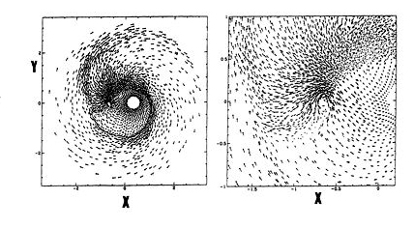
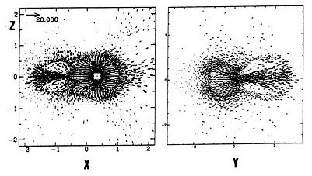
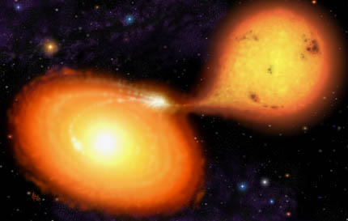
Mass Transfer
Stellar Wind
Theuns & Jorissen 1993; Boffin, Theuns & Jorissen 1994; Theuns, Boffin & Jorissen 1996
Roche lobe overflow

Slide 15
Mass Transfer
Stellar Wind
Theuns & Jorissen 1993; Boffin, Theuns & Jorissen 1994; Theuns, Boffin & Jorissen 1996
To answer, requires measuring the diameter of the red giant in symbiotic stars!
Ideal for interferometry
Roche lobe overflow

Slide 16
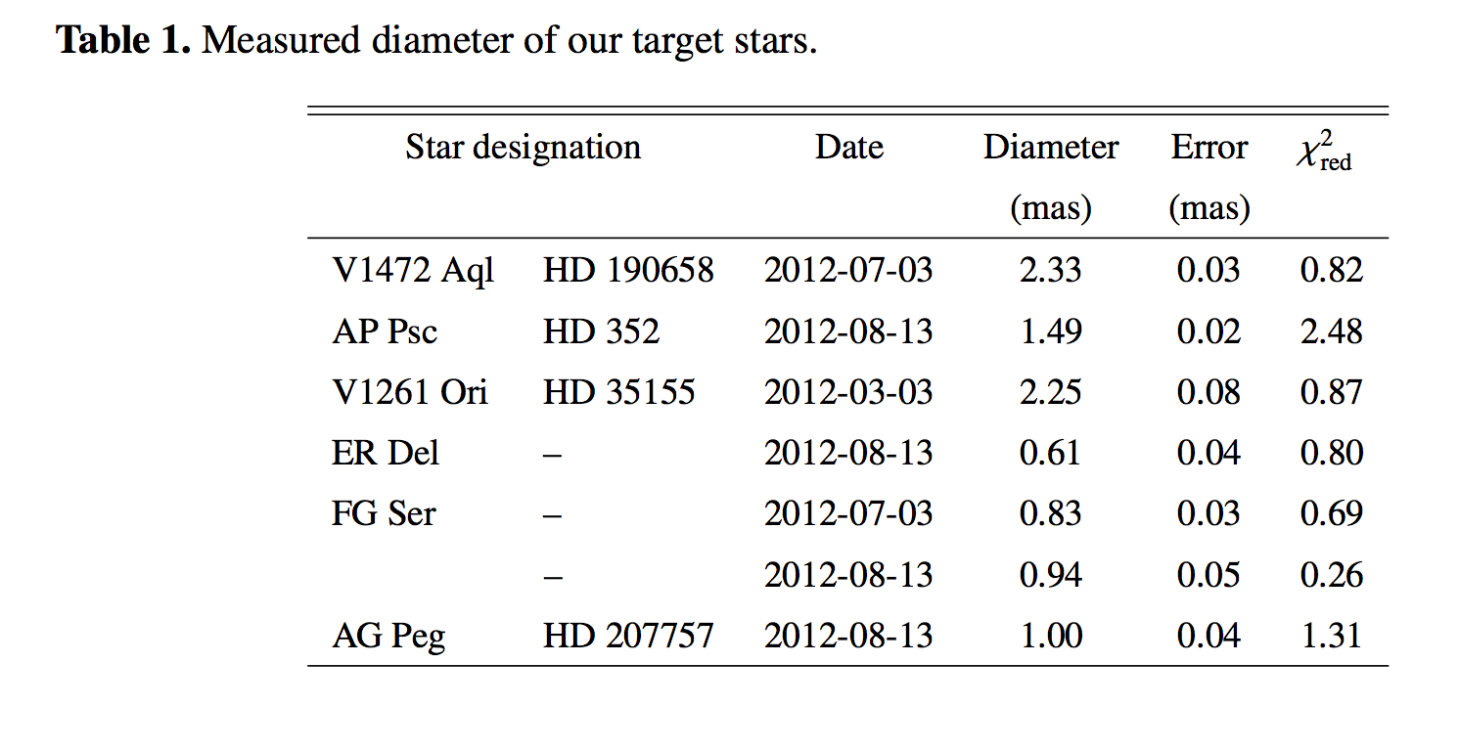
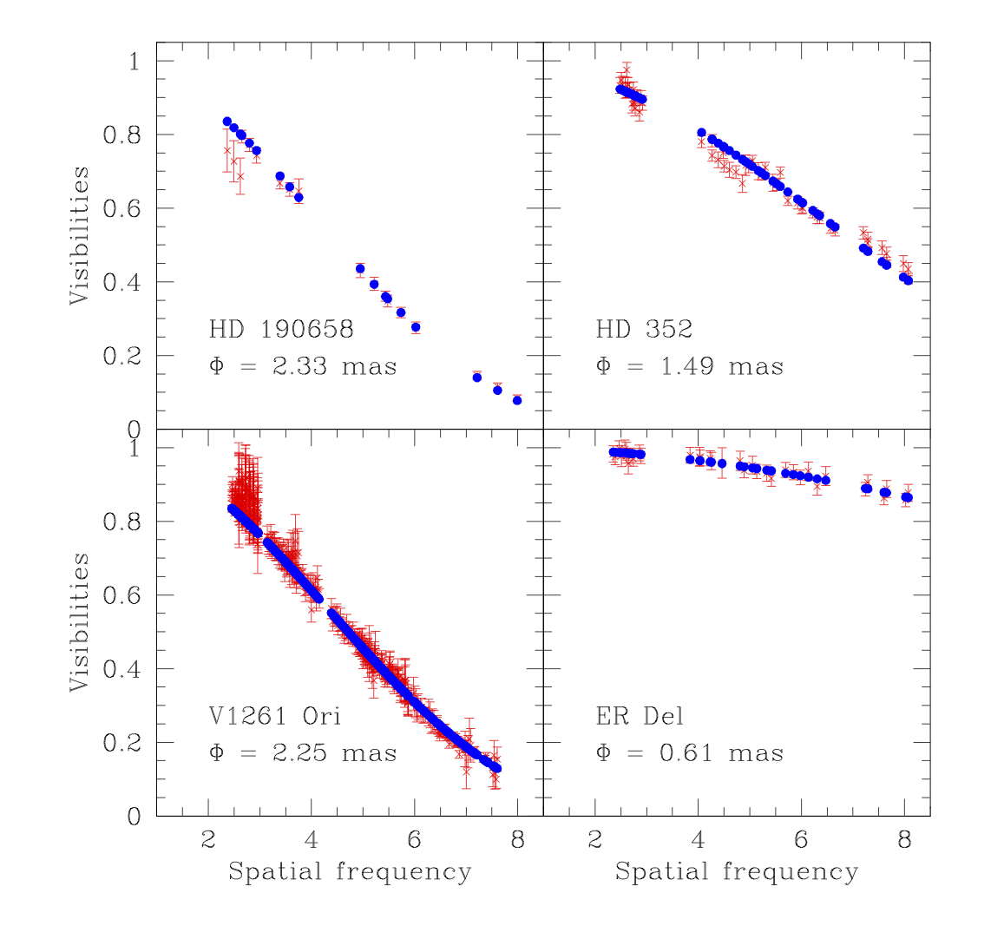
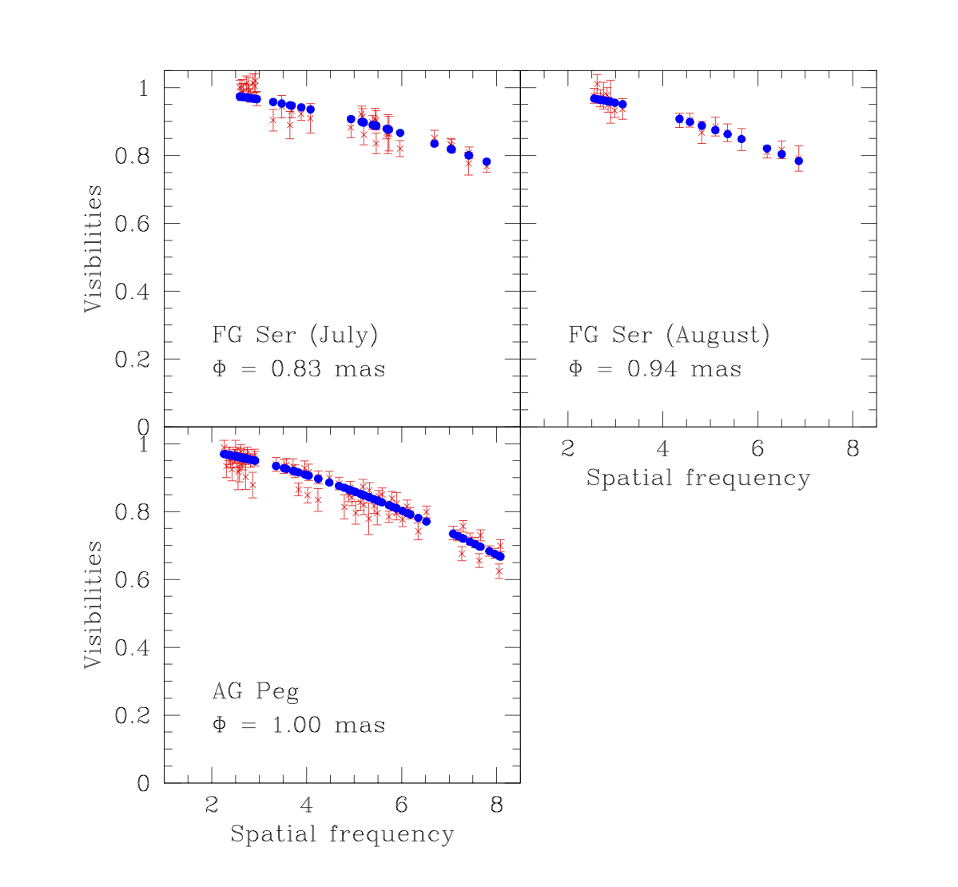
PIONIER Visibilities
Studied 6 symbiotic or related stars
Visibilities
Boffin+ 2014
Can generally be fitted with a simple uniform disc
Notes:
Spatial frequency in units of 10**7/rad

Slide 17
PIONIER mini-survey
Boffin+ 2014
Can use these to compare with Roche lobe radius, if can estimate distance and masses of components
Notes:
For all, but V1261 Ori, we used Nsp=3. For V1261 Ori, Nsp=7

Slide 18
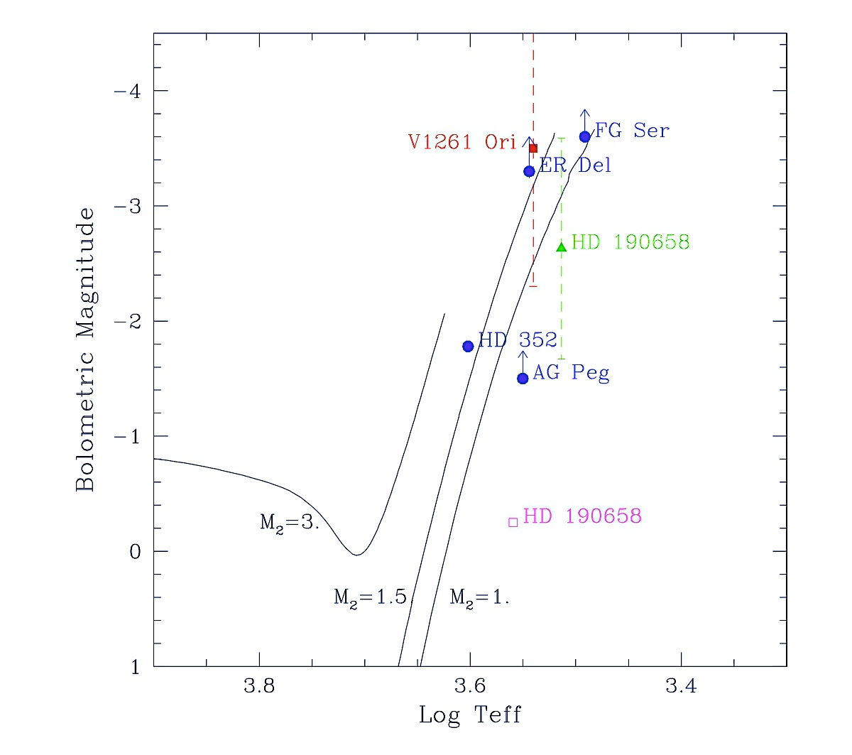
PIONIER mini-survey
Boffin+, 2014
Notes:
Here the results of the mini-survey – we see a dichotomy between systems filling their Roche lobe and those that don’t. We can also place the systems in an HR diagram.
These stars have V between 6.2 and 10.5, and H between 2 and 5.4 – as they are red giants, we won’t gain much in number of objects we can observe by going in the visible. This is not the case for all systems.

Slide 19
PIONIER mini-survey
Hen3-1761
Hen3-1761
M4IIIe
D=3.7 kpc
Mbol=-4.3
Teff=3000 K
R=206 R
Boffin+, in prep
Boffin+, 2014
Notes:
Here the results of the mini-survey – we see a dichotomy between systems filling their Roche lobe and those that don’t. We can also place the systems in an HR diagram.
These stars have V between 6.2 and 10.5, and H between 2 and 5.4 – as they are red giants, we won’t gain much in number of objects we can observe by going in the visible. This is not the case for all systems.

Slide 20
PIONIER mini-survey
Hen3-1761
Hen3-1761
M4IIIe
D=3.7 kpc
Mbol=-4.3
Teff=3000 K
R=206 R
Boffin+, in prep
Giants in these systems seem to be normal giants
→ Why the enhanced mass loss?
Boffin+, 2014
Notes:
Here the results of the mini-survey – we see a dichotomy between systems filling their Roche lobe and those that don’t. We can also place the systems in an HR diagram.
These stars have V between 6.2 and 10.5, and H between 2 and 5.4 – as they are red giants, we won’t gain much in number of objects we can observe by going in the visible. This is not the case for all systems.

Slide 21
HD 352 = AP Psc = 5 Cet
Semi-detached system? (Eaton & Barden 86, 88: hot secondary is immersed in dense lower atmosphere of K giant)
P = 96.4371 d
Ellipsoidal variations
ϖ = 3.58 ± 0.48 mas (van Leeuwen 07)
(d = 280 pc)
PIONIER: R = 0.745 mas → R = 45 ± 6 R
R_{L} ≈ 50 R → R/R_{L} ≈ 0.9 ± 0.1 !
Notes:
Jury still out on this one!
However, we should expect to have large deformations as the star is almost filling or is filling its Roche lobe

Slide 22
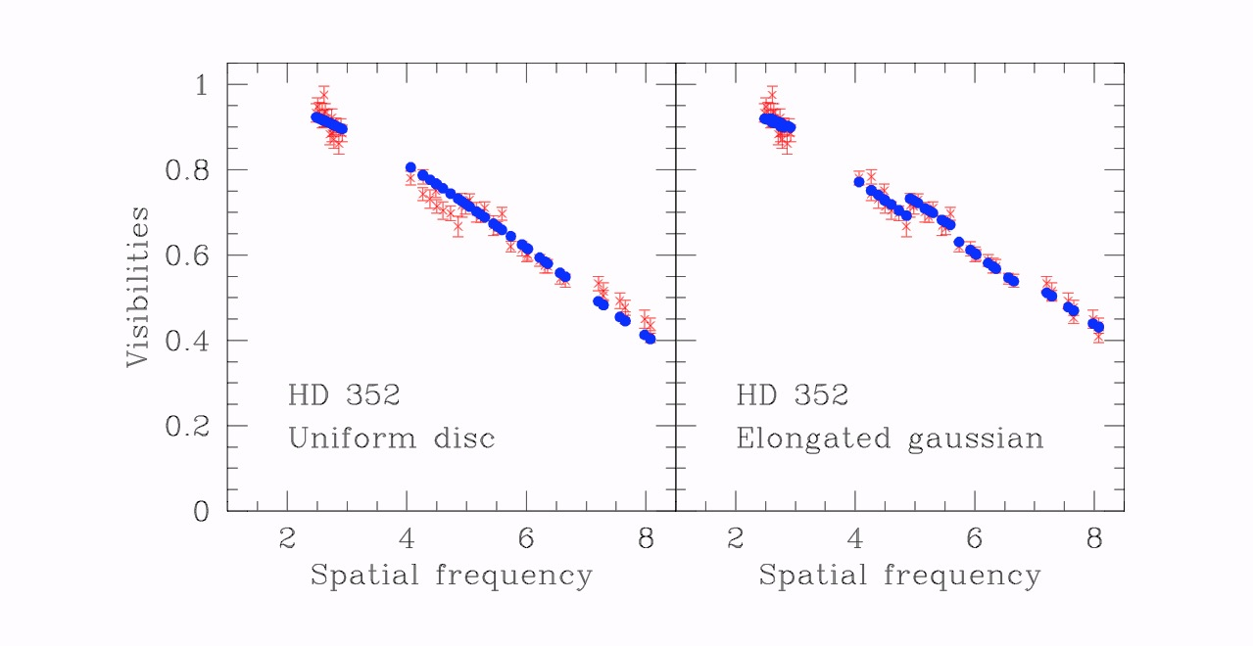
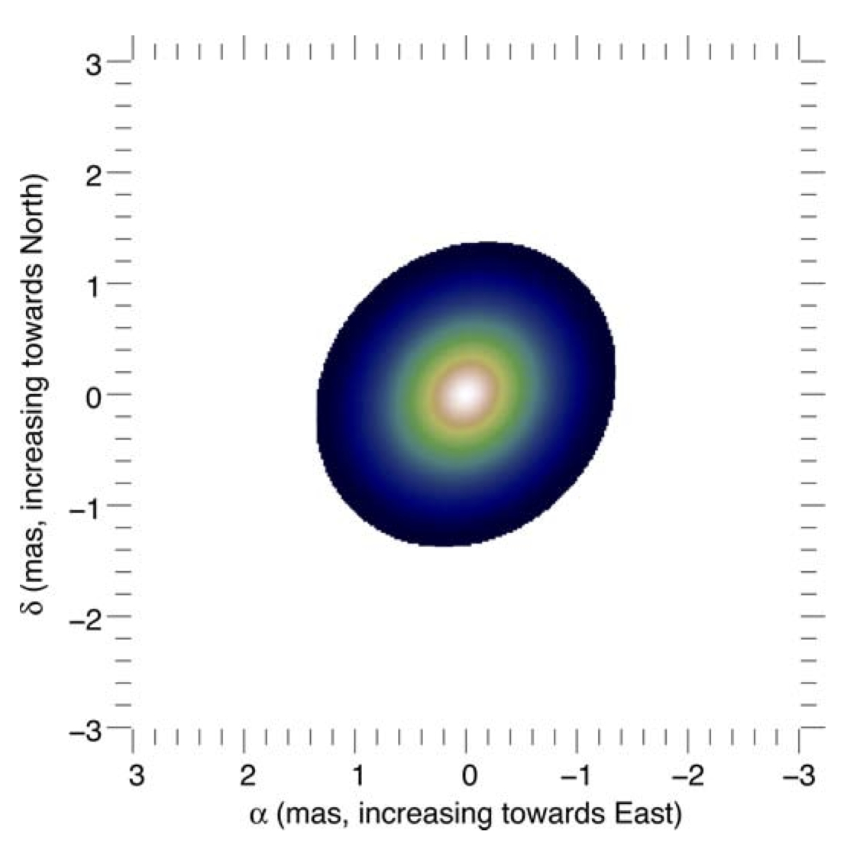
HD 352 - Elongated
V²
Elongation ratio: 1.16
1.38 x 1.6 mas
Model! Not reconstructed image!
Notes:
Using indeed an elongated gaussian provides a better fit to the squared visibilities, the chi-2 decreasing from 2.5 to 1.25

Slide 23
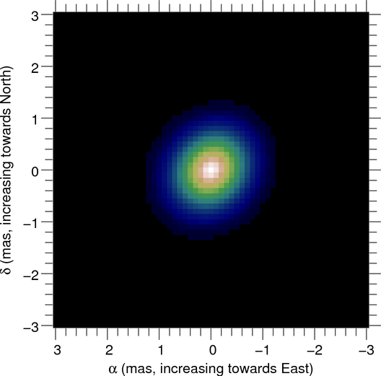
HD 352 - Elongated
13/8/2012
V²
Elongation ratio: 1.16
1.38 x 1.6 mas
Angle=138 deg
22/9/2014
Elongation ratio: 1.16
1.38 x 1.6 mas !
Angle=140 deg
Notes:
Using indeed an elongated gaussian provides a better fit to the squared visibilities, the chi-2 decreasing from 2.5 to 1.25

Slide 24
HD 352 - Elongated
13/8/2013
V²
Elongation ratio: 1.16
1.38 x 1.6 mas
Angle=138 deg
Consistent results
But would need to have observations at phase=0.5!
22/9/2014
Elongation ratio: 1.16
1.38 x 1.6 mas !
Angle=140 deg
Orbital phase=0.21
Orbital phase=0.20
Notes:
Using indeed an elongated gaussian provides a better fit to the squared visibilities, the chi-2 decreasing from 2.5 to 1.25

Slide 25
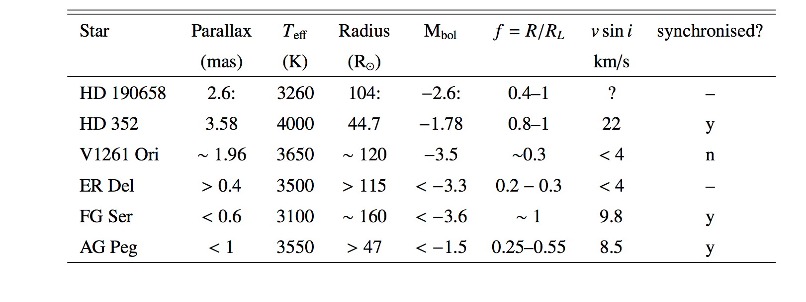
PIONIER mini-survey
Boffin+, 2014
Notes:
These stars have V between 6.2 and 10.5, and H between 2 and 5.4

Slide 26
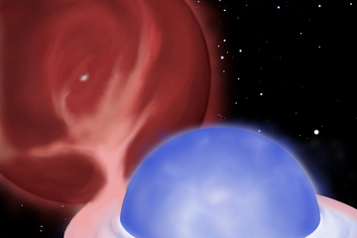
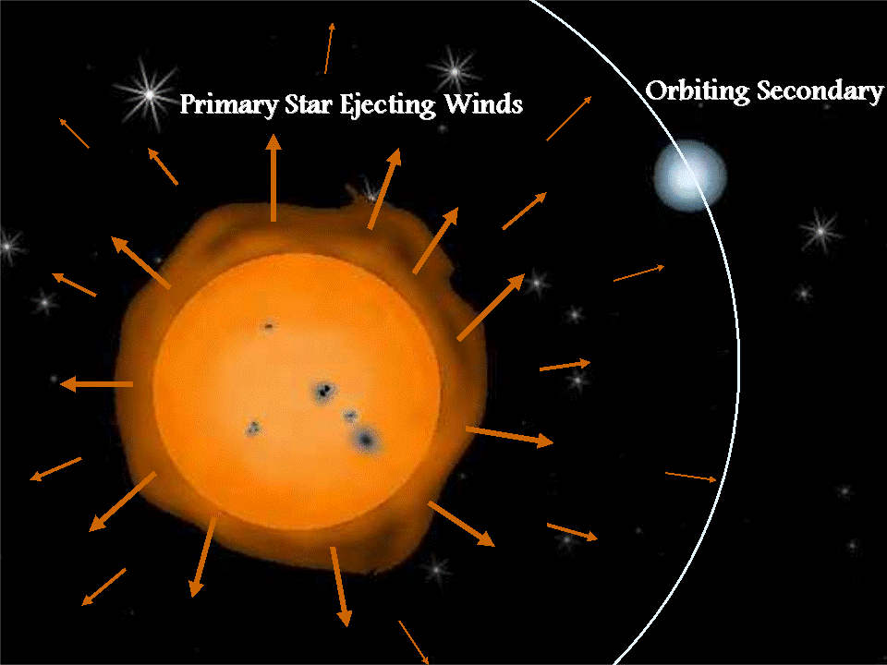
Binaries
Symbiotic stars can be divided into two categories based on the nature of the components:
  (a) a lobe-filling giant and a A-F main sequence star
  (b) a white dwarf or subdwarf and a red giant losing mass in a stellar wind

Slide 27
Binaries
Symbiotic stars can be divided into two categories based on the nature of the components:
Confirms conjecture by Kenyon & Webbink (1984)
RLOF: why is the mass transfer stable and is there no CE?

Slide 28
Binaries
Symbiotic stars can be divided into two categories based on the nature of the components:
Confirms conjecture by Kenyon & Webbink (1984)
RLOF: why is the mass transfer stable and is there no CE?
Answering this would address several binary star problems,
cf. talks by Orsola De Marco and Michel Hillen

Slide 29
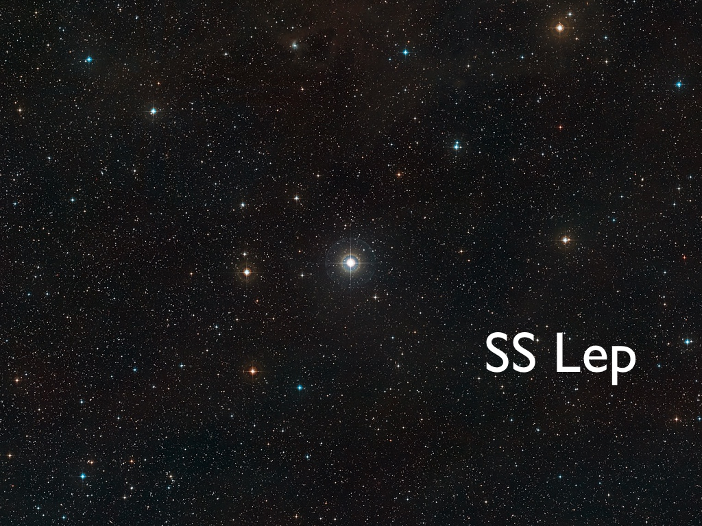
Thank you!
Looking in more details at….

Slide 30
SS Lep = 17 Lep = HD 41511
V = 5.0 !
M4 III star + A1 companion
P = 260.3 d
M giant is the least massive of two : mass reversal (Algol)
Mass transfer ongoing
Welty & Wade 1995
Notes:
HD 41 511 (=SS Lep). With P = 260.3 d and e = 0.02 (Welty & Wade 1995), it is the fourth shortest orbital period among the spectroscopic systems involving an M giant. As a further evidence to this claim, these authors show that the A-type companion appears to be a main-sequence star, which has swollen as a result of accretion from the lobe-filling M giant. Indeed, its radius is ten times that of a typical A1V star, but its mass, derived from the surface gravity and radius, is not that of a massive supergiant.

Slide 31
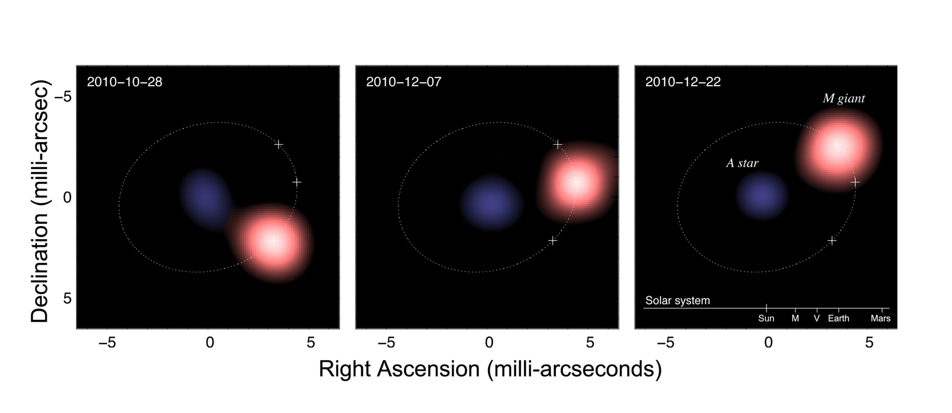
Image Reconstruction
PIONIER data - 2 month-span
Blind+ 2011
Notes:
PIONIER provides 6 visibilities and 4 cloture phases simultaneously and thus allow a relaiable image reconstruction.On the 4 images (4 epochs), the system is well resolved into 2 components, the separation being slightly smaller than 5 mas. We observe the observation of the system.The A star is about 0.5 mas and so is not resolved. Its image thus defines the PSF. M star is clearly resolved but the distortion we measure is due to the asymmetric filling of the uv-plane and is not real. Because we do not have data with baselines shorter than 20m, it is not possible to image the circumstellar envelope, which is 10 mas large.For the parametric modeling we considered a M giant, an A star and an envelope and we had 6 degrees of freedom.

Slide 32
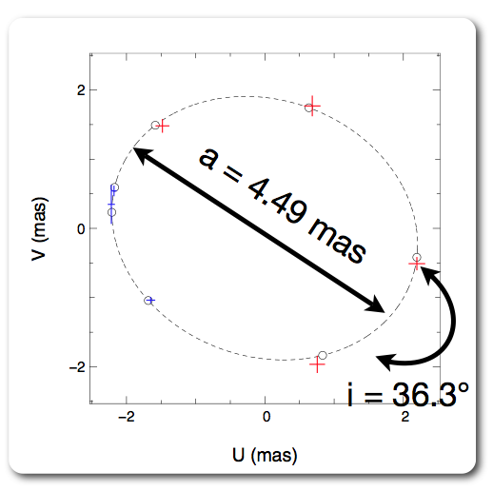
Orbit
Adding AMBER data
Blind+ 2011

Slide 33
SS Lep: Masses
 | Before | Now
d [pc] | 330±70 | 279±24
MA [M⊙] | 2~3 | 2.71 ± 0.27
MM [M⊙] | 0.35~1 | 1.3 ± 0.33
MA/MM | 4±1 | 2.17 ± 0.35
Mass ratio smaller than initially thought!
M giant initially more massive,
M_{M} > 2.2 M
→ Lost at least 0.9 M
A star accreted at least 0.5 M
Blind+ 2011
Notes:
New Hipparcos distance cf Van Leeuwen 2007 - parallax: 3.59 +\- 0.31 mas
Using the mass function of the system and the inclination angle, as well as the 3rd Kepler law, we can deduce the mass of the 2 compenOnts. The main result is that the mass ratio is smaller than initially thought.

Slide 34
Roche lobe overflow?
 | Before | Now
diameter ∅_{M} [mas] | 3.11 ± 0.32 | 2.208 ± 0.007
d [pc] | 330 ± 70 | 279 ± 24
∅M [R⊙] | 220 ± 60 | 132 ± 5
Roche lobe filling | 140% | 86%
Blind+ 2011
Notes:
New Hipparcos distance cf Van Leeuwen 2007 - parallax: 3.59 +\- 0.31 mas
Using the mass function of the system and the inclination angle, as well as the 3rd Kepler law, we can deduce the mass of the 2 compenOnts. The main result is that the mass ratio is smaller than initially thought.

Slide 35
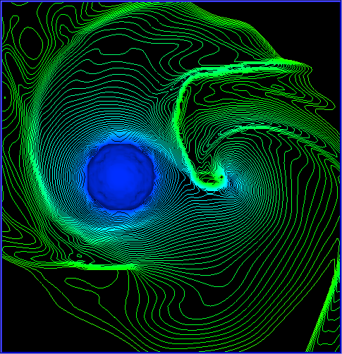
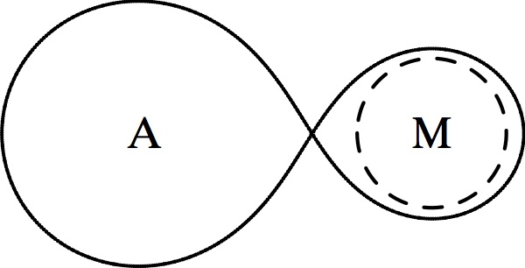
Roche lobe overflow?
 | Before | Now
diameter ∅_{M} [mas] | 3.11 ± 0.32 | 2.208 ± 0.007
d [pc] | 330 ± 70 | 279 ± 24
∅M [R⊙] | 220 ± 60 | 132 ± 5
Roche lobe filling | 140% | 86%
No Roche lobe overflow!
Blind+ 2011
Notes:
The answer will depend on the mass loss vs gravitation cf modified RLOF

Slide 36
How to loose 0.9 M?
Star is not yet very far in evolution (R ≈ 60 R), so Mdot is not high enough
Assuming Reimers mass loss ≈ 2 10^{–8} M/yr and as the star is on the AGB for a few 10⁶ yr at most, it would have lost a few 0.01 M only!
Invoke CRAP (Tout & Eggleton 87, 88): mass-loss rate is then up to 150 times higher, ~2.4 10⁻⁶ M/yr. Thus in a few 10⁵ – 10⁶ yr, one can lose 1 M!
Notes:
Symbiotic stars are known to have much higher mass loss rate than normal giants. From a theoretical point of view, the presence of a companion reduces the effective gravity of the mass losing star, thus enhancing the mass loss.
The mass loss and transfer occurred mostly during the last 500 000 years, with a mass loss ≃ 10−6 M⊙yr−1. During the whole process, the Roche lobe radius around the M star remained similar, with the smallest value being 74 R⊙ . No Roche lobe should thus have happened, unless the initial eccentricity was very high. The above scenario is certainly not the only possible, but it shows that we can explain the current and peculiar properties of SS Lep (including a low-mass circumbinary disc), without resorting to a RLOF.
Blondel et al. (1993) suggest an interpretation of the Lyman- α emission in terms of recombination of H+ during the in- flow of matter. They derive an accretion rate around 3.3 ∼ 5.5 × 10−7 M⊙ yr−1 . This is in rather good agreement with our expectations for a rather low accretion rate.

Slide 37
How to loose 0.9 M?
Star is not yet very far in evolution (R ≈ 60 R), so Mdot is not high enough
Assuming Reimers mass loss ≈ 2 10^{–8} M/yr and as the star is on the AGB for a few 10⁶ yr at most, it would have lost a few 0.01 M only!
Invoke CRAP (Tout & Eggleton 87, 88): mass-loss rate is then up to 150 times higher, ~2.4 10⁻⁶ M/yr. Thus in a few 10⁵ – 10⁶ yr, one can lose 1 M!
One needs CRAP
Notes:
Symbiotic stars are known to have much higher mass loss rate than normal giants. From a theoretical point of view, the presence of a companion reduces the effective gravity of the mass losing star, thus enhancing the mass loss.
The mass loss and transfer occurred mostly during the last 500 000 years, with a mass loss ≃ 10−6 M⊙yr−1. During the whole process, the Roche lobe radius around the M star remained similar, with the smallest value being 74 R⊙ . No Roche lobe should thus have happened, unless the initial eccentricity was very high. The above scenario is certainly not the only possible, but it shows that we can explain the current and peculiar properties of SS Lep (including a low-mass circumbinary disc), without resorting to a RLOF.
Blondel et al. (1993) suggest an interpretation of the Lyman- α emission in terms of recombination of H+ during the in- flow of matter. They derive an accretion rate around 3.3 ∼ 5.5 × 10−7 M⊙ yr−1 . This is in rather good agreement with our expectations for a rather low accretion rate.

Slide 38
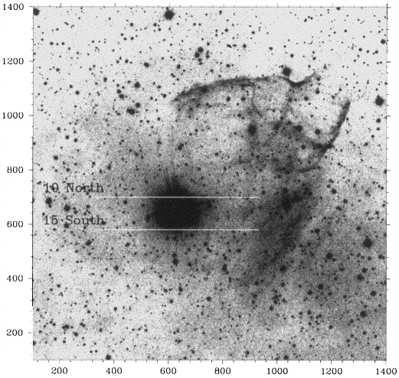
A look at a massive star
LBV
HR Car
Nota+ 1997

Slide 39
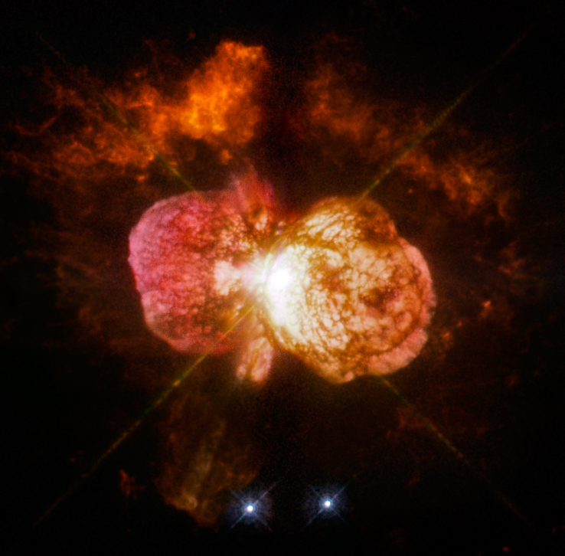
Another extreme: Eta Carinae
LBV 120 M + 30 M companion
Eccentric system
P = 5.5 years
Undergo outburst
Mass loss event seems to be due to binarity
Notes:
Another magnificent example is Eta Carinae, who in April 1843 was with a magnitude of −0.8 the second brightest star in the night-time sky (after Sirius at 8.6 light years away), despite its enormous distance.
It is now fainter but still visible with the naked eye and is known to contain 2 massive stars.

Slide 40
Binary model
Canonical evolution
O-typestar → Of/WNH → LBV →
WN → WC → SNIbc
Alternative (Smith & Tombleson 2015)
Mass transfer in binaries
And we know most massive stars are in binaries (Sana+ 2012)
Smith & Tombleson 2015

Slide 41
Binary model
Canonical evolution
O-typestar → Of/WNH → LBV →
WN → WC → SNIbc
Alternative (Smith & Tombleson 2015)
Mass transfer in binaries
And we know most massive stars are in binaries (Sana+ 2012)
Are there LBV binaries similar to η Car?
Smith & Tombleson 2015

Slide 42
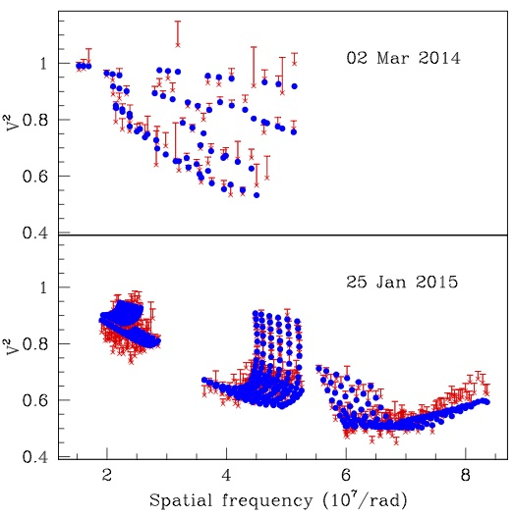
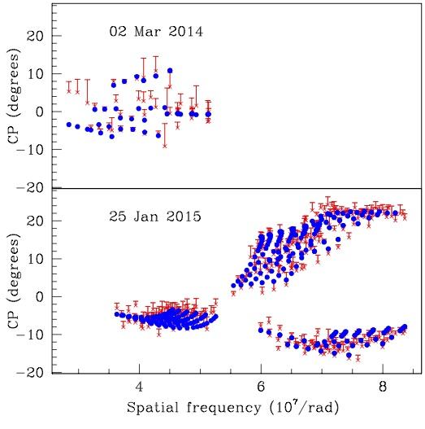
PIONIER Observations
Visibilities
Closure Phases
HR Car

Slide 43
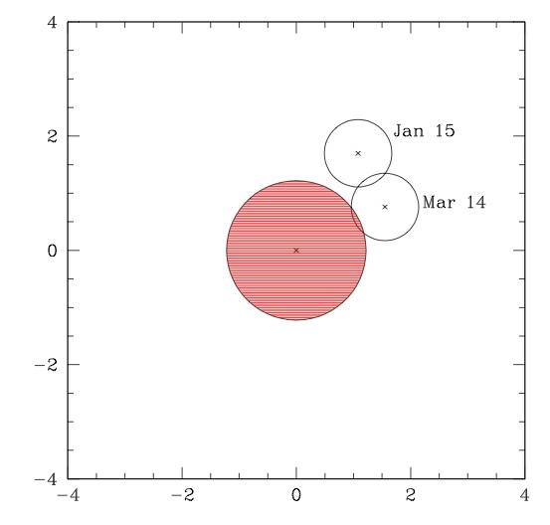
HR Car: A Binary!
Separation:
2.02±0.09 mas in 2014
1.73±0.05 mas in 2015
Angle: 64 degrees to 32 degrees in 330 days.
→
P~10 yrs
A~10-20 AU
Mar 14
Jan 15

Slide 44
SUMMARY
PIONIER has provided a complete new view on symbiotic stars, measuring diameters for a small subset
Interferometry also allows to determine distortion of star (tidal effect).
We revisited SS Lep with PIONIER/VLTI:
  Mass ratio lower than previously thought
  M star does not fill its RLOF
  System currently in wind RLOF configuration?
  Need for CRAP mechanism
Main limitations: distances → GAIA welcome!
We also found that the LBV HR Car is a binary system

Slide 45

Thank you
Nicolas Blind, Michel Hillen, Jean-Philippe Berger, Alain Jorissen, Jean-Baptiste Le Bouquin, Antoine Mérand, Joanna Mikolajewska
Thomas Rivinius, Willem-Jan de Wit, Andrea Mehner, Christophe Martayan, and Sylvain Guieu

Slide 46
Backup slides

Slide 47
CRAP
Simulation using this CRAP mechanism:
  a system having an initial period of 160 days and initial masses MM,0 = 2.28 M⊙, MA,0 = 1.85 M⊙
For about 1 Gyr, the system evolves without much change and the primary star starts its ascend of the AGB.
After 2.8 Myr, the masses and period have reached the values currently observed, with about 0.1 M⊙ having been lost by the system, and forming some circumbinary disc (quasi-conservative mass transfer!)
Wind RLOF?

Slide 48
A-star: Really fat or donut-shaped?
From the SED, RA = 18 R >> typical radius of A star
If real, this may be due to a mass accretion
at a rate ~ 5 10⁻⁵ M/yr (Kippenhahn & Meyer-Hofmeister 1977)
- high!
Is the A star really so fat?
Break-up velocity for A star of this size is 186 km/s!
      But v sin i = 118 km/s (Royer et al. 2002)
If assume star rotates in plane of binary system → v = 196 km/s!
Notes:
The increase in radius of the A star is due to the response of the star on a mass transfer happening faster than its Kelvin- Helmotz time. For a typical A star, this means that the star will react by increasing its radius for any accretion rate above ≃ 10−6 M⊙yr−1.

Slide 49
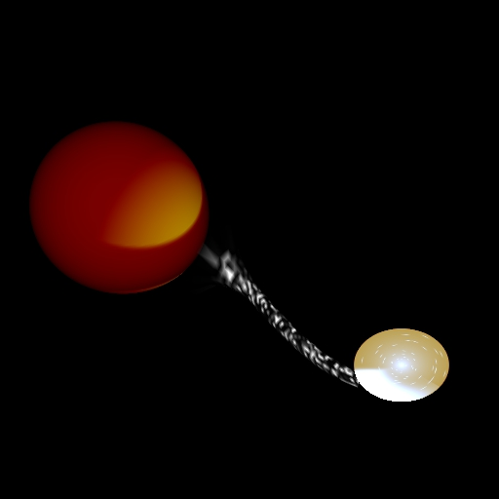
A-star: Really fat or donut-shaped?
If matter goes through L1 point,
one can compute the smallest radius of infalling material:
initially: rmin = 9 R>> 2 R (RA std);
now: rmin = 20 R > RA !
Material does not hit the A star
A disc should form instead!
Notes:
The increase in radius of the A star is due to the response of the star on a mass transfer happening faster than its Kelvin- Helmotz time. For a typical A star, this means that the star will react by increasing its radius for any accretion rate above ≃ 10−6 M⊙yr−1.

Slide 50
A-star: Really fat or donut-shaped?
If matter goes through L1 point,
one can compute the smallest radius of infalling material:
initially: rmin = 9 R>> 2 R (RA std);
now: rmin = 20 R > RA !
Material does not hit the A star
A disc should form instead!
Need data with higher resolution to probe if there is a disc around the A star!
Notes:
The increase in radius of the A star is due to the response of the star on a mass transfer happening faster than its Kelvin- Helmotz time. For a typical A star, this means that the star will react by increasing its radius for any accretion rate above ≃ 10−6 M⊙yr−1.

