Slide 1
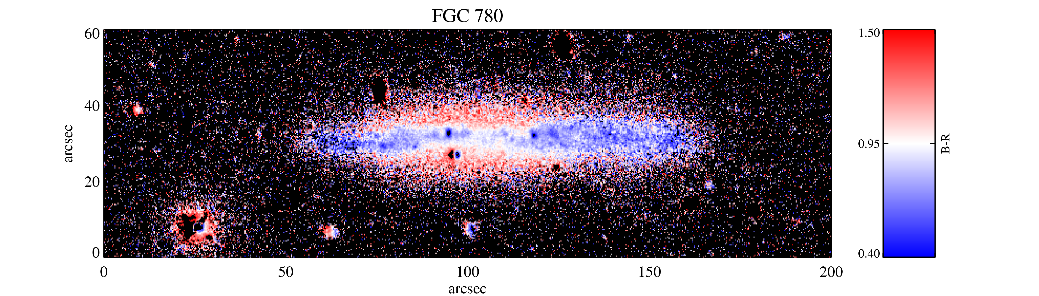
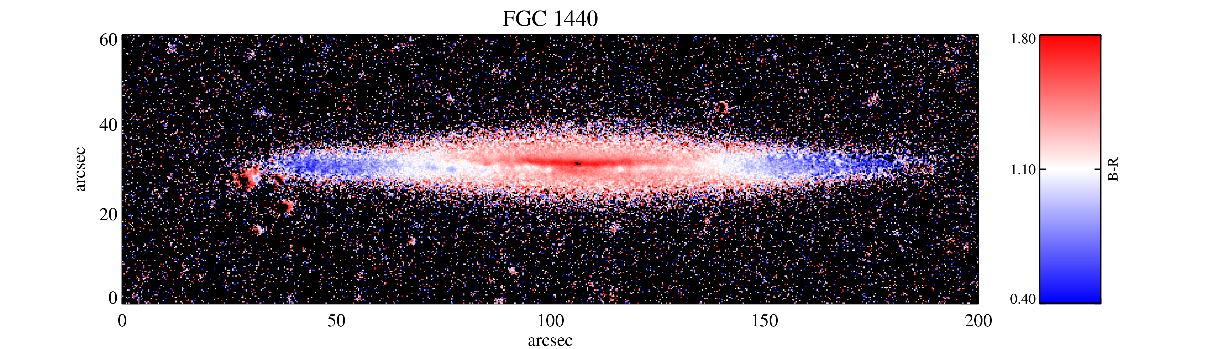
The Structure, Kinematics, and Stellar Populations of Thick Disks
Peter Yoachim
University of Washington, LSST

Slide 2
Recent Observations and Simulations of the Milky Way Thick Disk and
How Do Those Results Apply to Other Galaxies?
Peter Yoachim
University of Washington, LSST

Slide 3
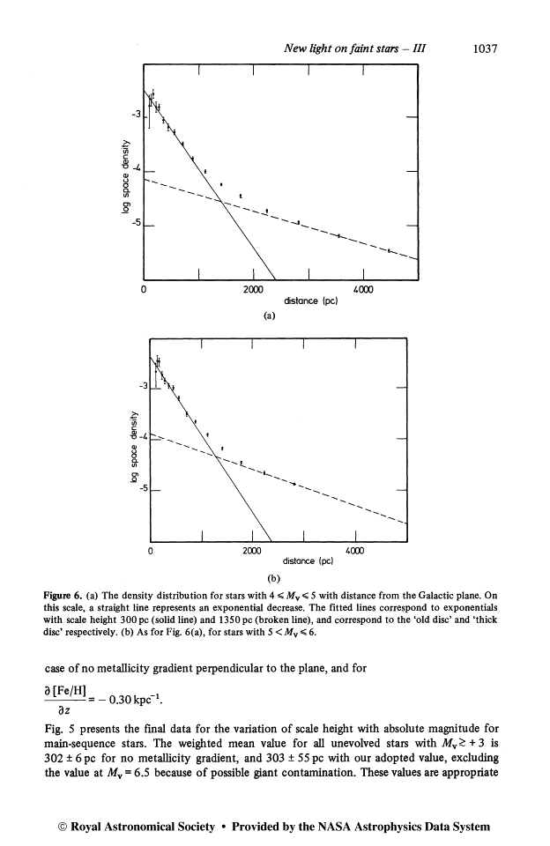
MW Thick Disk Discovery
At large heights above the galactic plane, there seems to be an excess of stars
Gilmore & Reid, ‘83

Slide 4
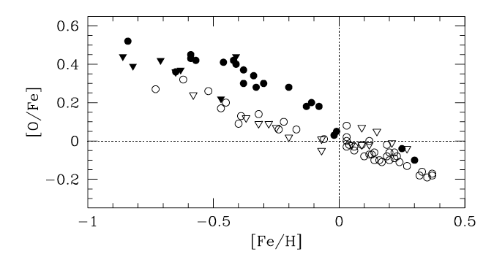
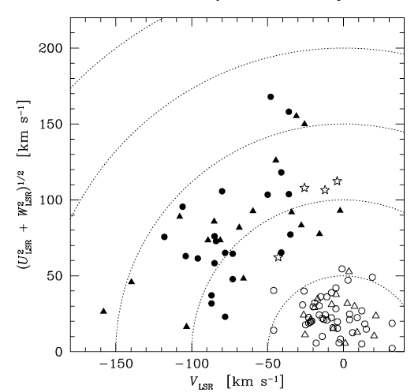
~100 F & G dwarfs
Kinematic selection reveals two chemical composition sequences
Bensby et al, 2004 & 2005

Slide 5
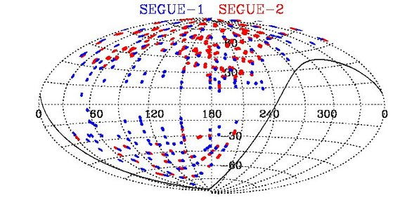
Classic view from nearby stars
The MW thick disk is
Old
Metal poor
Alpha-rich
Kinematically hot
~10% of local stars are thick disk members
SDSS SEGUE survey increases stellar sample sizes by a few orders of magnitude!

Slide 6
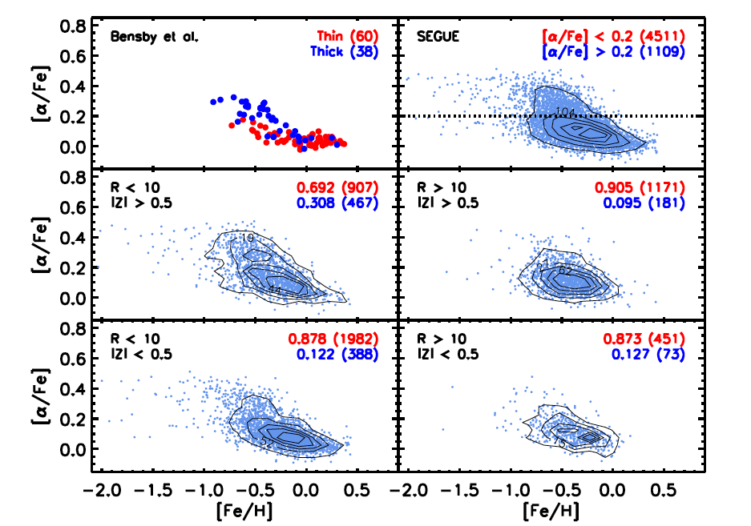
DATA
The thick disk at large radii is not alpha-enhanced. (But there are still stars at large Z in the outer disk)
Cheng et al, 2012

Slide 7
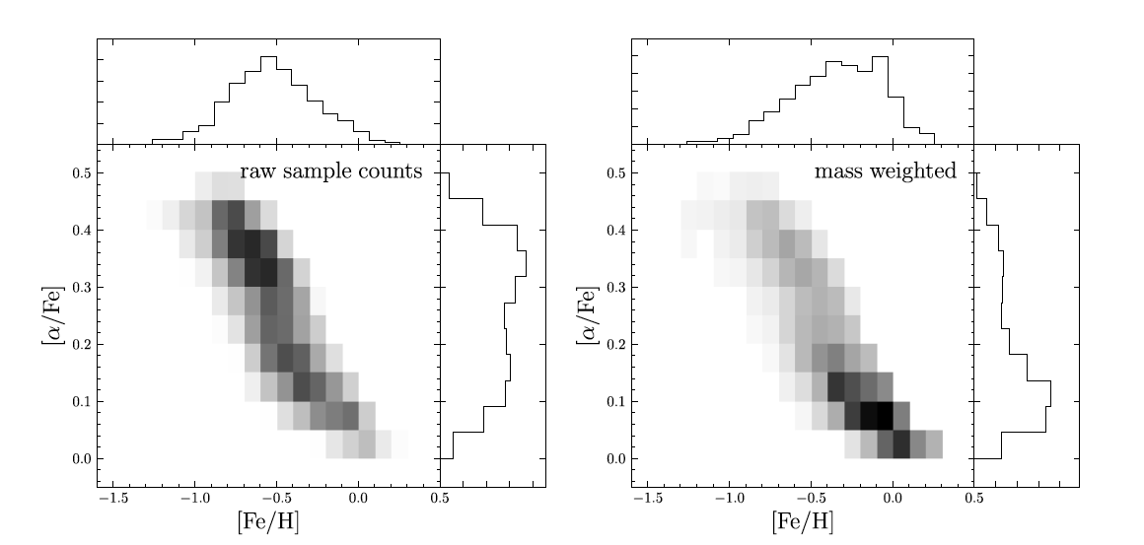
DATA
“The Milky Way Has No Thick Disk”
Bovy et al, 2011
Notes:
Some points from the paper: If you have a luminosity selected sample, you are also selecting on structural parameters.

Slide 8
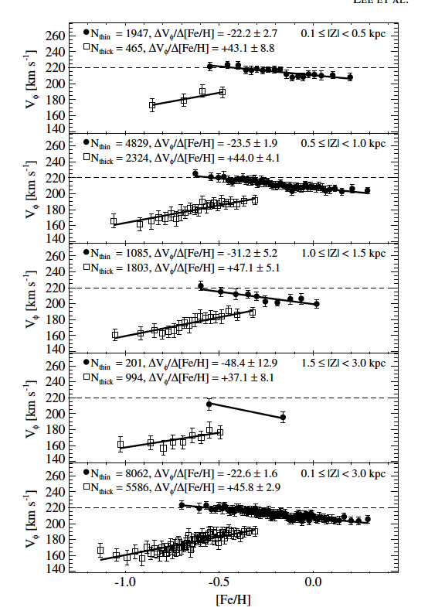
SEGUE stars. Thin and thick stars show different metallicity-kinematic trends.
I don’t understand this, but it seems important.
Lee et al, 2011

Slide 9
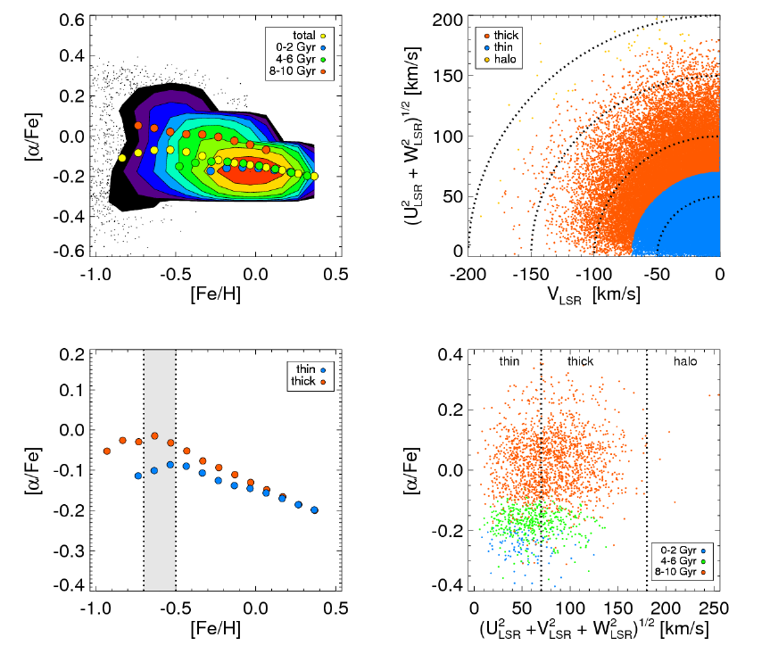
SIMULATION
This is a complicated parameter space!
Age
Fe/H
α/H
σ, σ, σ
R
Z
Example of how stars are in a complicated parameter space
Here, radial migration is the main driver for putting thick disk stars on their current orbits
Loebman et al, 2011

Slide 10
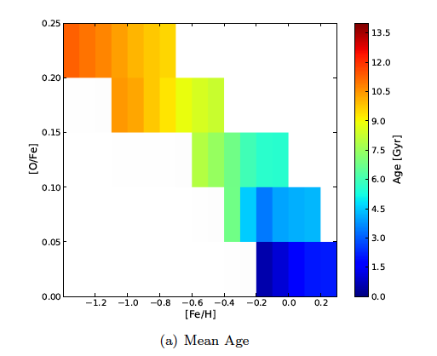
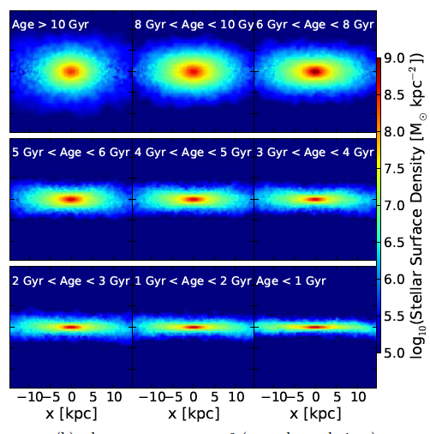
SIMULATION
Thick disk forms hot early, thin disk starts forming at z~1. Chemical distribution looks a lot like SEGUE
Stinson et al , 2013

Slide 11
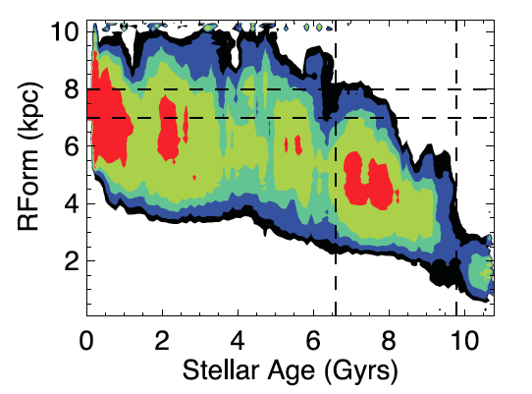
SIMULATION
Stars that end up in the solar annulus.
Short thick disk forms early, then radial migration takes over
Brook et al, 2012

Slide 12
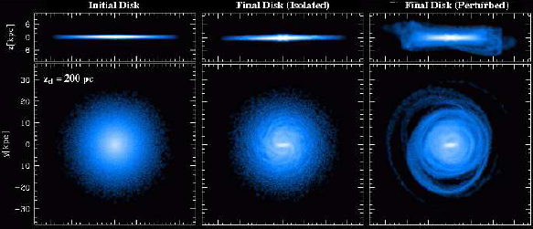
SIMULATION
Lots of mechanisms for driving radial migration—bar, spiral arms, and satellite mergers.
Bird et al, 2012

Slide 13
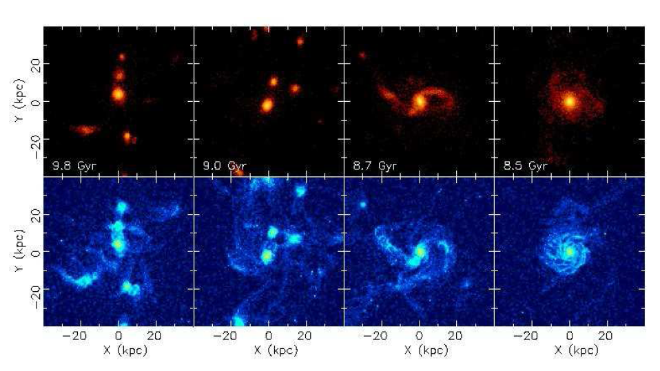
Milky Way summary:
Phase space is complicated! Making a kinematic cut has a large impact on your spatial selection (and vice-versa)
There are still stars far from the midplane (yes, there is a thick disk)
They are still old, metal poor, alpha-rich, kinematically hot.
high res Nbody sims now have enough resolution and baryonic physics that they can be moved to the SDSS-SEGUE observer plane! SEGUE did a great job understanding their selection biases!
The story that keeps showing up:
Stars form rapidly in early chaotic mergers. These stars are (now) old, metal poor, alpha-rich.
Radial migration can then move these stars to larger radii
Brook et al, 2005

Slide 14
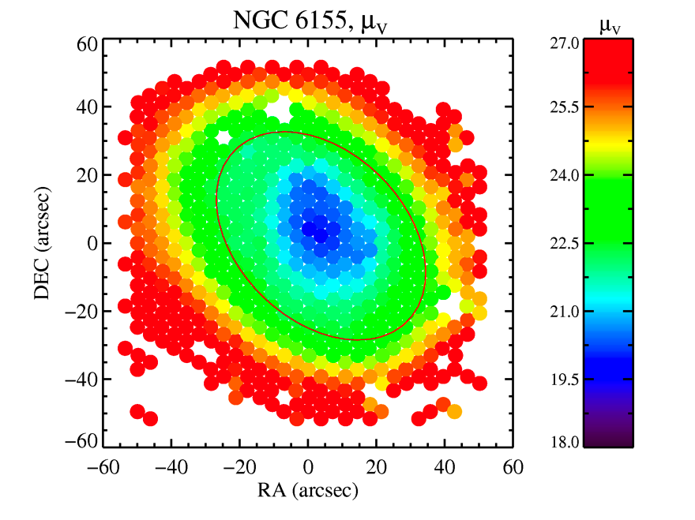
We see signs of radial migration in some face-on galaxies where the profile break corresponds to an age increase
Yoachim et al, ’10 & ‘12

Slide 15
Sims and data starting to have good qualitative agreement, but getting true quantitative agreement is still a way off

Slide 16
Does this story (early gas-rich mergers + radial migration) work for other galaxies?

Slide 17
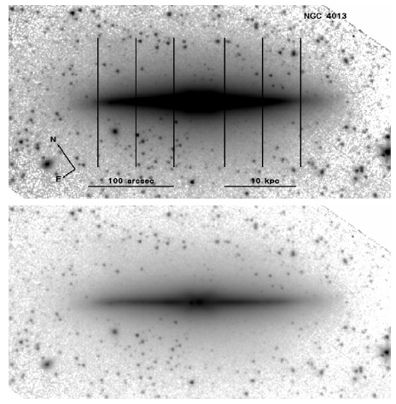
Beyond the MW
Long been noticed that edge-on galaxies stretch up more than out (they have thick disks).

Slide 18
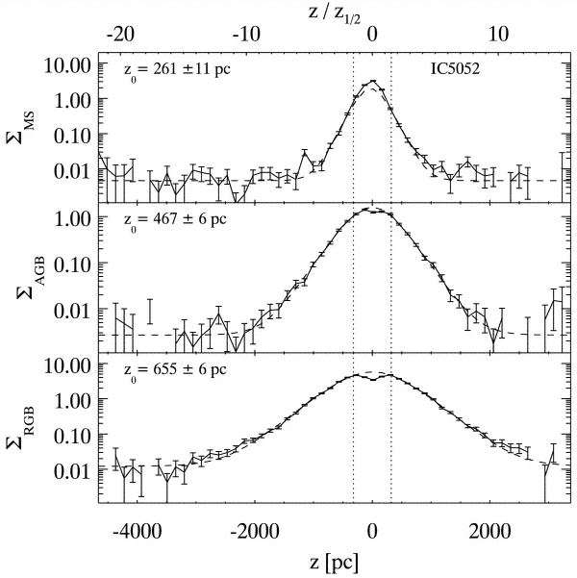
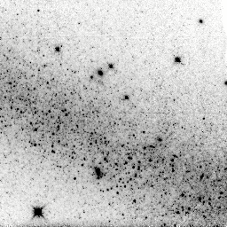
Main Sequence
AGB
RGB
HST observations looking at edge-on galaxies. Older stars have a larger scale-height.
Seth et al, 2005

Slide 19
Stars form in a thin disk on near circular orbits
Main Sequence
Kinematically heat over time (scatter off GMCs, etc)
AGB
RGB
How do we get stars this far off the plane?

Slide 20
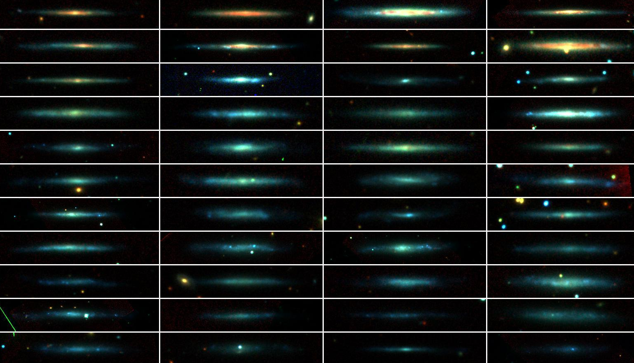
~50 nearby edge-on bulgeless galaxies
Dalcanton & Bernstein 2002
B, R, & K_{s} images, sorted by decreasing rotation speed
V_{c} = 35-250 km/s
Notes:
galaxies are very flat. Throughout, use circular velocity as a proxies for mass. Very simple systems--no worrying about bulge.

Slide 21
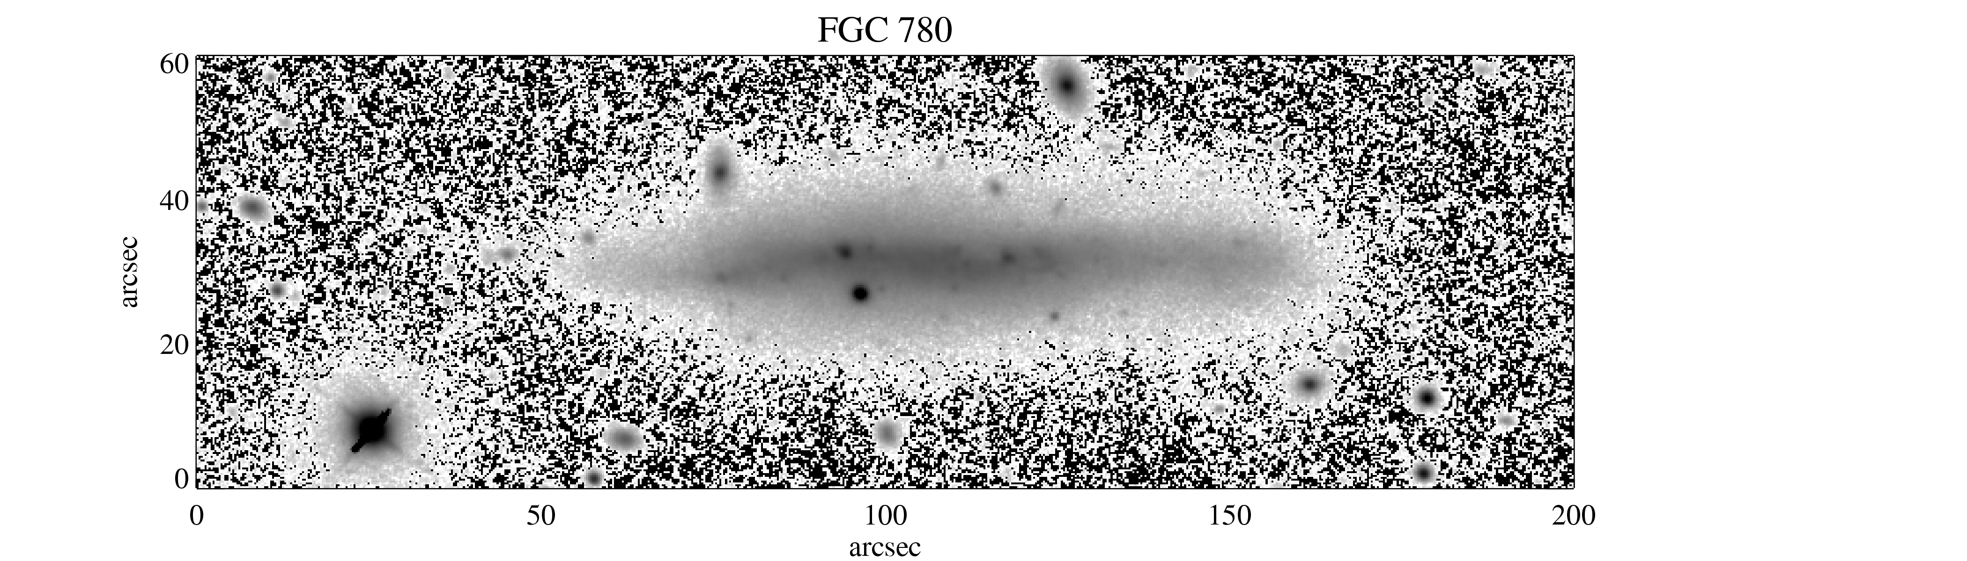
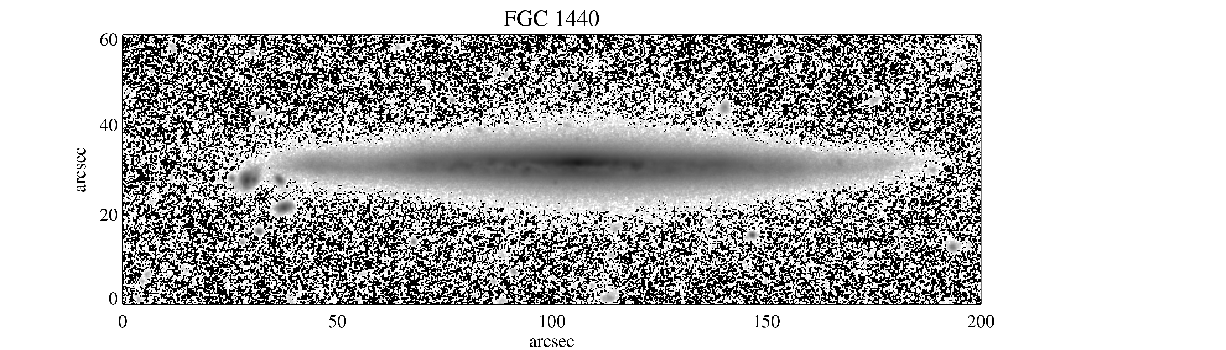
V_{c}=75 km/s
V_{c}=150 km/s
Notes:
2 examples. Top is lower mass than bottom.
clear red halo around FGC 780. Less prominent on 1440.

Slide 22
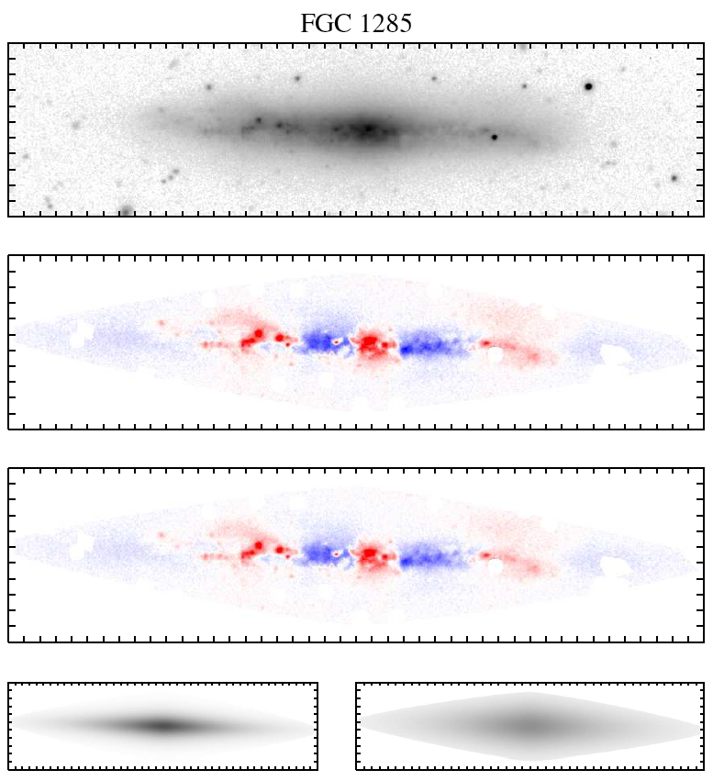
Thick & Thin Disk Decompositions
Residuals
Thin Disk
Thick Disk
For each disk L=L₀e^{-r/hR}sech²(z/z₀)
z_{0,thick} ~ 2z_{0,thin}
Notes:
Thick disks were universal! Needed the thick component to fit the faint outer regions for all the galaxies.
Use inverse weighting to emphasize low flux regions. Note that residuals are dominated by real structures--not Gaussian. So we calculate uncertainties by fitting a series of models.
we get 6 parameters--scale length, scale height, luminosity

Slide 23
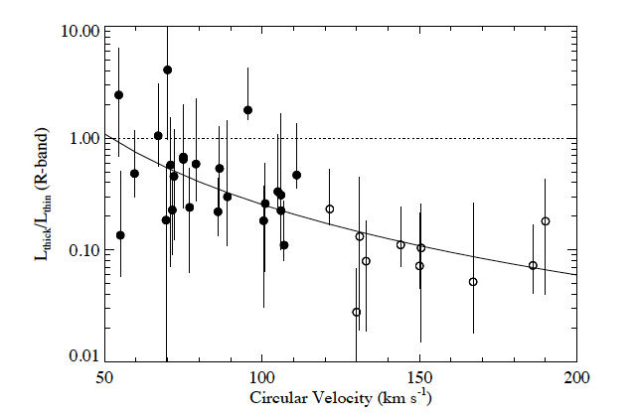
Thick to Thin Disk Luminosity Ratio

Slide 24
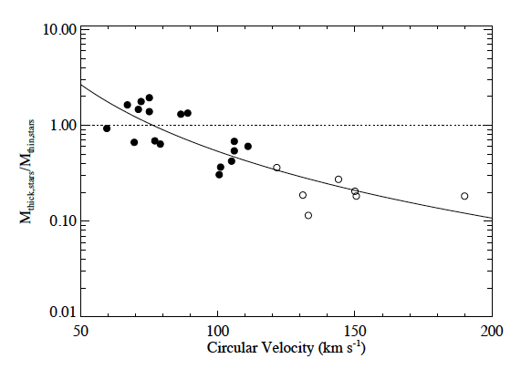
Thick to Thin Disk Mass Ratio
Thick disks are more prominent in low-mass galaxies. Why?
Yoachim & Dalcanton, 2006

Slide 25
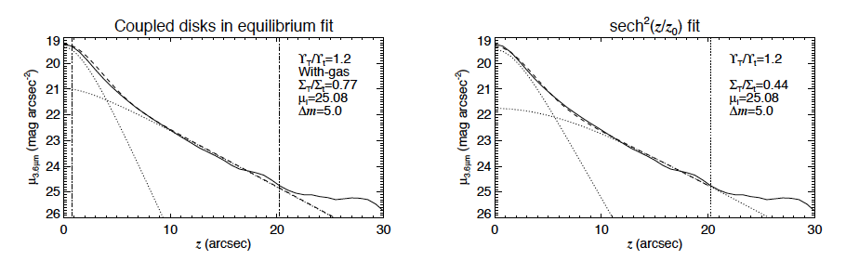
You can’t have any arbitrary combination of stars and gas! Need to demand the system is dynamically stable!
Comerón et al, 2011

Slide 26
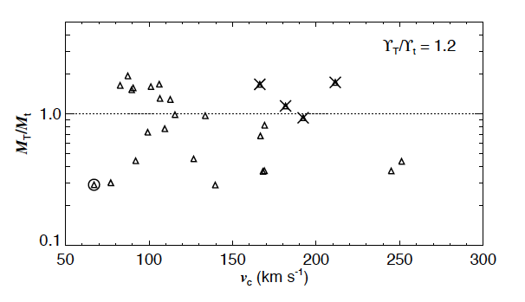
Thin to thick disk stellar mass ratio, now from Spitzer S4G
Again, thick disks are more prominent in low-mass galaxies. (Yay, my thesis isn’t wrong yet)
Comerón et al, 2011

Slide 27
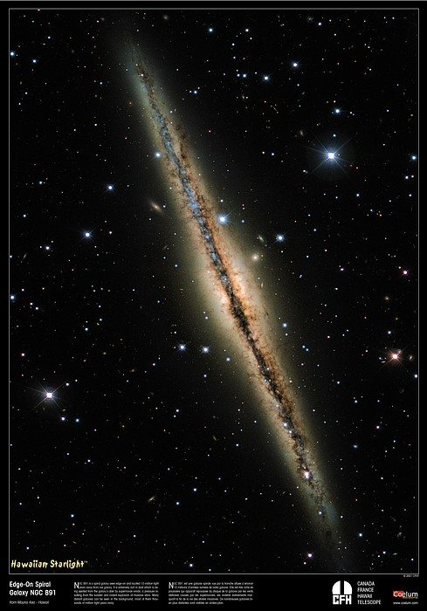
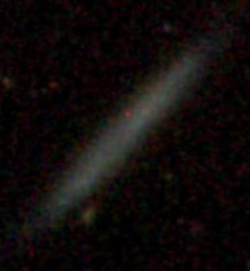
So, for Milky way mass galaxies, thick disks are:
Common
Red (old)
Metal poor
Dynamically hotter (thus they are thicker)
~10-20% of the stellar mass
In lower mass galaxies, thick disks are:
Common
Red (old)
Metal poor
Dynamically hotter
A significant fraction of the stellar mass
NGC 891
FGC 1642

Slide 28
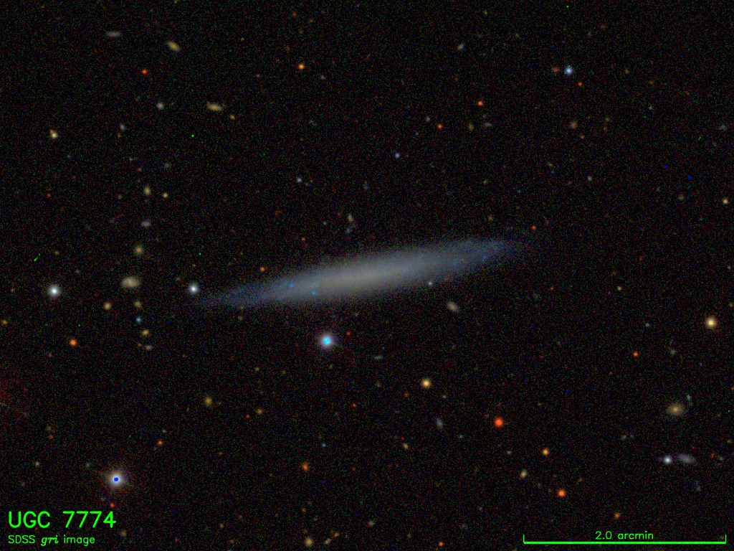
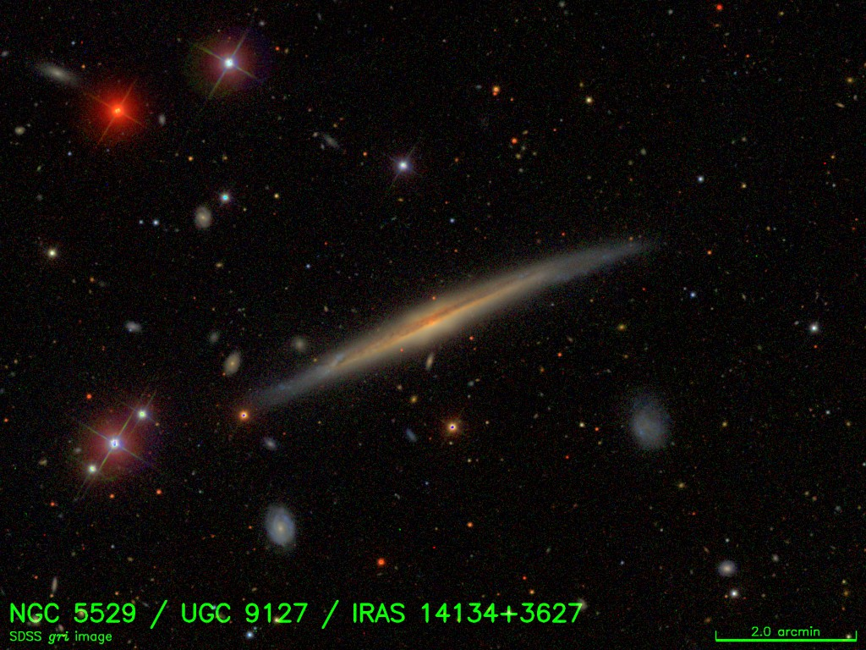
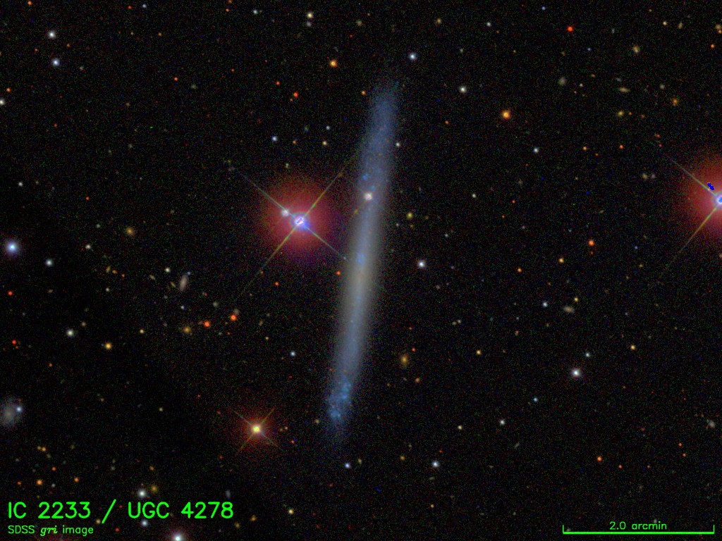
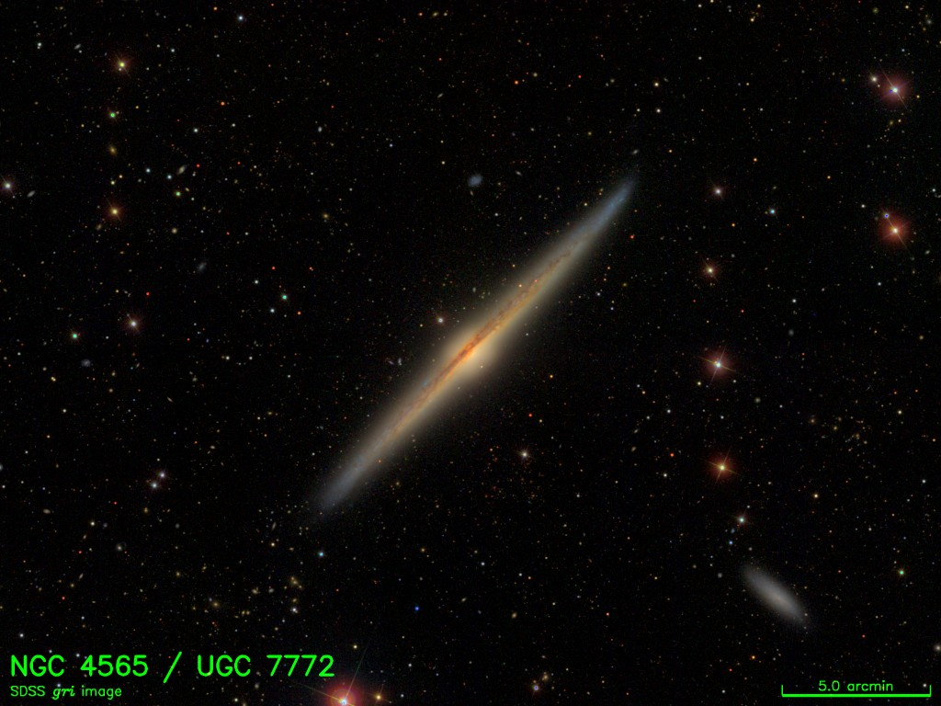
79 km/s
283 km/s
79 km/s
245 km/s
http://cosmo.nyu.edu/hogg/rc3/

Slide 29
245 km/s

Slide 30
79 km/s

Slide 31
High mass galaxies have unstable disks that collapse and form stars efficiently.
Low mass galaxies are more stable. Still gas rich at z=0.
Low mass galaxies don’t have bright thick disks, they have faint thin disks!

Slide 32
Does the MW story work for lower mass systems?
Sure looks like the thick disk is shorter and older. Could be formed thick in early mergers.
But there are some strange thick disks out there…

Slide 33
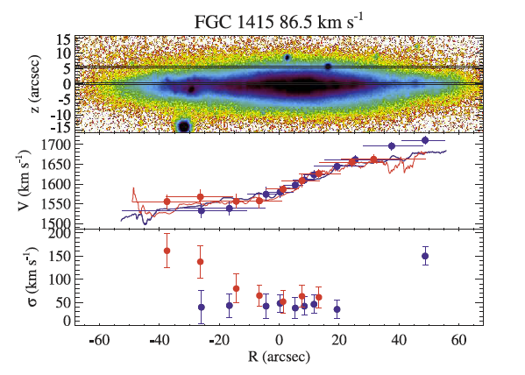
Kinematically, most thick disks look like the MW thick disk (thick disk stars have slight lag)
Yoachim & Dalcanton, 2008

Slide 34
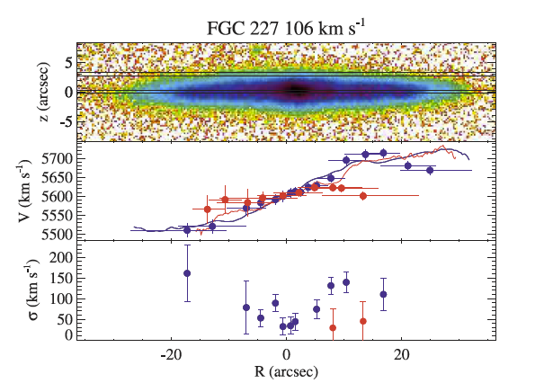

Slide 35
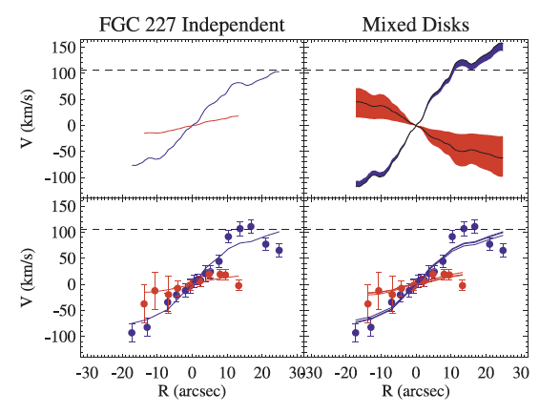
The best-fit is a counter-rotating thick disk

Slide 36
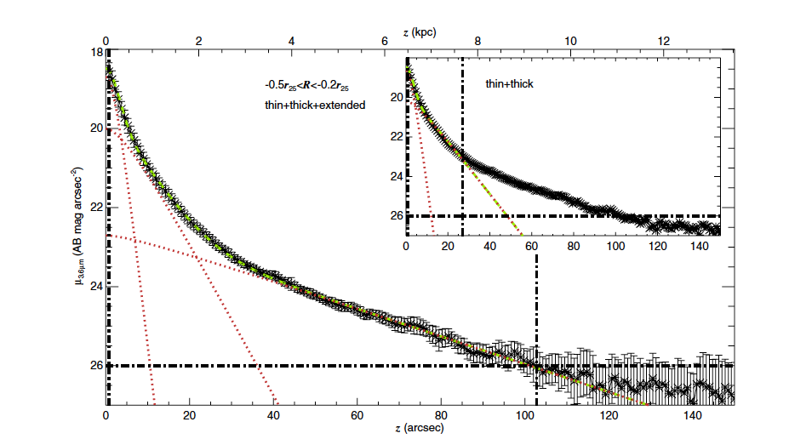
NGC 4013. Requires Disks to be dynamically stable. Can’t fit the system with only 2 disk components.
Comerón et al, 2011

Slide 37
The early formation is a nice scenario, then the later star formation efficiency could explain the trend of thick disk mass fraction
But the odd-balls seem to demand late mergers play some role
Brook et al, 2005

Slide 38
Are there stars here?
Did they get there via migration from the interior?
Can radial migration happen w/o building a bulge?
Do thick disks flare?

Slide 39
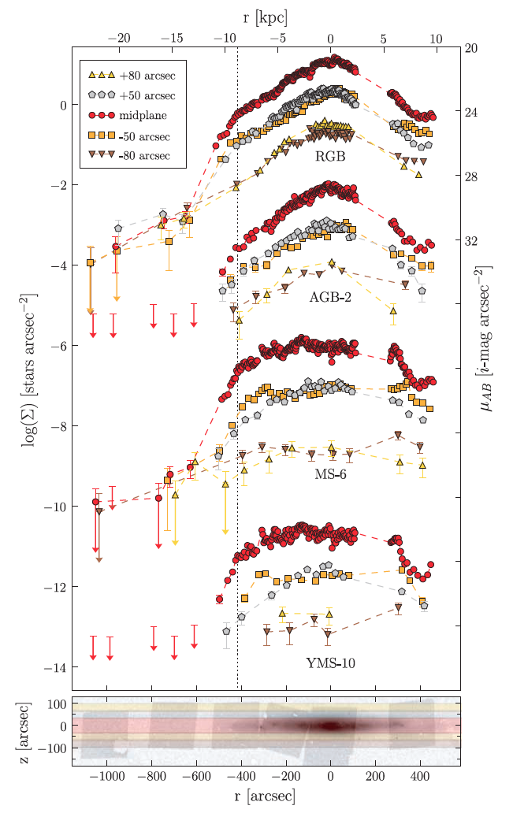
HST observations show all stars truncate at the same radius
de Jong et al, 2007

Slide 40
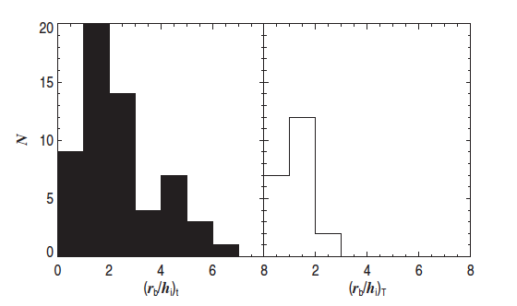
S4G disk truncations
31% of thick disks truncate (at about the same spot an the thin disk)
Several cases where the thin disk truncates and the thick disk continues
Comerón et al, 2012

Slide 41
Simulations increased their resolution
SEGUE increased stellar observations several orders of magnitude
How can we move past the ~50 galaxy sample limit for thick disks?

Slide 42
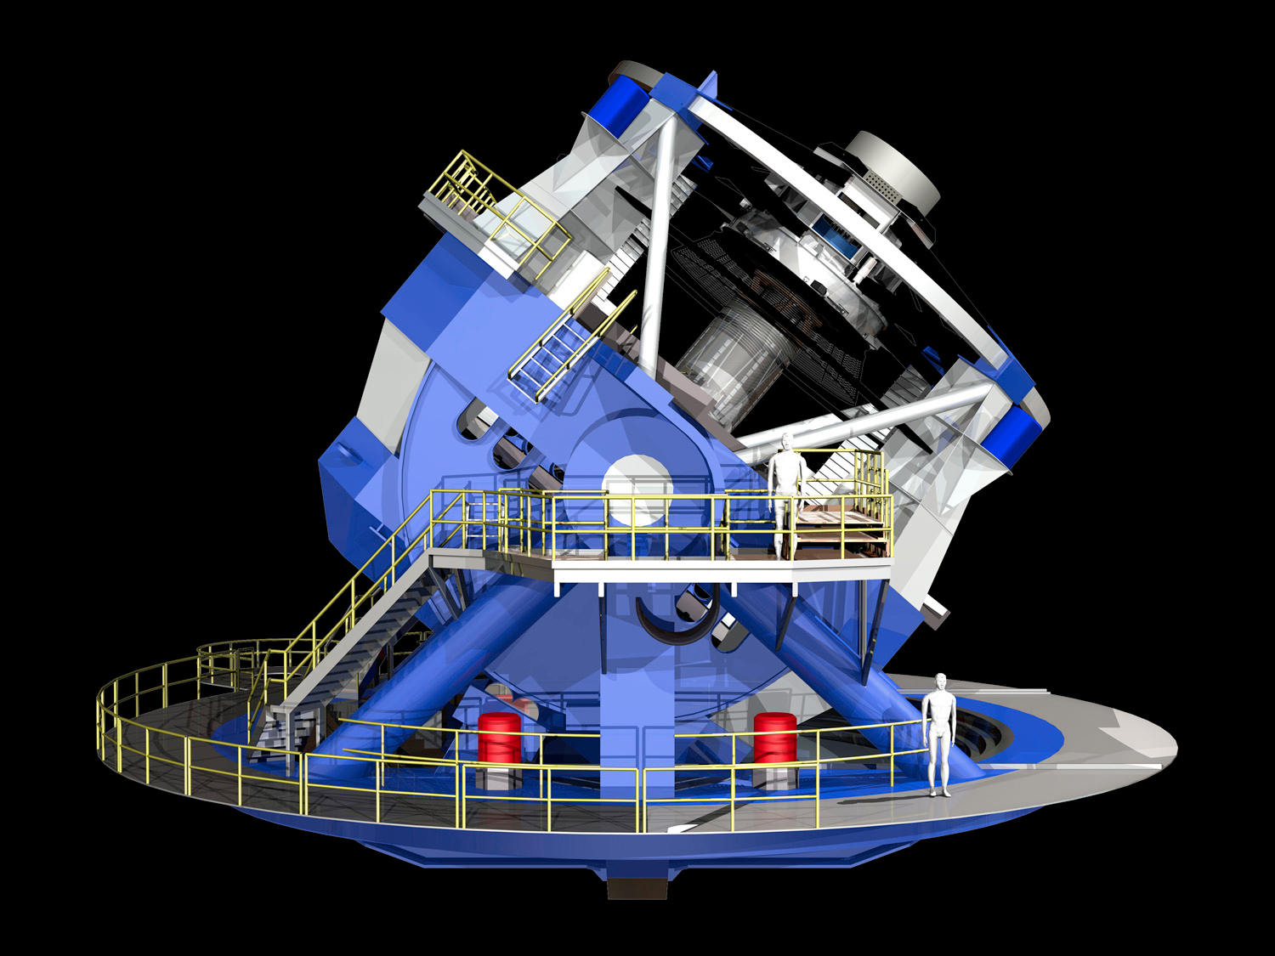
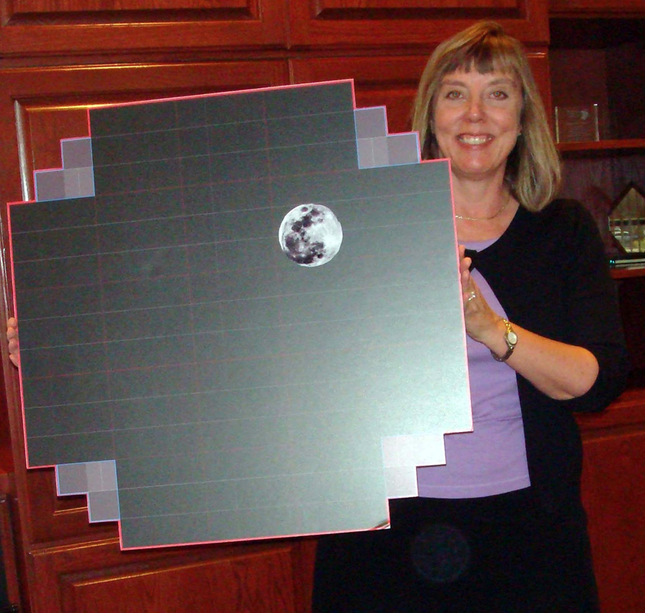
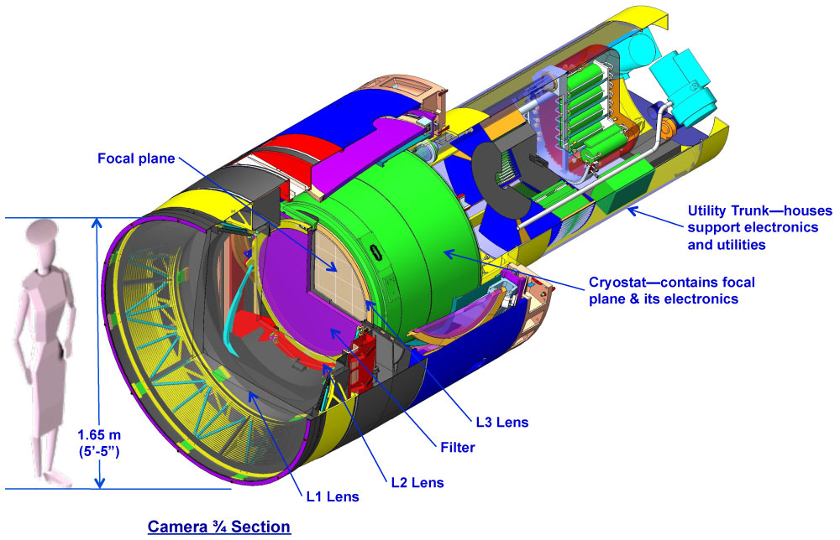
LSST
8.4m telescope
3.5 Gigapixel camera
ugrizy filters
10 year survey
Imaging ~the entire sky in two filters every week
Operations starting ~2022

Slide 43
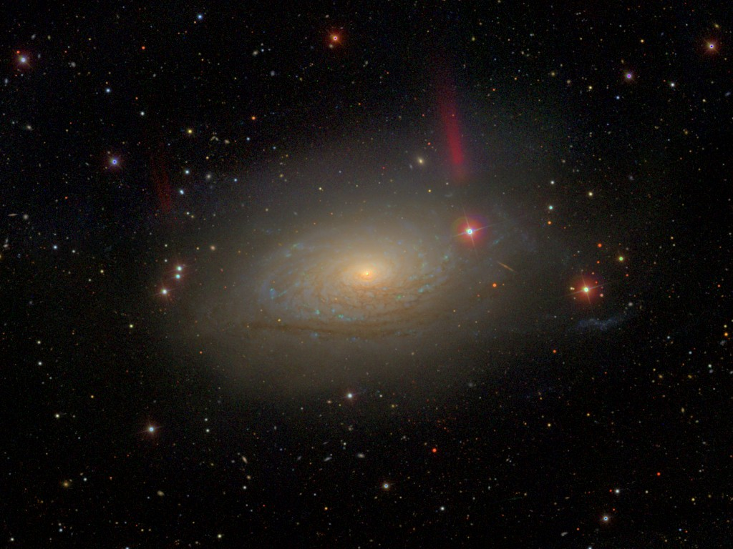
Going Deep
53.9s on 2.5m (SDSS)

Slide 44
960s on a 2.5m

Slide 45
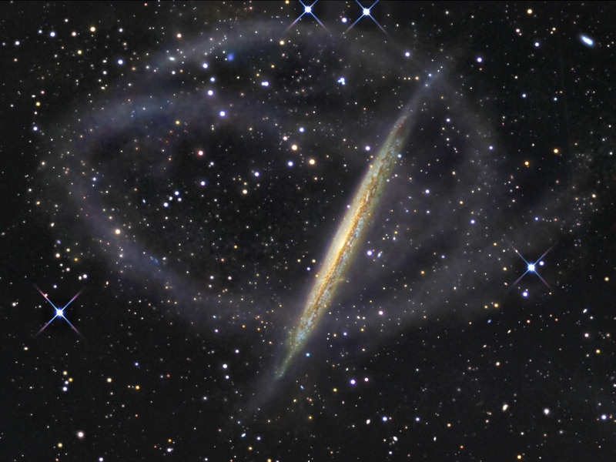
11.3 hours on a 0.5m
NGC 5907, Martínez-Delgado et al. 2008
Notes:
10 hours on a 0.5m telescope.
That means LSST with an 8.4m telescope can get that depth in 4-5 30s visits.

Slide 46
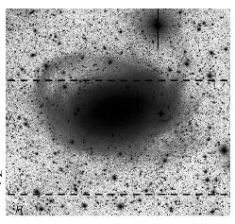
6 hours on a 0.8 m
Chonis et al. 2011

Slide 47
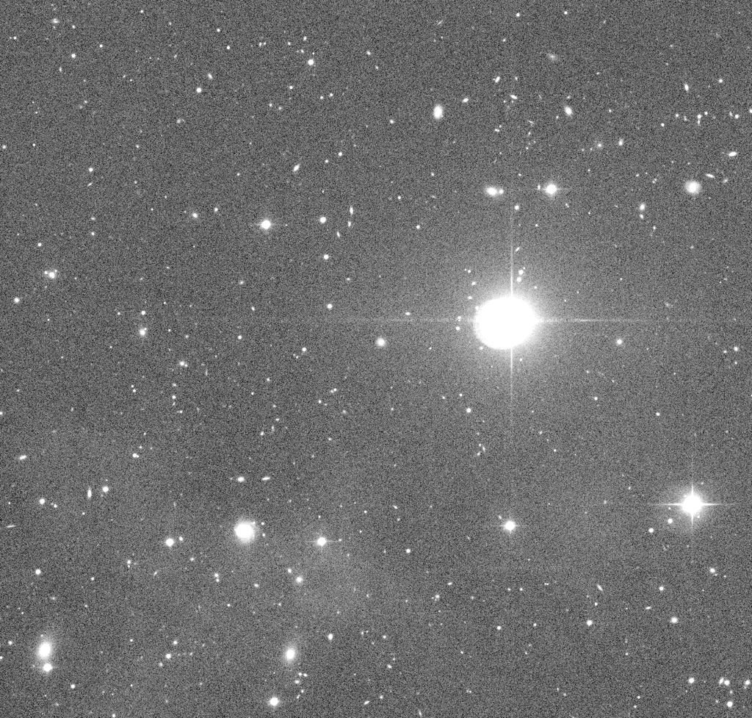
SDSS single frame

Slide 48
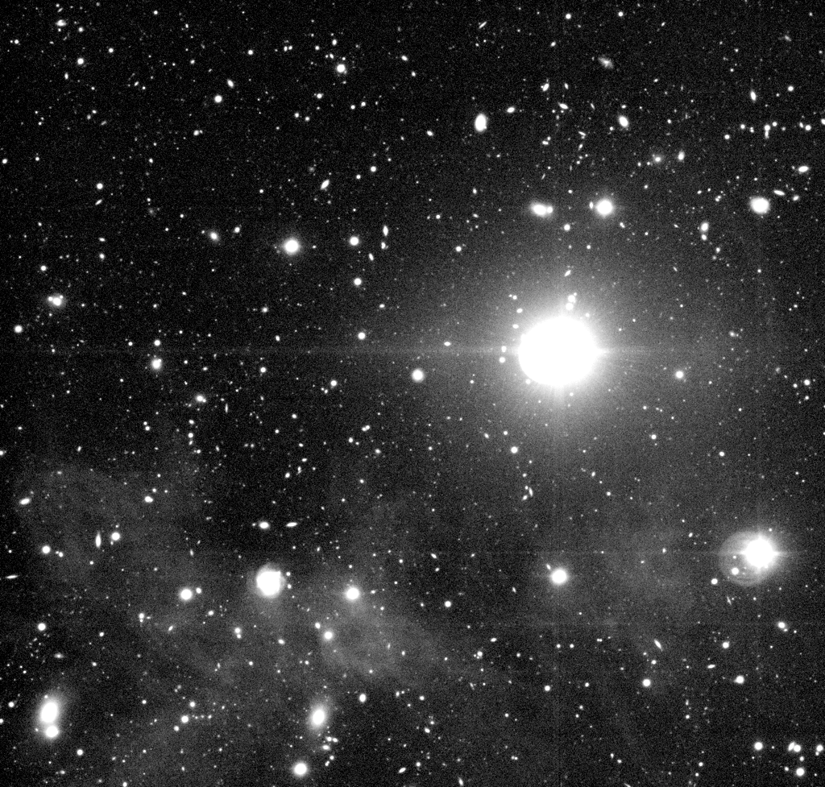
SDSS stripe 82 co-add (~70 frames)
AlSayyad, 2013

Slide 49
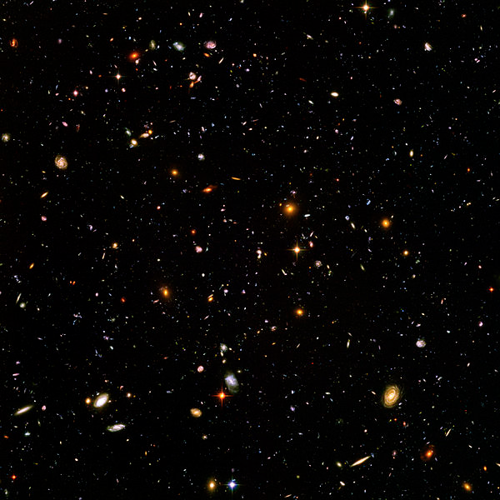
HST Ultra Deep
37.5 hours (in F606) on 2.5m
(11 days exposure time all filters)

Slide 50
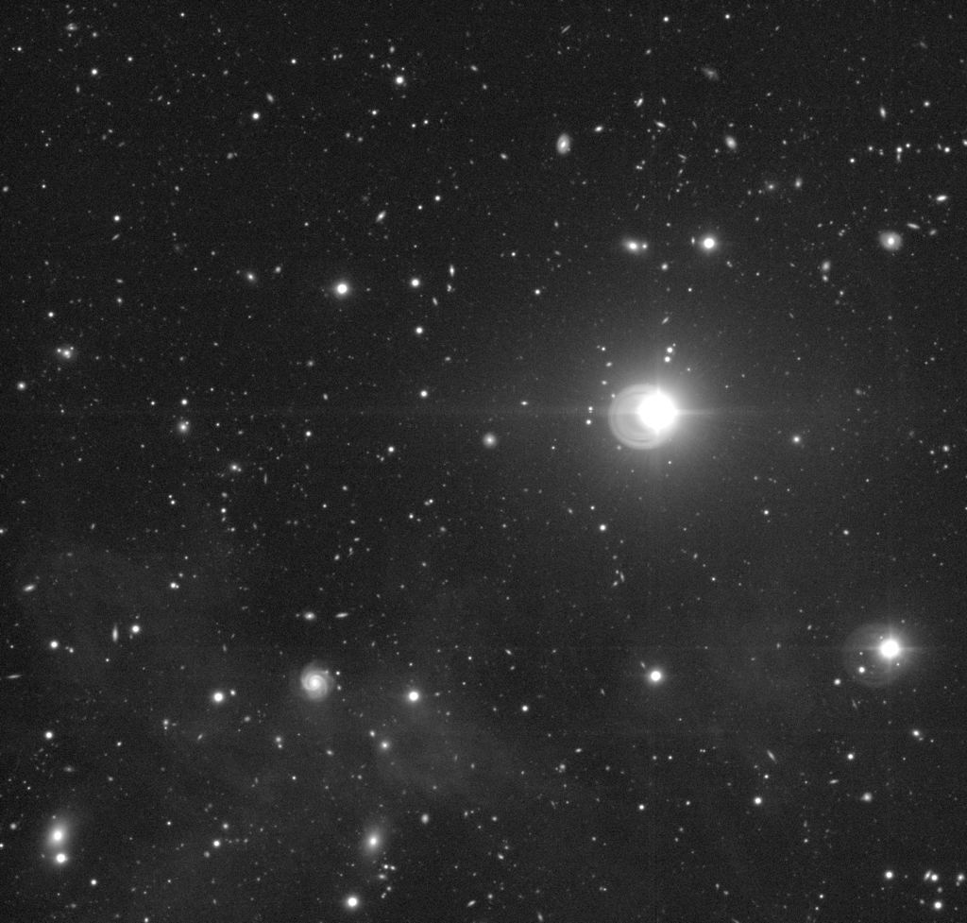
Approx image depth
        Dt^{1/2} (m s^{1/2})
SDSS 18
Thick Disks 77
Streams 100-122
Stripe 82 150
HST Ultra 920

Slide 51
        Dt^{1/2} (m s^{1/2})
SDSS 18
Thick Disks 77
Streams 100-122
Stripe 82 150
HST Ultra 920
46 LSST 30s
205 LSST 1yr
630 LSST 10yr
Notes:
8.4m telescope, with 30s exposures. After 1 year, ~30 visits. After 10 years, ~200 visits.

Slide 52
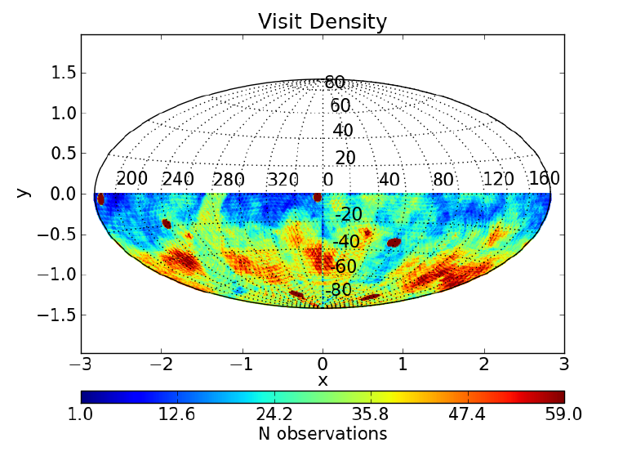
Simulated 2-years of LSST r observations
We hope to have a workshop in June dedicated to LSST cadence design. Would be great to have more voices on how we can optimize LSST for LSB galaxy work!

Slide 53
Conclusions:
Theory and Observations are converging on a formation scenario for the MW thick disk
Stars form thick in early mergers, radial migration moves and thickens stars.
Seems like the story could be extended to the thick disks we see in other galaxies, with galaxy mass correlating with how efficient the thin disk grows, but:
There are oddballs
We need simulations of lower mass systems
We need better stats on other galaxies (LSST should deliver thousands of nearby edge-on galaxies to very faint surface brightness levels in 6 filters)

Slide 55
XXX—how many large edge on galaxies does that come out to?
4743 galaxies in Hyperleda with inc > 88, t > 1, and large (greater than 20 arcsec diameter). Almost 3000 are Sc or later!
So we are looking at 1-2 order of magnitude increase in sample size over what Sebastian and I have done.

Slide 56
The key to observationally differentiating the various formation schemes is the thick disk behavior at large radius.
Does the thick disk truncate at large R?
Does it flare?
Does the chemical composition change?
In the MW, observers went out with SDSS and increased sample sizes by a few orders of magnitude.
We really need to do the same with other galaxies so we can get a better handle on thick disk properties statistically.

Slide 57

Atomic Gas
Mass Fraction
Thin Disk
Thick Disk
It’s not that thick disks are more massive in low-mass gals, but thin disks are much lower mass!

Slide 58

LSST will be deep AND
cover the entire southern sky!
We need more members in the Galaxies Science Collaboration to make sure LSST will generate the best possible co-adds for multi-band LSB work.
Possible workshop in June to discuss survey metrics cadences with the community. Come and design a metric so we know which scheduler is best for your science!
simulated LSST g,r,i image

Slide 59
25 min talk (20 + 5 ) probably.
We would be very pleased to have you discussing the properties of thick disks. In particular, how their structural properties depend on the host galaxy, their relation to thin disks and how they help us constrain galaxy formation and evolution.
Points I want to make:
Very hard to measure thick disk properties at large radii!
Really like Chris Brook’s mechanism of form thick, then the thin disk forms later
LSST has the potential to deliver amazingly deep surface brightness. BUT, the primary science drivers are things like cosmology, so it would be great if people here joined the science groups and helped make sure LSST data will work for you. Lots of people want to treat galaxies as psudo-point sources—not a lot of pressure to get low surface-brightness, large angular size objects right. Would be great to have more people around to make sure we get the large co-adds right. There’s a big push to keep users away from pixel-level data in LSST. We know LSST will find all kinds of cool LSB features, but no one has thought about how we are going to analyze them. XXX-some nice images in the science book. Would be great to have a LSB IFU spectrograph for nearby galaxies!

Slide 60
The recent results from the MW and MW sims:
Cheng 12: alpha-abundances from Segue. No alpha-enhanced start at large Z and large R. Implies early thick disk formation that makes an alpha-rich disk with short scale-length
Stinson 13: Mono-abundance population stuff. Also like an early forming thick disk.
Loebman 10: Radial migration can move alpha-enhanced stars to solar circle
Lee 11: Plot I don’t understand
Bovy 11: There is no thick disk

Slide 61


Slide 62

One major problem is that this is a nasty phase space to chop up:
Age,
X,Y,Z
V_{x},V_{y},V_{z}
[Fe/H]
[α/H]
Because there are so many correlations (and dynamical stability requirements), it’s easy to accidently confuse things
For example, it’s tempting to spatially select stars at Z~1 kpc since they should be an equal mix (by number) of thin and thick disk stars
Ivezic et al, 2008

