Slide 1
Keck spectroscopy and dynamical masses for a large sample of
1 < z < 1.6 passive red galaxies
Sirio Belli
with Andrew B. Newman and Richard S. Ellis
ApJ, submitted
(arXiv:1311.3317)

Slide 2
Introduction
The population of quiescent galaxies grow in size over 0 < z < 2.5
(e.g., Daddi et al. 2005, Trujillo et al. 2006, van Dokkum et al. 2006, 2008, and many others)
0.4 < z < 1
1 < z < 1.5
1.5 < z < 2.0
2.0 < z < 2.5
R_{e} (kpc)
Newman et al. 2012
log M★ (M)

Slide 3
Two Explanations for the Size Growth
z = 0
Newly quenched
quiescent galaxies drive the size growth
(progenitor bias)
z = 2
log size
?
z = 0
log stellar mass
Old quiescent galaxies physically
grow in size
What physical process?
Very open debate: Taylor et al. 2010, Newman et al. 2012, Carollo et al. 2013, Poggianti et al. 2013
Damjanov et al. 2013

Slide 4
Velocity Dispersions
Instead of looking at the population growth, we look at the physical growth
We need a way to connect progenitors and descendants
Numerical simulations show that velocity dispersions are very stable (e.g. Hopkins et al. 2009, Oser et al. 2012)
We assume that σ is constant with cosmic time
z = 2
σ
z = 0

Slide 5
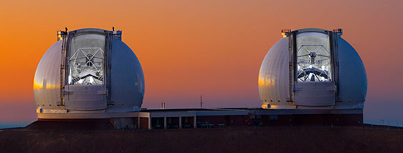
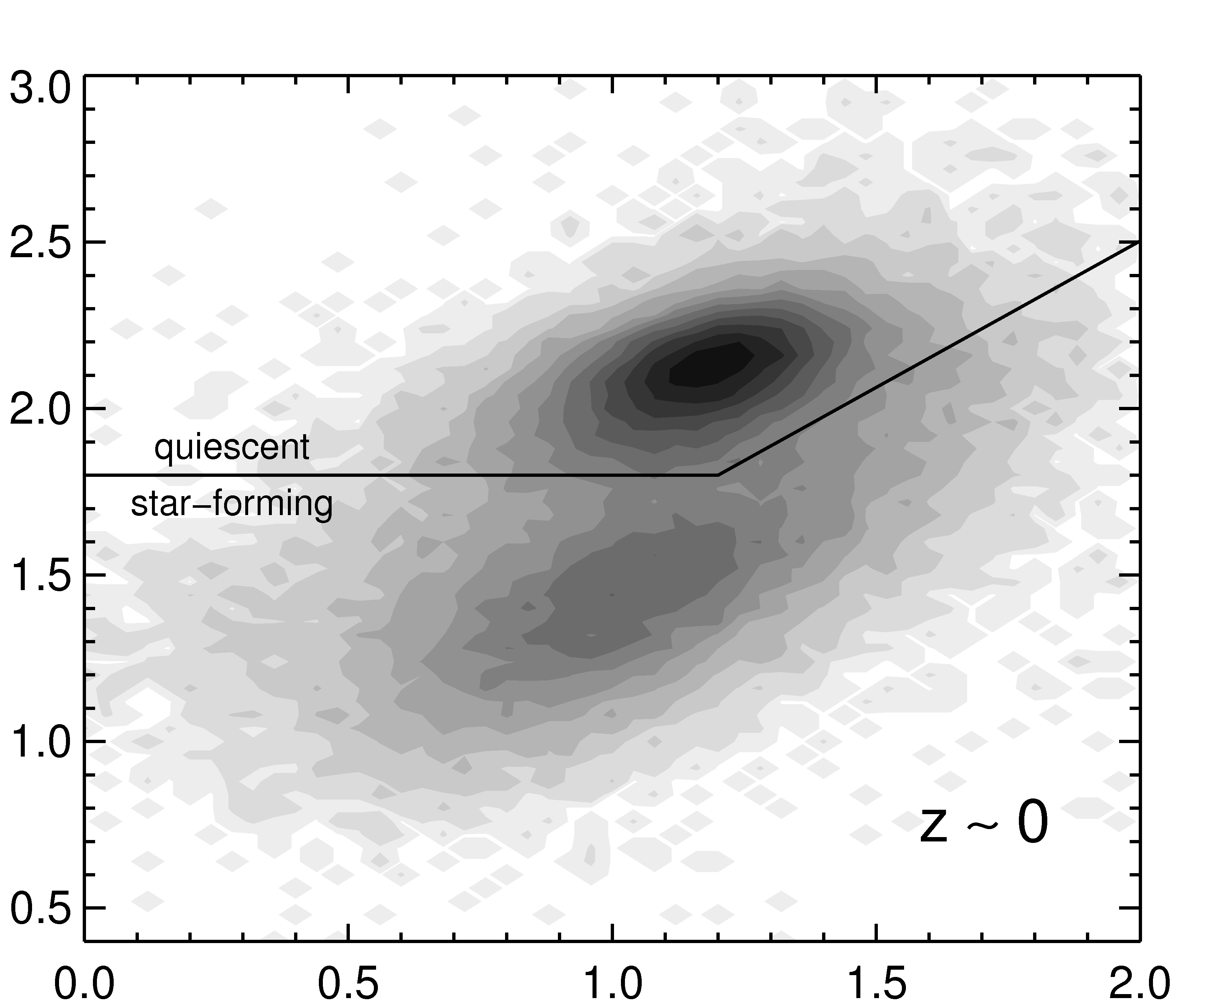
Data
Keck LRIS
CANDELS fields
3 – 8 hours per mask
1 < z < 1.6
103 total galaxies
69 quiescent
56 quiescent with S/N > 8
(U-V)_{rest-frame}
(V-J)_{rest-frame}

Slide 6
Spectra
[OII]
Balmer lines
Ca H & K
Notes:
S/N per resolution element between 8 and 40

Slide 7
Physical Properties
Keck LRIS spectra
+ pPXF (Cappellari & Emsellem 2004)
Public photometry
+ FAST (Kriek et al. 2009)
σ_{e}
M★
R_{e}
HST CANDELS F160W + GALFIT (Peng et al. 2002)

Slide 8
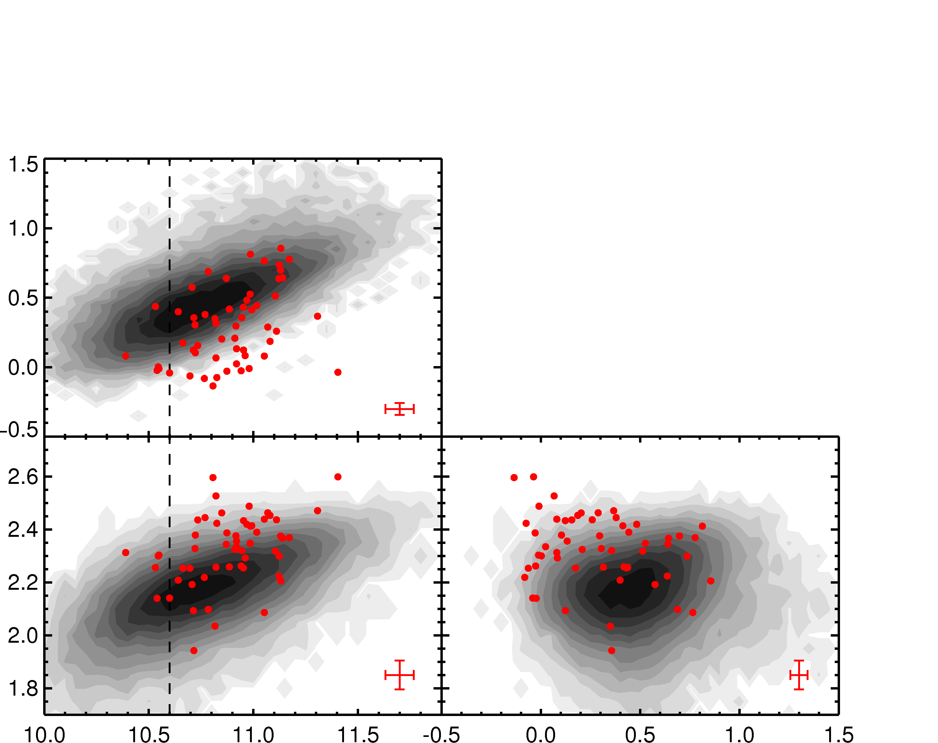
Observed Evolution in Size and Sigma
z = 0
z > 1
log R_{e} (kpc)
log σ_{e} (km/s)
log M★ (M)
log R_{e} (kpc)

Slide 9
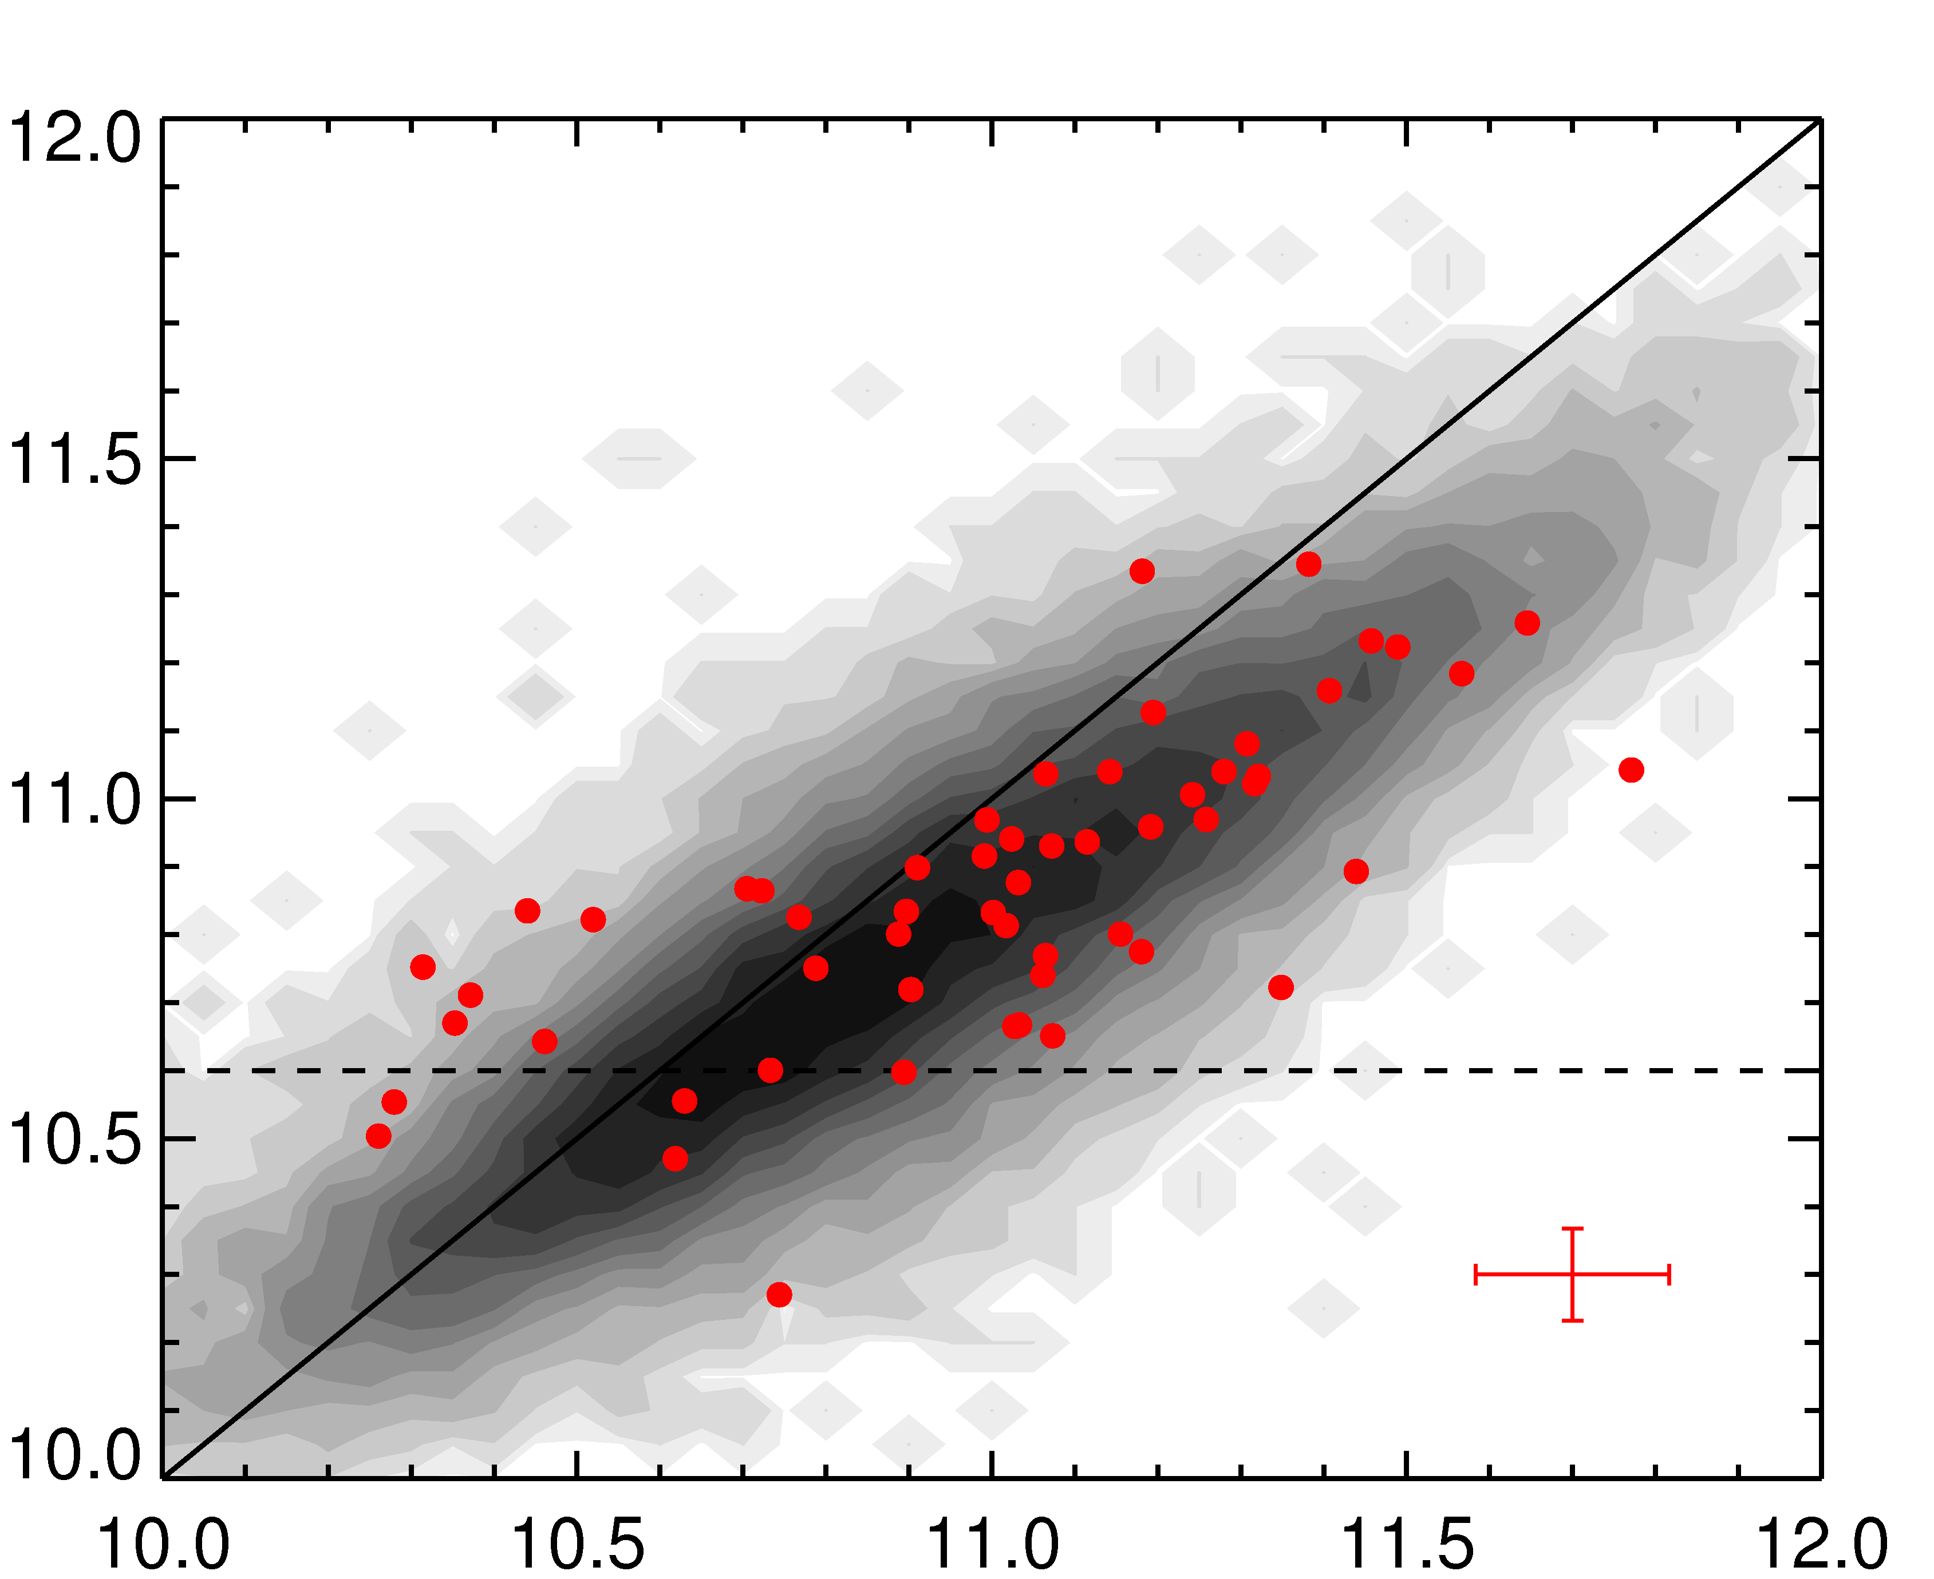
Dynamical Masses
log M★ (M)
The M_{dyn}- M★ relation is constant with redshift
log M_{dyn} (M)

Slide 10
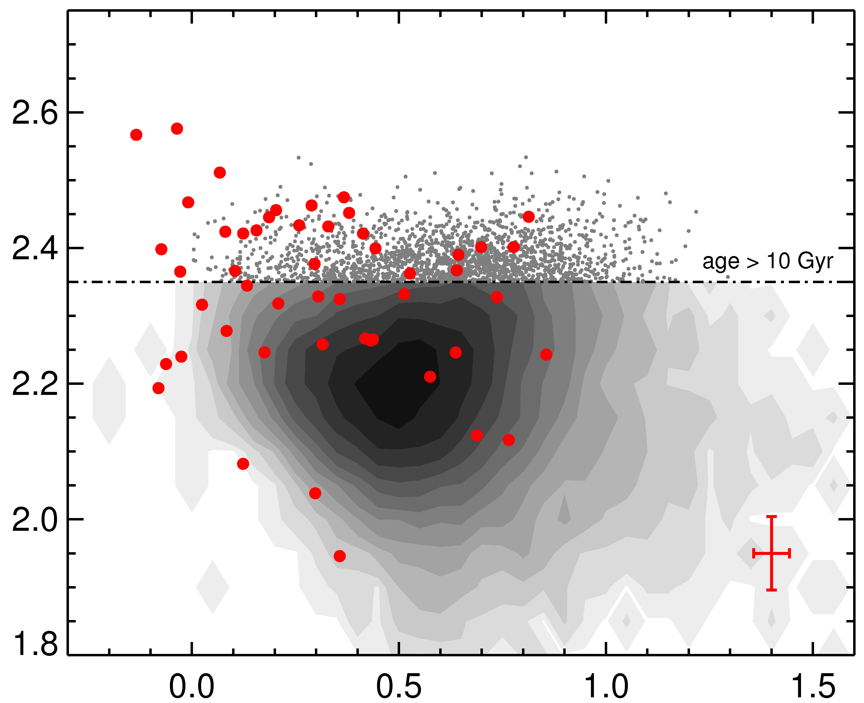
Velocity Dispersions are Important
age
These galaxies must physically grow
10 Gyr → z_{form} = 1.6
log σ_{e} (km/s)
no age trend at fixed σ
Results from
local universe studies (Graves et al. 2009)
log R_{e} (kpc)

Slide 11
Model 1: Fixed Dispersion
Δ log M★
log R_{e} (kpc)
Δ log R_{e}
log M★ (M)

Slide 12
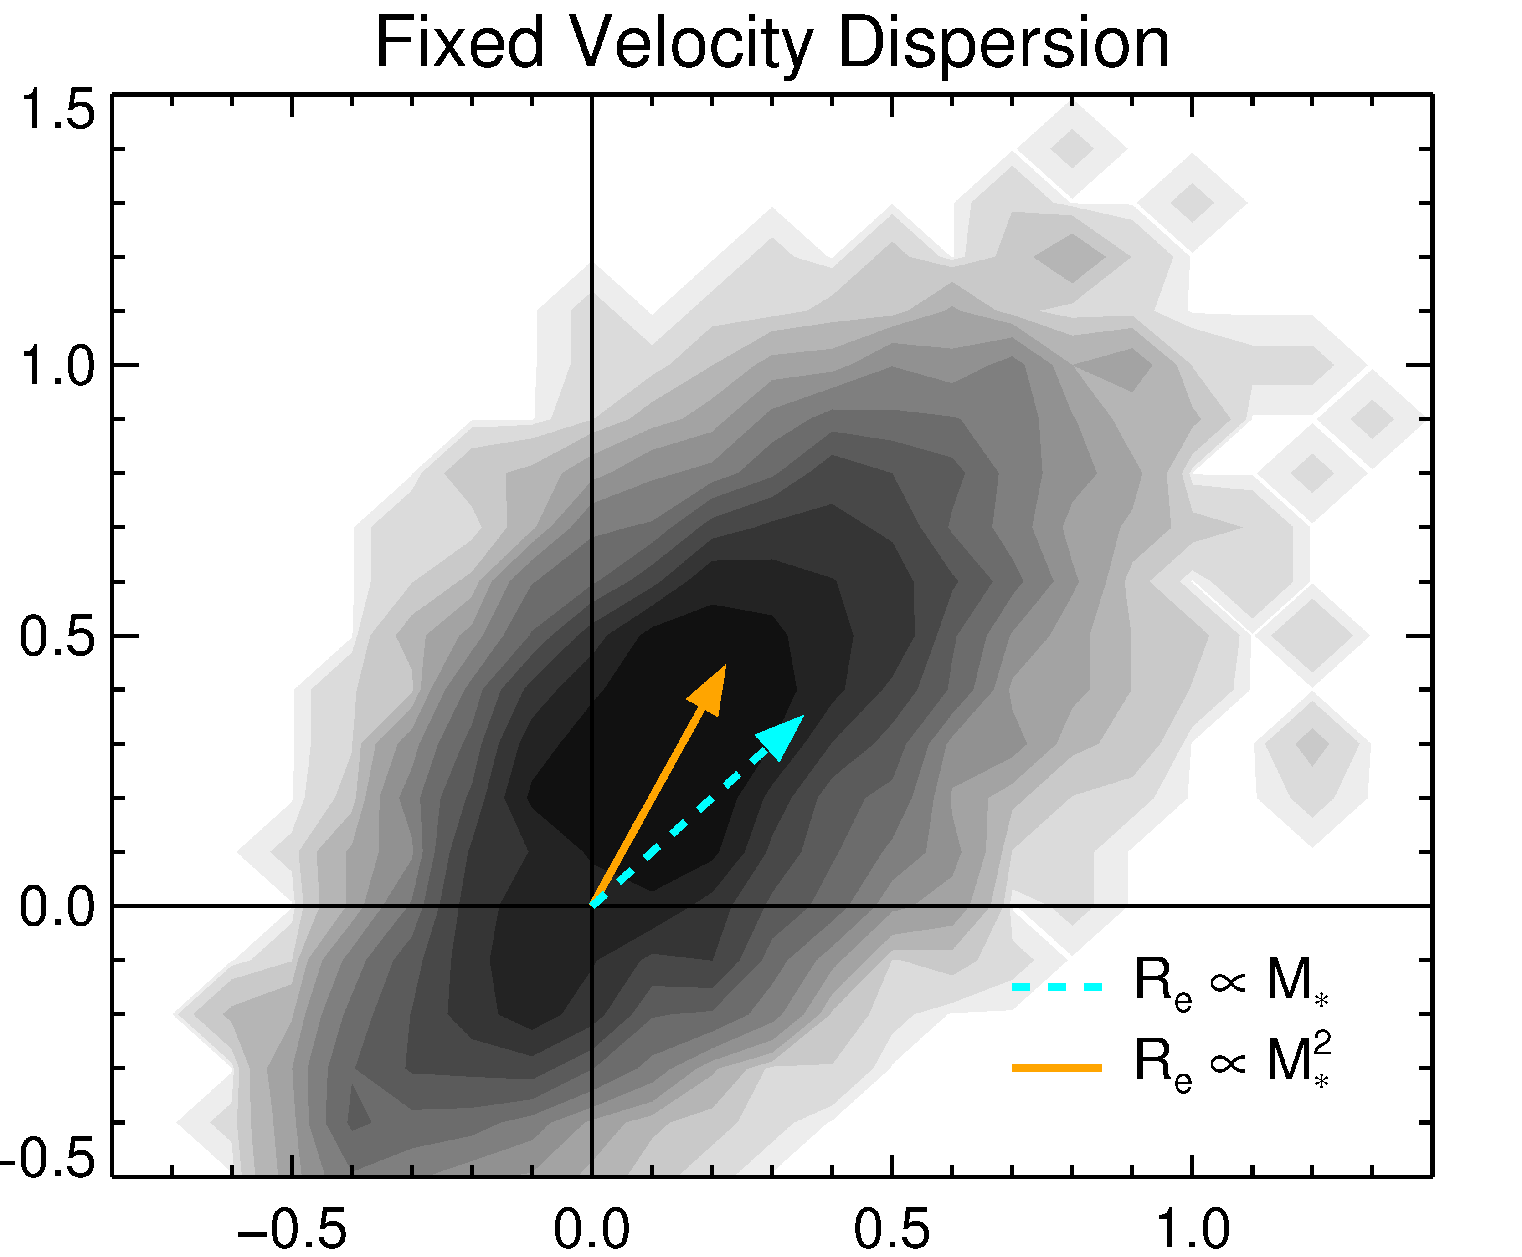
Model 1: Inferring the Growth
identical merger:
minor merger:
Δ log R_{e}
(Hernquist et al. 1993, Naab et al. 2009, Hilz et al. 2013, and many others)
Our result:
Δ log M★
Observed size growth of 0.25 dex
Consistent with minor merging

Slide 13
Model 2: Fixed Dispersion Ranking
Bezanson et al. 2011
There is a 1:1 relation between the high- and low-redshift populations in this plot
log R_{e} (kpc)
The number density of galaxies with σ > 280 km/s is constant!
log M★ (M)

Slide 14
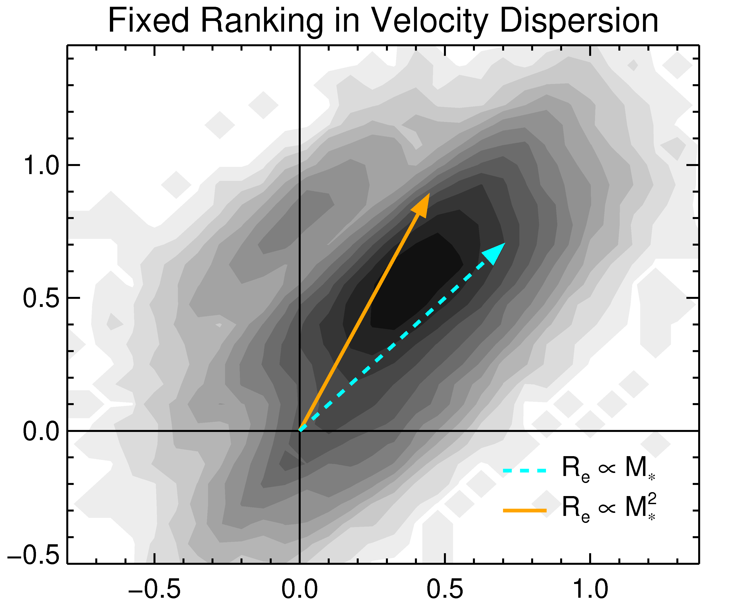
Model 2: Inferring the Growth
Δ log R_{e}
Strong size growth of individual galaxies (0.5 ± 0.1 dex)
Consistent with minor merging
Δ log M★

Slide 15
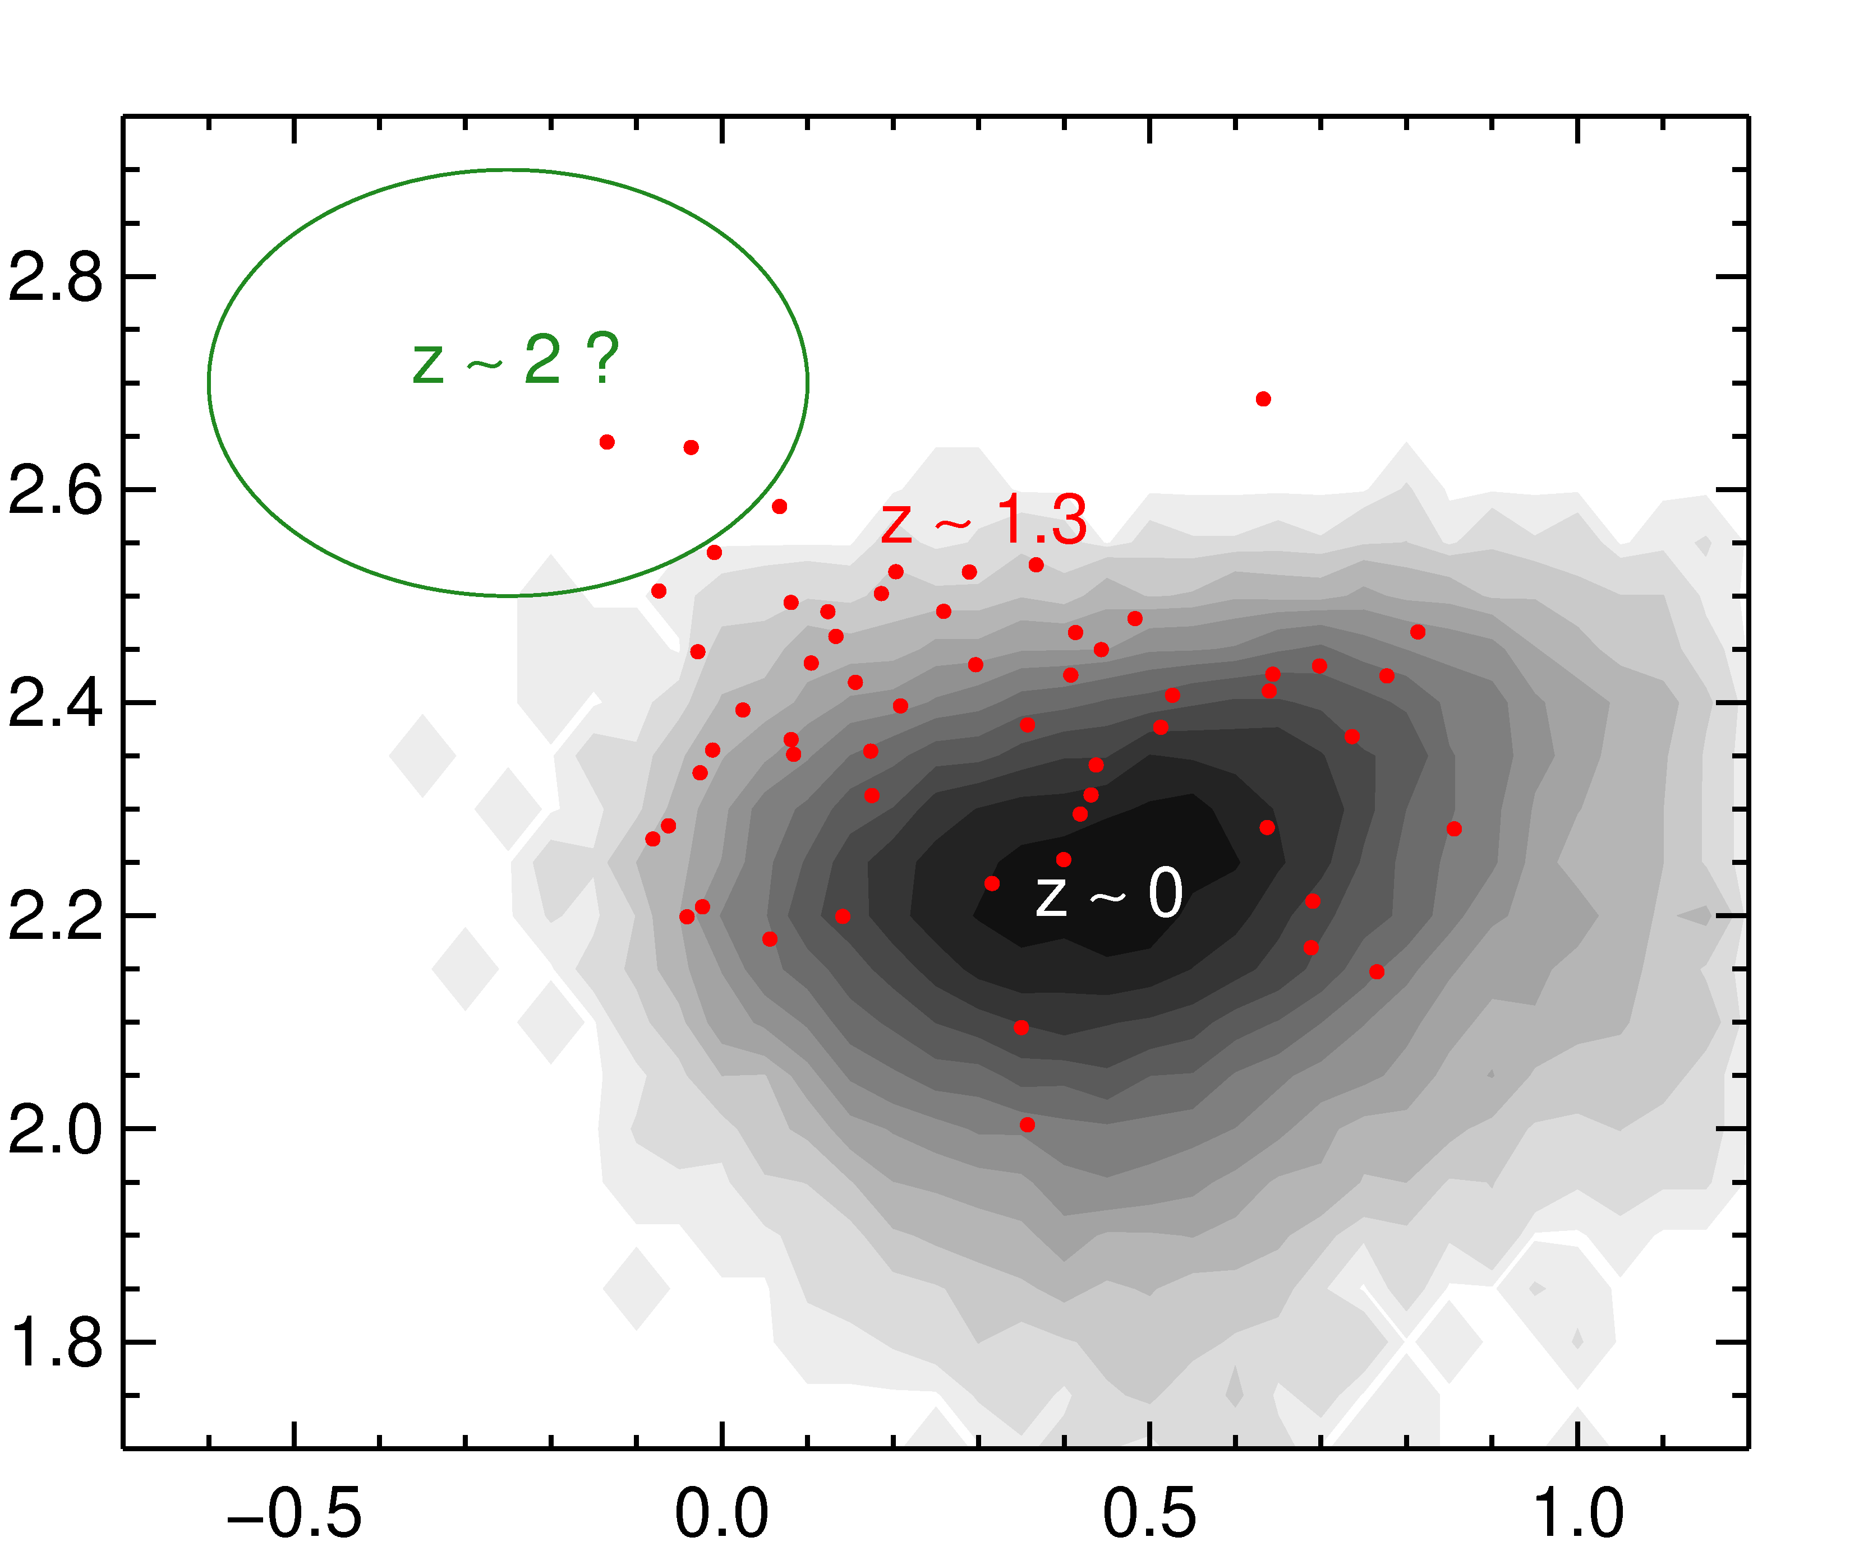

Work in Progress
At z > 1.5, quiescent galaxies are even smaller
Minor merger rate might not be high enough (e.g. Newman et al. 2012, Nipoti et al. 2012)
z = 2.09
σ = (321 ± 40) km/s
log σ_{e} (km/s)
log R_{e} (kpc)
Notes:
stellar mass = 11.8
log sigma = 2.5

Slide 16
Conclusions
Quiescent galaxies at z>1 have smaller sizes and larger dispersions than their local counterparts
The dynamical-stellar mass relation does not change with redshift
By assuming that the velocity dispersion does not change, we find significant evolution in mass and size
By assuming that the velocity dispersion ranking does not change, we find an even stronger evolution in mass and size
Both results are in agreement with simulations of minor merging
Progenitor bias alone cannot be responsible for the observed size evolution

Slide 17
Supplementary slides

Slide 18
Completeness
CANDELS photometric sample
log R_{e} (kpc)
our spectroscopic sample
log M★ (M)

Slide 19
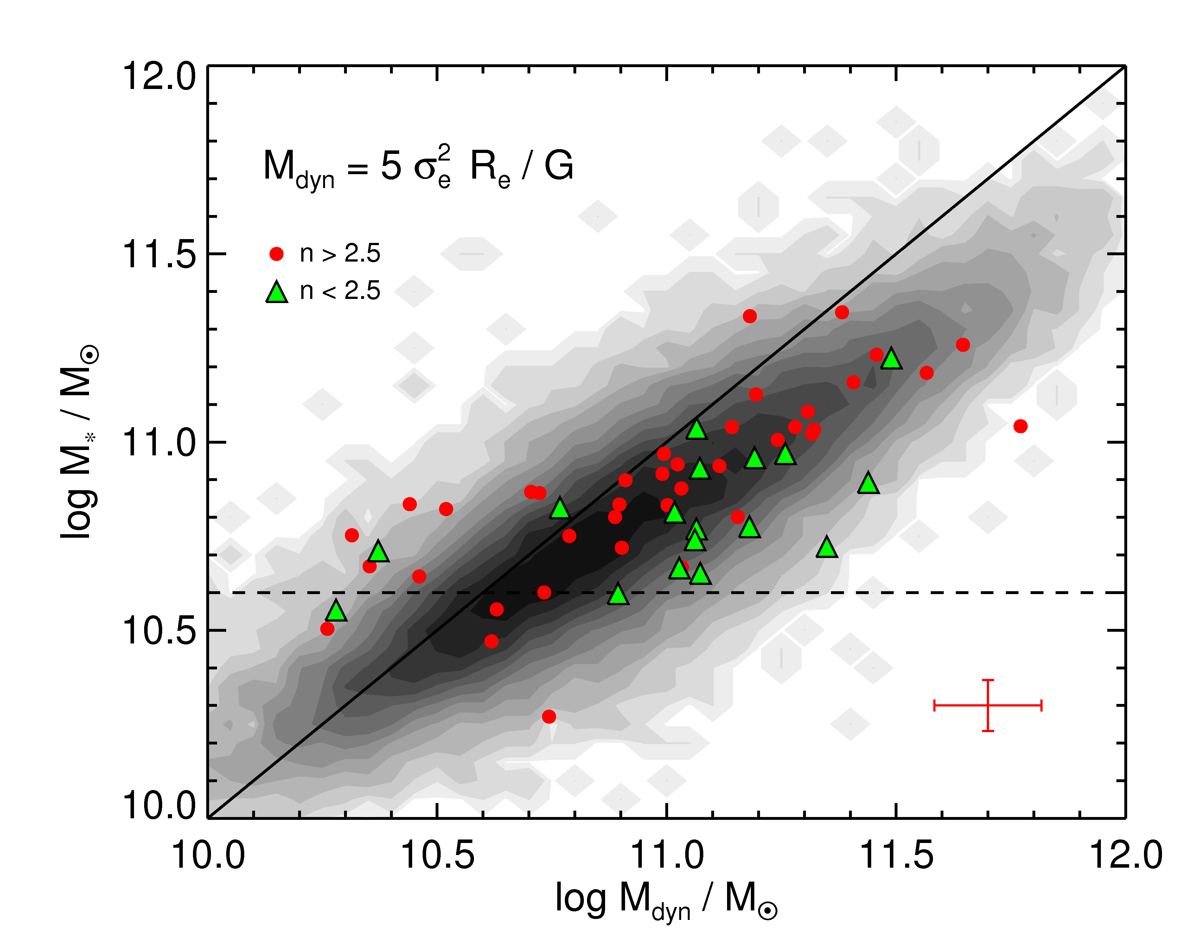
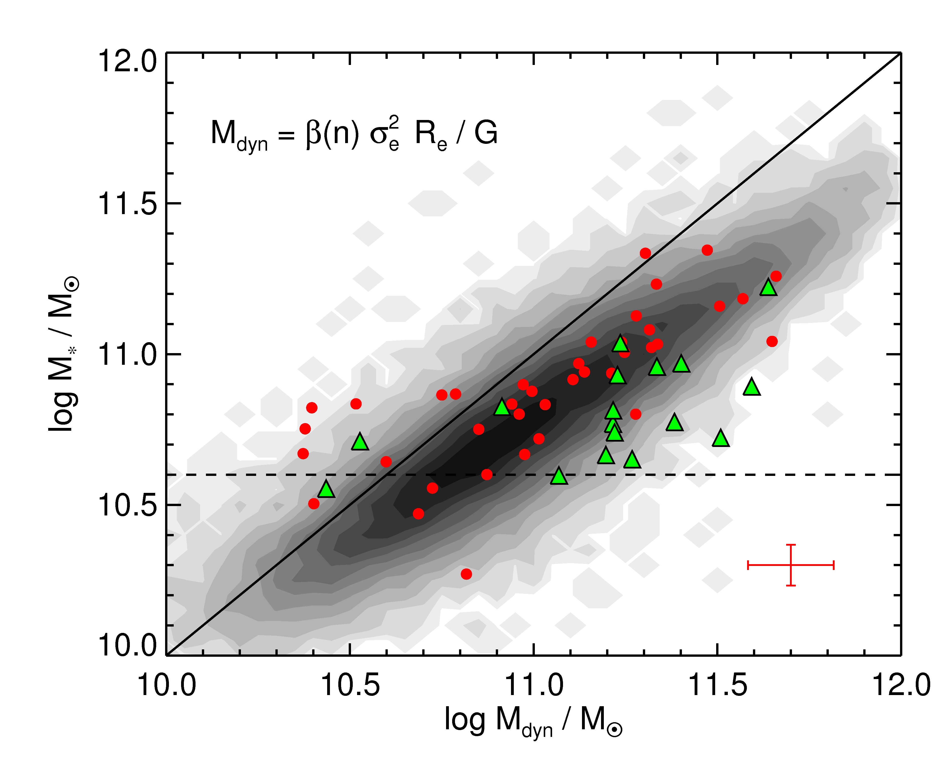
Galaxy Structure: Non-Homology

Slide 20
Measuring Velocity Dispersions: Tests

Slide 21
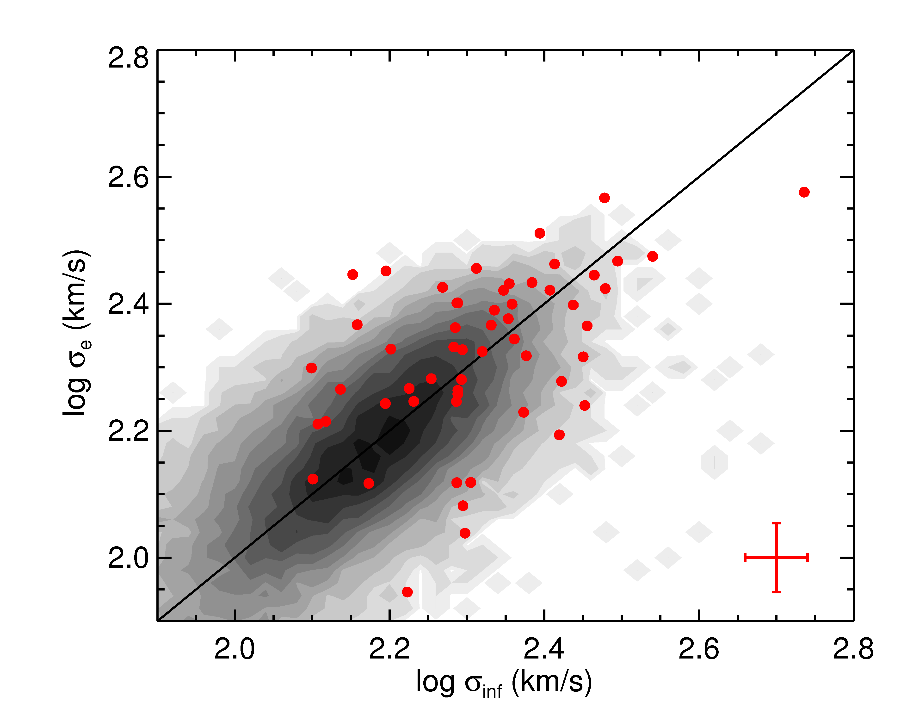
Inferred Velocity Dispersions

