Slide 1

Galaxy Morphology at the Peak of Galaxy Assembly from CANDELS
@CANDELS_team
http://candels-collaboration.blogspot.com
Jeyhan Kartaltepe, Hubble Fellow, NOAO
+ the CANDELS and GOODS-Herschel Collaborations
jeyhan@noao.edu
2013 November 18
Deconstructing Galaxies: Structure and Morphology in the Era of Large Surveys

Slide 2
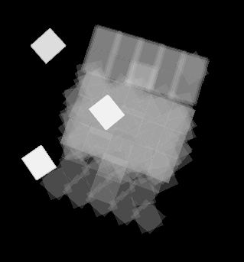
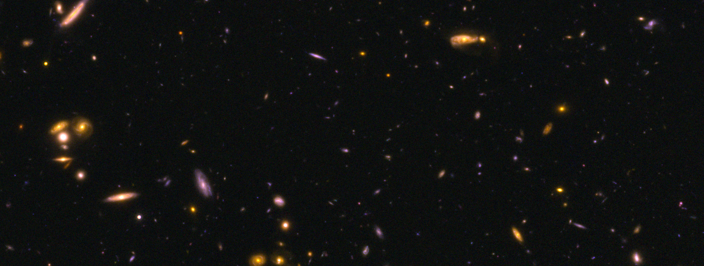
CANDELS
Largest HST Survey (PIs: S. Faber & H. Ferguson)
NIR imaging of 5 of the
most commonly studied
deep fields
Deep and wide areas
Imaging is now complete!
Work is ongoing
J and H band Coverage of GOODS-S
ERS
Deep region
UDF
Wide region

Slide 3
Galaxy Morphology at High-z
For galaxies at z~2, deep NIR imaging provides rest-frame optical structure
With CANDELS WFC3, can look at structure for large samples at z~2 for the first time
Visual Morphology
Quantitative Morphology
  GALFIT: Sersic index, B/D, size, etc.
  Non-parametric measures: Gini, M20, CAS, MID, etc.
  Use Visual Morphology to calibrate these at high-z

Slide 4
CANDELS Visual Classifications
Classifying all CANDELS Galaxies to H<24.5
  3 fields complete (UDS, GOODS-S, COSMOS)
  2 remaining
  Total of ~50,000 by the end of survey
  Classifications at multiple depths in deep area
  Primarily in H-band, use other bands to inform
Multiple classifiers for comparison and statistical analysis
  ~3-5 people per object
  ~65 classifiers in total
Catalogs to be made public (GOODS-S with Kartaltepe et al. 2013, in prep)

Slide 5
Classification Scheme
Two levels
  Main Morphological Class (disk, spheroid, irregular, point source, unclassifiable)
    NOT mutually exclusive! – can choose more than one
  Interaction Class (merger, interaction within/beyond segmap, non-interacting companion)
    Only one choice (or none)
Structure flags
K-correction flags
Quality flags
Clumpiness flags

Slide 6
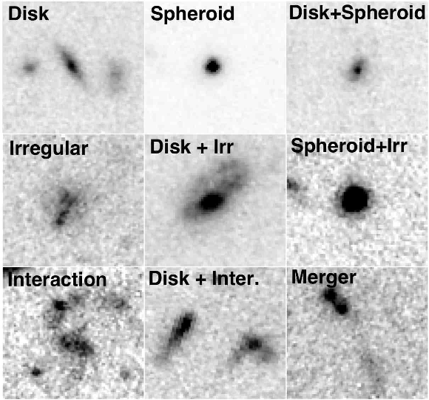
Classification Scheme
Main Morphological Class
Interaction Class

Slide 7
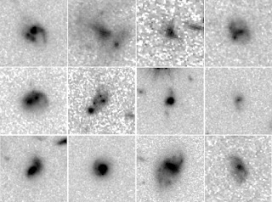
What is the Role of Galaxy Mergers?
In increasing a galaxy’s SFR
In contributing to the cosmic star formation history
In fueling AGN
In the morphological transformation of galaxies
  Forming spheroids
Evidence for the changing
role of mergers in the
recent literature but
many open questions
remain!

Slide 8
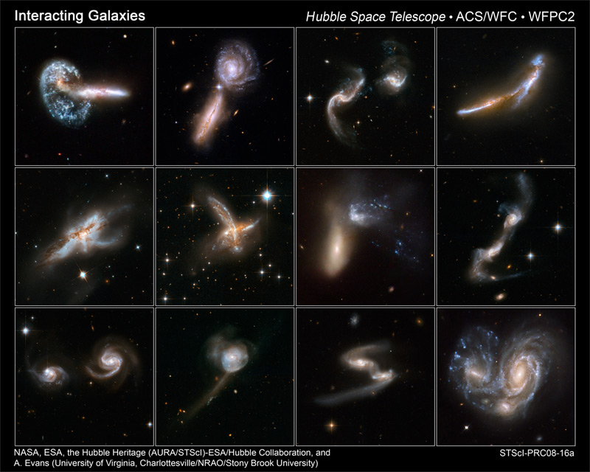

Slide 9
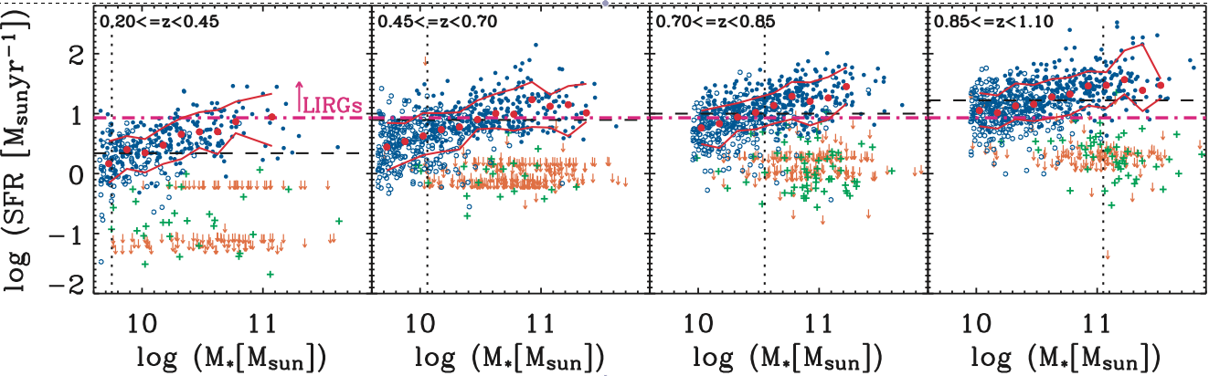
“Main Sequence” and Starburst Galaxies
Correlation between star formation rate (SFR) and stellar mass
  True locally (e.g., Brinchmann et al. 2004) and at high redshift (e.g., Noeske et al. 2007; Daddi et al. 2007)
  Evolves with redshift (increase in gas fraction?)
Galaxies elevated above this relation → Starbursts
Noeske et al. 2007

Slide 10
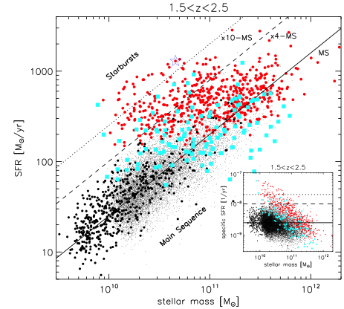
“Main Sequence” and Starburst Galaxies
What is the role of mergers among starbursts and “main sequence” galaxies at z~2?
Rodighiero et al. 2011

Slide 11
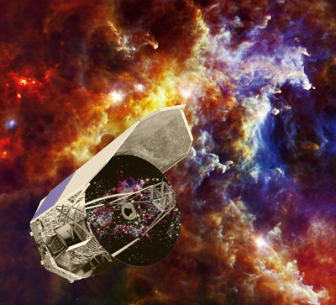
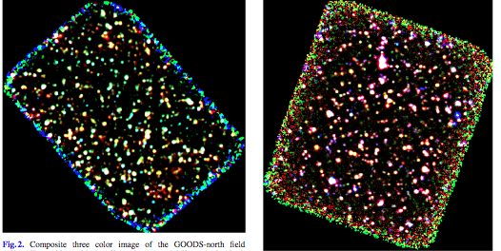
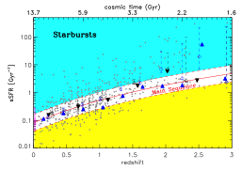
GOODS-Herschel
Herschel coverage of both GOODS fields (PI: D. Elbaz)
  Deepest Herschel data taken!
  Full GOODS-N field: 1.6 mJy (@ 100 μm)
  Central part of GOODS-S: 0.6 mJy (@ 100 μm)
Deep enough to reach main sequence galaxies at z~2
Imaging from CANDELS
Elbaz et al. 2011
GOODS-N
GOODS-S

Slide 12
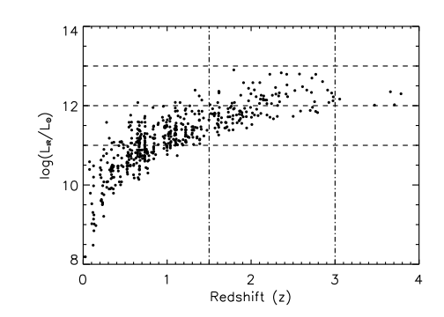
GOODS-Herschel ULIRG Sample
Focus on all ULIRGs with z = 1.5 - 3.0 in GOODS-S
52 ULIRGs with CANDELS imaging
  First complete, FIR selected sample of ULIRGs at z~2!
Additional 70 LIRGs over this z range
<log(L_{IR})> ~ 12.26
<z> ~ 2.2
Kartaltepe et al. 2012

Slide 13
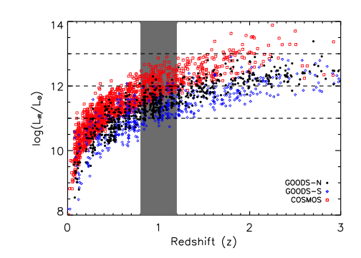
Comparison with z~1
COSMOS 70 mm
  277 sources 0.8 < z < 1.2
  Relatively shallow, but large area coverage
  log(L_{IR}) = 11.3 - 12.9
GOODS-Herschel
  North+South
  100/160 mm
  Smaller area, significantly deeper
  293 sources w/ 0.8 < z < 1.2
  Log(L_{IR}) = 10.6 – 12.4
Classified using ACS imaging and same scheme

Slide 14
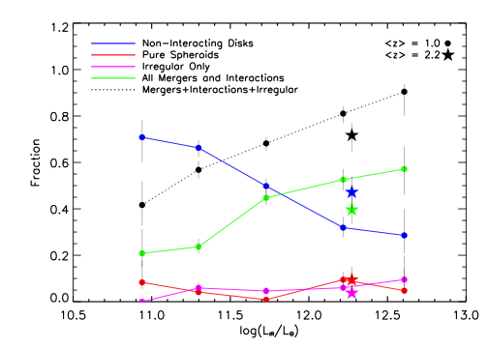
Kartaltepe et al. 2010b, 2012

Slide 15
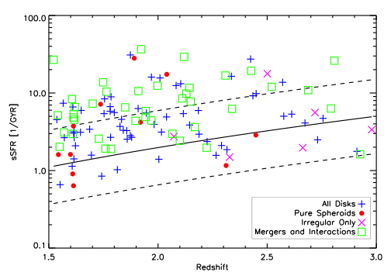
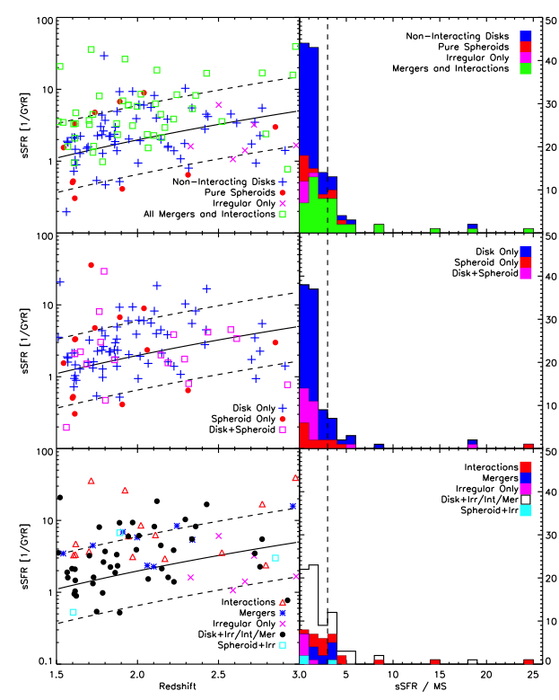
Are z~2 (U)LIRGs Starbursts?
Main Sequence (MS) from Elbaz et al. 2011
MS x3
Kartaltepe et al. 2012

Slide 16
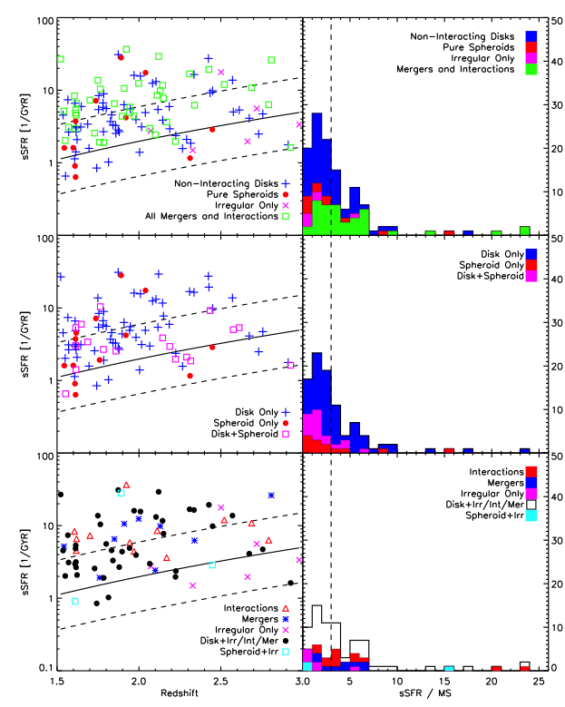
Are z~2 (U)LIRGs Starbursts?
Starbursts
Starbursts
Kartaltepe et al. 2012

Slide 17
Are z~2 (U)LIRGs Starbursts?
Disks:
med(sSFR/sSFR_{MS}) = 2.4
Starbursts
Starbursts
Kartaltepe et al. 2012

Slide 18
Are z~2 (U)LIRGs Starbursts?
Interactions & Mergers:
med(sSFR/sSFR_{MS}) = 3.8
Starbursts
Starbursts
Kartaltepe et al. 2012

Slide 19
What are z~2 “Main Sequence” Galaxies?
Starbursts
“Main Sequence”
Non-interacting disks: 57%
Interactions & Mergers: 24%
Kartaltepe et al. 2012

Slide 20
Are z~2 Starbursts Mergers?
Starbursts
Starbursts
Non-interacting disks: 42%
Interactions & Mergers: 50%
Kartaltepe et al. 2012

Slide 21
Summary
CANDELS Morphologies will be useful for many science goals and available to the community
Morphologies of z~2 ULIRGs show a wide diversity
  Including disks, mergers/interactions, irregular systems
Most (U)LIRGs on the “main sequence” at z~2 are disks (57%)
  BUT significant (24%) number are mergers
  Significant enhancement of SFR for a short time during the merger
Half of starbursts are mergers/interactions (50%)

Slide 22
Future Work
How can we disentangle major mergers from disk instabilities?
  Morphology is first step (pairs, double nuclei, tidal features), but not enough
  Clumpy star forming disks can look like mergers!
  Addition of velocity information may be crucial
Extend to larger sample from full CANDELS+GOODS Herschel Surveys to study trends as a function of L_{IR}, sSFR, AGN content, etc.
Even CANDELS area is too small to identify HyLIRGs, which may be the true high-z analogs to local ULIRGs

Slide 24
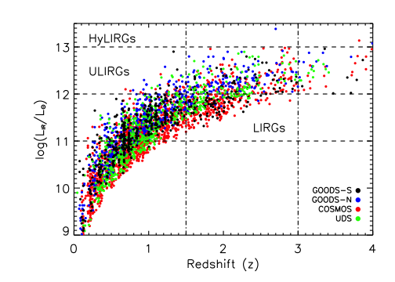
CANDELS-Herschel Parameter Space
NEW Herschel imaging
in additional CANDELS fields
All four fields
combined
    376 ULIRGs
Better statistics
Better sampling
of L_{IR} > 12.5
Many LIRGs

Slide 25
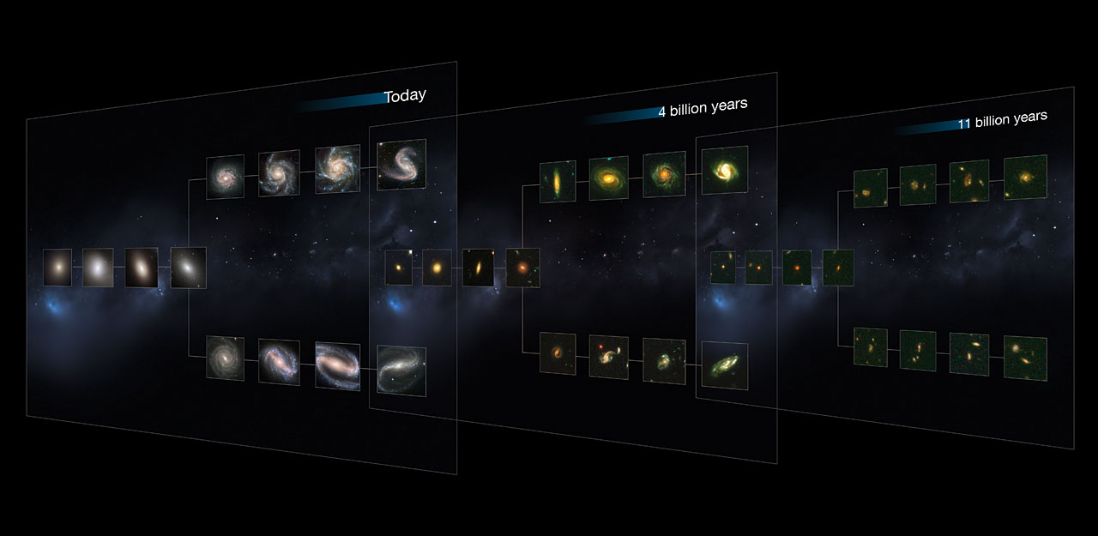
When did the Hubble Sequence Form?
a
z ~ 0
z = 0.3 - 0.7
z = 2.0 - 2.7
ESA Press Release on Lee et al. 2013

Slide 26
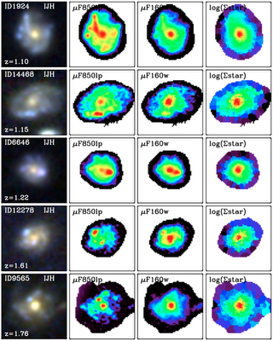
How Important are Clumps?
Disk instabilities?
Signatures of mergers?
More frequent in higher gas fraction systems?
Do these clumps become part of the bulge?
Wuyts et al. 2012

Slide 27
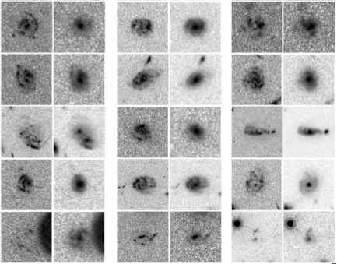
Morphological K-Corrections
Some objects are very different in the optical and NIR
Many clumpy irregular systems look regular in the IR
Bulges are more prominent in the IR
V H
V H
V H

Slide 28
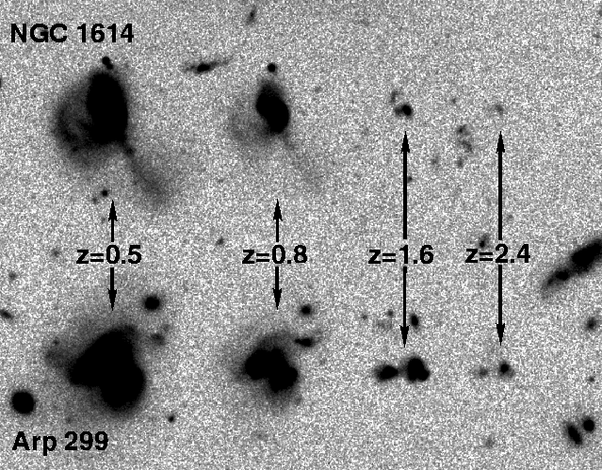
Identifying Mergers at z~2
What does a merger at z~2 look like?
Low surface brightness features are hard to see
Other causes of disturbed
morphology
  Disk instabilities?
Minor mergers?
Hibbard & Vacca 1997

Slide 29
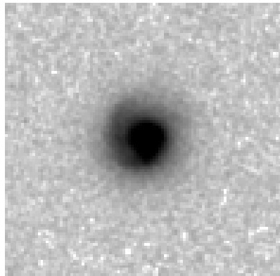
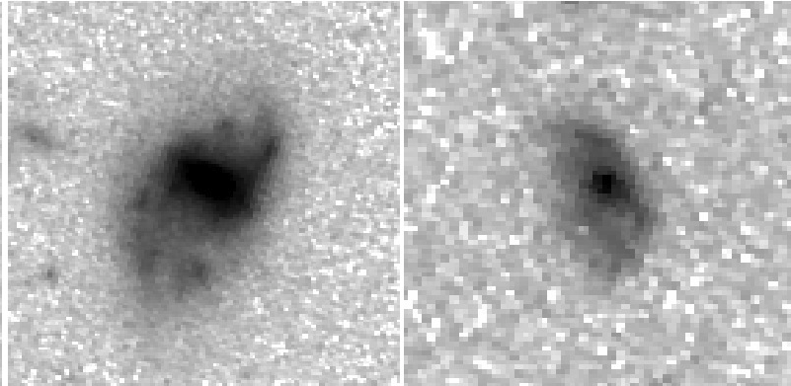
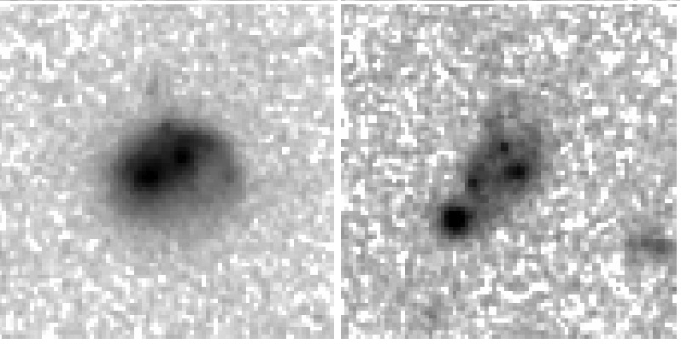
Identifying Mergers at z~2
Bona Fide Mergers
  Tidal tails
  Double nuclei
  Pairs (need redshift information!)

Slide 30



Identifying Mergers at z~2
Bona Fide Mergers
  Tidal tails
  Double nuclei
  Pairs (need redshift information!)
Tantalizing Suggestions
  Train wrecks (assumed to be mergers)
  Disturbed systems
  Slight Asymmetries (minor mergers?)

Slide 31


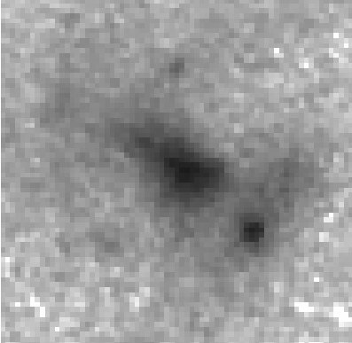
Identifying Mergers at z~2
Bona Fide Mergers
  Tidal tails
  Double nuclei
  Pairs (need redshift information!)
Tantalizing Suggestions
  Train wrecks (assumed to be mergers)
  Disturbed systems
  Slight Asymmetries (minor mergers?)
Unclear?
  Irregular systems / Diffuse blobs

Slide 32
Identifying Mergers at z~2
Bona Fide Mergers
  Tidal tails
  Double nuclei
  Pairs (need redshift information!)
Tantalizing Suggestions
  Train wrecks (assumed to be mergers)
  Disturbed systems
  Slight Asymmetries (minor mergers?)
Unclear?
  Irregular systems / Diffuse blobs
Post mergers?

Slide 33
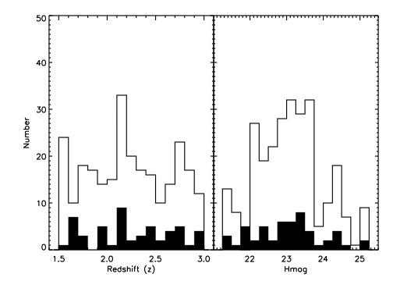
Comparison Sample
Selected 260 comparison galaxies (5 for each ULIRG)
  Not Herschel detected → less luminous z~2 population
Matched to redshift and H magnitude
Randomized and
classified
ULIRGs + comparison

Slide 34
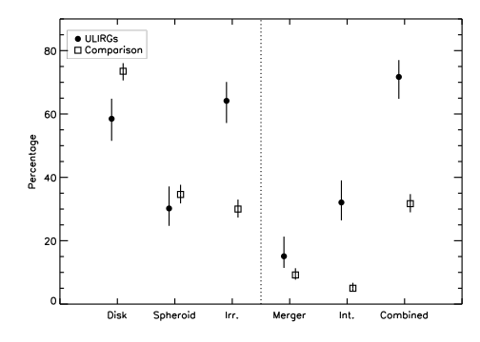
Results
Merger+Int+Irr
Kartaltepe et al. 2012

