Slide 1
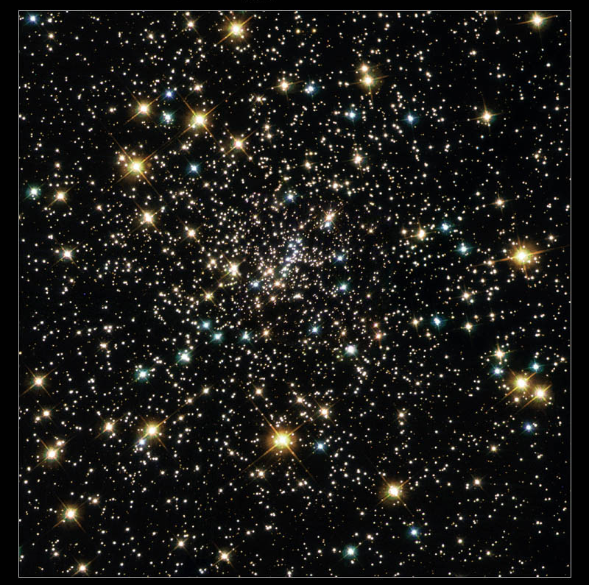
Blue Stragglers in Globular Clusters:
Observations, Statistics, Physics
NASA and the Hubble Heritage Team/A. Cool
Christian Knigge
University of Southampton

Slide 2
Outline
Physics
  Blue Straggler Formation Channels
Statistics
  N_{BSS} vs ???: the Search for the “Smoking Gun” Correlation
Observations
  Radial Trends
  Double Sequences
  …
Summary

Slide 3
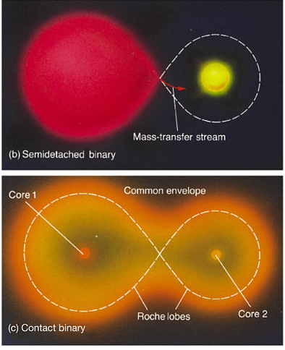
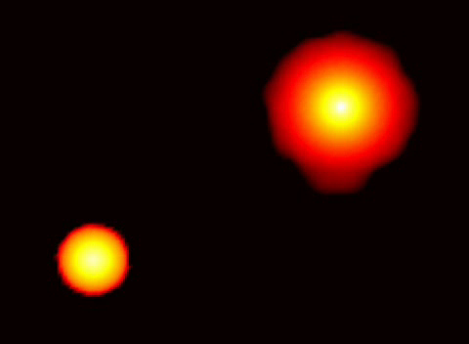
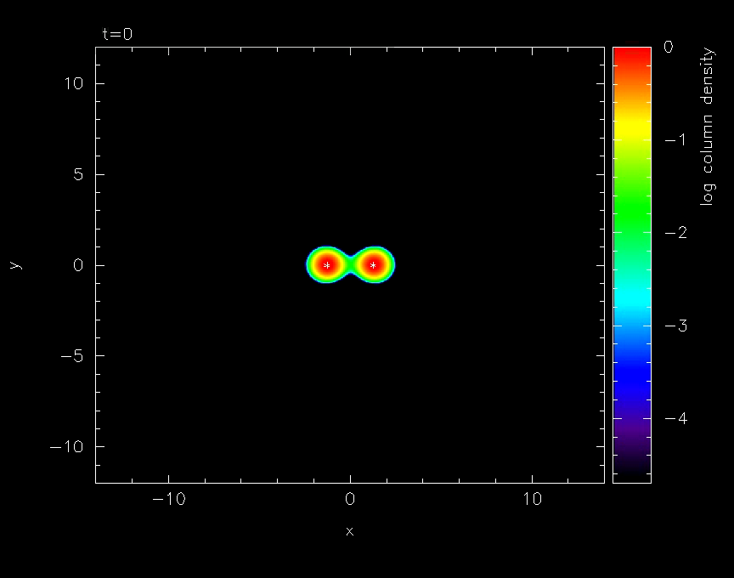


Straw-Man Models for BSS Formation
Stellar Collisions
  single-single
  $N_{BSS}∝Γ_{coll,1+1}∝R_{c}^{3}n_{c}^{2}σ_{c}^{−1}$
Binary Evolution
  mass-transfer…
  …or already coalesced
  $$N_{BSS}∝N_{bin}∝f_{bin}M_{tot}$$
Jamie Lombardi
©2005 Pearson Prentice Hall
Jamie Lombardi

Slide 4
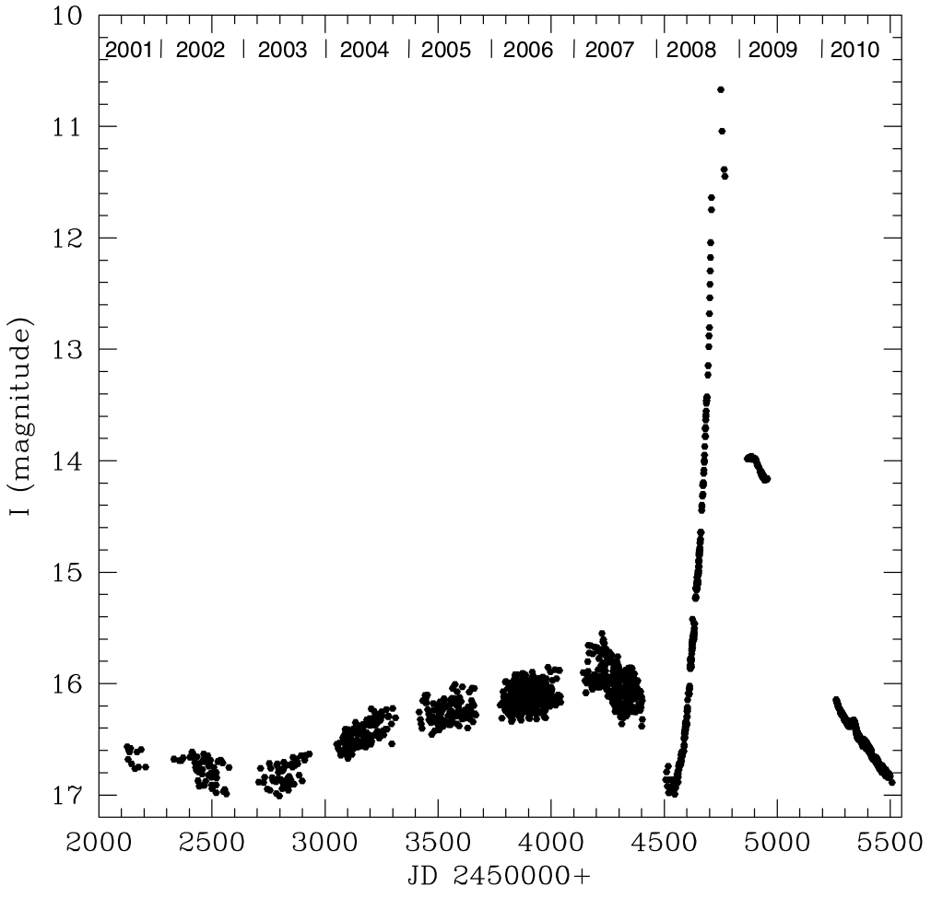
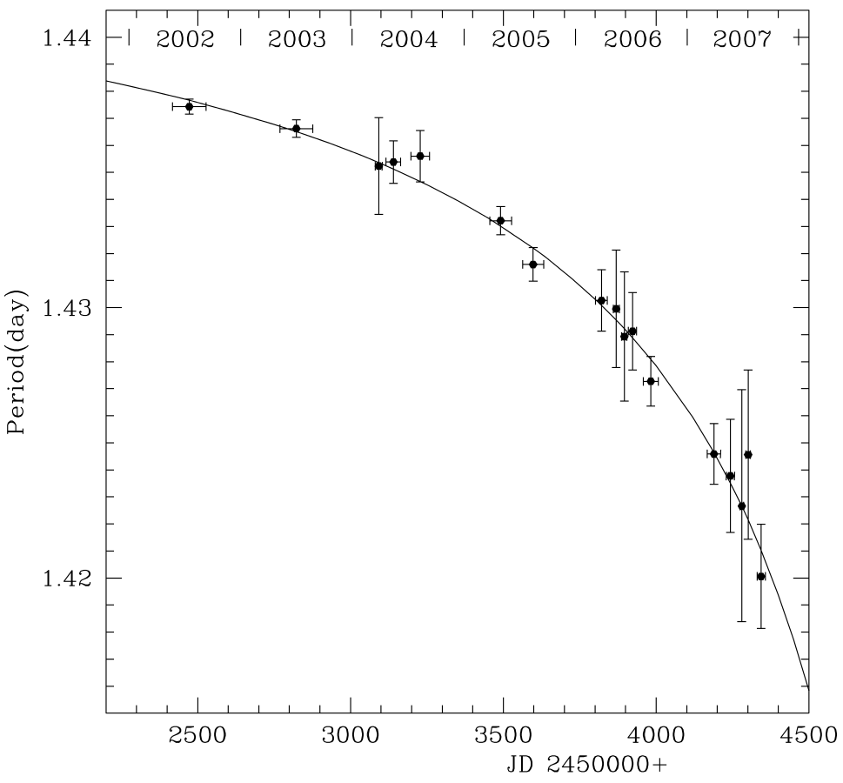
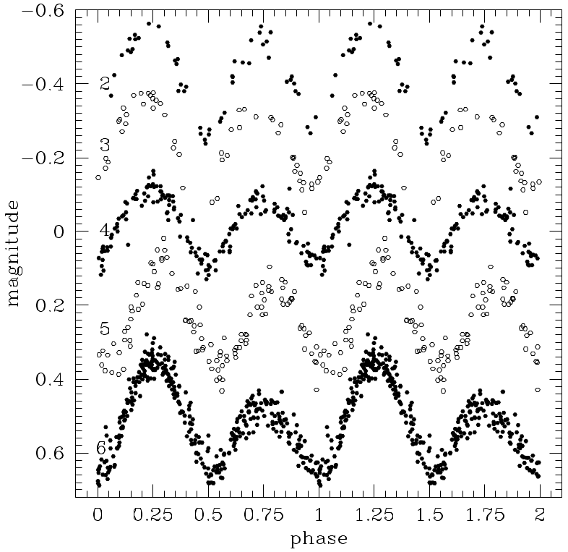
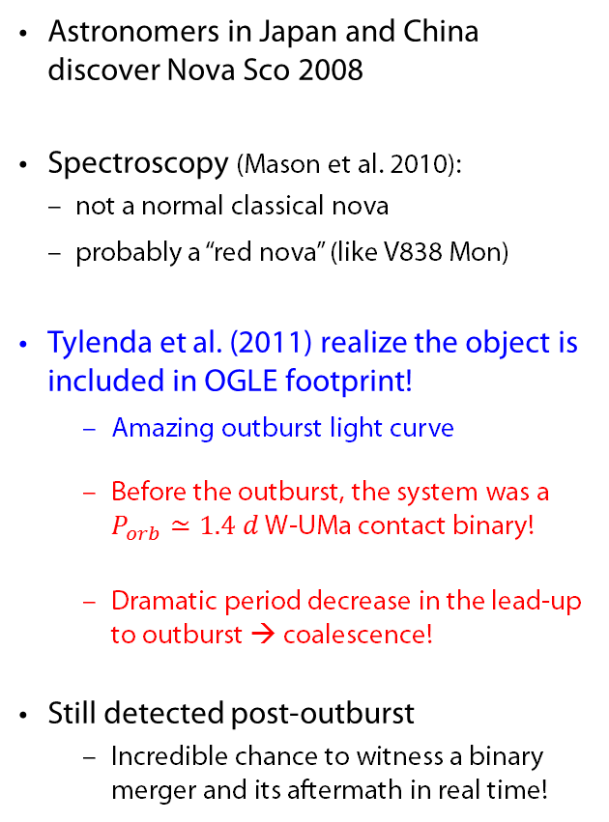
Digression I: All Theory is Grey
Binary Coalescence in Practice!
Astronomers in Japan and China discover Nova Sco 2008
Spectroscopy (Mason et al. 2010):
  not a normal classical nova
  probably a “red nova” (like V838 Mon)
Tylenda et al. (2011) realize the object is included in OGLE footprint!
  Amazing outburst light curve
  Before the outburst, the system was a $P_{orb}≃1.4 d$ W-UMa contact binary!
  Dramatic period decrease in the lead-up to outburst → coalescence!
Still detected post-outburst
  Incredible chance to witness a binary merger and its aftermath in real time!

Slide 5
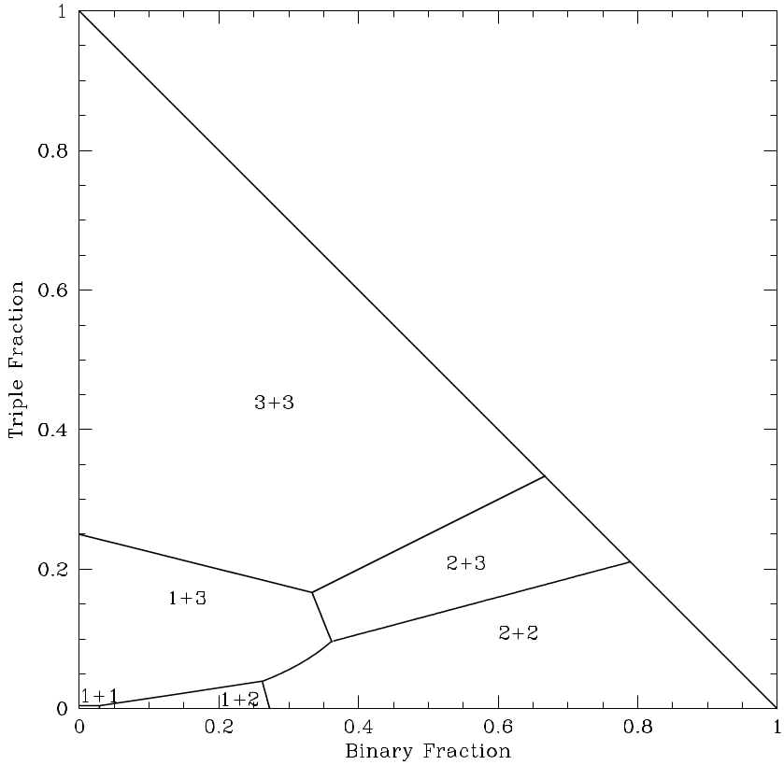
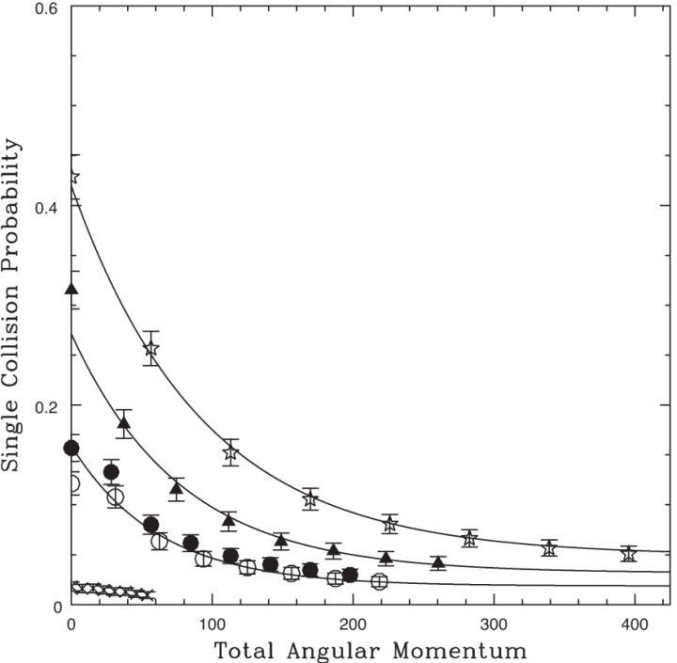
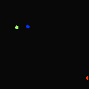

Back to our original programming…
Less Straw, More Model…
Collisions
  What about other encounters?
    Binary-Single
    Binary-Binary
    (Triples? Quads?)
Collisions/encounters can involve binaries!
Binary Evolution
  What about binaries formed/altered in dynamical encounters?
  Binaries can involve collisions/encounters!
Steve McMillan
Leigh & Geller (2012)
Leigh & Sills (2011)
Does this make the straw man models useless?

Slide 6
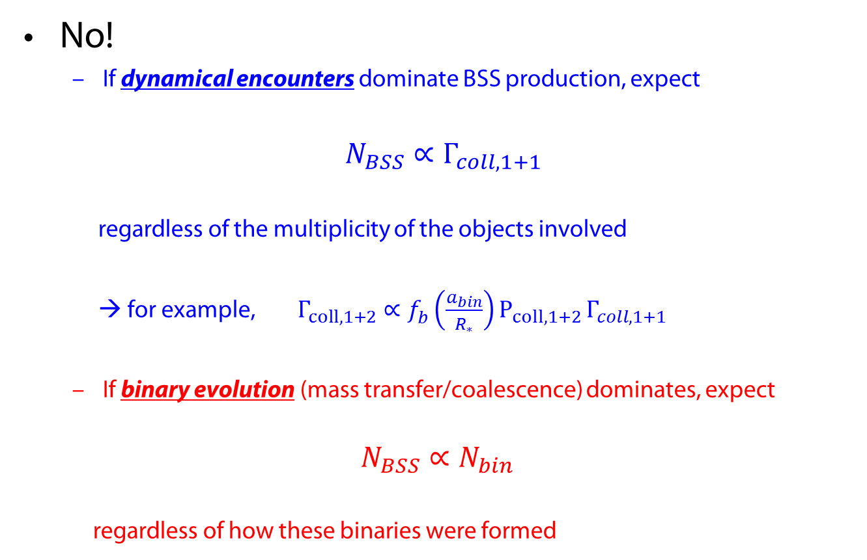
The Utility of Straw-Man Models
No!
  If dynamical encounters dominate BSS production, expect
$N_{BSS}∝Γ_{coll,1+1}$
  regardless of the multiplicity of the objects involved
  → for example, $Γ_{coll,1+2}∝{f_{b}^{}\left(\frac{a_{bin}}{R_{∗}}\right)P_{coll,1+2 }Γ}_{coll,1+1}$
  If binary evolution (mass transfer/coalescence) dominates, expect
$$N_{BSS}∝N_{bin}$$
  regardless of how these binaries were formed

Slide 7
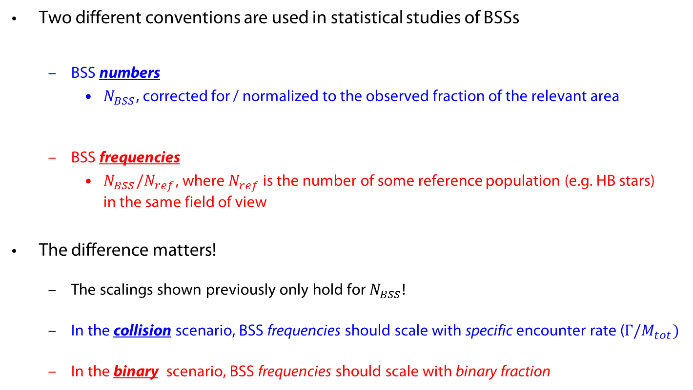
One Last Thing…
Two different conventions are used in statistical studies of BSSs
  BSS numbers
    $N_{BSS}$, corrected for / normalized to the observed fraction of the relevant area
  BSS frequencies
    $N_{BSS}/N_{ref}$, where $N_{ref}$ is the number of some reference population (e.g. HB stars) in the same field of view
The difference matters!
  The scalings shown previously only hold for $N_{BSS}$!
  In the collision scenario, BSS frequencies should scale with specific encounter rate ($Γ/M_{tot})$
  In the binary scenario, BSS frequencies should scale with binary fraction

Slide 8
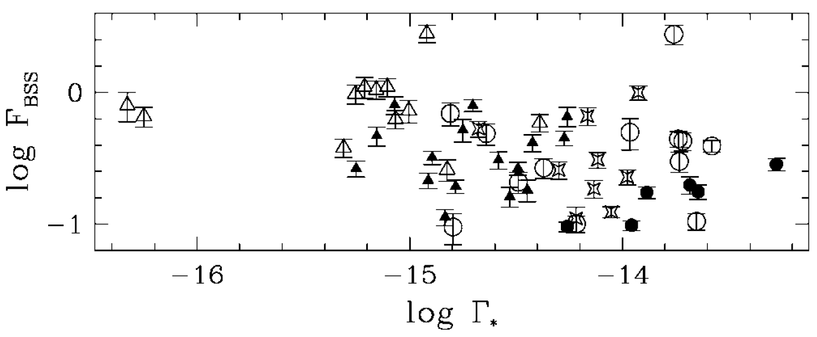
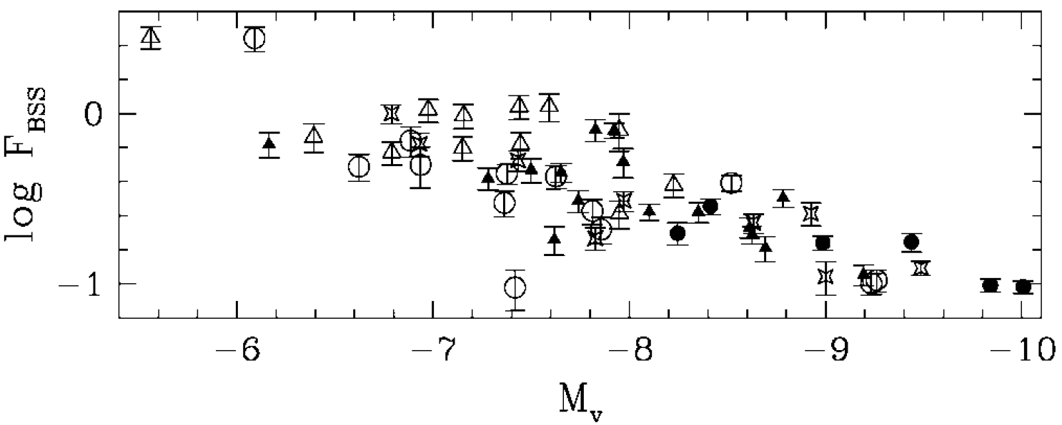
The Search for the Smoking Gun Correlation
Piotto et al. (2004) presented and analysed the first reasonably complete BSS catalogue, based on the HST/WFPC2 survey of 74 GCs (Piotto et al. 2002)
Surprising results!
  No correlation between BSS frequency and collision rate!
  Anti-correlation between BSS frequency and cluster luminosity/mass
Piotto et al. (2004)

Slide 9
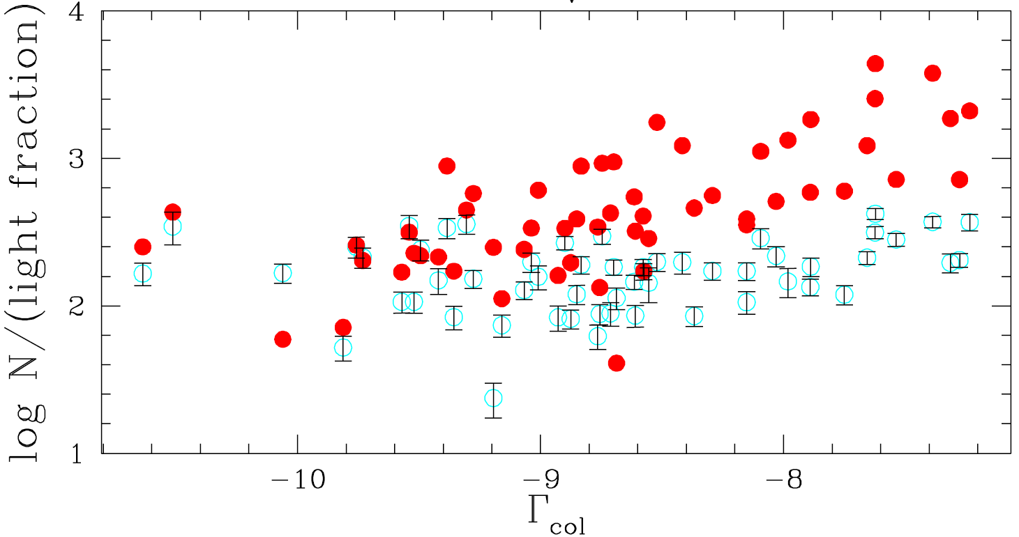
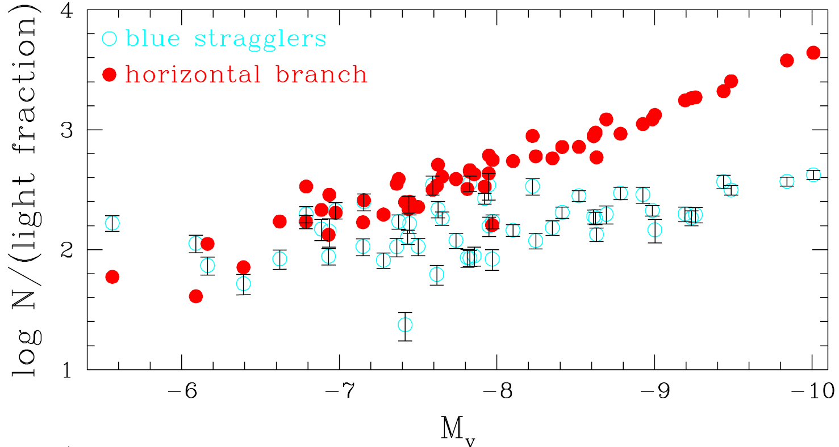

The Search for the Smoking Gun Correlation
But remember the issue with numbers vs frequencies!
  Is the expected result somehow hidden in the data?
Here are the same results shown in terms of BSS numbers
Davies, Piotto &
de Angeli (2004)
Still no correlation with collision rate
Maybe a mild (sub-linear) positive correlation with cluster mass?

Slide 10
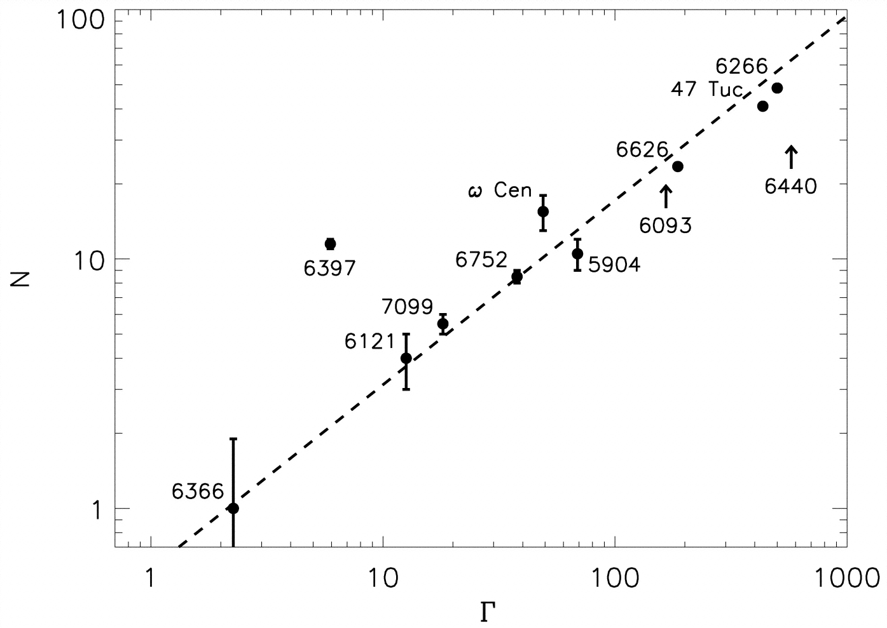
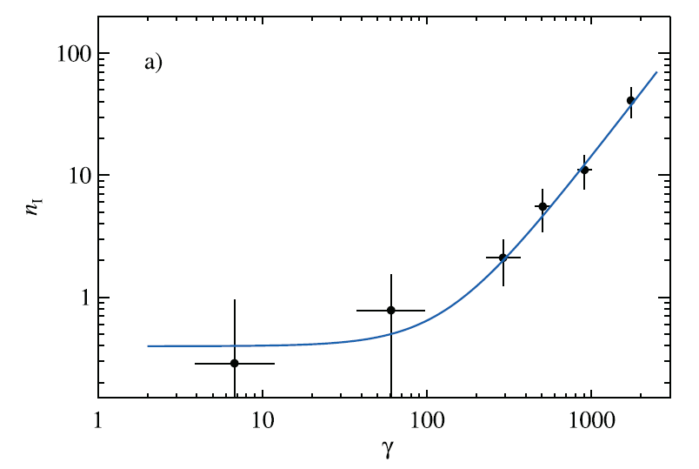
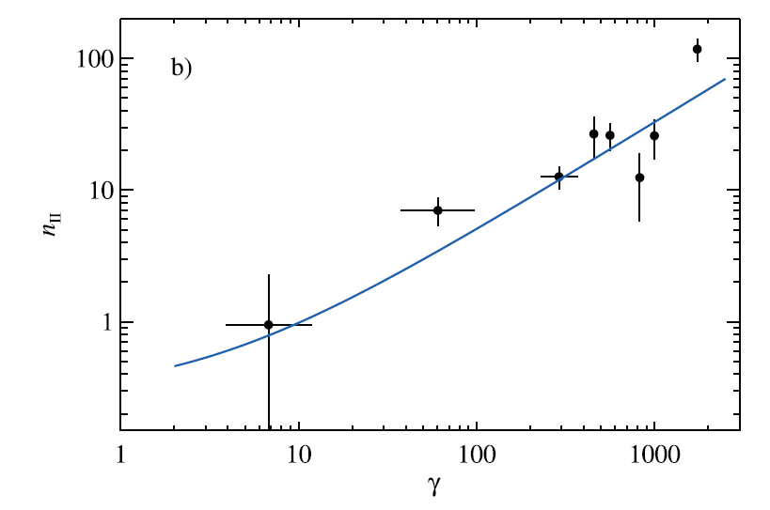

Digression II: Does this stuff ever actually work?
Yes, it does!
X-ray sources!
  $N_{X}$ scales with $Γ_{coll}$
  $N_{LMXB}$ scales (mostly) with $Γ_{coll}$
  $N_{CV}$ scales (mostly) with $Γ_{coll}$
  At low $Γ_{coll}$, both LMXBs and CVs may scale with $M_{tot}$
Pooley et al. (2003)
Pooley & Hut (2006)
Pooley & Hut (2006)
“LMXBs”
“CVs”

Slide 11
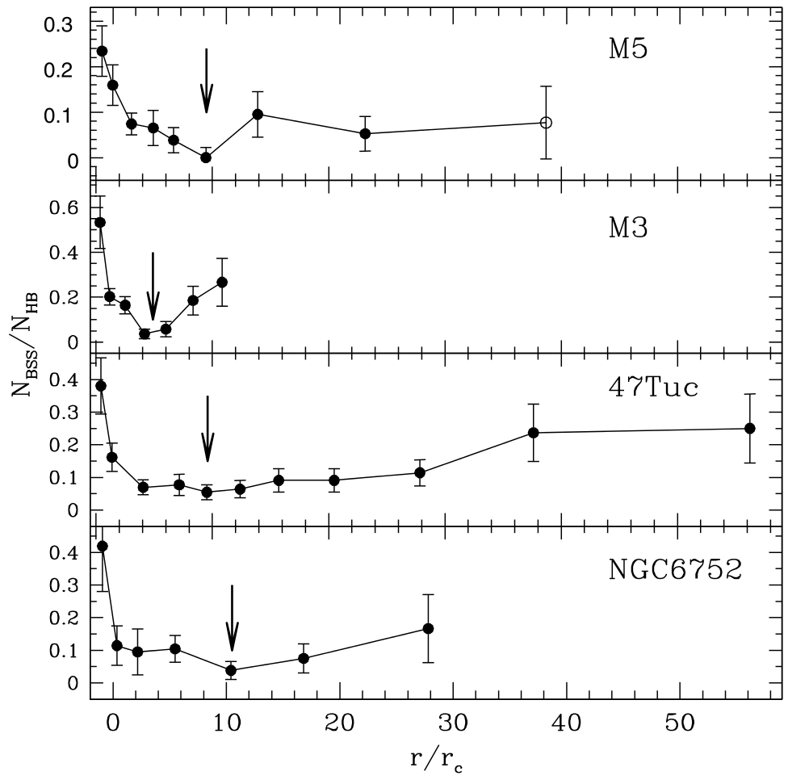
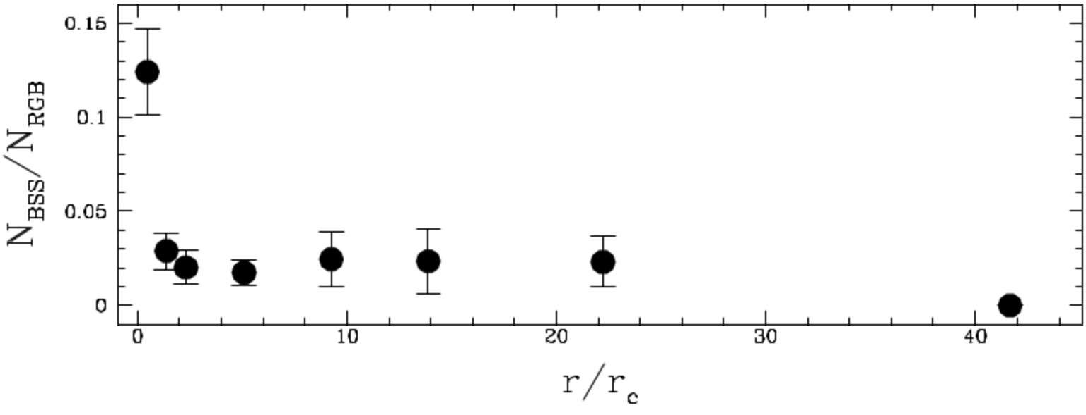
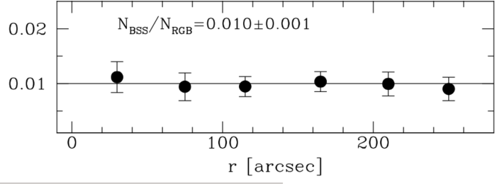
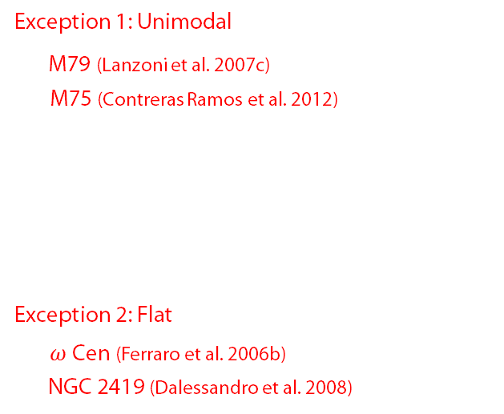

A Different Approach: Radial Distributions
Radial distributions of BSS frequency are usually bimodal (e.g. Ferraro et al. 1997, 2004, 2006a; Sabbi et al. 2004; Warren et al. 2006; Lanzoni et al. 2007ab…)
Lanzoni et al. (2007a)
Exception 1: Unimodal
M79 (Lanzoni et al. 2007c)
M75 (Contreras Ramos et al. 2012)
Exception 2: Flat
$ω$ Cen (Ferraro et al. 2006b)
NGC 2419 (Dalessandro et al. 2008)
M75
$ω$ Cen

Slide 12
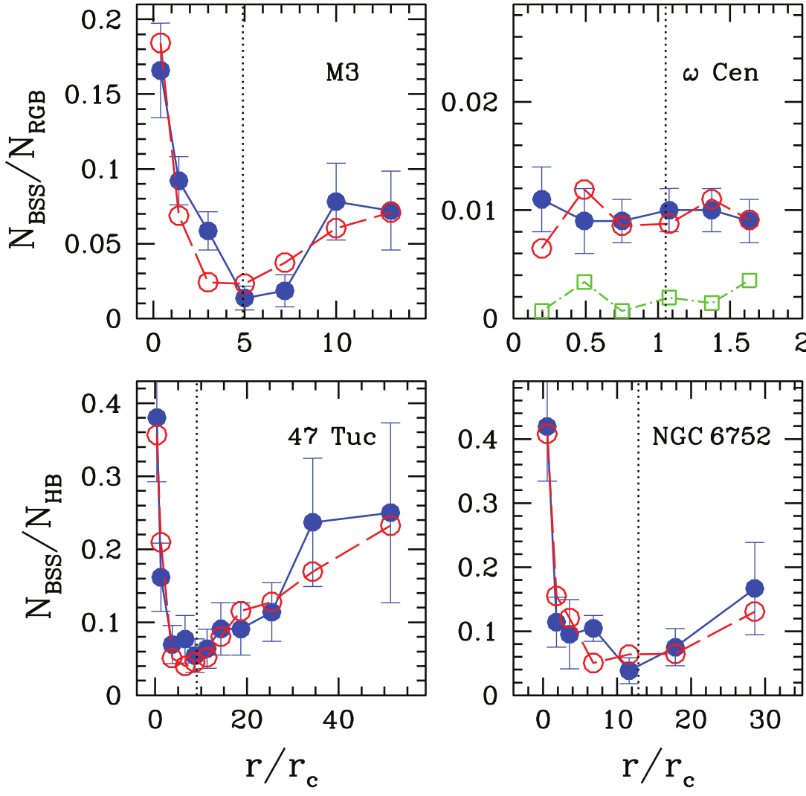
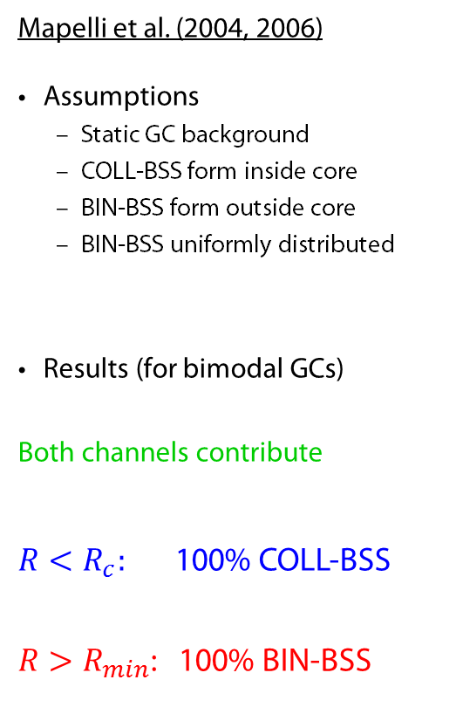
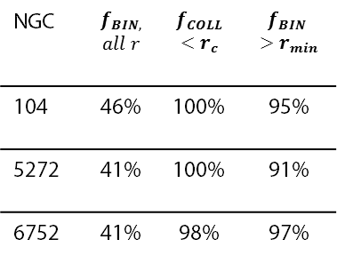
Modelling Radial BSS Distributions
NGC | $$f_{BIN,}$$ $$all r$$ | $$f_{COLL}$$ $$<r_{c}$$ | $$f_{BIN}$$ $>r_{min}$
104 | 46% | 100% | 95%
5272 | 41% | 100% | 91%
6752 | 41% | 98% | 97%
Mapelli et al. (2004, 2006)
Assumptions
  Static GC background
  COLL-BSS form inside core
  BIN-BSS form outside core
  BIN-BSS uniformly distributed
Results (for bimodal GCs)
Both channels contribute
$R<R_{c}:$ 100% COLL-BSS
$R>R_{min}$: 100% BIN-BSS

Slide 13
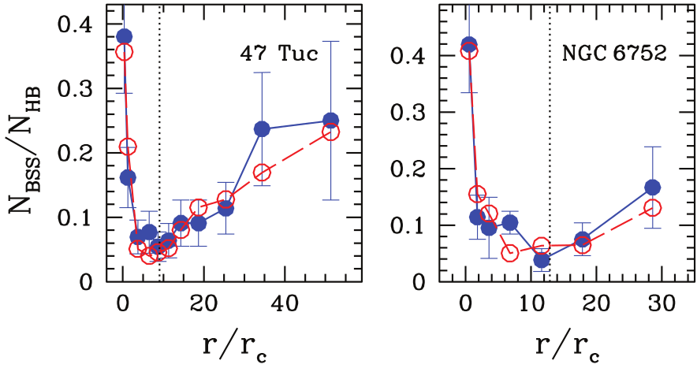
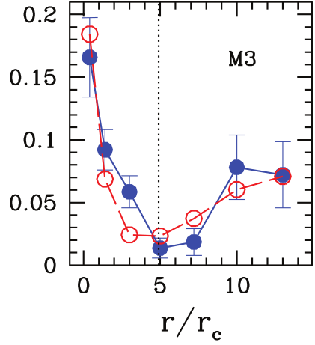

Radial Distributions:
Issues, Questions, Caveats
Why is the BSS distribution bimodal?
  BIN-BSS progenitors experience dynamical friction
  Those born inside $R(t_{DF}=t_{GC})$ have sunk to the core
  Those born outside $R\left(t_{DF}=t_{GC}\right)$ have not yet moved
    “zone of avoidance”
$$R_{min}∼R(t_{DF}=t_{GC})$$
    Pure BIN-BSS populations should still be bimodal!
So why the need for COLL-BSS at all?
  Not enough BIN-BSS are born inside $R_{min}$ by assumption
  Centrally-peaked BIN-BSS birth distribution may also match data (Mapelli et al. 2004)
Very different scenario from Davies et al. (2004)!
  Both favour a combination of BIN-BSS & COLL-BSS
  Davies et al. (2004): different channels dominate in different GCs
  Mapelli et al. (2006): different channels dominate in different locations within a given GC
Mapelli et al. (2006)

Slide 14
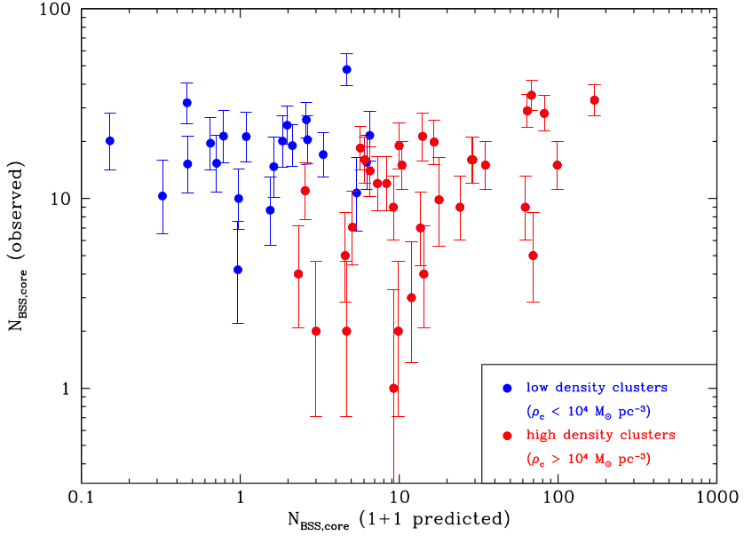
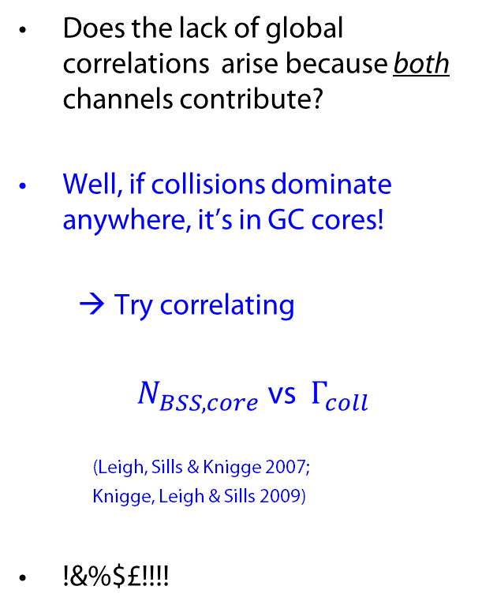
The Search for the Smoking Gun Correlation II:
An Obvious Idea
Davies et al. (2004)
Does the lack of global correlations arise because both channels contribute?
Well, if collisions dominate anywhere, it’s in GC cores!
  Try correlating
$N_{BSS,core}$ vs $Γ_{coll}$
(Leigh, Sills & Knigge 2007;
Knigge, Leigh & Sills 2009)
!&%$£!!!!
Knigge, Leigh & Sills (2009)

Slide 15
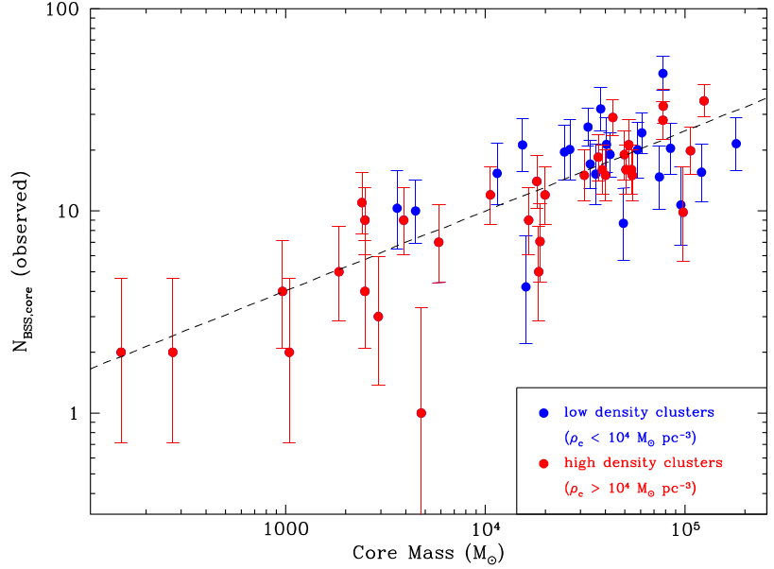
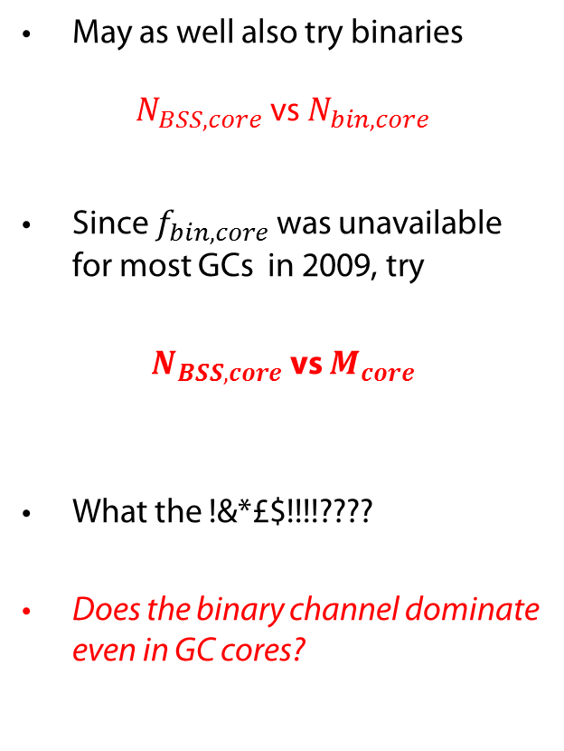
The Search for the Smoking Gun Correlation II:
A Last-Ditch Attempt
May as well also try binaries
$N_{BSS,core}$ vs $N_{bin,core}$
Since $f_{bin,core}$ was unavailable for most GCs in 2009, try
$N_{BSS,core}$ vs $M_{core}$
What the !&*£$!!!!????
Does the binary channel dominate even in GC cores?
Knigge, Leigh & Sills (2009)

Slide 16
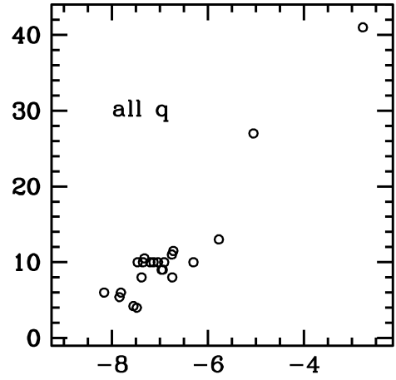
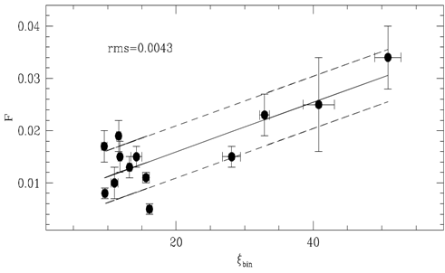




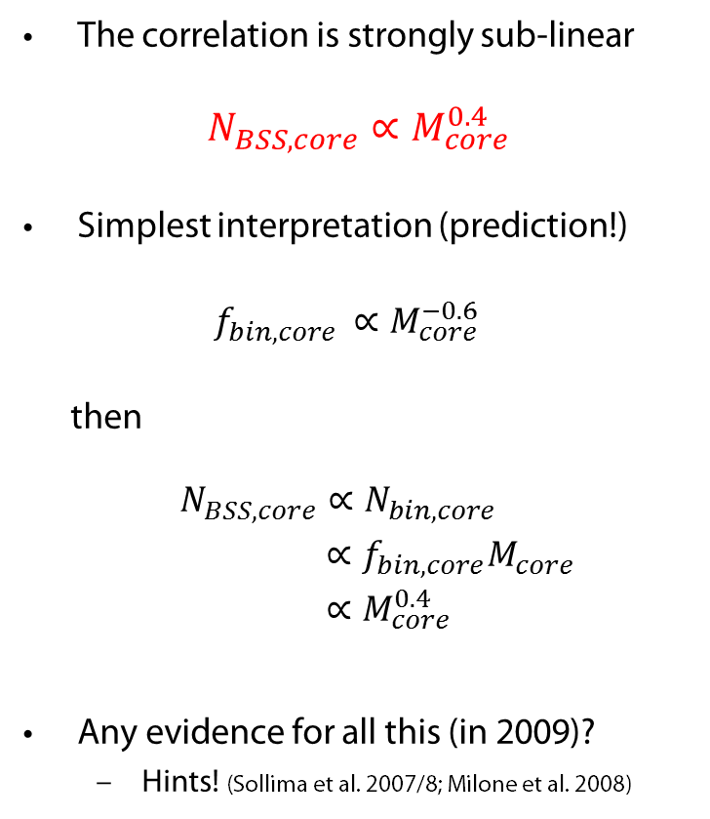

The $N_{BSS,core}$ vs $M_{core}$ correlation
The correlation is strongly sub-linear
$N_{BSS,core}∝M_{core}^{0.4}$
Simplest interpretation (prediction!)
  $f_{bin,core }∝M_{core}^{−0.6}$
then
$N_{BSS,core}∝N_{bin,core}$
$∝f_{bin,core}M_{core}$
$∝M_{core}^{0.4}$
Any evidence for all this (in 2009)?
  Hints! (Sollima et al. 2007/8; Milone et al. 2008)
Milone et al. (2008)
Sollima et al. (2008)
Knigge, Leigh & Sills (2009)
$$F_{BSS}$$
$$f_{bin,core}$$
$$f_{bin, core}$$
$$M_{V}$$

Slide 17
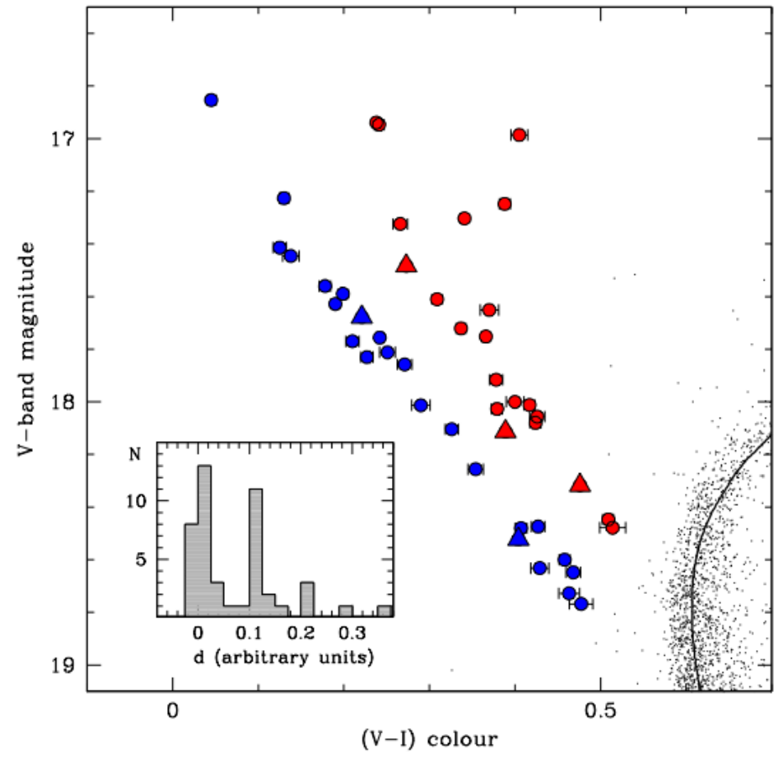
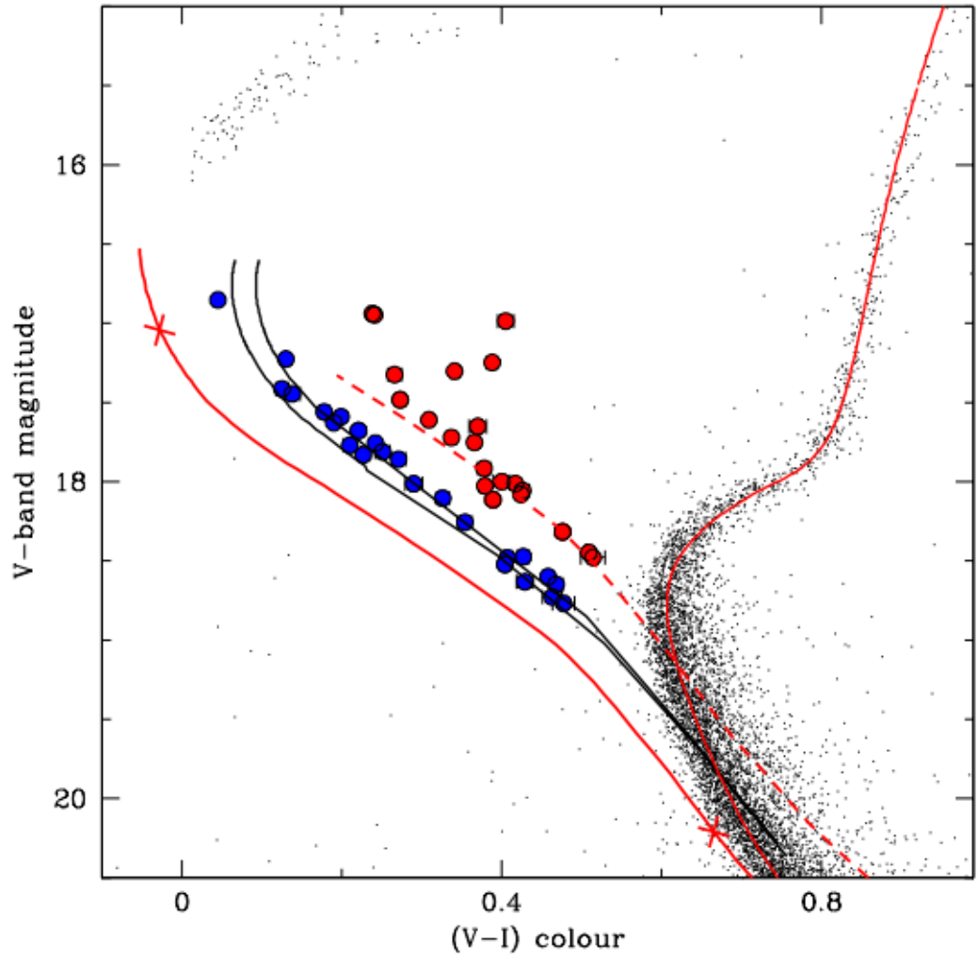
So, it’s all binaries then?
But what about…
The double BSS sequence in M30 (Ferraro et al. 2009)
  Interpreted as:
    Blue sequence: collisions
    Red sequence: binaries
  Why the clean separation?
    COLL-BSS formed in a short burst during recent core collapse
    All share the same evolutionary stage
  Both seqs present in most GCs?
    Just happen to be distinct in M30…
  However, BSS sample includes
    3 W UMa contact binaries
    2 other variables/binaries
    One of each on COLL-BSS sequence
Collisional
BSS
Binary BSS

Slide 18
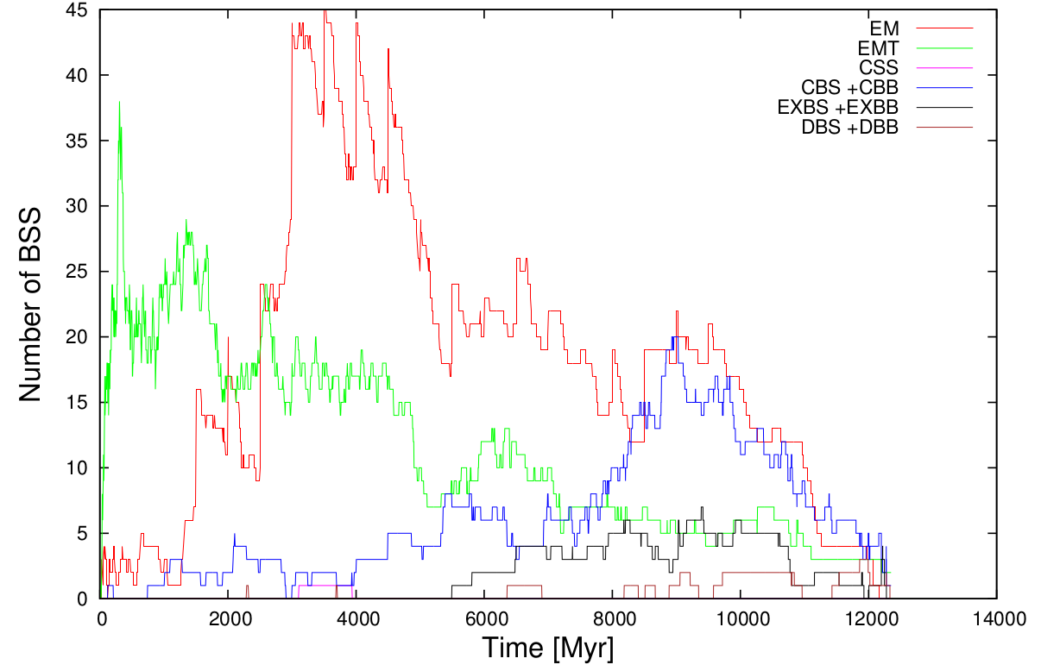
So, it’s all binaries then?
But what about…
Theoretical expectations
  Physical collisions must occur at something like the predicted rate
  Simulations suggest both channels can contribute (Hypki & Giersz 2012)
  (But remember: “collision → BSS” is just an assumption)
  “This poses a problem for the theory that blue stragglers are created via stellar collisions: either blue stragglers are not created through off-axis stellar collisions or some mechanism(s) can remove angular momentum from the star on short timescales.”
  Sills et al. (2001)

Slide 19
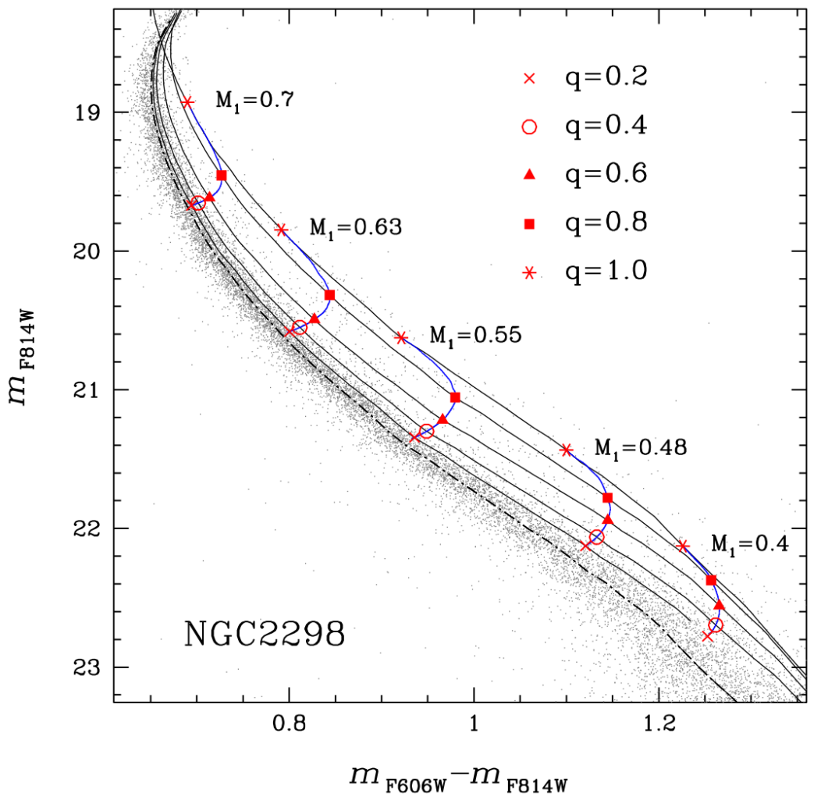
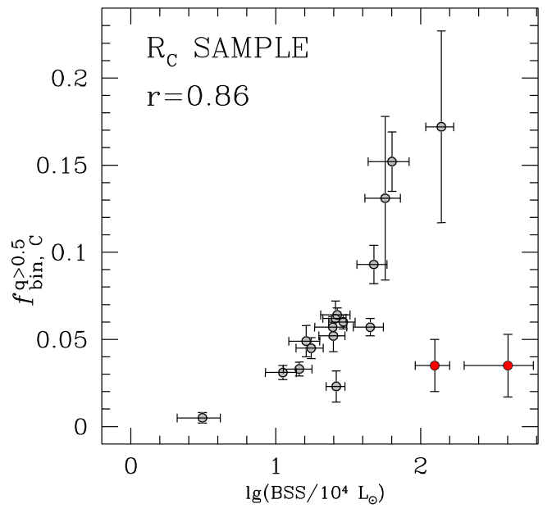
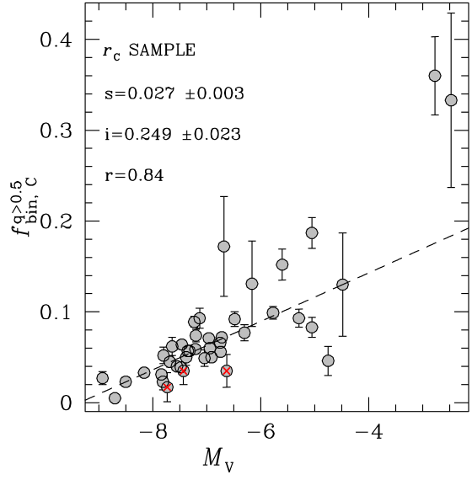
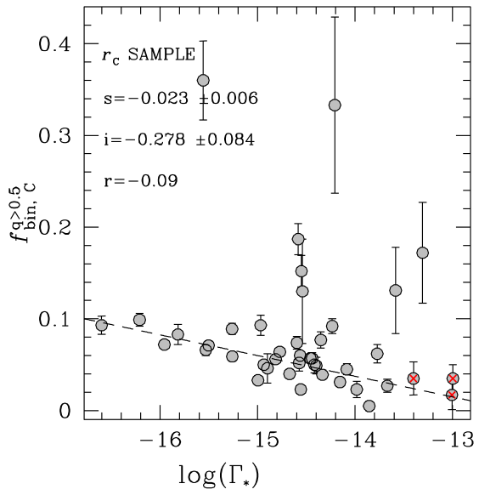
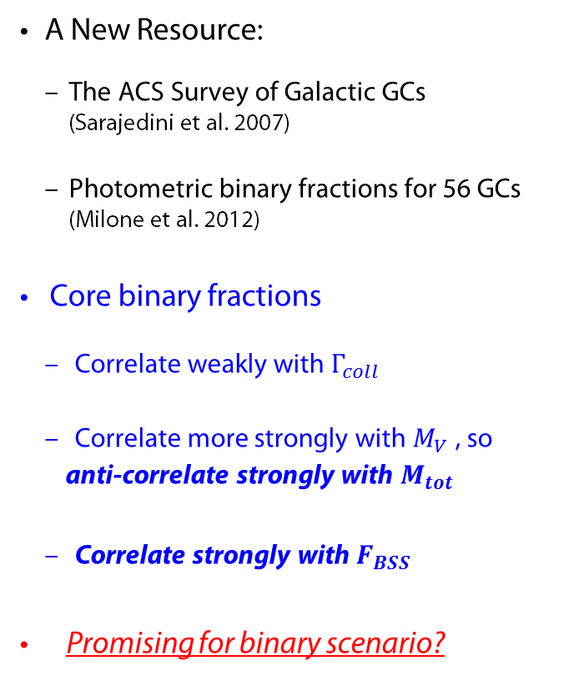
The Search for the Smoking Gun Correlation III:
Once more, with feeling
XXXXXX binary fractions
Milone et al. (2012)
A New Resource:
  The ACS Survey of Galactic GCs (Sarajedini et al. 2007)
  Photometric binary fractions for 56 GCs (Milone et al. 2012)
Core binary fractions
  Correlate weakly with $Γ_{coll}$
  Correlate more strongly with $M_{V}$ , so
  anti-correlate strongly with $M_{tot}$
  Correlate strongly with $F_{BSS}$
Promising for binary scenario?

Slide 20
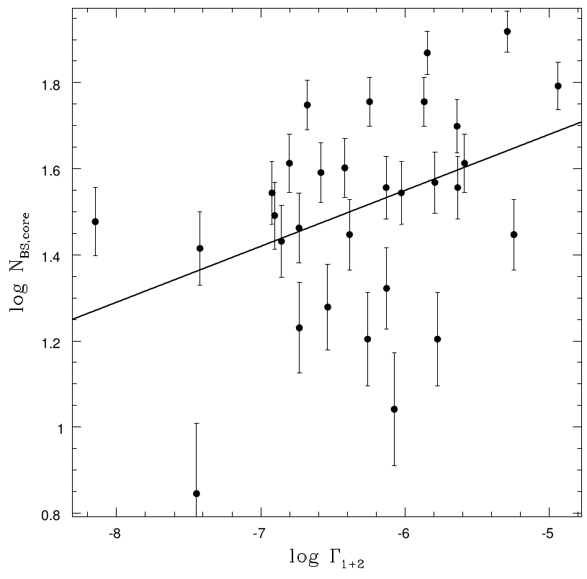

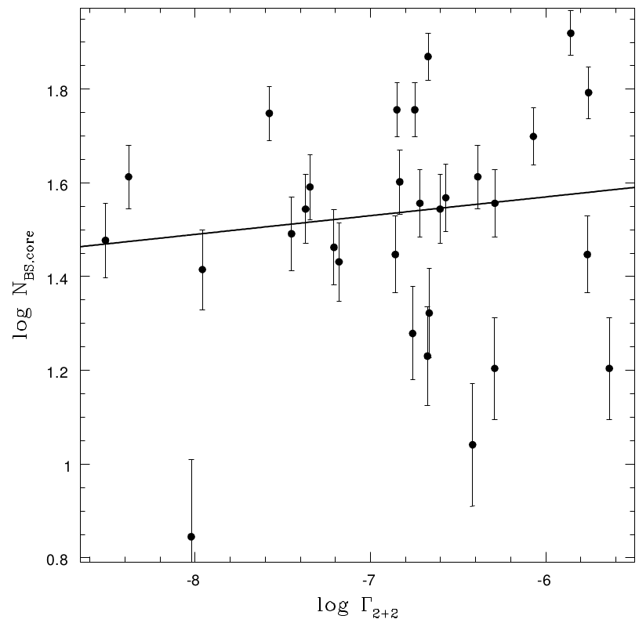
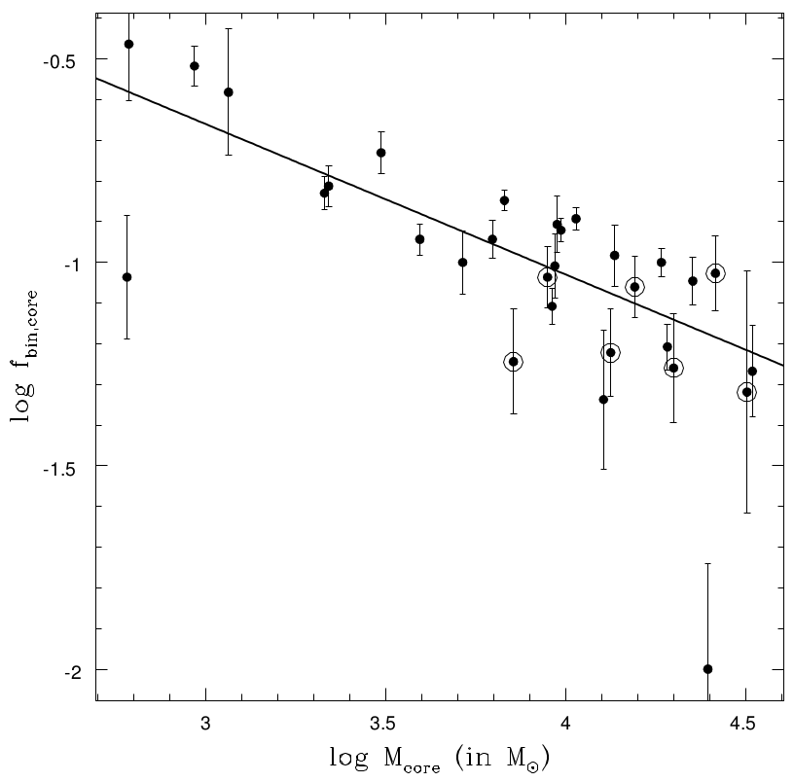





The Search for the Smoking Gun Correlation III:
Once more, with binary fractions
Leigh, Knigge, Sills, Perets,
Sarajedini & Glebbeek (2012)
Collisions:
  $N_{BSS,core}$ vs $Γ_{coll,1+1}$
  $N_{BSS,core}$ vs $Γ_{coll,1+2}$
  $N_{BSS,core}$ vs $Γ_{coll,2+2}$
→ collisional trends are weak
Binary Evolution:
  $N_{BSS,core}$ vs $M_{core}$
  $f_{bin,core}$ vs $M_{core}$
  $N_{BSS,core}$ vs $N_{bin,core}$
What the &*%$! is going on?

Slide 21






The Search for the Smoking Gun Correlation III:
A Thought Experiment…
Leigh et al. (2012)
  Suppose BSS are exclusively formed from (primordial) binaries:
$N_{BSS,core}∝N_{bin,core}$
  with just some modest intrinsic scatter
  We know that the observed $f_{bin,core}$ anti-correlates pretty well with $M_{core}$ and $M_{tot}$
  What if the true correlation is even stronger?
    → Then scatter in $f_{bin,core}$ vs $M_{core}$ is mostly observational ($σ_{obs}),$not intrinsic $(σ_{int})$
  But if $σ_{obs}>σ_{int}$, $M_{core}$ is a better tracer of the true $f_{bin,core}$ than the measured fractions!
  And $N_{BSS,core}$ would track $M_{core}$ more closely than the estimated $N_{bin,core}$… as observed!
  So the binary scenario might work…
  …if binary fractions are extremely closely coupled to core/total cluster masses (Leigh et al. 2012)
Milone et al. (2012)

Slide 22

Summary
Collisions, binary mass transfer and mergers must all happen in GCs!
  Mass transfer definitely produces BSS
  Mergers can be survived (V1309 Sco) and probably produce BSS
  Collisions may produce BSS (if enough AM can be lost)
There is no clean correlation between $N_{BSS}$ and $Γ_{n+m}$, even in GC cores
There is a strong, sub-linear correlation with $M_{core}$ / $M_{tot}$
There is a strong correlation with $f_{bin}$
    A binary origin for BSS, even in GC cores?
    (since no correlation with $Γ_{coll}$ , have these binaries not even been affected by encounters?)
But we do not get the best (and linear) correlation with $N_{bin}=f_{bin}M_{tot}$ !
  Is $M_{tot}$ actually a better trace of $f_{bin}$ than observationally measured binary fractions?
What about other evidence for COLL-BSS channel?
  Radial distributions? Double sequences?
There is no smoking gun yet!

Slide 23
Now with free bonus slides…

Slide 24



But let’s remember that…
Other factors may mask/alter the naïve straw man scalings
$N/M_{tot}$and $Γ$are always correlated themselves
  Encounter rates always scale with the available number of objects
Even if all BSS form via binary evolution, expect a scaling with encounter rate if the requisite binaries are dynamically formed/altered
  $$N_{BSS}∝N_{bin}∝Γ_{2+x}$$
$$Γ∝M_{tot}^{1.5}$$
$$logΓ=−0.6 M_{V}$$
Davies, Piotto &
de Angeli (2004)
Notes:
Gamma \propto M_tot^1.5 → log(Gamma) = -0.6*M_V

Slide 25





A Possible Interpretation?
Davies et al. (2004)
In high-mass / high-collision-rate GCs, massive stars exchange into binaries early
  By today, most suitable proto-BSS binaries have been “used up”
In low-mass / low-collision-rate GCs, collisions just don’t produce enough BSS
So scaling with $M_{V}$ is mild or absent because
  Binaries dominate in low-mass /
low-collision-rate GCs
  Collisions dominate in high-mass /
high-collision-rate GCs
Turnover due to
“binary burning”
All BSSs
Binary BSSs
Collisional BSSs

Slide 26

Predictions & Problems
Should still see a linear scaling with $Γ_{coll}$ at the high-$Γ_{coll}$ end
  Not really observed
In this picture, even binary BSSs require dynamical encounters, so actually still expect a linear scaling with $Γ_{coll}$ (via $Γ_{1+2}$)
  Not observed
“Binary burning” scenario is speculative
  Ignores late supply of binaries from halo to core
  Ignores changing environment as cluster evolves
  Specific implementation assumes persistent availability of stars with $M>M_{TO}$
  Should high-collision-rate GCs should have lower core binary fractions?
    Not observed (see later)

Slide 27









What else can we still do?
Gilliland et al. (1998)
Spectroscopy
  Abundances
    Are MT-BSS CO-depleted?
  Rotation
    Is the $v\sin{i}$ distribution bimodal?
  Kinematics
    Do COLL-BSS get a measurable kick?
Binarity
  Radial velocity variations?
  Photometric variability
    Eclipses, W UMa, …
  Direct detection of companions
    UV, X-ray…
Pulsations
  Some BSS are SX Phe pulsators
    Mode analysis can yield masses!
Ferraro et al. (2006)
Knigge et al. (2008)
Thomson et al. (2010)
Kaluzny et al. (2009)
Knigge et al. (2006)
Lovisi et al.
(2012)

