Slide 1
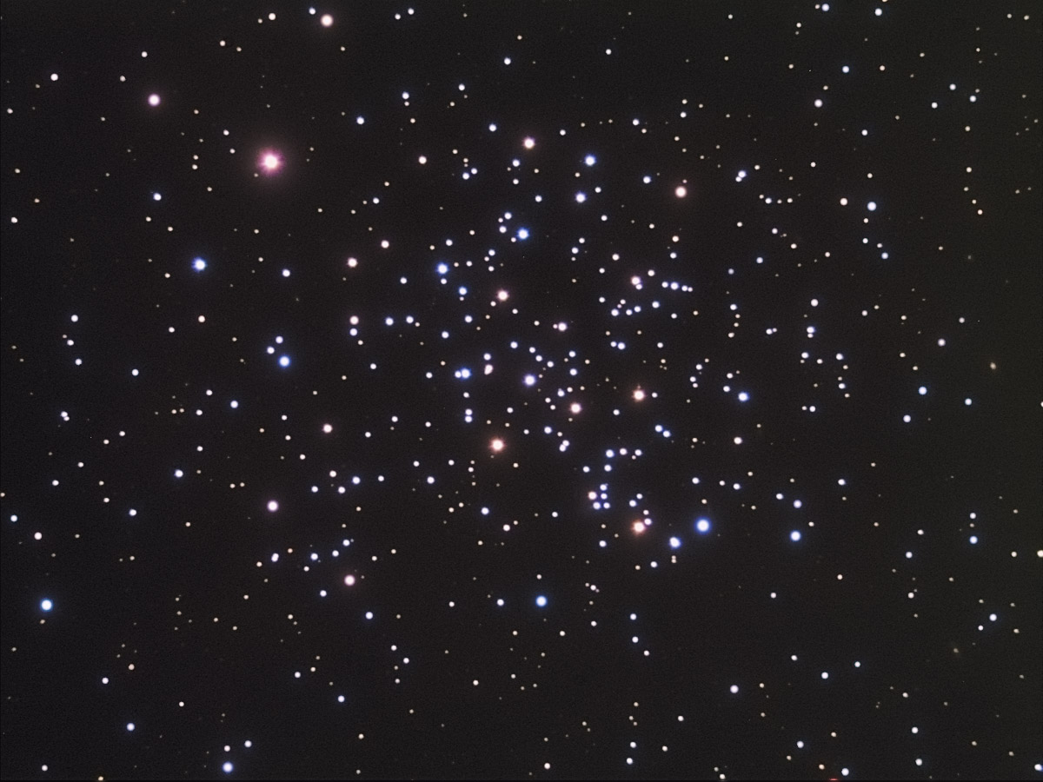
Open Clusters:
At The Interface of
Stellar Evolution and Stellar Dynamics
Robert D. Mathieu
University of Wisconsin - Madison

Slide 2
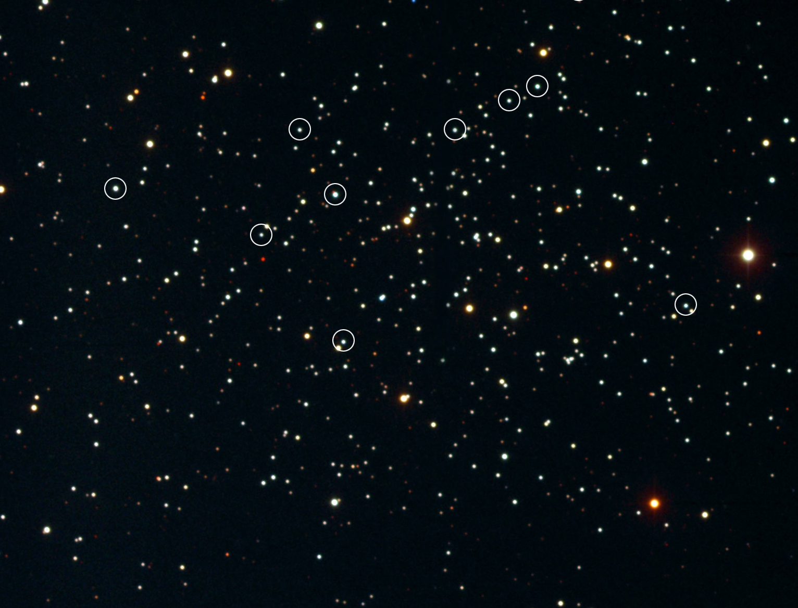
The Open Star Cluster NGC 188 (7 Gyr)
Aaron Geller
David Latham

Slide 3
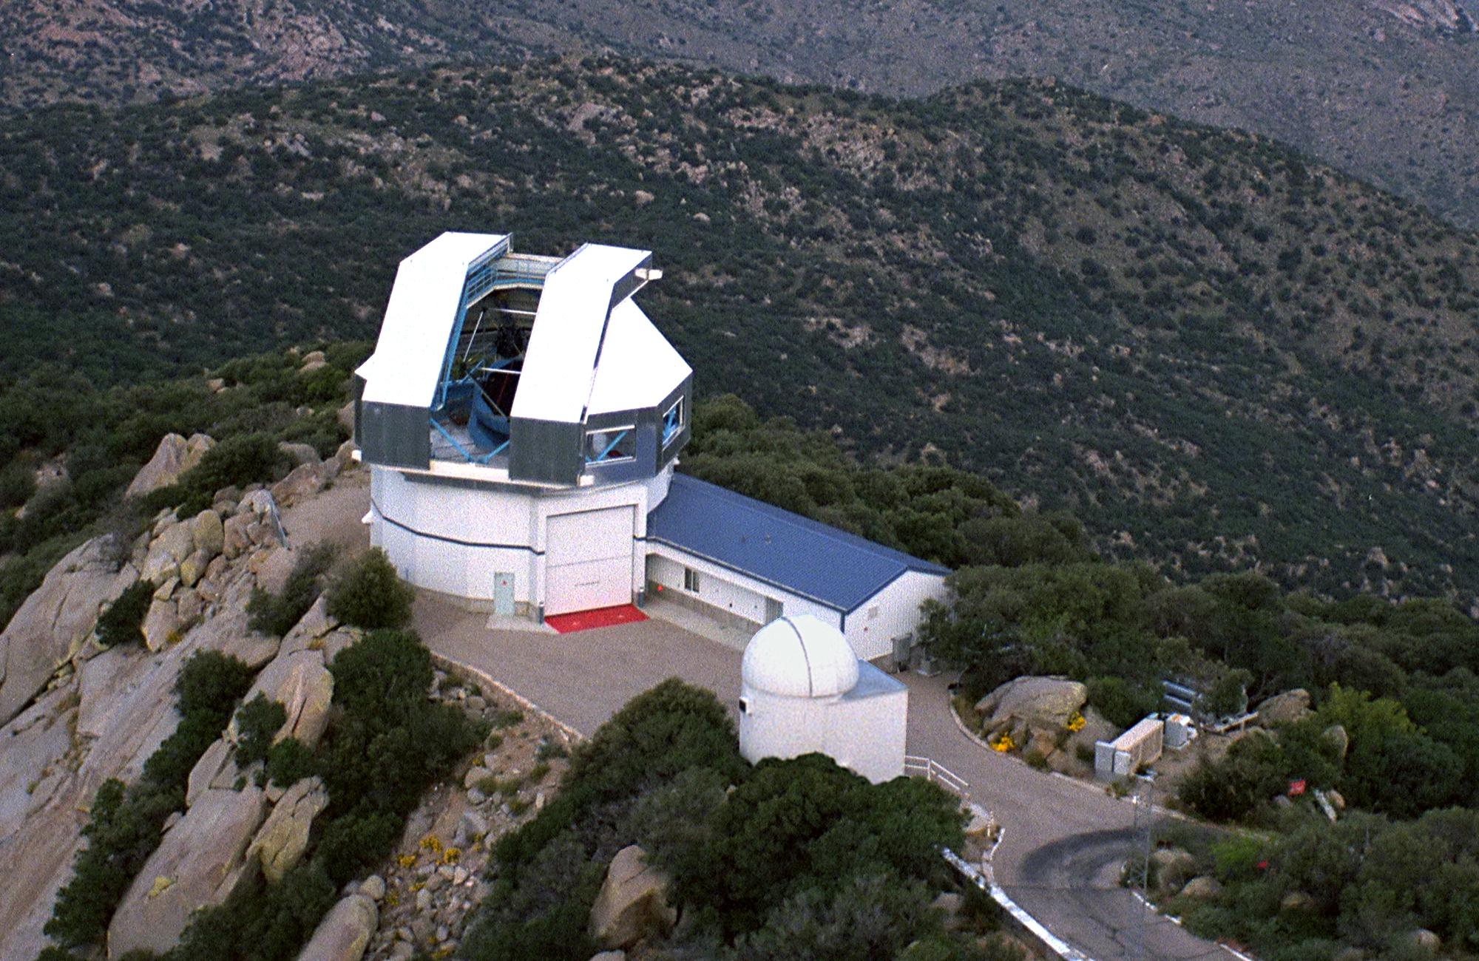
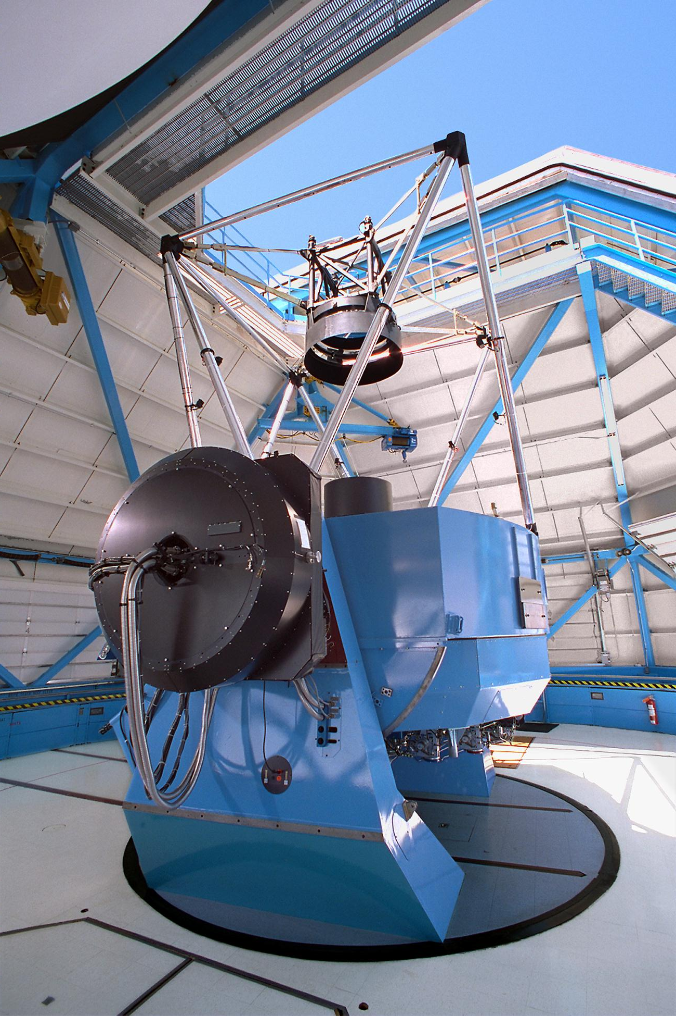
WIYN Open Cluster Study

Slide 4
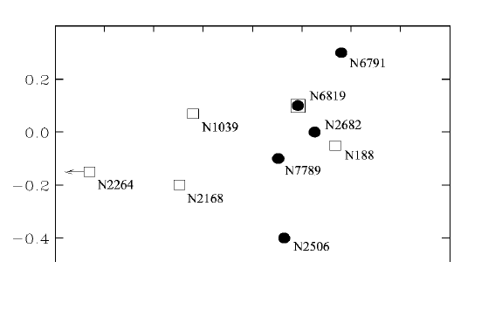

WIYN Open Cluster Study
N6791
N6819
N2099
N2682 (M67)
[Fe/H]
N188
N7789
N2264
N2168 (M35)
N2506
Log Age (Gyrs)

Slide 5
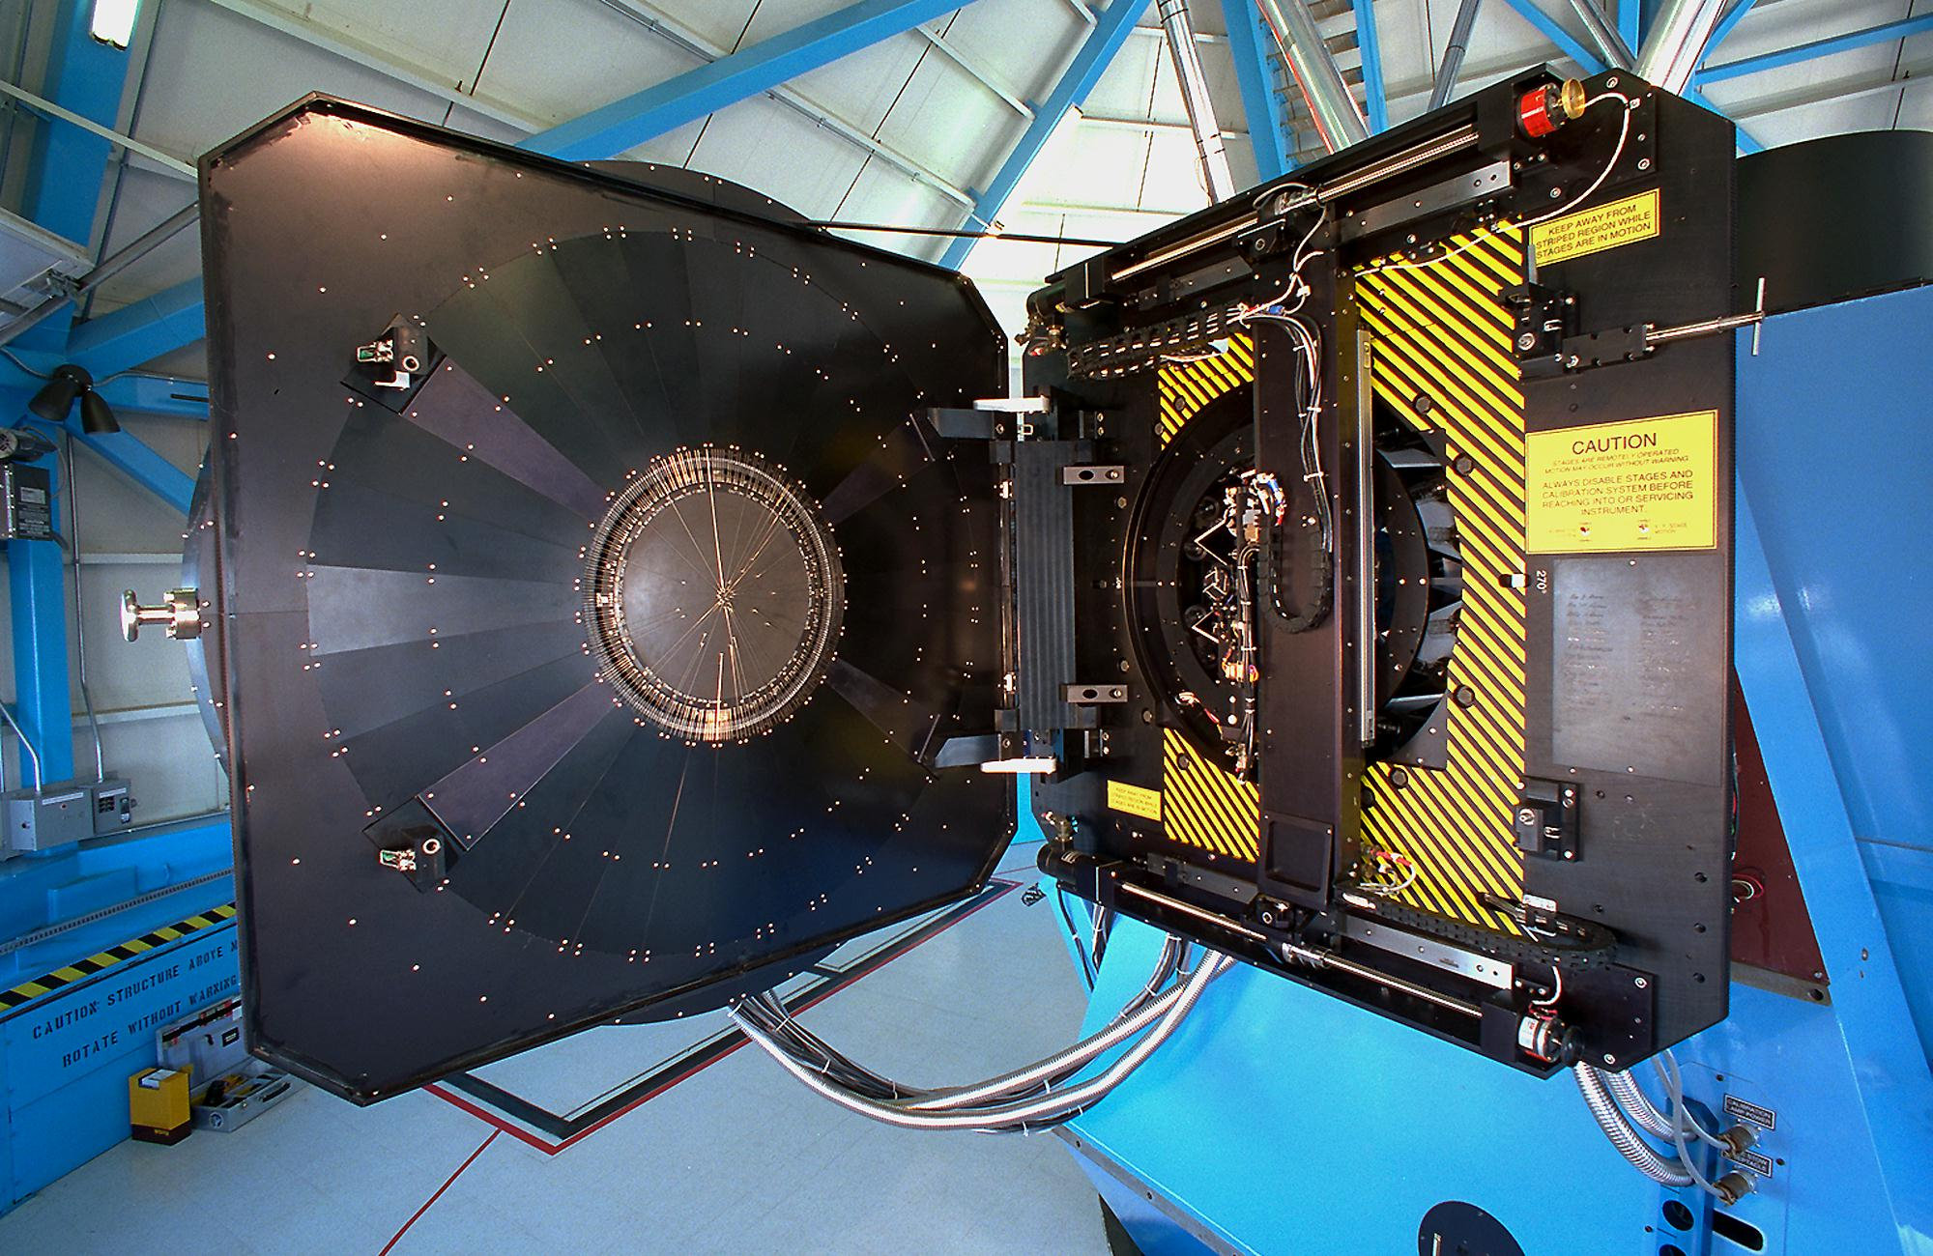
Stellar Radial Velocities
NGC 188 (7 Gyr)
  1197 stars (0.8 M_{o} < M* < 1.2 M_{o}) (V < 16.5, B-V > 0.4)
  10,101 measurements (σ = 0.4 km s⁻¹)
  132 binaries (P < 3000^{d})
NGC 2168 (M35) (0.15 Gyr)
  1690 stars
  8323 measurements
  102 binaries
  For N-body initial conditions

Slide 6
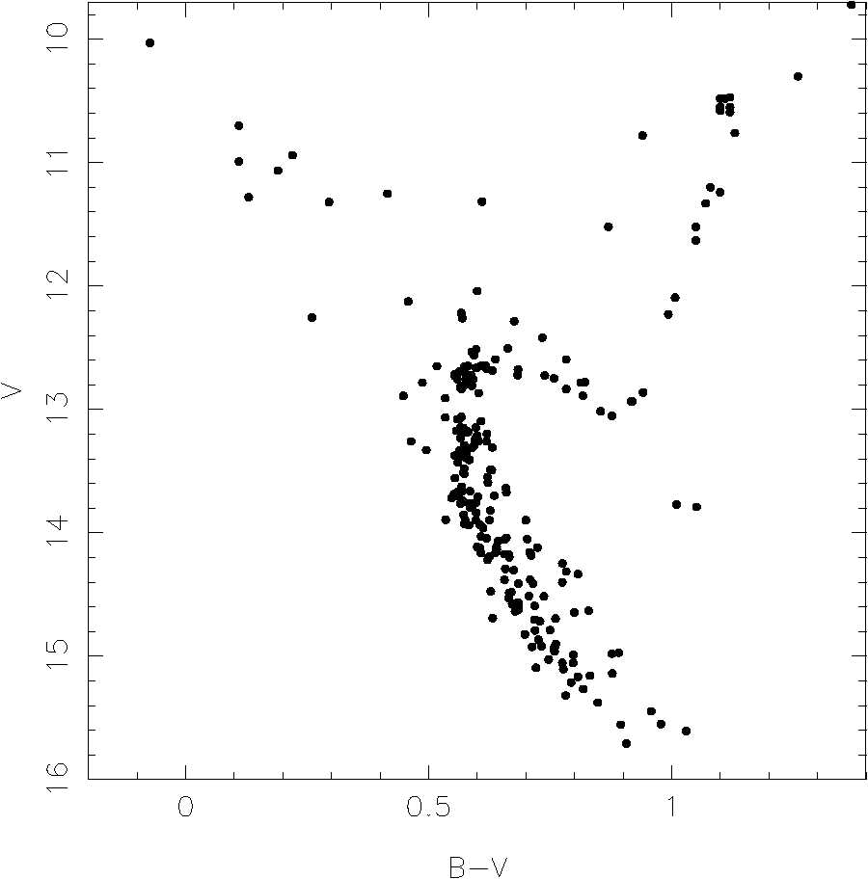
M67
4.5 Gyr
1.3 M_{o}
Spectroscopic
Binaries (P < 3000^{d})

Slide 7
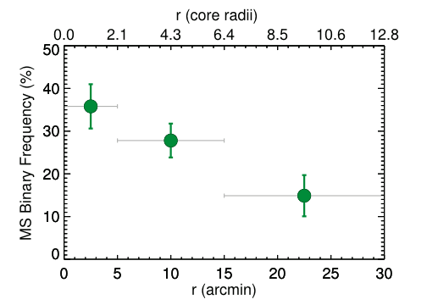
(Hard) Binary Frequency
NGC 188 (7 Gyr)
29% ± 3
P < 10⁴ days

Slide 8
The Open Star Cluster NGC 188 (7 Gyr)
Blue Stragglers

Slide 9
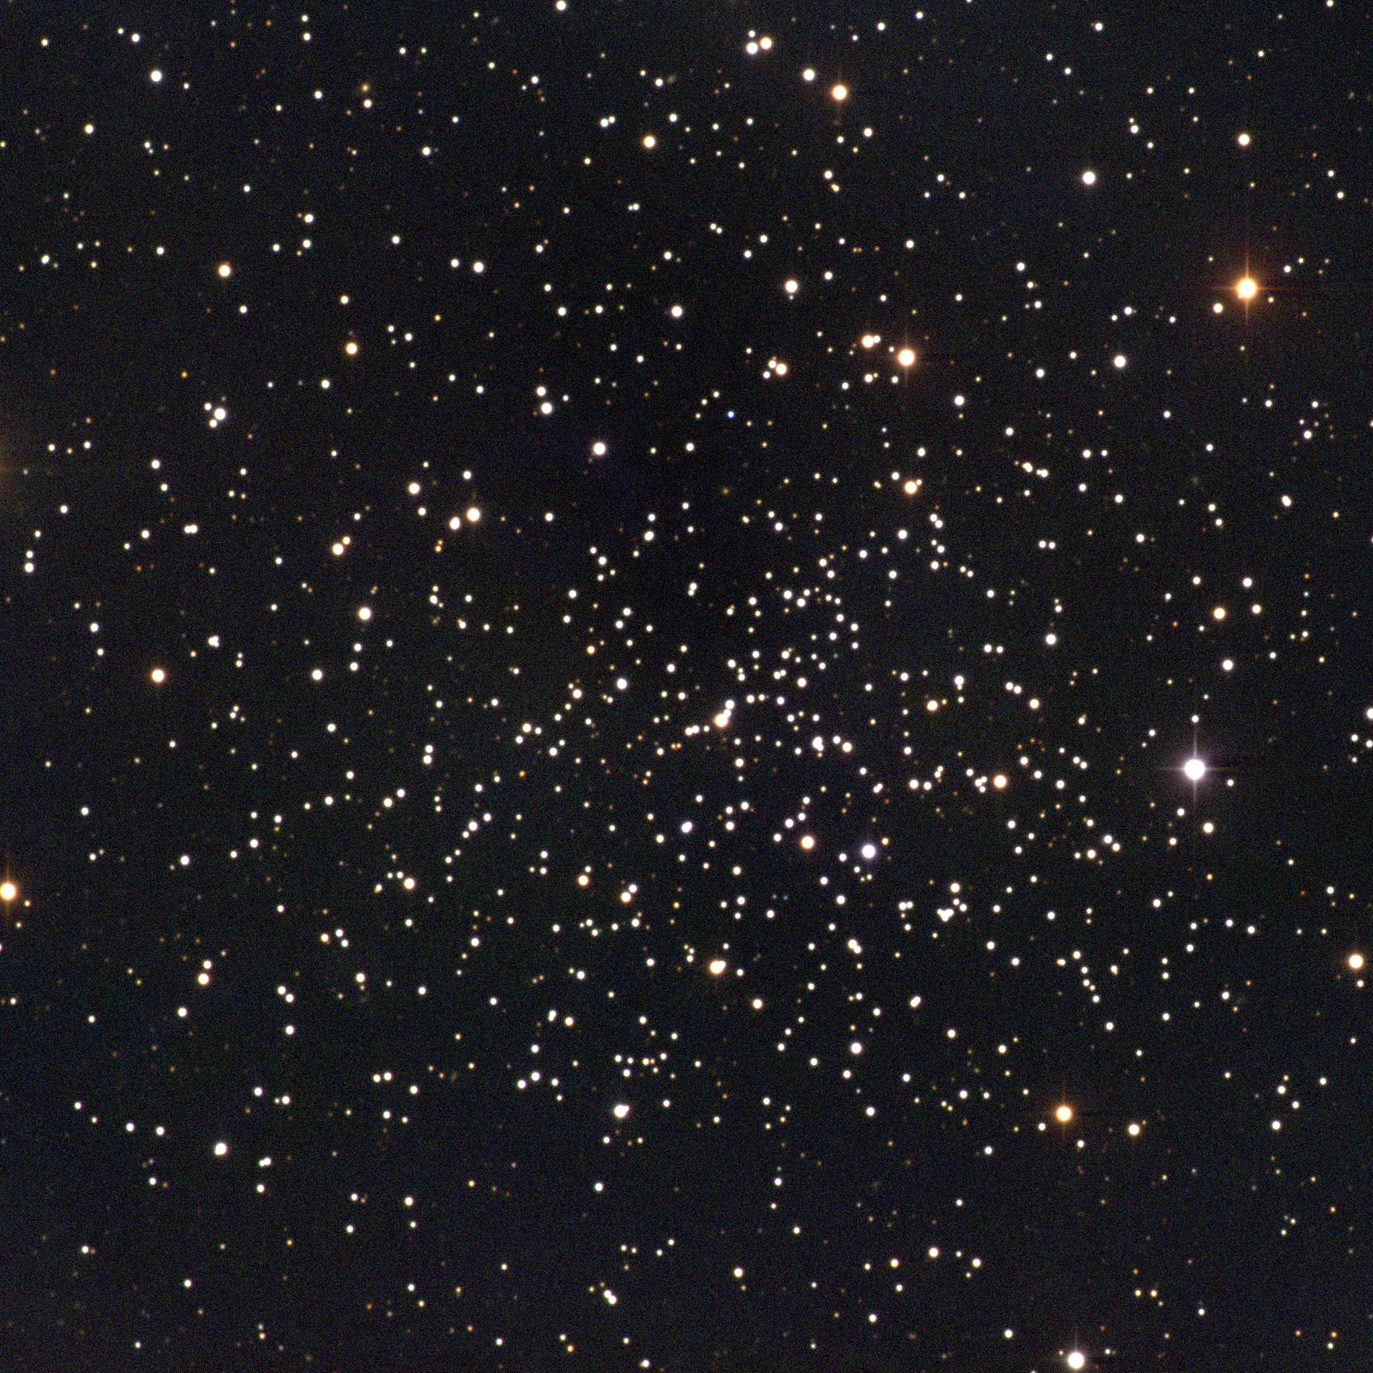
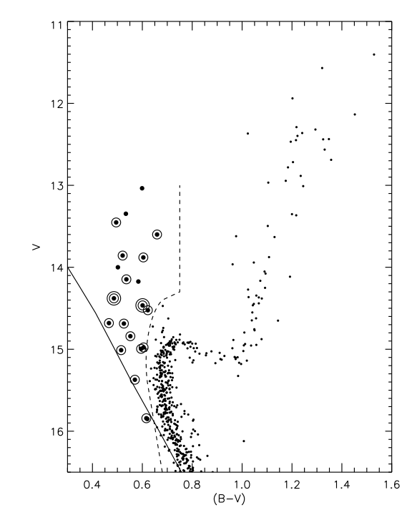
NGC 188 Blue Stragglers
Binary Frequency
76% ± 21%
Main Sequence
29% ± 3
Mathieu & Geller 2009

Slide 10
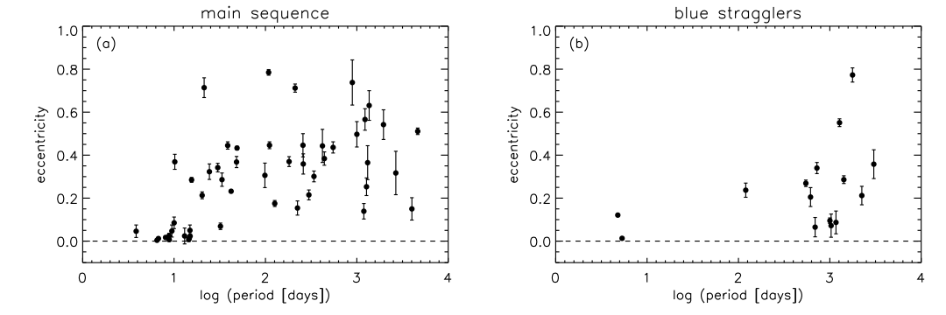
NGC 188 Blue Stragglers
Eccentricity - Period Distribution

Slide 11
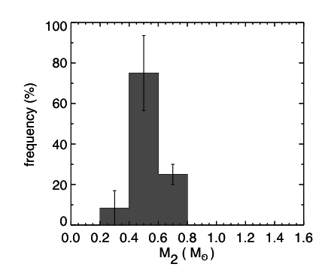
NGC 188 Blue Stragglers
Geller & Mathieu 2011
◉
Secondary Mass Distribution

Slide 12
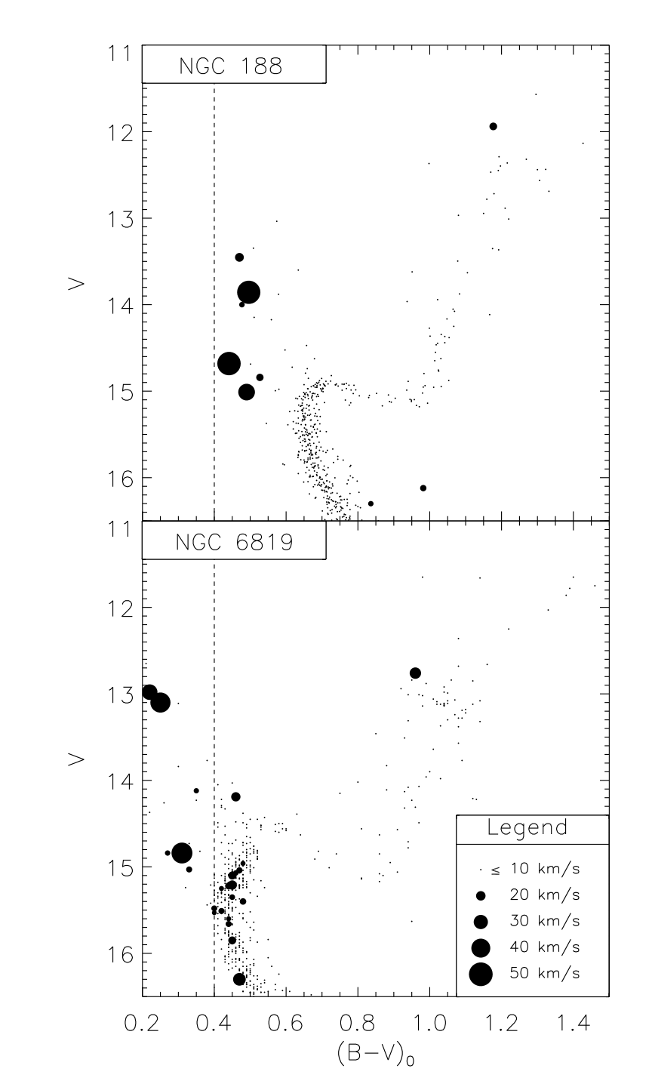
NGC 188 Blue Stragglers
7 Gyr
Rotation (vsin i)
Distribution
2.5 Gyr
Geller & Mathieu 2011

Slide 13
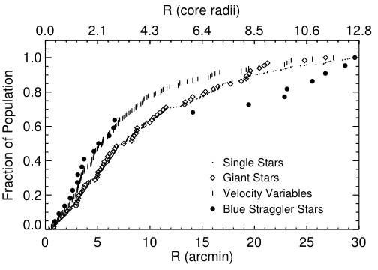
NGC 188 Blue Stragglers
2.5 Gyr
Geller et al. 2008
Spatial Distribution
Mathieu & Latham 1986

Slide 14
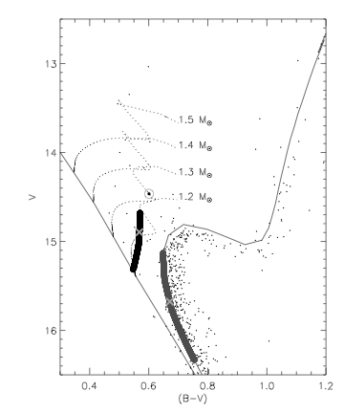
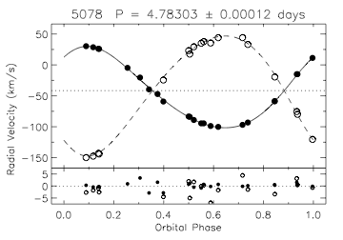
NGC 188 Blue Stragglers
Blue Straggler Mass
Secondary T_{eff} ⇒ M₂ ≈ 1 M
q = 0.68 ⇒ M₁ ≈ 1.5 M
But L and T_{eff} ⇒ M₁ ≈ 1.2 M
Dynamical
1.5 M_{o}
Photometric
x

Slide 15
NGC 188 Blue Stragglers
Hard binary frequency 76%
Typical orbital period ≈ 1000 days
Typical secondary mass 0.5 M_{o}
Rapidly rotating (modestly)
Bimodal spatial distribution
Dynamical mass < Evolution track mass

Slide 16
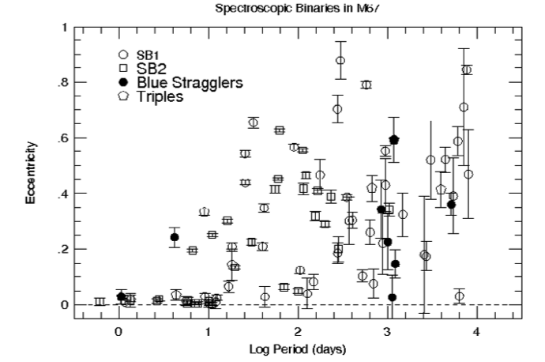
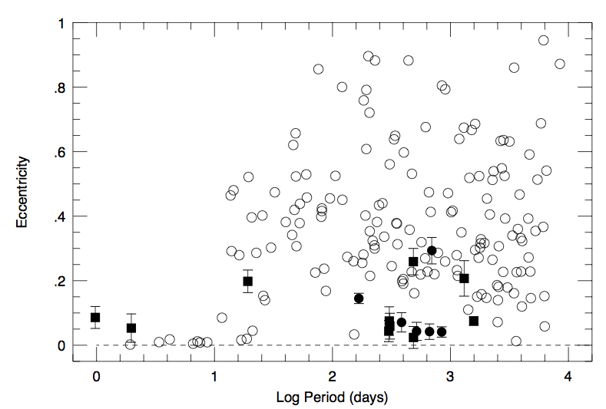
Blue Stragglers in Old Populations
M67
(Latham 2007)
NGC 188
Field
(Carney et al. 2001)

Slide 17
NGC 188 Blue Stragglers
How To Make Long-P Blue Stragglers
Hypothesis
Secondary Star
Mass transfer
(Case C – AGB)
C/O white dwarf
McCrea (1964), Chen & Han (2008), etc.
Collision during
binary encounter
Main-sequence star
Leonard (1996), Leigh & Sills (2011), etc.
Kozai-driven merger
of close binary in triple
Main-sequence star
Ivanova (2008), Perets & Fabrycky (2009)

Slide 18
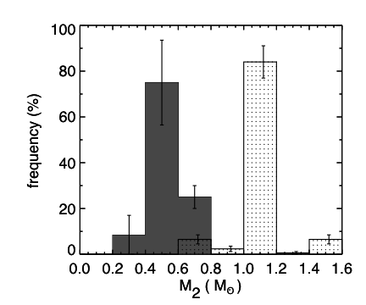
NGC 188 Blue Stragglers
How To Make Long-P Blue Stragglers
Collisions
(from N-body
model;
Geller, Hurley,
Mathieu 2012)
◉
Geller & Mathieu 2011

Slide 19
NGC 188 Blue Stragglers
How To Make Long-P Blue Stragglers
0.55 M
CO WDs
Case C
mass transfer
◉
Geller & Mathieu 2011

Slide 20
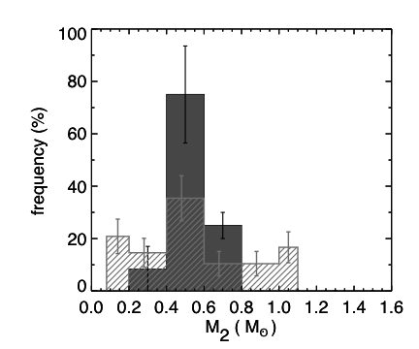
NGC 188 Blue Stragglers
How To Make Long-P Blue Stragglers
Evolved
tertiaries
from field
(Tokovinin 1997, 2008)
Geller & Mathieu 2011

Slide 21
NGC 188 Blue Stragglers
How To Make Long-P Blue Stragglers
One more constraint
on tertiary distribution:
All SB1s
6.6% chance to detect zero secondaries
1.8% chance to also realize the observed mass-function distribution
BS
Primaries
◉

Slide 22
NGC 188 Blue Stragglers
How To Make Long-P Blue Stragglers
Primarily Case C mass transfer
Some Case B mass transfer?
Some mergers in triples?
Outstanding questions
Orbital eccentricities (dynamical encounters? “e-pumping”?)
Luminosity and temperature (CMD) distribution

Slide 23
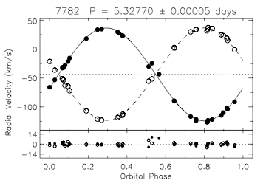
NGC 188 Blue Stragglers
How To Make Short-P BSs
SB2 => q ~ 1
Two blue stragglers!!!

Slide 24
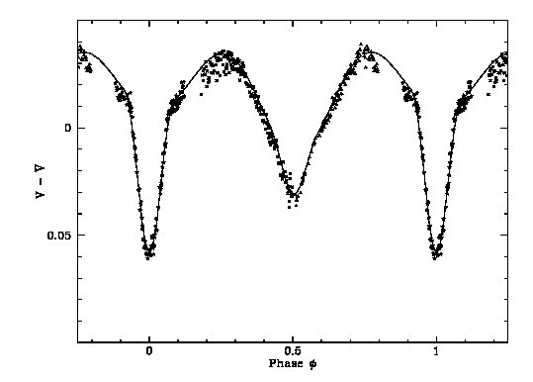
A Very Special M67 Blue Straggler
S1082
P=1.07^{d}

Slide 25
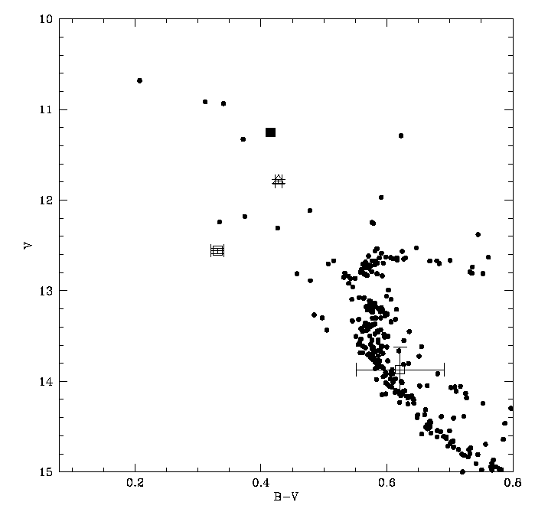
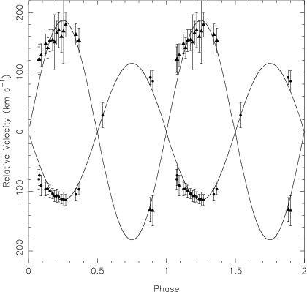
S1082
2.52 M_{o}
Van den Berg et al. 2001
Sandquist et al. 2003
1.07 ^{d}
1.58 M_{o}
P=1.07^{d}

Slide 26
A Caution from Stellar Dynamics
Simulation of M67
Primordial Binary
Period: 47,860 days
Eccentricity: 0.8
0.3 M
1.46 M
Hurley et al. 2005

Slide 27
Simulation of M67
2.089 Gyr later

Slide 28
Simulation of M67
4-body interaction
0.42 M
0.3 M
1.46 M
0.38 M

Slide 29
Simulation of M67
Period: 1.1 days
Eccentricity 0.8
0.42 M
1.46 M
circularized
mass transfer event
merger
1.88 M Blue Straggler

Slide 30
Simulation of M67
But wait…there’s more

Slide 31
Simulation of M67
0.86 M
A blue straggler formed through a merger ends up in the cluster core with an originally unrelated star.
Primordial Binary at cluster core
0.86 M
0.81 M
1.88 M Blue Straggler

Slide 32
NGC 188 Blue Stragglers
How To Make Open Cluster Blue Stragglers
Hypothesis
Frequency
Mass transfer
(Case C – AGB)
Primary channel
Collision during
binary encounter
What can happen, will
Merger of close
binary in triple
What can happen, will

Slide 33
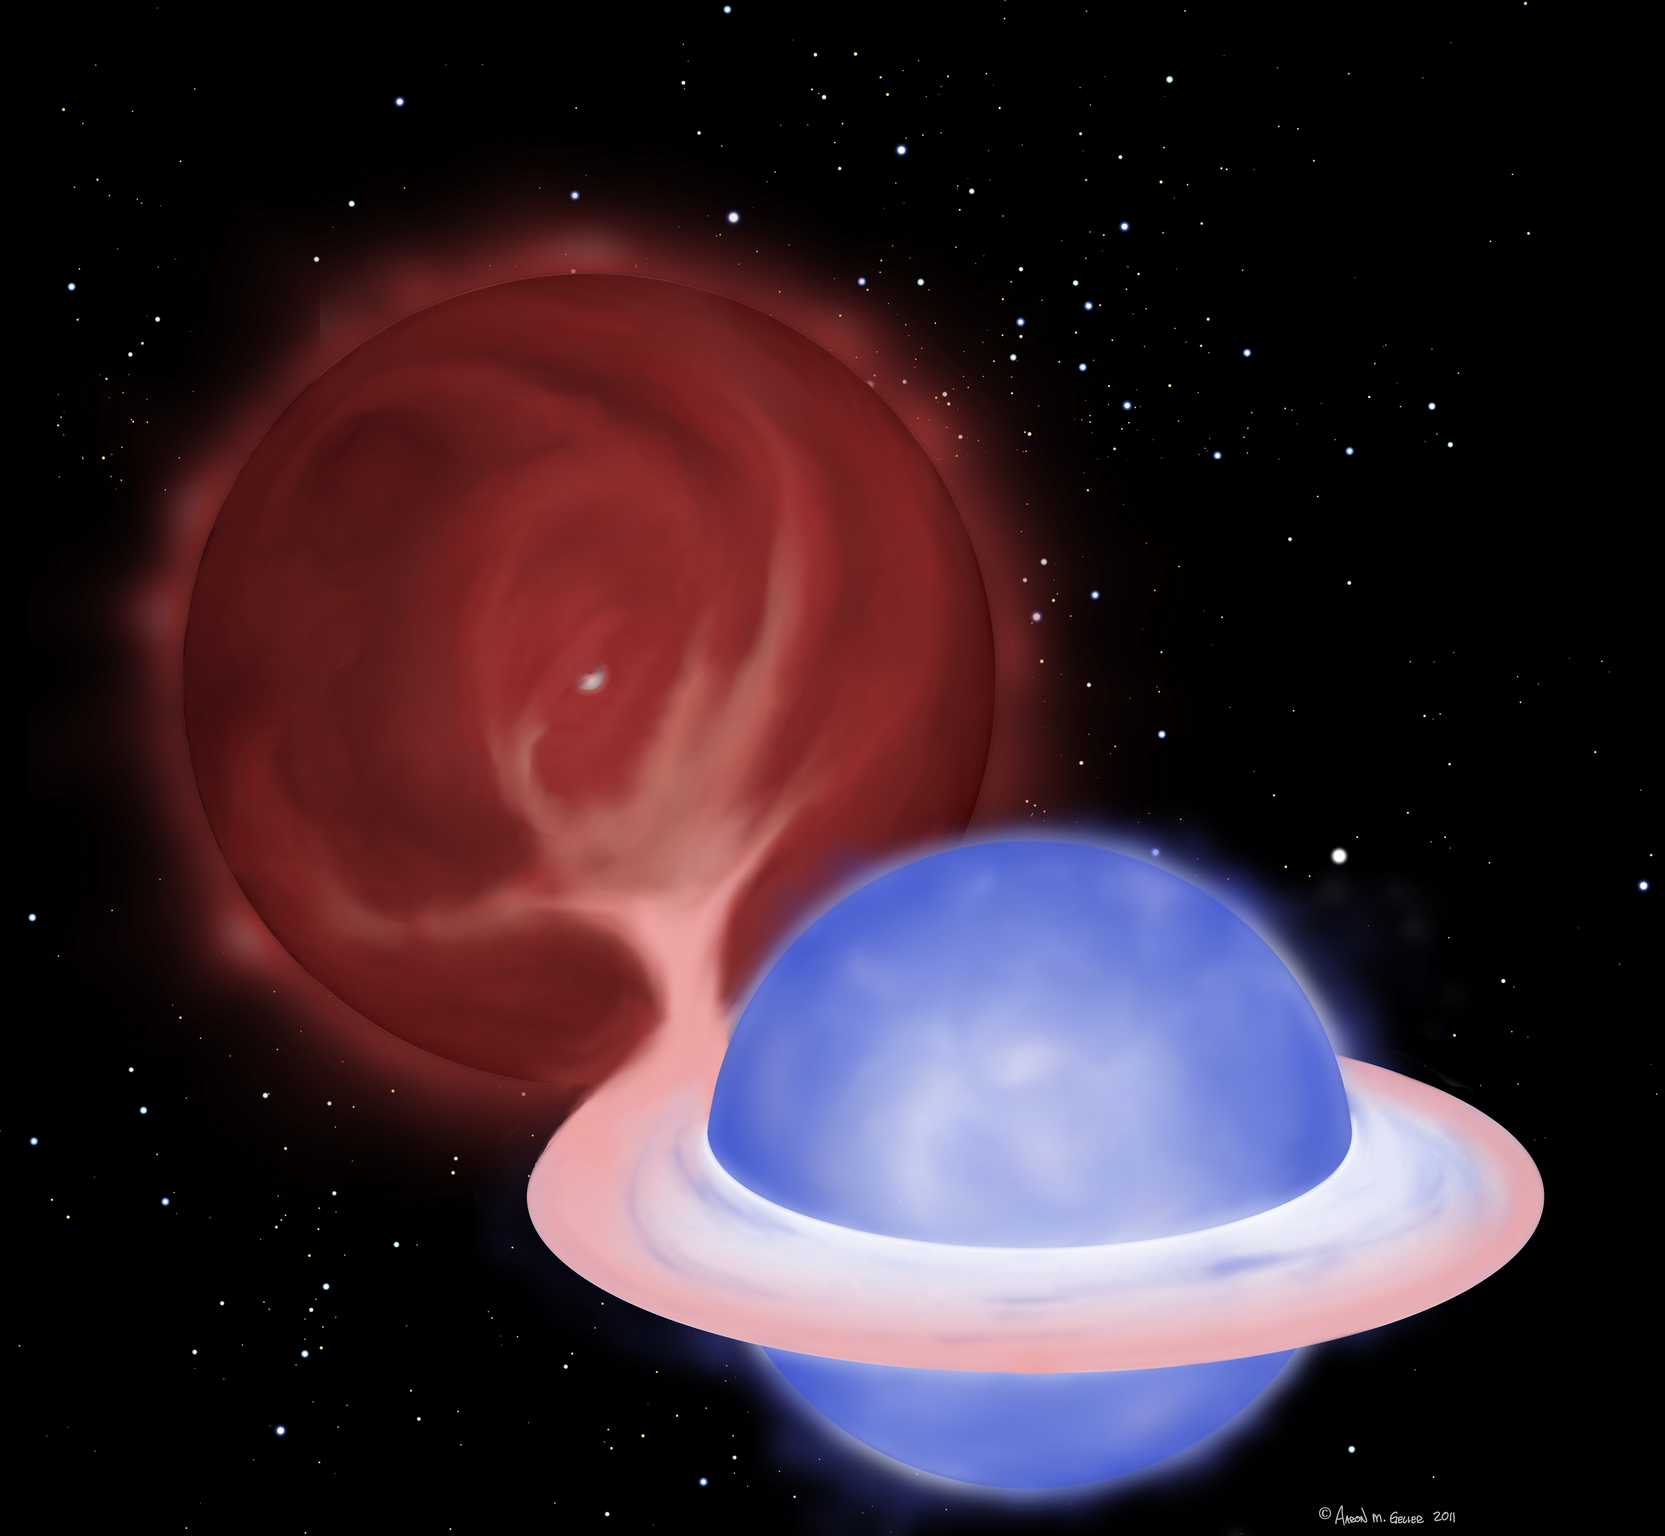
Credit : A. M. Geller

Slide 34
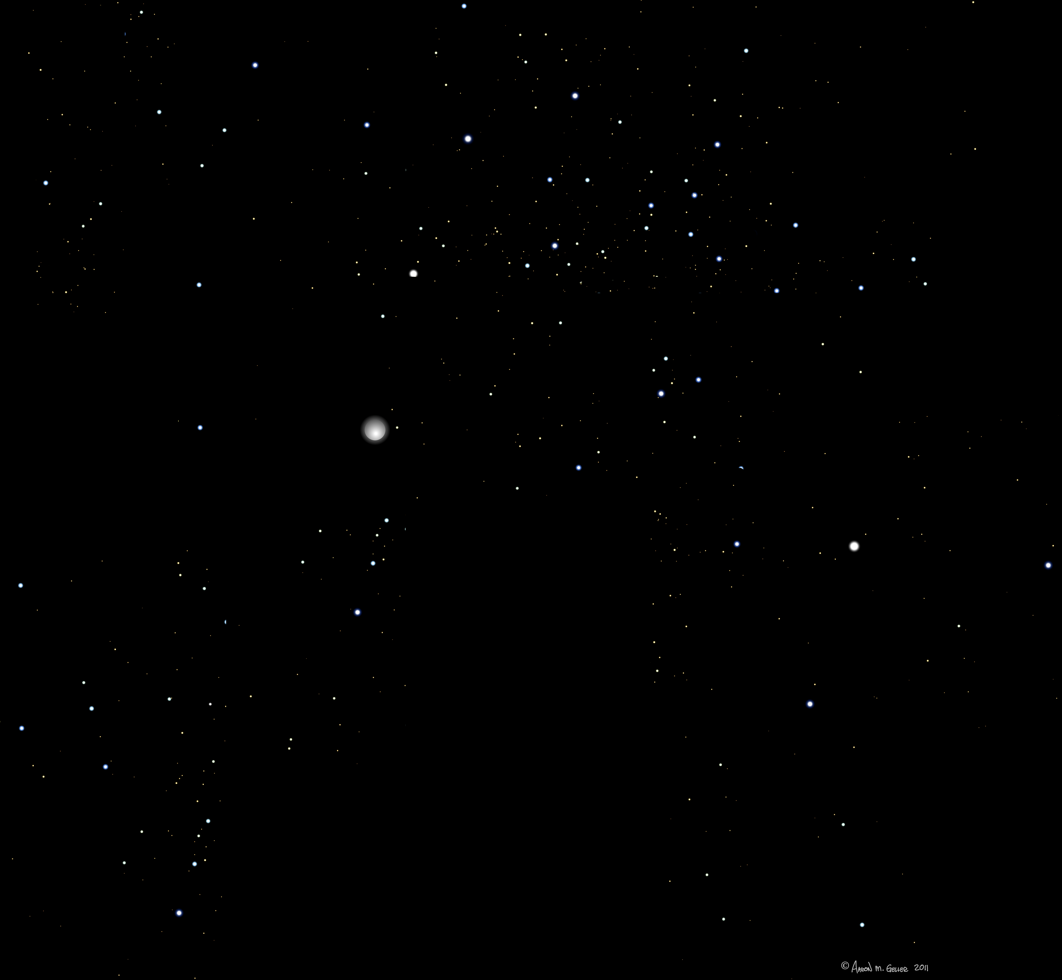


51
41 orbits of Hubble Space Telescope ACS
to see if the white dwarfs are there!
Credit : A. M. Geller

Slide 35
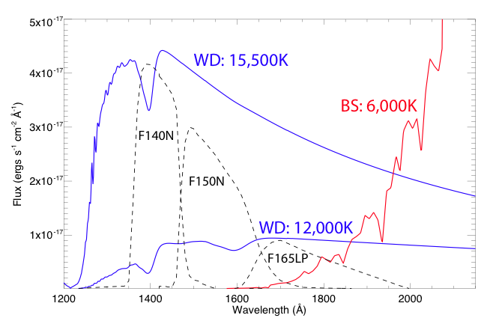
NGC 188 Blue Stragglers
“Future” Observations
Gosnell et al. poster – UV imaging of NGC 188 BS with Hubble

Slide 36
NGC 188 Blue Stragglers
Findings from N-Body Simulations
Aaron Geller… on Thursday! …

Slide 37
Open Cluster Blue Stragglers
Summary
Case C (& B) Mass Transfer
Dynamical Processes
And don’t forget the 5 blue stragglers with constant RV (singles or long period?)
Multiple formation mechanisms, but
mass transfer dominates

Slide 38
NGC 188 Blue Stragglers
How To Make Long-P Blue Stragglers
Case C (& B) Mass Transfer
(+ dynamical encounters/“e-pumping”,
mergers in triples?)
And don’t forget the 5 blue stragglers with constant RV (singles?)
Multiple formation mechanisms, but
mass transfer dominates
Aaron M. Geller

