Slide 1
Nial Tanvir
University of Leicester
GRBs in the era of ELTs
Feeding the Giants, 2011

Slide 2
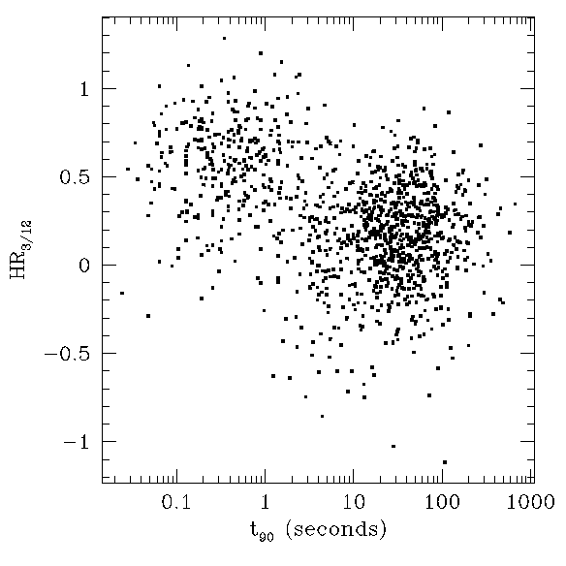
GRB types
Classical long bursts are associated with core collapse of some H-stripped massive stars
Short duration bursts are suspected of being (mostly) due to compact binary mergers

Slide 3
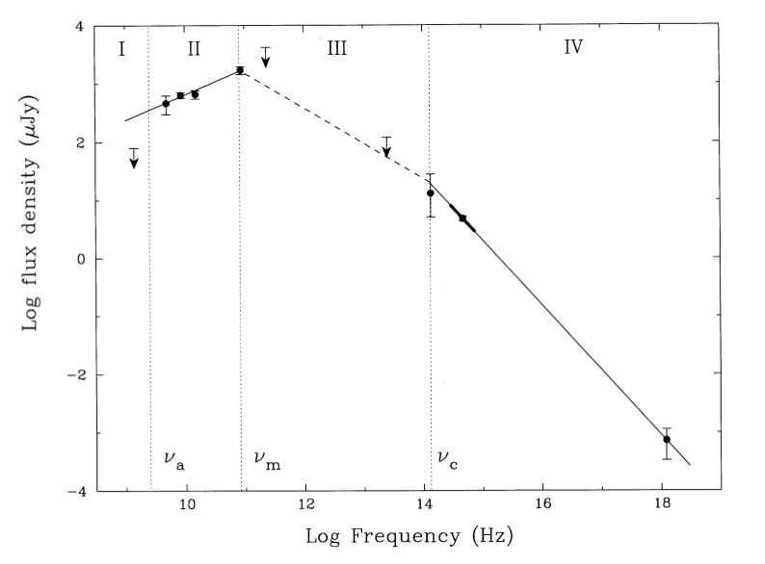
GRBs
Afterglow emission is very broad band, and probably multi-messenger

Slide 4
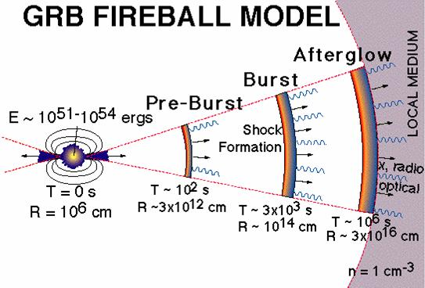
(Long bursts)
How long does central engine remain active?
Role of magnetism?
High energy neutrinos/CRs?
Is the model basically right?
What factors decide if a GRB is produced and how bright it is?
Progenitor – single star or binary star (or both)?
What is jet structure?
What really is environment?

Slide 5
(Short bursts)
How long does central engine remain active?
Are short bursts also relativistic fireballs?What is there space density?
Progenitor – NS-NS, NS-BH (both, neither)?
Gravity wave signal?

Slide 6
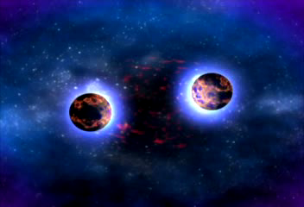
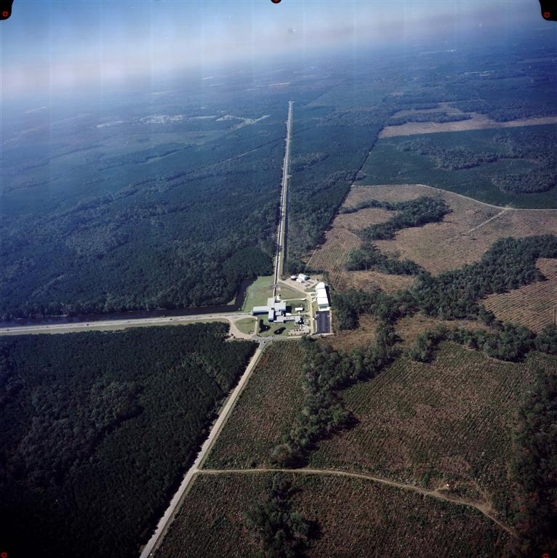
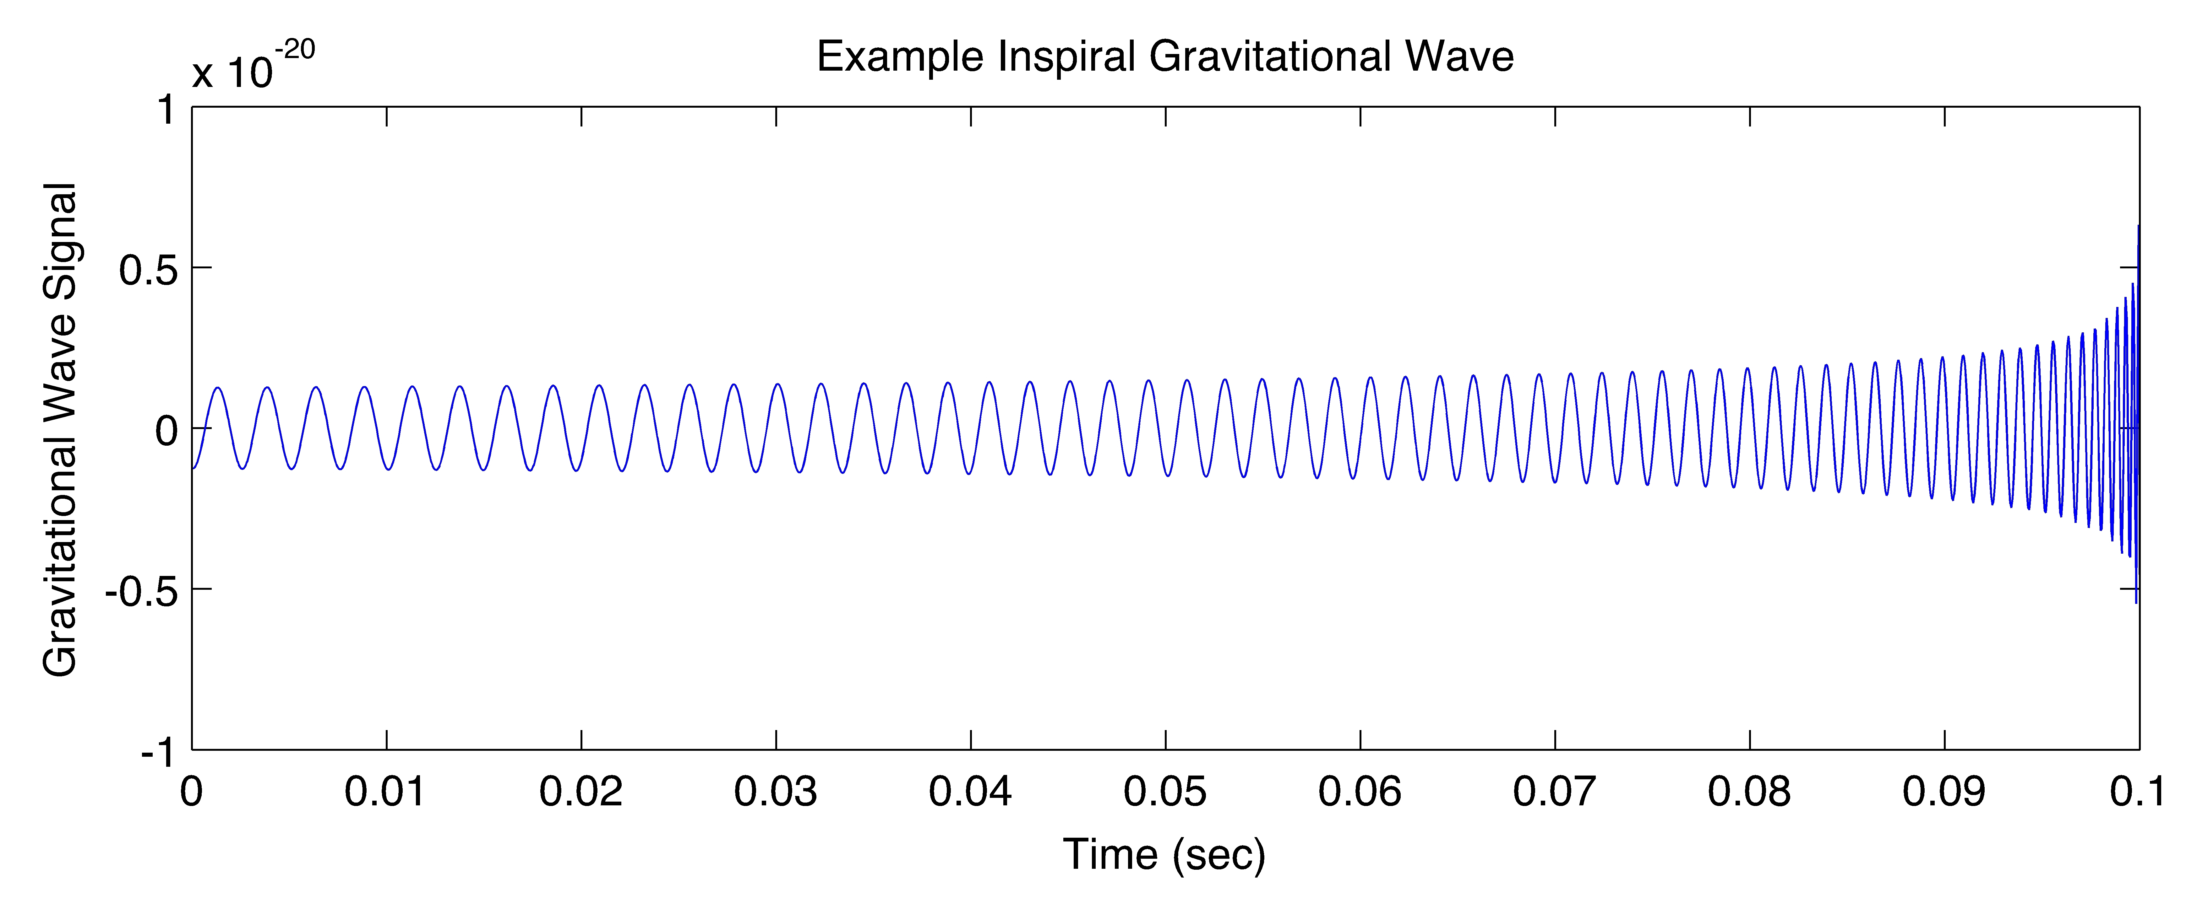
Short-duration bursts
NS-NS/NS-BH inspirals and mergers are primary targets of next generation GW detectors e.g. A-LIGO in ~2014.
If they also produce short-GRBs then can enhance search sensitivity and make first steps in EM/GW astrophysics.

Slide 7
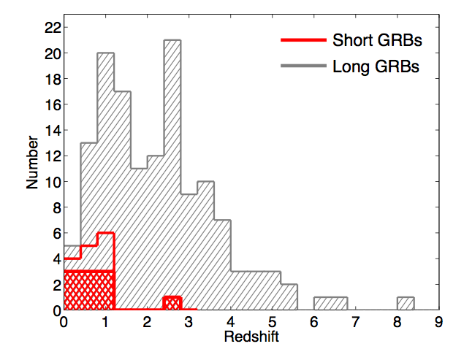
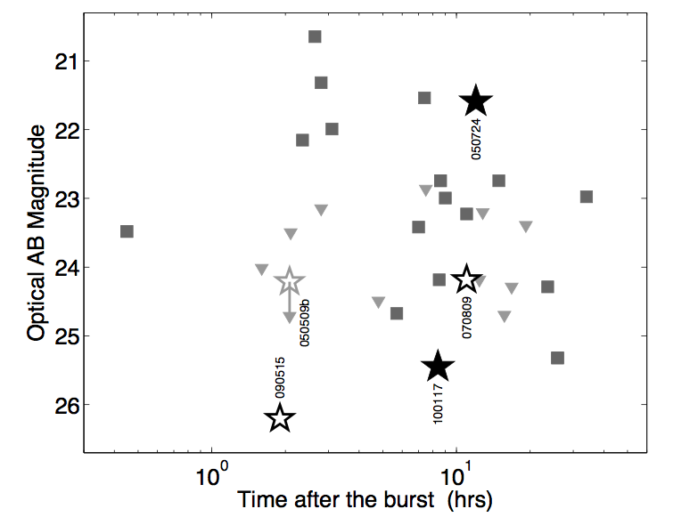
Short-duration bursts
Seem to be lower luminosity (hence lower <z>) and found in hosts with less ongoing star formation. But:
Some afterglows too faint to give X-ray position
No un-ambiguiously short burst yet with absorption redshift
Some have no apparent host, so no definite redshift (hence rely on probabilistic arguments and assume progenitor kicked from host)
Fong et al. 2011
Berger 2011

Slide 8
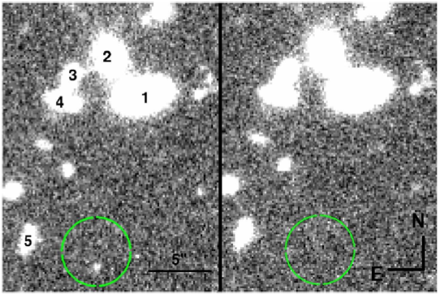
Short-duration bursts
Typically afterglows very faint and/or fade fast in optical/IR. Rapid response from very large aperture telescope may be key (e.g. to get absorption redshifts, to search for accompanying faint SN-like events).
e.g. GRB090515 afterglow R~26.5 at 2 hours post burst. No host.
Very tough for 8 m, but good target for ELT spectroscopy.
Rowlinson et al. 2010

Slide 9
GRBs as high-redshift probes
  Extremely bright and visible potentially to z~20 or more (gamma-ray and hard X-ray flux unaffected by intervening material).
  Afterglows pinpoint their hosts - may provide redshifts, chemical enrichment, dust, molecules etc. irrespective of galaxy luminosity.
  Provide backlight for measuring neutral fraction in IGM.
  Trace (pop I/II/III ?) massive star formation.
  → These are highly complementary to other routes to investigating early star and galaxy populations, and reionization.

Slide 10
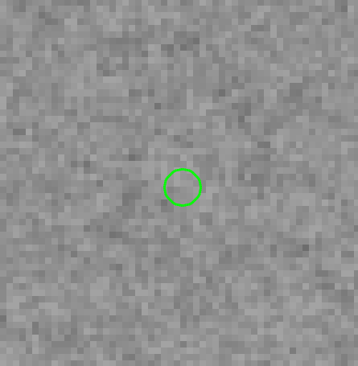
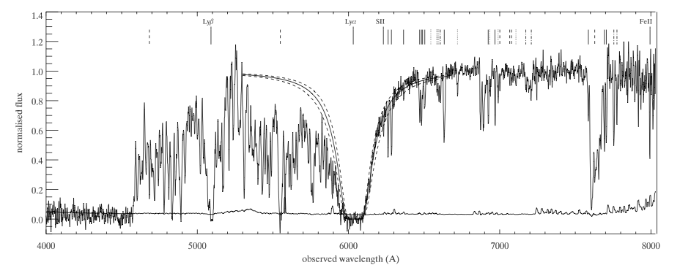
GRBs: powerful probes of host galaxies
GRBs select high-z galaxies independently of host galaxy luminosity.
Afterglow spectroscopy can give redshift, chemical abundances, dust, molecular content, dynamics.
E.g. GRB 050730: faint host (R>28.5; Levan et al. in prep.), but z=3.97, [Fe/H]=-2 and low dust, from afterglow spectrum (Chen et al. 2005; Starling et al. 2005).
HST/ACS

Slide 11
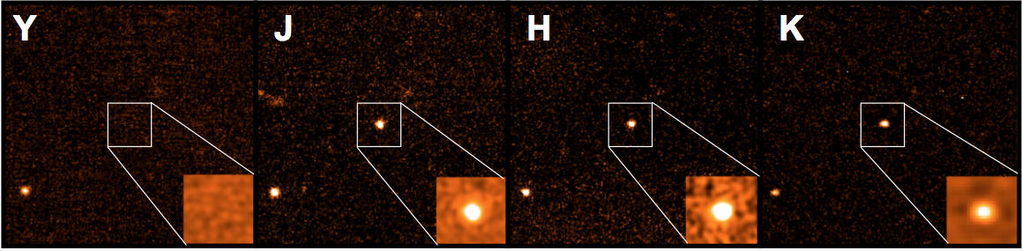
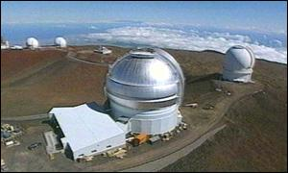
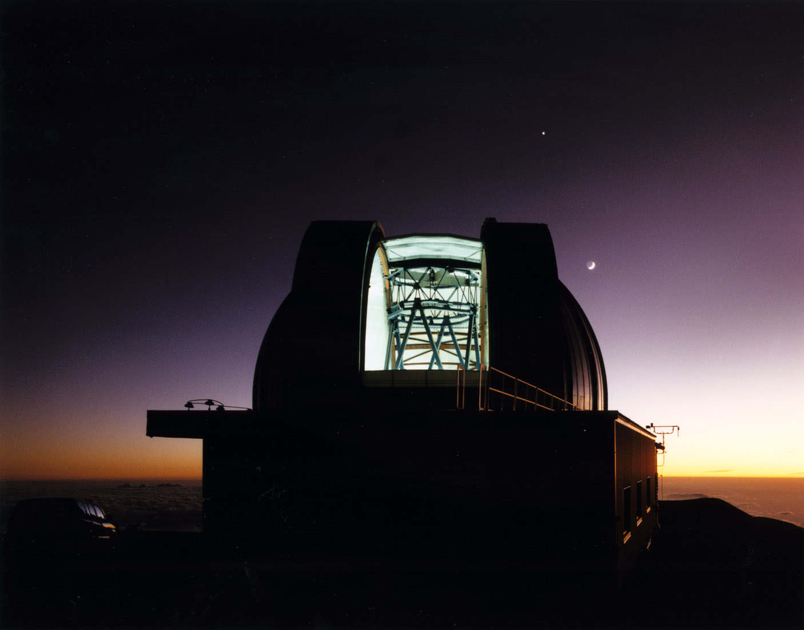
GRB 090423

Slide 12
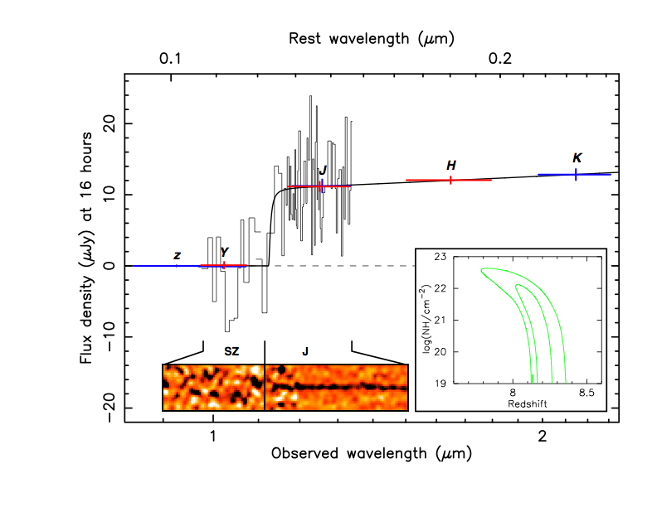
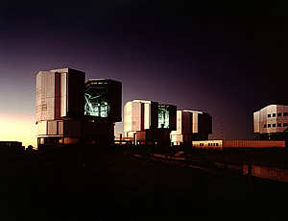
GRB 090423
z = 8.23 ± 0.08
Power law continuum ⇒ photo-z robust
Age of universe = 630Myr
NT et al. 2009, see also Salvaterra et al. 2009.

Slide 13
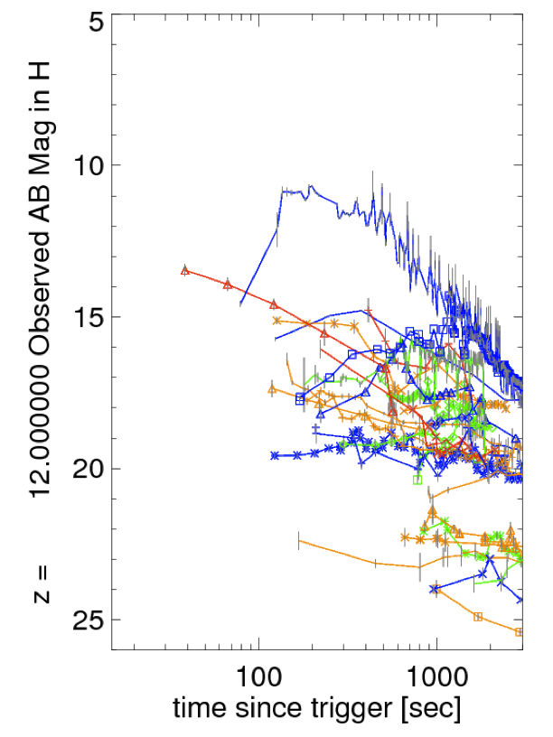
GRBs: can be
very bright!
8m limit for detection
  Brighter afterglows easily detectable at very high redshifts. (in part because cosmological time dilation means we can get on target earlier in the rest frame)
ELT limit for detection
Figure from Grindley et al. 2010

Slide 14

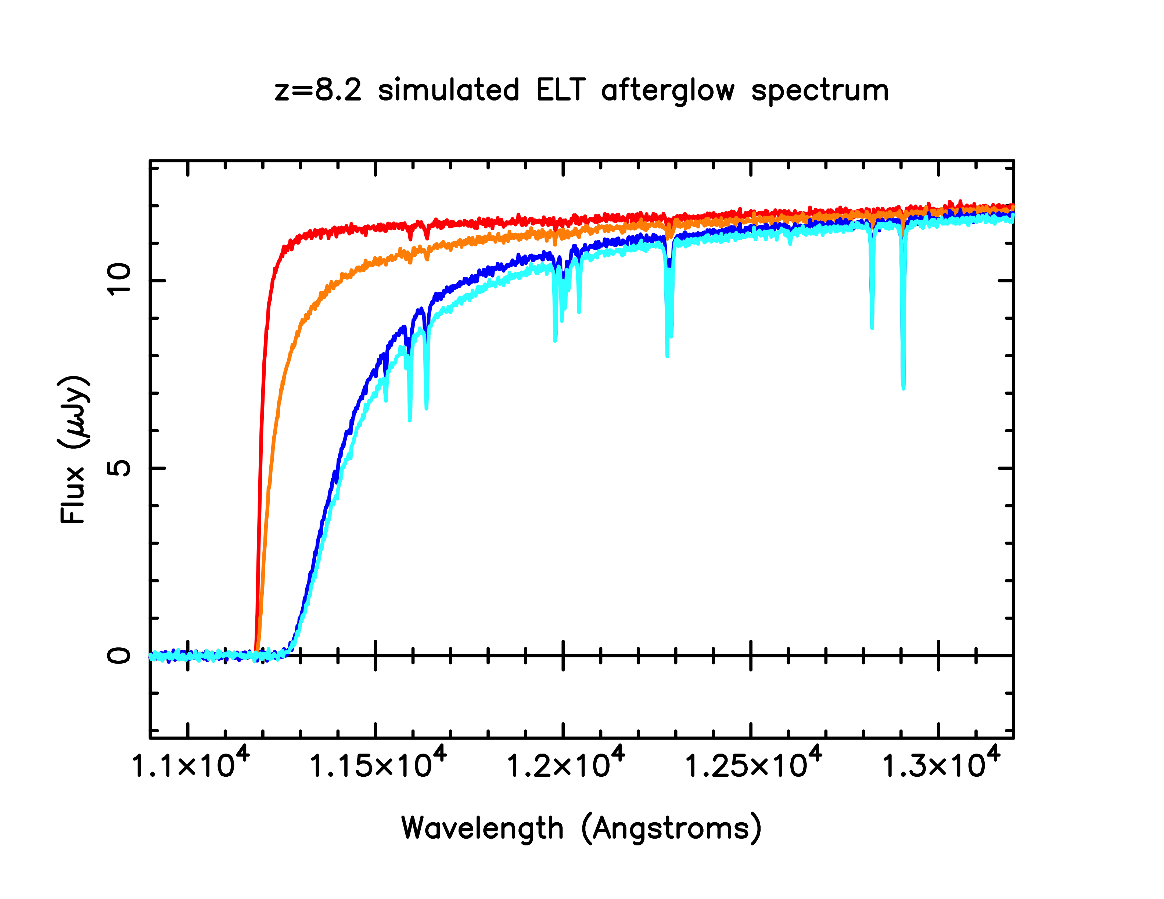
Log(NH) (host) | NF (IGM)
20 | 0
20 | 0.8
22 | 0
22 | 0.8
Little gas in host ⇒ good characterization of IGM.
Much gas in host ⇒ superb metallicity determinations.
Simulated GRB090423 spectrum taken by ELT rather than VLT (remember this was a faint afterglow!)

Slide 15
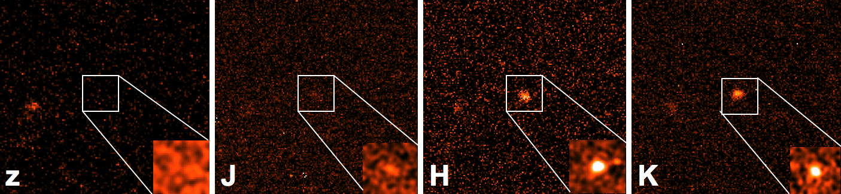
GRB 090429B
Optically dark e.g.
z > 21.8 at 13 minutes (GROND: Olivares et al. GCN 9283)
z > 23.5 at ~1 hour (VLT: D’Avanzo et al. GCN 9284)
z > 24.1 at ~3 hours (Gemini-N)
Infrared bright (Gemini-N at ~3 hours):
J(AB)=22.8
H(AB)=21.5
K(AB)=21.2

Slide 16
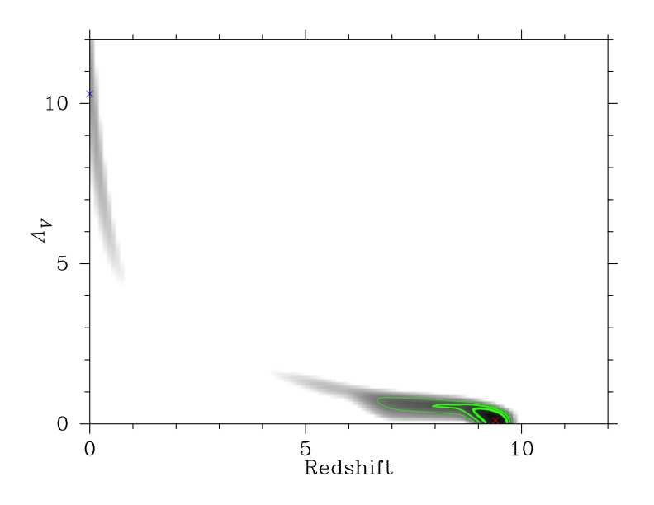
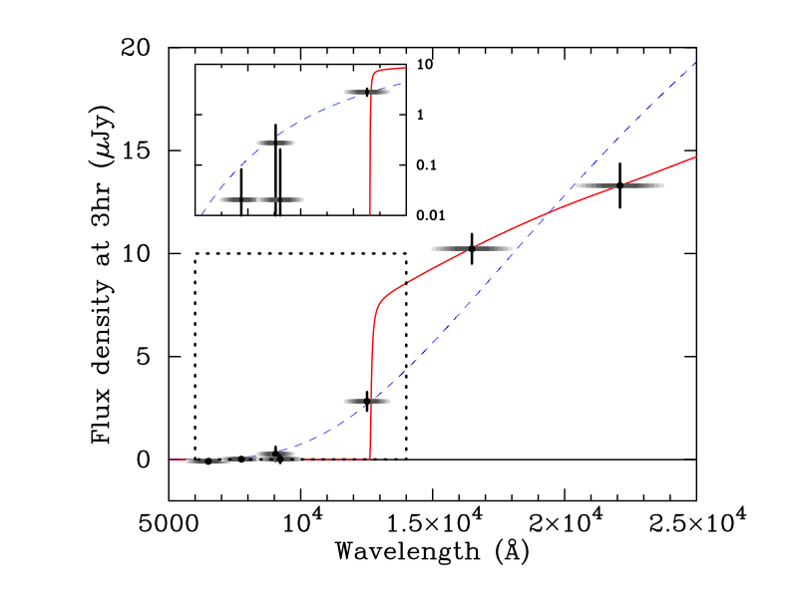
GRB 090429B
Another high-redshift candidate (photo-z~9.4).
SMC dust
Cucchiara et al. 2011

Slide 17
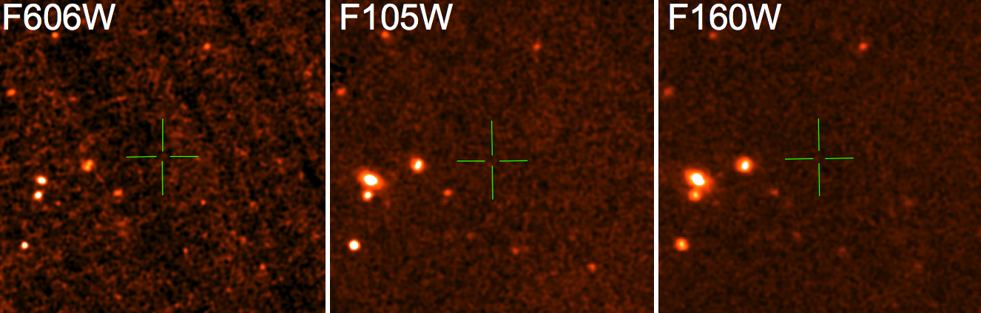
GRB 090429B
Other evidence...

Slide 18
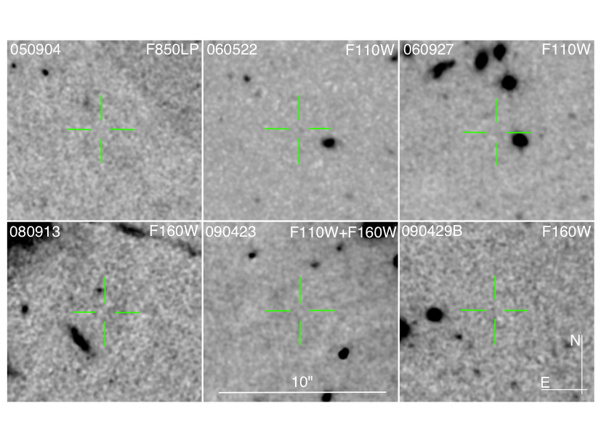
Is non-detection of high-z hosts expected?
Tanvir/Levan et al. in prep
Notes:
I calculate that H=28.2 corresponds to M_H=-19.0 at z=8.2.

Slide 19
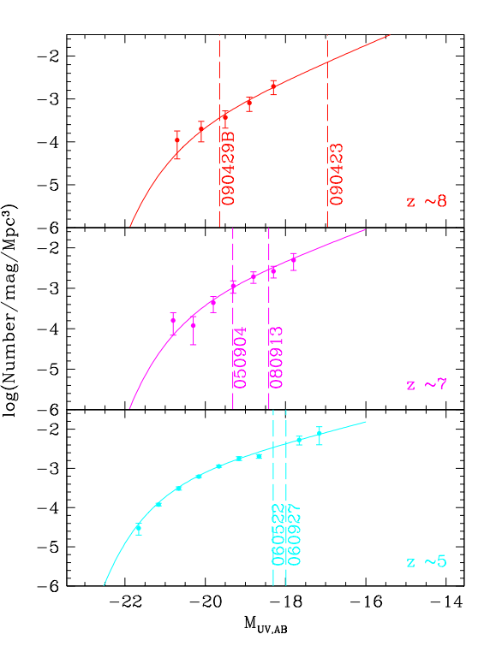
JWST deep field limits
Limits in some cases very deep since knowledge of position allows us to look for low-significance detections (and we don’t need deep veto integrations).
Detailed analysis shows that non-detection of hosts is consistent with the very steep faint-end slope of the galaxy LF at z>6 found by some studies of UDF.
Marginally inconsistent with a non-evolving LF.
Notes:
I calculate that H=28.2 corresponds to M_H=-19.0 at z=8.2.

Slide 20
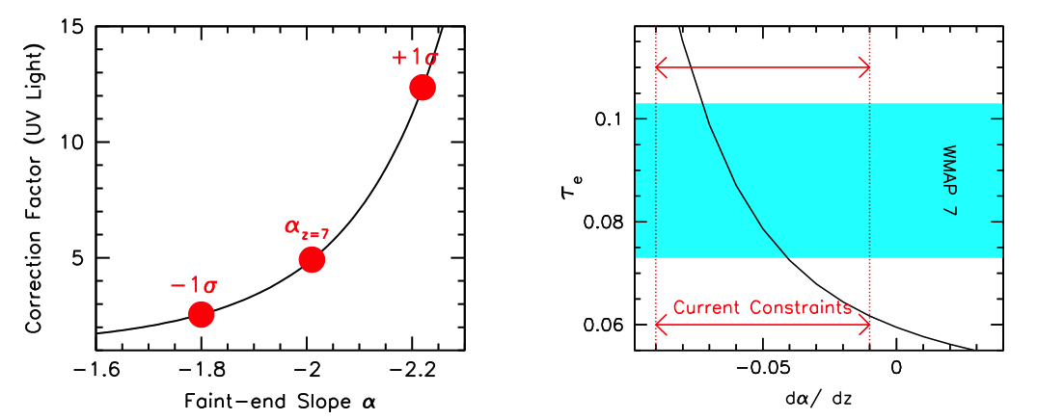
Does it matter?
Yes! – and there are other uncertainties too: is Schechter function appropriate? Is there dust not accounted for? What is the Lyman continuum escape fraction at high redshift? Cosmic variance?
Bouwens et al. 2011

Slide 21

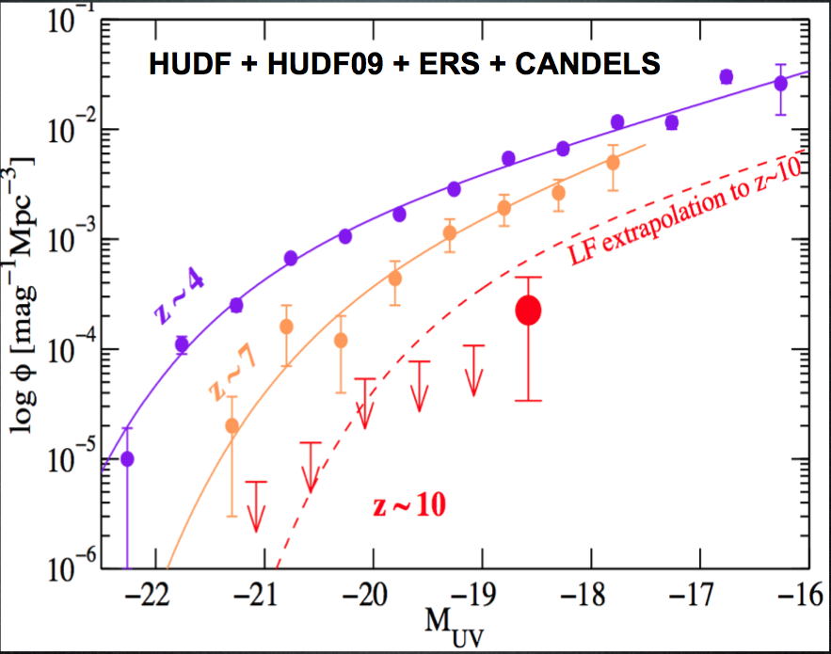
Rapid evolution?
Oesch et al. 2011

Slide 22
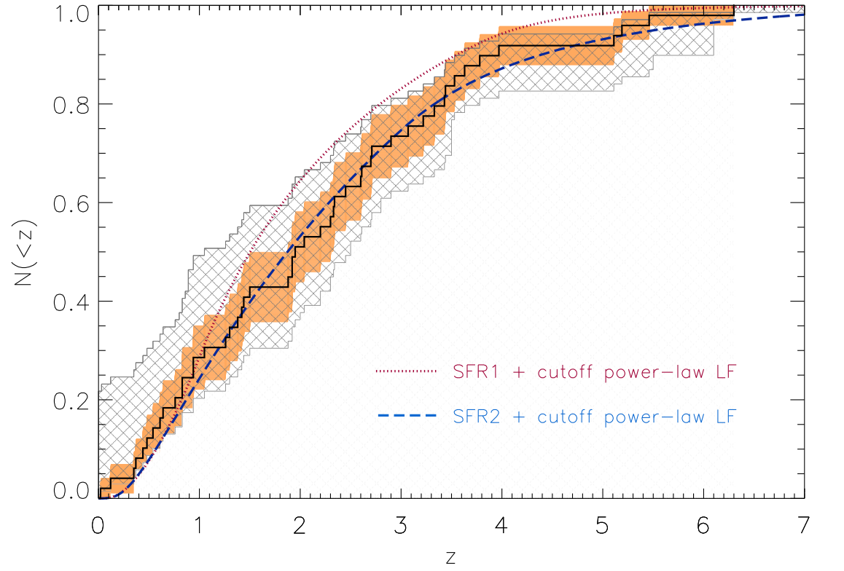
GRBs: redshift distribution
TOUGH: The Optically Unbiased GRB Host sample!
<z> ~ 2
< 5% of Swift burst at z >7.
Most optically “dark” bursts are dusty.
Jakobsson et al. in press

Slide 23
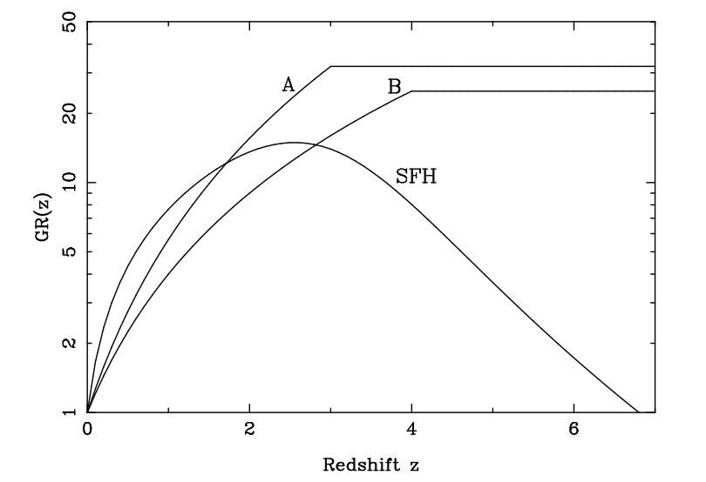
GRBs: redshift distribution
Canonical
Normalised SFR
Jakobsson et al. in press

Slide 24
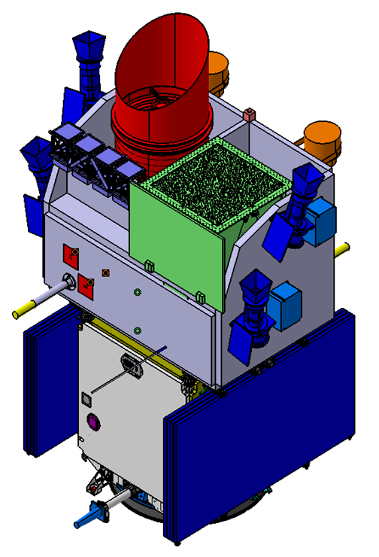
Future
(there’s no such thing as a free launch!)
  Chinese/French mission.
  Similar to Swift but enhanced optical imaging capability (50 cm VT sensitive to 1 micron). Hence more rapid identification of candidate high redshift bursts.
  Several other new mission concepts are also being proposed, but nothing else yet approved.
SVOM - 2015

Slide 25
Conclusions
Great potential for GRB science in era of ELTs and other next generation facilities – many problems remain, for which detailed multiband, time-resolved data will likely make progress.
Detection and redshifts for short bursts may be key for exploiting synergy with GW experiments.
GRBs provide powerful means of locating and studying star formation and galaxy evolution throughout cosmic history and into the era of reionization. GRB hosts and their progenitor populations may be typical of the sources driving reionization.
Host(s) of z>5 GRBs so far undetected in deep HST observations, consistent with steep LF slope – and therefore helpful for reionization by stars.
Question remains – what mission(s) will provide the necessary triggers in the ELT era?

