Slide 1
Spectroscopic Studies:
Galactic Disk Populations
Bacham E. Reddy
Indian Institute of Astrophysics
Bengaluru
30 August 2011, 03:00 PM
Feeding the Giants: ELTs in the era of surveys

Slide 2
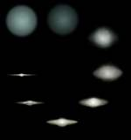
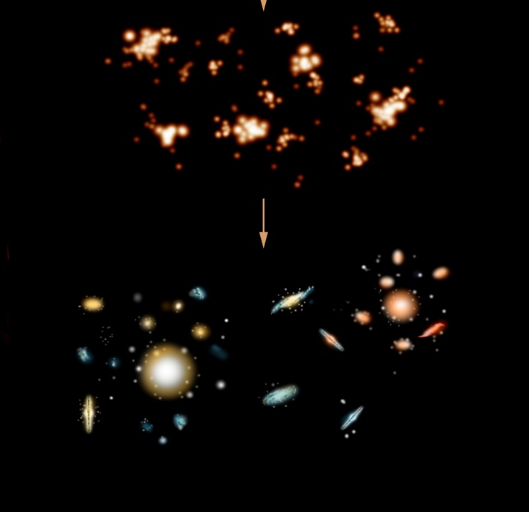
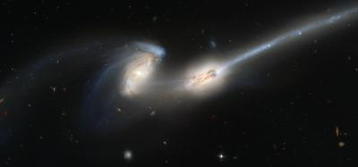
The Milky Way galaxy: formation Scenarios
Monolithic collapse of a proto-galactic cloud
Signatures: continuity in the kinematic and chemical properties of its constituents.
Hierarchical formation (through multiple mergers) in Lambda CDM models.
Signatures: discontinuity in the kinematic and
chemical properties of its constituents

Slide 3
Chemodynamics of the Galaxy: Ingredients
Photometry
scale lengths, scale heights, number densities etc
Astrometry
Distances, proper motions, radial velocities
kinematic motions, orbital parameters
(U, V, W) , (Rm, e, |Z|)
Chemical tagging
High resolution spectra of samples of stars
Derivation of abundances of elements of
different nucleosynthesis history

Slide 4
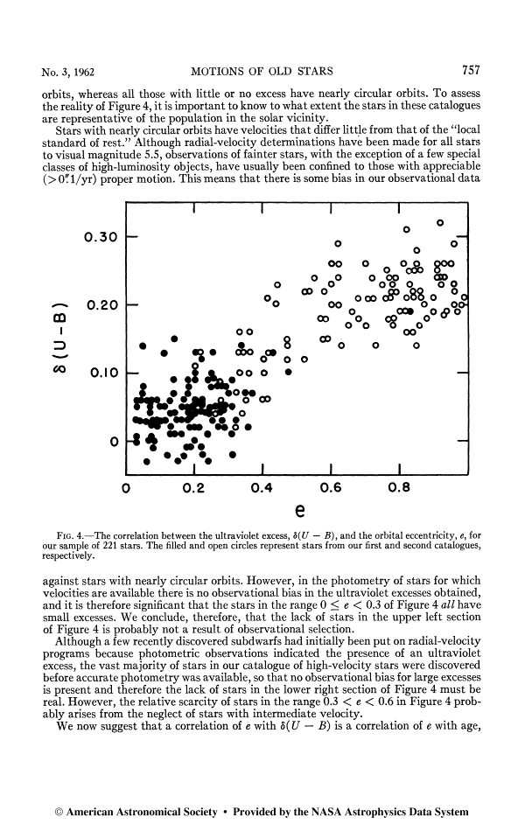
Setting the stage
“The stars with the largest excess
are moving in highly elliptical
orbits, whereas stars with little/no
excess move in circular orbits”
Rapid collapse model for
the Galaxy formation
Eggen, Lynden-Bell and
Sandage (1962)

Slide 5
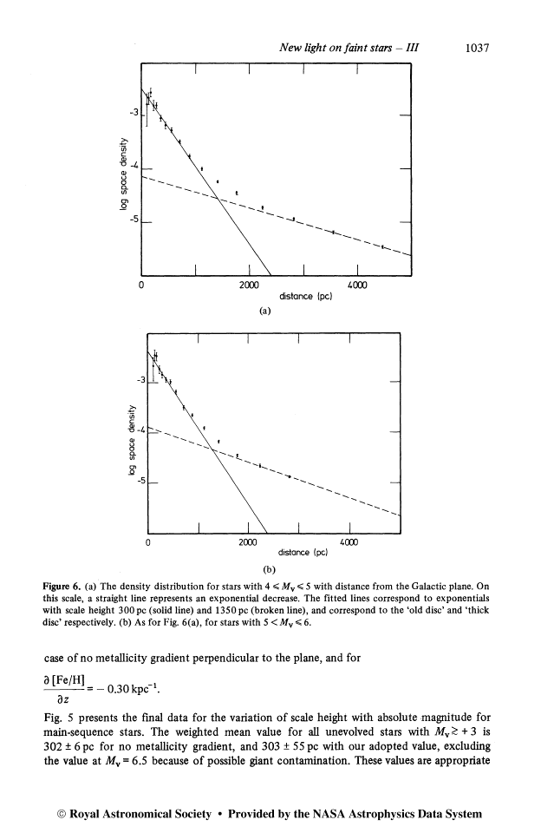
The Thick Disk in the Milky Way
A major modification to ELS model
The density distributions for a sample
of 12,500 stars from the Galactic plane.
Identified two disk components: the
thin disk with a scale height of 300pc
and the second component- thick disk
with a scale height of 1350pc.
The second component contains 2% of
the total stars in the solar neighborhood.
Distance (pc)
Gilmore & Reid, 1983

Slide 6
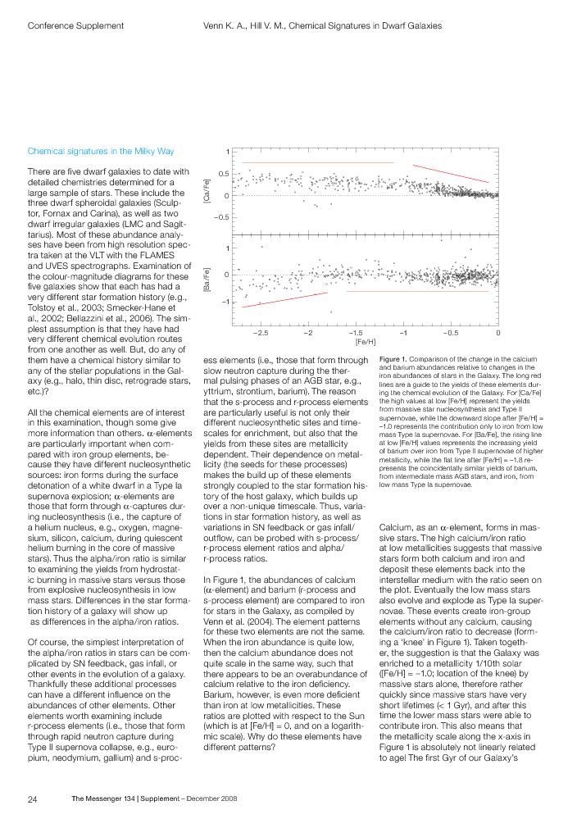
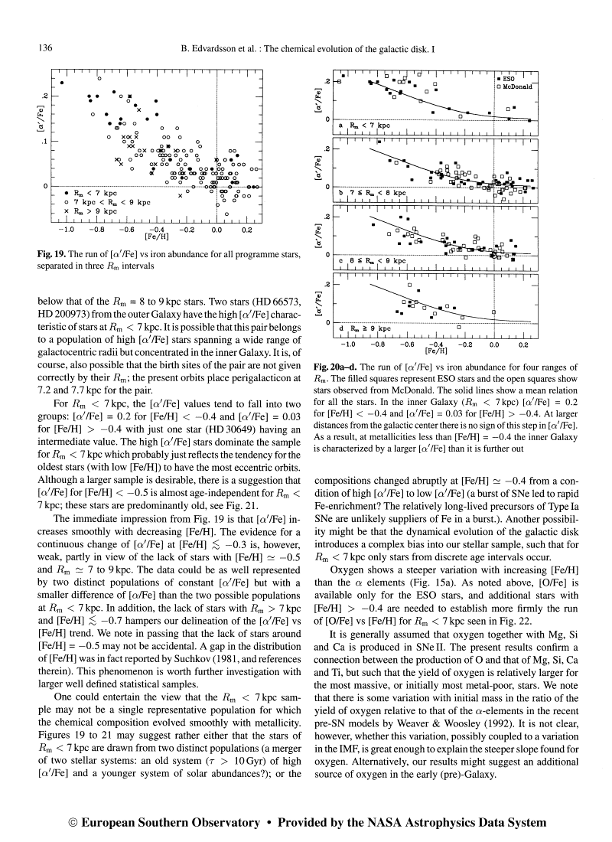
Evolution of Abundance Ratios in the Galaxy
Overwhelming majority of Galactic field stars have [X/Fe] with very little scatter over a range of 4 dex in [Fe/H].
the star forming gas must be well mixed
Rate of star formation must be low enough to allow time for element creation followed by large scale mixing
Edvardsson et al; 1993.
scatter exists in the trends of [α/Fe] Vs. [Fe/H] and more for stars with R_{m} < 7 kpc, metal-poor and old.
Interpreted as efficient SFR in the inner disk compared to the outer disk

Slide 7
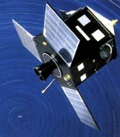
The Milky Way: Post Hipparcos era
An European Space mission to
measure accurately stellar positions
space motions, and distances for
precise astrometry.
It produced Hipparcos catalogue
containing more than one hundred
stars up to magnitude limits mv=9
and distances with accuracies
<= 10% upto 100 pc.
Hipparcos: High precision parallax collecting satellite.

Slide 8
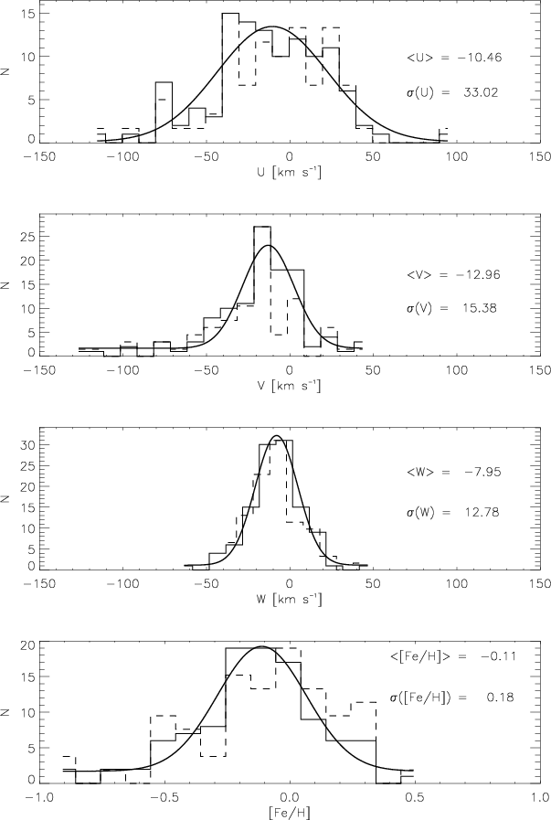
The Milky Way components: kinematic definitions
Comp. f Vlag σ_{u} σ_{v} σ_{w}
_{(km /sec)}
Thin 93% -12 39 20 20
Thick 7% -51 63 39 39
Halo 0.6% -220 131 106 85
(Based on Hipparcos: Dehnen, Binney, 1998, Soubiran et al. 2000, Robin et al. 2003)

Slide 9
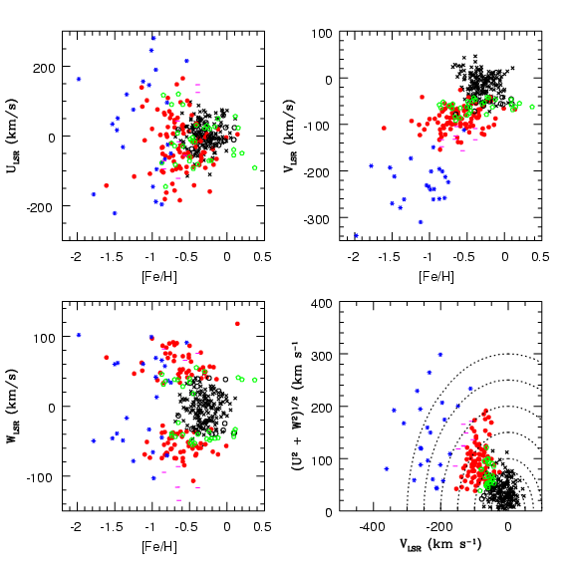
The Milky Way: Kinematic Samples
Thin Disk
Thick Disk
Samples grouped into the thin disk,
the thick disk and the halo based
on kinematic definitions.
No metallicity or age criteria employed
Reddy et al. 2003,2006; Bensby+; Fuhrman+

Slide 10
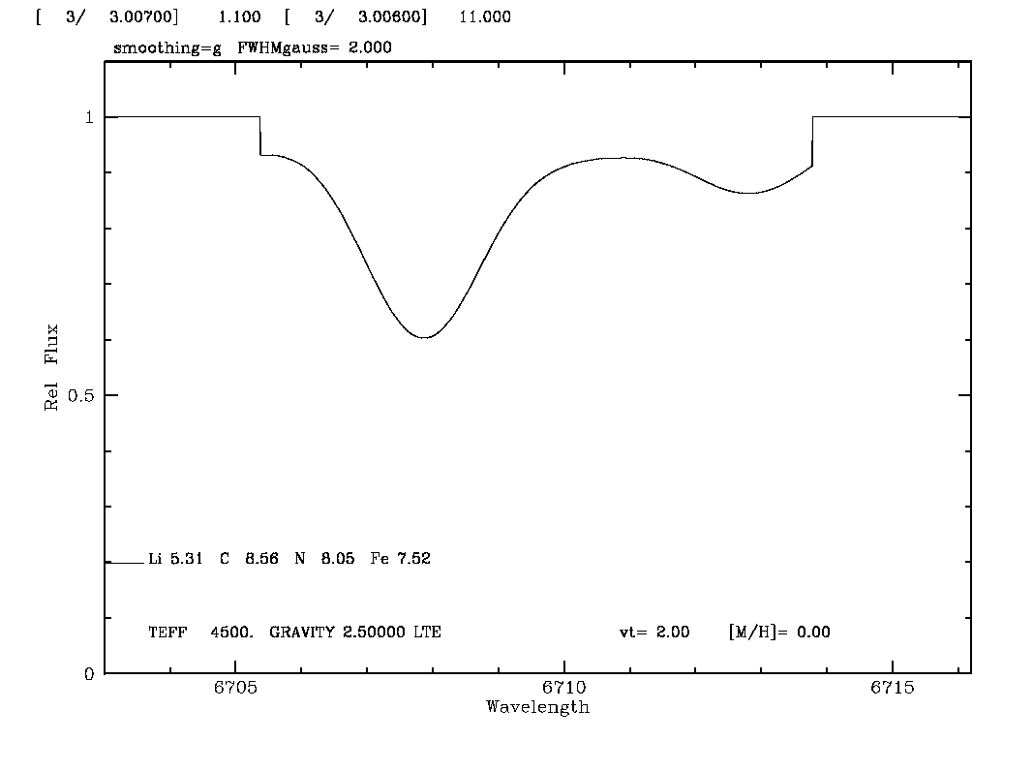
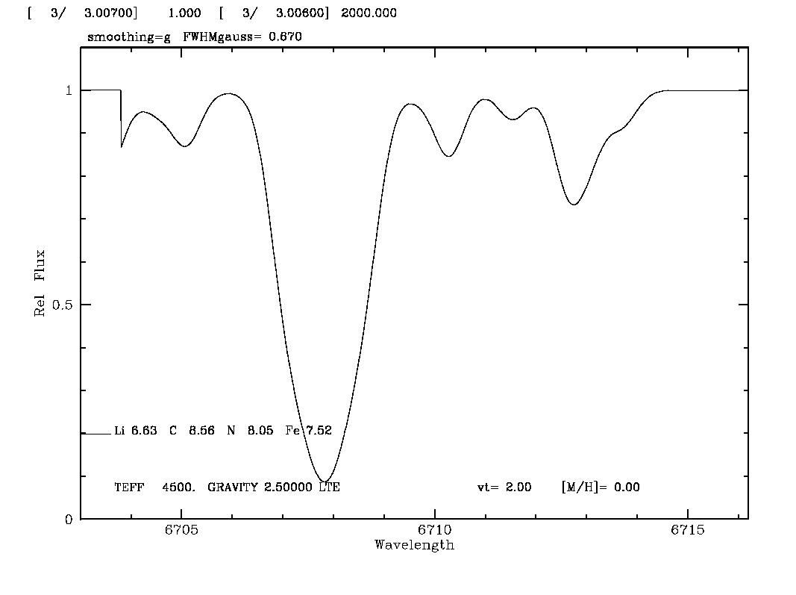
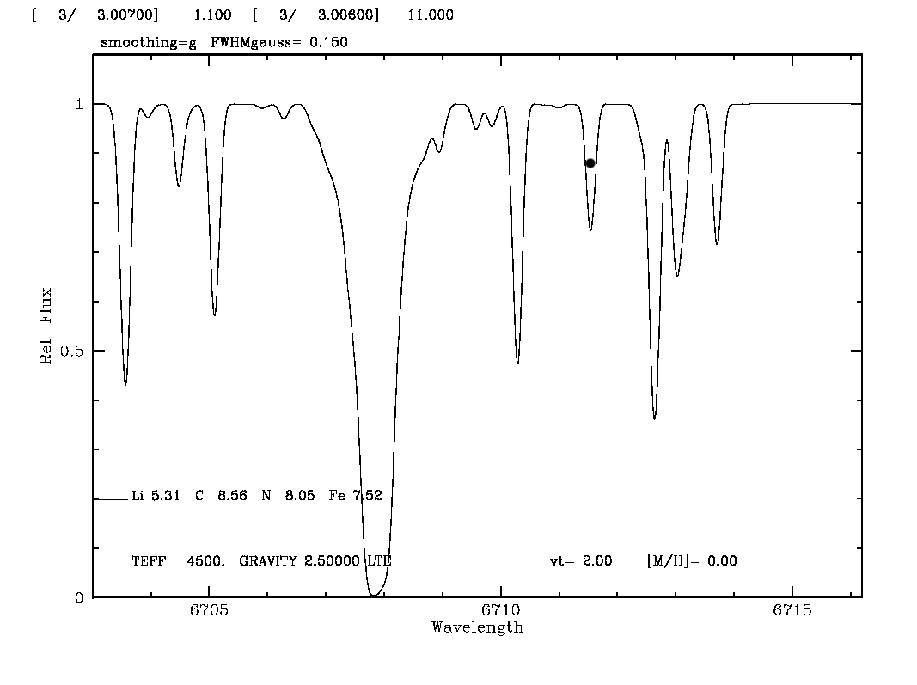
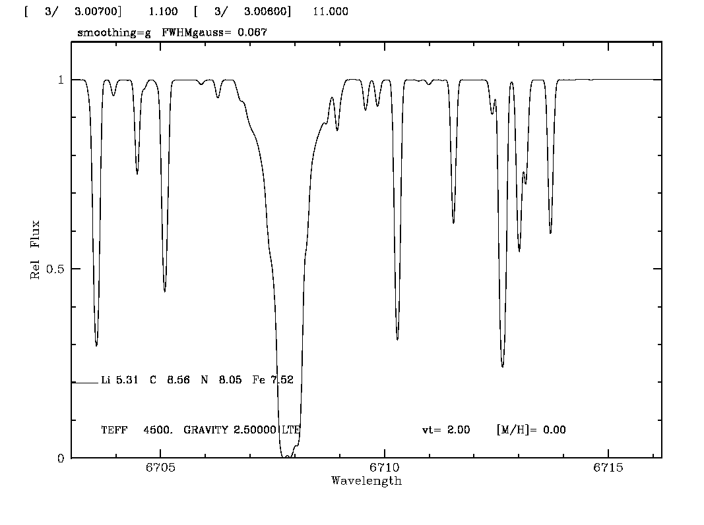
Chemical Tagging of stars
estimates of Teff and metallicity
Teff, log g, Rvs, [Fe/H], a few elemental abundances
atmospheric parameters and complete range of elemental abundances
R~3500
A few possibilities
R~10000
R~60000
Many possibilities
Precise abundances, isotopes
R~100000

Slide 11
Samples for high resolution studies
F-, G- and K main sequence dwarfs:
Numerous
Long lived
Reflect initial chemical composition
Relatively easy spectra
Accurate abundances

Slide 12
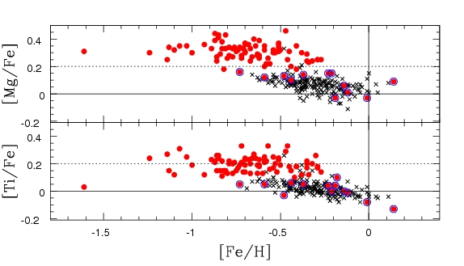
Galactic disk decomposition: Accuracy is the Key
Thick
Thin
High resolution studies of kinematically pre-selected samples suggested
a clear separation between thin and thick disk populations
[α/Fe] ratios showed little/no trend with [Fe/H] upto [Fe/H]~-0.4 dex
suggesting quick history of star formation.
Reddy et al. 2003, 2006: Also see Fuhrman, Bensby et al.

Slide 13
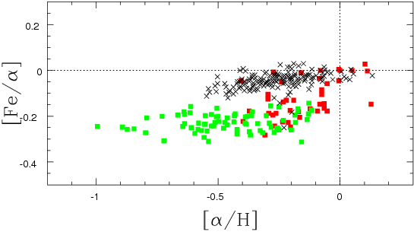
Evolution of Thin and Thick Disks: Perspective from observations
Thin disk
Thick disk
current thick disk may be the pre-existing thin disk
the violent gas-rich but metal-poor merger reformed the thin disk
thick disk seems to have been polluted by SNIa products
Data requires to prove substructures within thick disk
Reddy , 2010

Slide 14
Galactic Disk Studies: limitations
Results based on data within about 100-150pc
Lack of accurate astrometry for stars beyond solar neighborhood
Small number of thick disk stars : about 5-6 in every 100 thin disk stars
No reliable data on metal-poor end of the thick disk: very few of
thick disk stars below [Fe/H] < -1.0 in the solar neighborhood.

Slide 15
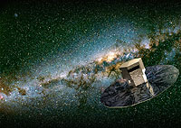
Census of our Galaxy: GAIA mission
26 million stars upto mv~15 with 7-25µas
250 million stars upto mv ~18
Billion stars upto mv~20 with 300µas
Census covers 50 kpc
Rvs upto mv=17
Data will help kinematic segregation of stellar groups with
unprecedented accuracy .
greater opportunities for large aperture telescopes to follow-up detailed
high spectral resolution studies.

Slide 16
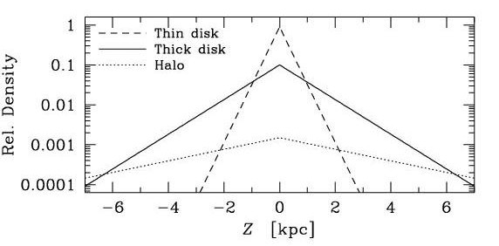
Galactic Disk Studies: A case for GSMTs
1 kpc < Z > 4 kpc: ~80% of stars are from thick disk, rest are mostly from inner halo.
Halo dominates
Thick disk dominates
Thin disk dominates
Thick disk dominates
Halo dominates
A typical G or K dwarf is too faint for high
res. studies with existing telescopes.
10m keck, with R~60K and S/N~100
1kpc: mv=14.8 requires ~ 2 hours
2kpc: mv=16.3 requires ~9 hours
5kpc: mv=18.3 requires ~>50 hours
GAIA’s astrometry combined with GSMTs high res. studies would characterize disk populations much more clearly and lead to better understanding of its origin.

Slide 17
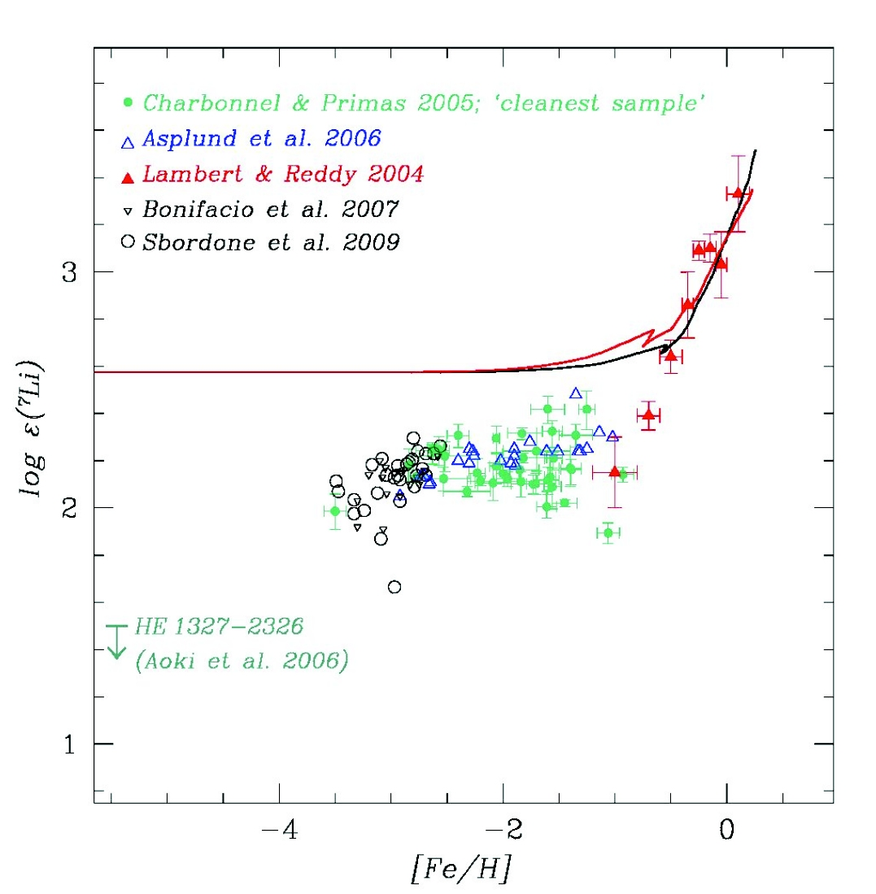
Li evolution in the Galaxy: A discrepancy
Spite Plateau broken at about ~-2.8
Below [Fe/H]~-2.8, Li shows significant scatter
Is there Li plateau in other old nearby galaxies like dSphs?
Li evolution within disk: sources of Li other than Spallation.
ISM
WMAP
Spite Plateau
What is the primordial Li?
Combined with the LSST survey, GSMTs would help to resolve this issue by providing better quality spectra for a large number of ultra metal-poor stars that are very faint.

Slide 18
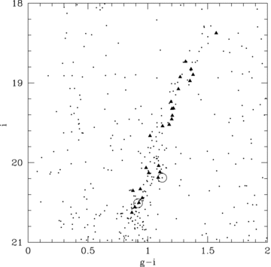
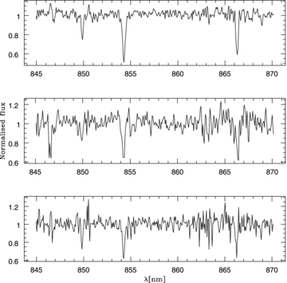
dwarf spheroidals and nearby galaxies: A case for GSMTs
Provide evidence for hierarchical structure formation
Star formation histories
Provide pre-Galactic nucleosynthesis history
Primordial Li abundances: tests can be
conducted
Canes VenticiI
Ural ete al.,’10
Gemini Telescope with GMOS
RGB: I=19 to 20, R~3500 with exposures like 3-5 hours [Fe/H] and Rvs
With GSMT it will be possible to do much better job with R~10,000-25,000

Slide 19
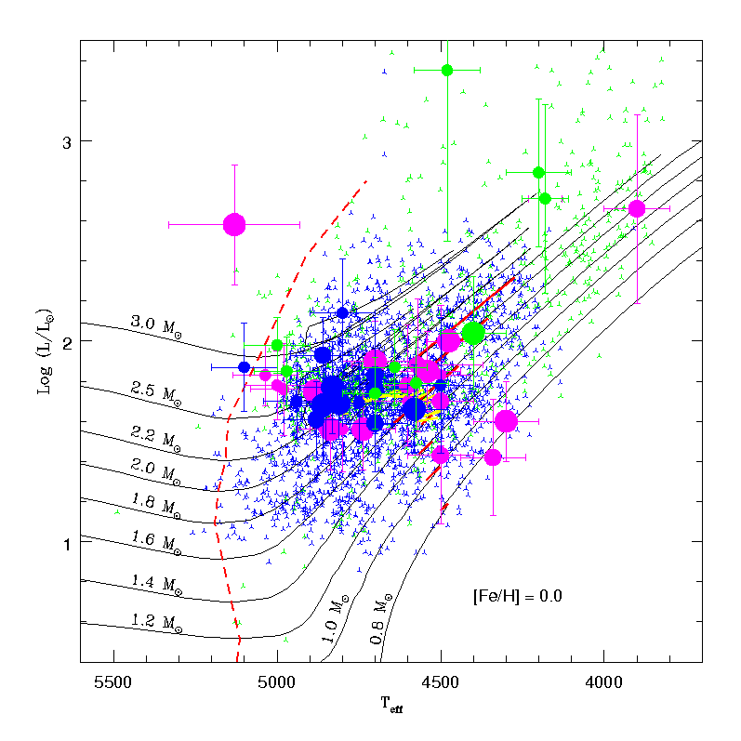
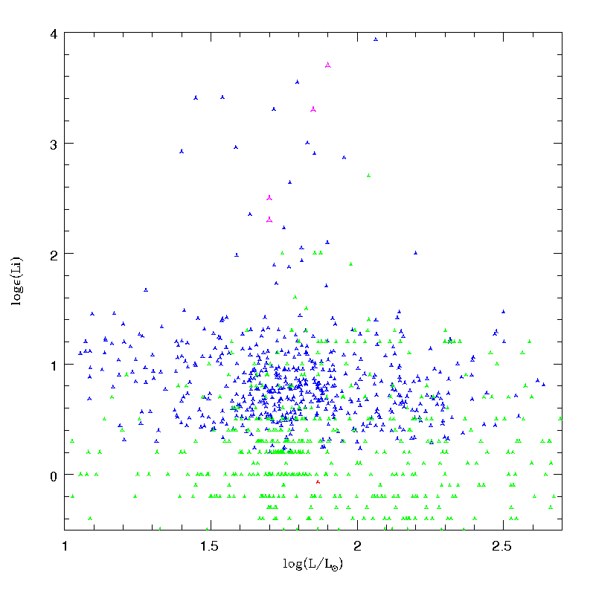
An another source of Li in the Galaxy: K giants
Log L/L__{sun}
Teff
No Li K giant well before or after the RGB-bump
Implies no planet or brown dwarf engulfment for Li excess
Li phenomenon seems to be very short lived and related to stellar evolution
Bharat & Reddy 2009,2011,ApJL

Slide 20
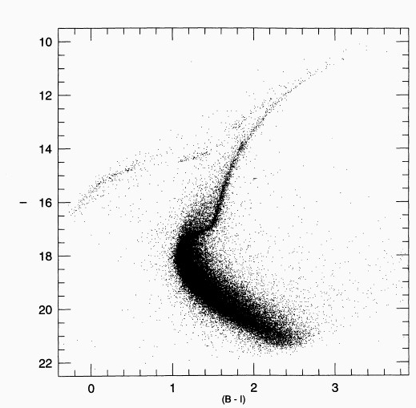
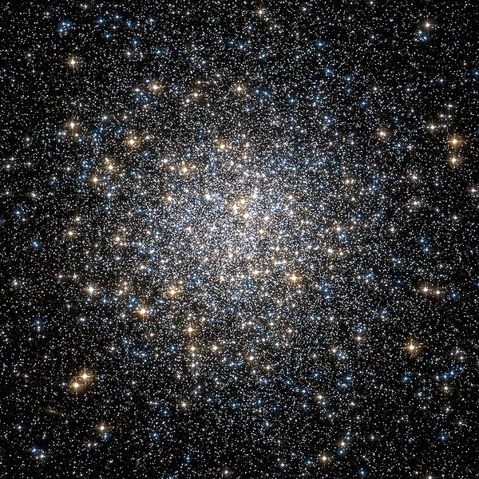
Need of large aperture telescopes
NGC 5905
RGB BUMP
HB
Does every low mass K giant undergo Li phenomenon?
Yes: significant source of Li to the Galaxy
No: requires refinement of stellar evolution and mixing models
Tools: Large aperture Telescope with high resolution spectrograph

Slide 21
Summary
GAIA’s astrometry coupled with high resolution spectra has potential to
decompose the disk into many layers in the order they have formed.
What is primordial Li? Does Li plateau exists in other galaxies?
LSST (photometric survey); GAIA (astrometry) and the GSMTs ( high resolution spectroscopy) may undoubtedly will help to decompose the disk leading to our understanding the way our galaxy and other galaxies formed and evolved

Slide 22
Thanks

Slide 23
Lithium Evolution in the Galaxy: What is primordial Li?
Log (Li)
3.3
ISM
Spite Plateau broken at about ~-2.8
Below [Fe/H]~-2.8, Li shows significant scatter
Is there Li plateau in other old nearby
galaxies like dSphs?
Li evolution within disk: sources of Li
other than Spallation.
Kirkman et al. 2003
2.6
WMAP
Primordial Li???
Thin disk
Lambert & Reddy , 04
2.1
Sbordone et al.2010
Spite plateau
1.8
Primordial Li???
-4.0
-3.0
-2.0
-1.0
-0.5
0.0
Fe/H
Combined with the LSST survey, GSMTs would help to resolve this issue by providing better quality spectra for a large number of ultra metal-poor stars that are very faint.

Slide 24
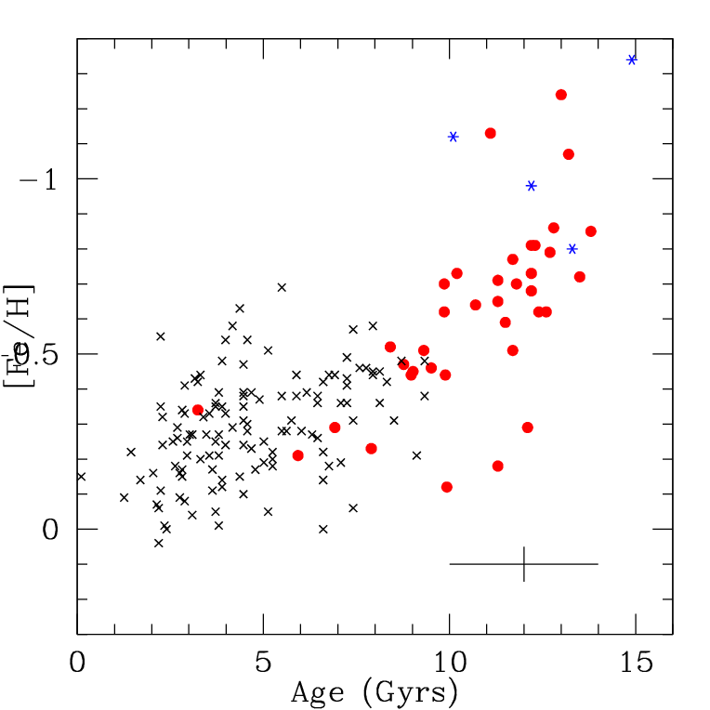
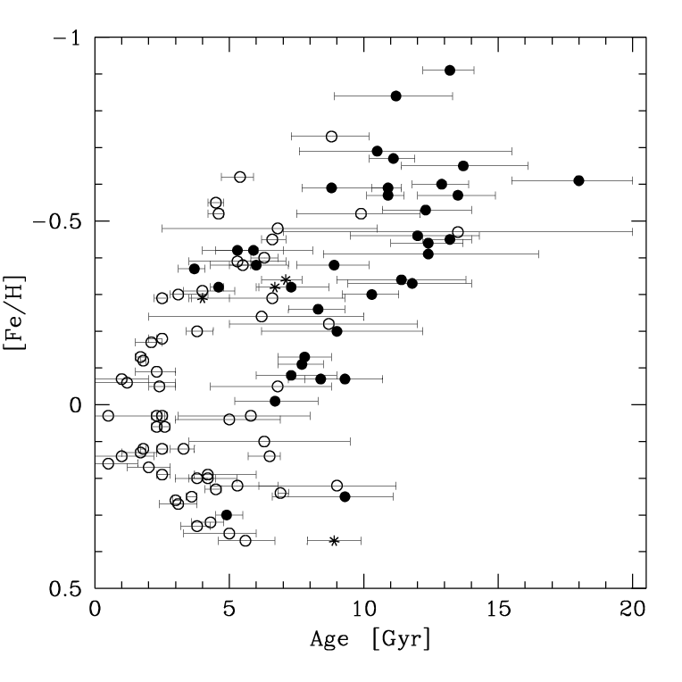
Thick Disk: Age metallicity relation
Reddy et al.
Mean age for the thick disk~12±1 Gyrs (stars up to [Fe/H]~-0.3
Thin disk age <= 10 Gyrs
2-3 Gyrs elapsed between the formation of
the first thick- and the first thin disk stars.
Sufficient time for SN Ia or AGB to contribute the gas
Bensby et al.

Slide 25
Li synthesis in stars
Production
Destruction
³He + ⁴He ->⁷Be + γ
⁷Be + e⁻ -> ⁷Li + ν
⁷Be + p ->⁸B + γ
⁸B + e+ ->⁸Be+ν ->⁴He + ⁴He
⁷Li + p ->⁴He + ⁴He
Fresh Be gets transported to cooler regions, just below the convective
envelop, where it gets converted into fresh Li.
Freshly produced Li quickly dredged-up to the photospheres
Boothroyd and Sackman 1999

Slide 26
Chemodynamics of the Galaxy: Ingredients
Future
Photometry
scale lengths, scale heights, number densities etc
LSST, JWST
Astrometry
Distances, proper motions, radial velocities
kinematic motions, orbital parameters
(U, V, W) , (Rm, e, |Z|)
GAIA, SIM!
Chemical tagging
High resolution spectra of samples of stars
Derivation of abundances of elements of
different nucleosynthesis history
GSMTS

Slide 27
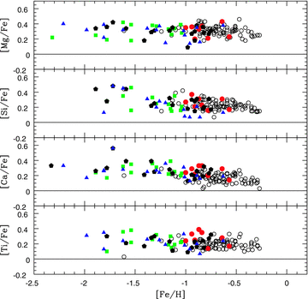
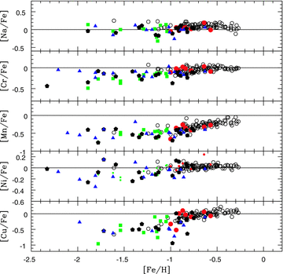
Metal-weak thick disk: Abundance ratios
MWTD
Thick disk
Thick disk
Halo
Halo and MWTD ratios show no
clear differences in [X/Fe]
Continuous trend in [X/Fe] may
indicate MWTD is the metal-poor
tail of the thick disk
Unable to identify a conclusive
signature distinguishing a MWTD
star from a halo star
Accurate astrometry for larger
sample of thick disk stars at large
distances required: RAVE and GAIA
[Fe/H]
Reddy et al. 2008

Slide 28
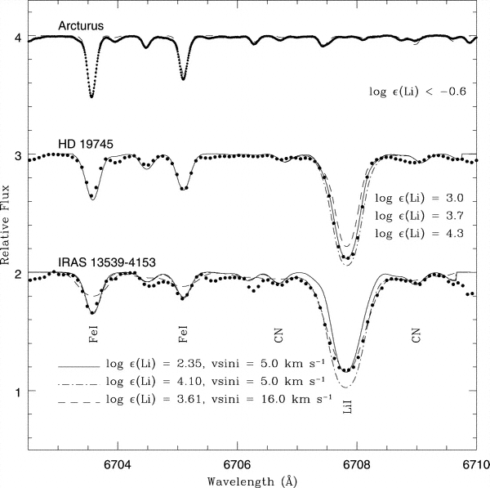
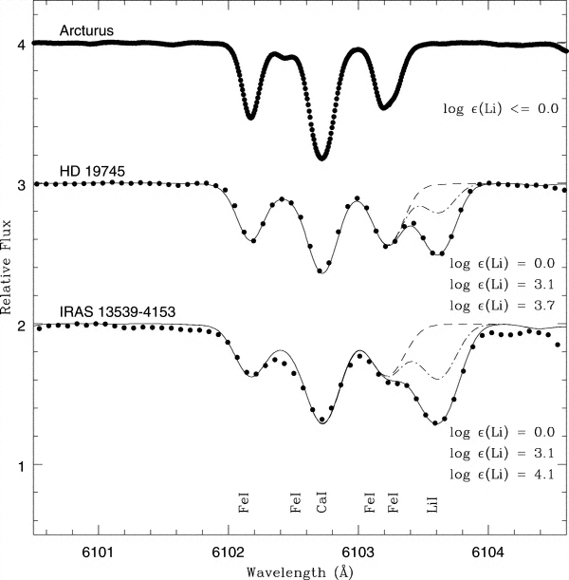
Li in K giants: a challenge to stellar theory
Standard stellar evolutionary models
Maximum log (Li) = 1.4 dex in K giants
12C/13C = 25-35
Observations: log (Li) << 1.4 (-0.5 – 1.0)
most cases 12C/13C = 10-25
Sun= log (Li) ~1.0, 12C/13C~90
Puzzle: a handful of K giants show
log (Li) = 3.2 dex (ISM value)
Reddy & Lambert 2005
Log (Li) = log (NLi/NH) +12

Slide 29
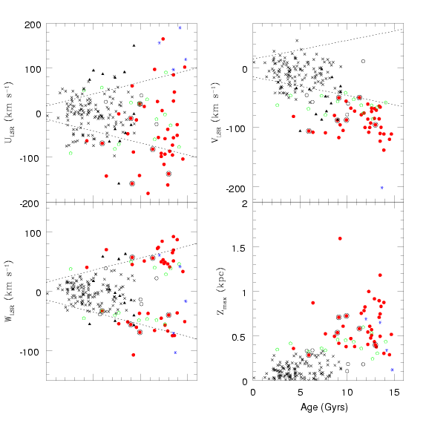
SCENARIO - II
Kinematic heating of thin disk causes
thick disk
Signatures: Increase in velocity dispersion with
age, overlapping ages with the thin disk , color
gradient with height etc.
Reddy et al. 2006
Thick disk is the result of radial
mixing and scattering of stars.
Predictions: velocity dispersions, abundanc
ratios and the ridge between the thin and
thick disks.
Schonrich & Binney 2009; Haywood 2009

Slide 30
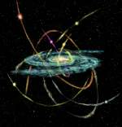
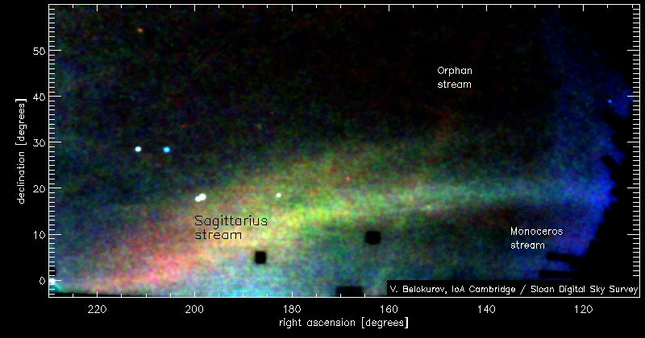
SCENARIO - II
Thin disk heating by satellite mergers
Signatures: distinct kinematic and chemical properties,
older Age
Accretion of material directly from satellite
debris
Signatures: distinct kinematic and chemical properties, no
overlapping metallicity with the thin disk
Thin disk is mainly from the mixed gas:
satellites plus galactic
Gas rich mergers with star bursts
Signatures: trends with metallicity and evidence
for SNIa contributions
Quinn et al. 1993; Abadi et al. 2003; Brook et al: 2004,2007; Springel & Hernquist 2005

Slide 31
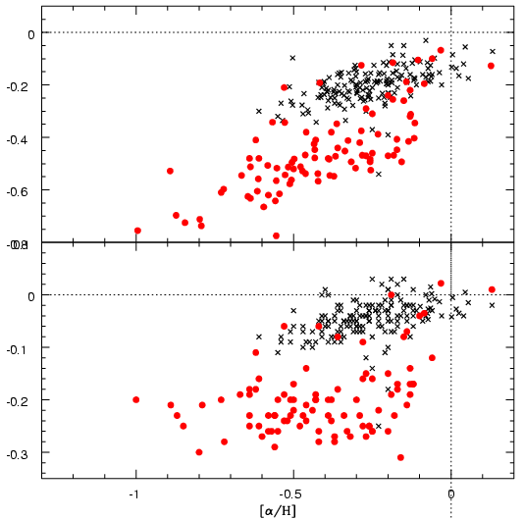
Evolution of Thin and Thick Disks: Perspective from observations
[Mn/α]
Evolution from A to E depends on the element X
Increase in [Mn/Fe] is attributed to a metallicity-dependent Mn yield from SNII
Iron offers a contrasting view.
Yields of Fe from SNII are independent of
mass or metallicity.
Jump suggests Fe is the dominant product
from SNIa.
E
D
C
B
A
[Fe/α]
E
D
A
C
B
[α/H]
Reddy et al. 2006

Slide 32
The Milky Way: Answers Lie in Large Datasets
Photometry for large samples
scale lengths, scale heights, number densities etc
Accurate astrometry for large samples
kinematic motion (U,V and W), orbital parameters: tracing
the origin of the stars
Low and high resolution spectroscopy data
Elemental abundance ratios: ages and star-formation
histories
Theoretical modeling and simulations: putting things into
perspective

Slide 33
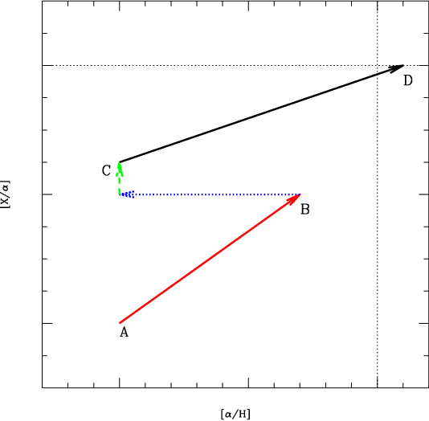
Thick Disk formation: Perspective from observations
A to B (Thick disk evolution): Here X (Mn) is an element whose yield from SNII is metallicity dependent.
After the violent merger thin disk reforms
with the metal-poor gas from the satellites
and the metal-rich ([Fe/H]~-0.3) thin disk
Thin disk starts with the resultant gas of
[Fe/H] ~ -0.8 dex.
Jump (green arrow) indicates delayed SNIa
in the thin disk .
C to D quiescent thin disk evolution with SNII , SNIa and AGB contribution.
Thin disk
Thick disk

Slide 34
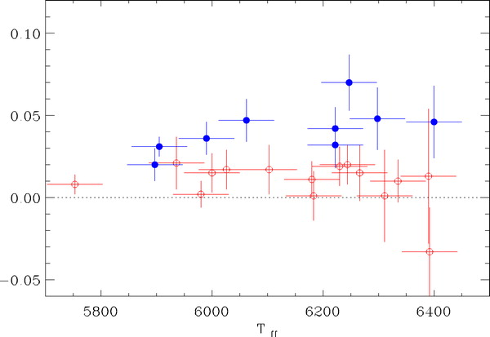
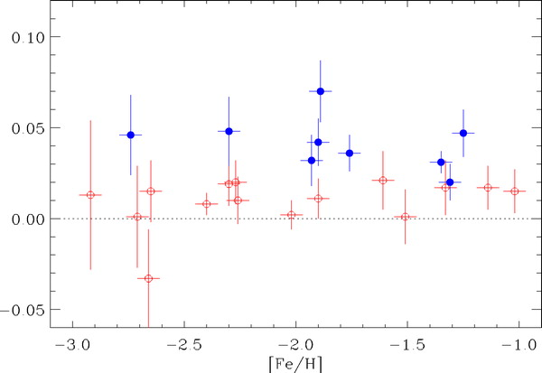
S/N~500, mv~11, R~120000
In 2 hours, with VLT
UVES

Slide 35
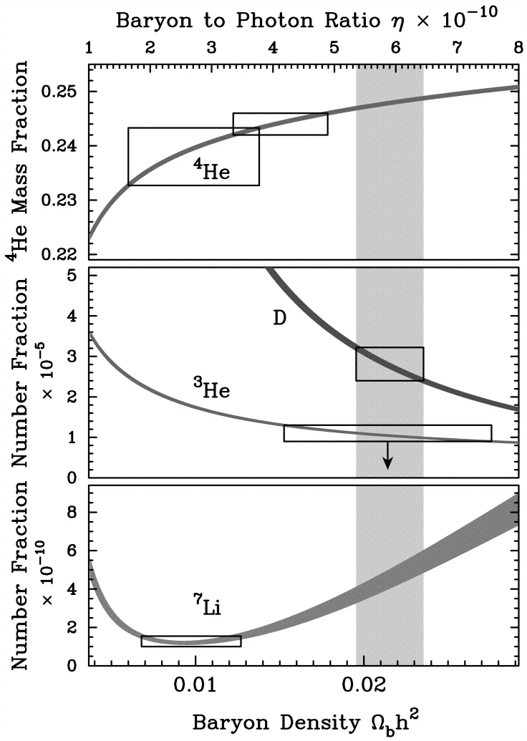
Cosmological Lithium Discrepancy
D/H (high red shift Lyα observations)
+BBN implies ή ~ 5.9 X 10⁻¹⁰
Predicts log (Li) = 2.6 dex which is in
good agreement with WMAP results .
Kirkman et al. 2003

