Slide 1

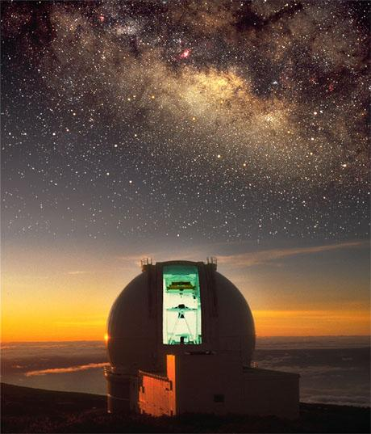


WEAVE
Fibre-MOS spectroscopy for the next decade
Gavin Dalton
(RALSpace & Oxford)
Feeding the Giants 31/8/2011
http://www.ing.iac.es/weave

Slide 2
Outline
Science cases for new 4m-class MOS systems
  GAIA related
  Cosmological
  Galaxy Evolution Studies
WEAVE concept & timeline
(Outline of 4MOST & complementarities)

Slide 3
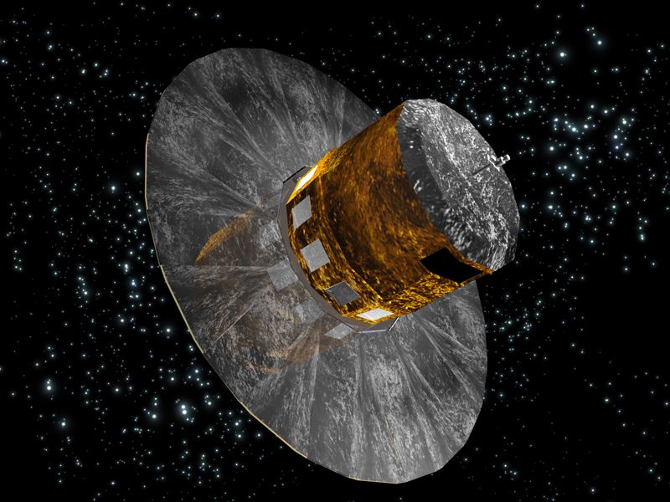
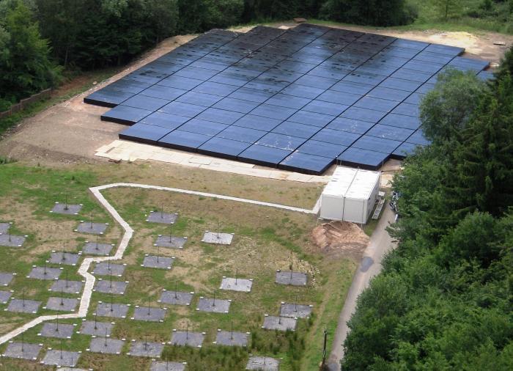
4m Science Overview
Key themes:
What are the stellar content and stellar distribution in the Milky Way?
  The Northern Hemisphere follow-up instrument for GAIA.
What is the nature of dark matter and dark energy?
  BAO, RSD, Probes of gravity models
How do galaxies form and evolve?
  What are the contents, internal structures, and mechanisms of galaxies?
  What is the role of environment and interactions in galaxy evolution?

Slide 4
Gaia
Gaia launch June 2013
10⁹ stars, I<20 in 5 years

Slide 5
Gaia Science Questions
Dynamics of the Milky Way
  Velocity distributions along the disk; resonance maps; coupling of dark halo, bar and disk
  Halo shape, density and granularity
  Streams as tracers of mass distribution and evolution
Structure and history of the disks
  Characterization of star formation and chemistry as f(R)
  Models of the formation of thick disk
  Inter-relation between various components
Metal-poor components
  Streams in the halo to trace merger history
  Constrain the IMF, and star formation in the early Universe

Slide 6
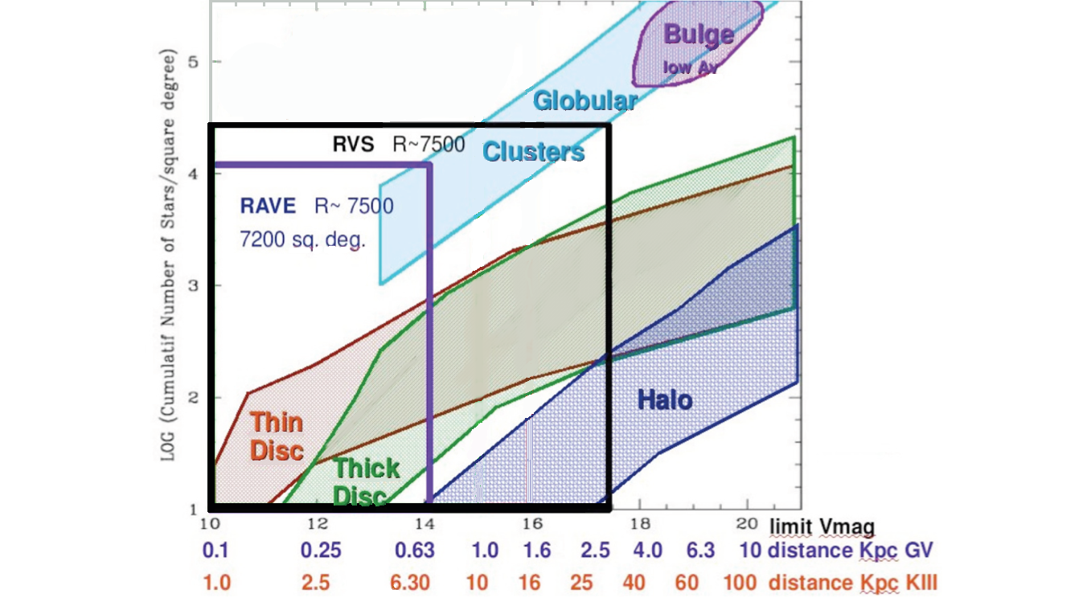
WEAVE/Gaia Survey Space
WEAVE, R~5000
370-1000nm
δv_{r} < 5kms⁻¹
δ[Fe/H] < 0.2 dex
>10⁶ stars
10000 deg²
Enough to measure
Metallicity Distribution Function
Figure courtesy Vanessa Hill, OCA

Slide 7
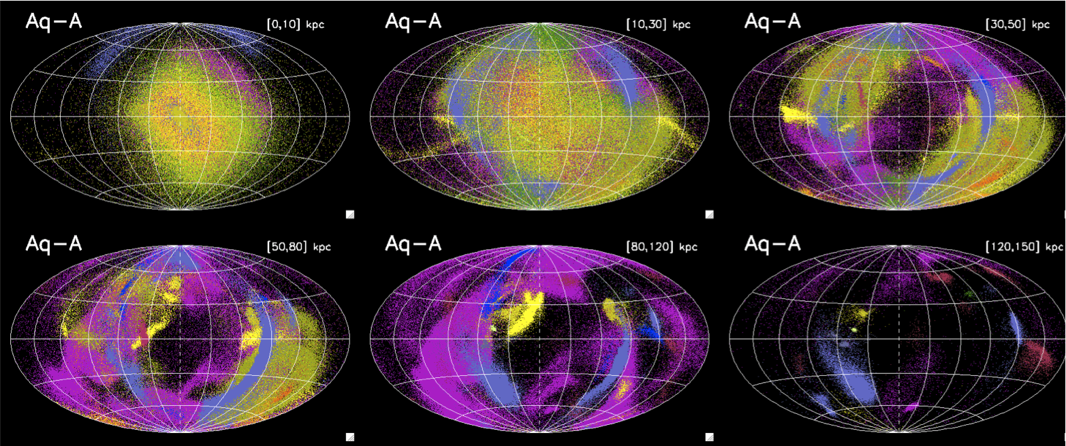
Mapping the Halo
Simulations suggest the distribution of merger remnants is highly anisotropic.
Northern Hemisphere required to sample outer disk and outer halo.
Aquarius simulations of recent MW mergers. (Helmi et al. arXiv:1101.2544)

Slide 8
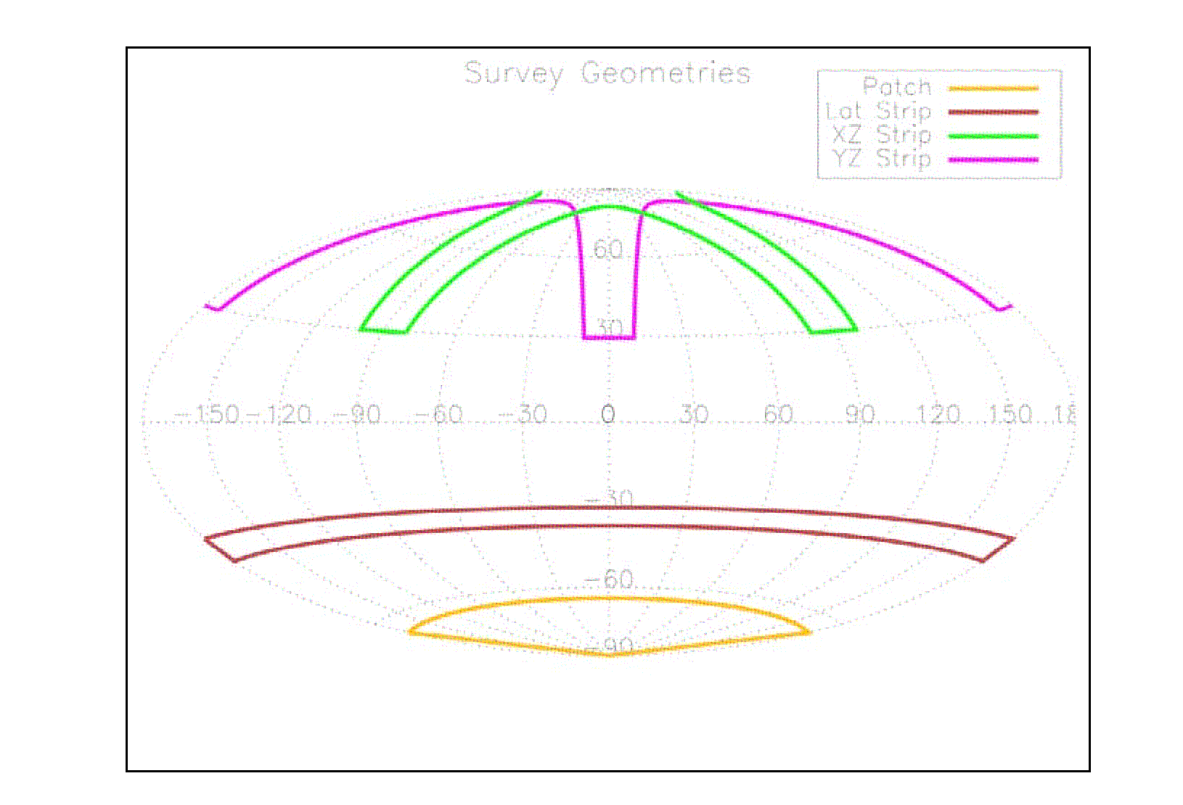
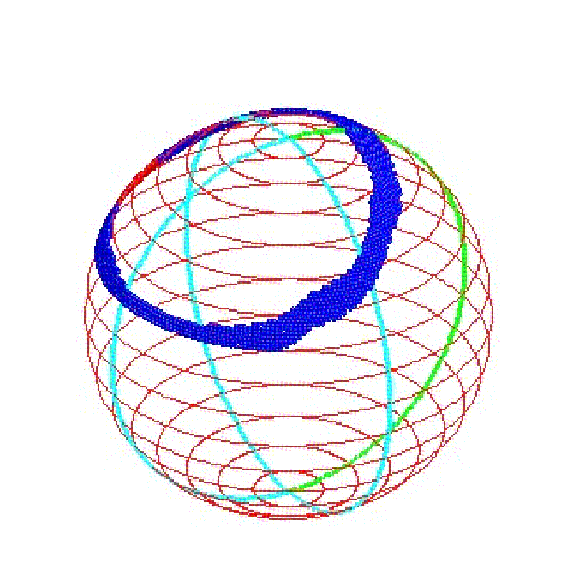
Low Resolution Strategy?
From WFMOS study: Consider various possible survey geometries… optimal approach for primary survey is to sample MS stars in a single latitude stripe. 10⁶ stars to V~20 at R=5000, 60% Halo, 40% Outer disk. ~1100 square degrees.
Good starting point, but need to re-optimise for WEAVE!

Slide 9
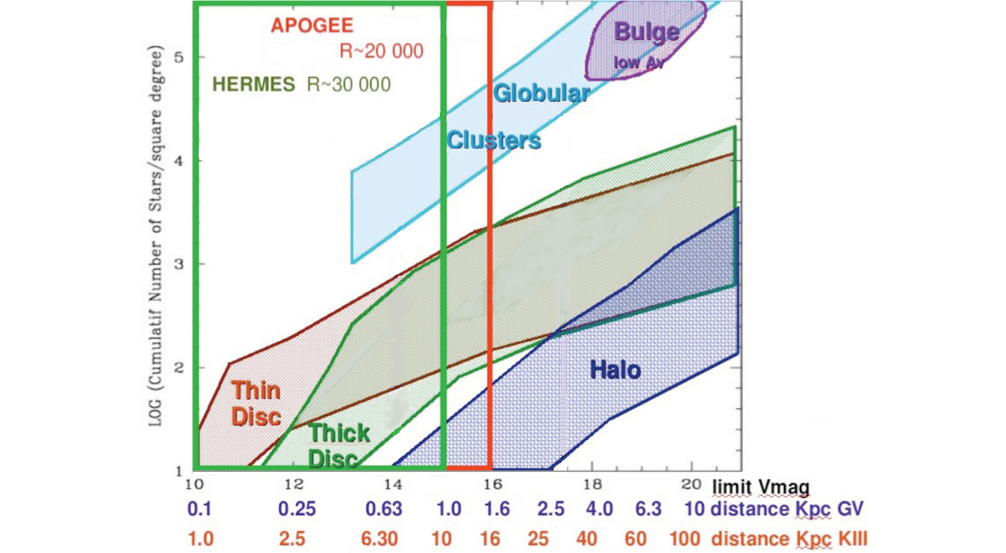
WEAVE/Gaia Survey Space
WEAVE, R~20000
δv_{r} < 1kms⁻¹
δ[Fe/H] < 0.1 dex
500 streams
50,000 halo giants
2500 deg²
Chemical labeling of stars to formation events

Slide 10
Chemical Labelling
  Formation history uniquely identified by relative abundances of 7 key groups of elements:
  Light elements (Na, Al)
  Mg
  Other alpha-elements (O, Si, Ca, Ti)
  Fe-peak elements (Fe, Sc, V, Cr, Ni, Mn, Co, Cu, Zn)
  Light s-process elements (Sr, Y, Zr, Mo)
  Heavy s-process elements (Ce, Nd, Ba, La)
  r-process elements (Eu)
  Red band: 600Å including OI/Hα regions (6280-6780)
  Blue band: 250Å covering the Mg-b region (5015-5268)
  N.B. Red band alone will sample all 7 groups.

Slide 11
Resolution Requirements
From Bland-Hawthorn & Freeman (2004)
Resolving power required to measure metallicities for fractions of the total population at different wavelengths.
-More confusion in the blue
-More confusion in higher [Fe/H] stars
At R=20000 we should be able to measure 65% of the lines in the Mg-b region for solar-type stars, rising to 80% for the halo giants.

Slide 12
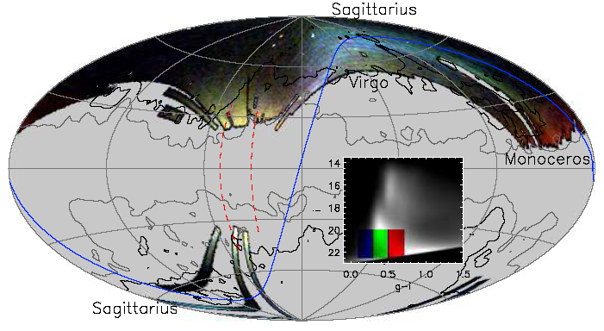
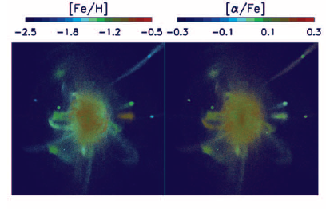
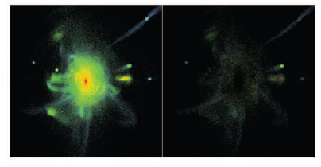
Outer halo:
Clear evidence of substructure
Limited to high-surface brightness features (progenitors/time of events)
Abundance substructure also expected
Belokurov et al. 2007
Font et al. 2006
Characterize the properties of the building blocks of the halo
500 streams -> 100*/stream -> 5x10⁴ stars, wide-field (2-3 deg²) 100 multiplex,
V ~ 17 for a survey of 2000 deg² (V ~ 15 for 10000 deg²); HR ~ 20,000

Slide 13
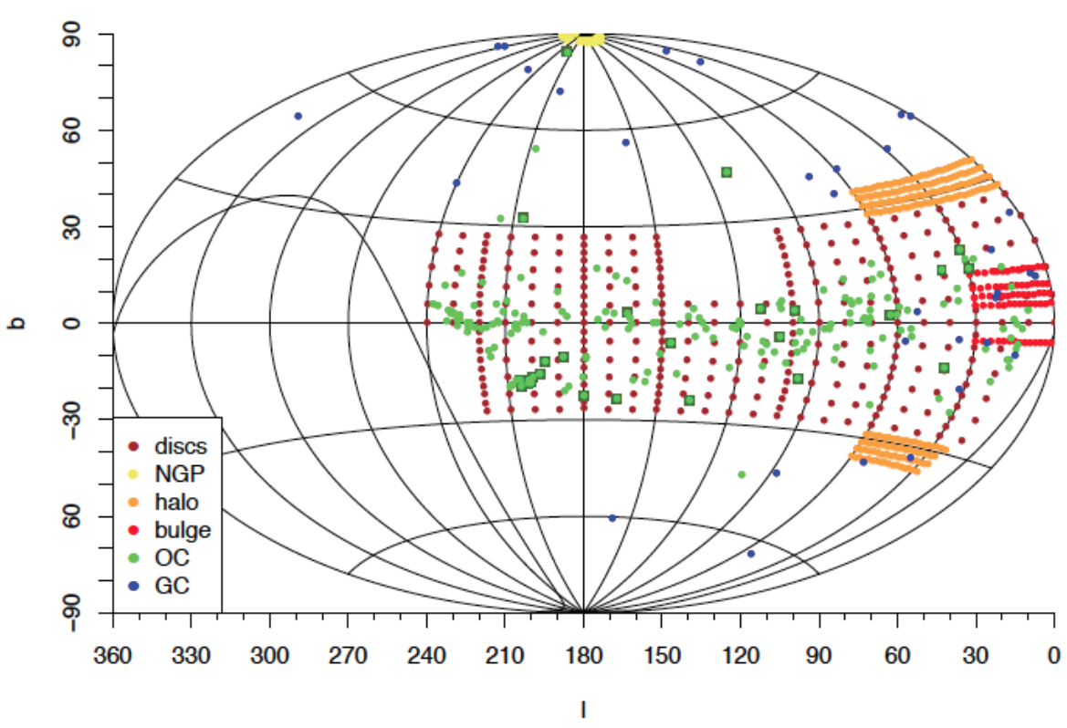
High Resolution Strategy?
From the GYES concept study… (Bonifacio et al.)

Slide 14
Cosmological Survey
Baryonic Acoustic Oscillations:
Imprint of horizon scale at recombination due to the imprint of sound waves on the matter distribution.
Evolution of this scale as f(z) gives information on Dark Energy
Notes:
Too detailed? (I think it’s fine, but…)

Slide 15
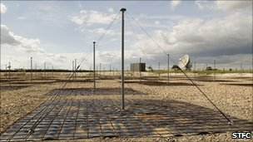
Cosmological Survey
What is dark energy and (how) does it evolve?
0.1% in growth rate,
0.7% on dH(z)
0.4% on d_{A}(z)
Select galaxies from LOFAR continuum surveys 30,60,120 & 200MHz (0.1mJy)
  ~10000 deg², radio continuum detections (no redshifts)
  ~10⁷ targets, z<1.3 (Hα/OII) & z>2.3 (Lyα)
  Strongly biased towards star forming galaxies… >10M/year at z=0.5, easily detectable with WEAVE
  BAO survey with high (>90%) redshift success rate in ~800 nights (c.f. 30% success rate implied for FMOS surveys based on broad-band colour selection)
  R=5000: easy to work in the OH forest at 900nm
But a lot of the point of this is just to follow up LOFAR!
Notes:
Too detailed? (I think it’s fine, but…)

Slide 16
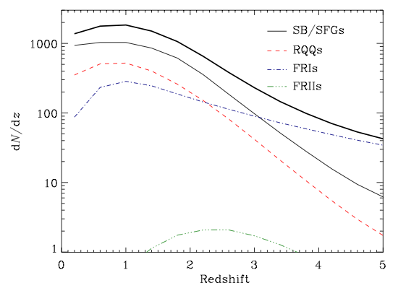
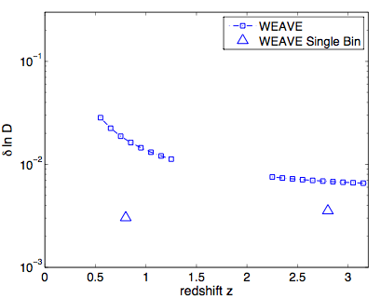
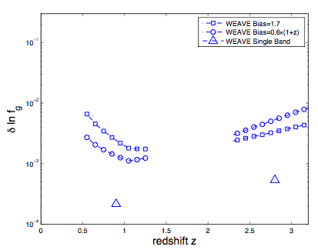
Cosmological survey
Predicted number densities for the LOFAR tier-2 wide field survey…
…predicted performance on the angular diameter distance D(z) and the growth function f(z).

Slide 17
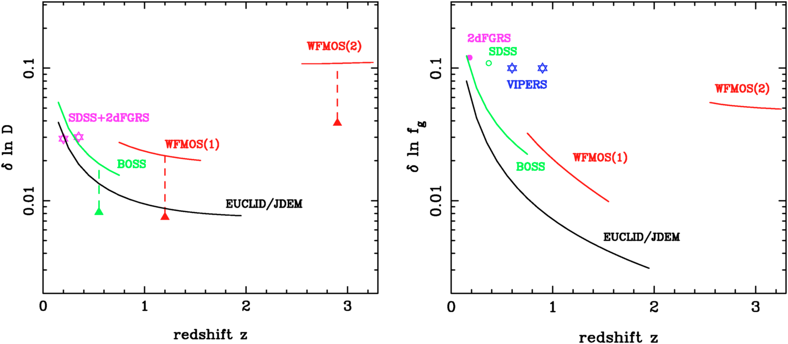
Cosmological survey in context…
…BIGBOSS proposed survey ~factor of 2 better than WEAVE for ~6x cost

Slide 18
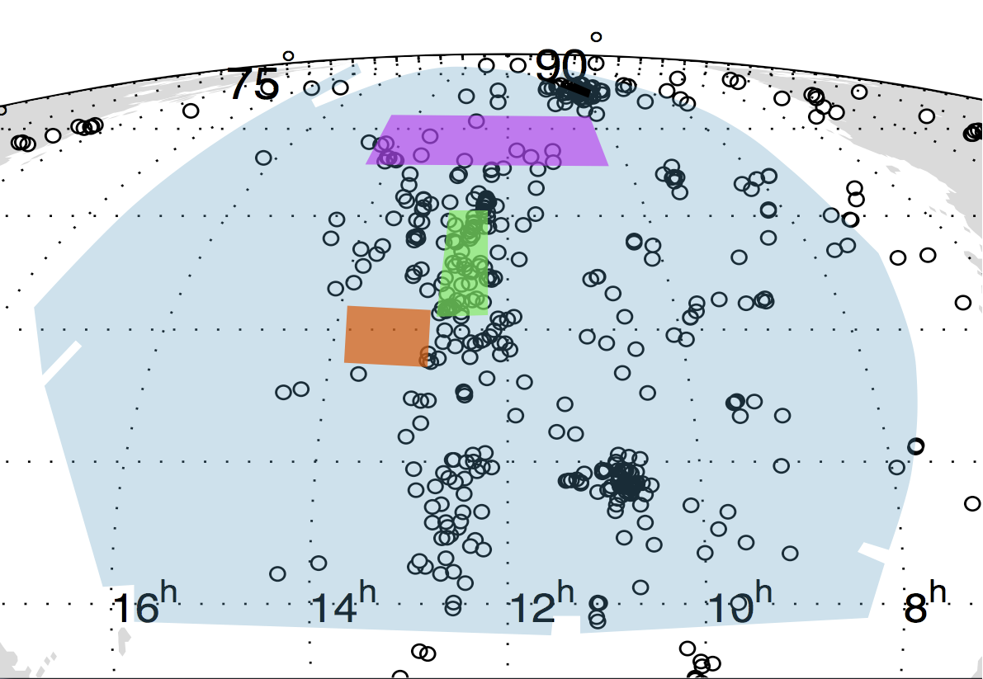
Galaxy Evolution: WEAVE/APERTIF
Connect galaxy evolution to internal and external effects:
Couple internal motions and stellar content to
neutral gas and large-scale environment
APERTIF is a set of phased array detectors at the Westerbork Synthesis Radio Telescope... Northern Hemisphere SKA pathfinder.
APERTIF Medium Deep Survey
500 square degrees, 10⁴ galaxies z<0.4 with full HI velocity maps
Correlate HI velocity maps with stellar populations and star formation using WEAVE IFUs, R=10000 spectra.
Nearby targets observed with a single large (3’) IFU
HETDEX
H-ATLAS
CVn groups
Nearby Galaxy
WEAVE+APERTIF pathfinder science for E-ELT+SKA
Notes:
Describe what an IFU is…? Extra picture?

Slide 19
Serendipity
Large spectroscopic surveys generate small numbers of pathalogical sources for further study:
  Spectroscopic SNe
  Galaxy-galaxy lenses
  Extreme objects (e.g. IRAS 10214)
  Cool WDs
  ….. the unexpected…

Slide 20
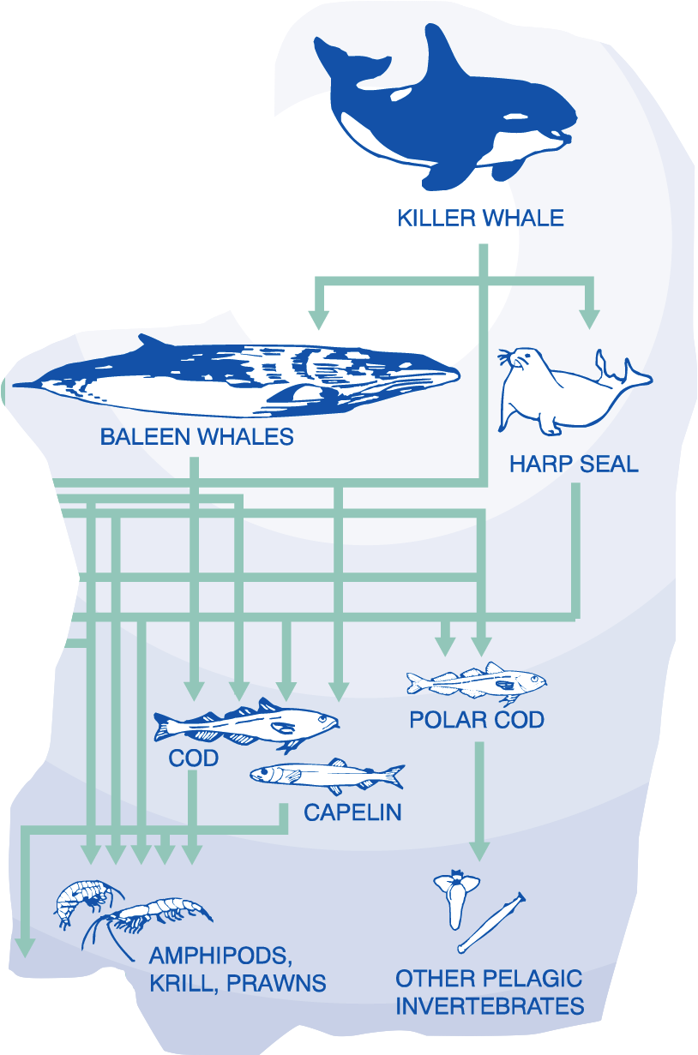
Instrument design approach:
With the giants around, the smaller fish need exist on modest resources.
-Need to find a cost-effective solution for
High multiplex spectroscopy.
Try to stick to what we know and don’t
rely on expensive technology development.
Why fibres?
Large FOV with high multiplex.
Decouple spectrograph location from focal plane
-size and stability

Slide 21
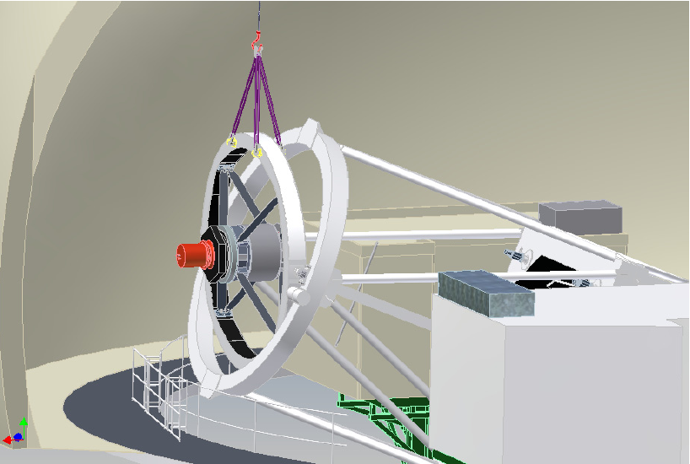
Instrument Overview
New top end and 2° FOV prime focus corrector
Retain full telescope functionality
Pick-and-place fiber positioner (2dF-like)
IFUs incorporate naturally into this design
1000 fiber dual-beam VPH spectrograph optimised for R=5000
R=20000 from grating change and rotation

Slide 22
Design Parameters & Performance
Field of View | 2 degree diameter
MOS multiplex | 1000
Wavelength Coverage (R=5000) | 370-1000nm
Wavelength Coverage (R=20000) | 500-527nm & 628-678nm
Open Shutter Efficiency | >90%
Multi IFU multiplex | 30
Multi IFU FOV | 9x9 arcsec
Single IFU FOV | 3x3 arcminute
HR mode ~5% lower, but still beats FLAMES/UVES at this resolution (10x collecting power)

Slide 23
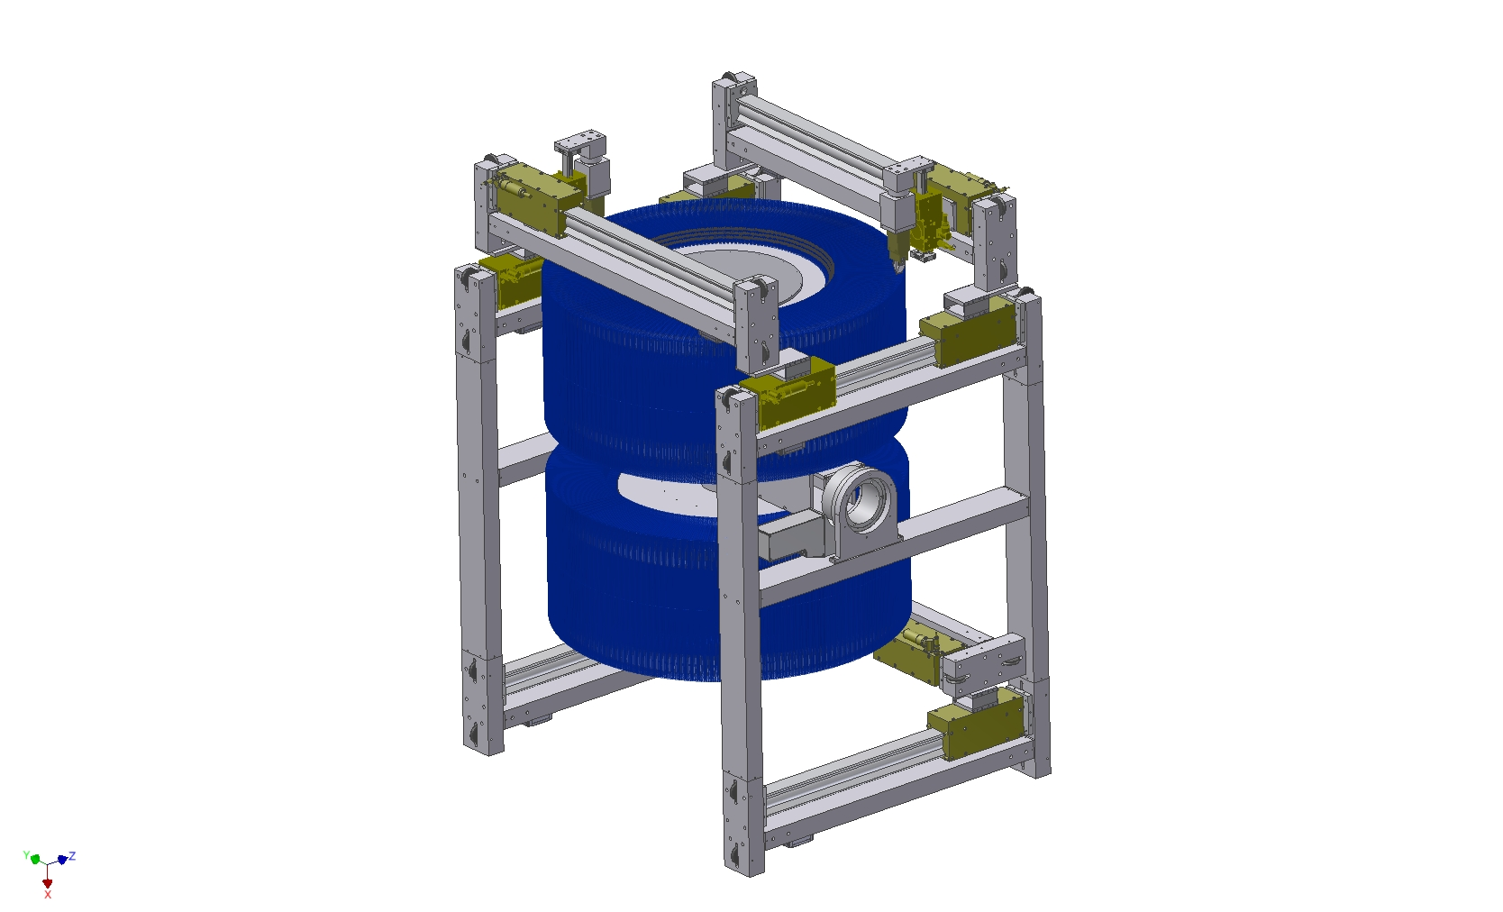
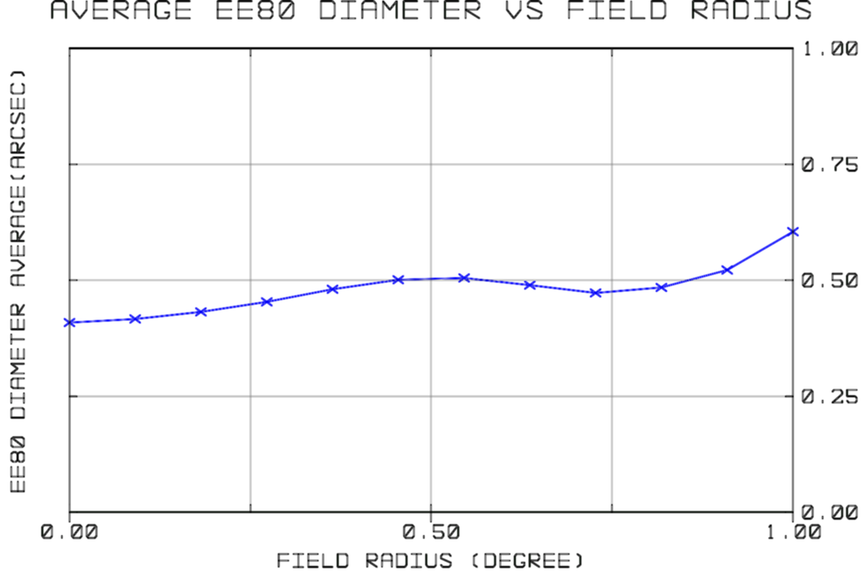
WEAVE Instrument
A new 4m instrument in the era of 8-10m 3rd Generation instrumentation must be low risk and cost-effective (instrument cost comparable to facility operations costs).
2 degree diameter FOV with ADC gives good imaging performance and efficient sky coverage (minimal losses from differential refraction above 45 degrees elevation).
Single dual-beam spectrograph accommodates all fibers, cost-balance between optics and detectors (lessons learned from E-ELT instrument design studies)
Positioner based on successful 2dF tumbler concept, but now with COTS robot – low cost, robust low level software.

Slide 24
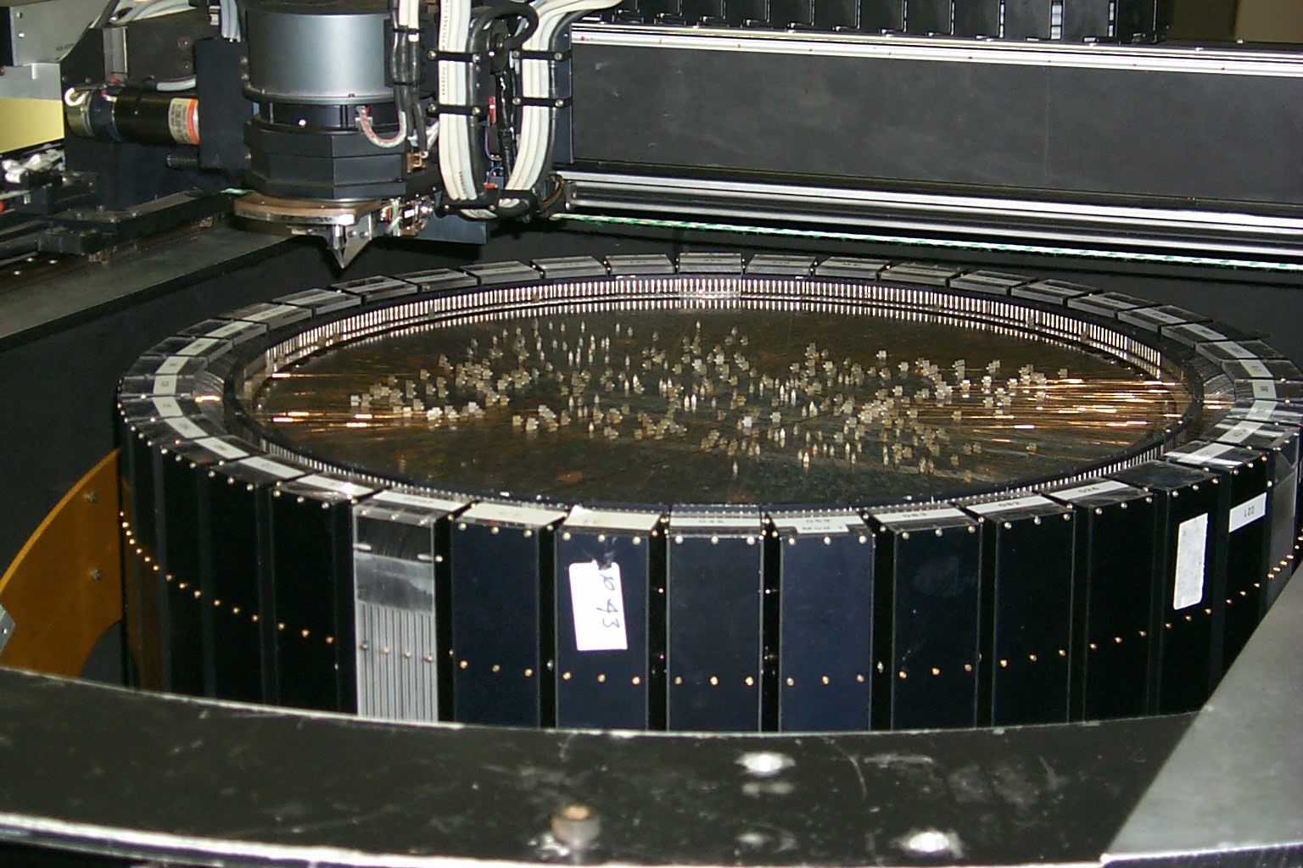
Positioner concept similar to AF2/2dF, but all COTS components…

Slide 25
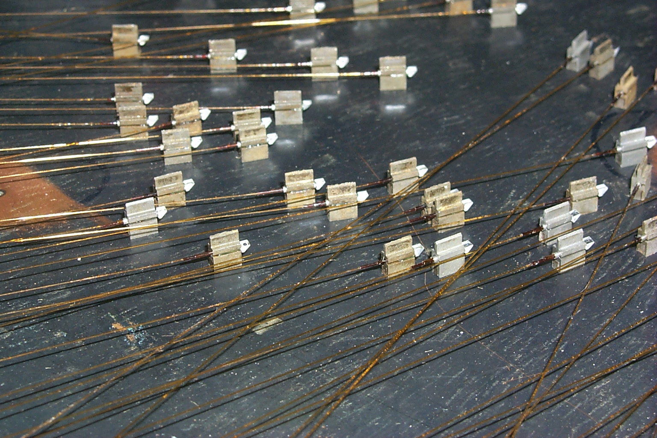

Slide 26
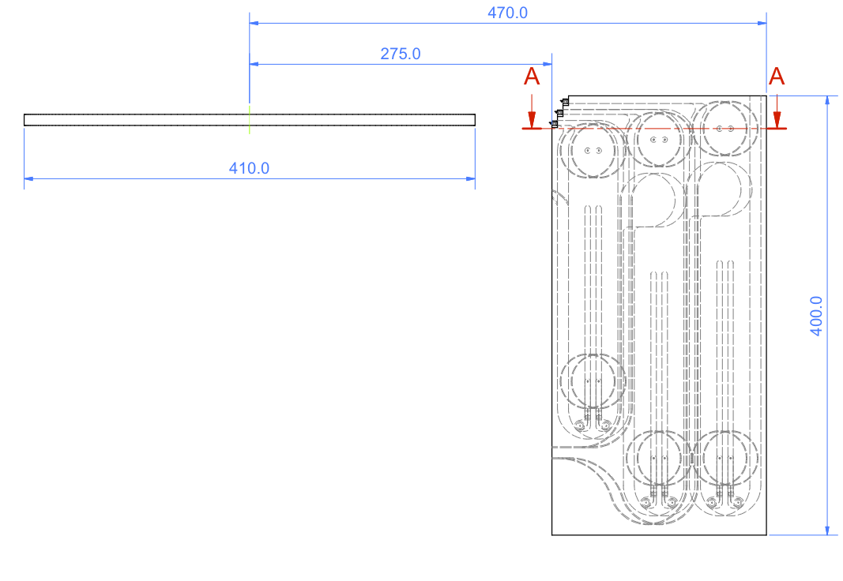
Retractor Concept
Push park locations beyond the useful field edge to ease accomodation.
Triple-parking concept.

Slide 27
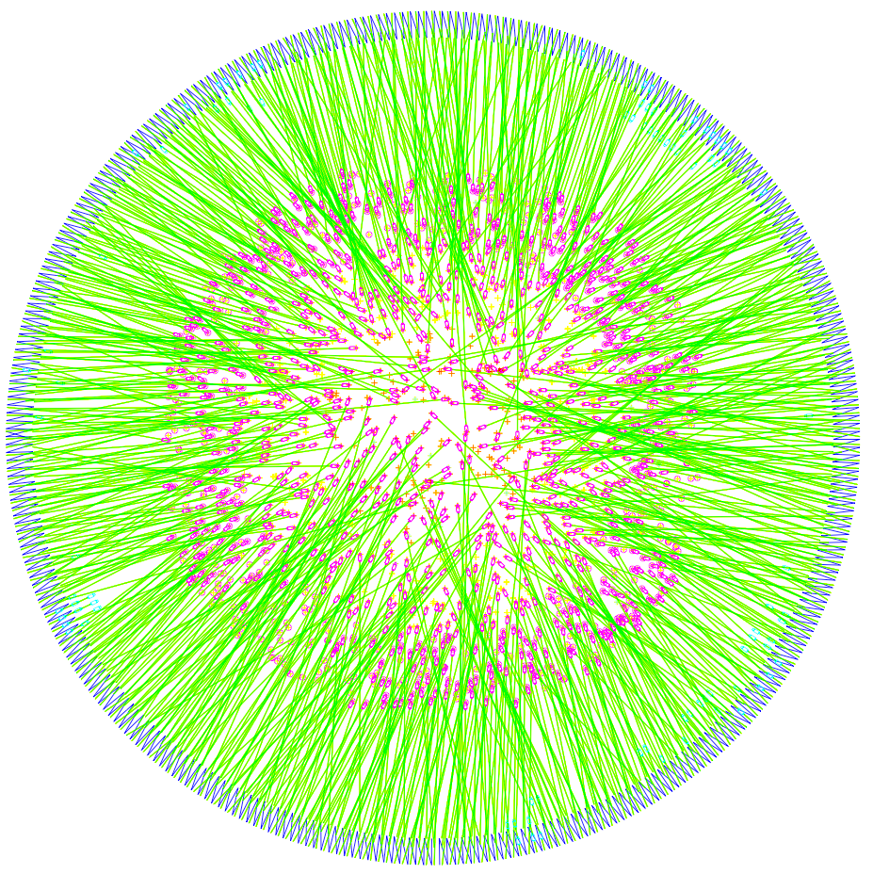
FIELD SIMULATION
Random target distribution, oversampled
(1800 targets)
970 targets allocated
8300 fibre crossings
Reconfiguration simulations imply ~1600 moves to reconfigure…, but some optimisation still to be done…
Need a second Y-gantry to achieve timing performance

Slide 28
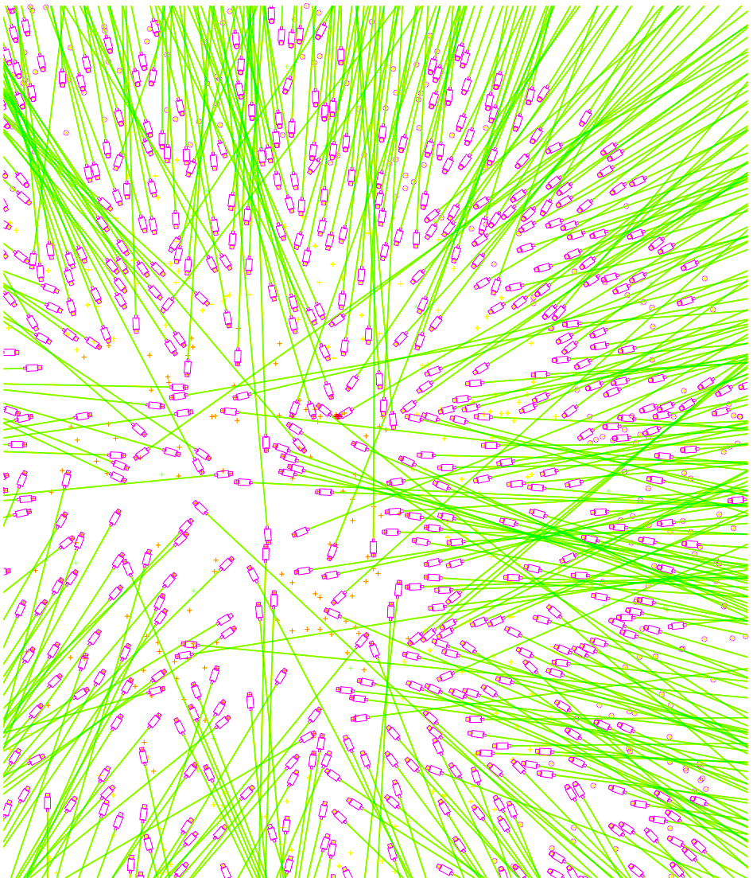
Simulations will be used for considering impacts of any suggested design changes on the overall survey efficiencies.
Realistic button and retractor geometries
Algorithm developed for 2dF surveys

Slide 29
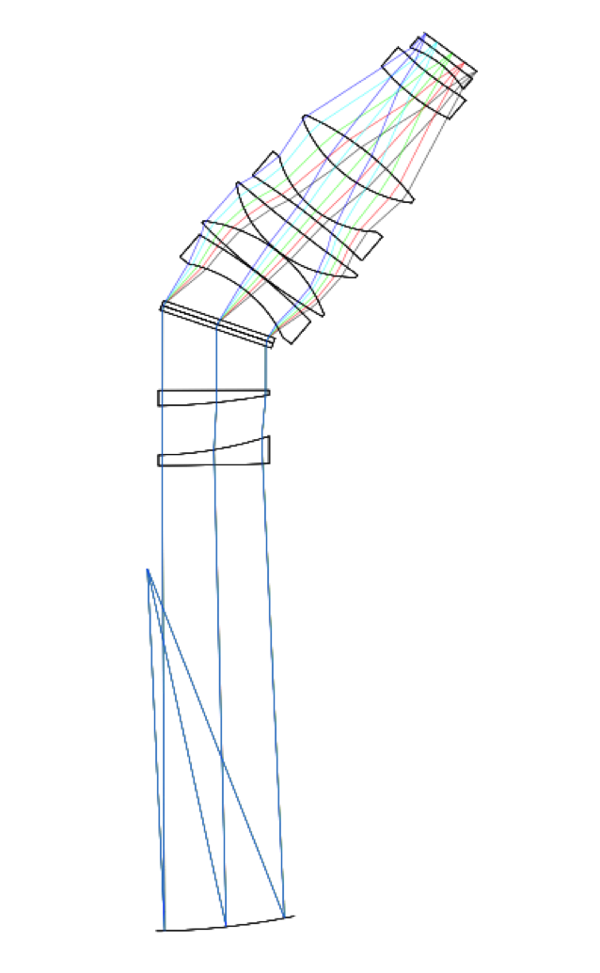
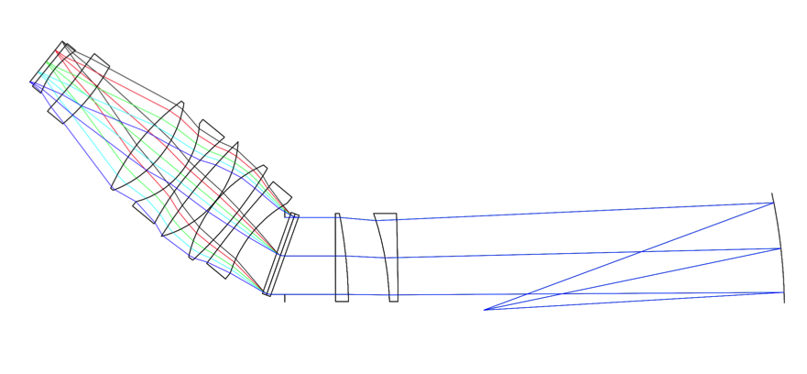
Spectrograph
Evolution of OPTIMOS-EVE design
VPHGs (848/1368l/mm)
Dichroic at 604nm
2m x 2m x 0.6m
180mm beam size (155mm FP)
curved entrance slit
f/3.5 collimator (optimal FRD)
f/2 cameras
8kx6k focal planes
R=5000 (mid-range) for 1.5” input

Slide 30
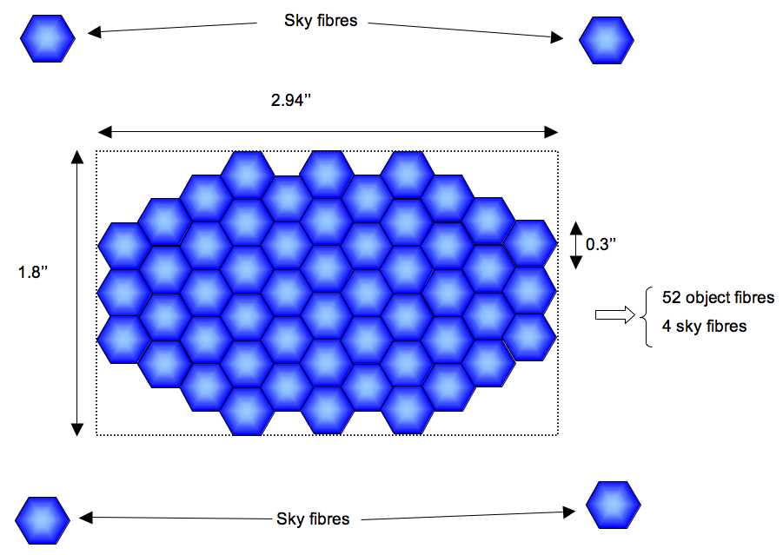
WEAVE IFUs
Use the full available slit length of the spectrograph.
20-30 small field IFUs, same fibre size as MOS
Large single-field IFU uses full slit length in a single IFU located at 90° tumbler position
IFUs stored on one MOS field plate, perhaps at the cost of a small number of MOS science fibres.
Physical size of IFU unit still governed by 57μm/” plate scale, so still only a few mm button size.
Aimed at galaxies, but possible application to crowded stellar regions?
14.7”
1.5”
9”

Slide 31
Survey Profile
5 Year Survey Programme:
Gaia low resolution survey in grey/bright time. (700 nights)
Gaia high resolution survey in bright time. (150 nights)
LOFAR/APERTIF surveys in dark time, but combine with outer halo stars. (800 nights)
Baseline assumption is ‘public’ surveys with processed data made available to the user community immediately after QA evaluation.

Slide 32
4MOST
New fibre MOS proposed for ESO 4m telescope (NTT or VISTA)
2-3 degree diamter FOV (telescope choice)
2000-3000 fibres @ R=5000
Small number of fibres (500) to separate High Resolution (R~20000-25000) spectrograph
Targetting Southern GAIA follow-up (few x10⁶, bulge and inner disk) and e-ROSITA AGN/Galaxy Clusters. Pure cosmology survey possible if good target selection strategy is available)
Phase A study KO next month, telescope choice in ~6 months after trade-off study
Technology choice is telescope-dependent & requires R&D (pick and place will not scale beyond WEAVE numbers)
First light ~2018

Slide 33
Summary
Substantial new fibre MOS systems in development for 4m telescopes (natural selection/evolution)
Cost/performance has to fit within the resource envelope (ecological balance)
Strong science cases
Low order filters for ELT target selection & development of science strategies.
Surveys in place and ongoing as the ELTs come online

