Slide 1
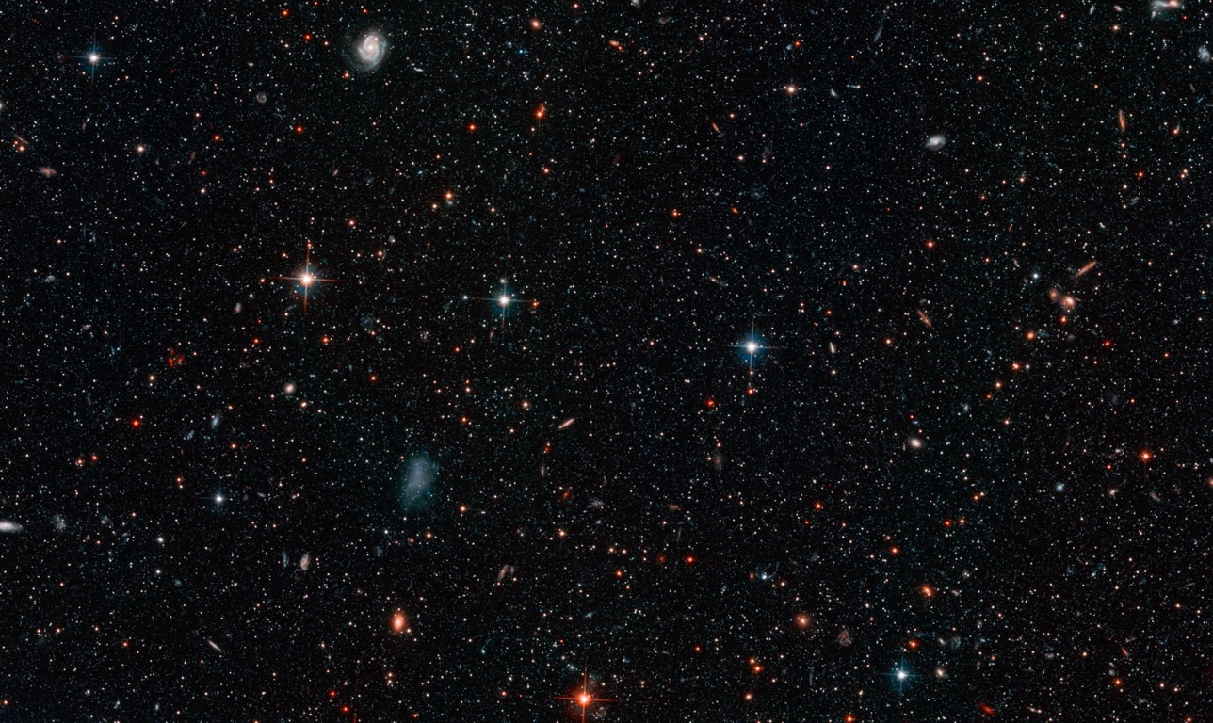
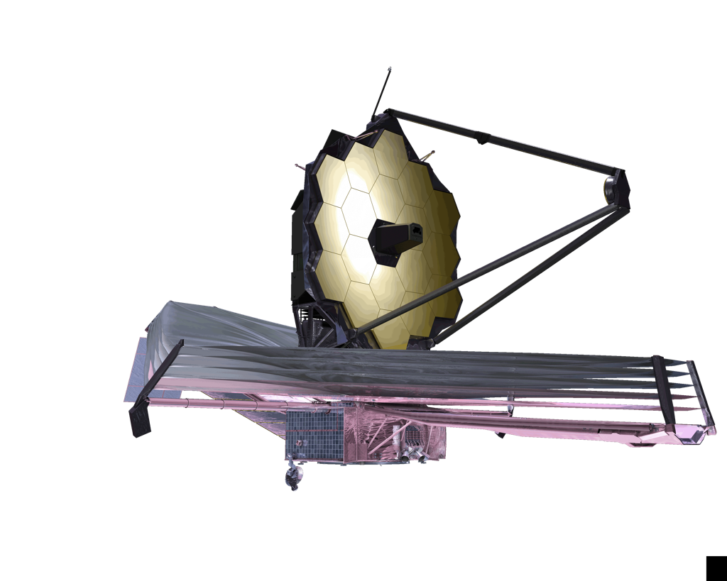

Overview of the
James Webb Space Telescope
Mark Clampin - JWST Observatory Project Scientist
mark.clampin@nasa.gov
Goddard Space Flight Center

Slide 2
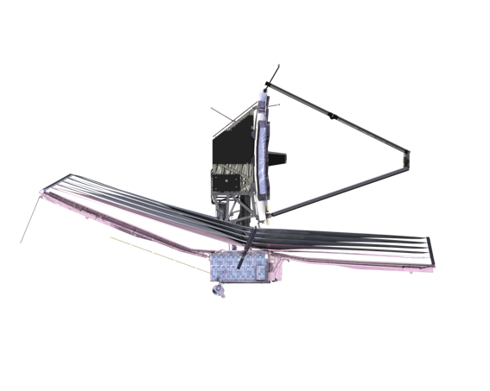
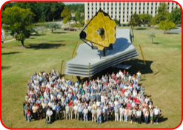


James Webb Space Telescope (JWST)
Organization
Mission Lead: Goddard Space Flight Center
Project Scientist: Dr John Mather (Nobel Laureate)
International collaboration: ESA & CSA
Prime Contractor: Northrop Grumman Space Technology
Operations: Space Telescope Science Institute
Instruments
Near Infrared Camera (NIRCam) – Univ. Arizona
Near Infrared Spectrograph (NIRSpec) – ESA
Mid-Infrared Instrument (MIRI) – JPL/ESA
Fine Guidance Sensor (FGS) – CSA
JWST Full scale model
Notes:
Project 101: who’s who in the project !

Slide 3
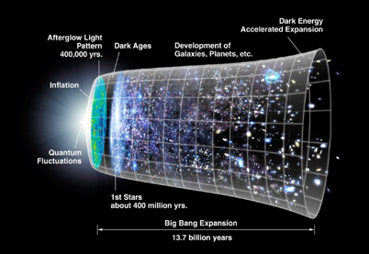
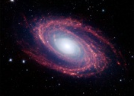
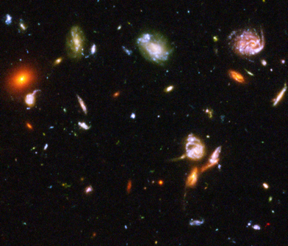
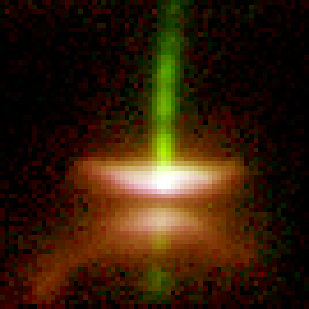
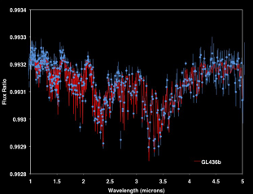
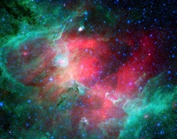
JWST Science Themes
M81
HST-UDF
First Light and Re-Ionization
Assembly of Galaxies
HH-30
GL146
M-16
Birth of stars and
proto-planetary systems
Planetary systems and the
origin of life

Slide 4
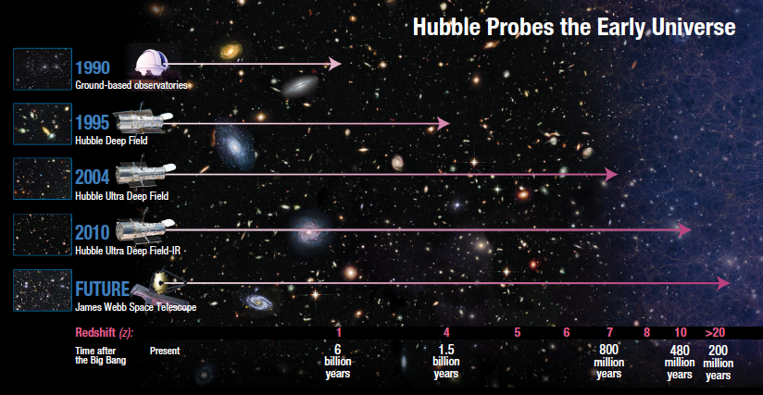
First Light with JWST

Slide 5
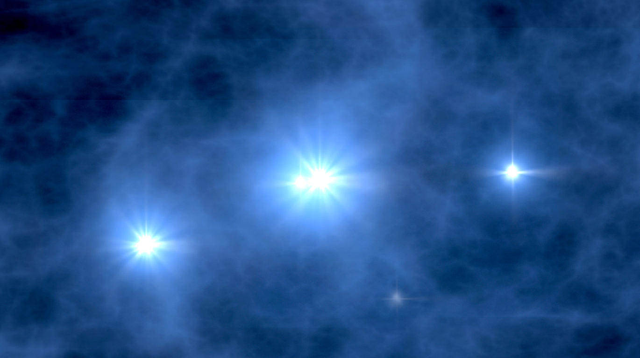
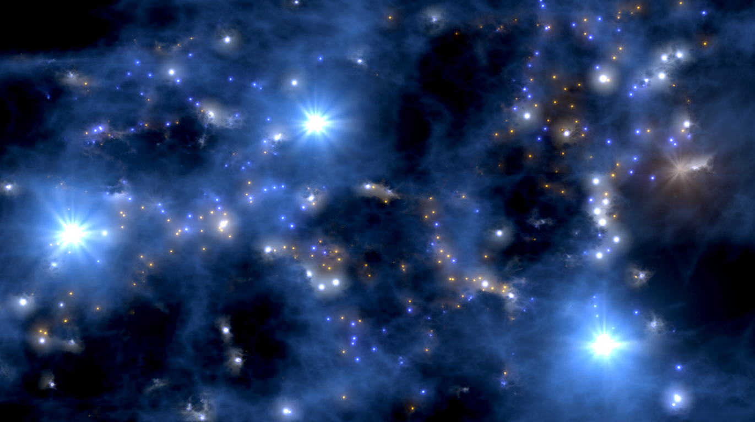
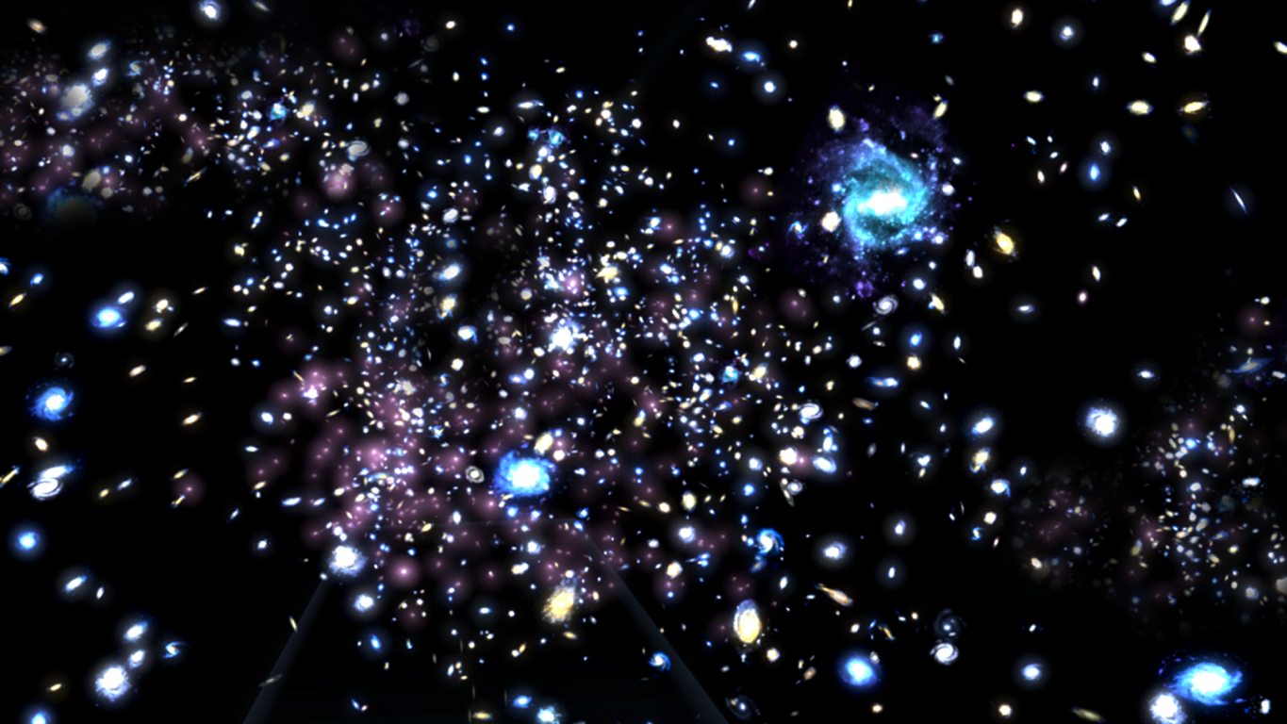
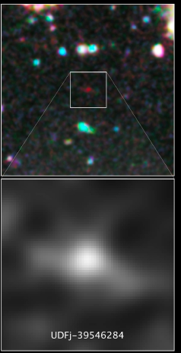
First Light and Re-Ionization
What is First Light?
  Typically, first light is defined as the appearance of the first galaxies or super-star clusters
How do we know we have seen first light
  Luminosity function evolution
  Metallicity: First light galaxies should
  have lowest metallicity
  Supernovae
Candidate Z~10 galaxy
Bouwens et al. 2011

Slide 6
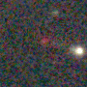
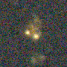
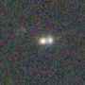
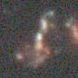
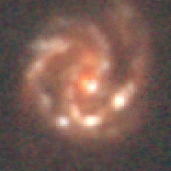
Assembly of Galaxies
Assembly of Galaxies: Determine how galaxies and the dark matter, gas, stars, metals, morphological structures, and active nuclei within them evolved from the epoch of reionization to the present day.
  Where were stars in the Hubble Sequence Galaxies formed, when did luminous quiescent galaxies appear?
  Where and When are the Heavy Elements Produced and to What Extent do Galaxies Exchange Material with the Intergalactic Medium?
  What is the relation between the Evolution of
  Galaxies and the Growth and development of
  Black Holes in their nuclei?
1.0 Gyr
1.8 Gyr
2.2 Gyr
3.3 Gyr
5.8 Gyr

Slide 7
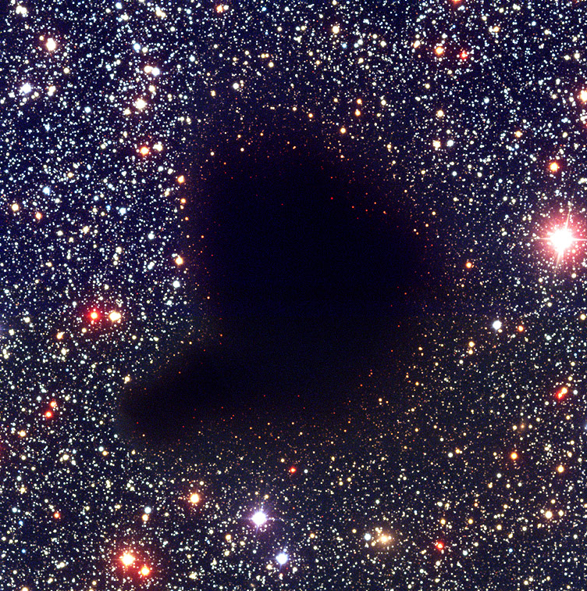
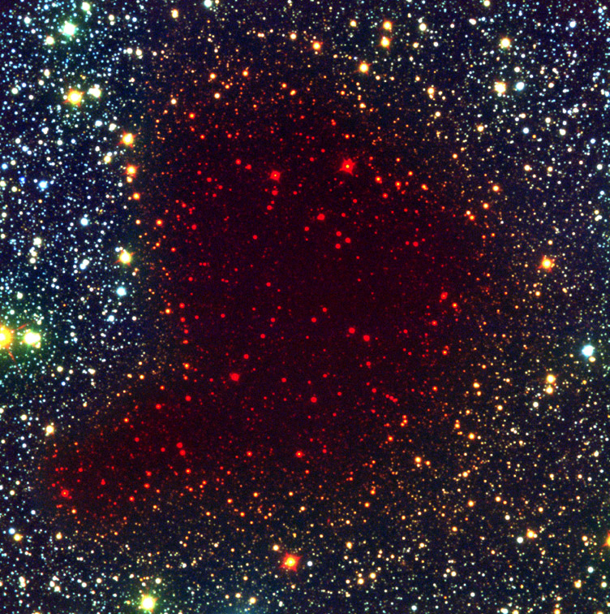
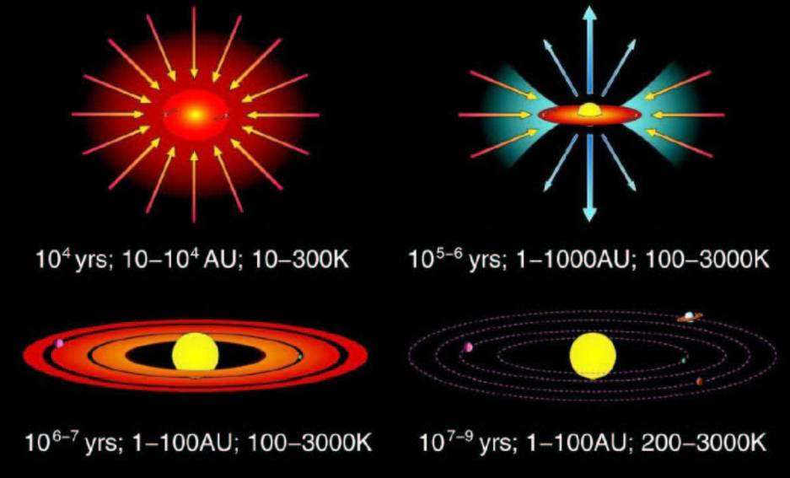
Birth of stars and Proto-Planetary Systems
How do protostellar clouds collapse?
What is the early evolution of protostars?
How do massive stars form and affect their environment?
How do protoplanetary systems form?
What are the life cycles of gas and dust?
How do protostellar clouds collapse?
What is the early evolution of protostars?
How do massive stars form and affect their
environment?
How do protoplanetary systems form?
What are the life cycles of gas and dust?
Barnard 68

Slide 8
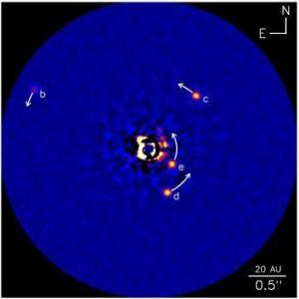
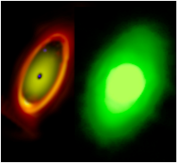
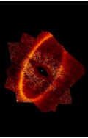
Planetary Systems & Origins of Life (PSOL)
Planetary Systems and the Origins of Life: To determine the physical and chemical properties of planetary systems including our own, and to investigate the potential for the origins of life in those systems
    How Do Planets and Brown Dwarfs Form?
    How Common are Giant Planets and what is their orbital distribution?
    How Do Giant Planets affect the formation of Terrestrial Planets?
Debris Disk morphology - Indirect evidence of
exoplanets e.g. Stark & Kuchner (2008), Kalas et al. 2008
HR8799: Marois et al. 2010
Imaging of young, self luminous planets Exoplanets with ≥ 0.2 MJ at ≥ 10 AU
Imaging of planets around nearby M stars (≤ 2 Gyr) Exoplanets with ≥ 2 MJ at ≥ few AU
Spitzer (24 μm)
ACS (Visible)
JWST (20 μm)

Slide 9
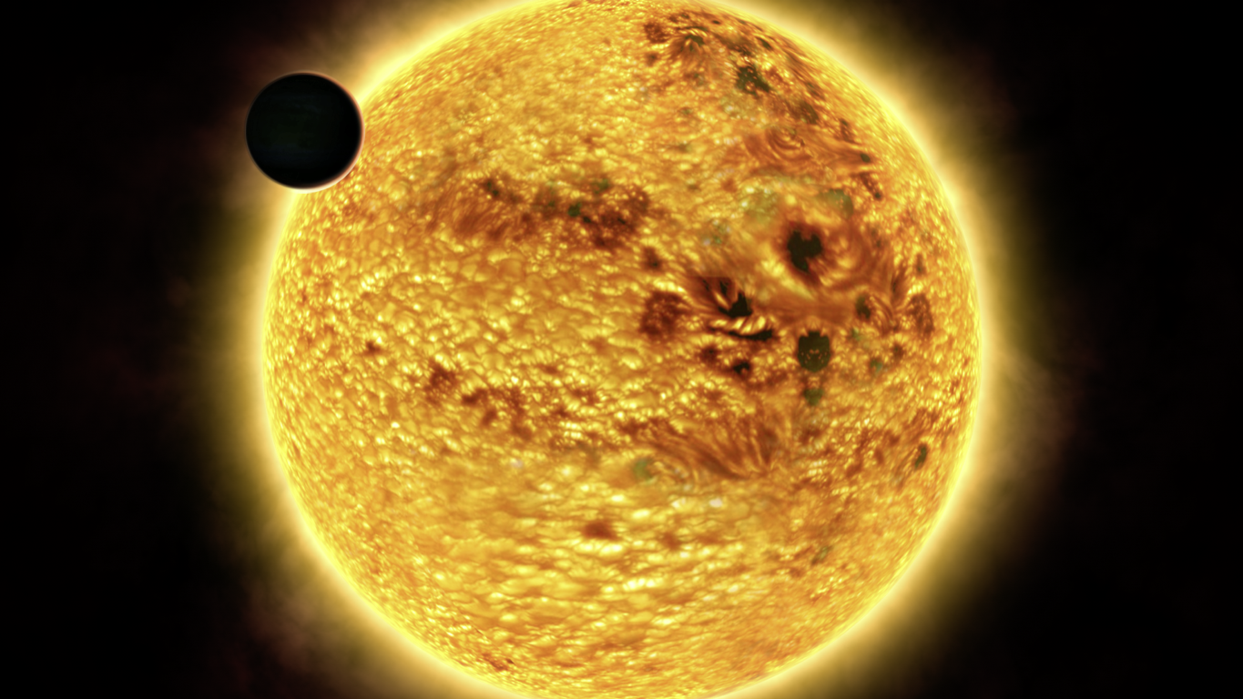
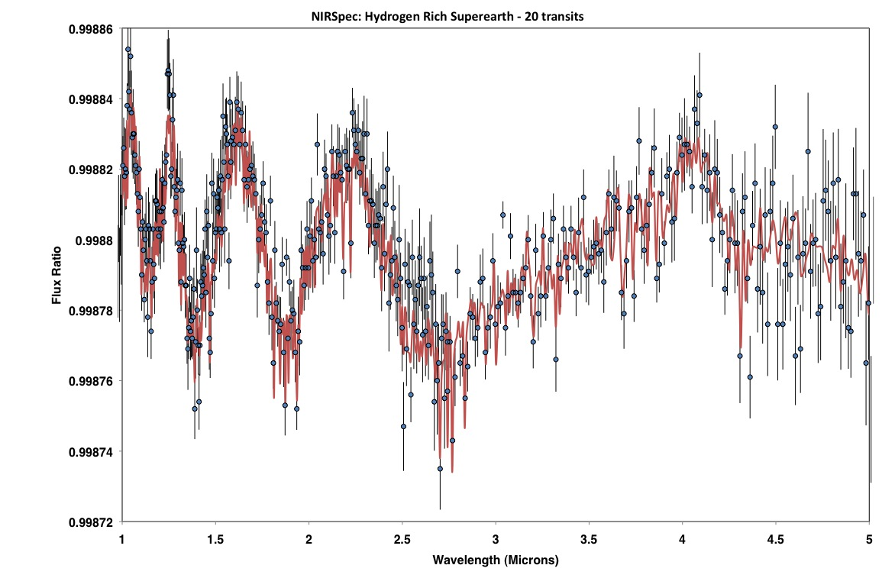
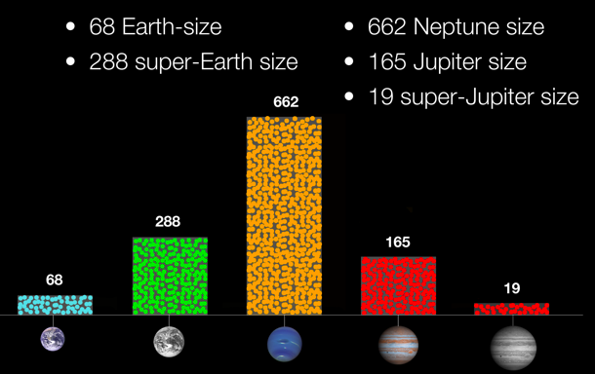
Characterization of Exoplanets
JWST will be the primary tool for the characterization of exoplanet atmospheres
Exploit Kepler, Corot, RV surveys and TESS (Deming et al. 2009)
Increasing number of Superearths being discovered by Kepler
Borucki et al 2011
NIRSpec- 20 transitsBinned to R~300
Clampin and Lindler 2009

Slide 10

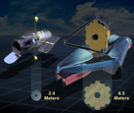
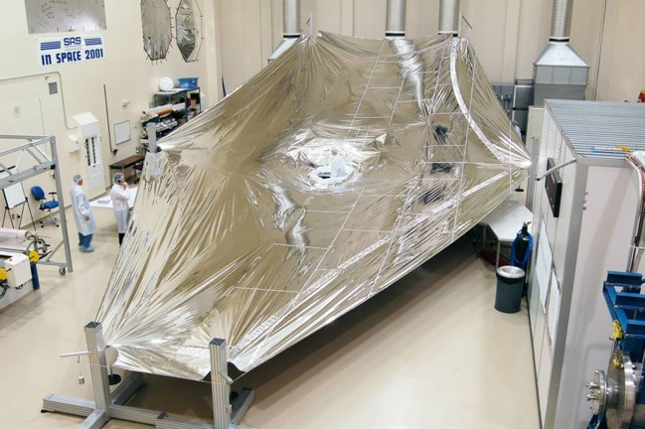
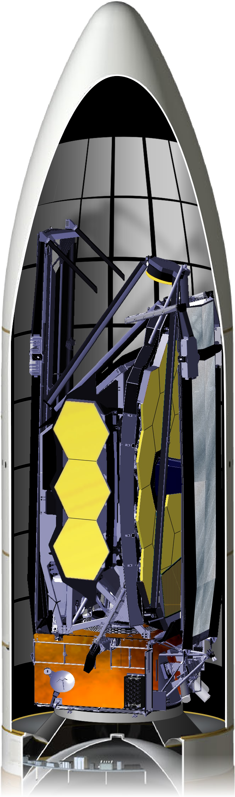
Key Design Drivers
Sensitivity;
- Detection of First Galaxies
Aperture
- Collection area 25 m²
- Diffraction limited @ 2 µm
Low Backgrounds
- Cryogenic observatory
- Passive cooling
Stowable/Deployable Architecture
- Telescope stowed for launch

Slide 11
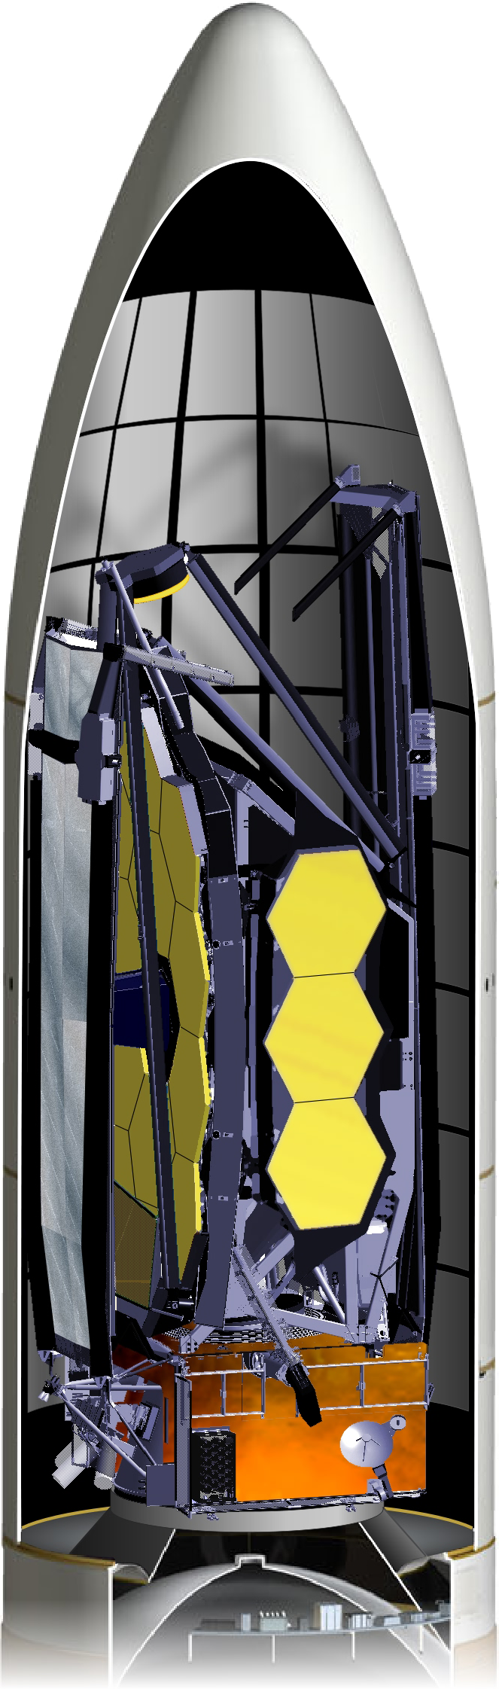
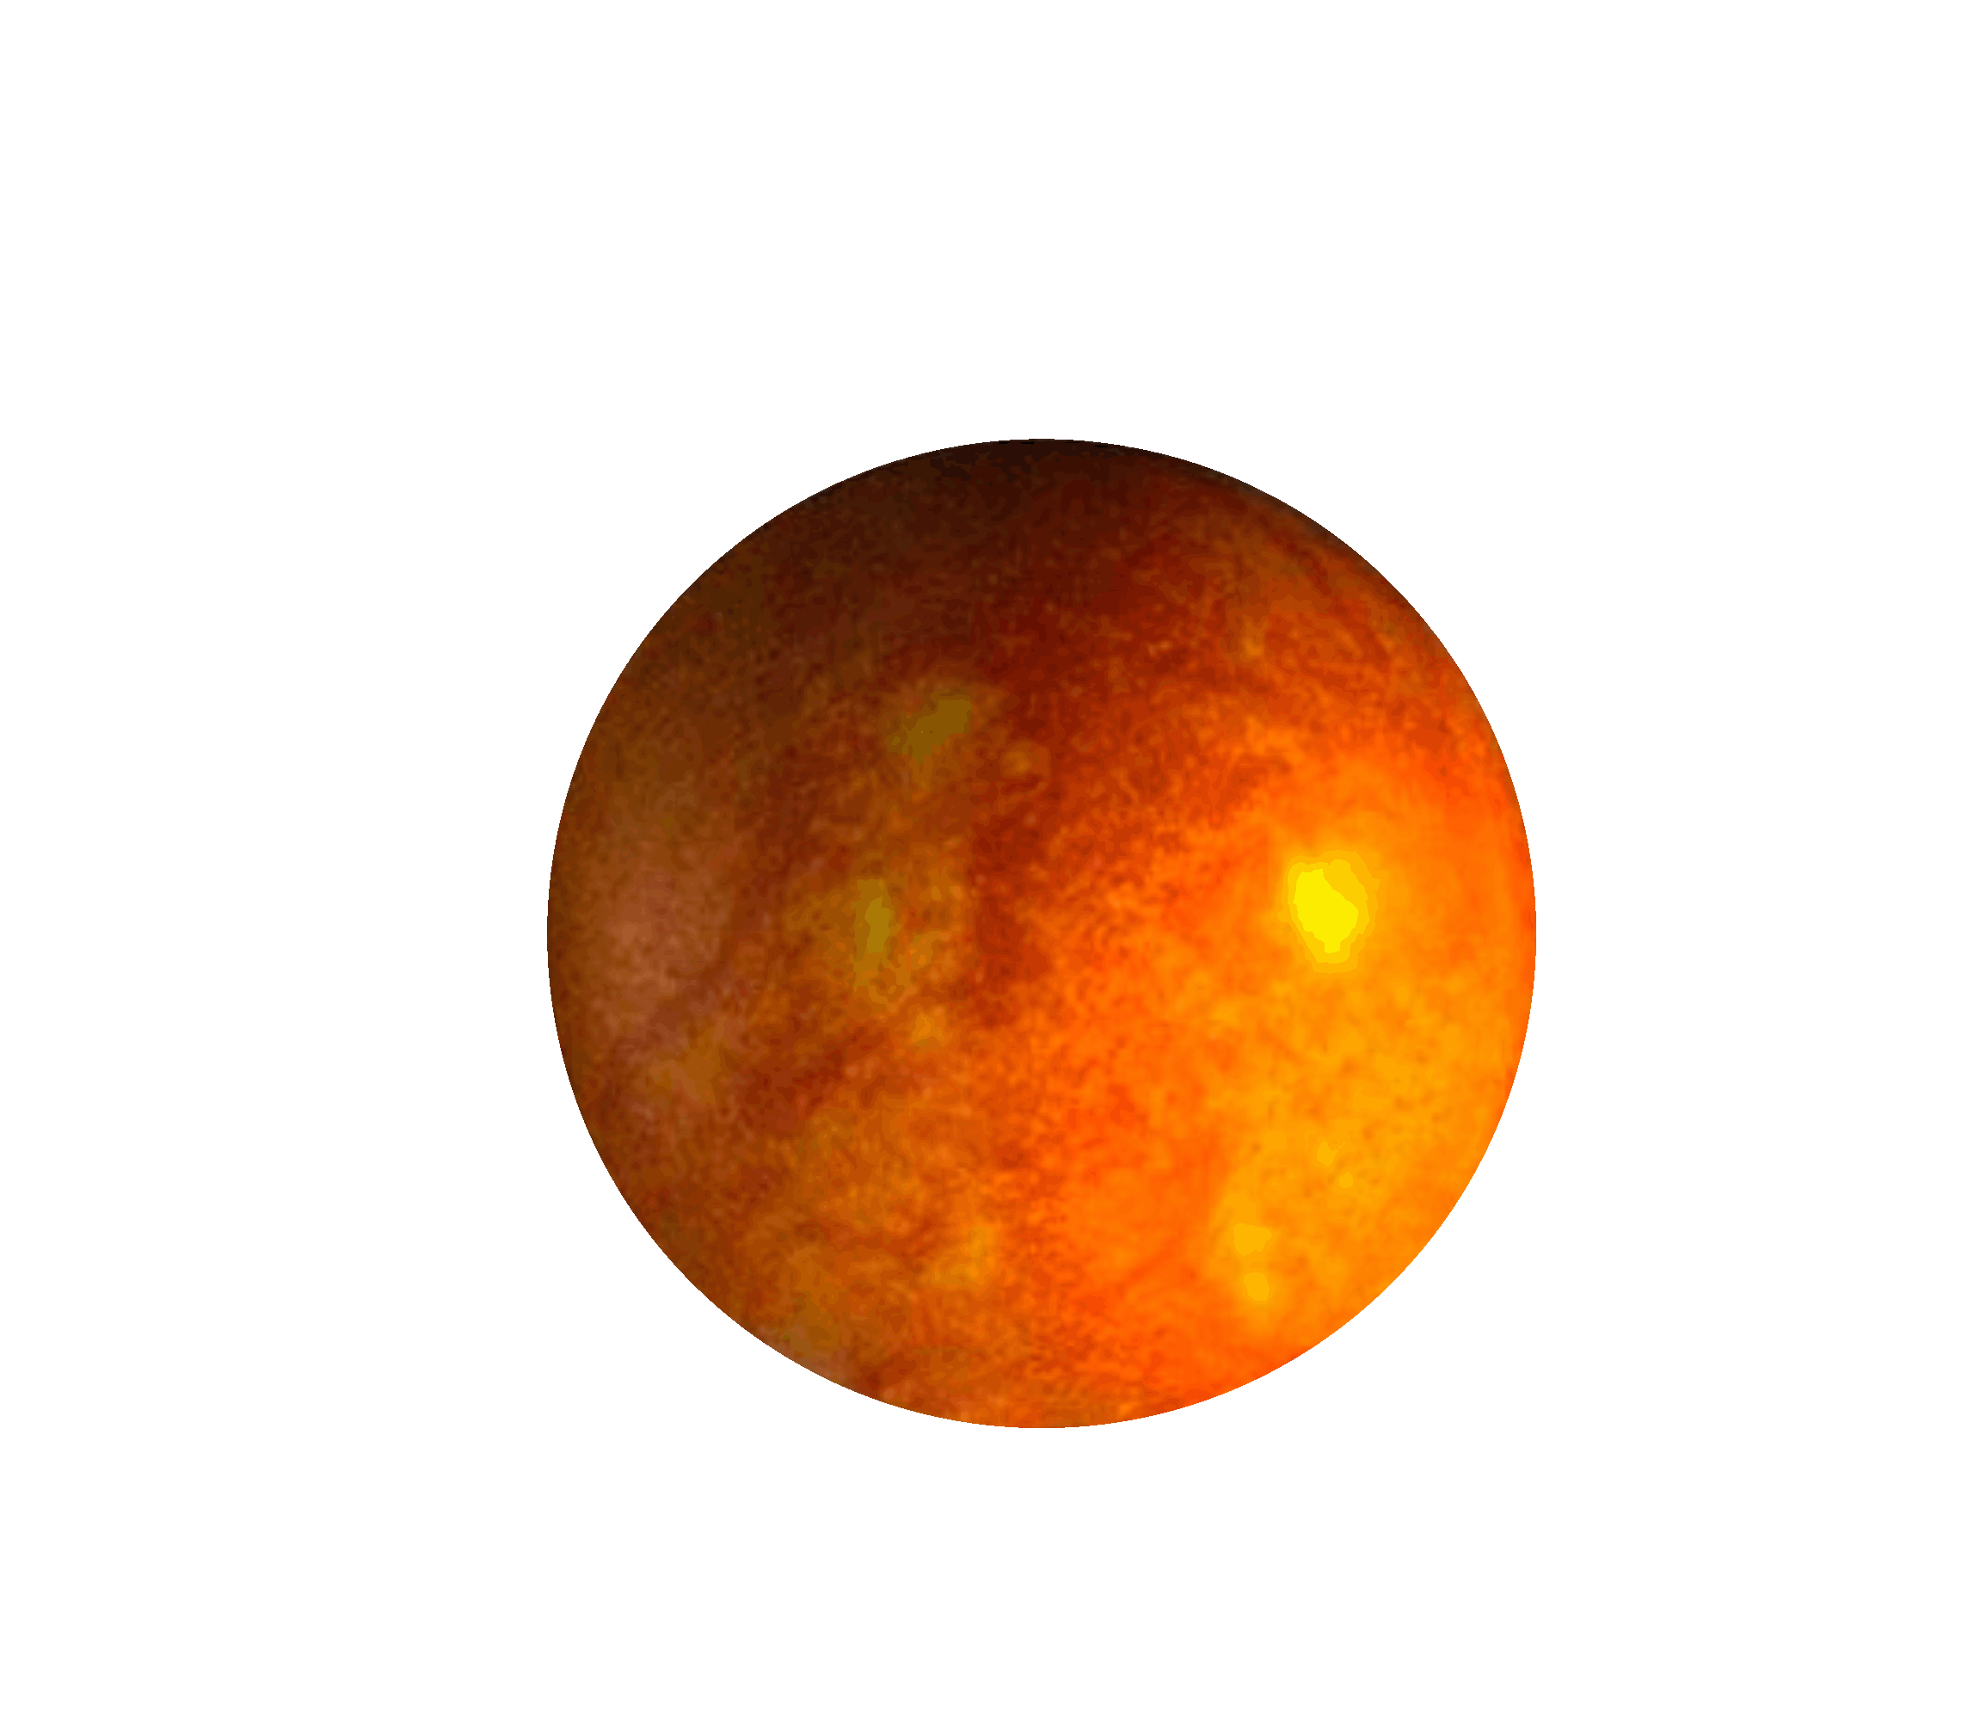

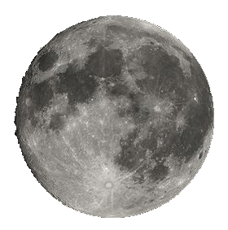
How JWST Works
Integrated Science
Instrument Module (ISIM)
Cold Side: ~40K
Primary Mirror
JWST is folded
and stowed for launch
5 Layer
Sunshield
Observatory is deployed after launch
Solar Array
Secondary
Mirror
Spacecraft Bus
Hot Side
Sun
JWST Orbits the 2nd Lagrange Point (L2)
239,000 miles (384,000km)
930,000 miles (1.5 million km)
Earth
Moon
L2
Notes:
1) Passive cooling drives the overall design: Cold side reaches 40K and is shielded from sun by sunshield
2) Too big for any fairing – post-launch deployment is required (origami telescope)
3) Orbit: L2
- orbiting around L2:
- Provides
- thermal stability & 24/7 science (unlike LEO)
- also support for large data volumes unlike drift-away

Slide 12
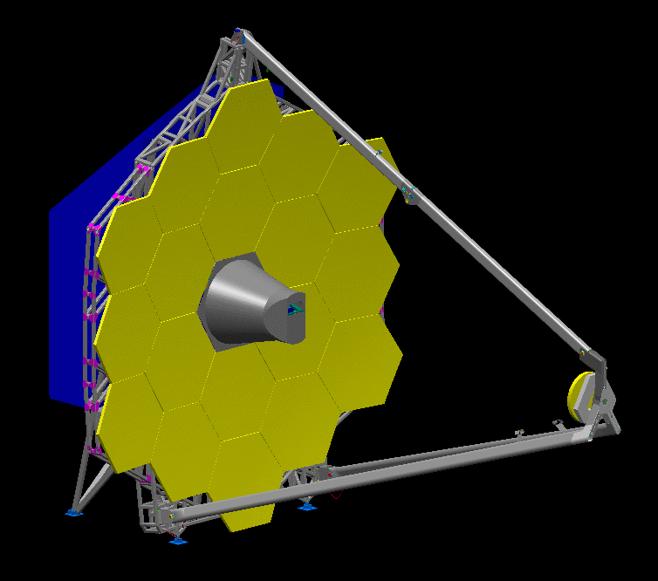
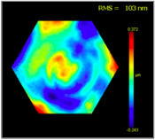
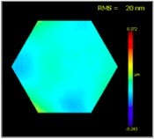
JWST’s Telescope
  Elliptical f/1.2 Primary Mirror (PM)
  Hyperbolic Secondary Mirror (SM)
  Elliptical Tertiary Mirror (TM) images pupil at Flat Fine Steering Mirror (FSM)
  Diffraction-limited imaging at ≥ 2 µm [150 nm WFE @ NIRCam focal plane]
18 primary mirror segments
6 degrees of freedom + radius
Beryllium mirrors
40 K operation
Cryo-polishing required
Long lead time fabricationn
Ambient Surface
Cryo Surface
Notes:
Design of optical system

Slide 13
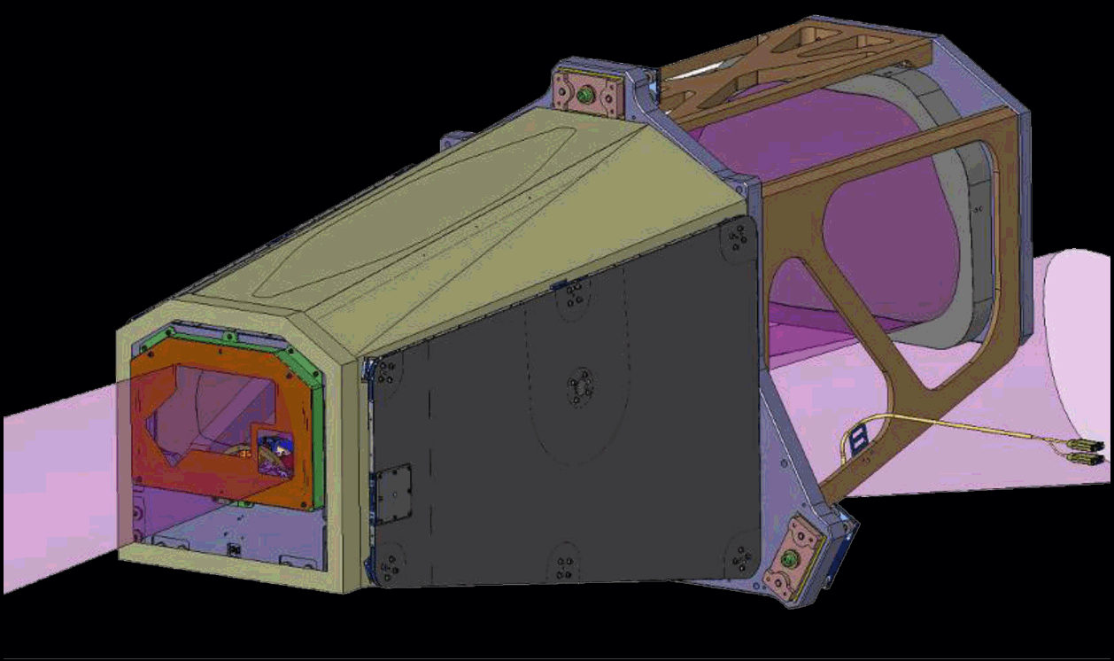
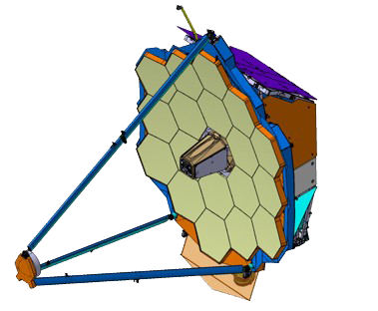
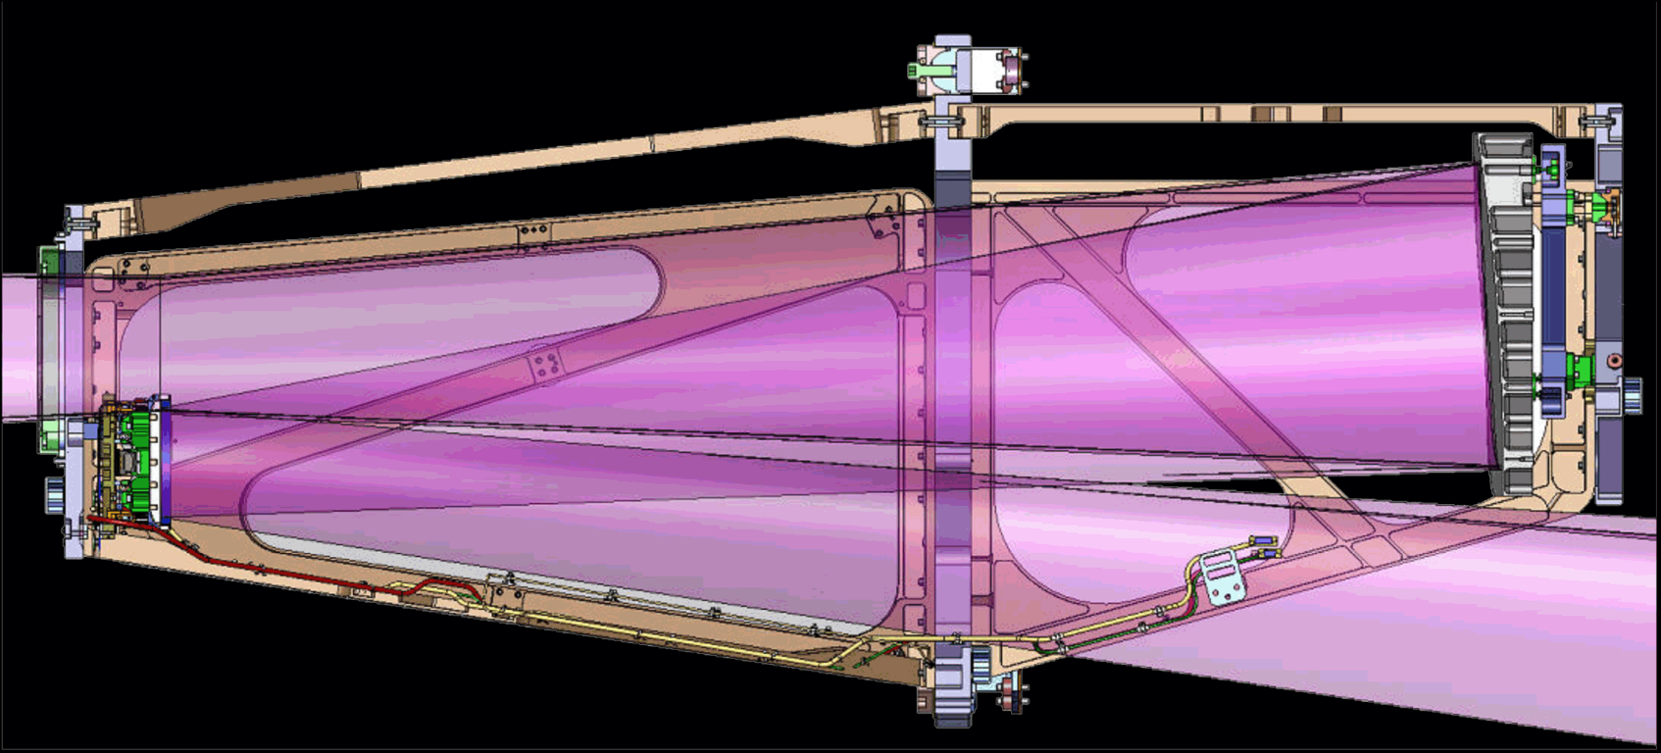
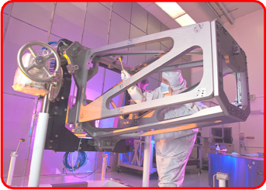
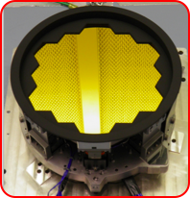
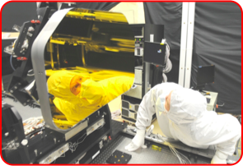
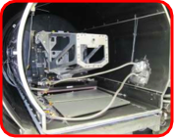
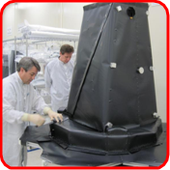
Aft-Optical System (AOS)
Aft optics and optical
bench complete
Fine Steering Mirror
Tertiary Mirror
AOS in cryo-test
Notes:
Aft-optical system comprises the Tertiary mirror and Fine steering mirror (removes jitter)
Also provides stray light baffling
Mirrors are complete

Slide 14
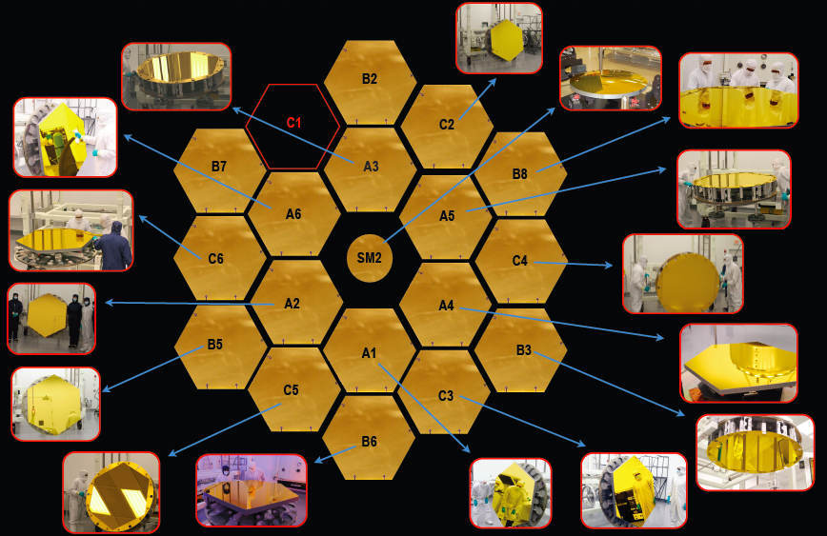
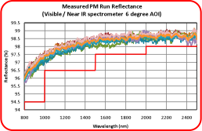
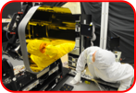

Gold Coated Mirror Assemblies
Mirrors ≥ 98% at 2 µm
Tertiary Mirror
Fine Steering Mirror
Notes:
Making excellent progress
All mirror polishing complete
- one more mirror to gold coat and then we are complete

Slide 15
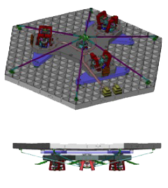

Flight Mirrors: Cryo-Performance
Cryo-performance of flight primary mirror segment assembly (PMSA)
  Mirror Segment + delta plane + actuator assemblies & strongback
A5
18 nm
200 nm
A2
21 nm
A4
16 nm
A1
17 nm
C3
15 nm
B6
19 nm
-200 nm
Notes:
After gold coating mirrors undergo final cryo-performance measurement
- First six are complete and meet requirements

Slide 16


Predicted Image Quality: 0.7 μm - 4 μm
F115W
F200W
F070W
F444W
Log
Scale
Linear
Scale
Notes:
Predicted image quality modeled with data from one of first mirror segments cryo-tested

Slide 17




OTE Integration
GSFC - JWST Cleanroom
Backplane Pathfinder
Watch JWST being built on the web !
http://jwst.gsfc.nasa.gov/webcam.html
Backplane Support Structure
Notes:
Pahfinder is prototype backplane for verification of test design at JSC – central section only
Backplane support structure goes in Bld 29 cleanroon at GSFC. It supports the backplane as we install mirror segments

Slide 18


Optical End-to-End Test @ JSC
Goals of Cryogenic Optical Test
Optical workmanship
Optical alignment - are we within the capture range of the active optics ?
Thermal balance - will the telescope cool to 40K ?
Notes:
Test Program
TATcommittee re-iterated need for JSC test
- can we get to temp
- cryogenic alignment
- Workmanship check -

Slide 19




Sunshield
Sunshield deployment tests
Clearance checking
Sunshield deployment systems testing
Notes:
Example of deployment testing for sunshield

Slide 20


Sky Background
JWST should be zodi-limited at λ < 10 μm
Background levels will include contribution from stray light
NIR stray light is controlled by baffling and contamination control of optical surfaces e.g. Mirrors, baffles, sunshield, struts
MIR stray light is controlled by thermal control of critical surfaces and contamination control of surfaces e.g.
Notes:
Stray light predictions look good.
Show min-zodi (blue) and predictions for UDF field and North Ecliptic Pole field

Slide 21




















JWST Science Instruments
Wavefront Sensing
& Control (WFSC)
Coronagraphic
Imaging
Multi-Object, IR spectroscopy
IFU spectroscopy
NIRCam
NIRSpec
Long Slit spectroscopy
Deep, wide field broadband-imaging
Fine Guidance Sensor
Moving Target
Support
FGS/NIRISS
MIRI
Mid-IR, wide-field Imaging
Slitless
Spectroscopy
Near-IR imaging
High Contrast Closure
Phase Imaging
Mid-IR Coronagraphic
Imaging
IFU spectroscopy

Slide 22

NIRCam

Slide 23

NIRSpec

Slide 24

MIRI

Slide 25


FGS/NIRISS

Slide 26


Observatory Sensitivity: Imaging
IRAC
IRAC
MIRI
HST-ACS
HST-WFC3
NIRCam

Slide 27





















JWST: Under Construction
Primary Mirror Segments
Mirror Electronics
Aft Optics System
PM Flight Backplane
Tertiary Mirror
Fine Steering Mirror
SMSS Flight Struts
ISIM Flight Bench
SM Hexapod
Mid-boom Test
NIRCam
SM Segment
DTA tube
NIRSpec
Membrane Mgmt
Pathfinder Membrane
IC&DH unit ETU
HGA
MIRI
FGS/TFI

Slide 28


JWST Summary
JWST is making excellent technical progress
JWST will be the dominant astronomical facility for a decade, and will undertake a broad range of investigations by the astronomical community
  JWST remains the brilliant advance recommended by the 2000 Decadal Survey
  JWST science forms the underpins the 2010 Decadal Surveys
  JWST has the capability to address new observing opportunities such as exoplanet characterization......

