Slide 1
Feeding the Giants (with data and funding)
Roger Blandford
KIPAC
Stanford

Slide 2
Federal Funding in US
US budget deficit reduction focused on discretionary non-defense spending
Federal budgets expressed in $$
Have to grow to keep up with inflation
Later and later
NSF
AST pays for operations, grants…
Unlikely to grow
-MREFC pays for major facilities
Surplus-> deficit
European funding stronger?
Notes:
Doubling
225->100 in 12

Slide 3
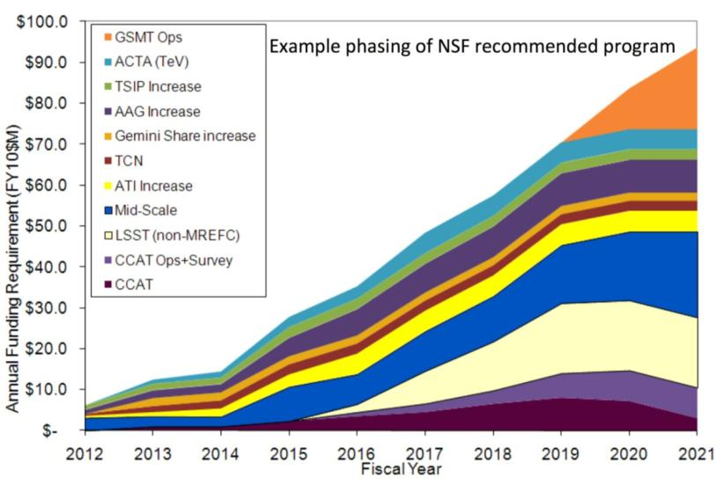
NSF
Program dependent upon MREFC
early entry of LSST
followed by GSMT
In event NSF budget is as projected by agency, there can be no new starts without closure of major facilities following senior review
If moderate budget increase
First priority is small program (including time-critical Gemini augmentation), Mid-scale Innovations program, and starting LSST operations.
- Second priority is GSMT operations, and starting ACTA

Slide 4
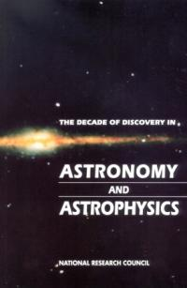
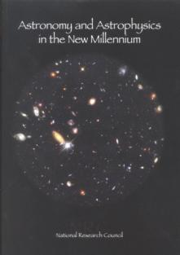
U.S. Decadal Surveys
1964: Ground-based Astronomy: A Ten Year Program (Whitford)
1972: Astronomy and Astrophysics for the 1970s (Greenstein)
1982: Astronomy and Astrophysics for the 1980s (Field)
1991: The Decade of Discovery in Astronomy and Astrophysics (Bahcall)
2001: Astronomy and Astrophysics in the New Millennium (McKee-Taylor)
2010: New Worlds, New Horizons in Astronomy and Astrophysics

Slide 5
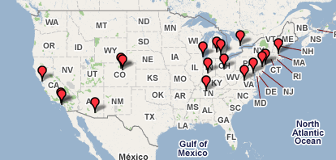
Community Input
An unprecedented response
324 Science White Papers (a unique snapshot of the field)
69 State Of The Profession Position Papers
70 White Paper on Technology Development, Theory, Computation, and Laboratory Astrophysics
108 Community Responses to a Request for Information on Research Activity Proposals
Email Inputs to the Committee
Community-organized Town Halls
Notes:
Program represents community

Slide 6
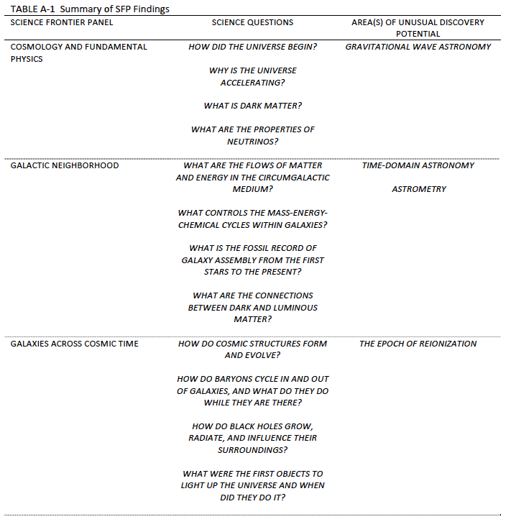
p. 1/2

Slide 7
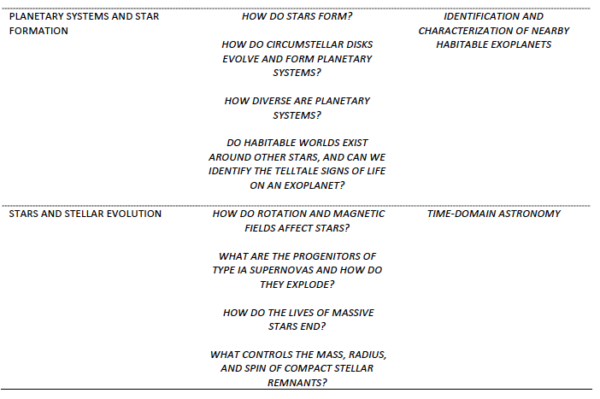
p. 2/2

Slide 8
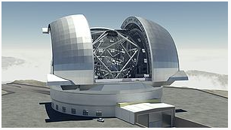
GSMT Highlighted Science
First (oldest) stars, galaxies, elements
Evolution of black holes
Exoplanets and disks
Dark vs luminous matter
Gas flow in galaxies
Distant supernovae and progenitors
…
Notes:
Acknowledge hosts
Observatory
Will transform

Slide 9
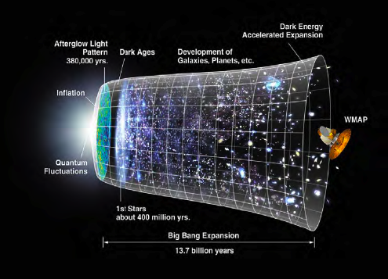
Cosmic Dawn Searching for the first stars, galaxies, and black holes
We have learned much about the history of the universe, from the Big Bang to today
A great mystery now confronts us: when and how the first galaxies formed and the earliest stars started to shine - our cosmic dawn
JWST, ALMA and radio telescopes already under construction will help point the way
Approaches:
Locating “reionization” – finding the epoch ~0.5 billion years, when light from the first stars split interstellar hydrogen atoms into protons and electrons
“Cosmic paleontology” – finding the rare stars with the lowest concentrations of heavy elements

Slide 10
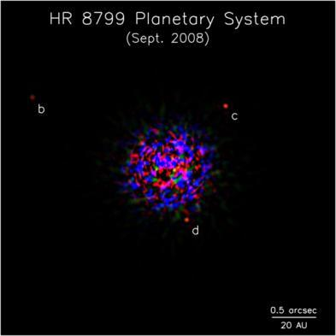
New Worlds Seeking nearby, habitable planets
Nearly 500 extrasolar planets now detected - extraordinarily rapid progress
Huge range of properties exhibited, surprisingly different from those in our own solar system
Many ongoing approaches seek new “Earths” – potentially habitable rocky planets with liquid water and oxygen
New techniques being developed
Kepler data adds over 300 "candidates" to the list, including many less than twice the size of Earth
Next great step forward: understand frequency of different types of planets and lay scientific and technical groundwork to inform future strategies for detailed study of nearby Earth-like planets

Slide 11
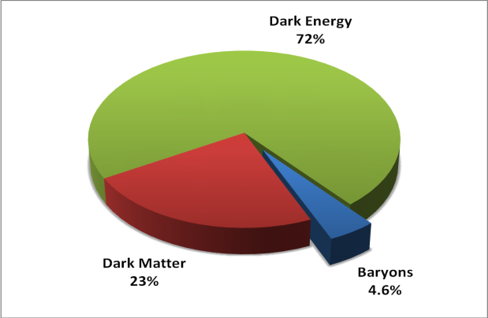
Physics of the Universe Understanding Scientific Principles
Determine properties of dark energy, responsible for perplexing acceleration of present-day universe
Reveal nature of mysterious dark matter, likely composed of new types of elementary particles
Explore epoch of inflation, earliest instants when seeds of structure in the universe were sown
Test Einstein’s general theory of relativity in new important ways by observing black hole systems and detecting mergers

Slide 12
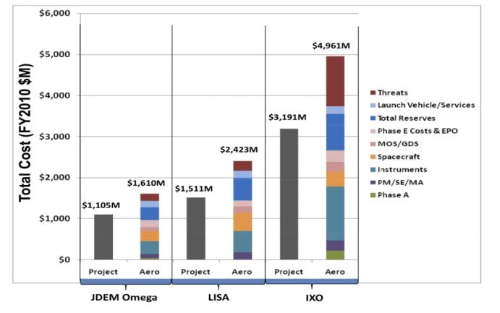
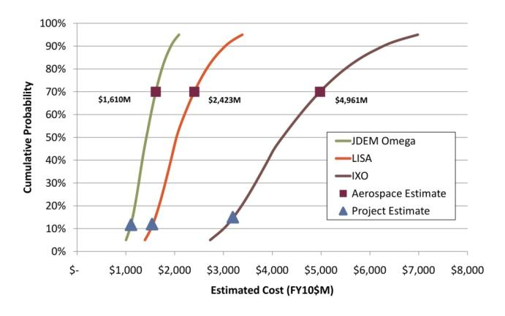
Cost, Risk, and Technical Evaluation
Early call for Notices of Intent followed by open Request for Information
Activities selected by PPPs and committee for a 2nd Request for Information
Subset selected by PPPs and committee for CATE review
Independent cost appraisals
Evaluations of technical readiness schedule and risk assessment
Notes:
No JWST

Slide 13
Optimizing the Recommended Program
Prioritizing based on science objectives
Building upon existing astronomical enterprise
Evaluating cost risk and technical readiness
Maximizing scientific return under highly constrained budget guidelines
Choosing most urgently needed activities from long list of compelling ideas and concepts
Considering international and private partnerships

Slide 14
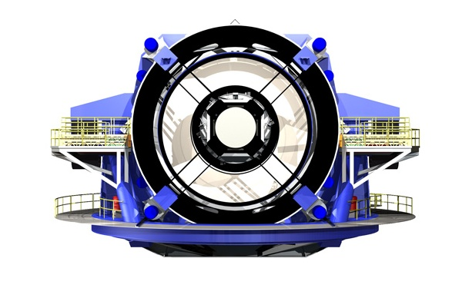
LSST- Science
Efficient, deep optical survey telescope
Will transform observation of the variable universe and address broad questions:
Dark energy using gravitational lensing and supernovae
Dark matter
Near-Earth, Kuiper-belt objects
Solar neighborhood
Transient phenomena
Gamma-ray bursts, Variable stars, Supernovae…
Publicly accessible archive – >100 Pbyte
Notes:
Not on poster
Not on team

Slide 15
LSST – Program Details
8.4 m diameter telescope located in Chile
3.5 degree field of view -- Observe half sky every four days using six filters from 0.3-1μm
NSF-DOE partnership with private and international contributions
Total appraised cost $465M; Annual operation $42M
Medium/Low risk excepting data management and archive software
RECOMMEND entry into MREFC line as soon as possible
Ten year lifetime, followed by Senior Review
Notes:
170M in AANM w 5yr ops
Data not world public, only alerts. Seek~12M/yr in ops from foreign partners. 16 institutes involved. ESO won’t address until they fund ELT.

Slide 16
Mid-Scale Innovations Program – Overview
Large number of exciting and viable projects addressing survey goals are in ~$10-$100M range
RECOMMEND creation of competed program at NSF that will meet this need, like NASA Explorer program
Notes:
Many candidates are surveys

Slide 17
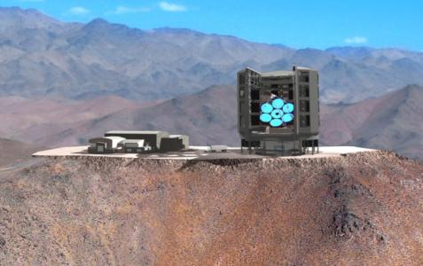
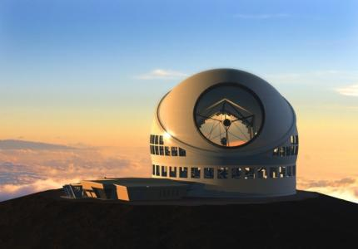
GSMT - Overview
Will transform a broad range of science including stellar astronomy, exoplanets, black holes:
Complements JWST, ALMA, LSST, GAIA, eROSITA….
High spatial resolution; high sensitivity spectroscopy
Top ground-based recommendation in AANM
Now two U.S. projects for 30m class optical-infrared telescopes under development:
Giant Magellan Telescope in Chile
Thirty Meter Telescope in Hawaii
Also ESO’s E-ELT in Chile
Notes:
Sizes

Slide 18
GSMT - Details
GMT and TMT have each garnered private and international funding and made significant technical progress
RECOMMEND to provide access to the entire U.S. community,NSF should partner with one of the two U.S. projects and invest in a quarter share through some combination of construction, operations and instrumentation
Total appraised cost of projects $1.1-1.4B
Project estimate of total annual running costs $36M (GMT) and $55M (TMT)
Expect science in mid 2020’s; risk Medium to Medium-High
LSST to be ahead of GSMT in MREFC queue
Notes:
Agree with panel
350+partners in AANM

Slide 19
GSMT - Details
The committee concluded that more than one GSMT will be required in the world to fully exploit the identified science opportunities. The reasons are that there are advantages to having capability in two hemispheres, that the desired suite of instruments may require different optimizations of telescope design, and that so many new scientific problems can be addressed that any credible number of GSMTs is likely to be oversubscribed.
It is imperative that at least one of the U.S.-led telescope projects have U.S. federal investment.
The committee believes that access to a GSMT will, as opportunities opened by large telescopes have in the past, transform U.S. astronomy by means of its broad and powerful scientific reach, and that federal investment in a GSMT is vital for the United States to be competitive in ground-based optical astronomy over the next two decades.
The third-place ranking reflects the committee’s charge, which required the prioritization to be informed not only by scientific potential but also by the technical readiness of the components and the system, the sources of risk, and the appraisal of the costs.
Notes:
Immediate federal partner choice
3rd place ranking due to technical readiness, risk and delay due to downselect not scientific potential

Slide 20
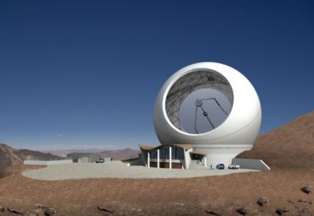
CCAT
Kick-off example of Mid Scale Innovations Program
25m wide-field submillimeter telescope in Chile
Work as survey facility in conjunction with ALMA
RECOMMEND NSF to be one-third partner
Total appraised cost $140M; annual operations $11M
Needs immediate start to be ready for ALMA
Estimated completion date 2020; Medium risk
Notes:
Optical chauvinism
Survey telescope for ALMA
Swift
Fermi
eROSITA

Slide 21
The Past 50 years in Astronomy
More channels
70 octaves x 2
More countries do research at highest level
All continents
More collaborative
500 author papers
More proposals
Pressures on young astronomers
More expensive
Telescopes, instruments, data, theory…
More disciplines
Physics chemistry, biology, engineering, CS…
Notes:
Technology, space
Look around the room all good

Slide 22
Globalization
Convergence of scientific agendas
Astronet, Aspera, ESA, Canadian, Indian Australian, Japanese, Chinese, Chilean…
Uncoordinated implementation
Collaboration and cooperation a desirable and inevitable feature of 21^{c} astronomy
Notes:
Discussed with all of the list

Slide 23
Improving Observatory Science?
Shared construction
Shared instrumentation
Shared observing time
Shared data
Notes:
These are the options

Slide 24
International Collaboration
Plus
Better sites
More expertise
More money
More fun
Minus
Hostage to more economic problems
Multiple approval processes, managements
“25%” overhead
Technology transfer issues

Slide 25
International Matters
Astronomy is more collaborative, international and interdisciplinary than ever. Most major facilities and spacecraft are multi-national and/or public/private
Principle of open skies is compatible with maximizing scientific output
RECOMMENDATION: U.S. investors in astronomy and astrophysics, both public and private, should consider a wide range of approaches to realize participation in international projects and to provide access for the U.S. astronomy and astrophysics community to a larger suite of facilities than can be supported within the United States. The long-term goal should be to maximize the scientific output from major astronomical facilities throughout the world, a goal that is best achieved through opening access to all astronomers.
Notes:
All GSMTs are international Public time subject to open skies in US
Scientific cooperation on instruments sites etc
Hope for reciprocal time
Ample time for three

Slide 26
International Matters
Globalization of astronomy mandates streamlined strategic planning
The practical step is to formalize the coordination and sharing of regional strategic plans at the highest level
RECOMMENDATION: Approximately every 5 years the international science community should come together in a forum to share scientific directions and strategic plans, and to look for opportunities for further collaboration and cooperation, especially on large projects.
Notes:
Would be desirable
Difficult as long as funding from national sources.
May stifle creativity?
cf Particle physics

Slide 27
Broad Access to Big, Expensive teLescopes?
Restricting access to results of surveys etc in giant collaborations is unsustainable
How do you write papers?
Open skies for federal funding in US
Not for private facilities, some other countries
Data access can be expensive
eg LSST, SKA!
GSMTs will need access to major surveys
As valuable as building a new instrument
Urgent need to confront implications

Slide 28
Summary
All three GSMTs have made great strides, technically, organisationally and financially
The science opportunities are growing and will consume three telescopes
The relationship to surveys (including RXγ) will be even stronger than with 8-10m
LSST linkage very important; also GAIA, eROSITA
Complement JWST, ALMA(CCAT) as well…
Optimizing and executing science in GSMT era will require major change in attitudes of observers
Notes:
Good question I do not have time to discuss is are there too many surveys relative to the follow up capability. In particular is too much effort going into OIR surveys that will be superceded soon.

