Slide 1
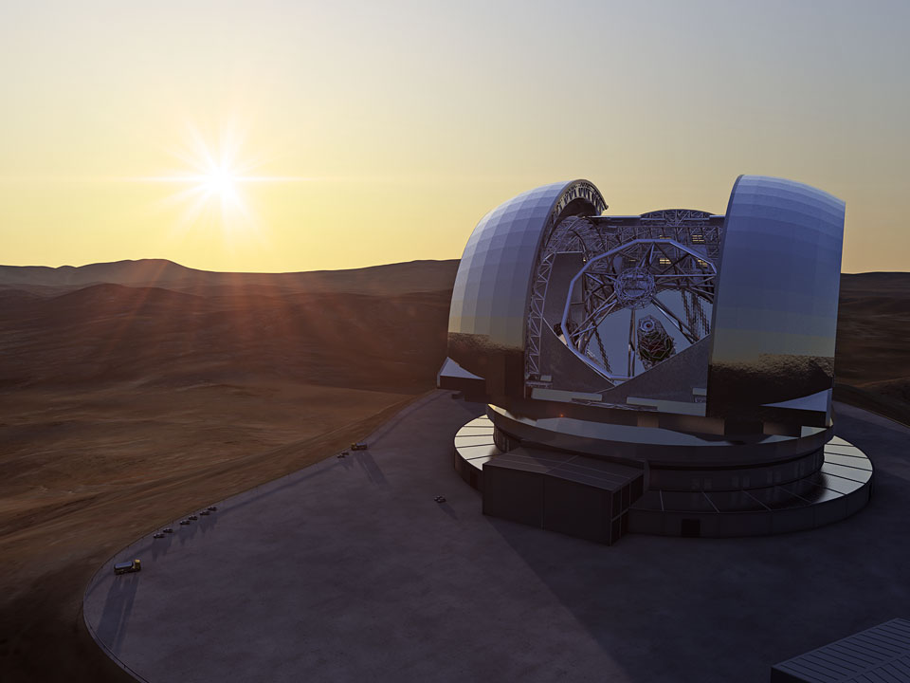

The
European
Extremely Large Telescope

Slide 2
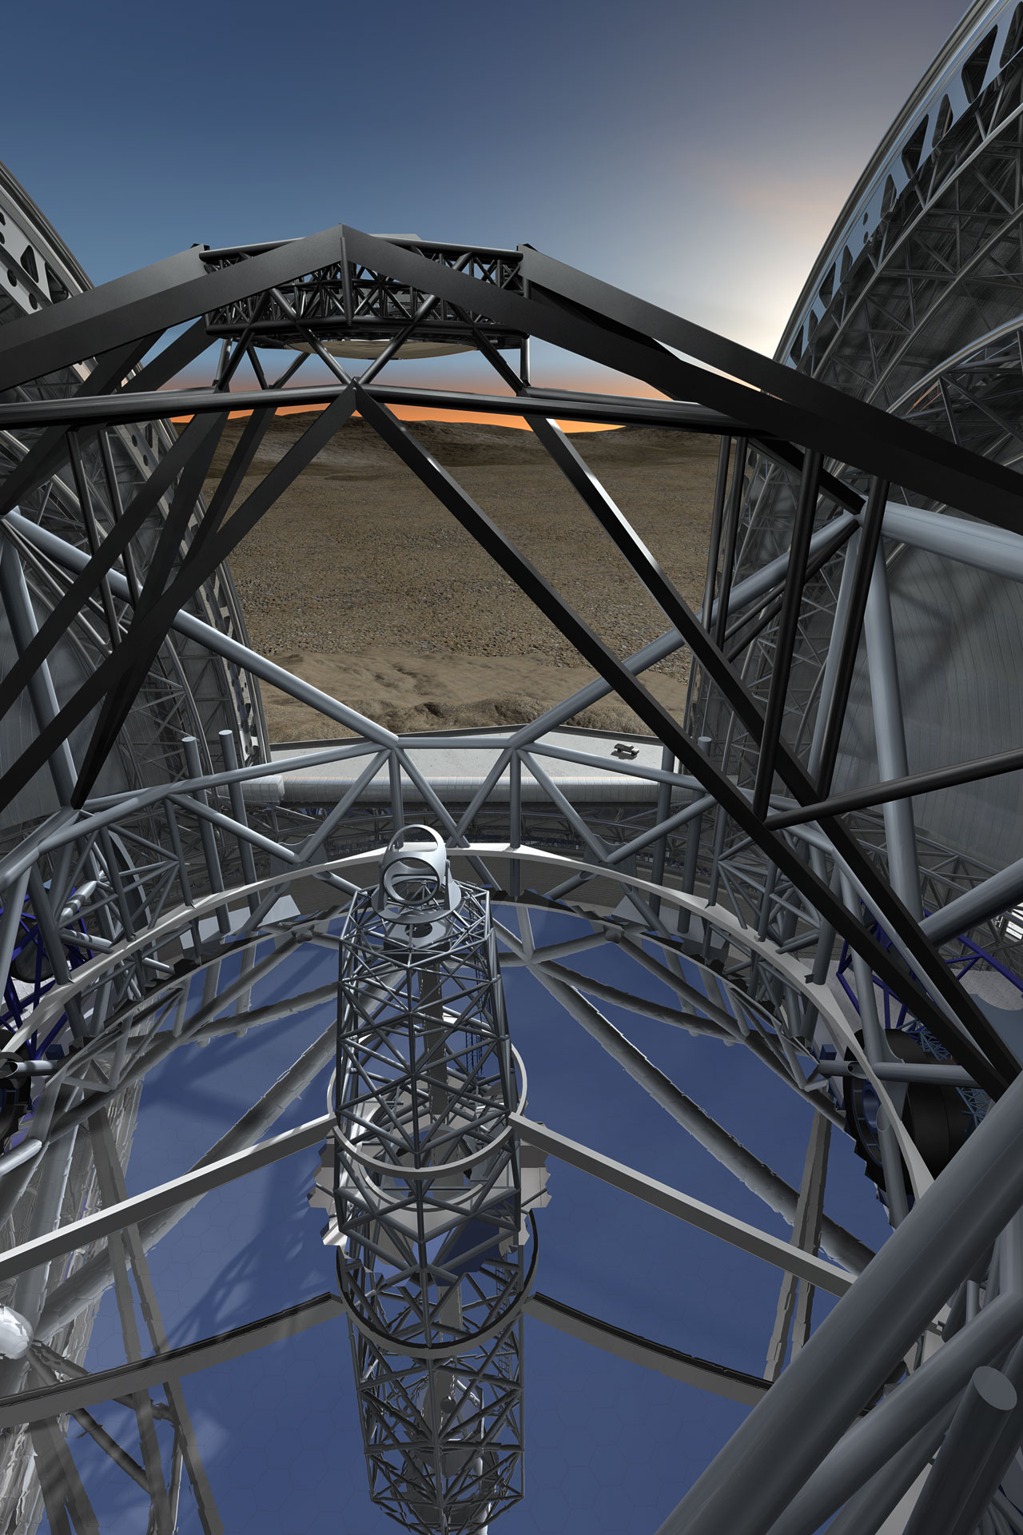
The E-ELT
40-m class telescope: largest optical-infrared telescope in the world.
Segmented primary mirror.
Active optics to maintain collimation and mirror figure.
Adaptive optics assisted telescope.
Diffraction limited performance.
Wide field of view: 10 arcmin.
Mid-latitude site (Armazones in Chile).
Fast instrument changes.
VLT level of efficiency in operations.

Slide 3
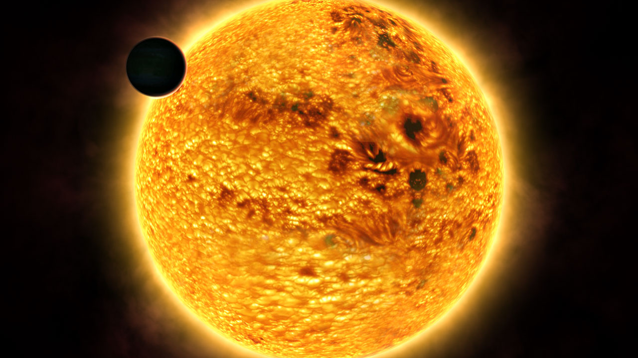
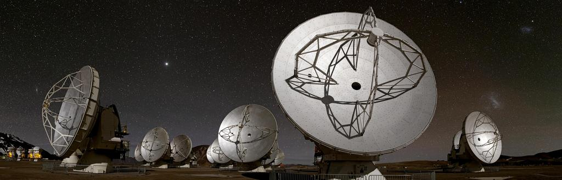
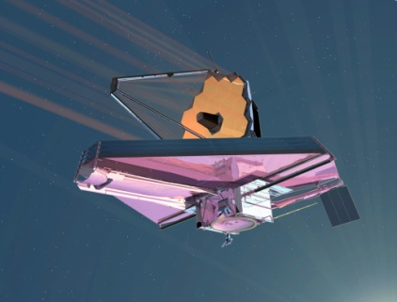
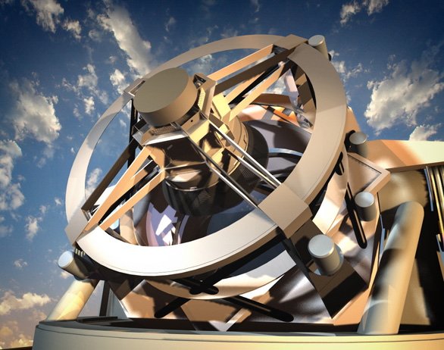
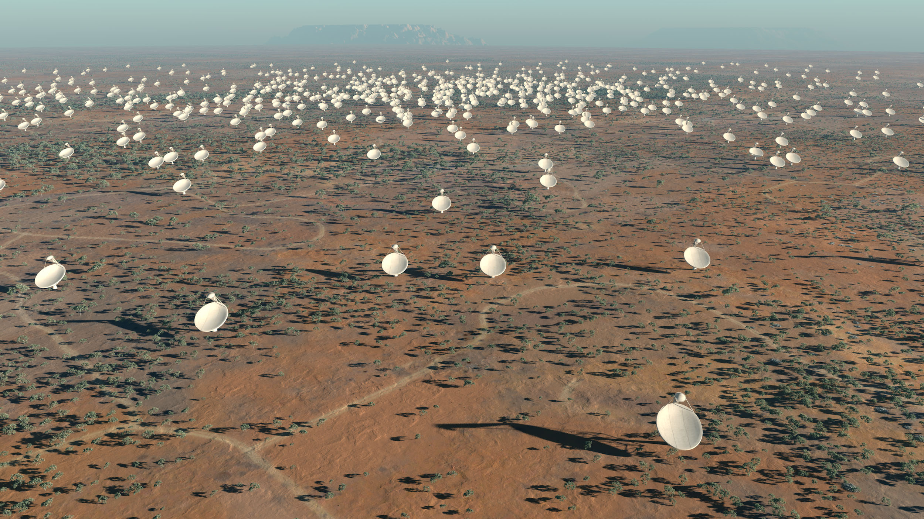
The Science
Contemporary science:
Exoplanets: radial velocity detections, direct imaging, transit spectroscopy, proto-planetary disks
Fundamental physics: GR in the strong field limit, variation of fundamental constants, expansion history of the Universe
Resolved stellar populations: beyond the Local Group
The physics of high-redshift galaxies
…and much more!
Synergies with other top facilities:
ALMA
JWST
LSST and other survey telescopes
SKA
Discovery potential:
Opening new parameter space in terms of spatial resolution and sensitivity
ALMA
JWST
LSST
SKA

Slide 4
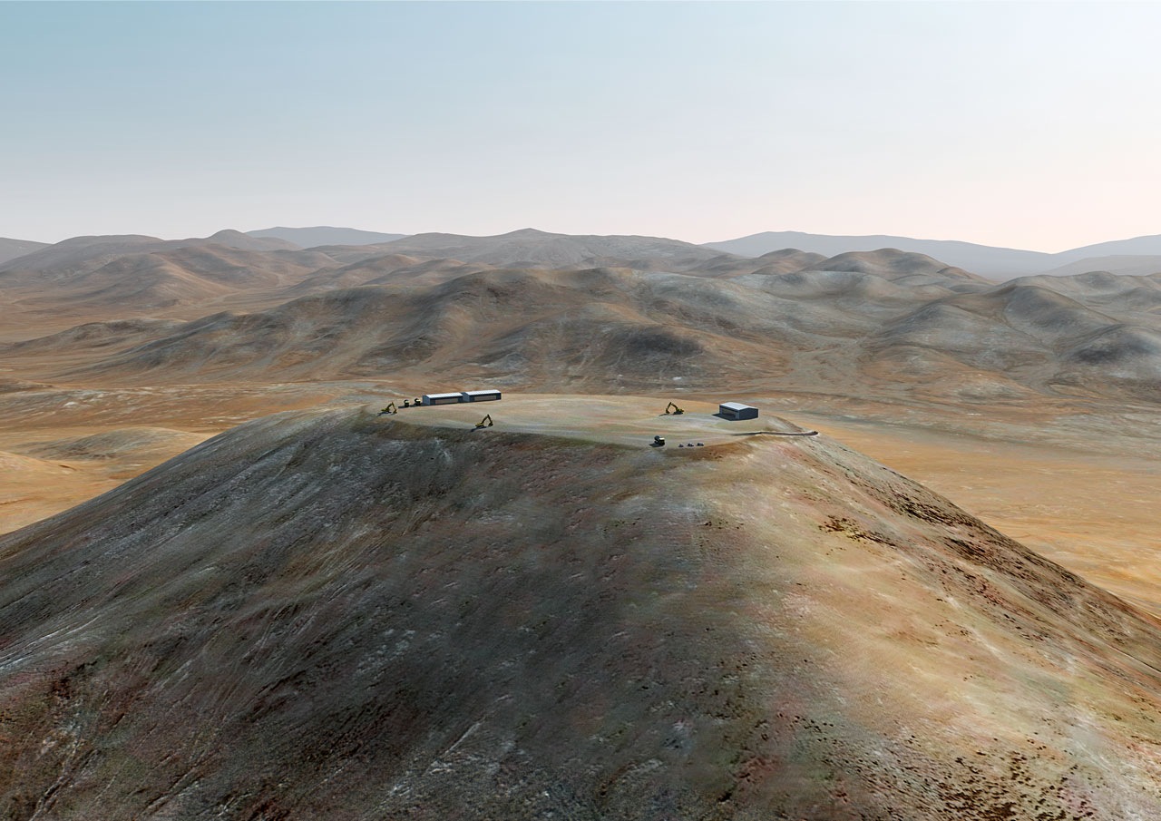
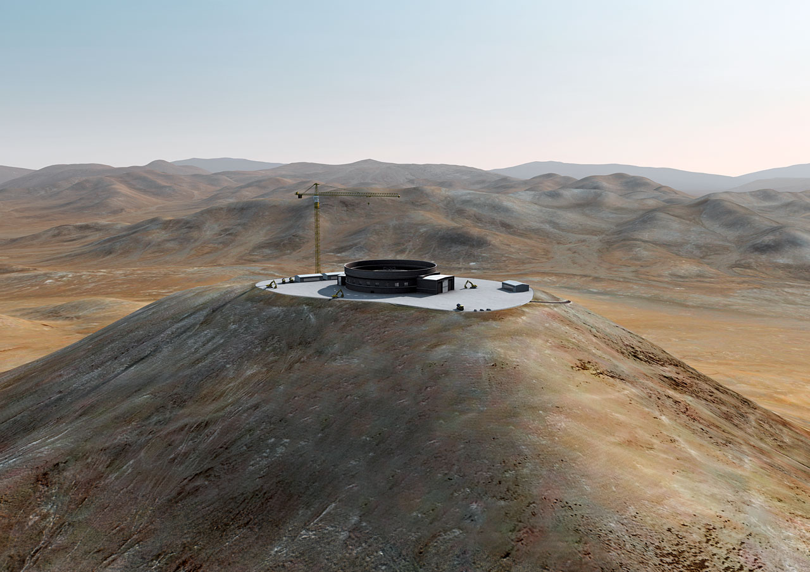

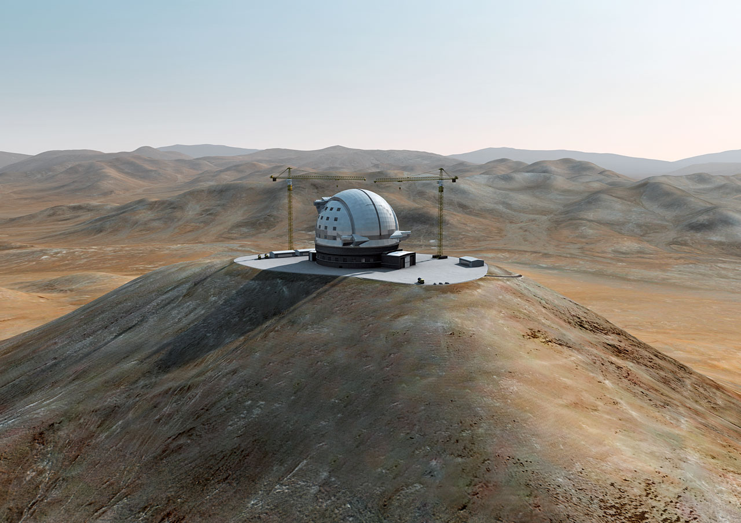
The E-ELT Project
Top priority of European ground-based astronomy (on Astronet and ESFRI lists).
Cerro Armazones in Chile selected as the E-ELT site in April 2010.
Detailed Design Phase completed in 2011. Construction Proposal published in Dec 2011.
Instrument Roadmap (Nov 2011): 2 first-light instruments + plan for 1st generation.
Project fully approved in Dec 2012.
Construction started in 2013.
Start of operations early next decade.
Construction cost: 1083 M€ (including first-light instrumentation).

Slide 5
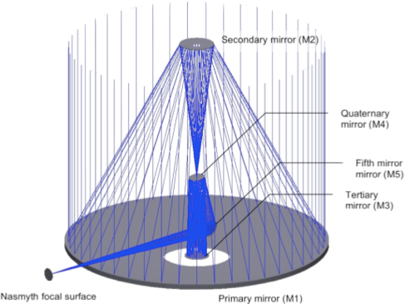
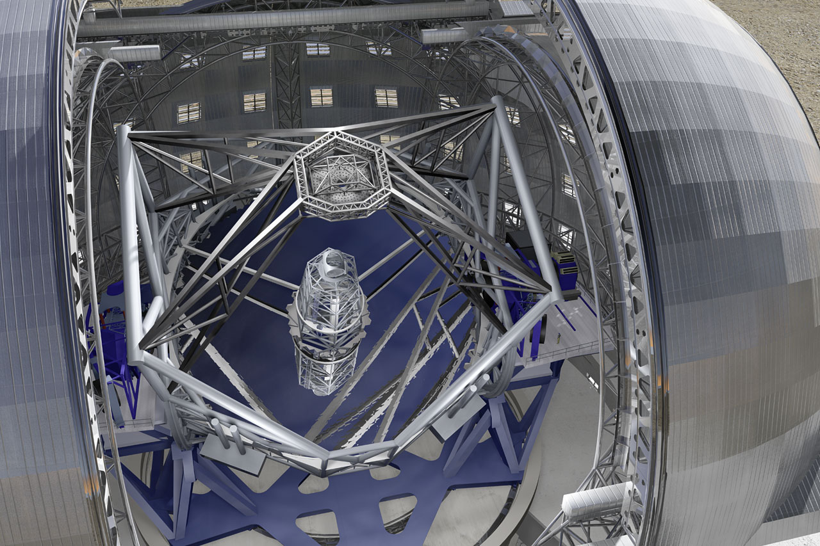
The Telescope
Nasmyth telescope with a segmented primary mirror.
Novel 5 mirror design to include adaptive optics in the telescope.
Classical 3mirror anastigmat + 2 flat fold mirrors (M4, M5).
M2: 4.2 m
M4 (AO): 2.4 m
M5 (TT): 2.6x2.1 m
M3: 3.8 m
Nasmyth focus
M1 (seg): 39.3 m
Two instrument platforms nearly the size of tennis courts can host 3 instruments each + Coudé lab.
Multiple laser guide stars, launched from the side.
Nearly 3000 tonnes of moving structure.

Slide 6
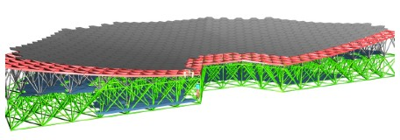
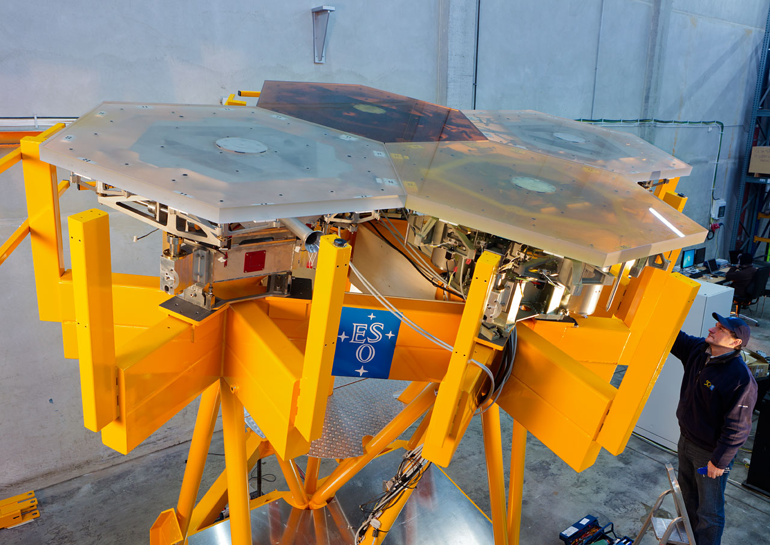
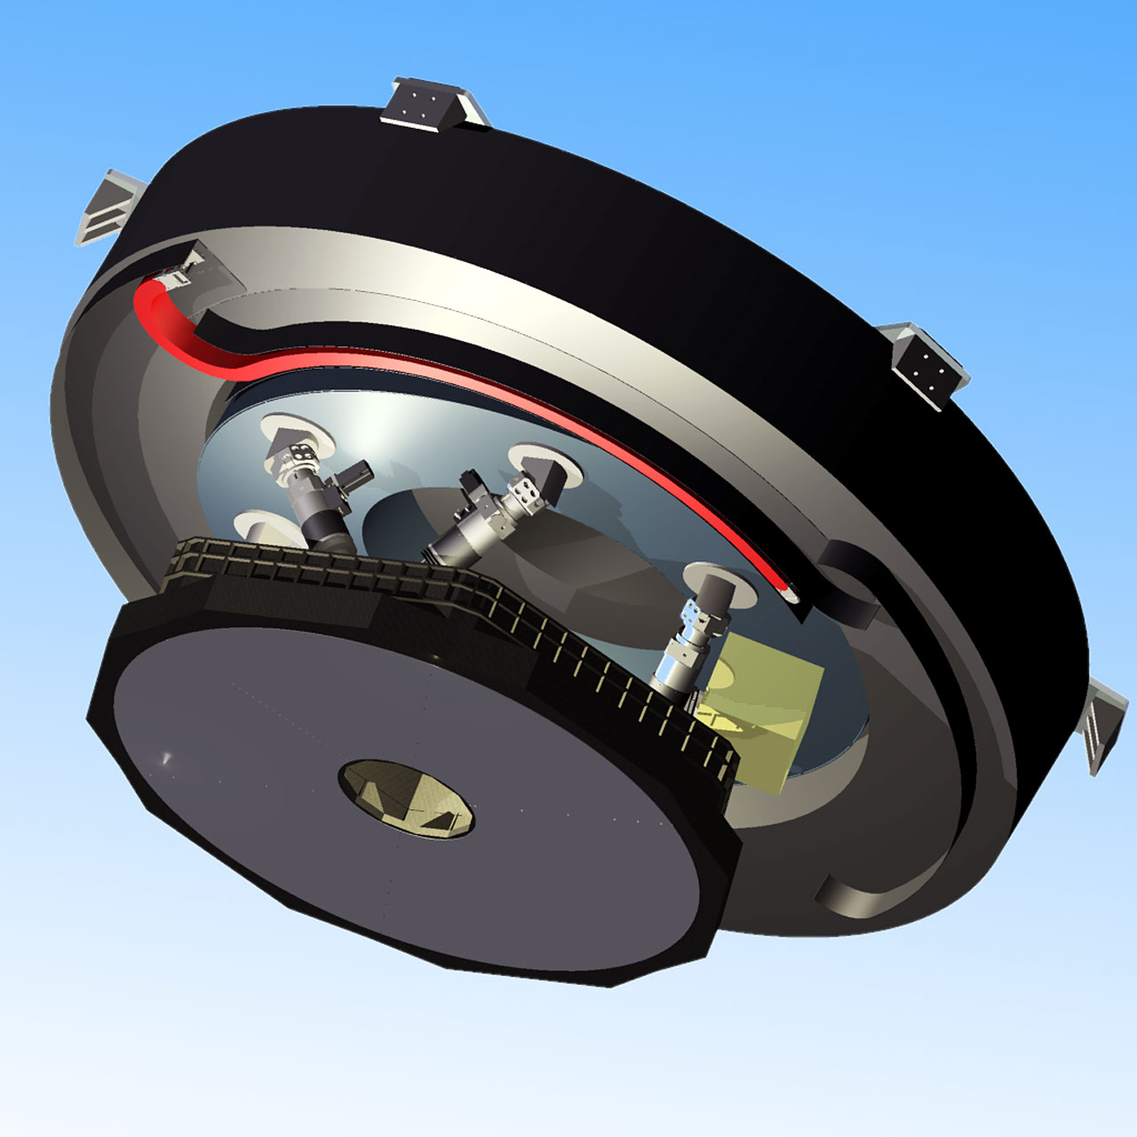
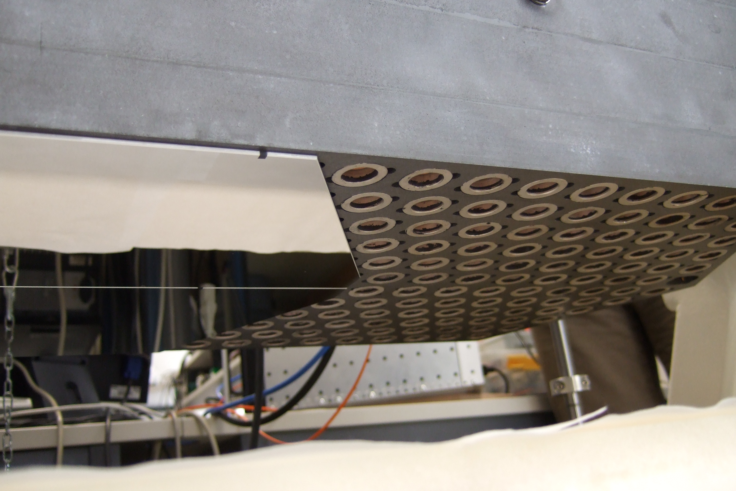
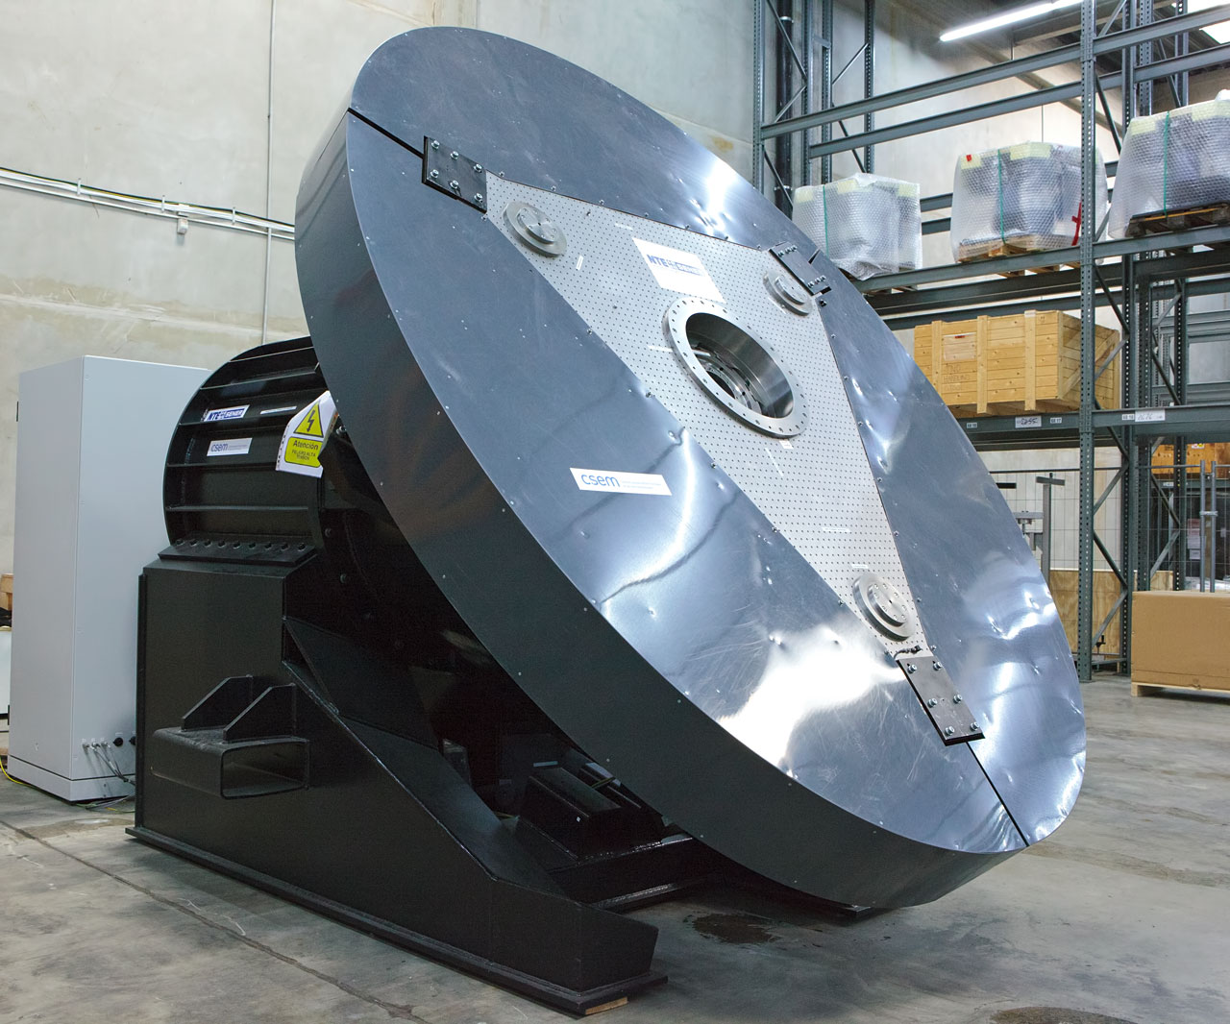
The Mirrors
M1: 39.3 m, 798 hexagonal segments of 1.45 m tip-to-tip: 978 m² collecting area
M4: 2.4 m, flat, adaptive 6000 to 8000 actuators
M5: 2.6 x 2.1 m, flat, provides tip-tilt correction

Slide 7
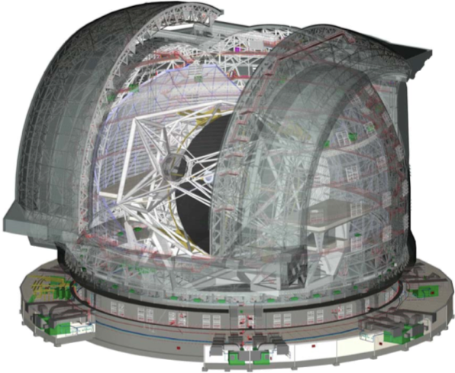
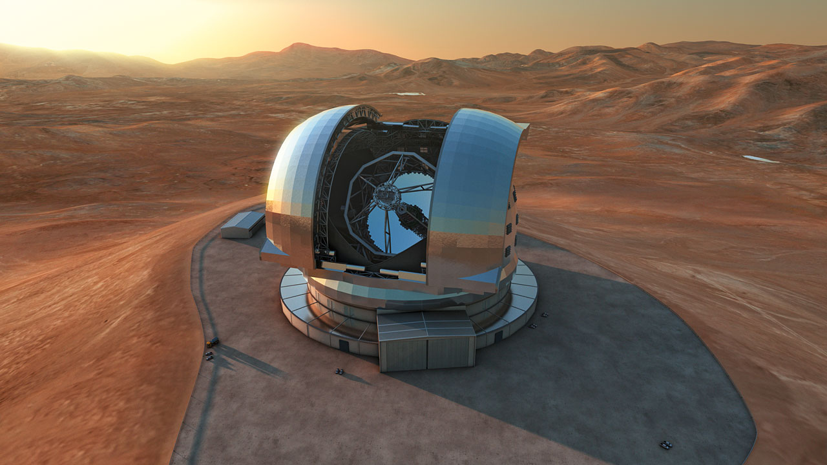
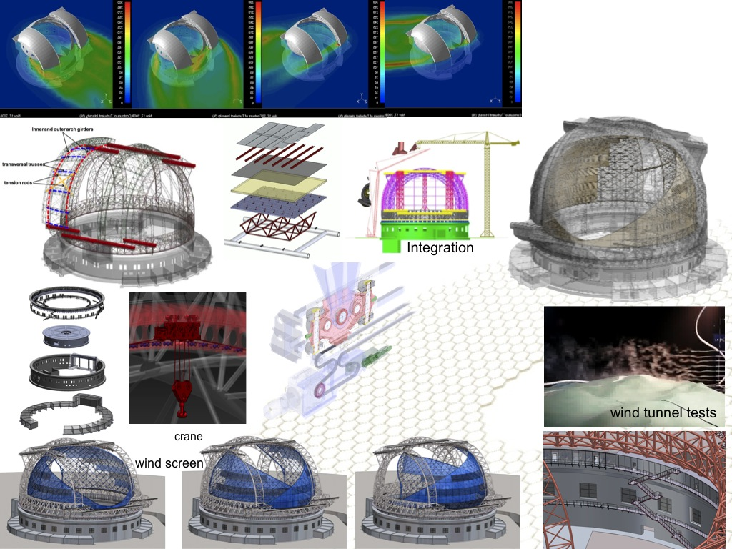
The Dome
Classical design.
Diameter = 86 m, height = 74 m.
~3000 tonnes of steel.
Fully air-conditioned and wind shielded.

Slide 8
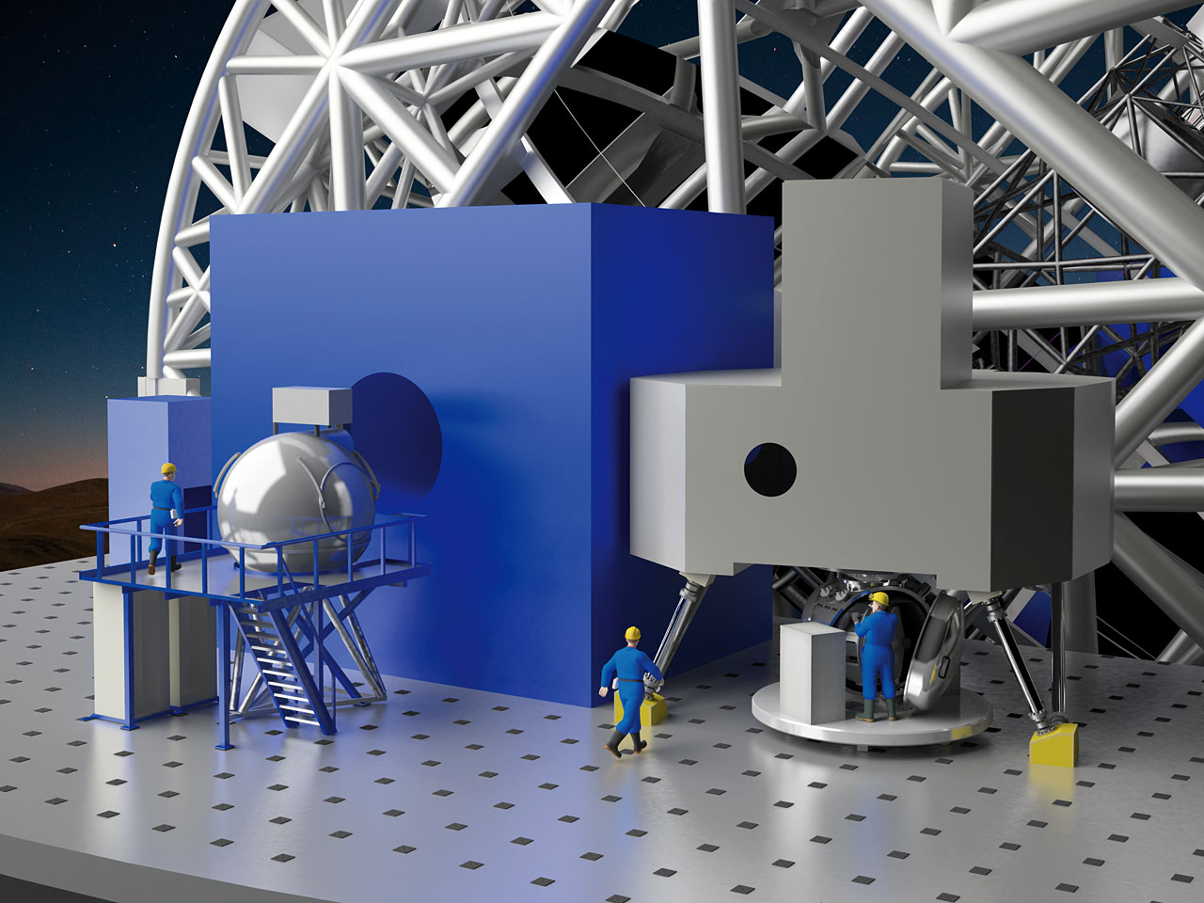
The Instruments
The telescope can host eight instruments.
2007 – 2010: eight instrument and two adaptive optics module concept studies were conducted by the community.
Instrument Roadmap (2011):
  Following recommendations by the E-ELT Science Working Group and ESO's Scientific Technical Committee two first-light instruments have been identified: a diffraction-limited near-infrared imager and a single-field near-infrared wide-band integral field spectrograph.
  The next group (ELT-3, 4 and 5) has been broadly identified as covering the mid-infrared, as well as multi-object and high-resolution spectroscopy.
  Planet camera and spectrograph on separate track.
  Flexibility is maintained by including an as yet unspecified instrument.
  All concept studies remain in the pool of possible instruments.

Slide 9
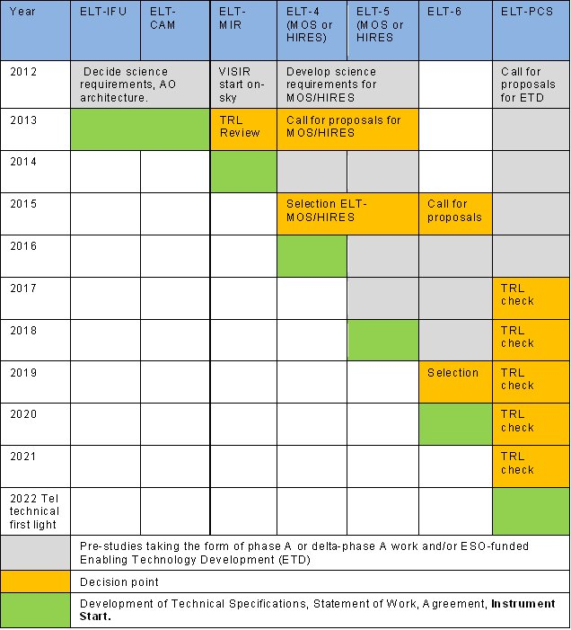
Instrument Roadmap

Slide 10
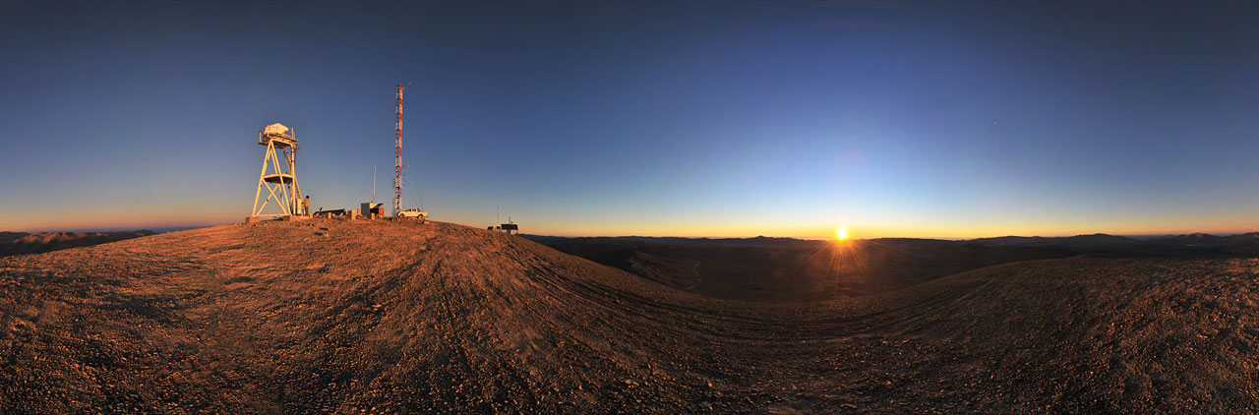
The Site
Following an extensive site testing campaign, involving several sites in Chile, Morocco, the Canary Islands, Argentina, Mexico, etc, ESO Council selected Cerro Armazones as the E-ELT site.
Selection criteria: impact on science, outstanding atmosphere, but also construction and operations logistics (roads, water, electricity, nearby cities, ...).

Slide 11
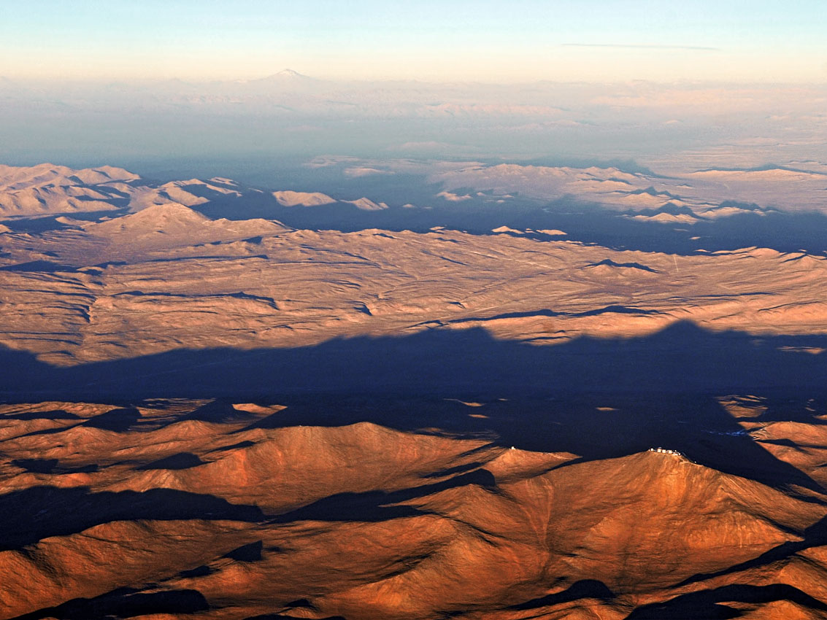
Armazones
Paranal

Slide 12
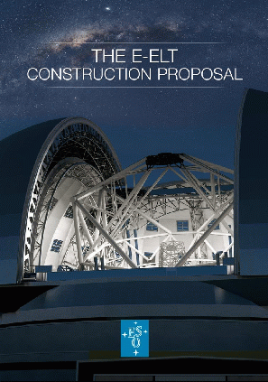
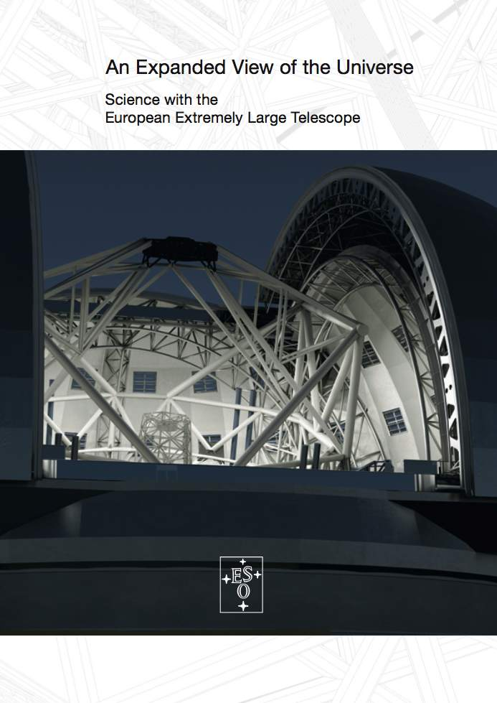
More information
The science users web pages:
www.eso.org/sci/facilities/eelt
The E-ELT Construction Proposal:
www.eso.org/sci/facilities/eelt/docs/eelt_constrproposal.pdf
The E-ELT Science Case:
www.eso.org/sci/facilities/eelt/science/doc/eelt_sciencecase.pdf
The E-ELT Design Reference Mission:
www.eso.org/sci/facilities/eelt/science/doc/drm_report.pdf
The public web pages:
www.eso.org/public/telesinstr/eelt.html
Brochures, Posters, etc:
www.eso.org/public/products/brochures/
Gallery:
www.eso.org/public/images/archive/category/eelt/

